Slide 1
Presentation and management of patients with hematuria and renal mass
Presented by :
Raed alhabshan
Saleh aljaralh
Mohanad almajed
Supervised by:
Dr.dani rabah

Slide 2
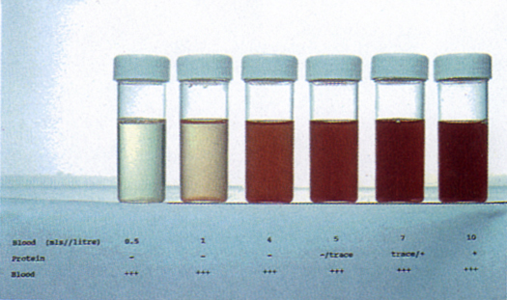
Outline
Hematuria
Definition & etiology.
Case scenario.
How to approach hematuria.
History.
Examination.
Investigation.
How to manage.
Renal masses
Differential diagnoses.
Renal cysts.
Renal Cell Carcinoma.
How to approach common renal masses.

Slide 3
Definition
Gross hematuria: is urine that is visibly discolored by blood or by blood clot. It may present as urine that is red to brown, or as frank blood.
Microscopic hematuria: is not visible to inspection and is defined as 3 or more RBCs/HPFs on microscopic inspection on 2 of 3 urine specimens (non contaminated ).

Slide 4
etiology
According to anatomy:
Kidney:
Glomerular disease
Polycystic kidney
Carcinoma
Stone
Trauma
TB
Vascular malformation.
Embolism
Renal v thrombosis

Slide 5
etiology
Ureter:
Stone .
Neoplasm.
Bladder :
CA, Stone ,Trauma , TB , cystitis , schistosomiasis.
Prostate:
BPH, CA.
Urethra:
Trauma , stone , neoplasm , urithritis.

Slide 6
etiology
Bleeding Disorders e.g. Sickle cell
Vigorous exercise.
Medications .
Food.
Malaria.
AIP.

Slide 7
Case
A 50 Y old Saudi gentleman presents to the ER with 4 week Hx of blood in urine , he denies any pain , He has been smoking 1p/d for over 20 years , and was admitted for a stroke last year . on examination , HR=110,temp=37.1,RR=14, BP=110/75. No flank tenderness.

Slide 8
How to approach ?
Stable vs. unstable

Slide 9
History

Slide 10
What to ask | why to ask
Age | patients over the age of 50 with gross hematuria are at high risk for GU tract cancer and require a full evaluation
Gender | -premenopausal females may have pseudohematuria from menses or recent intercourse. -Women tend to have more UTIs then men. -Men have a higher incidence of urinary tract cancer. -Pregnant women with prior cesarean sections are at risk for placenta percreta.
When during urination does the blood appear ? with clot ? | important clue in localizing the source of bleeding. Initial: urethra, prostate . Terminal: bladder neck , prostate. Total: UUT , bladder. clots=significant hematuria ,gives you clue about the site .
Do you have to urinate often? Does it hurt? | dysuria, urinary frequency, urgency, and urethral discharge points to an infectious process. Benign prostatic hyperplasia (BPH) can cause hematuria and obstructive urinary symptoms such as urinary hesitancy, straining to void, and a sensation of incomplete emptying.

Slide 11
What to ask | why to ask
Do you have any pain ? | Yes : colicky at flank radiating to groin =stone. During micturation = infection . Suprapubic = Intermittent or total bladder outlet obstruction by a bladder stone or clot. No: prompt evaluation for malignancy.
Have you lost weight or been sick (sore throat, fever)?or had contact with sick people ? | -Weight loss, extrarenal manifestations (rash), arthritis, arthralgia, or pulmonary symptoms suggest a variety of systemic illnesses, including vasculitic syndromes, malignancy, and tuberculosis. -A recent sore throat or skin infection is consistent with post streptococcal Glomerulonephritis or IgA nephropathy.
Do you take any medications or drugs? | Causing: hematuria: analgesics=analgesic nephropathy anticoagulants= from multiple sites . OCP : loin pain hematuria syndrome . cyclophosphamide=↑risk bladder CA. Pigmenturia : rifampicin . Myoglobinuria : Amphotericin B,Barbiturates,Cocaine,Codeine

Slide 12
What to ask | why to ask
Do you have any similar condition in the past ?have you experienced any recent trauma ? | Stones , tumors ,TB, schistosomiasis , bleeding disorder (from multiple sites ).trauma to urethra or pelvis. Hx of Atrial fib, mechanical valves , stroke .
Have you had any recent urologic interventions done ? surgery? radiation? | bladder catheterization, placement of an indwelling ureteral stent, or recent prostate or renal biopsy. Malignancy.
Does any member of the family have the following conditions ? Or: are there any illnesses in your family that you are aware of ? | kidney stones, cancer, prostatic enlargement, sickle cell anemia, collagen vascular disease and renal disease (polycystic kidney), bleeding disorders , benign familial hematuria.
Social history: Do you smoke? What are your hobbies?(lifestyle) What do you do for a living? Where are you from , where do you live now ? Have you been traveling ?where? Tell me about your diet ? Any new habits ? | -Major risk for bladder CA. -vigorous physical activity , exposure to toxins , STD. -industrial chemicals (benzene, aromatic amines): linked to transitional cell carcinomas. -sickle cell , TB, schistosomiasis . -TB, schistosomiasis . -food such as rhubarb, food coloring, blackberries, beets or beet soup (borscht).

Slide 13
Additional points
One classification of causes is (urological vs.nephrological)
Ask of duration and frequency
Episodic hematuria could be a sign of malignancy
Vitals are very important to asses blood loss
Anticoagulant medications per se do not cause hematuria , but will make hematuria of another cause (e.g. trauma , malignancy ) manifest earlier, so you have to investigate the actual cause .

Slide 14
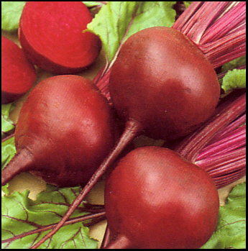

Slide 16
Key points
Age >4o + painless hematuria is considered GU malignancy until proven otherwise .
More than one cause may co exist e.g. Urinary stasis, caused by severe BPH, can lead to UTI and bladder stone formation.
Check for co morbid conditions e.g. hyperparathyroidism , SLE , URTI.

Slide 17
Key points
Cyclic hematuria in women that is most prominent during and shortly after menstruation, suggesting endometriosis of the urinary tract .
Painful hematuria points towards infection but does not rule out malignancy .
Painless hematuria points towards malignancy but does not rule out infection .

Slide 18
Key points
Check Hx of bleeding from other orifice (bleeding disorders , anticoagulant use ).
In female patient : detailed OB/ Gyne Hx:
Menstrual cycle .
Gynecological procedures/operatios .
Use of OCPs.
Hx of radiation e.g. for cervical CA

Slide 19
Key points
Check for other source of bleeding considered by the patient hematuria e.g. hemorrhoids .
Gross hematuria is a presenting sign in more than 66% of patients with urologic cancer.
Gross hematuria =always requires further investigation.

Slide 20
Physical Examination

Slide 21
Vital signs: | hypotension and tachycardia are seen in patients that are hemodynamically unstable from acute blood loss. Fever=infection .
Pallor of the skin and conjunctiva: | in patients with anemia=chronic course .
Periorbital, scrotal, and peripheral edema: | may indicate hypoalbuminemia from glomerular or renal disease.
Cachexia: | Malignancy, TB.
Tenderness of the flank or costovertebral angle: | may be caused by pyelonephritis or by enlarging masses such as a renal tumor.
Suprapubic tenderness: | can be elicited in the setting of cystitis, whether caused by infection, radiation, or cytotoxic medications.
Palpable bladder | In acute urinary retention, usually seen in cases of BPH or obstruction by clots, the bladder is palpable and may be felt up to the level of the umbilicus.

Slide 22
PR exam : An abnormal, nodular, digital rectal exam: | -may signify prostatic adenocarcinoma or an invasive bladder tumor.
An enlarged prostate or enlarged median lobe of the prostate . Look for hemorrhoids | -is a sign of benign prostatic hyperplasia. -Could be source of bleeding .
Palpable adenopathy: | -either supraclavicular or inguinal, may indicate a neoplastic process. P.S: supraclavicular: testicular CA. Urinary tract CA: below diaphragm(inguinal)
The presence of a urethral catheter or suprapubic catheter : | may signify an iatrogenic cause of bleeding that is generally benign.
Look for extrarenal symptoms e.g. rashes, arthritis , hemoptysis , bone tenderness , jaundice , eccomosys . | SLE,TB, malignancy , blood disorders, vasculitic syndromes .

Slide 23
Physical Examination
Be sure that the patient is stable (vital signs )
Always check for extrarenal manifestations and co morbid conditions .
Check for other sites of bleeding.
PR examination should not be missed .
Inspect external genitalia in male for trauma.

Slide 24
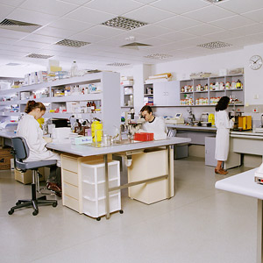
Investigation (lab work)

Slide 25
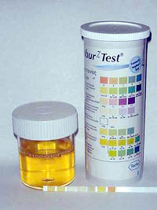
Urine dip strip analysis
False-positive tests may occur in the setting of myoglobinuria or hemoglobinuria, confirmed by the absence of RBCs on microscopic examination.
A low specific gravity is seen in urine that is poorly concentrated due to intrinsic renal disease(<1.008).

Slide 26
Urine dip strip analysis
Heavy proteinuria (>3 g/day) suggests glomerulonephritis.
The presence of nitrite or leukocyte esterase may indicate infection.

Slide 27
Urine dip strip analysis
Don’t forget U&E , creatinine , BUN
Ca: for paraneoplastic syndrome.
Creatinine: kidney failure, and to know if you can use contrast in investigation without causing contrast nephropathy.

Slide 28
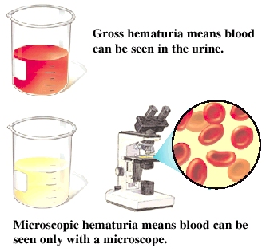
Microscopic evaluation of the urine will confirm the hematuria

Slide 29
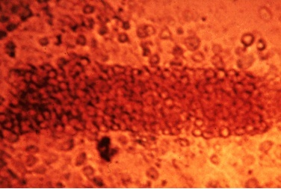
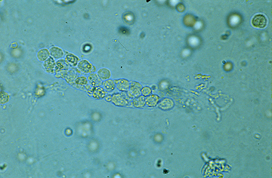
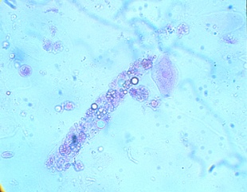
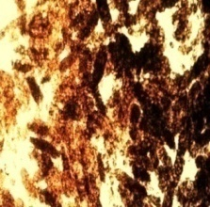
Urinanalisys
For (4c):
Cast
Crystals .
Culture .
Cytology.
Red cell casts | Glomerulonephritis Vasculitis
White Cell casts | Acute Interstitial nephritis
Fatty casts | Nephrotic syndrome, Minimal change disease
Muddy Brown casts | Acute tubular necrosis

Slide 30
Urinanalisys
Red cell casts or dysmorphic RBCs indicate a tubular/glomerular source of bleeding.
Bacteria, WBCs, and white cell casts indicate a UTI.
Crystals in the urine indicate urolithiasis.

Slide 31
Urinanalisys
Urine cultures should be performed in patients with clinical evaluation suggestive of infection to identify the cause of a UTI and the sensitivity data used to direct appropriate antimicrobial therapy.
Urine cytology should be sent for patients with any risk factors for transitional cell carcinoma, Renal cell carcinoma and prostate cancers are not detected by this test.

Slide 32
Urinanalisys
CBC: (rule out anemia, leukocytosis) , If you find high hemoglobin --- Think about polycythemia secondary to
( Renal cell CA ) secreting erythropoietin .
Coagulation studies may be performed if there is suspicion for undiagnosed coagulopathy, disorders of hemostasis, or super therapeutic anticoagulation therapy.

Slide 33
Urinanalisys
In case of suspicion :
Other specific testing may include hemoglobin electrophoresis to diagnose sickle cell disease.

Slide 34
Imaging studies
In patients with normal renal function (creatinine <2.0 mg/dL) and no adverse reactions to intravenous contrast dye, the initial evaluation should be IVP.(but most doctors skip it and start CT)
A CT is considered the golden standard .
With contrast : for tumors , without contrast :for stones .
U/S :It is particularly useful in detecting and characterizing renal cysts vs. solid masses.

Slide 35
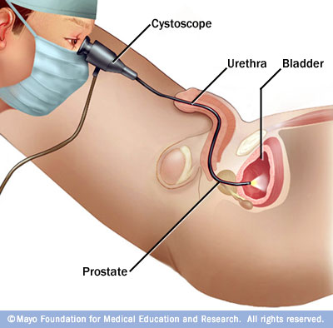
procedures
Cystoscopy:

Slide 36
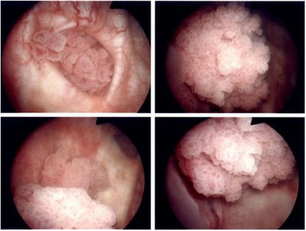
Cauliflower lesion

Slide 37
Acute Management of Hematuria patient :
- First , check Is patient stable ?
- If Yes , request ( Urine C&S , Cytology , Abdominal U/S , Cystoscopy )
- If Not ,
Start with ABCs .
Then , IV fluids .
Then , Transfuse if necessary .
Request ( Urine C&S , Cytology , Abdominal U/S,Cystoscopy )

Slide 38
Acute Management of Hematuria patient :
secondary to advanced bladder cancer or hemorrhagic cystitis
manual irrigation via catheter with normal saline to remove clots
start continuous bladder irrigation (CBI) using large (22-26 Fr) 3-way Foley if bleeding is minimal to help prevent clot formation
cystoscopy if bleeding quite active
identify resectable tumours
coagulate obvious sites of bleeding

Slide 39
Acute Management of Hematuria patient :
Refractory bleeding:
continuous intravesical irrigation with 1% alum (aluminum potassiumˇ sulfate) solution as needed.
P.S: in case of clots , they have to be removed initially via saline before irrigation with alum or silver .
intravesical instillation of 1% silver nitrate solution .
intravesical instillation of 1-4% formalin (need general anesthesia) .
embolization or ligation of iliac arteries.
cystectomy and diversion rarely.

Slide 40
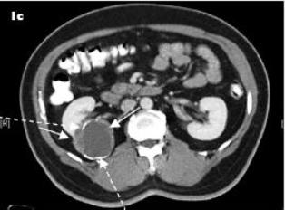
Renal Mass
A 77-year-old woman presented with abdominal discomfort and on further investigation was found to have a right renal mass.

Slide 41
Inflammatory | Malignant | Benign
Abscess Pyelonephritis | *Renal cell carcinoma The commonest Metastases | *Simple cyst The commonest Angiomyolipoma | Common
Infected renal cyst Tuberculosis Xanthogranulomatous pyelonephritis Rheumatic granuloma | Lymphoma Leiomyosarcoma Haemangiopericytoma Liposarcoma Rhabdomyosarcoma Schwannoma Osteosarcoma Fibrous histiocytoma Neurofi brosarcoma Invasion by adjacent neoplasm Carcinoid Wilms’ tumour Mesoblastic nephroma Leukaemia | Oncocytoma Pseudotumour Reninoma Phaeochromocytoma Leiomyoma Haemangioma Cystic nephroma Fibroma AV. malformation Haemangiopericytoma Renal artery aneurysm | Uncommon

Slide 42
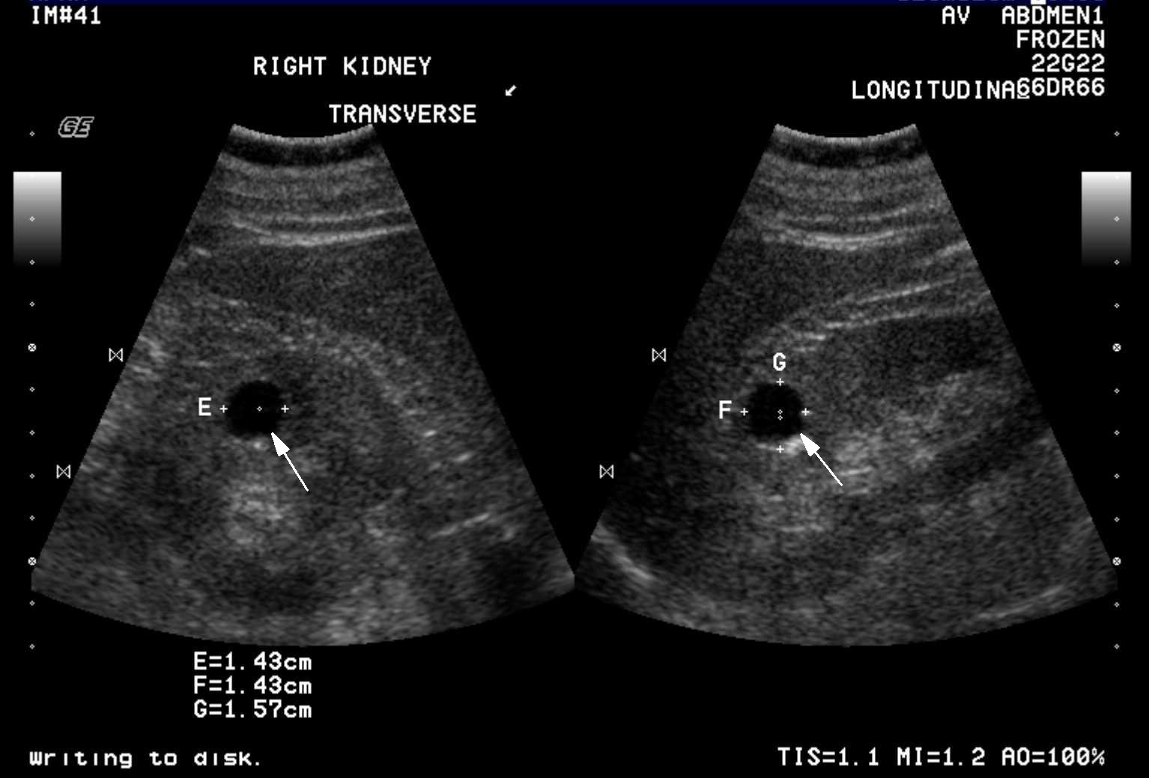
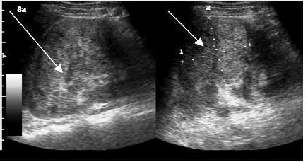
Ultrasonography
The modality of choice in determining whether a lesion is solid or cystic

Slide 43
Renal Cyst
Simple cysts are the most common benign renal lesions, comprising more than 70% of all asymptomatic renal masses.
Cysts may be unilateral or bilateral, and solitary or multiple.
They are found in more than 50% of patients older than
50 years.

Slide 44
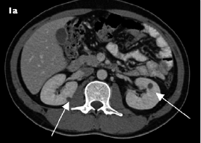
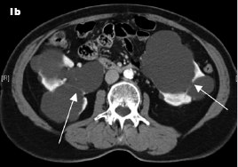
Renal Cyst
The Bosniak classification of renal cyst:
Category I : simple cyst
Category II : high density cyst ; smooth septa
or linear calcification
Category IIF :
Multiple smooth , thin septae or thickened , nonenhancing septa ; high density cyst > 3 cm

Slide 45
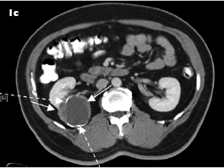
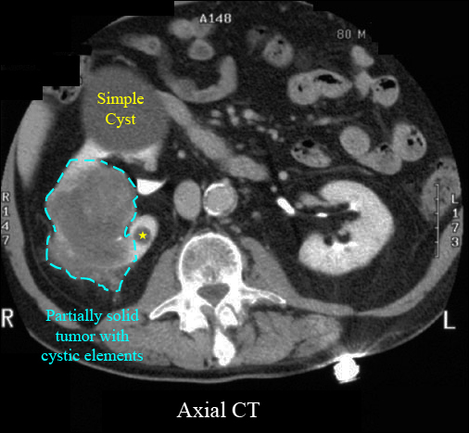
Renal Cyst
Category III :
indeterminate lesions ; numerous or thick septa , or both ; thick calcification
Category IV :
High probability of malignancy with cystic component , irregular margins , and solid vascular elements

Slide 46
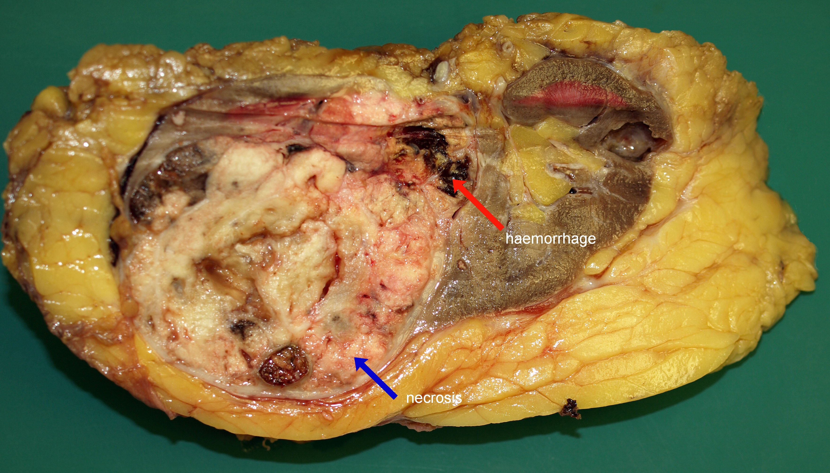

Slide 47
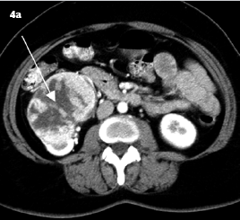
RCC
85% of all primary renal neoplasms.
Peak incidence between 55 and 60 years.
Male-to-female ratio is 2:1

Slide 48
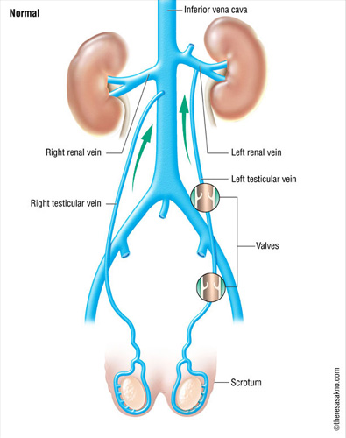
RCC
Features of RCC
Common/Important • Incidental • Total Haematuria 40% (gross or microscopic, without dysuria) • Flank pain 40% • Loin mass 25% Non-specific • Weight loss • Fever • Night sweats • Anemia Less common • Non-reducing varicocele/ new varicocele after age of 40 • Paraneoplastic syndromes
Risk factors of RCC
• Age 40 years or more • Tobacco smoking • End-stage renal failure on dialysis with acquired renal cystic disease • Family history of RCC • Tuberous sclerosis • Von Hippel-Lindau disease a rare, autosomal dominant genetic condition^{[1]:555} in which hemangioblastomas are found in the cerebellum, spinal cord, kidney and retina

Slide 49
RCC
Paraneoplastic syndromes : ( 10% to 40% )
Hypertension from renin overproduction is common
Stauffer syndrome ( nonmetastatic hepatic dysfunction )
Hypercalcemia from parathyriod hormon like protien production.
Erythrocytosis from erythropoietin production.
 The most common sites of RCC metastasis are:
Lung (75%)
Soft tissues (36%)
Bone (20%)
Liver (18%)
Cutaneous sites (8%)
Central nervous system (8%)

Slide 50
investigation
 Lab : CBC , electrolytes “calcium” , creatinine and LFT
 Imaging :
CT ( abdomen + pelvis ) with and without contrast for staging
Chest radiograph
MRI for staging ( in pts. with renal insufficiency or allergy to contrast dye )
Radionuclide bone scan is not necessary in pts. without skeletal symptomes who have normal AP and serum calcium levels.

Slide 51
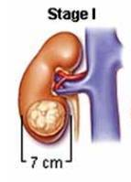
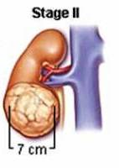
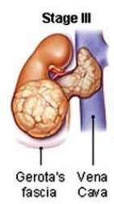
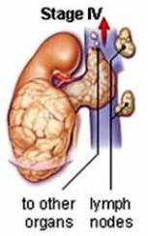
staging

Slide 52
staging
Metas. | Node NM0 | Tumor T | stage
M0 | N0 | T1 | I
M0 | N0 | T2 | II
M0 M0 M0 | N1 N1 N0,N1 | T1 T2 T3 | III
M0 M0 M1 | N0,N1 N2,N3 Any N | T4 Any T Any T | IV

Slide 53
Symptomatic flank mass
Incidental discovery on IVU
Hx. + Exam.
US
Incidental discovery on US
cystic mass
solid mass
Simple cyst No further investigation
Cyst calcification, wall irregularity, solid component, multilocculated cyst
Contrast CT
If resectable mass: radical nephrectomy
Bosniak III/IV ,
suspicious solid mass
Bosniak II: no F/U
IIF: require F/U
If unrsectable mass:
Immunotherapy e.g. interleukin 2 , interferon
RCC is resistant to Radiation & Chemotherapy

Slide 54
Thank you

