Slide 1
Presentation and Management of Intracranial Space Occupying lesions (ICSOL)

Slide 2
Types of ICSOL’s
Neoplasms:
Primary, secondary
Inflammatory:
Abscess, Tuberculoma, Syphilitic gumma, Fungal granulomas.
Parasitic:
Cysticercosis, Hydratid cyst, Amebic abscess, Schistosoma japonicum.
Traumatic:
Chronic subdural haematoma
Congenital:
Arachnoid and other benign cysts

Slide 3
Mechanisms leading to symptoms
Mass effect
CSF obstruction
Irritation of cortex
Compression
Invasion
Impairment of regional circulation
Increased ICP
Seizures
Focal neurological deficit

Slide 4
Presenting Symptoms & Signs
Very important
The main groups:
Symptoms of raised ICP
Seizures
Neurological deficit (focal signs)
Endocrine dysfunction
Personality changes & impaired higher functions

Slide 5
I. Symptoms & Signs of Raised ICP
Headache: Worsens in
Early morning
Flat position
Nausea and/or vomiting (projectile in the morning)
Visual disturbances:
Papilledema
Abducent nerve palsy (False localizing)
Impaired consciousness

Slide 6
II. Seizures:
Benign lesions tend to present more with seizures
Generalized:
Partial:
Simple
Complex

Slide 7
III. Neurological deficit (Localizing signs)
Depends on the location of the lesion
Includes:
Cranial nerve deficits: mainly in skull base tumors
Motor weakness
Sensory deficit

Slide 8
IV. Endocrine dysfunction
Mainly caused by pituitary lesions
Hyperscretion:
Prolactinoma
Acromegaly
Cushing disease
Hyposecretion:
Non-secreting pituitary adenoma
Craniopharyngioma

Slide 9
V. Personality Changes & Impaired Higher Functions
Personality alteration
Changes in mood
Inability to concentrate
Memory disturbance

Slide 10
Management
Full medical history
Complete general & neurol. Examination
Investigations
Treatment

Slide 11
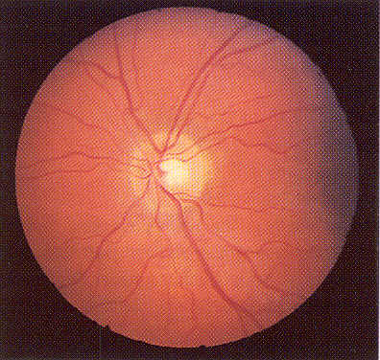
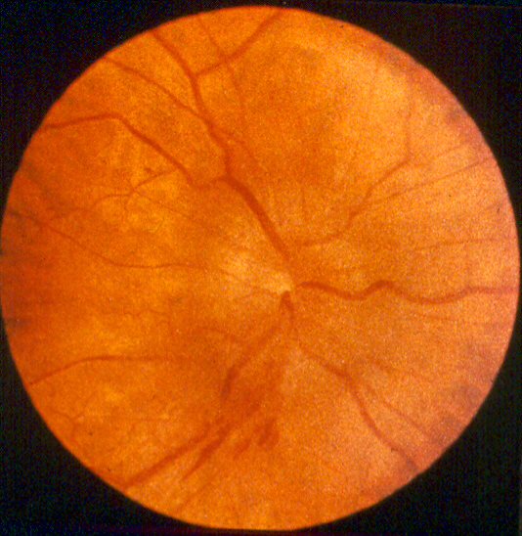
Neurological Examination Do not forget: PAPILLEDEMA
Normal
Papilledema

Slide 12
Investigations
Lab work up:
CBC, U&E, PT, PTT, blood group, etc
Radiological imaging:
CT-scan: Method of choice for emergency
MRI: shows more anatomical details of the lesion
Cerebral angiography: Mainly for vascular lesions
Others: plain skull x-rays, isotope scan
Neurophysiological tests: EEG, EVOP’s

Slide 13
Treatment
Initial treatment (Emergency)
Definitive treatment

Slide 14
Initial treatment
Very important
Often started in the ER
Goals:
Control of raised ICP
Control of seizures
Prepare patient for definitive treatment

Slide 15
Management of raised ICP
Elevate the head to about 30°
Adequate oxygenation
Avoid fluid overload
Dexamethasone
Hyperventilation
Mannitol
ICP monitoring
Only in patients with decreased LOC

Slide 16
Control of Seizures
Interruption of a seizure or status epilepticus: Benzodiazepines
Perioperative prophylaxis:
Phenytoin

Slide 17
Definitive treatment
Depends on the type and location of the lesion.
Most intracranial tumors need surgical excision.
Radiotherapy for:
Inoperable tumors
Postoperative for malignancies
Chemotherapy: adjuvant in malignancies.

Slide 18
Intracranial tumors
Responsible for 2% of all cancer death.
Overall incidence: 8-10 cases per 100.000 population per year
Two peaks:
Early childhood
5th-7th decades of life
Benign or malignant.

Slide 19
Etiology
Unknown for most of brain tumors in humans.
Chromosomal abnormalities have been noted in various benign & malignant brain tumors.
Clear genetic factors play a minor role:
5% of patients have family H/o brain tumors
Neurofibromatosis: autosomal dominant
NF I: causative gene on the long arm of chromosome 17
NF2: causative gene on the long arm of chromosome 22
Increased incidence of brain tumors following cranial irridiation

Slide 20
Classifications
Based on the cell of origin
glial(gliomas)and non-glial
In relation to brain tissue:
Extrinsic vs. intrinsic
In relation to their site:
Supratentorial vs. infratentorial (posterior fossa)
Age of presentation:
Pediatric vs. adult.

Slide 21
WHO Classification Based on the cell of origin
Neuroepithelial tumors: e.g. gliomas
Primitive neuro-ectodermal tumors: e.g. medulloblastoma
Nerve sheath tumors (neuroma): e.g. vestibular schwannoma
Meningeal tumors: e.g. Meningiomas
Pituitary tumors
Germ cell tumors: e.g. germinoma
Lymphomas
Malformative tumors: e.g. craniopharyngeoma
Vascular tumors
Metastatic tumors
Local extensions from regional tumors: e.g. Glomus jugulare

Slide 22
Glioma
Most common primary brain tumor (50%)
Arise from the supporting cells of the brain.
Neuroectodermal in origin.
Usually supratentorial.
Rarely metastasize.
Tumor in single lobe may be treated by lobectomy.
Recurrence is common despite postoperative radiotherapy.

Slide 23
Astrocytoma
Arise from the astrocyte cells
Comprise 80% of all glioma and 40% of all brain tumors
Peak incidence: 35 - 45 yrs (early middle age)
Males > females
All are inflitrative.

Slide 24
Histopathological Grading
Benign (Low grade)
Grade 1
Grade 2
Malignant (High grade)
Grade 3
Grade 4

Slide 25
Clinical presentation :
Duration of symptoms:
Benign : Often long (years)
Malignant : Often short (wks.)
Symptoms of SOL
Headache (70%)
Papilledema (60%)
Seizures (40 - 75%)
Focal neurological deficit (20 - 40% ).
Mental changes (30%)

Slide 26
Investigations
Low grade astrocytoma:
CT: Hypodense non-enhancing area.
MRI: Hyperintense T2 + non-enhancing hypointense T1
High grade astrocytoma:
CT: Mixed density area with strong, irregular contrast enhancement
MRI: Hyperintense T2 + enhancing hypointense T1

Slide 28
Treatment
Benign A. (grade 1 & 2):
Surgical Excision (+/- Radiotherapy)
Malignant A. (grade 3 & 4):
Surgical Excision + Radiotherapy
(+/- Chemotherapy)

Slide 29
Prognosis :
Benign A. (grade 1 & 2):
Variable
Cure possible after complete excision in grade I A.
Malignant A. (grade 3 & 4):
Generally POOR!
Mean survival: about 2 years

Slide 30
Meningioma
Arises from the arachnoid villi & granulations
Comprises 15-20% of all intracranial tumors
It is the most benign intracranial tumor
Peak incidence: 35 – 70 yrs (Rare in children)
Female preponderance (f:m ratio = 2:1)

Slide 31
Clinical presentation
Often long history (for many years)
Symptoms of SOL:
Focal neurological deficit depending on the site of meningioma
Epilepsy: mainly in frontal & temporal convexity meningioma
Cranial nerve deficits: common in basal M.
Mental changes: in large anterior & middle fossa M.

Slide 32
Investigations
Plain skull X-rays:
Positive findings in up to 70% of cases
Direct signs: Hyperostosis, calcification, bone erosion
Indirect signs: Shifted pineal gland, sella changes
CT scan
MRI (Investigation of choice )
Angiography:
Indicated in M. neighboring major vessels & sinuses
Shows:
Tumor relationship to major cerebral vessels
Blood supply of tumor
Whether pre-operative embolization is needed

Slide 34
Treatment & Prognosis
Treatment of choice:
TOTAL EXCISION
High recurrence rates occur in cases of:
Incomplete excision
Malignant M.
Radiotherapy plays a very limited role

Slide 35
Pituitary Tumors
Pituitary tumors represent between 10% and 15% of all intracranial tumors.
Slightly more frequent in women
Most pituitary tumors occur in young adults

Slide 36
Pituitary tumors: Classification & Presentation
Secretary : ~70-80%
Prolactinoma:
In women → amenorrhea-galactorrhea syndrome.
In men → impotence.
GH secreting: cause gigantism, acromegaly
ACTH secreting: cause Cushing’s disease
Non-secretary:
Produce compressive symptoms:
On optic chiasm → bitemporal hemianopia
On secretory cells → hypopituitarism

Slide 37
Investigation:
MRI: Method of choice.
CT : is contraindicated if MRI available because of radiation of optic chiasm.
Ophthalmological assessment.
Endocrinological assessment.

Slide 39
Treatment
Prolactinomas: Medical treatment
Dopamin agonists
Other pituitary adenomas:
Surgical excision:
Transsphenoidal
Transcranial
Radiotherapy: as adjunct to surgery for large or recurrent tumors
Hormonal substitution

Slide 40
Vestibular Schwannoma (Acoustic Neuroma)
Arise in the internal auditory meatus from the nerve sheath (Schwann) cells of the vestibular branch of the 8th cranial nerve
Early symptoms:
Unilateral sensori-neural deafness, tinnitus & vertigo
Late symptoms
Loss of corneal reflexes
Facial weakness and unilateral taste loss.
Dysphagia, dysarthria and hoarseness.
Ataxia and nystagmus.

Slide 41
Investigations
ENT assessment:
Audiometry
Radiological imaging:
MRI
CT-scan
Are helpful in determining the location and size of a tumor and also in planning its removal.
Neurophysiological testing:
Brainstem auditory evoked response (BAER)

Slide 42
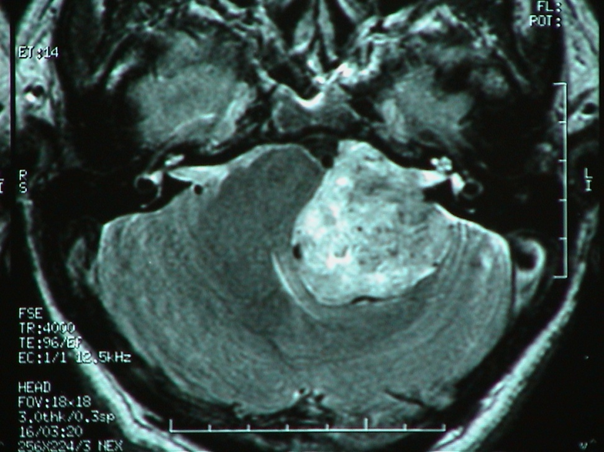
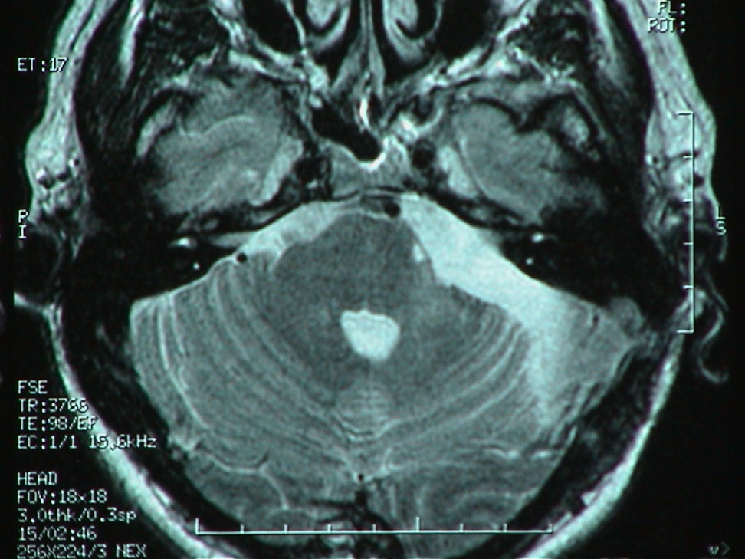
Vestibular Schwannoma: MRI
Preop.
Postop.

Slide 43
Treatment
Standard treatment: Surgical excision
Main surgical risk in large tumors: Facial paralysis
Alternative options:
Observation for patients with small lesion and little symptoms
Radiosurgery: Can be used to reduce the size or limit the growth of tumors up to 25 mm in diameter

Slide 44
Medulloblastoma
A highly cellular, malignant tumor
Originates from the external granular layer of the fetal cerebellum (Obersteiner’s layer)
Comprises ~3% of all brain tumors
2/3 of patients are children
Higher involvement of males

Slide 45
Clinical Presentation
Relatively short history (1-4 months)
Symptoms & signs of raised ICP mainly due to obstructive hydrocephalus→ 80%
Focal neurological signs → 60%
Cerebellar: Truncal & gait ataxia
False localizing : 6th nerve palsy
Brain stem: Nystagmus

Slide 46
Investigations
CT scan
MRI: Brain & spine (Diagnostic test of choice)

Slide 48
Treatment
Surgical excision + Radiotherapy (+Chemotherapy)
Ventriculoperitoneal shunt often needed
Prognosis:
5-year survival = 70%

Slide 49
Brain Metastasis
It account almost 50% of brain tumors.
Lung (most common)
Breast
Kidney
Melanoma
Colon (the least)

Slide 50
Surgical Intracranial infections
A large spectrum of microorganisms can give rise to infectious intracranial mass lesions
Causative organisms include:
Bacteria
Parasites
Fungi
Most common:
Brain abscess
Intracranial tuberculoma

Slide 51
Brain abscess
Brain abscess is a focal infection, which begins when organisms are inoculated into the brain parenchyma, usually from a site distant from the central nervous system (CNS).
Male > female
Peak incidence in the 3rd to 5th decades of life
Up to 25% of abscesses are cryptogenic and have no clear primary source.

Slide 52
Pathogenesis
There are 3 mechanisms of entry of organisms to the brain:
1- Direct extension: Infections stemming from the sinuses, teeth, middle ear, or mastoid
2- Hematogenous: Seeding of the brain occurs from distant infection sites and often results in multiple brain abscesses.
3- Following penetrating head injury or neurosurgery

Slide 53
Clinical Presentation
There are no specific symptoms for brain abscess.
Mainly present with symptoms of ICSOL, including:
Headache
Vomiting
Lethargy
Neurological deficit
Also can present with symptoms of toxicity include:
Fever
Irritability
Neck stiffness
Symptoms from the primary site of infection e.g. middle ear infection

Slide 54
Investigations
Imaging:
CT-scan
MRI
Lab work-up:
Lumbar puncture:
Should be avoided
There is a high risk of transtentorial herniation

Slide 55
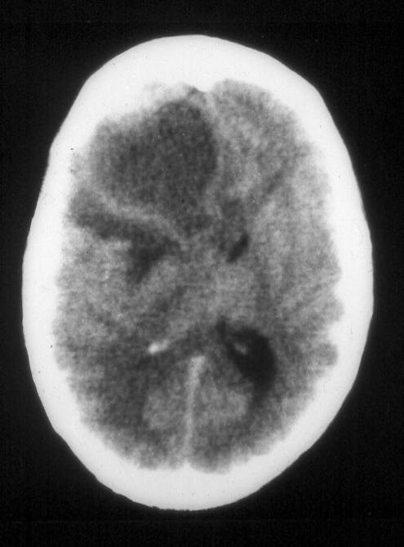
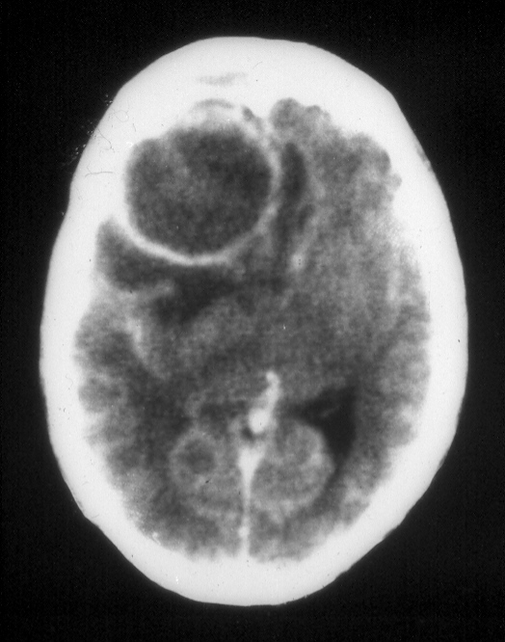
Right frontal brain abscess
Before contrast
After contrast

Slide 56
Treatment
The main treatment of brain abscess is the antimicrobial therapy.
Surgery is necessary for 2 reasons:
Gain samples of the infectuous material to identify the causative organism and the suitable antibiotic(s)
Decrease the mass effect & ICP
Surgery consists typically of:
Burr hole &
Aspiration of abscess

Slide 57
Intracranial Tuberculoma
Tuberculosis may affect the central nervous system in which case it is called TB meningitis, TB cerebritis, and TB myelitis ,respectively.
Granulomas from CSF extension or blood spread
Widely distributed
Usually multiple and less than 1cm diameter
Central zone of caseatin

Slide 58
Clinical presentation:
The patient may be asymptomatic , have pulmonary symptoms or have Symptoms and signs of raised intracranial pressure ( the usual presenting feature).

Slide 59
Incidence:
In western countries: <1% of all ICSOL
In Saudi Arabia: ~5% of all ICSOL
In last 2 decades there was a worldwide rise in association with AIDS
Often affects children & young adults

Slide 60
Intracranial Tuberculoma
Incidence:
In western countries: <1% of all ICSOL
In Saudi Arabia: ~5% of all ICSOL
In last 2 decades there was a worldwide rise in incidence secondary to AIDS.

Slide 61
Intracranial Tuberculoma ETIOLOGY & PATHOGENSIS
Caused by human type of Mucobacterium tuberculosis, but rarely by atypical strains
Secondary hematogenous spread from another lesion elsewhere in the body, usually lungs
Most patients have no history of T.B. meningitis
50% of patients have a +ve history of T.B. or contact with T.B. patient
Concomitant extracranial T.B. lesions detected:
In 10% of patients in clinical series, and
In >70% of autopsied patients

Slide 62
Intracranial Tuberculoma CLINICAL PRESENTATION
Symptoms & signs of progressive ICSOL:
Raised ICP: in nearly all infratentorial and most (80%) of supratentorial tuberculomas
Epileptic seizures: in 70 – 85% of patients with supratentorial tuberculomas
Focal neurological deficit: ~50% of patients
General symptoms (malaise, anorexia, perspiration, fever): ~50% of cases

Slide 63
Intracranial Tuberculoma INVESTIGATIONS
Lab work-up:
Increased WBC: 60% of cases
ESR: elevated or normal
Mantoux test: Often positive
CXR: +ve findings for T.B. in ~50% of cases
Methods of choice:
CT- scan
MRI

Slide 64
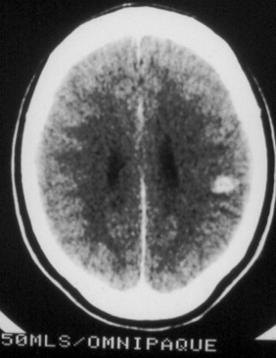
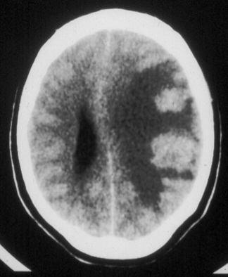
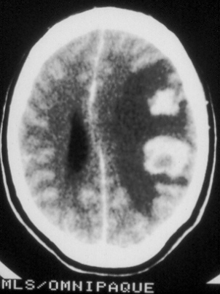
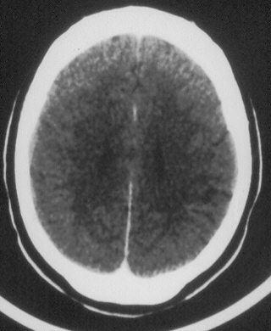
Multiple intracranial tuberculomas

Slide 65
Treatment & Prognosis
The main treatment is a combined anti-TB drug therapy for at least one year or even longer.
Surgery is often required for histopathological confirmation of diagnosis
Prognosis is generally good

Slide 66
Thank you ..

