Slide 1
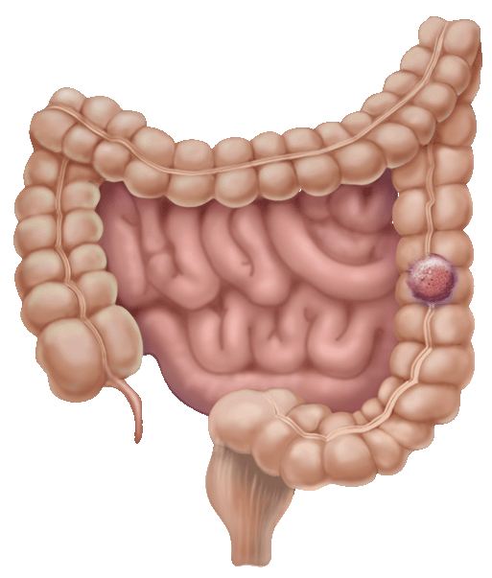
Left lower quadrant abdominal pain and mass

Slide 2
left lower quadrant mass causes
1-Skin
Sebaceous cyst (malformation)
Abscess (inflammation)
Primary and metastatic carcinomas (neoplasm)
Contusion(truma)
2-Subcutaneous Tissue and Fascia
Hernia
Cellulitis
Metastatic carcinoma ⇧
Contusion
Lipoma
3-Muscle
Myositis
Contusion

Slide 3
left lower quadrant mass causes
4-Sigmoid Colon
Diverticulum
Diverticulitis and abscess
Carcinoma and polyp
Perforation
Volvulus
Contusion
Intestinal obstruction
Tuberculosis
Foreign body
Granulomatous and ulcerative colitis

Slide 4
left lower quadrant mass causes
5-Tube and Ovary
Hydatid cyst of Morgagni
Tubo-ovarian abscess
Ovarian cyst and carcinoma
Ectopic pregnancy
6-Iliac Artery and Veins and Aorta
Aneurysm
Thrombophlebitis

Slide 5
left lower quadrant mass causes
7-Lymph Nodes
Tuberculous and acute infectious adenitis
Metastatic tumor
8-Ilium
Osteomyelitis
Sarcoma
Fracture or contusion

Slide 6
Left lower quadrant pain causes
1-Abdominal abscess
2. Colonic volvulus 3. Constipation 4. Crohn's disease
5. Cystitis 6. Diverticular Disease 7. Ectopic pregnancy 8. Inguinal hernia
9. Intussusception 10. Ovarian cysts 11. Pelvic Inflammatory Disease 12. Pelvic abscess
13. Rectal abscess 14. Tuberculosis 15. Ulcerative colitis 16. Ulcerative proctosigmoiditis 17. Uterine fibroids

Slide 7
Colorectal cancer
* Includes cancerous growths in the colon, rectum and appendix.
*Precursor of ~90% of colorectal cancers is the adenomatous polyp. These mushroom-shaped growths are usually benign, but some develop into cancer over time.
*Very curable if detected in early stage

Slide 8
adenomatous polyp
colorectal cancers

Slide 9
Colorectal cancer
*The transition from normal mucosa to polyp to invasive cancer is usually a lengthy process (7 – 12 years in many cases).
Polyp size correlates to cancer probability
Polyps < 1 cm → 1% are cancerous
Polyps > 2 cm → 30% are cancerous

Slide 10
Human colon carcinogenesis progresses by the dysplasia/adenoma to carcinoma pathway

Slide 11
Epidemiology
*There are nearly one million new cases of colorectal cancer diagnosed world-wide each year and half a million deaths.
*Most frequent form of cancer among persons aged 75 years and older.
*It is the fifth most common form of cancer in the United States and the third leading cause of cancer-related death in the Western world.

Slide 12
Epidemiology
30% - 50% of population will develop adenomatous polyps over lifetime
1% - 3% of polyps become malignant
Most remain asymptomatic & undetected
Prevalence of polyps increases with age
50% of men, 40% of women by age 50
> 90% of CRC diagnosed after 55 yrs
Notes:
The prevalence of polyps can only be estimated from data gathered in autopsy surveys or selected population-screening studies—the sources for this prevalence range.

Slide 13
pathology
Colorectal cancer is a disease originating from the epithelial cells lining the colon or rectum , as a result of mutations along the 'Wnt signaling pathway. Some of the mutations are inherited, and others are acquired. The most commonly mutated gene in all colorectal cancer is the APC gene, which produces the APC protein.

Slide 14
Colon Cancer Module
The malignant potential of a polyp based on histology is: tubular < tubulovillous < villous. Cancer risk also rises with increasing size of the polyp. The table below shows the incidence of invasive carcinoma related to polyp histology and size based on analysis of 7000 polypectomy specimens.
Tubular
Tubulovillous
Villous size cm
0.5-0.9 0.3% 1.5% 2.5%
1.0-1.9 3.6% 6.4% 5.7%
2.0-2.9 6.5% 11.4% 17.0%
>3.0 11.0% 16.0% 20.0%
Colonic polyps article
Back
Images from: www.endoatlas.com/atlas_co.html
Notes:
Images downloaded from: http://www.endoatlas.com/atlas_co.html

Slide 15
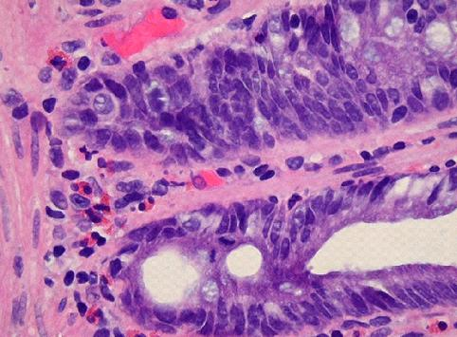
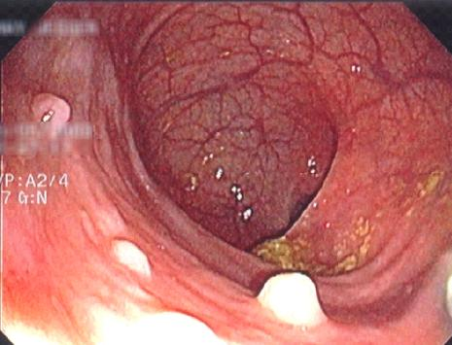
Colon Cancer Module
Hyperplastic Polyps
www.GI-Pathology.net
www.GI-Pathology.net
The epithelial cells at the base of the crypt (regenerative zone) have mildly enlarged, but uniform nuclei and brisk mitotic rate, feature which is normally present in reactive colonic mucosa
Endoscopic image of hyperplastic polyps
Back

Slide 16
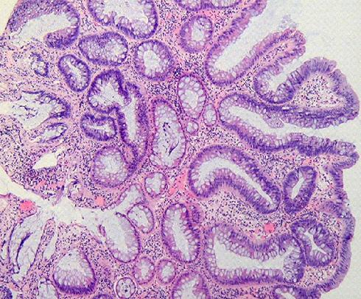
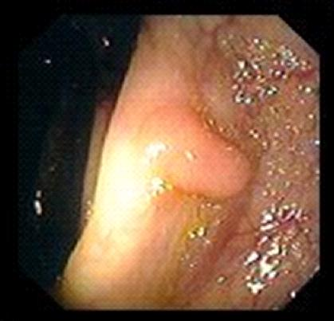
Colon Cancer Module
Tubular Adenoma
www.GI-Pathology.net
www.endoatlas.com/atlas_co.html
The adenomatous polyp has a smooth outline and is composed of numerous architecturally simple crypts with mild irregularity in size and shape
Endoscopic image of a tubular adenoma
Back

Slide 17
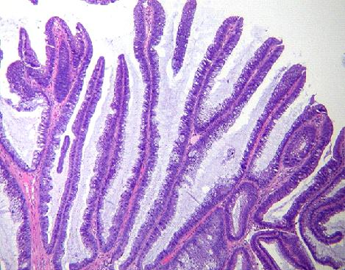
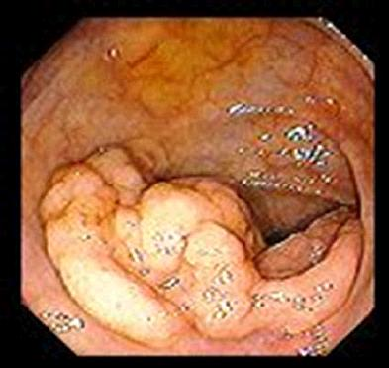
Colon Cancer Module
Villous Adenoma
www.GI-Pathology.net
www.endoatlas.com/atlas_co.html
Villous adenoma with glands that extend straight down from the surface to the base as fingerlike projections
Endoscopic image of a villous adenoma
Back

Slide 18
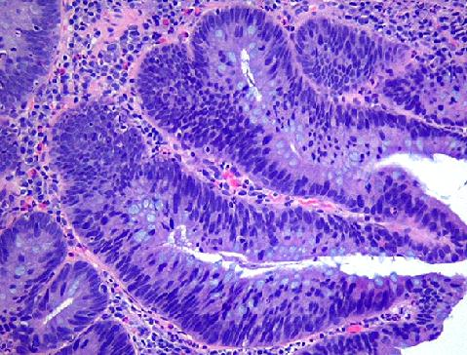
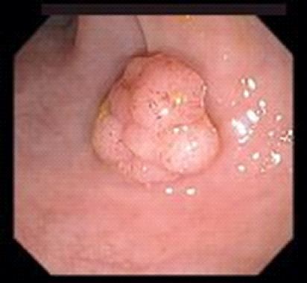
Colon Cancer Module
Tubulovillous Adenoma
www.GI-Pathology.net
www.endoatlas.com/atlas_co.html
Tubulovillous adenoma with 80% tubular histology and 20% villous histology
Endoscopic image of a tubulovillous adenoma
Back

Slide 19
The most common colon cancer cell type is adenocarcinoma which accounts for 95% of cases. Other, rarer types include lymphoma
and squamous cell carcinoma.

Slide 20
Local symptoms
*change in bowel habit
*feeling of incomplete defecation (tenesmus)
and reduction in diameter of stool→rectal cancer.
*passage of bright red blood in the stool.
*mucus
*Melena →when the disease is located in the beginning of the large bowel.

Slide 21
Local symptoms
Large tumor:
*Bowel obstruction(constipation, abdominal pain, abdominal distension, vomiting, perforation and peritonitis)
*Noticed by physical examination.

Slide 22
Local symptoms
Local invasion:
-blood or air in the urine (invasion of the bladder)
-vaginal discharge (invasion of the female
reproductive tract).

Slide 23
Constitutional symptoms
*chronic occult bleeding cause iron deficiency anemia→ fatigue, palpitations and pallor.
*decreased appetite and wieght loss. paraneoplastic syndrome:
*Fever(unusual)
*thrombosis, usually deep vein thrombosis (most common)

Slide 24
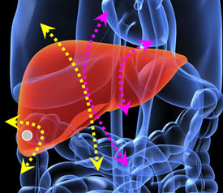
Metastatic symptom
Colorectal cancer most commonly spreads to the liver →jaundice , abdominal pain.

Slide 25
Risk factor
Average risk”
AGE: population > 50 years
~ 75% of CRC cases occur in this group
*Before 50 uncommon unless a family history of early colon cancer.

Slide 26
Risk factor
High risk”
Factors include personal and/or familial history of CRC or polyps, genetic syndromes (hereditary CRC), history of inflammatory bowel disease
~ 25% of CRC cases occur in this group

Slide 27
Risk factor
Hereditary:
Familial adenomatous polyposis (FAP) carries a near 100% risk of developing colorectal cancer by the age of 40 if untreated
Hereditary nonpolyposis colorectal cancer (HNPCC) or Lynch syndrome

Slide 28
Risk factor
Inflammatory bowel disease: About one percent of colorectal cancer patients have a history of chronic ulcerative colitis.
Crohn's disease have a risk of colorectal cancer, but less than that of patients with ulcerative colitis.

Slide 29
Colon Cancer Module
Inflammatory Bowel Disease Ulcerative Colitis & Crohn’s Colitis
www.learningradiology.com
www.GI-Pathology.net
www.GI-Pathology.net
Ulcerative Colitis gross specimen
Crohn’s Colitis endoscopic view
Barium enema: colon with "lead-pipe" appearance in ulcerative colitis
Back

Slide 30
Familial Adenomatous Polyposis

Slide 31
Risk for Colorectal Cancer
Dietary factors
*High fat diets correlate w/ high rates of CRC
*Protective effects of fiber are still unproven
*Excessive calorie intake may enhance risk
Behavioral factors
*Physical activity may reduce risk
*Excessive alcohol use and smoking have been associated with increased risk
Notes:
Epidemiological studies in many different countries implicate environmental factors, particularly diet, in CRC incidence and mortality rates. Populations in countries with highest risk, including the U.S. and Canada, consume a diet that is high in red meat and total fat. Individuals moving from a low risk country to a high risk country assume the higher risk of the new country within a generation or two as they westernize their diets. Although genetic alterations are the underlying mechanisms of CRC carcinogenesis, genetic-environmental interactions seem to be key to the process.
Biochemical basis for cancer-promoting action of fat has not been identified, but proposed mechanisms include: 1) High-fat diets increase concentration of biliary sterols that damage epithelial cells; 2) Lipid peroxidation releases free radicals that enhance carcinogenesis; and 3) Fat-induced prostaglandin synthesis promotes cellular proliferation
Effects of fiber: 1) Inhibits carcinogenesis by diluting and decreasing intestinal transit time of luminal contents; 2) Reduces luminal pH, inhibiting harmful bacteria and reducing effects of bile acids; and 3) Binds and neutralizes potential carcinogenic substances.
Case control studies have shown inconsistent results regarding the association between dietary fiber and colon cancer, although meta-analyses of these studies show an overall beneficial effect of fiber on CRC incidence (USPSTF 1996).
It is not known how excessive calorie intake enhances carcinogenesis. The direct effect of calories, lack of exercise altering metabolic rates, and altered body weight and composition have all been postulated as primary factors enhancing CRC risk.
Physical activity decreases colonic transit time, (like fiber ingestion), which may decrease exposure to luminal carcinogens (Bond 2000).
Specific dietary guidelines for CRC prevention include limiting daily fat intake to less than 30% of total daily caloric intake and ingesting at least 20-23 g of fiber daily

Slide 32
Colorectal cancer risk
*Women who have had cancer of the ovary, uterus, or breast are at higher risk of developing colorectal cancer.
*Exogenous estrogens such as hormone replacement therapy (HRT), tamoxifen, or oral contraceptives might be associated with colorectal tumors
*Lifestyle changes could decrease the risk of
colorectal cancer as much as 60-80%.

Slide 33
Early Detection of Colorectal Cancer
Detecting and removing polyps has been shown to reduce incidence of CRC
Commonly used screening tests include
Digital Rectal Exam
Double-Contrast Barium Enema (DCBE)
Fecal Occult Blood Test (FOBT)
Flexible Sigmoidoscopy (FS)
Colonoscopy

Slide 34
Digital Rectal Examination (DRE)
*Not effective as CRC screening test
*Sensitivity for CRC less than 10%
*Often used to obtain stool sample for FOBT with chance for increased false positive results

Slide 35
Double-Contrast Barium Enema
*Radiologic study—barium is used as contrast material to visualize lumen of the colon
*Effectiveness as screening test debated
*National Polyp Study: Sensitivity of 48% for polyps > 1 cm
*Further evaluation required if polyps detected
*Less risk of perforation than endoscopic exams
*May be recommended with flexible sigmoidoscopy for CRC screening

Slide 36
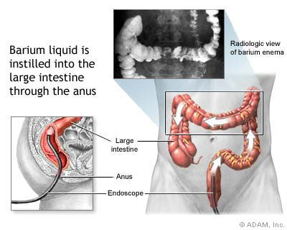

Slide 37
This is an x-ray called barium enema. The area in the circle shows an advanced cancer of colon that has produced an apple core lesion. The name apple core comes from the x-ray appearance of circumferentially eaten apple.

Slide 38
This represents the infiltration of the cancer into the muscular wall of the colon and the consequent loss of elasticity of the colon itself

Slide 39
Double-Contrast Barium Enema
Rectal cancer
Colon cancer

Slide 40
Fecal Occult Blood Testing (FOBT)
*Detects blood from cancers or large polyps
*Bleeding is intermittent and increases with polyp size and stage of cancer
*Hemoccult II (guaiac-based) most widely used (0ne of FOBT type)
*Inexpensive and easy to perform
*Diet and medications affect results
False positives: oral iron, aspirin, NSAIDs, anticoagualants
False negatives: vitamin C
*33% CRC mortality reduction with annual screening

Slide 41
Sigmoidoscopy
Advantages
Relatively accurate
Quick procedure performed w/out sedation
Inexpensive

Slide 42
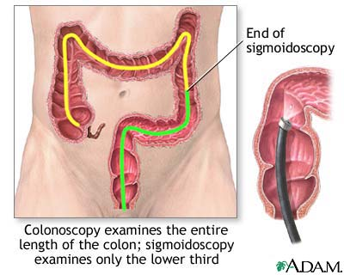

Slide 43
Sigmoidoscopy
Disadvantages
*Misses 40% - 50% of CRC and polyps
*Risk of colon perforation is 1 to 2 per 10,000 exa
*Evidence for most effective screening interval is inconclusive

Slide 44
Colonoscopy
*95% of CRC in reach of colonoscope
*could eliminate 80% to 90% of CRC mortality in population over age 50 years
*Diagnostic use after positive results on FOBT or FS
*Recommended as initial screening test for high risk individuals

Slide 45
Polyps can be detected and removed during colonoscopy. Studies show this procedure would decrease by > 80% the risk of cancer death, started by the age of 50, and repeated every 5 or 10 years.

Slide 46
Colonoscopy
Disadvantages
Expensive
Negative impact on patient’s daily life
Trained endoscopists must perform
Bowel perforation most serious complication→1 to 3 per 1000 procedures

Slide 47
CRC Screening Guidelines
Screening should be individualized according to age and comorbidities
Three screening options suggested:
*Double-contrast barium enema (DCBE) plus FS every 5 years
*Colonoscopy every 10 years
*FOBT annually and
flexible sigmoidoscopy (FS) every 5 year.

Slide 48
Monitoring
Carcinoembryonic antigen (CEA) is a protein found on virtually all colorectal tumors. CEA may be used to monitor and assess response to treatment in patients with metastatic disease. CEA can also be used to monitor recurrence in patients post-operatively.

Slide 49
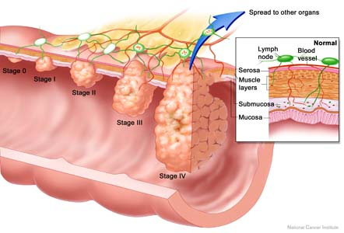
staging
TNM (for tumors/nodes/metastases) system
"T" denotes the degree of invasion of the intestinal wall, "N" the degree of lymphatic node involvement, and "M" the degree of metastasis.

Slide 50
staging
Dukes system
A - Tumour confined to the intestinal wall
B - Tumour invading through the intestinal wall
C - With lymph node(s) involvement (this is further subdivided into C1 lymph node involvement where the apical node is not involved and C2 where the apical lymph node is involved)

Slide 51
TNM stage criteria for colorectal cancer^{[39]} | TNM stage | AJCC stage
Tis: Tumor confined to mucosa; cancer-in-situ | Tis N0 M0 | Stage 0
T1: Tumor invades submucosa | T1 N0 M0 | Stage I
T2: Tumor invades muscularis propria | T2 N0 M0 | Stage I
T3: Tumor invades subserosa or beyond (without other organs involved) | T3 N0 M0 | Stage II-A
T4: Tumor invades adjacent organs or perforates the visceral peritoneum | T4 N0 M0 | Stage II-B
N1: Metastasis to 1 to 3 regional lymph nodes. T1 or T2. | T1-2 N1 M0 | Stage III-A
N1: Metastasis to 1 to 3 regional lymph nodes. T3 or T4. | T3-4 N1 M0 | Stage III-B
N2: Metastasis to 4 or more regional lymph nodes. Any T. | any T, N2 M0 | Stage III-C
M1: Distant metastases present. Any T, any N. | any T, any N, M1 | Stage IV

Slide 52
Treatment Surgery remains the primary treatment while chemotherapy and/or radiotherapy may be recommended depending on the individual patient's staging and other medical factors.

Slide 53
surgery
Curative
palliative
bypass
fecal diversion
open-and-close.

Slide 54
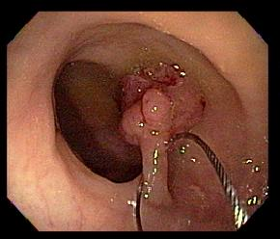
polypectomy
Curative
*tumor is localized.
*Very early cancer → polypectomy at the time of colonoscopy.

Slide 55
curative surgery
more advanced tumor →colectomy:
removal of the section of colon containing the tumor with sufficient margins
and radical resection of mesentery and lymph nodes to reduce local recurrence.
*The remaining parts of colon are anastomosed
*If anastomosis not possible, a stoma is created

Slide 56
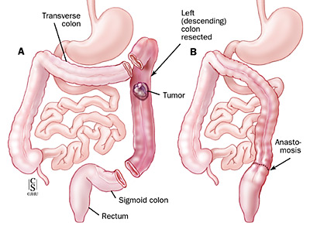
Colon Cancer Module
Left Hemicolectomy
Back

Slide 57
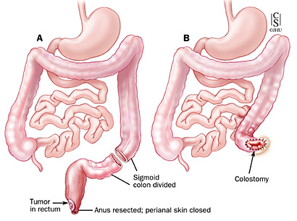
Colon Cancer Module
Abdominoperineal Resection
Back

Slide 58
colectomy specimen containing two adenomatou polyps

Slide 59
palliative (non curative) resection
In case of multiple metastases
to reduce further morbidity → bleeding, invasion, and catabolic effect
*Surgical removal of isolated liver metastases ( common ) with chemotherapy may be curative in selected patients.

Slide 60
palliative (non curative) resection
If the tumor invaded into adjacent vital structures which makes excision technically difficult, the surgeons may prefer to bypass the tumor (ileotransverse bypass) or to do a proximal fecal diversion through a stoma.

Slide 62
open-and-close
The worst case would be an open-and-close surgery, when surgeons find the tumor unresectable and the small bowel involved; any more procedures would do more harm than good to the patient. This is uncommon with the advent of laparoscopy and better radiological imaging. Most of these cases formerly subjected to "open and close" procedures are now diagnosed in advance and surgery avoided.

Slide 63
Chemotherapy
• Stage III patients benefit most from chemotherapy
after surgery.
• Some Stage II patients may also benefit.
• Usually given for 6 months.
• Old standard was 5-FU/Leucovorin given weekly,
or for 5 days in a row once a month.
• Oral chemotherapy drug, Xeloda, is equivalent to
the IV 5-FU.
• Newly approved drug, Oxaliplatin, given with 5-
FU adds additional benefit.

Slide 64
Follow-up after Surgery/Chemo
• Clinical Exam every 3 months for 2 years,
every 6 months for 5 years
• Colonoscopy within 1 year of resection
• Tumor Markers- (CEA and CA 19-9)
substances produced by cancer cells which
are detectable in the blood, may be any
early indication of recurrent disease
• CT scans can be considered for high risk

Slide 65
Rectal Cancer
• Radiation has a major role
• Given either before surgery, or after surgery
• Chemotherapy with 5-FU is given by continuous
infusion through an intravenous (IV) line at the
same time as radiation to make the radiation more
effective.
• Studies show that radiation along with surgery
decreases the risk of recurrence
Radiotherapy is not used routinely in colon cancer

Slide 66
Progonsis
 | STAGE | TNM | GROUP | GROUP | DUKE’S | Prognosis
 | Stage I | T1 | N0 | M0 | Duke’s A | 5 year survival >90%
 |  | T2 | N0 | M0
 | Stage II | T3 | N0 | M0 | Duke’s B | 5 year survival 70-85%
 |  | T4 | N0 | M0 |  | 5 year survival 55-65%
 | Stage III | any T | N1 | M0 | Duke’s C | 5 year survival 45-55%
 |  | any T | N2, N3 | M0 |  | 5 year survival 20-30%
 | Stage IV | any T | any N | M1 (distant) | Duke’s D | 5 year survival < 5%

