Slide 1
SURGICAL EMERGENCIES
Supervised by
Dr. Zohair Alaseri

Slide 2
Definition
Shock is equivalent to underperfusion of tissue.
Medical emergency
Mortality: Always greater than 20% in large studies regardless the cause

Slide 3
Pulmonary embolism
Cardiac tamponade
Pneumothorax
Valvular dysfunction
Acute thrombosis of prosthetic valve
Critical aortic stenosis
Hypovolemia
Obstructive
Bleeding
Burns
vomiting
Arrhythmia
Ischemia
rupture
Cardiogenic
Cellular Poisons
Hyperdynamic sepsis syndrome (early sepsis)
Anaphylactic shock
Central neurogenic shock
Drug overdose (dihydropyridines, α1 -antagonists)
Adrenal crisis
Carbon monoxide
Hydrogen sulfide
Cyanide
disturbutive

Slide 4
SURGICAL CAUSES OF SHOCK: (present acutely)
Obstructive : PE ,pneumothorax.
Hypovolemic: bleeding.
Cardiac: rupture.
Distributive: neurogenic shock.

Slide 5
NOTES
The most common type of shock is hypovolemic shock.
In adult most common causes of hypovolemic shock is bleeding from RTA,but in pediatric bleeding from gastroenteritis.
Hypovolemia may be caused by dehydration in pediatrics and underdeveloped countries.
Most common cause of cardiogenic shock is arrhythmias and ischemia.
Cellular poisons: may be imp in trauma, especially if patient is still hypotensive or in shock. A common toxin with trauma is CYANIDE.
SURGICAL CAUSES OF SHOCK: (present acutely)
Obstructive : PE (massive, cannot be treated with thrombolytics, treated by embolectomy), pneumothorax.
Hypovolemic: bleeding.
Cardiac: rupture.
Distributive: neurogenic shock.

Slide 6
Presentation
Decrease in BP and malfunction of underperfused organ systems, most notably:
Lactic acidosis. ( marker of underperfusion )
Renal (anuria/oliguria)
CNS dysfunstion (altered mentation)
[ Hypotension – Oliguria – Tachycardia – Altered mental status ]→ Common to all forms of shock

Slide 7
NOTES IMP.
Is it important to have hypotension to diagnose shock?!
  NO, because a young patient may have normal BP, but is behind in fluids.
  A hypertensive patient may have a higher baseline.
SO, u might have shock in a patient with normal BP.
If patient is hypotensive then he is definitely in shock.
If patient has normal BP, u must have a combination of symptoms, signs and blood tests, to give u an idea of the patients perfusion status, and help u diagnose shock. E.g capillary refilling is a very sensitive sign of shock (but not in patients with bad vascular disease)

Slide 8
Blood Lactate and Shock
Elevated concentrations of blood lactate is a sentinel marker of widespread inadequate tissue perfusion and disappear when adequate resuscitation has been achieved.
Note: why is lactate produced? In underperfusion, pyruvate converts to lactic acid.
The most imp. Marker in shock is lactic acid.

Slide 9
General Characteristics
Characterized by its effect on:
Cardiac output
Systemic vascular resistance (SVR)
Volume status
Volume status is assessed via jugular venous pressure or pulmonary capillary wedge pressure [PCWP]
Note: PCWP not recommended anymore, because it is invasive, u enter thru the subclavian artery to the right atrium to the right venticle to the pulmonary circulation.. A problem in any of these sights might give u a false reading. E.g old MI will give u PCWP.

Slide 10
NOTES
JVP may be a good indicator of shock, but its absence doesn’t mean absence of shock. Because, tension pneumothorax and cardiac tamponade have high JVP, and patients are in shock.
So JVP is important to include shock but not to exclude shock.

Slide 11
Hemodynamic changes associated with different types of shock
Shock | Cardiac output | SVR | PCWP
Cardiogenic
Hypovolemic
Neurogenic
Septic
SVR: systemic vascular resistance.

Slide 12
Approach
History and PE to determine possible cause:
Fever and a possible site of infection →septic shock.
Trauma, GI bleeding, vomiting, or diarrhea →hypovolemic shock.
History of MI, angina, or heart disease →cardiogenic shock
If JVD is present →cardiogenic shock
Spinal cord injury or neurologic deficits →neurogenic shock.

Slide 13
Cont. Approach
2. Initial steps:
2 large-bore IV, peripheral, intraosseous, central line
Fluid bolus (500-1,000 mL NS ) given in most cases.
Draw blood: CBC, electrolytes, renal function, PT/PTT
ECG, CXR
Continuous pulse oximetry
Vasopressors (dopamine or norepinephrine) if patient remains hypotensive despite fluids.
Still Dx? → echocardiogram may help.

Slide 14
Treatment
ABCs (airway, breathing and circulation.) all patients in shock
Specific treatment for each type.
Note: central arterial line is not standard.
What is best for the patient central or peripheral line in early stage of shock? Peripheral, because the 18 gauge needle is very wide and short, makes giving fluids thru it very easy. And it an easy procedure.
If peripheral fails, do intraosseous, if it fails, then insert a central line.

Slide 15
Hemorrhagic Shock =Hypovolemic
Rapid reduction in blood volume
Baroreceptor activation
Increased heart rate
Increased strength of cardiac contraction
+
Vasoconstriction
increase in the diastolic BP narrow
pulse pressure
Hemorrhagic Shock
Ventricular filling
Cardiac output

Slide 16
Cause of hypovolemic
Hemorrhage:
- Trauma
- GI bleeding
- Retroperitoneal
Nonhemorrhagic
- Voluminous vomiting
- Severe diarrhea
- Severe dehydration
- Burns
- Third-space losses in bowel obstruction

Slide 17
Diagnosis
If unclear from the vital signs and clinical picture, a central venous line maybe helpful for hemodynamic monitoring .
( CVP/PCWP, SVR, CO )
Almost always normal BP doesn’t exclude shock in trauma cases.
Increase in HR, and BP is still normal.

Slide 18
Hemorrhagic Shock
Treat.
Ensure adequate ventilation/oxygenation.
Provide immediate control of hemorrhage, when possible (e.g., traction for long bone fractures, direct pressure).
Initiate infusion of crystolloid solution (10–20 ml/kg)
  Note: give 2 L of NS, if doesn’t work, give RL to avoid hyperchloremic metabolic acidosis, still doesn’t work, give blood products.
With evidence of poor organ perfusion and 30-minute anticipated delay to hemorrhage control, begin packed red blood cell (PRBC) infusion (5–10 ml/kg).
With suspected central nervous system trauma or Glasgow Coma Scale score <9, immediate PRBC transfusion may be preferable as initial resuscitation fluid.
O-negative blood is used in women of childbearing age and O-positive blood in all others imp.

Slide 19
Cont. Treatment
For nonhemorrhagic (hypovolemic shock), blood is not necessary. Crystalloid solution with appropriate electrolyte replacement.
Monitoring urine output is the useful indicator of the effectiveness of treatment.
When there is massive bleeding we should be cautious to give vasopressor.

Slide 20


Slide 21
Obstructive Shock
Acute massive pulmonary embolism (PE)
right ventricular overload
impairs left ventricular
Circulatory Shock
Note: #1 cause of PE and DVT in hospitals is orthopedic surgery. Pt always started on heparin.

Slide 22
Obstructive Shock
Note: Rt ventricle enlarges on the expense of left ventricle, End Diastolic Volume of left ventricle will fall, and as a result COP will decrease.

Slide 23
Massive Pulmonary Embolism
PE complicated by shock is best treated by
Ventilatory support
Volume infusion
Norepinephrine
Thrombolytic therapy.
Note: norepi is the best vasopressor, why?
Selectively decreases pulmonary vascular resistance.
Can we give other vasopressors? Yes

Slide 24
Fluid therapy in Massive PE
Infusion of 500 mL of dextran 40 over 20 mins
Excessive fluid may be counterproductive in massive PE and has been reported to worsen hypotension.
Since right ventricular pressure is already elevated, volume administration further raises pressure that compromises coronary diastolic filling and left ventricular function.
Note: first line fluid is NS
Over distension of the right ventricle causes a shift of the septum towards the left ventricle. This limits left ventricular filling and subsequent cardiac output.
Therefore, cautious, judicious administration of fluids is recommended.
Note: if u give fluids, it will decrease the resistance.

Slide 25
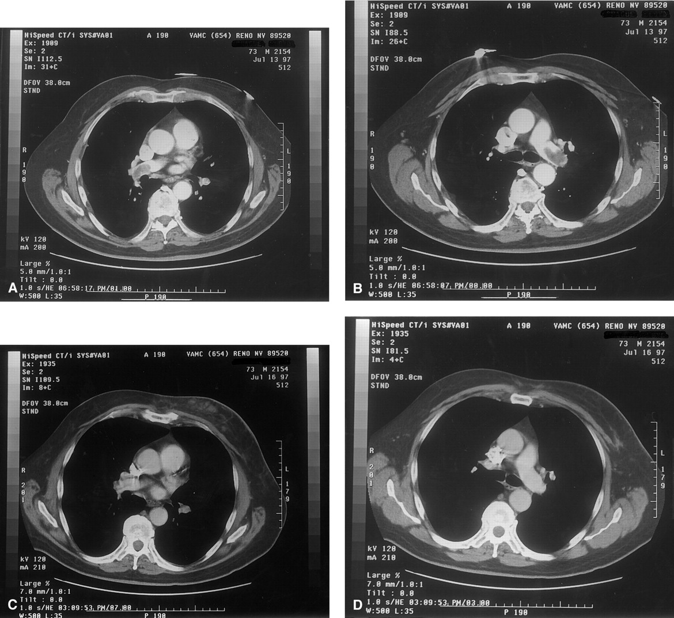

Slide 26
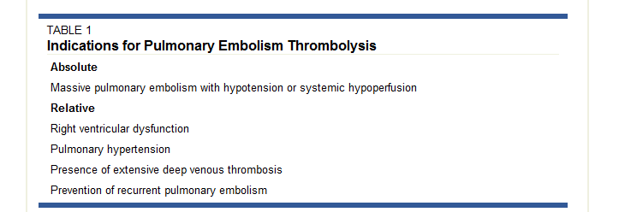

Slide 27
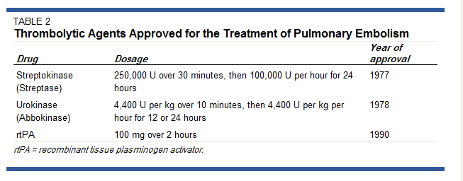

Slide 28
Thrombolysis vs. Surgical Therapy
Very little data are available on the benefits of thrombolysis versus
surgical therapy for pulmonary embolism.
The largest study to date to compare these therapies examined 37 patients with massive PE and shock who were randomized to receive one of the two interventions.
It showed that patients treated with thrombolytic therapy had a
higher death rate, increased risk of major hemorrhage and an increased
rate of PE recurrence when compared with patients treated surgically
with embolectomy.
However, the disadvantage of embolectomy is that it requires more
hospital resources and may not always be available.

Slide 29
TENSION PNEUMOTHORAX
It is the accumulation of air under pressure in the pleural space.
this condition rapidly progresses to respiratory insufficiency, cardiovascular collapse, and, ultimately, death if unrecognized and untreated.

Slide 30
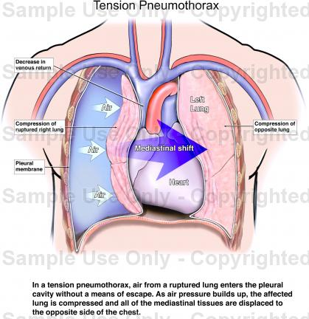
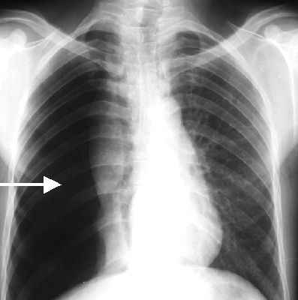

Slide 31
TENSION PNEUMOTHORAX cont.
It is a clinical diagnosis: No time for investigation.
Dyspnea
Tachypnea
Tachycardia
pleuritic chest pain
decrease breath sounds & hyperresonance on the affected side
Tracheal deviation away
JVD

Slide 32
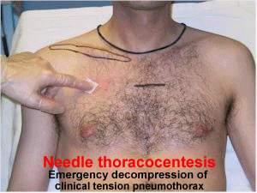
Rx : Immediate decompression by needle thoracostomy in the 2nd intercostal space midclavicular line
followed by tube thoracostomy
in the midaxillary line in the 4th
intercostal space (definitive)

Slide 33
CARDIAC TEMPONADE
It is a bleeding into the pericardial sac resulting in constriction of heart , decrease inflow & decreased cardiac output .

Slide 34
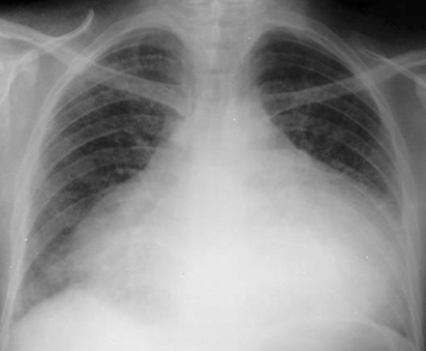
Dx :
Tachycardia
beck’s tried ( hypotension , muffled heart sound , JVD )
Kussmaul’s sign ( JVP rises with inspiration )

Slide 35
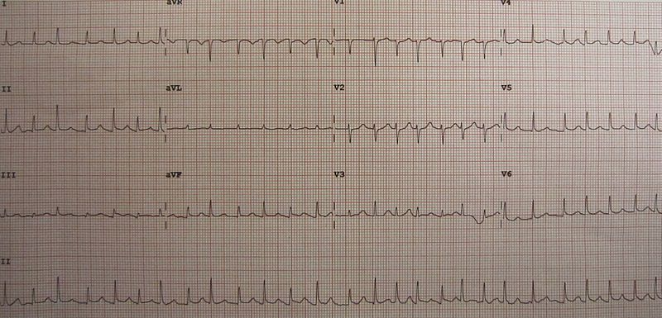
ECG:Electrical alternans
Alteration of QRS amplitude or axis

Slide 36
Rx :
O2 , IV line fluid bolus
Inotropic agent (dobutamine)
pericardiocentesis. (through the fifth intercostal space, and aspirating fluid)
in cardiac tamponade dx by echocardiogram
in treatment surgery is mandatory

Slide 37
Acute splenicsequestration crisis (ASSC)
Pooling of blood in the spleen
characterized by
  rapid fall in hemoglobin concentration
  rise in reticulocyte count
  splenomegaly
  shock
requires prompt recognition and treatment.
In the adult patient, ASSC is extremely rare.

Slide 38
Hypotension caused by large volumes of blood (mainly sickled cells) entrapped in the spleen.
Hb levels may fall acutely more than 2 g/dL less than the patient's normal value, causing circulatory compromise
Prompt diagnosis and Rx with red blood cell transfusions are therefore crucial to prevent hypovolemic shock.
Surgical splenectomy may be indicated in certain patients to prevent recurrences

Slide 39


Slide 40
Distributive shock
Anaphylactic shock
Septic shock
Neurogenic shock

Slide 41
Anaphylactic shock
Presentation:
Dyspnea
Wheeze
Vomiting
Bronchial spasm
Syncope & dizziness
Respiratory rate ≥25
SBP <90 mmHg
Laryngeal edema
Stridor
Cyanosis
flushing, and swelling of the lips
loss of consciousness

Slide 42
Anaphylactic shock
Treatment:
Remove antigen
Airway.
  Have a low threshold for intubation.
Breathing.
  100% oxygen administration
Intravascular volume expansion
Epinephrine, mainstay of treatment.
Steroids, IV

Slide 43
Anaphylactic shock
Fluid Resuscitation :
Volume expansion is important as part of the resuscitation with epinephrine to treat acute hypotension.Because anaphylaxis causes increase in vascular permeability, transferring intravascular fluid into the extravascular space rapidly.
Initially we give, 2 to 4 L of Ringer Lactate, NS or colloid.

Slide 44
Causes of death in anaphylaxis
Respiratory failure, 75%
loss of consciousness, 12.5 %
Cardiovascular system, 12.5 %
THE best treatment is Anaphylactic shock IS Epinephrine IM
Venom give anti venom
Insect bite anaphylactic Epinephrine

Slide 45
Septic shock
Primarily a form of distributive shock.
Sepsis: infection + systemic signs of inflammation(fever, ↑WBC, tachycardia)
Severe sepsis: hypoperfusion with signs of organ dysfunction.
Septic shock: the above & significant tissue hypoperfusion and systemic hypotension.
Characterized by= peripheral VD, ineffective oxygen delivery and utilization.

Slide 46
(hypoperfusion despite normal or high COP)
Macrovascularsplanchnic blood flow
Microvascular Shunting
Contractility
PVR
Distributive
Septic
Shock
Obstructive
Cardiogenic
Cytotoxic
Hypovolemic
Cellular inability to utilize oxygen
despite adequate supply
Capillary leak (absolute hypovolemia)
Venodilation (relative hypovolemia)

Slide 47
Etiology:
Gram –ve septecemia, most common
Gram +ve septecemia, fungal, less common
About 50% blood cultures are positive in pt with bacterial septic shock.
Major complications: DIC, multiple organ failure and death.

Slide 48
Septic shock
Presentation:
Fever
Tachycardia
Tachypnea
Hypotension
Hypoperfusion: confusion, oliguria
Septic shock (surgical causes):
1.Ascending Cholangitis.
2.Perforation.
3.Bowel obstruction or ischemic.
4. Necrotizing fasciitis.
5. pancreatitis.

Slide 49
Septic shock
Treatment:
ABC
  Intubate if necessary
Fluid resuscitation
  500 –1000cc Crystalloid.
Empiric antibiotics
Vasopressors: norepinephrine, epinephrine, dopamine, phenylephrine
Activated protein C for severe sepsis. Why?
Cause in DIC it was found that it is mostly caused by deficiency of these factors.
Look for site of infection, drain if possible.
Send blood for CBC, lactic acid, glucose, blood culture.
  Hyperglycemia, leukocytosis, elevated lactic acid.
  acidosis

Slide 50
Necrotizing fasciitis
A surgical cause of septic shock.
A term used to label uncommon but potentially lethal infections.
Types:
  1- Type 1 is polymicrobial and involves non-group A streptococci plus anaerobes.
  2- type 2, the pathogen is group A beta-hemolytic streptococci.
Sites:
  Type 1: abdomen, perineum
  Type 2: extremities
Pathophysiology:
A substance in the cell wall of streptococci causes a separation of the dermal connective tissue, resulting in continued inflammation and necrosis.

Slide 51
Necrotizing fasciitis
Clinical features:
fever
Numbness
Early on, the skin of site is erythematous, tender, and edematous
Day2 to day 4, necrotic patches and bullae, as a serosanguinous watery fluid begins to ooze.
Deep structures and muscles are not involved.
Hypotension, tachycardia, leukocytosis, and hypocalcemia ensue with systemic toxicity out of proportion to the clinical findings.

Slide 52
Necrotizing fasciitis
Diagnosis:
X-ray: may reveal gas in the tissues. Absence of gas does not exclude diagnosis.
MRI: helps differentiate acute cellulitis from necrotizing fasciitis.
Frozen section biopsy
Has a rapidly progressive and frequently fatal outcome, thus delaying treatment to wait for imaging is not justified.

Slide 53
Necrotizing fasciitis
Management:
surgical debridement
  aggressive and may have to be repeated
fluid and critical care resuscitation
antibiotics.
The mortality rate: 6 to 76%
Predictors of mortality:
Diabetes mellitus(the most important).
Advanced age
two or more associated comorbidities,
a delay before surgery of greater than 24 hours
presence of streptococcal toxic shock syndrome

Slide 54
Neurogenic shock
A shock that results from cervical spine injury.
Resulting in loss of sympathetic tone, which will result in:
  Arterial and venous dilatation >> Blood pools in the periphery, venous return is decreased, and cardiac output falls, blood pressure falls.
  Bradycardia.
  All patients who have sustained spinal trauma should be assumed to have hypovolemic shock from associated injuries until proved otherwise.

Slide 55
Neurogenic shock
Presentation:
Hypotension < 90 mm Hg systolic, or mean arterial pressure < 70 mm Hg.
  should first be treated with atropine to increase HR and prevent sudden death.
Bradycardia
Neurologic deficits

Slide 56
Neurogenic shock
Treatment:
ABC
Stabilize spine
Fluid resuscitation
  begin with several liters of balanced salt solution
Atropine
  rapidly reverse hypotension associated with bradycardia.
Vasoconstrictors
  The agents of choice are α1 -adrenergic specific including phenylephrine and ephedrine.
Rule out other causes of shock
With spinal cord injury, BP must be normalized, even if urine output indicates adequate renal perfusion.

Slide 57
Neurogenic shock
Following recovery from spinal shock, reflex hypertension, sweating, pilomotor erection, or, rarely, bradycardia or cardiac arrest (autonomic dysreflexia) may occur.
This is usually precipitated by painful stimuli such as bladder catheterization, respiratory suctioning, or colorectal manipulation. Hypertensive crises, which can be life-threatening, should be treated .

Slide 58
Thank you..

