Slide 1
Presentation & Management of Burn Patients
D r. Gamal Hassanain

Slide 2
Introduction
Classification
Pathophysiology
Content
Complications
Management
Estimate of
burn size

Slide 3
Introduction
A burn is defined as a coagulative necrosis causing destruction of the epithelium.

Slide 4
Introduction
Friction
Burn
Wet Heat
Radiation
Dry Heat
Electricity
Chemicals
Causative Agents

Slide 5
Wet Heat
Friction
Burn
Commonest type of burn injury
1-Water
2-Steam
3-fat-oil
( the max temperature u can hold in your hand without throwing the object away is 60 degrees).
Radiation
Dry Heat
Electricity
Chemicals

Slide 6
Dry Heat
Friction
Burn
Wet Heat
1-Flame : e.g matches, cigarettes, gas .
2-Domestic appliances e.g: irons.
Radiation
Electricity
Chemicals

Slide 7
Chemicals
Friction
Burn
Wet Heat
1-It can be acid or alkali.
2-Degree of injury depends on strength of agent, its concentration and duration of contact with skin.
3-Risk of absorption and systemic effect.
4-Risk of inhalation of fumes.
Radiation
Dry Heat
Electricity
Acid | Alkali
Coagulative necrosis with a result of hard tissue. The burns are clearly demarcated, dry and hard. Edema is mild | Lequifactive necrosis permitting the deeper invasion of the tissue so the burns are deep with marked edema

Slide 8
Chemicals
Friction
Burn
Wet Heat
Indicators of inhalation injury:
In closed space
Head, Face, Neck or Chest burn
Singed Nasal hair or eyebrow
Hoarseness, tachypnea
Nasal/Oral mucosa red or dry
Soot around mouth or nose
Coughing up black sputum (carbon particle).
Radiation
Dry Heat
Electricity

Slide 9
Electrical
Friction
Burn
Wet Heat
Effects depend on:
1-Amount of electricity (Voltage)
2-Nature of current (AC or DC)
3-Area of contact
4-Duration of contact
-Dry skin has high resistance.
-Wet or sweaty skin has low resistance
in electrical burns there is an entery wound (small) and an exit wound (large)
Radiation
Dry Heat
Chemicals

Slide 10
Radiation
Friction
Burn
Wet Heat
1-UV light from sun or sunbeds (the commonest)
2-Usually superficial but may be widespread.
3-Post radiotherapy.
Dry Heat
Electricity
Chemicals

Slide 11
Friction
Burns
Wet Heat
E.g RTA When the victim is pulled out of the car , Slides over the road.
Radiation
Dry Heat
Electricity
Chemicals

Slide 12
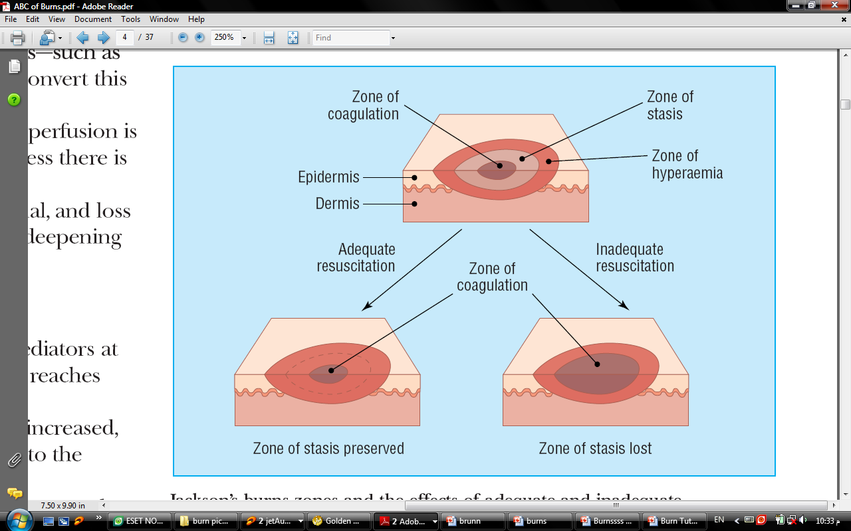
Pathophysiology
Local Effect:
  Three Zones within a major burn
      Zone of coagulation
      Zone of stasis
      Zone of Hyperemia

Slide 13
Pathophysiology
Systemic Effect:
    The release of cytokines and other inflammatory mediators at the site of injury has a systemic effect once the burn reaches 30% of total body surface area.
    Cardiovascular changes—Capillary permeability is increased, leading to loss of intravascular proteins and fluids into the interstitial compartment., result in systemic hypotension and end organ hypoperfusion.
    .Immunological changes—Non-specific down regulation of the immune response occurs, affecting both cell mediated and humoral pathways.​

Slide 14
Classification
destruction of epidermis.
Very painful, dry, red burns due to dilation of dermal capillaries, which blanch with pressure. They usually take 3 to 7 days to heal without scarring.
The most common type of first-degree burn is sunburn. First-degree burns are limited to the epidermis, or upper layers of skin.
1
Superficial burns 1st degree
2
Superficial partial-thickness 2nd degree
3
Deep partial-thickness 2nd degree
4
Full thickness 3rd degree
5
4th degree

Slide 15
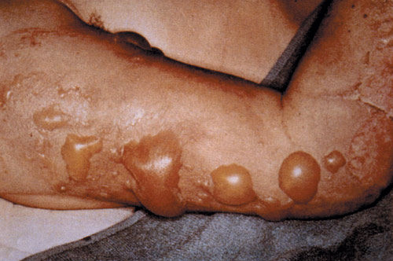
Classification
Involve epidermis & superficial portion of dermis.
Typically, they blister with clear fluid and are moist, red, weeping burns which blanch with pressure .
They heal in 7 to 21 days.
Scarring is usually confined to changes in skin pigment.
1
Superficial burns 1st degree
2
Superficial partial-thickness 2nd degree
3
Deep partial-thickness 2nd degree
4
Full thickness 3rd degree
5
4th degree

Slide 16
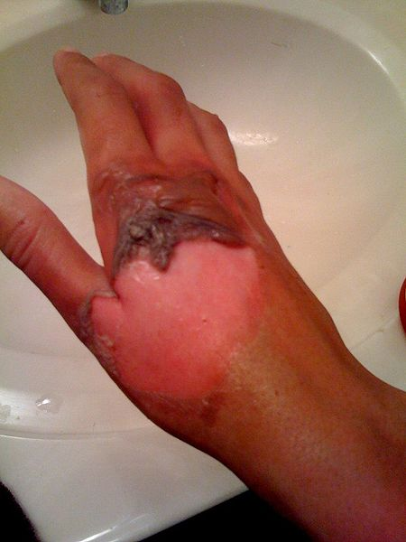
Classification
Extend to reticular dermis.
Bloody blistering which are non blanching which could be wet or waxy.
Their color may range from patchy, cheesy white to red.
Less painful than superficial partial thickness burn.
They take over 21 days to heal and scarring may be severe, May need grafting.
1
Superficial burns 1st degree
2
Superficial partial-thickness 2nd degree
3
Deep partial-thickness 2nd degree
4
Full thickness 3rd degree
5
4th degree

Slide 17
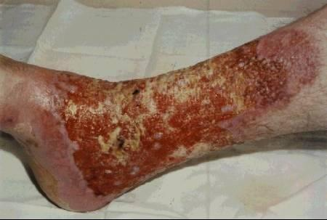
Classification
Whole of the dermis .
It is Painless, dry, hard leathery.
Capillary refill will be absent .
May see coagulated vessels.
Skin grafts are necessary.
Charred with eschar which is black, grey, white or cherry red in colour, hairs not attached, may see thrombosed veins.
1
Superficial burns 1st degree
2
Superficial partial-thickness 2nd degree
3
Deep partial-thickness 2nd degree
4
Full thickness 3rd degree
5
4th degree

Slide 18
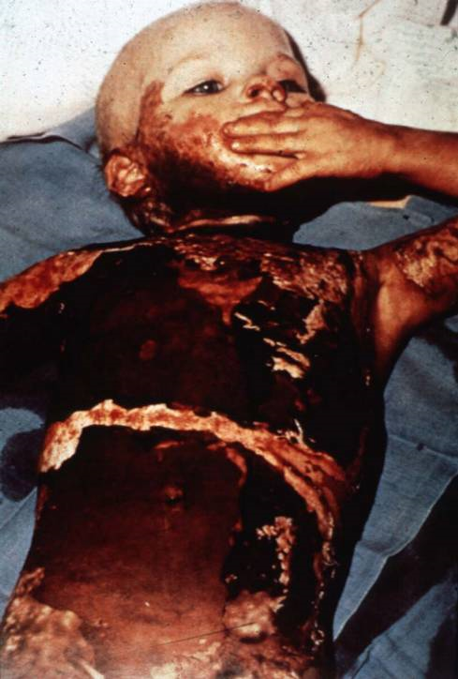
Classification
1
Superficial burns 1st degree
It is a life threatening injuries.
Extends through skin, subcutaneous tissue and into underlying muscle and bone.
Dry, painless.
2
Superficial partial-thickness 2nd degree
3
Deep partial-thickness 2nd degree
4
Full thickness 3rd degree
5
4th degree

Slide 19
Estimation of burn size
Rule of nines
      Also known as Wallace’s rule of 9.
      The most common method, but not the best.
      It is different in children due to their different surface area, they have bigger head and small limbs in proportion to their trunk

Slide 20
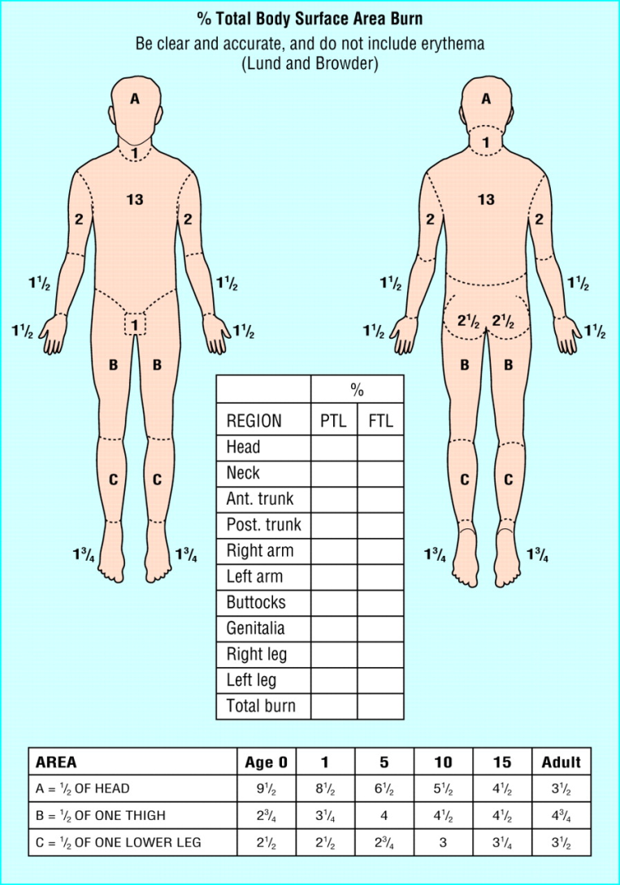
Estimation of burn size
Lund an Browder Chart
      The best and most accurate method.
      It considers the variation of the surface area according to the age.
      Is expressed as a percentage of total body surface area.
      There are 3 variables (A, B and C) which are the areas that their size percentage is affected by growth.
      Only partial and full thickness burns are included in this estimate of burn size.
(A) head (B) thigh (C) lower leg

Slide 21
Estimation of burn size
Rule of Outstretched Hand
    Gives a rough estimate of the total body surface area.
    The out stretched patient’s hand equals 1% of his body’s surface area.

Slide 22
Management
Resuscitation
  ABC’s
    a)Airway: ensure adequate airway.
    b)Breathing:
    Circumferential burns of neck or chest may constrict breathing.
    Stridor or difficulty breathing indicates endotracheal intubation
    or ventilation .
    Prophylactic endotracheal/ nasotracheal intubation in case of:
    inhalation Injury.
    supraglottic obstruction.
    extensive burns > 60%.
    deep facial burns. facial fracture. Closed head injury with unconsciousness.
    c)Circulation:
    Monitor : pulse, BP, failure to maintain adequate circulation may be followed by renal failure and eventually multi-organ failure.

Slide 23
Management
Hx
  The cause
  Time and place
  Age
  Any chronic illnesses, e.g. DM, HTN..etc
  Immunization for tetanus ( open wounds), we give immunoglobulins for patients who have never been vaccinated

Slide 24
Management
Exam.
  Expose patient TOTALLY, remove any burned clothing.
  Examine generally.
  Suspect any associated injury.
  Examine locally at the site of burn:
  Assess depth (degree) & calculate the size of burn.

Slide 25
Management
Monitor the resuscitation by IV fluids:
  Fluid replacement is the prime object of initial burn treatment.
  IV resuscitation is required for any burn patient with; more than 10% of body surface in children
  or more than 15% of body surface in adult.
  Assess fluid requirement.
To assess fluid requirement we need to identify:
Time of burn
Patient weight
%TBSA involved

Slide 26
Resuscitation Formulas
Parkland’s formula:
  Using Ringer's lactate solution
  4ml ringer's lactate x body weight x % of burn
  = total fluids for 24 hours
    Give half of the calculated total fluid in first 8.
    Second and third 8 hrs, give one fourth.
  In the 2nd day u give colloids..and plasma protien factors..and pottasuim

Slide 27
Resuscitation Formulas
Muir and Barclay formula:
  Using colloid with plasma
  Body weight x % of burn /2 =1 ratio
  In first 12hours, give 3 ratios.
  In second 12 hours, Give 2 ratios .
  In the third 12hours, give 1 ratio.

Slide 28
Resuscitation Formulas
Modified Brook formula:
  Using lactate Ringer’s solution.
    In adult at the first day:
      2ml/(body weight X %burn)
    In children at the first day:
      3ml/(body weightX%burn)
    In the second day, to maintain urine output:
      0.5 ml colloid x %burn + 5% dextrose water

Slide 29
Management
Maintenance fluid:
  For adult ; 2-3 liters/day
  For children
  A- first 10 kg 100cc/kg
  B- from 10-20kg 50cc/kg
  C- above 20kg 20cc/kg

Slide 30
Management
Dressing:
  The aim of the burn dressing is to keep the wound clean and dry, and prevent infection
  Two types.

Slide 31
Management
Closed Method
Open Method
Dressing Types

Slide 32
Management
Leave it exposed
Just put ointment such as Flamazine (silver sulphadiazine cream or Mebo ).
Used for face or limbs burns (the limb should be elevated to reduce edema).
Silver Sulphadiazine is for pseudomonas & not to apply on face ( very irritant !) → use MEBO instead .
Be careful for silver allergy( they will lose their skin).
Open Method
Dressing Types

Slide 33
Management
The burn is cleansed with antiseptic solution
Covered with silver sulphadiazine cream (antibacterial).
Non adherent layer of gauze.
Absorbent layer Cotton wool
Change the dressing daily or as often as necessary.
On each dressing change, remove any loose tissue.
Always use Closed dressing except :
Face ,hand ,perineum.
Closed Method
Dressing Types

Slide 34
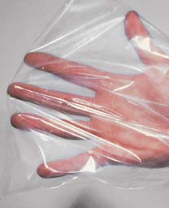
Management
Burned Hand Dressing
  Treat burned hands with special care to preserve function.
  Cover the hands with silver sulfadiazine and place them in loose polythene gloves or bags

Slide 35
Management
Skin Graft
  Skin grafts are used in treating partial thickness and full thickness burns
  Early surgical removal (excision or debridement) of burned skin followed by skin grafting reduces the number of days in the hospital and usually improves the function and appearance of the burned area, especially when the face, hands, or feet are involved.
  Role of grafting:
                Decrease evaporation & pain.
                Protects neurovascular tissue & tendons.
                Prevent facial desiccation & subsequent infection.
                Prevent scarring ,contracture & deformity.

Slide 36
Management
Types of Skin Graft
  Autograft (from self).
        1. Split-thickness (sheet vs. mesh).
        2. Full-thickness.
  Allograft ( same species i.e. cadaver)
  Xenograft ( different species i.e. porcine)
  Skin substitutes ( e.g. cultured keratocytes)

Slide 37
Management
Supportive Care
  Physiotherapy:
  from the first day.
  Analgesia:
  Methadone.
  IV morphine for acute pain
      Don't give analgesia in cases of intracranial or intra abdominal injury (we have to exclude them first) ➔ coz it will mask them.

Slide 38
Burn Complication
  Infection: most serious complication (pneumonia)
  GI complications: Curling ulcer in 12% of all burn patients (prevented by prophylactic antiacids and H2 blockers)
  Respiratory complication: major cause of death in burned patient.
  Hyperkalaemia in the 1st 24 hr because the destruction of RBCs.
  In the 2nd day there will be hypokalemia due to potassium loss in the urine.
  Suppurative thrombphlebitis(change iv position in the first 72hours)
  Circumferential burn relived by escharotomy
  Cataract.
  Late Complications:
    Dyspigmentation .
    Wound contracture.
    hypertrophic scar and keloid (in deep parital & post-graft) .
    Hyperpigmentation .

Slide 39
Burn Unit Referral Criteria
  Greater than 15% burns in an adult, and more than 10% burns in a child .
  Inhalation injury.
  Any full thickness or deep dermal burn .
  Burns of special regions: face, hands, perineum.
  Circumferential burns .
  Associated trauma or significant pre-burn illness: e.g. diabetes .
  Any patients with burns and concomitant trauma (e.g., fractures).

Slide 40
Thank You
Any Questions

