Slide 1
Lower Urinary Tract Symptoms (LUTS)
Supervised by:
Dr- Al Traifi

Slide 2
Objectives:
Why LUTS?
What are the symptoms?
Common causes?
Patient work up
Details of the Common etiology BPH

Slide 3
INTRODUCTION
LUTS is the commonest presentation in urology .
It’s a group of symptoms not a diseases
It is due to many diseases

Slide 4
Lower Urinary Tract Symptoms (LUTS)
Causes
Males:
Pediatric
Adult
Females:
Pediatric
Adult

Slide 5
LUTS
LUTS
Voiding
storage
post voiding

Slide 6
LUTS
Voiding (Obstructive)
Hesitancy.
Loss of force and decrease of calibre of the stream.
Straining for voiding
Interruption of the urinary stream
Terminal dribbling.

Slide 7
Storage (Irritaive)
Frequency.
Nocturia.
Urgency.
Urge incontinence.

Slide 8
Post void Symptoms
Post void Dribbling
Sense of incomplete emptying the bladder

Slide 9
History of
DM
Urological intervention
CNS problems and symptoms
Hematuria
Previous urinary retention
Burning Micturation and Febrile UTI
Drugs intake
Constipation

Slide 10
International Prostate Symptoms Score (IPSS) & Q of L
 | Not at All | Less Than 1 Time in 5 | Less Than Half the Time | About Half the Time | More Than Half the Time | Almost Always
1. Over the past month, how often have you had a sensation of not emptying your bladder completely after you finished urinating? | 0 | 1 | 2 | 3 | 4 | 5
2. Over the past month, how often have you had to urinate again less than 2 hours after you finished urinating? | 0 | 1 | 2 | 3 | 4 | 5
3. Over the past month, how often have you found you stopped and started again several times when you urinated? | 0 | 1 | 2 | 3 | 4 | 5
4. Over the past month, how often have you found it difficult to postpone urination? | 0 | 1 | 2 | 3 | 4 | 5
5-Over the past month, how often have you had a weak urinary stream? | 0 | 1 | 2 | 3 | 4 | 5
6. Over the past month, how often have you had to push or strain to begin urination? | 0 | 1 | 2 | 3 | 4 | 5
7. Over the past month, how many times did you most typically get up to urinate from the time you went to bed at night until the time you got up in the morning? | None 0 | 1 time | 2 times | 3 times | 4 times | 5 times
If you were to spend the rest of your life with your urinary condition just the way it is now, how would you think/believe about that? | Delighted 0 | Pleased 1 | Mostly satisfied 2 | Mixed equally 3 | Unhappy 4 | Terrible 5

Slide 11
Clinical Examination
Abdominal examination
Bladder palpation
Kidney palpation
PR examination.

Slide 12
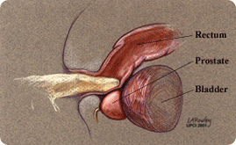
Per- rectal Examination

Slide 13
Investigations
MSU & Urine culture
Urine Cytology
U&E
LFT
PSA

Slide 14
US

Slide 15
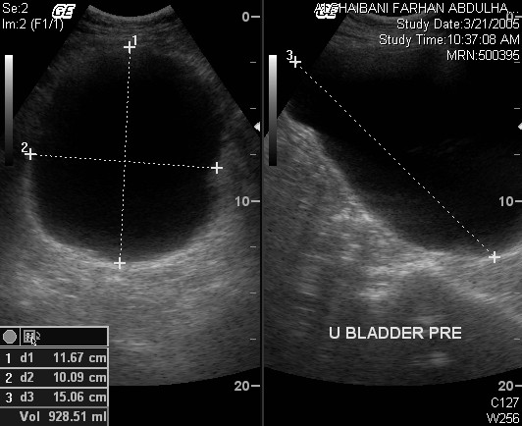

Slide 16
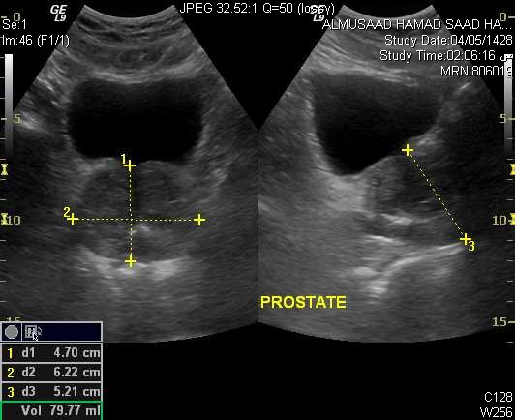

Slide 17
Ascending Urethrogram

Slide 18
Urodynamics

Slide 19
Voiding Diary

Slide 20
Uroflometry

Slide 21
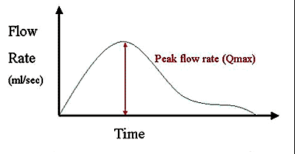
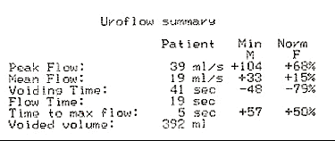

Slide 22
Cystometry

Slide 23
Cystometry
Pdetmax

Slide 24
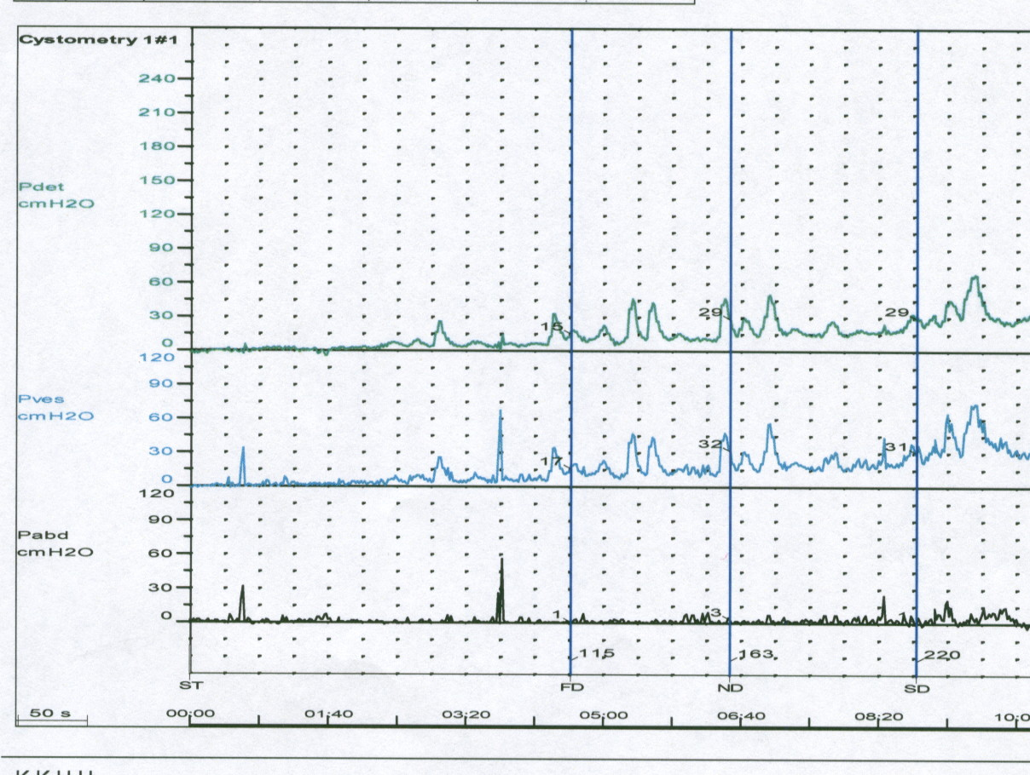
Over active Bladder

Slide 25
Pressure/Flow Study

Slide 26
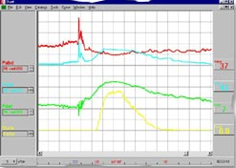

Slide 27
Management
Watchful Waiting
Alpha Blockers
Alpha Reductase Inhibitors

Slide 28
Benign Prostatic Hyperplasia BPH
It is a histological diagnosis and represents an increase in the number of epithelial and stromal elements of prostate
It is the comments etiology of LUTS
Disease of elderly men

Slide 29
Clinical manifestation:
Hesitancy
Poor stream
Frequency
Urgency
Double voiding
Post void dribbling
Incomplete emptying

Slide 30
PR examination
Normally, prostate is firm, smooth and with a palpable sulcus.
signs of BPH: enlarged firm with palpable sulcus.
Sign of malignancy: hard nodular surface with impalpable sulcus.

Slide 32
Investigation
Urinalysis
PSA
BUN and Cr
US
LFT

Slide 33
Treatment
Medical:
Tamsulosin:
It blocks adrenergic alpha-1 receptor of smooth muscle of prostate.
It decrease bladder neck and urethral resistance.
It is usually indicated in BPH.

Slide 34
ADVERSE EFFECT:
1- Headache .
2- Arthralgia .
3-Rhinitis .
4- Decrease libido .
5- back pain .
Contraindications:
1- Liver disease .
2- Orthostatic hypotension .
3- Hypersensetivity .

Slide 35
Finasteride
It is a 5-alpha reductase inhibitor.
It is an antiandrogenic drug .
It is used in case of BPH .
It is also indicated in case of alopecia in women .

Slide 36
ADVERSE EFFECT:
1- Breast enlargement
2- Impotence
3- Rash
CONTRAINDICATION:
1- Hypersensitivity
2- Pregnancy
3- Children

Slide 37
BPH Indications for surgery
Renal impairment.
Hydronephrosis.
Recurrent UTI
secondary vesical stones
Recurrent Hematuria
Retention of urine
Significant symptoms not responding
to medication

Slide 38
Surgery
Transurethral
Minimal Invasive
Invasive, Transurethral Resection Prostatectomy ( TURP)
Open Prostatectomy

