Slide 1
Approach to Common Pediatric Surgical Problems
Ahmed alsghaier
Mohammed alsharani
Abdulelah Khdr
Supervised by : Dr. Ayman AlJazaeri

Slide 2
Neonatal intestinal obstruction
Intestinal obstruction in the newborn infant and older child may be due to a variety of condition:
Foregut obstruction
Esophageal atresia
Pyloric stenosis
Malrotation
Duodenal atresia
Annual pancrease
Midgut obstruction :
Intestinal atresia
Meconium ileus
Hindgut obstruction :
Hirschsprung
Imperforated anus
Meconium plug

Slide 3
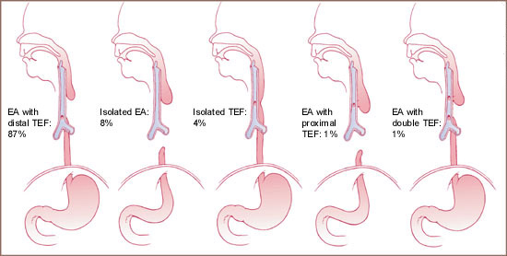
Oesophageal atresia & TOF
Incidence: 1: 5000 live births, 50% associated with anomalies
Types:
Symptoms and Signs:
Excessive salivation
Respiratory Distress
Inability to pass NG tube
Choking and coughing on feeding
VACTERL Syndrome

Slide 4
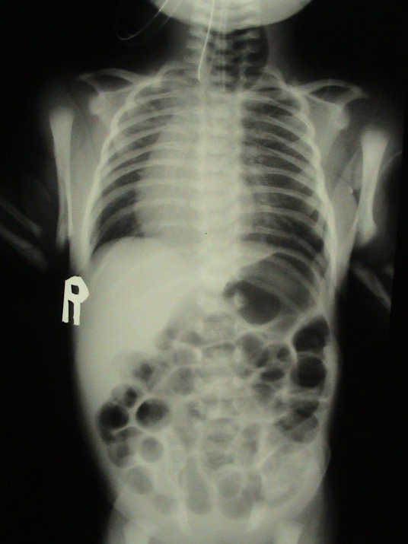
Diagnosis – Clinical & CXR
Management: Resuscitation
Common type
Right thoracotomy
Division and repair of TOF
Primary anastomosis
Pure TOF
Division and repair
Isolated atresia
>3 vertebra
Staged surgery (gastrostomy and followed in 3-6 months by delayed repair. If fails then need esophageal replacement (stomach or colon)

Slide 5
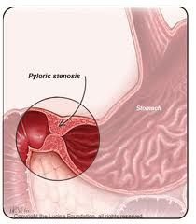
Pyloric stenosis (infantile hypertrophic )
Risk factors : Family Hx, firstborn male.
Age: 2 weeks to 2 months.
Sign and symptoms :
projectile vomiting , constant hunger, hypochloremic alkalosis,wt loss or poor wt gain.
Diagnosis and Treatment :
Gastric perstalsis, pyloric mass (olive).
Ultrasound.
IV line , pyloromytomy.

Slide 6
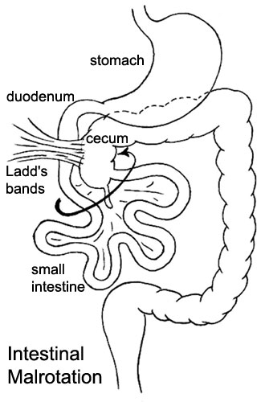
Malrotation
If the small bowel mesentery is not fixed at the duodenojejunal flexure or ileocecal region
Predisposing to valvulus.
Ladd‘s bands may cross the duodenum… obstruction.
Age : 1/3 (1 week), ¾ ( 1 month), 90% ( 1 year ).
Present with bilious vomiting.
Diagnosis :
Upper GI contrast study showing cut off in duodenum; BE showing abnormal postion of cecum .

Slide 7
Management
Maintain patients on nothing by mouth (NPO).
Correct fluid and electrolyte deficits.
Administer broad-spectrum antibiotics.
If a patient has signs of shock, administer appropriate fluids.
Surgery :
The Ladd procedure:
1- counterclockwise reduction of midgut.
2-splitting of ladds bands.
3-division of peritoneal attachments to cecum.
4-appendectomy.

Slide 8
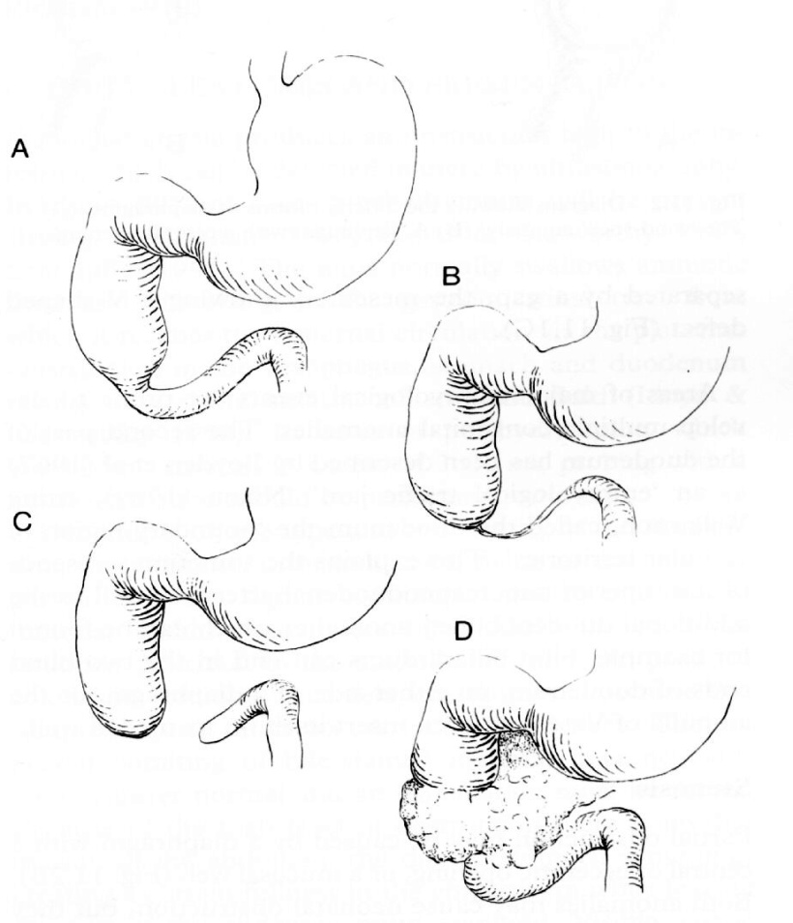
Duodenal obstruction
Divided into:
Complete (atresia)
Partial ( stenosis)
Antenatal diagnosis:
Polyhydramnios
Dilated stomach and 1st part Duodenum
Down syndrome 30%.
Symptoms and Signs:
vomiting, bilious 80%
High gastric aspiration: >30ml

Slide 9
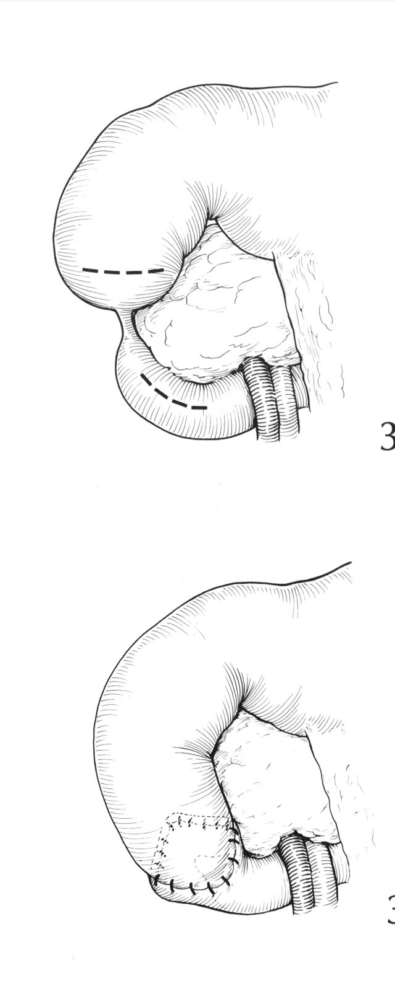
Duodenal obstruction
X-rays:
Double bobble shadow ( one air in the stomach and other in duodenum).
Management:
Exclude the Volvulus and resuscitation
NGT, Vitamin K,
stabilized before surgery
Duodeno-duodenostomy

Slide 10
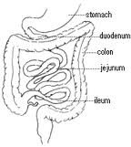
Intestinal atresia
is a malformation where there is a narrowing or absence of a portion of the intestine. This defect can either occur in the small or large intestine.
The different types of intestinal atresia are named after their location:
Duodenal atresia
Jejunal atresia
Ileal atresia
Colon atresia
Duodenal atresia has a strong association with Down syndrome. It is the most common type, followed by ileal atresia.

Slide 11
Causes:
The most common cause of non-duodenal intestinal atresia is a vascular accident in utero
In the case that the superior mesenteric artery, or another major intestinal artery, is occluded, large segments of bowel can be entirely underdeveloped
Dignosis:
Intestinal atresias are often discovered before birth: either during a routine sonogram which shows a dilated intestinal segment due to the blockage, or by the development of polyhydramnios.
Treatment
laparotomy.
If the area affected is small, the surgeon may be able to remove the damaged portion and join the intestine back together.
In instances where the narrowing is longer, or the area is damaged and cannot be used for period of time, a temporary Stoma may be placed.

Slide 12
Meconium Ileus :
Intestinal obstruction from solid meconium .
Bilious vomiting, abd. Distention,failure to pass meconium,Neuhauser‘s sign.
Diagnosis :
Family Hx of Cf, AXR, BE.
Tratment :
Gastrografin enema .
If enema is unsuccessful, then enterotomy.

Slide 13
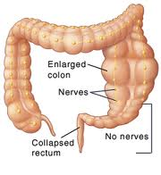
Hirschsprung's Disease
Due to congenital absence of ganglion cells in the distal bowel.
Incidence: 1/4500-5000 live births
Sex: 4:1 male predominance,
Age: 96% Full term & 4% premature
Site: Commonly: rectum/rectosigmoid
Less commonly: total colonic with or without small intestine

Slide 14
Diagnosis
Neonatal:
Delayed or failure to pass meconium with low intestinal obstruction.
late presentation: Failure to thrive, Poor feeding bloody Diarrhea with abdominal distension and occasionally with enterocolitis.
Examination: Abdominal Distension,
PR: tight sphincter with gush of loose stool
Malnutrited child, Enterocolitis.

Slide 15
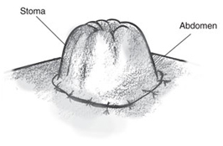
Treatment :
Pull-through preceduore
Ostomy surgery

Slide 16
Imperforate Anus
imperforate anus or anal atresia is a birth defect in which the rectum is malformed. Its cause is unknown.
Diagnosis :
p/E
X-ray
Ultrasound
These tests can show your baby's doctor some details, such as where the rectum ends and whether it connects to another structure.

Slide 17
Treatment
Imperforate anus usually requires immediate surgery to open a passage for feces.
Depending on the severity of the imperforate, it is treated either with a perineal anoplasty or with a colostomy.

Slide 18
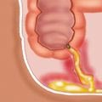
Acute appendicitis
Pathophysiology.
In preschool children.
The Dx is more difficult.
Fecoliths are more common and can be seen on plain films.
Perforation may be rapid as the omentum is less well developed.

Slide 19
They present with : Anorexia, vomiting, abdominal pain(initially central but then localized to the right iliac fossa).
DDx:
Gastroentritis
Mesentric lympadenitis
Ovarian pathology
UTI
Renal stone.

Slide 20
Dx
> 3 years, diagnosis is mainly clinical
Hx, P/E and CBC+diff
< 3 years esp. Infant, difficult Dx
Early rupture = (elderly group)
Sepsis (fever, ↑ WBC)
Vomiting (ileus or abscess)

Slide 21
Investigation
Not needed if the clinical picture is clear.
Mainly used in difficult Dx
Abdominal XR
U/S
CT scan

Slide 22
Investigation
If H&P is doesn’t suggest AP
Low probability → observation + re-evaluation
Observation NPO, No analgesia, repeat (Exam + CBC)
If AP → it will become clear (worse inflammation)
Higher probability
Laparoscopy or open appendicectomy
5-10% can be normal
When normal
Look for other ddx
Do appendicectomy (even if it’s normal)

Slide 23
Late presentation (ruptured)
Contained → abscess
Percutaneous drain + antibiotics
> 6 wks if no abscess → appendicectomy
Diffuse peritonitis
Laparotomy or laparoscopy
Abdominal washout
Appendicectomy

Slide 24
Treatment
Resuscitation
NPO, NGT
IVF
IV medication
Pain medication
Appendectomy.
Abscess >> percutaneous drainage + iv antibiotic.

Slide 25
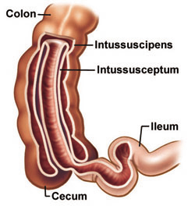
Inussusception
pathophyisology:
Invagenation of proximal bowel into a distal segment. Most common site ileocecal valve.
Presentation with :
paroxysmal, sever colicky pain.
Sausage shaped mass.
Recurrent jelly stool comprising blood stained mucus.
Abdominal distention.

Slide 26
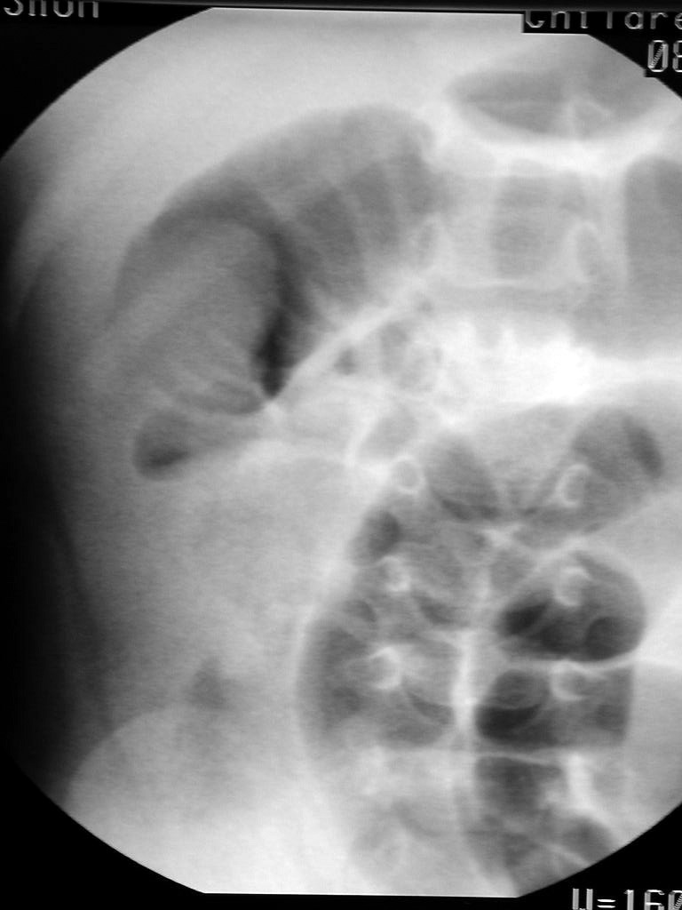
Dx
Best by U/S
Target sign, Donut sign.
95% accurate
Contrast Enema
Dx and treatment
Rx
Pressure reduction
Barium
Water
Air is most common (less complications)
Failed pressure reduction
Only few patients (15%)
Next is surgical reduction → if can’t → resection
Likely PLP

Slide 27
Thank U

Slide 28
Meckel’s Diverticulum
Is a result of the failed obliteration of the omphalomesenteric duct
Obliteration normally occurs during the 5th week of embryologic development
Can present with obstruction, inflammation, or hemorrhage

Slide 29
Role of 2
More frequent in children (62% <2 yrs)
Mostly in males (2/1)
Prevalent in 2% of the population
Normally occur within 2 feet of ileocecal valve (though reports of diverticula up to 180 cm have occurred)
Most are approximately 2 inches long

Slide 30
Presentation
Intestinal hemorrhage, typically painless bleeding.
Intestinal obstruction (more common in adults)
can be from intussusception, inflammation, adhesions
Diverticulitis
Perforation
Neoplasm (usually sarcoma, carcinoid, adenoca)

Slide 31
Pathophysiology
50% of MD contain ectopic tissue:
Gastric mucosa most common (60-85%)
Pancreatic tissue seen in 5-16%
Other tissues reported, but rare (colonic, duodenal, jejunal, hepatic, and endometrial)
Acidic secretions of gastric tissue or alkaline secretions of pancreatic tissue can cause ulcerations and subsequent bleeding

Slide 32
investigations
Technetium pertechnetate (99mTcO4) imaging is the best non-invasive method to diagnose when heterotopic gastric mucosa (HGM) is present
AP → during OR for AP → AP is normal → look for Meckle's → if found → remove.

Slide 33
Foregin body
Aspiration and ingestion
greatest in children aged 6 months to 4 years
concomitant psychiatric problems
mental disturbances
Younger children may be "fed" foreign bodies by older children
Food particle

Slide 34
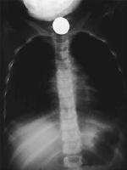
X-ray

Slide 35
investigations
plain radiograph
Most foreign body are radiolucent
CT scan or MRI is rarely indicated but may enhance the detection of foreign bodies or complications
Bronchoscopy in inhalation
If the history and physical findings are typical, no workup is needed

Slide 36
managment
Most swallowed foreign bodies harmlessly pass through the GI tract
Surgical therapy for an airway foreign body involves endoscopic removal, usually with a rigid bronchoscope.

Slide 37
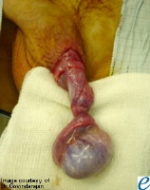
Acute scrotum
Torsion of testis and appendage
Infection: epididymitis, epididymo-orchitis, orchitis
Trauma
Hernia
Idiopathic scrotal edema

Slide 38
Testicular torsion
Torsion occurs when an abnormally mobile testis twists on the spermatic cord, obstructing its blood supply.
Patients present with acute onset of severe testicular pain.
The ischemia can lead to testicular necrosis if not corrected within 5-6 hours of the onset of pain.
Torsion can be intermittent and can undergo spontaneous detorsion.
Types: Intravaginal– most common, peak incidence b/w 13-16 years of life.
Extravaginal- less common and confined to perinatal period.

Slide 39
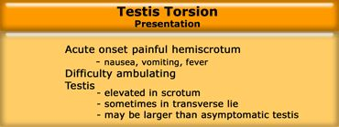
Clinical presentation

Slide 40
investigations
Color Doppler
Complete absence of intratesticular blood flow and normal extratesticular blood flow on color Doppler images is diagnostic
High-resolution ultrasonography
Nuclear scanning
Radioisotope scanning has been reported to be highly accurate for diagnosis of testicular torsion.

Slide 41
management
in some cases of testicular torsion, manually untwisting the spermatic cord may allow re-establishment of vascular flow. The technique involves manipulating the involved testis so that the anterior surface rotates from medial to lateral. This is termed the "open book" method because the motion resembles opening the cover of a book (for a right testis)

Slide 42
management
The goals of surgical exploration include
(1) confirmation of the diagnosis of torsion
(2) detorsion of the involved testis
(3) assessment of the viability of the involved testis
(4) removal (if nonviable) or fixation (if viable) of the involved testis
(5) fixation of the contralateral testis

Slide 43
Complications
Testicular atrophy
Torsion recurrence
Wound infection
Subfertility

Slide 44
Inguinal hernia
Visible swelling or bulge in inguinoscrotal aerea
May or may not painful
After crying or straining
Resolve during baby sleep

Slide 45
Risk factor
risk of inguinal hernia:
Prematurity and low birth weight (Incidence approaches 50%.)
Urologic conditions
Hypospadias
Epispadias
Exstrophy of the bladder
Abdominal wall defects
Family history
Meconium peritonitis
Cystic fibrosis
Connective tissue disease
Mucopolysaccharidosis
Congenital dislocation of the hip

Slide 46
Incarceration risk
incarceration indicate the following risk patterns:
Incarceration occurs in 17% of right-sided hernias and 7% of left-sided hernias.
More than 50% of cases of incarceration occur within the first 6 months of life; the risk gradually decreases after age 1 year.
Premature infants have twice the risk of incarceration than the general pediatric population.
More than two thirds of all incarcerations occur in children younger than 1 year.
Girls are more likely to develop incarceration of an inguinal hernia; the incidence in girls is 17.2%, whereas the incidence in boys is 12%.

Slide 47
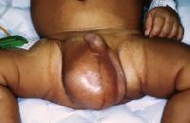
investigations
Ultrasonography: Some advocate the use of ultrasonography to differentiate between a hydrocele and an inguinal hernia
laparoscopy

Slide 48
management
Parents may be instructed on the application of gentle pressure on the bulge of an inguinal hernia to prevent incarceration until the elective operative repair is performed.
(1) high ligation and excision of the patent sac with anatomic closure
(2) high ligation of the sac with plication of the floor of the inguinal canal (the transversalis fascia)
(3) high ligation of the sac combined with reconstruction of the floor of the canal.

Slide 49
Perianal sepsis
Etiology
remains unclear
crypts of Morgagni=small infection, or cryptitis
abnormal crypts, which predispose to cryptitis and abscess formation
Presented with
1-abscess
2-fistula

Slide 50
investigations
healthy babies with perianal abscess or fistula require no laboratory studies.
Blood counts and cultures should be obtained in all patents who are immunocompromised by any cause
Colonoscopy with biopsy may be needed to confirm Crohn disease

Slide 51
management
childL<1year with small abscess=try to attain full resolution with an antibiotic regimen and no drainage
Child<1year with large<tender abscess=The abscess should be drained, and oral antibiotics initiated.
Babies who present with a fistula after surgical or spontaneous drainage of an abscess should undergo a period of nonoperative observation and should be observed until age 18 months

Slide 52
Thank U

Slide 53
Abdominal wall defects
Mainly are indirect inguinal hernias.
Incidence : 1-5%. 60% RT.

Slide 54
Risk factors
male gender (8:1).
Prematurity and low birth weight.
Urologic conditions.
PPV.
Abdominal wall defects.
Others.

Slide 55
Risk of incarceration
Increased in :
Right-sided hernias.
Premature infants.
Children younger than 1 year.
Girls.

Slide 56
Rx
Inguinal hernias => surgical repair (elective, urgent or emergent):
If incarcerated => reduction => herniorrhaphy within the next 24 hrs.
If strangulated or female can’t be reduced => emergency operation.
Umbilical hernias : surgical repair can be delayed until the age of 5 years.

Slide 57
Omphalocele & Gastroschisis
Defects in abdominal wall.
Omphalocele.
Gastroschisis.
Can be associated with other anomalies most commonly with omphalocele.

Slide 58
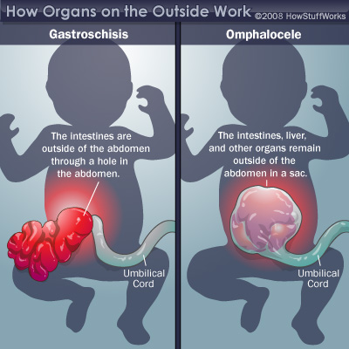

Slide 59
Childhood obesity
For the last 3 decades, the prevalence of obesity nearly quadrupled for 6- to 11-year-old children and tripled for 12- to 19-year-olds. Although rates vary among different ethnic groups, the overall prevalence of childhood obesity is 17.1%.
Complications : endocrine , CV, respiratory, hepatobiliary, orthopedic, CNS, others.

Slide 60
Definitions

Slide 61
Risk factors
Environmental.
Medications.
Genetic factors.
Endocrine factors.
Multifactorial.

Slide 62
features | syndrome
Short stature, short metacarpals and metatarsals, round facies, delayed dentition, +/- hypocalcemia and/or vicarious mineralization, precocious puberty, mild cognitive deficit | Albright hereditary osteodystrophy
Blindness, deafness, acanthosis nigricans, chronic nephropathy, type 2 diabetes, cirrhosis, primary hypogonadims in males only, normal cognition | Alstrom-Hallgren
Mental retardation, hypotonia, retinitis pigmentosa, polydactyly, hypogonadism +/- glucose intolerance, deafness, renal disease | Bardet-Biedl
Hyperinsulinemia, hypoglycemia, hemihypertrophy, intolerance of fasting | Beckwith- Wiedeman
Mental retardation, short stature, brachycephaly, polydactyly, syndactyly of feet, cryptorchidism, umbilical hernia, high-arched palate, hypogonadism in males only | Carpenter
Mental retardation, microcephaly, small hands and feet, cryptorchidism, hypotonia and failure to thrive in infancy, prominent central incisors, long, thin fingers and toes | Cohen
Microcephaly, short stature, hypotonia, almond- shaped eyes, high-arched palate, narrow hands and feet, delayed puberty, early failure to thrive with hyperphagia and increased weight gain by 2-3 years, mild to moderate cognitive deficit; | Prader- Willi

Slide 63
Dx
Hx.
PE.
Lab : FBG + insulin level, Lipid profile, LFT (liver enzymes), serum 25-OH vitamin D, Others as needed.

Slide 64
Non-surgical Rx
Referral to geneticist.
Evaluation for obesity-associated comorbidities.
Intensive lifestyle modification.
+ Pharmacotherapy.

Slide 65
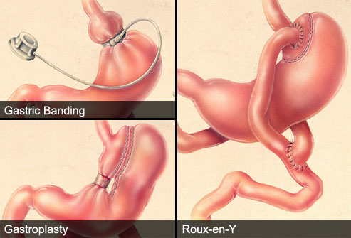
Surgical Rx
Indications.
Types of surgery used.

Slide 66
Vascular malformations
Classification
Cavernous hemangioma (strawberry nevus)
High-flow Vascular Malformation
AVMs
AVFs
Low-flow Vascular Malformation
Venous Malformations
Lymphatic Malformations
Capillary malformations (port-wine stains)

Slide 67
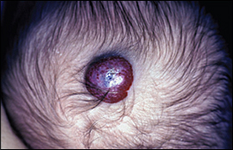
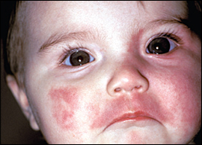
Cavernous hemangioma (strawberry nevus): first appear a few weeks after birth and regress after the age of 1 yr.
Capillary malformations (port-wine stain, nevus flammeus) : present from birth and grow with the time.
Sturge -Weber syndrome
Klippel - Trenaunay syndrome
Venous malformations : spongy, masslike lesions composed of abnormal veins with a relative lack of smooth muscle cells in their walls.

Slide 68
Presentions
Hemangiomas : red, flat or raised rubbery to firm lesion usually on the head and neck.
Lymphatic Malformations: cervicofacial localized small lesions or diffuse lesion affecting particular body part or organ system with soft-tissue and skeletal overgrowth.The overlying skin can be normal, or it may have tiny characteristic vesicles.

Slide 69
Dx & Rx
Dx: clinical.
Hemangiomas
Indications of Rx.
Modalities of Rx (non invasive, inavsive)
Others:
Complications.
Modalities of Rx.

Slide 70
Children Motor vehicle trauma
Motor vehicle crashes are the leading cause of death among those age 5-34 in the U.S.
Placing children in age- and size-appropriate car seats and belts reduces serious and fatal injuries by more than half.
for children less than 16 years, riding in the back seat is associated with a 40% reduction in the risk of serious injury.
In 2008, one in every five children between the ages of 5 and 9 who were killed in traffic crashes was a pedestrian.

Slide 71
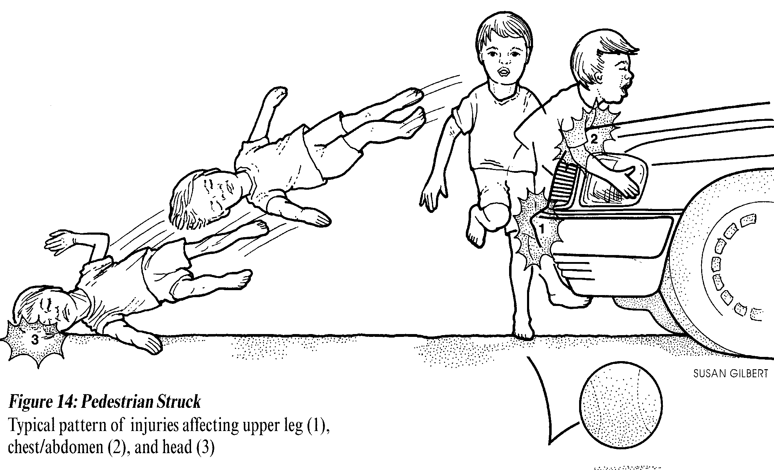
Mechanisms of Pediatric Injury

Slide 72
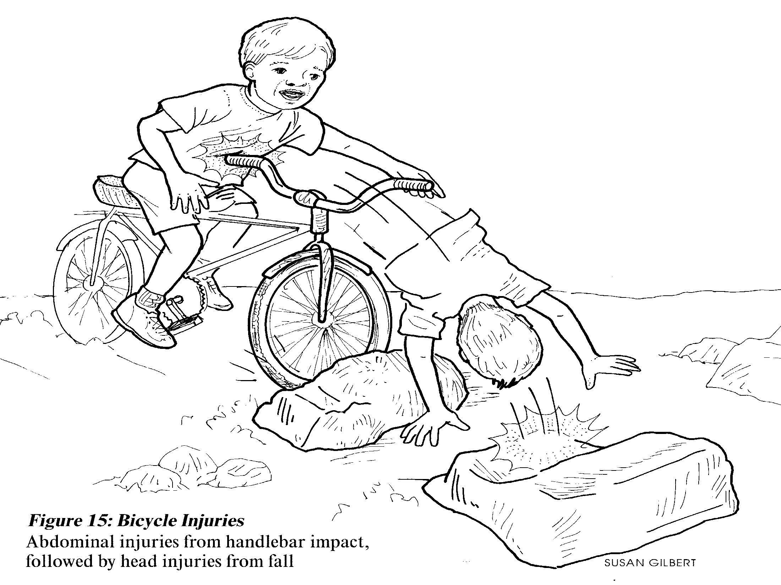
Mechanisms of Pediatric Injury

Slide 73
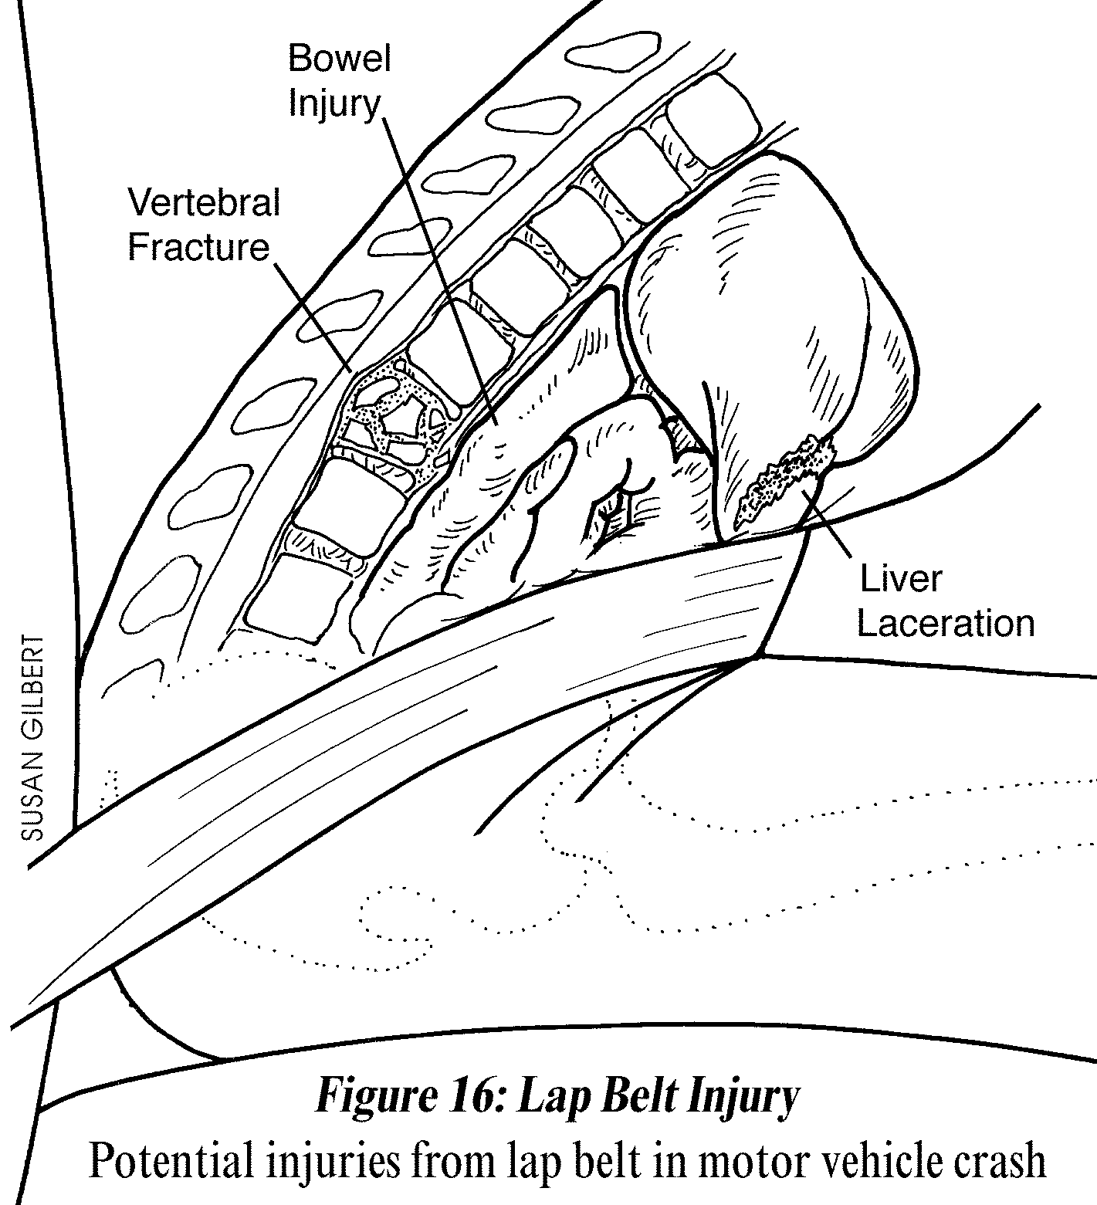
Mechanisms of Pediatric Injury

Slide 74
Initial management ATLS APPROACH
1ry survey (<5–10 min)
Look + listen + feel + manage: Airway and C-spine, Breathing, Circulation and Hemorrhage, Disability, Exposure.
ADJUNCTS:
Monitors (Pulse ox, BP and cardiac monitor, ET CO2 monitor)
XR: C-spine, CXR, and pelvic XR.
DPL/ABUS or CT if appropriate.
NG and urinary tubes if not contraindicated

Slide 75
2ry survey
Brief history, head to toe exam (H/N, Chest, Abd, U/G, Neuro, Msk, back) for Identify all injuries requiring surgical intervention, Prioritize management of injuries found.
ADJUNCTS:
CBC; coagulation profile, LFT, amylase and lipase blood, type and cross match, CT scans, complete cervical spine series and angiography if necessary and available.

Slide 76
Children are not little adults
Smaller body mass so more severe injuries.
Internal organ damage without obvious overlying external fractures b/c of pliable skeleton.
Large surface area to body volume thus hypothermia more of a concern. iv fluids should be warmed, blankets.

Slide 77
Children are not little adults
Different pulse rate, BP, RR.
Difficult airways.
Bradycardia, hypotension or irregular respirations are late and ominous signs of shock.
Different fluid requirement.
Broselow Pediatric Resuscitation System can be used.

Slide 78
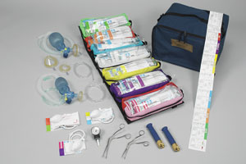
Broselow Pediatric Resuscitation System
a length-based, color-coded system for estimating weight to determine the correct sizes for equipment and the proper doses of medications during pediatric resuscitation.

Slide 79
Children are not little adults
Narrow lumen of ETT : means using smaller ETTs which get blocked more easily with secretions, blood, etc
Additional vascular access options: intraosseous and umbilical vein (newborn).
Small lung volumes, especially in neonates/infants thus aggressive ventilation can easily cause pneumothoraces.

Slide 80
Children are not little adults
Mediastinal structures are more mobile than in adults .. So can damage each other.
Gastric distension easily compresses the lungs.
Less abdominal wall musculature protection, Less abdominal fat protection, Larger spleen and liver thus easy compression of spleen and liver.

Slide 81
Thank U

