Slide 1
Management of head injury

Slide 2
epidemiology
Head injury is a leading cause of morbidity and mortality and it is the most common cause of death among all patient suffering of traumatic injury.
Motor vehicle accident are the most frequent cause of traumatic brain injury peaking in 15-24
Childe abuse is a common cause of head injury in very young infants
Falls is the most common source of head injury in patient above 80

Slide 3
Pathophysiology
Head injuries include both injuries to the brain and those to other parts of the head, such as the scalp and the skull.
Brain injury is divided into primary and secondary
Primary: occurs at the time of brain injury( direct result of trauma ) or immediate there after eg:(skull fracture ,laceration of the brain , hemorrhage in or around the brain)
Secondary ( after the primary ): denotes the brain response to injury eg:(cellular ischemic injury and cerebral edema )

Slide 4
Primary brain injury
Primary brain injury could be caused by penetrating or blunt trauma .
The brain is much more sensitive to diffuse angular application of force than focal linear one.

Slide 5
Secondary brain injury
They occur from subcellular to macroscopic level
Tissue ischemia due to the fact that Cerebral blood flow drop concededly in the early face after traumatic brain injury.
Cerebral edema occur due to cytotoxic ( BBB is intact) and vasogenic ( BBB is broken ) mechanism and acts as an additional mass which increase intracranial pressure .
Notes:
Cytotoxic due to inadequate functioning of the sodium and potassium pump results n retention of sodium and water ,,, wiki : In this type of edema the BBB remains intact. This edema is due to the derangement in cellular metabolism resulting in inadequate functioning of the sodium and potassium pump in the glial cell membrane. As a result there is cellular retention of sodium and water. There are swollen astrocytes in gray and white matter. Cytotoxic edema is seen with various intoxications (dinitrophenol, triethyltin, hexachlorophene, isoniazid)تذكر ان الصوديوم يسحب الماء
Due to a breakdown of tight endothelial junctions which make up the blood-brain barrier (BBB). This allows normally excluded intravascular proteins and fluid to penetrate into cerebral parenchymal extracellular space. Once plasma constituents cross the BBB, the edema spreads; this may be quite fast and widespread

Slide 6
Clinical assessment
The basic management is divided into:
initial resuscitation(a,b,c,d,e)
primary neurologic survey(glasgow coma scale+ pupils+gross motor)
search for lesions that require immediate surgical management
identification and management of cerebral edema and increased intra cranial pressure.
Notes:
The specific goals in the acute management of severe traumatic brain injury are:
Protect the airway & oxygenate
Ventilate to normocapnia
Correct hypovolaemia and hypotension
CT Scan when appropriate
Neurosurgery if indicated
Intensive Care for further monitoring and management

Slide 7
All patient with sever brain injury may require intubation purely on the basis of a reduced ability to protect the airway and maintain ventilation.
Restoring and maintaining adequate blood pressure is important
data base research demonstrate that a single episode of hypotension following brain injury doubles the risk of dying compared to patients who never had an episode.

Slide 8
Primary neurological survey

Slide 9
Glasgow coma scale
Notes:
Measures severity
Localizes painful stimuli 5
Flexion / Withdrawal to painful stimuli 4

Slide 10
The score range from 3-15.
A score between 3-8 indicate severe brain injury .
A score between 9-12 indicate moderate brain injury.
A score between 13-15 indicate mild closed head injury.

Slide 11
In addition to determining the GCS the primary neurological survey include an assessment of the pupil and gross motor function .
The mass of hematoma may produce uncle herniation with unilateral pupillary dilatation and contralateral hemiparesis and these indicate a life threatening intra cranial hemorrhage is present.

Slide 12
Sign and symptoms
Presentation varies according to the injury. A patient may present with or without neurologic deficit.
Common symptoms of head injury include: coma, confusion, drowsiness, personality change, seizures, nausea and vomiting, headache and a lucid interval, during which a patient appears conscious only to deteriorate later.
When we have a skull fracture :
leaking cerebrospinal fluid and is strongly indicative of basilar skull fracture.
an eye that cannot move or is deviated to one side.
wounds or bruises on the scalp or face.
Basilar skull fractures, those that occur at the base of the skull, are associated with Battle's sign, a subcutaneous bleed over the mastoid hemotympanum, and cerebrospinal fluid rhinorrhea and otorrhea.
Notes:
Temporarly recovery of consciousness after head injury before relapse into coma : lucid interval

Slide 13
Diagnostic imaging
All patient with moderate and sever brain injury should have a CT scan of the head . Also with mild with risk factor such as the use of anticoagulants.
Plain skull X ray is not advised as substitute for CT.
MRI maybe useful in assessing cervical and intracranial vasculature and helpful in accurate prognostication of injury outcome

Slide 15
Conventional angiography ,CT scan ,and MRA are potential consideration in case of cervical intra cranial vascular injury
Conventional angiography is the gold standard and offers endovascular treatment.
After the head CT scan the clinical and radiographic information should be synthesized to formulate a plan either to operate or evaluate for intra cranial hypertension or to observe clinically for worsening of neurological status

Slide 16
Clinical injury pattern and herniation syndrome
Immediate recognition and treatment of these syndromes is essential for patient survival.
Subfalcine herniation occur when part of the cerebrum is forced from one side to an other under the falx cerebri.
There is a general correlation between the degree of Medline shift , the depression in the level of consciousness and the severity of the injury.
Notes:
. Herniation can be caused by a number of factors that cause a mass effect and increase intracranial pressure (ICP): these include traumatic brain injury, stroke, or brain tumor.[
Brain herniation, also known as cistern obliteration, is a deadly side effect of very high intracranial pressure

Slide 17
Notes:
Because herniation puts extreme pressure on parts of the brain and thereby cuts off the blood supply to various parts of the brain, it is often fatal. Therefore, extreme measures are taken in hospital settings to prevent the condition by reducing intracranial pressure. Herniation can also occur in the absence of high ICP when mass lesions such as hematomas occur at the borders of brain compartments.^{[2]}

Slide 18
Uncal herniation
Occur when the uncus of the temporal lobe is shifted medially
It can compress the oculomotor resulting in loss of it’s parasympathetic function
With more sever or prolonged compression the extra oculor muscle function is also lost leading to an eye that is deviated anteriorly and laterally. down and out position in the affected eye
if the uncus is forced further medially it compress the cerebral peduncle producing counter lateral hemiparesis
Notes:
Loss of accomodation and dialtation of pupil ,, cerebral peduncle is continouation of internal capsule ,, NB decaussation of corticospial will happen in medulla

Slide 19
Tonsillar herniation
Occur when the intra cranial content particular the content of the posterior fossa are forced out of the foramen magnum
The tonsils of the cerebellum are pushed downward and compress the medulla oblongata leading to respiratory depression and death

Slide 20
Notes:
Supratentorial herniation
Uncal
Central (transtentorial)
Cingulate (subfalcine)
Transcalvarial
Infratentorial herniation
Upward (upward cerebellar or upward transtentorial)
Tonsillar (downward cerebellar)

Slide 21
The cushing triad
This is physilogical response of high ICP
Bradycardia
Hypertension
Respiratory irregularity
Intubation and mechanical ventilation often obscure the respiratory part of the triad
Notes:
Indicate herniation and increase intracranial pressure

Slide 22
Specific injuries & surgical management
Skull fracture
They are usually categorized into open or closed( non- penetrating) depressed or non depressed and basilar or convexity varieties
Depressed fracture can tear the Dura or lacerate the cortex of the brain and they are usually considered for operative repair
Skull fractures that are not depressed usually do not require repair
Basilar skull fractures can damage the the vasculature and crainial nerves and can lead to a CSF leak and meningitis
Clinically one may suspect a basilar skull fracture in the presence of Battle’s sign or Raccoon eyes

Slide 23
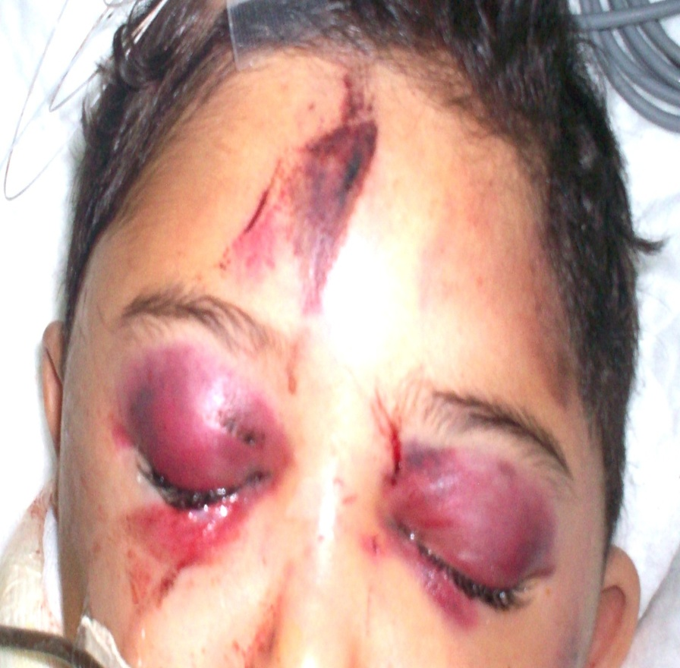
Battle’s sign
Raccoon eyes

Slide 24
Epidural hematoma
The bleeding occures on the outside of the dura and collects in and expands the potential epidural space between the dura and the bone
The classic example is laceration of the middle meningeal artery by the temporal bone because of fall or blow on the temple
The hematoma can compress the adjacent brain to the point of serious injury and death
venous epidural hematoma are less likely to produce life threatening compression
Distinguishing between the two types is location (temporal vs non temporal) ,size (small vs large) ,and the rate of exchange (slow vs fast)
Notes:
When u fall on ur side and fracture ur skull this will tear midde m. artery and cuz it’s artery it’ will be under pressure so it will contn. To bleed and will bkeed quickly , tends to occure on age of 45 ,, pt uaually presnt with a fall on side of head with brief loss of consciness person wakes up fine then few hrs later the start to be drowsy they start to throw up this is due to collection of blood is large enough to push brain across skull so that ur heart and respiration becomes irregular and u will sli into coma or even death

Slide 25
The classic presentation of a tamporal epidural hematoma is a patient suffering from a blow of the temple and a brief loss of consciousness . This is fallowed by a lucid interval during which the patient appears to be neurologically well
during this time either the epidural hematoma expands slowly enough for the compensatory mechanism of the brain to maintain consciousness or the hemorrhage stops temporarily
Subsequently either due to rebleeding or exhaustion of the compensatory mechanisms a rapid decline in the level of consciousness and associated with other element of uncal herniation

Slide 27
Epidural hematoma has a lens shaped appearance and limited by the suture lines
CT image is also helpful in assessing the impact of the hematoma on the brain such as the degree of the midline shift or compression of the nearby structures
Management of epidual hematoma is determined by lesion size ,location and time from injury to diagnosis
Generally, an epidural hematoma more than 1cm in depth is considered for surgical management( crainiotomy)
When the diagnosis has been delayed, it is considered safe to observe patients with epidural hematoma of modest size (1cm) since the bulk of the hematoma expansion occures within the first 24-36 houres
Notes:
n the head, the dura is continuous with the periosteum, the tough fibrous lining of the inside of the skull. This means that, in the head, the epidural space is known as a potential space, which means that normally it does not exist.

Slide 28
In contrast , a 1cm thick temporal epidural hematoma in a patient only 30 minutes out from injury should be strongly considered for emergent surgical removal of the hematoma

Slide 29
Acute subdural hematoma
The blood collects between the dura and the arachnoid membrane , in the potential subdural space
Shaking (acceleration-deceleration) injury leading to tearing of bridging veins in the subdural space. In young children, this may result from child abuse.
Most patients present with a significantly depressed level of consciousness and may have other finding related to the compressive mass of the hematoma ( headache confusion sezures )
Notes:
The subdural space (or subdural cavity) is an artificial space created by the separation of the arachnoid mater from the dura mater as the result of trauma, pathologic process, or the absence of cerebrospinal fluid as seen in a cadaver. In the cadaver, due to the absence of cerebrospinal fluid, the arachnoid mater falls away from the dura mater. It may also be the site of trauma, such as a subdural hematoma, causing abnormal separation of dura and
arachnoid mater. Hence, the subdural space is referred to as "potential" or "artificial" space.
Here the veiens which r bw dura and aracnoid , and viens under low pressure , as we get older brian will shrink so there will bit more space so with accelartion decerlation ( motor v. accident ) viens will strich and they bleed if pt is old the space will be more so s/s will apear later so will be chronic subdural hematoma

Slide 31
It has more of a crescent shape and there is no barrier to it’s spreading over the hemispheric surface of the brain
Associated intracerebral hemorrhage and edema is often evident beneath the acute subdural hematoma
Acute subdural bleeds have a high mortality rate, higher even than epidural hematomas and , because the force (acceleration/deceleration) required to cause them causes other severe injuries as well. The mortality rate associated with acute subdural hematoma is around 60 to 80%.
Management of the acute subdural hematoma involves emergent operative removal by craniotomy for lesions more than 1cm thick
Acute brain swelling during the surgical procedure must be expected
Bleeding source usually difficult to stop and often best managed with gentle packing of hemostatic materials rather than aggressive exploration
Notes:
Under age of 45 , fall brief loss of cons .

Slide 32
Medical management of elevated intracrainial pressure ( osmotic diuritucs and hypervent. Which will dec. PaCo2 which will lower ICP) and the underlying brain injury is an essential part of patient care
Outcomes are often poor with mortality of 50%-90%. Survivors often have significant disabilities
In elderly the subdural hematoma can present several months after injury due to the space caused by brain atrophy and they are labeled as chronic subdural hematoma and outcomes post surgery are much better than acute subdural hematoma
Notes:
Presence of carbon dioxide can also increase ICP. Carbon dioxide is a potent vasodilator that dilates aretrioles (including those in the chorionic plexus in the
brain) which elevates cerebral blood volume and ICP.
CO2 and NO (nitric oxide): most potent natural vasodilators

Slide 33
Hematoma type | Epidural | Subdural
Location | Between the skull and the dura | Between the dura and the arachnoid
Involved vessel | Temperoparietal locus (most likely) - Middle meningeal artery | Bridging veins
Symptoms | Lucid interval followed by unconsciousness | Gradually increasing headache and confusion
CT appearance | Biconvex lens | Crescent-shaped

Slide 34
Penetrating brain injury
Usually produce a focal injury pattern specific to the site of penetration
Gunshot wound that pass through the ventricular system are most often fatal
Management of less severe penetrating injury revolves around manging the potential infection ,complication of injury and repairing the breach of the skull

Slide 36
Subarchnoid hemorrage
is bleeding into the subarachnoid space—the area between the arachnoid membrane and the pia mater surrounding the brain
Trauma is most common fallowed by cerebral aneurism
aneurysm is classically associated with the sudden onset of a severe headache, traumatic subarachnoid presentation all depends on the mechanism of injury, the severity of the overall injury and other associated traumatic injuries to the brain.
other types of traumatic hemorrhages, such as epidural hematoma or subdural hematoma, often require surgical removal, bleeding into the subarachnoid space spreads out into the cerebrospinal fluid and thus does not cause a mass that requires evacuation thus does not require any specific treatment

Slide 37
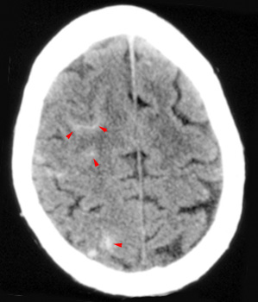
Notes:
appear white)
high density in sulci and fissures in this pic
Hyperdense sulci= opaque

Slide 38
Traumatic intraventricular hemorrhage
bleeding in the ventricular system . Primary IVH is uncommon Intraventricular hemorrhage more commonly occurs in the setting of intracerebral hemorrhage or subarachnoid hemorrhage (secondary IVH).
Management ??

Slide 40
Traumatic Intraparenchymal Hemorrhage
bleeding into the tissue of the brain caused by trauma
An intraparenchymal hemorrhage rarely occurs alone so the presenration will vary
smaller hemorrhage often require no specific treatment other than the standard treatment of any trauma victim, very large hematomas may require surgical removal.

Slide 41
Concussion
Is an immediate and transient loss of consciousness or normal mentation after head trauma often associated with period of amnesia
The severity of concussion appears to be proportional to the duration of amnesia particularly the anterograde amnesia

Slide 42
Management for isolated concussion in the ER includes a period of observation for at least 2 hours
Long term outcome are generally good however 25% of patients report an increased incidence of headache and memory difficulties even several months later
post concussive syndrome include depression, anxiety, memory loss , headache , emotional lability , insomnia
Treatment is reassurance

Slide 43
Diffuse axonal injury
Occurs when the axons become sheared off between the boundary between gray and white matter during rapid brain acceleration or deceleration
it does not generally cause specific, focal neurological symptoms. However, it can often contribute to a depressed level of consciousness
contribute to the long-term neurological disability cuz axons cannot regrow
patients who have severe DAI often remain in coma or a persistent vegetative state.
The CT of a patient with diffuse axonal injury may be normal despite the patient's presentation with a profound neurological deficit. With CT, diffuse axonal injury may appear as ill-defined areas of high density or hemorrhage however MRI is better
Management is primarily medical
Notes:
state of partial arousal rather than true awareness

Slide 44
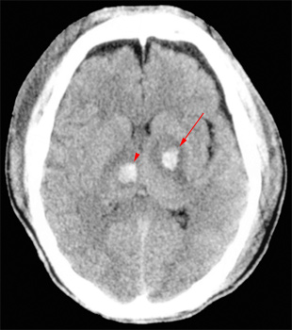
Notes:
Hemorrhage of the posterior limb of the internal capsule (arrow) and hemorrhage of the thalamus (arrowhead).

Slide 45
Medical management after traumatic brain injury
Seizure management
Homeostasis
Management of increased intracranial pressure by (venous drainage , CSF drainage, sedation, osmotic agent and diuretics, hyperventilation ,barbiturate, hypothermia , surgical decompression

Slide 46
Thank you

