Slide 1
Peadriatic Neurosurgery
Dr.Safdar Malik

Slide 2
Cont.
As the name indicate It’s the study of Neurosurgical problems in Children.
In KKUH children are up to the age 12years.
Its consists of
Clinical Examination of children.
Traumatic Peadriatic Neurosurgery
Congenital anomalies
Peadriatic Brain and Spinal cord tumors.

Slide 3
Clinical examination
It consists of
History taking
General physical examination.
Higher mental functions
Cranial nerves examinations
Motor and sensory examinations
Cerebellar Examination
Gate
Spine
Sphincters

Slide 4
General Physical Exam.
Examination is always from head to toe. After exposure.
New Born
Observe the normal flexion of the full term infant in contrast to the non flexed, even flaccid appearance of the normal resting premature. The shape of the premature skull is usually dolichocephalic (long and narrow).
Palpate the head to identify the anterior and posterior fontanels as well as the sagittal, coronal, metopic and lambdoid sutures.
Elicit the normal reflexes of grasping (hand and foot), sucking, rooting, Moro and automatic walking.

Slide 5
Head: Key Points
Head Circumference (HC): Frontal Occipital Circumference (FOC)
Fontannels/sutures: Anterior closes at 10-18 months, posterior by 2 months
Tense and bulging with increased intracranial pressure (ICP)
Depressed with dehydration
Conditions associated with a large anterior fontanel (greater than 3 cm): hydrocephaly, achondroplasia, hypothyroidism, osteogenesis imperfecta, and Vitamin D deficiency rickets
Symmetry & shape: Face & Skull: Variations
Molding (suture overlap) resolve 2 days
Capput succedaneum (scalp swelling) resolve 2 days
Cephalhematoma (sub periosteal hemorrhage)resolve wks./months

Slide 6
Head: Key Points
Large HC/ICP: Increased HC due to increased ICP (before suture closure), tense & bulging fontanels, dilated head veins, “sunset sign.”
Head may trans illuminate. Hydrocephalus.
Intraventricular hemorrhage, trauma, meningitis or tumors.
In older child, after cranial sutures close, increase ICP is present similarly as in adults like
( headache, vomiting, BP increases, change in LOC)
Small HC: May indicate microcephaly or craniosynostosis

Slide 7
Neurologic Examination
A. Cerebral Function:
General behavior, level of consciousness, intelligence, emotional status, memory, orientation, illusions, hallucinations, cortical sensory interpretation, cortical motor integration, ability to understand and communicate, auditory-verbal and visual-verbal comprehension, recognition of visual object, speech, ability to write, performance of skilled motor acts.

Slide 8
Cont.
Cerebellar Function: Finger to nose, finger to examiner's finger, rapidly alternating pronation and supination of hands; ability to run heel down other shin and to make a requested motion with foot; ability to stand with eyes closed; walk; heel to toe walk; tremor; ataxia; posture; arm swing when walking; nystagmus; abnormalities of muscle tone or speech.
Cerebellar Function
Balance, gait & leg coordination, ataxia, posture, tremors
Finger to nose (fingers to thumb) 3-4 yrs
Finger to examiner's finger 4-6 yrs
Ability to stand with eyes closed (Romberg) 3-4 yrs
Rapid alternations of hands (prone, supine) school age
Tandum walk 4-6 yrs
Walk on toes, heels school age
Stand on one foot 3-6 yrs

Slide 9
Cont.
Motor System: Muscle size, consistency, and tone; muscle contours and outlines; muscle strength; myotonic contraction; slow relaxation; symmetry or posture; fasciculations; tremor; resistance to passive movement; involuntary movement.
Gross motor & fine motor movements
Involuntary movements, posture
Sensory System:
Hearing, vision, light touch, pain, position, vibration
Sensory function
Sharp-dull
2 point discrimination
Stereognosis
Graphesthesia

Slide 10
Cont.
Reflexes:
1. Deep reflexes - Biceps, brachioradialis, triceps, patellar, Achilles; rapidity and strength of contraction and relaxation.
2. Superficial reflexes - Abdominals, cremasteric, plantar, gluteal.
3. Pathologic reflexes – Babinski,Holfman,.
Spine and Back Posture, curvatures, rigidity, webbed neck, spina bifida, pilonidal dimple or cyst, tufts of hair, mobility, Mongolian spots, tenderness over spine, pelvis or kidneys.

Slide 11
Cranial Nerves
1. I (olfactory) - Identify odors; disorders of smell
2. II (optic) - Visual acuity, visual fields, ophthalmoscopic examination, retina.
3. III (oculomotor), IV (trochlear), and VI (abducens) - Ocular movements, ptosis, dilatation of pupil, nystagmus, pupillary accommodation, and pupillary light reflexes.
4. V (trigeminal) - Sensation of face, corneal reflex, masseter and temporal muscles, maxillary reflex (jaw jerk).
5. VII (facial) - Wrinkle forehead, frown, smile, raise eyebrows, asymmetry of face, strength of eyelid muscles, taste on anterior portion of tongue.
6. VIII (acoustic) -
a. Cochlear portion - Hearing, lateralization, air and bone conduction, tinnitus.
b. Vestibular - Caloric tests.
7. IX (glossopharyngeal), X (vagus) - Pharyngeal gag reflex, ability to swallow and speak clearly; sensation of mucosa of pharynx, soft palate, and tonsils; movement of pharynx, larynx, and soft palate; autonomic functions.
8. XI (accessory) - Strength of trapezius and sternocleidomastoid muscles.
9. XII (hypoglossal) - Protrusion of tongue, tremor, strength of tongue.

Slide 12
Infants Response(Primitive reflexes)
Infants: responsive to touch, vision, hearing, smell
Present only one sensory stimulation at a time, if testing
Infant Automatisms:
Blink (dazzle) to bright light, 1st year of life, absence indicates blindness
Suck Sucks in response to stimuli, may persist during infancy, weak or absent reflex indicates developmental/neurological disorder
Extrusion Tongue extends out when touched, disappears at 4 months, persistent extrusion may indicate Down’s syndrome

Slide 13
Cont.
Galant's (trunk incurvation)
Back moves toward paraspinal side stimulated, present for 4-8 weeks, absence may indicate spinal cord lesions
Dance or step
Feet withdraw or step up, when foot touched to surface, present 4- 8 weeks, persistence indicates neurological problem
Palmar grasp
Finger’s curve around object placed in palm or palmar aspect of fingers, disappears 3-4 months, persistence indicates neurologic disorder. Appears by 28 wks., is fully developed by 32 wks. gestation.
Plantar grasp
Place your thumb on the sole of the infant’s foot under the toes
Observe the toes curl around your thumb

Slide 14
Cont.
Moro Reflex (startle response)
•Hold the infant supine and support the infant’s head with one hand.
Gently move the infant’s head (while supporting it) below the level of the rest of the body
Observe,
the infant extend both arms & legs suddenly and rapidly with open hands
And bring both hands back to midline in an “embrace”.
Appears by 28-30 wks. of gestation; fully developed at term & lasts for 5-6 month. It absence or asymmetry indicate injury, neurological disorder or hearing loss.
.

Slide 15
Primitive reflexes
Reflexes should be symmetric. Asymmetry suggests weakness in a particular muscle group.
Primitive reflexes disappear as the infant matures;
persistence of these reflexes is a signal of underlying neurological dysfunction.
Asymmetric Tonic Neck Reflex (Fencer’s position)
Appears by 35 wks. gestation, is fully developed at 1 month & lasts 6-7 months
Infant Reflexes: Most disappear between 4-6 months of age

Slide 16
Reflexes & Its root values
Deep tendon: Biceps C5, C6
Triceps C6, C7, C8
Brachioradialis C5, C6
Patellar L2, L3, L4
Achilles S1, S2
Superficial: Cremasteric T12, L1, L2
Abdominal T7, T8, T9, T10, T11

Slide 17
Head Trauma
TBI and head injury is generally classified based on 3 factors which are; the level of consciousness as indicated by Glasgow Coma Scale, the period of loss of consciousness as an immediate result of the impact of the trauma, and post traumatic amnesia.
Therefore, TBI and head trauma may be classified as follow:
1. Severe head trauma; in cases where GCS is 8 or less, loss of consciousness more than 24 hours and posttraumatic amnesia is for more than one day.
2. Moderate head trauma; in cases where GCS is between 9-12, loss of consciousness less than 24 hours but more than one hour and posttraumatic amnesia is for a period between one hour and 24 hours.
3. Mild head trauma; in cases where GCS is between 13-15, and the period of loss of consciousness less than one hour as the period of post traumatic amnesia.

Slide 18
Skull Fractures:
There are different types of skull fractures such as:
1. linear skull fracture
2. Diastatic fracture
3. Growing fracture
4. Ping-pong fracture
5. Skull Base fracture
6. Depressed fracture
7. Compound comminuted fractures
8. Crushed fracture

Slide 19
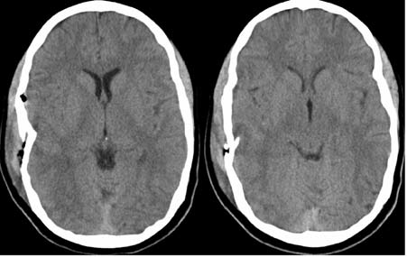
Depress Fracture

Slide 20
Depress fracture

Slide 21
Fracture

Slide 23
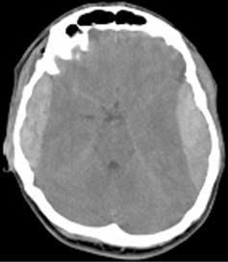
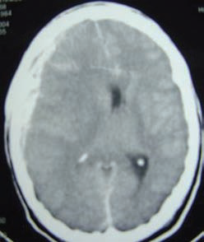
EDH,SDH

Slide 25
Contusions

Slide 26
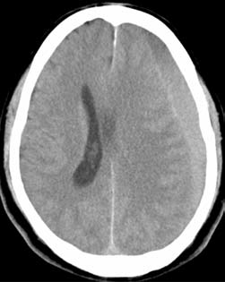
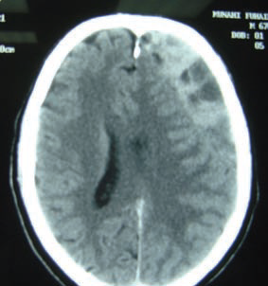
CSDH

Slide 27
CSDH

Slide 28
SAH

Slide 29
Brain edema &mid line shift

Slide 30
SD Hygroma

Slide 32
Post. Fossa Tumor

Slide 35
Congenital Anomalies
Hydrocephalous
Neural tube defects
Encephaloceles
Arachnoid Cysts
Chiari malformation
Dandy Walker Cysts
Cranisynostosis

Slide 36
ENCEPHALOCELES
An encephalocele is formed when intracranial contents herniate out from its normal confines of the skull, usually through a defect in the skull.
The actual pathological basis is not known.
In general, premature growth arrest of surrounding confining tissue or early herniation of intracranial contents preventing closure of skull tissue have been proposed.
Encephaloceles are not neural tube closure defects (the neural tube defect equivalent of spinal bifida is anenecephaly).

Slide 37
Types Of Encephaloceles
Encephaloceles are classified based on location.
In general there are 6 main categories
Posterior encephaloceles
1.occipital
2.occipital-cervical
3. parietal
4. temporal
Anterior encephaloceles
5.sincipital (fronto-ethmoidal)
6. basal.
Posterior encephaloceles appear as lumps or swellings arising from the cranial vault
whereas the anterior encephaloceles present as swellings arising from the facial region in particular, para-orbital region for the fronto-ethmoidal encephaloceles or in the nasal cavity for basal encephaloceles.

Slide 38
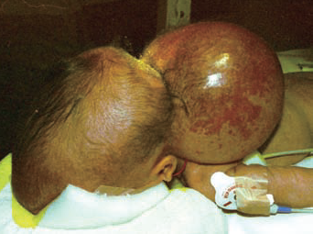
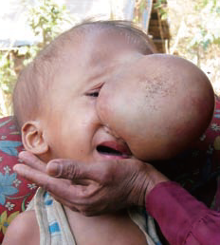
ENCEPHALOCELES

Slide 41
DANDY WALKER MALFORMATION
The Dandy Walker malformation is recognized when the following 3 features are present
1. Cystic dilatation of the 4th ventricle
2. Partial or complete absence of the cerebellar vermis
3. Hydrocephalus
Hydrocephalus may not be present at the time of initial diagnosis.
Other pathological features commonly seen in the Dandy-Walker malformation include enlargement of the posterior fossa with elevation of the transverse sinus, and obstruction of the foramina of Luschka and Magendie.
The pathological basis of this condition is not fully understood, though it is generally believed to involve mal-development of cerebrospinal fluid outlets within the 4thventricle.
The overall incidence is approximately one in 30,000 live births.

Slide 42
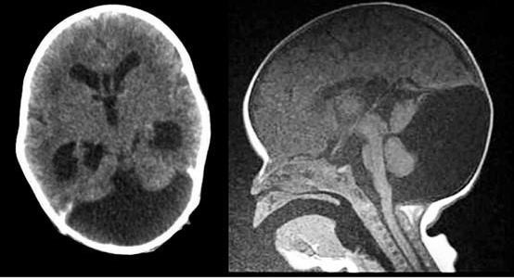
DANDY WALKER MALFORMATION

Slide 43
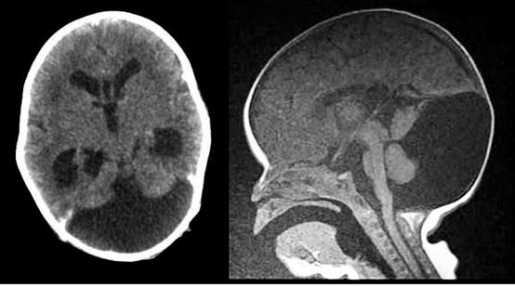
DANDY WALKER MALFORMATION

Slide 44
DANDY WALKER MALFORMATION
A number of congenital anomalies involving the central nervous system are associated with this syndrome, namely, agenesis of the corpus callosum, occipital encephalocele, aqueductal stenosis and cerebral or cerebellar heterotopias. Systemic anomalies involving the skin (hemangioma), musculoskeletal (hypoplastic limbs), and cardiovascular system (septal defects), are also frequently observed.
Clinical presentation of these patients comprise the following
1. Macrosomia
2. Psychomotor developmental delay/Mental retardation
3. Ataxia
4. Spasticity
5. Cranial nerve and ocular abnormalities
MRI is the imaging modality of choice.
Treatment would involve shunting the cyst. If hydrocephalus persists, then a
ventriculo-peritoneal shunt is also inserted.

Slide 45
POSTERIOR FOSSA TUMORS
These are the most frequent and typical tumors at the pediatric age.
They represent 55 to 60 % of intracranial tumors in children.
Cerebellar Astrocytoma
Medulloblastoma
Ependymoma
30 to 40 % of the Brain Stem lesions.

Slide 46
Cont.
Astrocytoma are four types
Pilocytic Astrocytoma
Astrocytoma grade 2
Anaplastic Astrocytoma
Glioblastoma grade 4
Most common Astrocytoma in Posterior fossa in children is Pilocytic Astrocytoma

Slide 47
Medulloblastoma

Slide 48
PFT

Slide 50
Type of Brain Stem Tumors
Type I : Intrinsic tumor, diffuse, hypodense on CT, low intensity in T1, with no
or minor significant enhancement. Surgery is not indicated, only radiation and
Chemotherapy may be indicated. The 5 years survival remains very poor. We do
not recommend stereotactic biopsy since the management will not change
whatever the histology.
Type II : Intrinsic and focal tumor, which may be solid or cystic. Surgery is
indicated in all cases since most of these lesions are benign. 8 years survival is
around 72 %.
Type III : Exophytic tumor, either dorsally or laterally. They are benign lesions
which can be surgically removed; 8 years survival is 75 %.
Type IV : Bulbo-medullary tumor. They are mostly benign and may be cured by
surgery alone, with a 8 years survival of 77%.

Slide 51
Arachnoid cysts (ACs)
Arachnoid cysts (ACs) are congenital fluid-filled compartments that do not
communicate with the normal subarachnoid spaces and develop within the arachnoid membrane. They are believed to depend on a splitting or duplication of this structure.
ACs represent 0.1-0.5 % of all nontraumatic intracranial mass lesions. The mean age of presentation is during the first two decades of life. A male prevalence is reported.

Slide 52
ARACHNOID CYSTS
It is believed to arise from splitting of the arachnoid membrane as it delaminates from the overlying dura during development.
Arachnoid cysts may be classified according to location. 75% are supratentorial in location while the remainder are infratentorial. Sylvian fissure arachnoid cysts, on the
whole, make up the majority of cysts accounting for up to 50%, the rest are located in the quadrigeminal or suprasellar regions. Convexity and interhemispheric arachnoid cysts occur less commonly accounting for 10% or less of intracranial cysts. Infratentorial cysts may be located in the cerebellopontine angle, vermian or retroclival region.

Slide 53
Arachnoid cysts (ACs)
ACsinvolve the Sylvian fissure/middle fossa in nearly a half of cases, while the CP angle, the quadrigeminal cistern, the retrocerebellar area, and the sellar/suprasellar region are affected in 10% of cases, respectively.
Less commonly, ACs are located within the interhemispheric fissure, the cerebral convexity, the prepontine cistern, the cervicomedullary junction.
Even more rare are the ACs which develop within the cerebral ventricles or in the spinal compartment.
Arachnoid cyst of intracranial compartment varies from a few centimeters in diameter to large sizes.

Slide 54
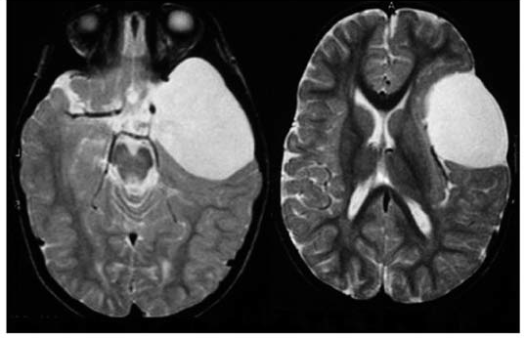
ARACHNOID CYSTS

Slide 55
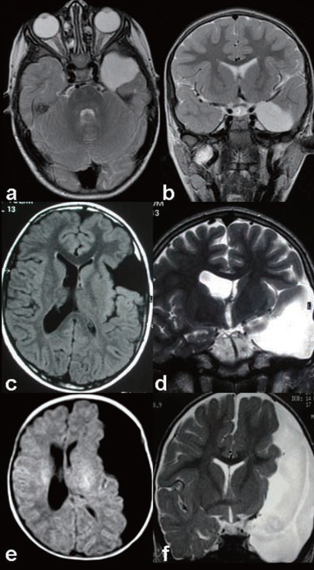

Slide 56
Other Cysts
These cysts should be differentiated by “secondary” or “false” arachnoid cysts that are acquired accumulation of cerebrospinal fluid characterized by the presence of inflammatory cells and hemosiderin deposits within the delimiting membranes, which
result from the inflammatory loculation of the subarachnoid space after head injury, infection or hemorrhage. Moreover, ACs differ from other cysts communicating with the natural pathways of the CSF circulation, such as dilated cisterns, arachnoid pouches and poroencephalic cavities.

Slide 57
Treatment of ACs
No surgical management is required for asymptomatic arachnoid cysts which are not
causing significant mass effect. They should be observed with regular follow up. Regular
imaging is not necessary unless symptoms occur.
Symptomatic arachnoid cysts may be treated with either one of three ways:
1. Open craniotomy and cyst aspiration, cyst wall excision and/or fenestration into
subarachnoid space.
2. Endoscopic cyst aspiration and fenestration into subarachnoid space
3. Cyst-peritoneal shunt
The method would depend on surgeon preference as well as on the location of the cyst

Slide 58
CHIARI MALFORMATION
The term is named after Hans Chiari, an Austrian pathologist who classified hindbrain
malformations into 4 types based on his autopsy study of 40 patients in the late 1800’s.
The malformations are described as follows-
Type 1
Caudal descent of the cerebellar tonsils below the foramen magnum (generally taken as more than 5mm). There is an association with syringomyelia.

Slide 59
CHIARI MALFORMATION
Type 2
Caudal descent of the cerebellar vermis, brainstem and 4th ventricle below the
foramen magnum. Type 2 Chiari malformations are associated with myelomeningocele
and hydrocephalus.
Type 3
Occipital cervical encephalocele
Type 4
Cerebellar hyoplasia or aplasia
Pathogenesis
The pathogenesis of Chiari malformations is not well understood. It remains to be
proven whether Type 1 to 4 Chiari malformations represent a continuous spectrum of
disease or whether they are distinct separate entities. Theories were initially put forth by
Gardner and further elaborated by Williams and a unified theory relating the
development of Chiari 2 malformation and myelomeningocele has been suggested.
The latter essentially attributes the hindbrain abnormality to a lack of cranial

Slide 60
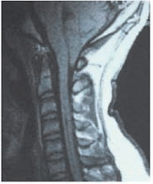
CHIARI MALFORMATION

Slide 61
SPINAL DYSRAPHISM
Spinal dysraphic states arise from a failure of fusion of dorsal midline structures of the back during embryological development.
Development of the spinal cord occurs between day 18 to day 48 of gestation. Primary neurulation (between day 18 and day 28) consists of separation of the neuroectoderm from the neural plate and lateral infolding of the neuroectoderm, resulting in formation of the spinal cord.
Following this, the cutaneous portion of the neuroectoderm also separates and fuses in the midline to form the overlying skin. Mesoderm migrates between the cutaneous ectoderm and neuroectoderm to form the posterior vertebral arch, back musculature and subcutaneous tissue.

Slide 62
SPINAL DYSRAPHISM
Secondary neurulation (canalisation) occurs from day 28 and involves theformation of the caudal cell mass at the caudal end of the spinal cord.
This mass ultimately differentiates into neural, genitourinary and notochordal structures.
The last phase occurs from day 41 and is termed retrogressive differentiation. The caudal spinal cord regresses to form a filum terminale with the conus ending at L2.
There is an association between antenatal folate deficiency and spinal dysraphism

Slide 63
Myelomeningocele
Lipoma of the conus medullaris (lipomyelomeningocele)
Occult spinal dysraphism
Split cord malformation (diastematomyelia and diplomyelia)
Dermoid sinus tract
Lipoma of the filum terminale
Meningocele
Limited dorsal myeloschisis
Myelocystocele
Terminal syringomyelia
Neurenteric cyst

Slide 70
Hydrocephalus
Pathophysiology of hydrocephalus is not well understood, yet, because of the lack of
knowledge of CSF production and absorption. There are well accepted classifications.
1. Overproduction of CSF: choroid plexus papilloma and choroid plexus carcinomas
are included in this group. These are rare form of hydrocephalus.
2. Disorders of CSF circulation: this is a group of disorder in which the path of CSF
circulation is obstructed. The obstruction may be inside the ventricles or in the subarachnoid space. Tumors, hemorrhage, congenital malformation such as aqueductal stenosis, and infections could cause the obstruction.
3. Disorders that cause CSF mallabsorption into the venous system.
Hydrocephalus can also be divided in two group based on the patency of CSF
pathways. Respecting this we could define two types:
one is obstructive (noncommunicationg)hydrocephalus
the other is non-obstructive (communicating)hydrocephalus.
Hydrocephalus is also classified into acute and chronic hydrocephalus based on the
period between the occurrence of the symptoms and the onset of the disease.

Slide 71
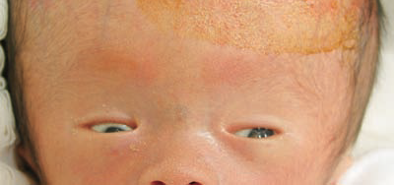
Sunsetting eyes

Slide 72
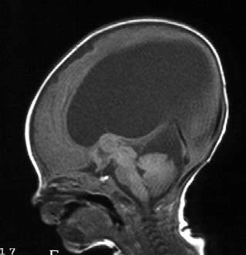
Hydrocephalus

Slide 73
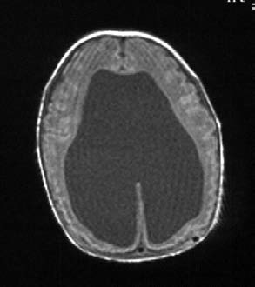
Hydrocephalus

Slide 76
Craniosynostosis
Premature closure of cranial sutures.
This can be primary due to closure of one or more sutures due to abnormal skull development.
This occurs in ~ 1/2000 children and is most often present at birth. It can also be secondary due to abnormal brain development.

Slide 77
Pathogenesis
The pathophysiology for craniosynostosis remains prooly understood. The Most popular theory suggests that the abnormal cranial base induces premature stenosis secondary to the forces in the dura.
[6] Another theory state that the basal sutures respond to the premature fusion of the vault sutures.
[7] The theories proposed do not explain the compensatory changes in cranial shape that occur throughout the cranial
vault. Craniosynostosis most likely results from many different pathologic processes. [8]

Slide 78
Simple craniosynostosis
Sagittal Synostosis
Bicoronal synostosis
Unilateral coronal synostosis
Metopic craniosynostosis
Syndromic craniosynostosis
Crouzon syndrome
Apert syndrome
Pfeiffer’s syndrome
Saethre-Chotzen syndrome

Slide 79
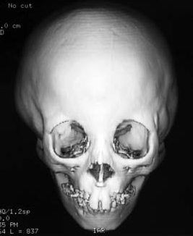
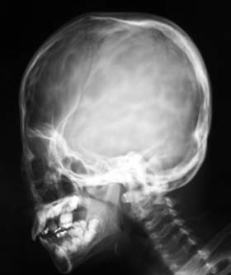

Slide 81
Surgical management
The simple strip craniectomies and pi procedures in Sagittal
Simple suturectomy, early in coronal suture.
For metopic the optimal age of surgery is 3 to 6 months. Most widely employed procedure involves bilateral fronto-orbital advancement with or without frontal remodeling.
The surgical management of syndromic craniofaciostenosis have two main objectives:
(1) to correct the craniocerebral disproportion
(2) to normalize the impaired CSF
circulation and absorption, before irreversible brain damage is established

Slide 82
Surgical management
Hydrocephalus; Classically, preoperative CSF shunting is indicated only in cases
Cranial expansion
According to the site of early closure of the cranium, either frontal cranial expansion, posterior cranial expansion or total calvarial remodeling need to be selected for each individual. Since repeated operations will be required in future in the cases with syndromic craniosynostosis, well advanced operative planning is mandatory to obtain good operative results.

Slide 83
Sagittal synostosis

Slide 84
Sagittal synostosis

Slide 85
THANKS

Slide 86
Hydrocephalous

Slide 87
Cont.

Slide 90
Black eye

Slide 97
Fascial Nerve

Slide 98
Cont.

Slide 99
Decompressive Craniotomy

Slide 101
Lesion with edema

Slide 102
Meningioma

