Slide 1

ECG Interpretation

Slide 2
Outlines:
ECG definition.
Leads presentation.
Electrical conduction.
How to read an ECG paper.
Cardiac dysrhythmias.

Slide 3
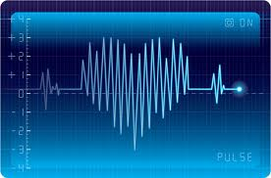
Part 1
ECG definition.
Leads presentation.
Electrical conduction.
How to read an ECG paper.

Slide 4
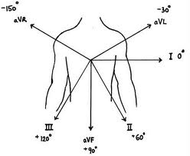
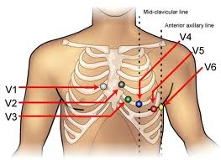
Leads Presentation

Slide 5
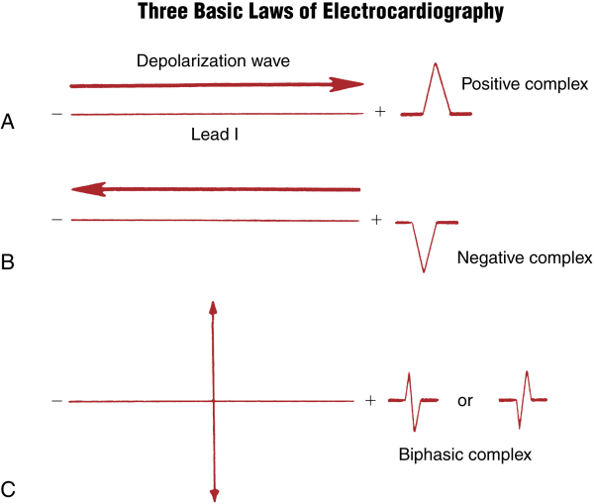

Slide 6
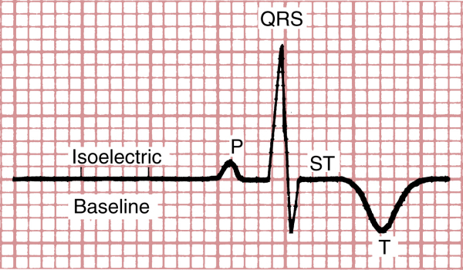
Waves

Slide 7
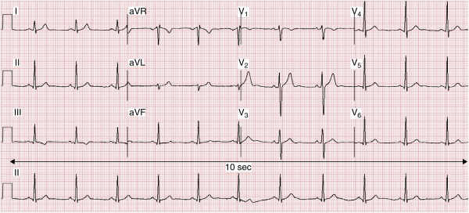
12 Leads EKG

Slide 8
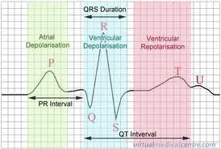
QRS Complex
It represents ventricular depolarization.
Normal QRS duration
≤ 3 ss (≤ 120 seconds)

Slide 9
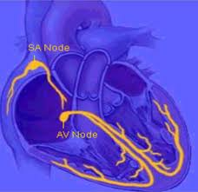
Electrical Conduction

Slide 10
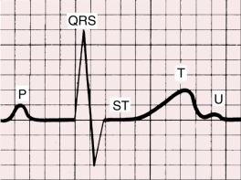
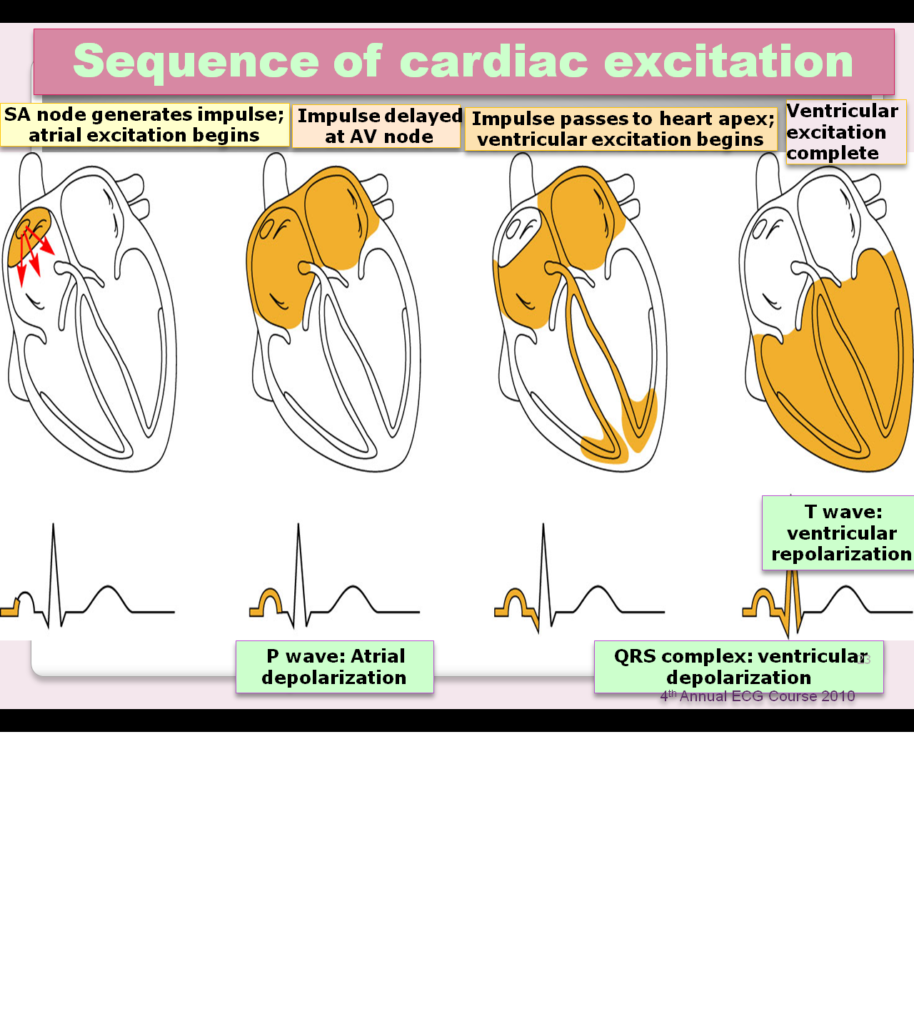
Waves

Slide 11
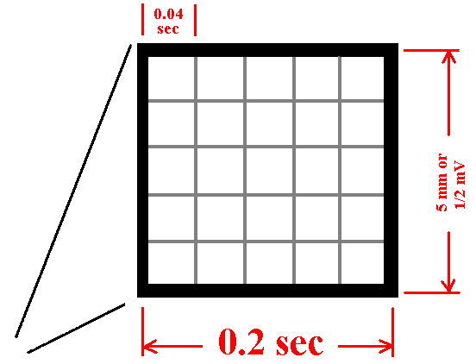
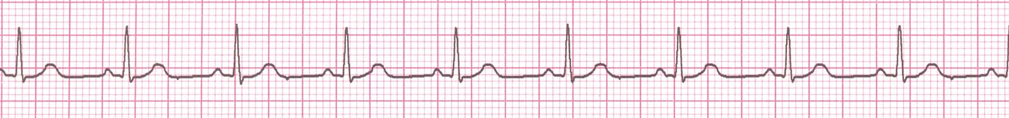
The ECG Paper
Horizontally
  One small box - 0.04 s
  One large box - 0.20 s
Vertically
  One large box - 0.5 mV

Slide 12

How to interpret ECG
Caliber.
Rhythm.
Rate.
Axis.
Waves.

Slide 13
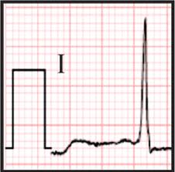
Caliber
It should be ≤10 mm otherwise you have to repeat the ECG.

Slide 14

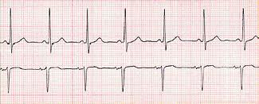
Rhythm
LEDA II: Positive P wave preceding each QRS.
V1: Biphasic P wave.
Lead II
V1

Slide 15
Rate
Normal sinus rate: (60-100).
Tachycardia: >100.
Bradycardia: <60.

Slide 16
How to Calculate Rate
300/No. of large squares R-R.
1500/No. of small squares R-R.
No. of (R) waves in the strip×6.
300›››150 ›››75 ›››60 ›››55

Slide 17
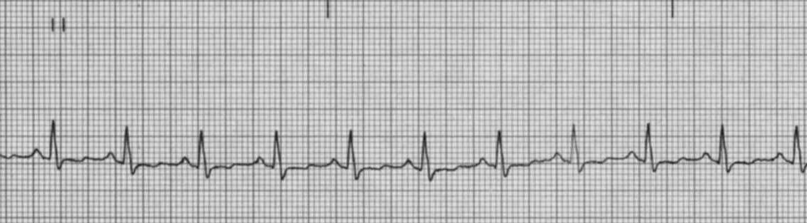
Rate
Start if possible on a beat whose QRS (usually R wave) is on the
border of a large square
300 100 60 40
Count Large squares
(0.2 seconds each)
150 75 50
This tracing example shows a rate of 100 bpm

Slide 18
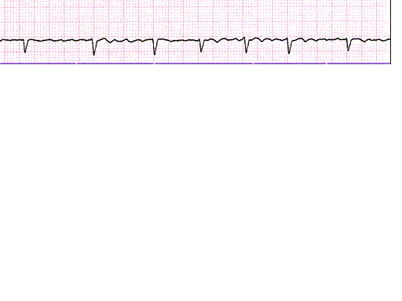
Rate determination for irregular rhythm
*
8 times 10 = 80 bpm
30
For irregular rhythm (such as atrial fibrillation), the method shown on the last slide
may be inaccurate. Use this alternate method.
Start as before by finding a QRS that lands on the border of a large square (*).
Then count 30 large squares (= 0.2 X 30 = 6 seconds). Add up all beats (QRSs)
that land within the interval (not counting that first beat (*) and multiple by 10.
This equals the number of beats per minute.

Slide 19
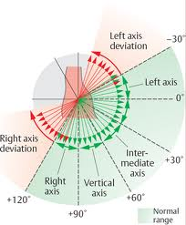
Axis
Normal axis.
Right axis deviation.
Left axis deviation.
Extreme axis deviation.

Slide 20
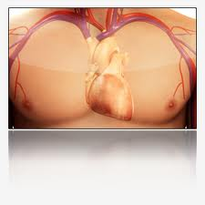
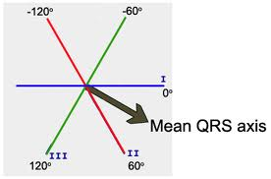
Normal Heart Axis

Slide 21
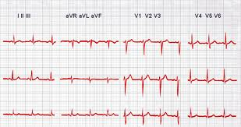
Normal Heart Axis Cont…

Slide 22
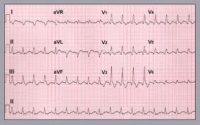
Right Axis Deviation

Slide 23
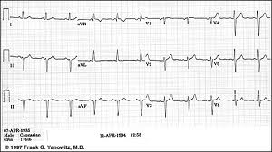
Left Axis Deviation

Slide 24
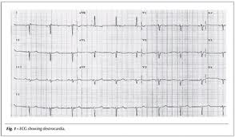
Extreme Axis Deviation

Slide 29
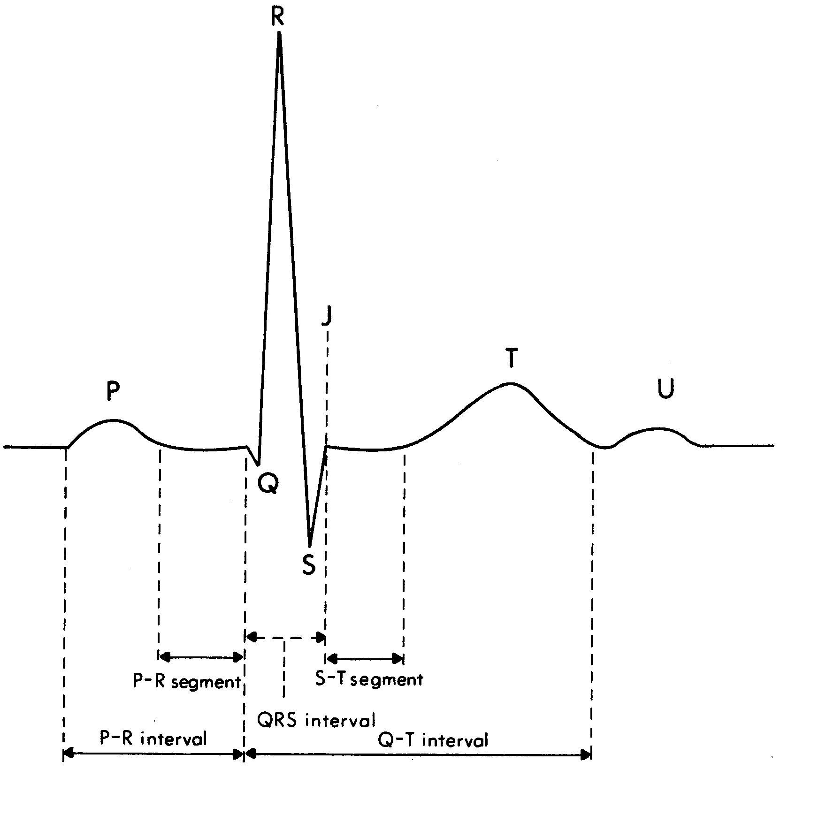
The P Wave
Normally from sinus node
Upright in I, II, aVF, V4-V6
Monophasic (except V1)
Normal ranges:
  < 0.12 sec wide
  < 2.5 mm tall

Slide 30
The PR Interval
Measure from beginning of P wave to onset of QRS. Usually measure in Lead II
Measure the longest PR interval in the limb leads
Normal range 0.12-0.20 seconds
< 0.12 = Accelerated conduction
> 0.2 = Heart block
Notes:
In childhood 0.10 - 0.12 sec
In adolescence 0.12 - 0.16 sec
In adulthood 0.14 - 0.22 sec
Overall normal range 0.10 - 0.22 sec

Slide 31
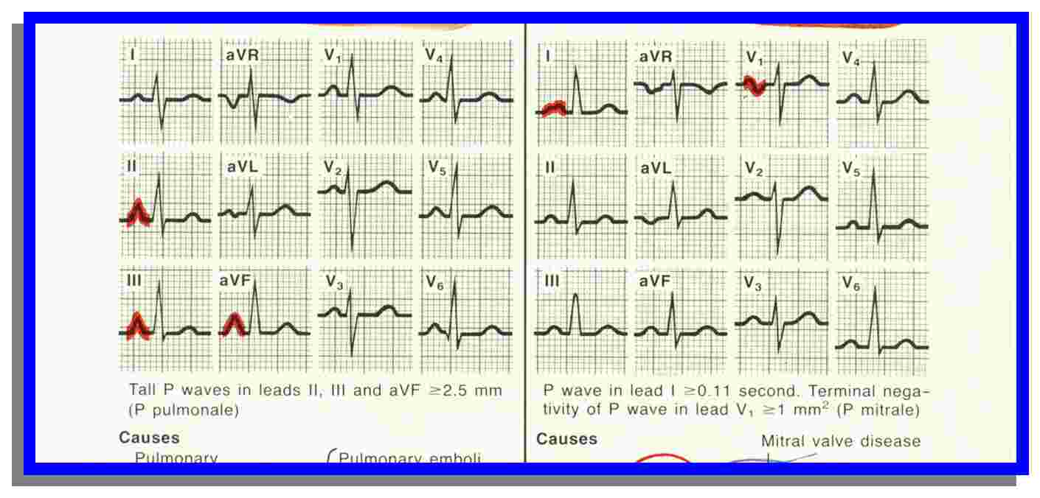
Right Atrial Enlargement

Slide 34
Left Atrial Enlargement

Slide 36
The QRS Complex

Slide 37
The Q Wave
Notes:
Q wave Causes may include

Slide 38
The J - Point

Slide 39
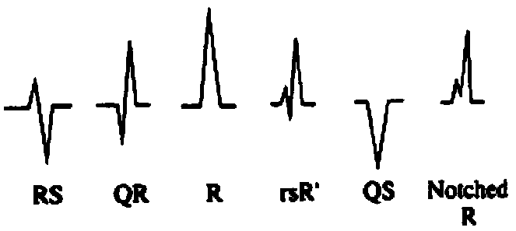
QRS Waveforms

Slide 40
The ST Segment

Slide 41
The T Wave
T waves may be normally inverted in aVR (almost always), III (frequently), and V1 (sometimes).
T waves are “tall” if their height is:
  > 50% QRS height
  > 5mm in limb lead
  > 10 mm in precordial lead

Slide 42
The QT Interval
Notes:
Bazetts formula
Hodge’s QTc = QT + 1.75 (ventricualr rate- 60)

Slide 43
The U Wave
Causes:
  Normal
  Bradycardia
  CAD
  Hypertension
  Hypokalemia
  Hypercalcemia

Slide 44
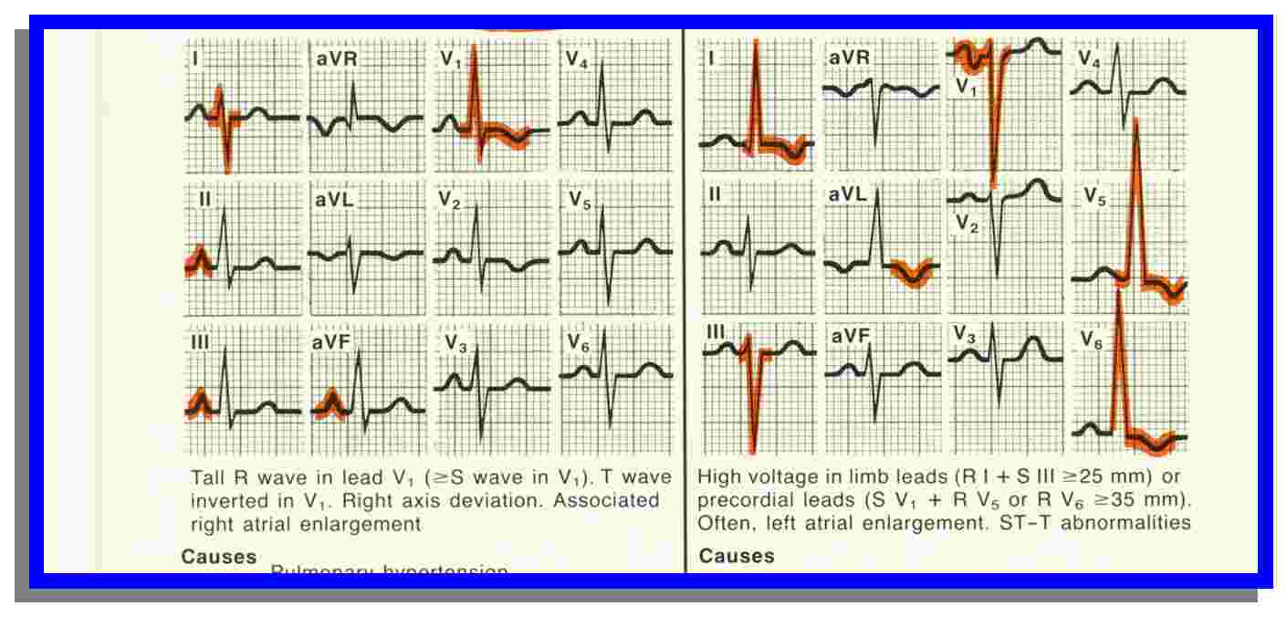
Left Ventricular Hypertrophy
*
*
*
*

Slide 45
Right Ventricular Hypertrophy

Slide 46
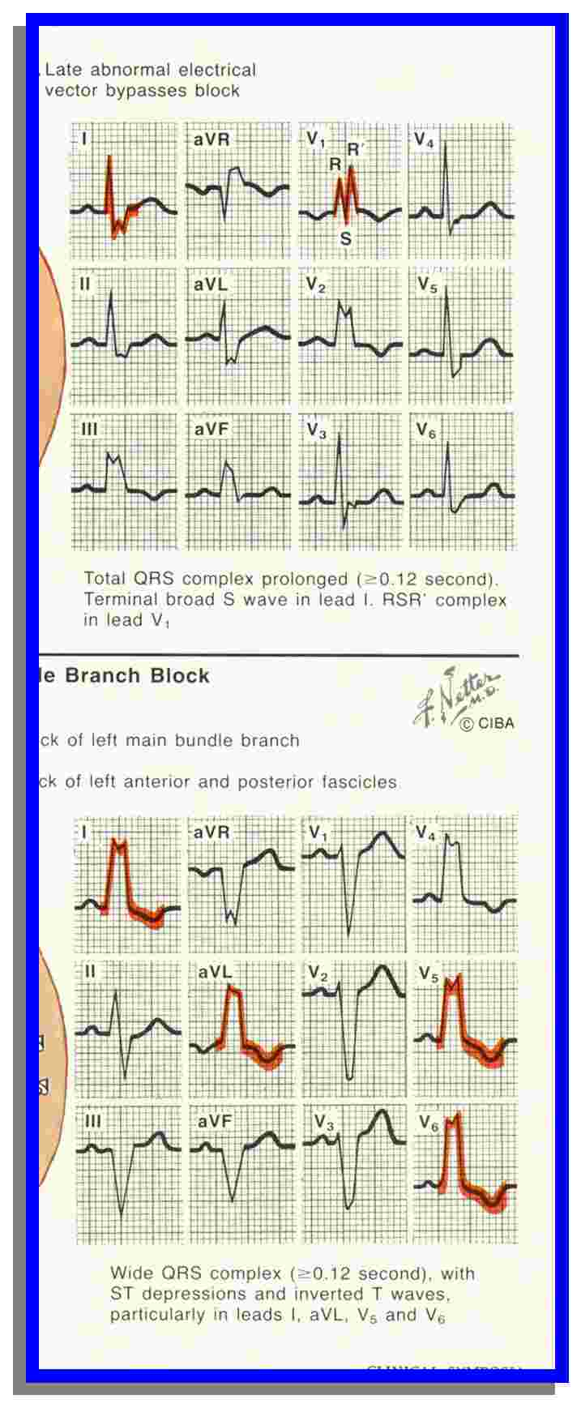
LBBB

Slide 47
RBBB

Slide 48
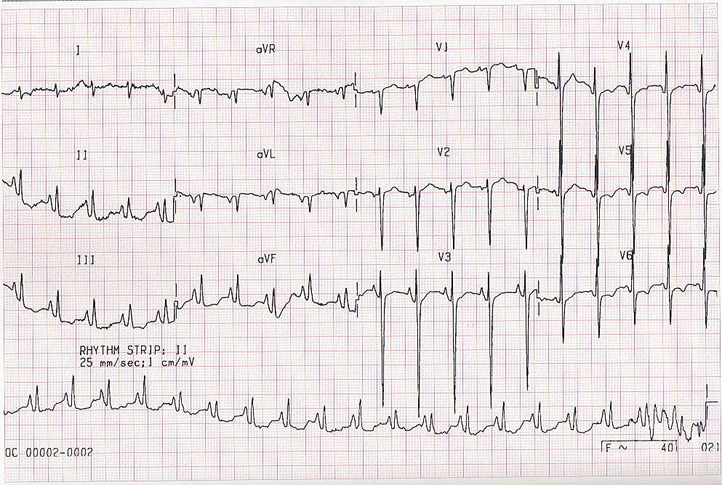
Realty check

Slide 49
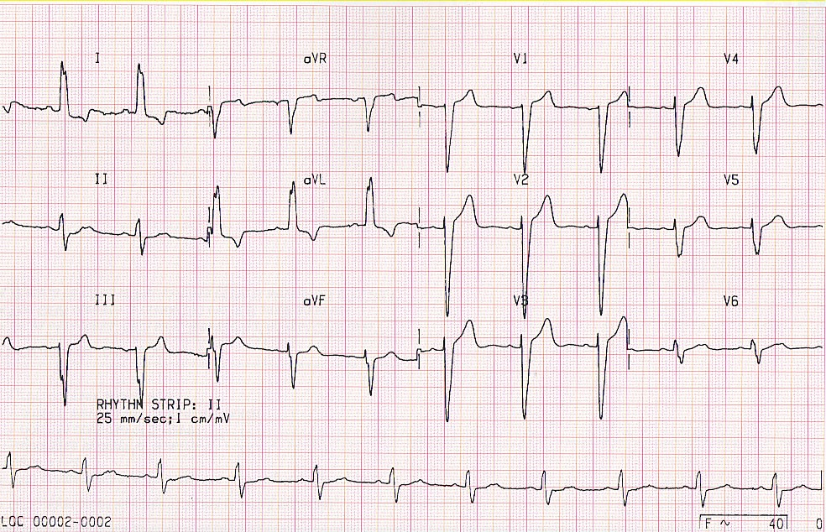
Realty check

Slide 50
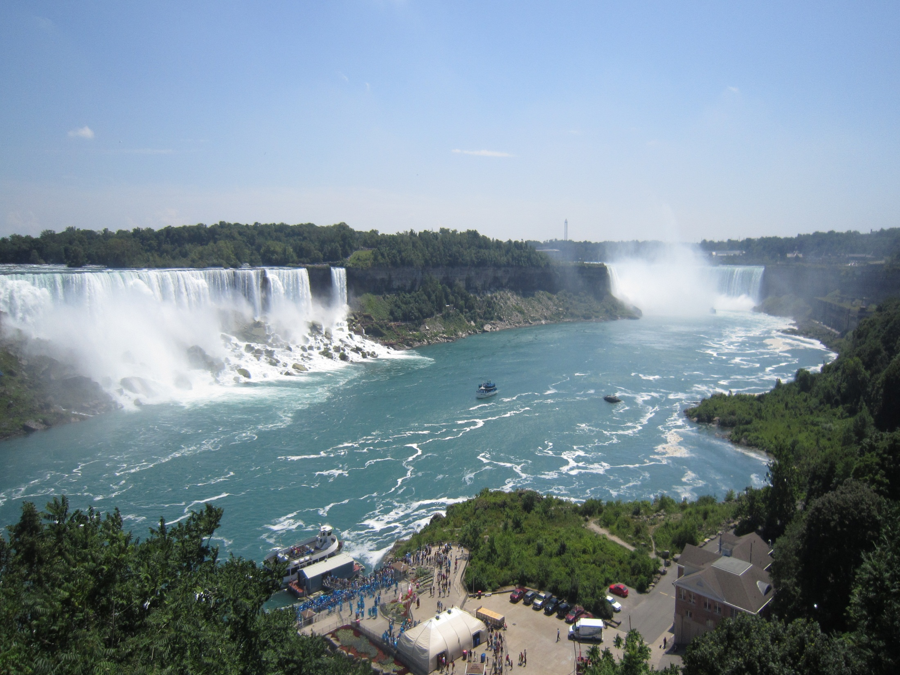

Slide 51
Heart Block
1^{st○}
Constant PR prolongation without drop beat.
2^{nd○}
Mobitz1: Progressive PR prolongation + drop beat.
Mobits2: Constant PR prolongation + drop beat.
3^{rd ○}
Complete dissociation between P and QRS.

Slide 52
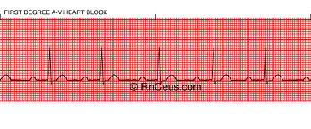
First Degree Heart Block

Slide 53
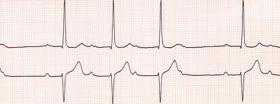
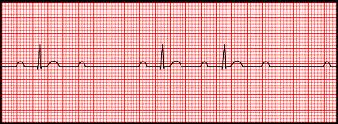
Second Degree Heart Block
Mobitz (I):
Mobitz (II):

Slide 55
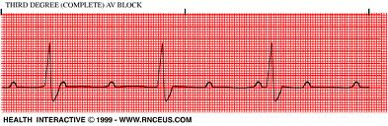
Third Degree Heart Block

Slide 57
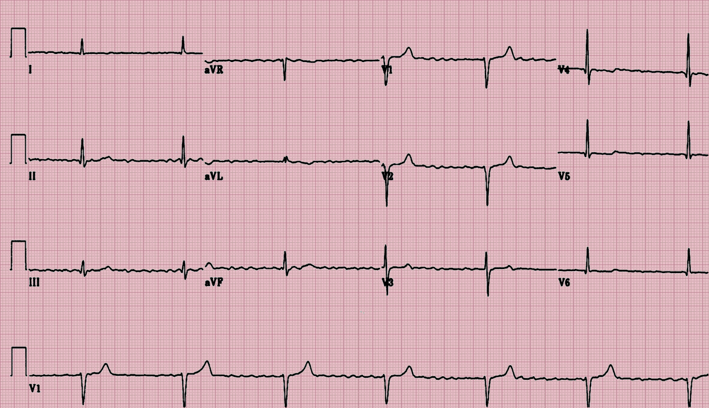
60 yrs old man with dilated CHF presented with nausea&vomating

Slide 58
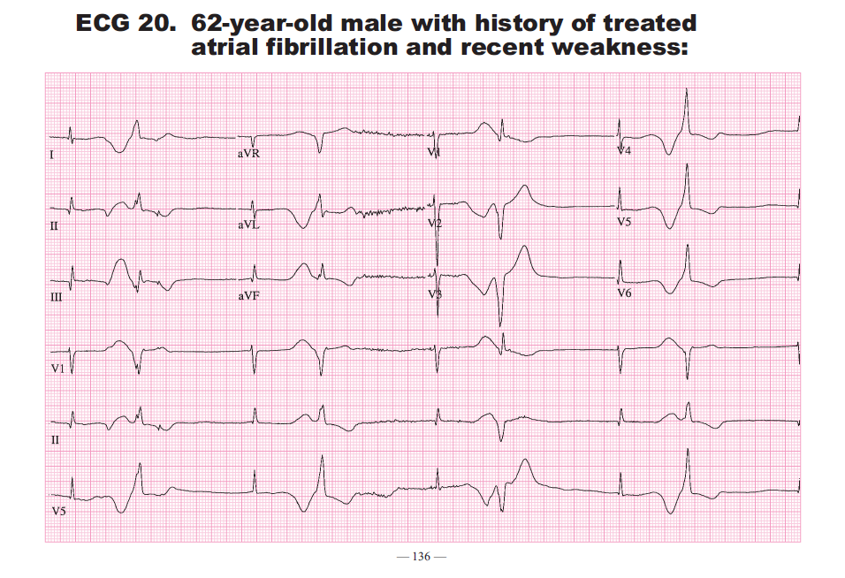

Slide 59
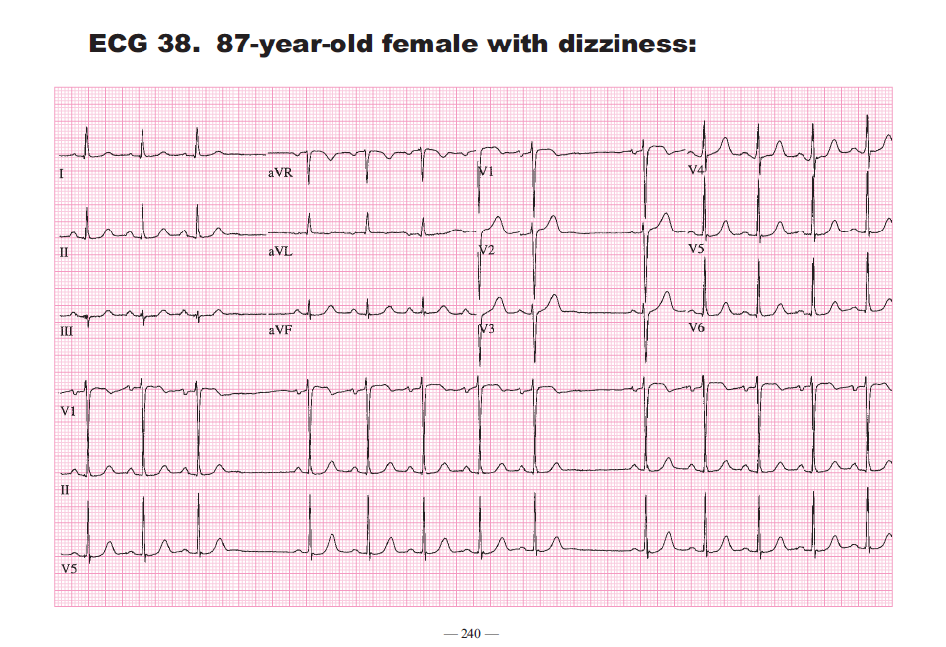

Slide 60
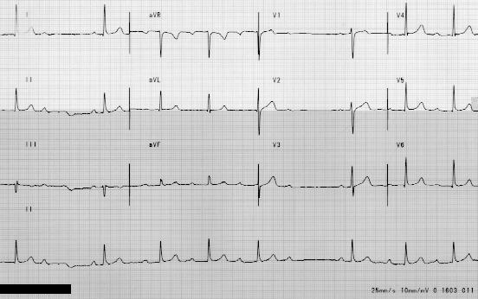
Realty check

Slide 61
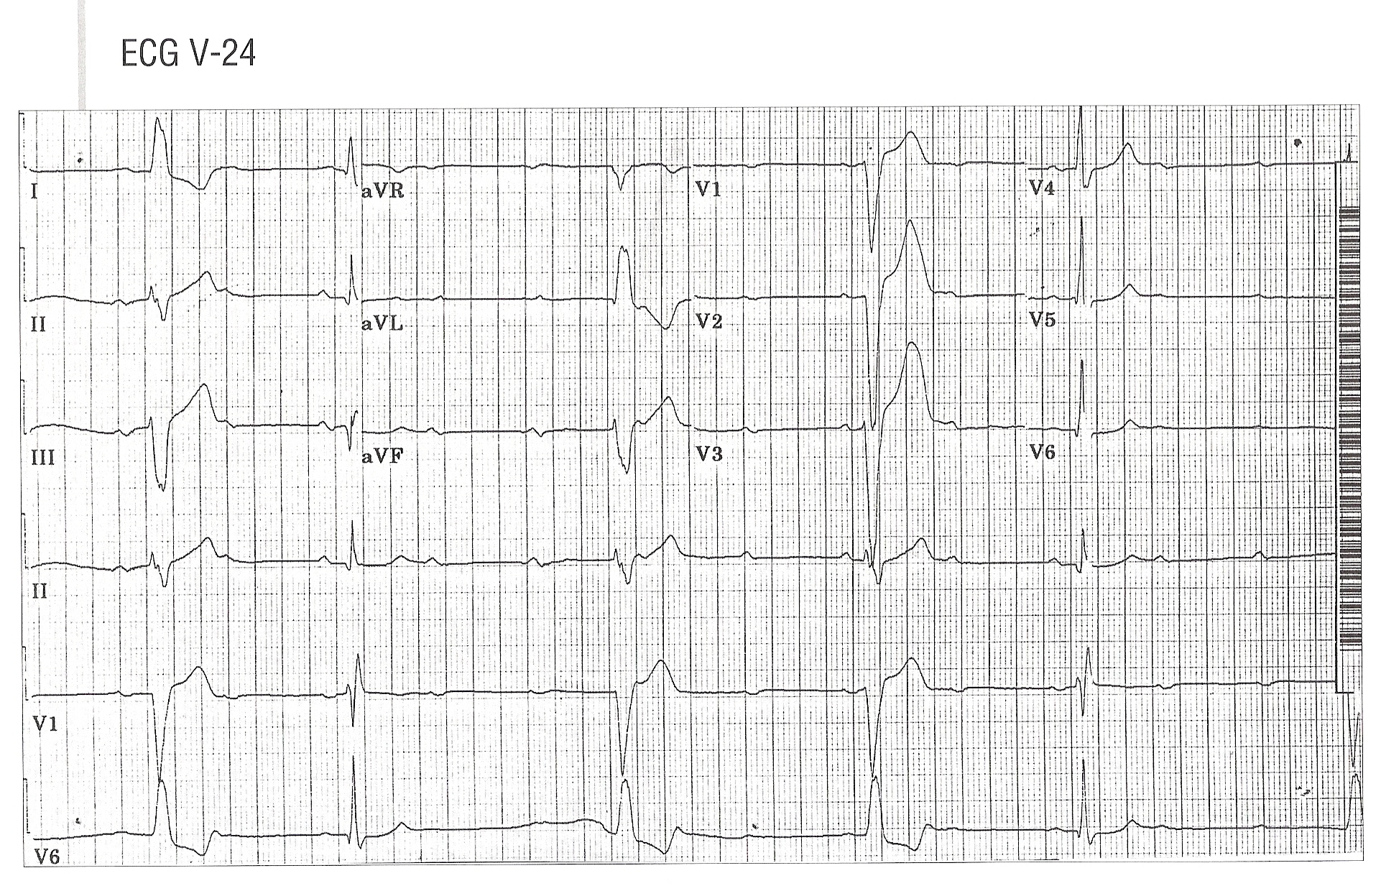

Slide 62
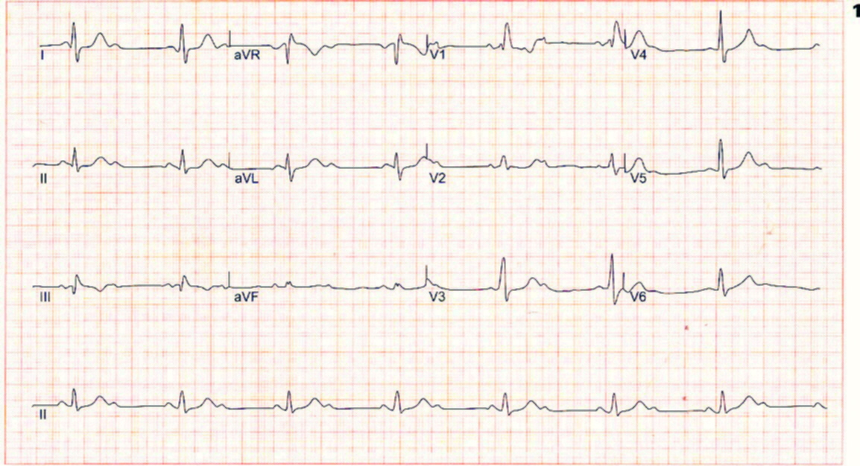
Realty check

Slide 63
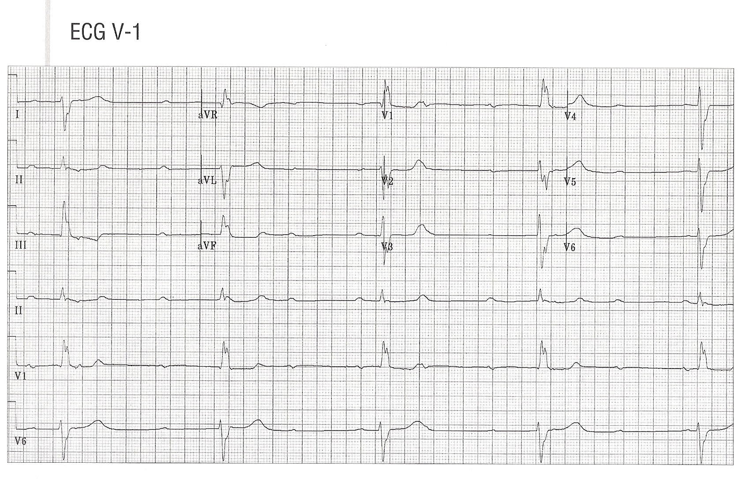
Realty check

Slide 64
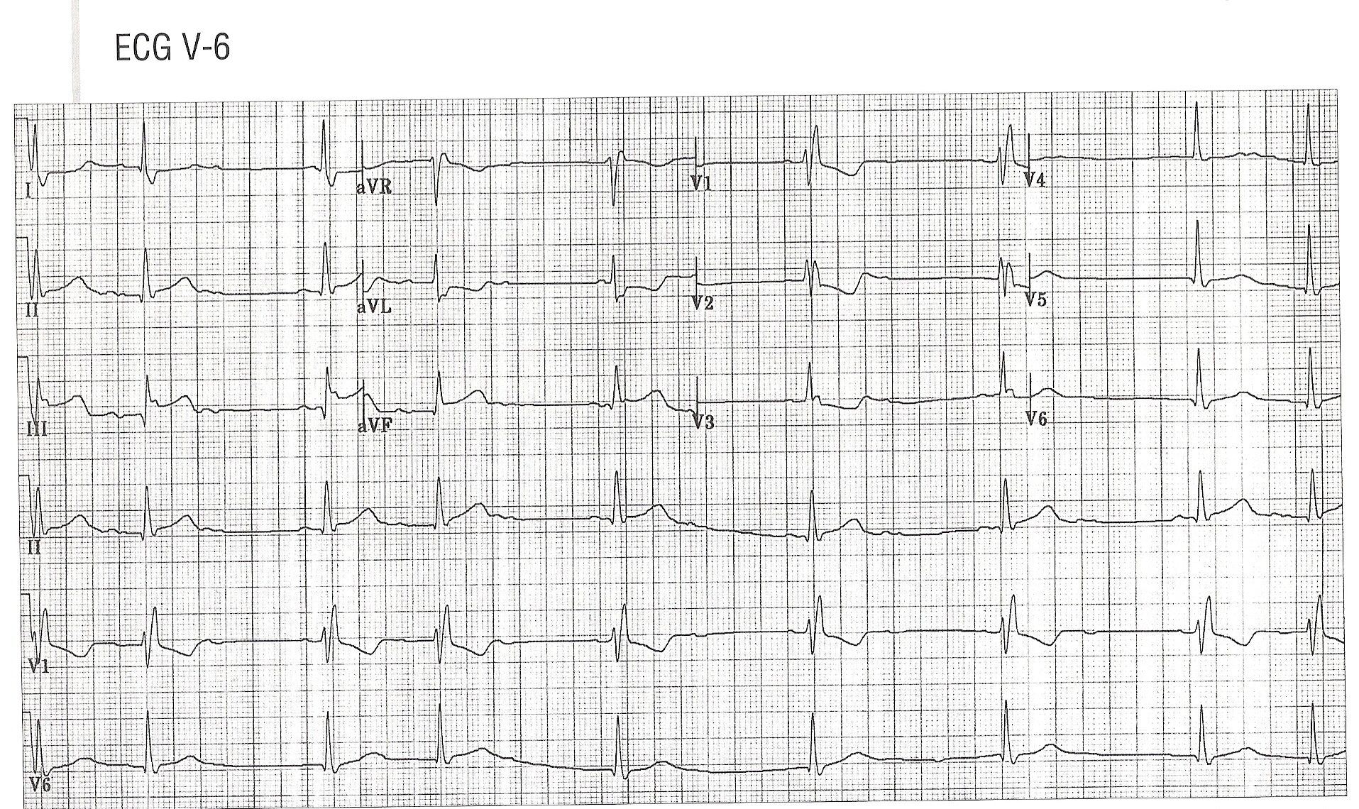
Realty check

Slide 65
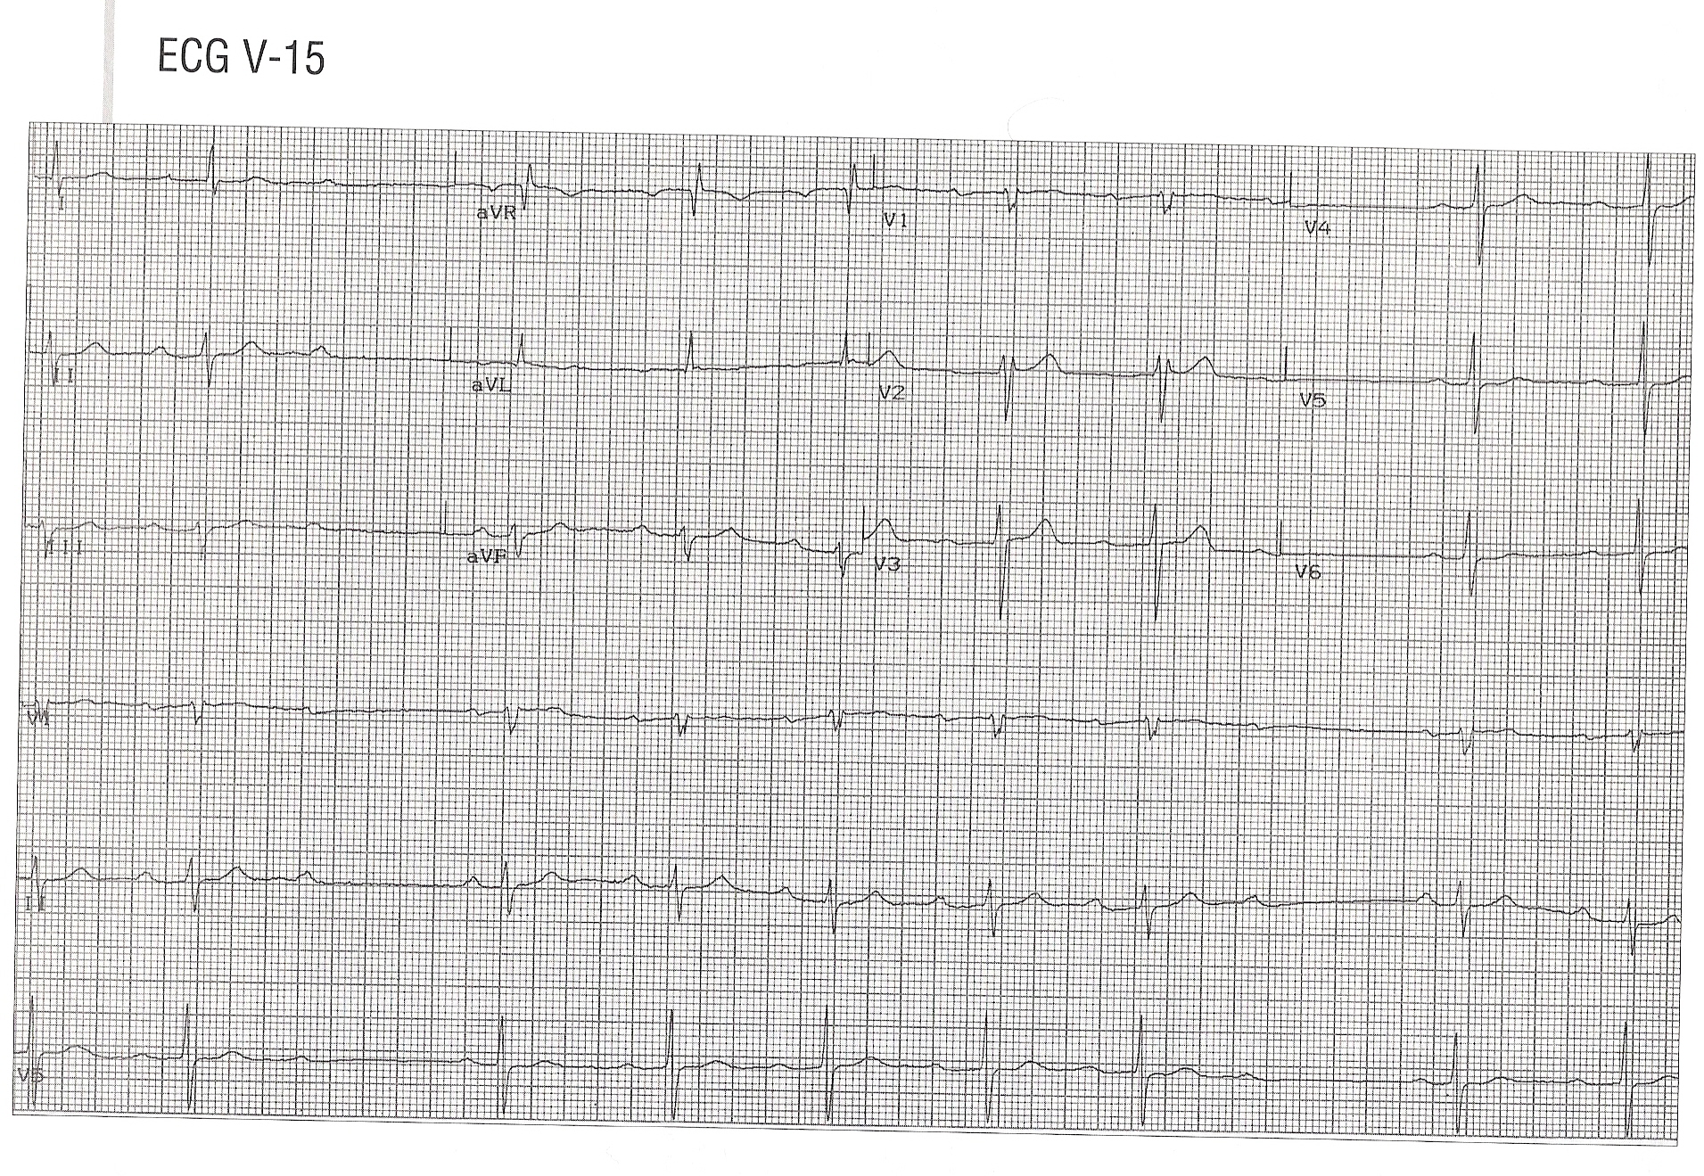
Realty check

Slide 66
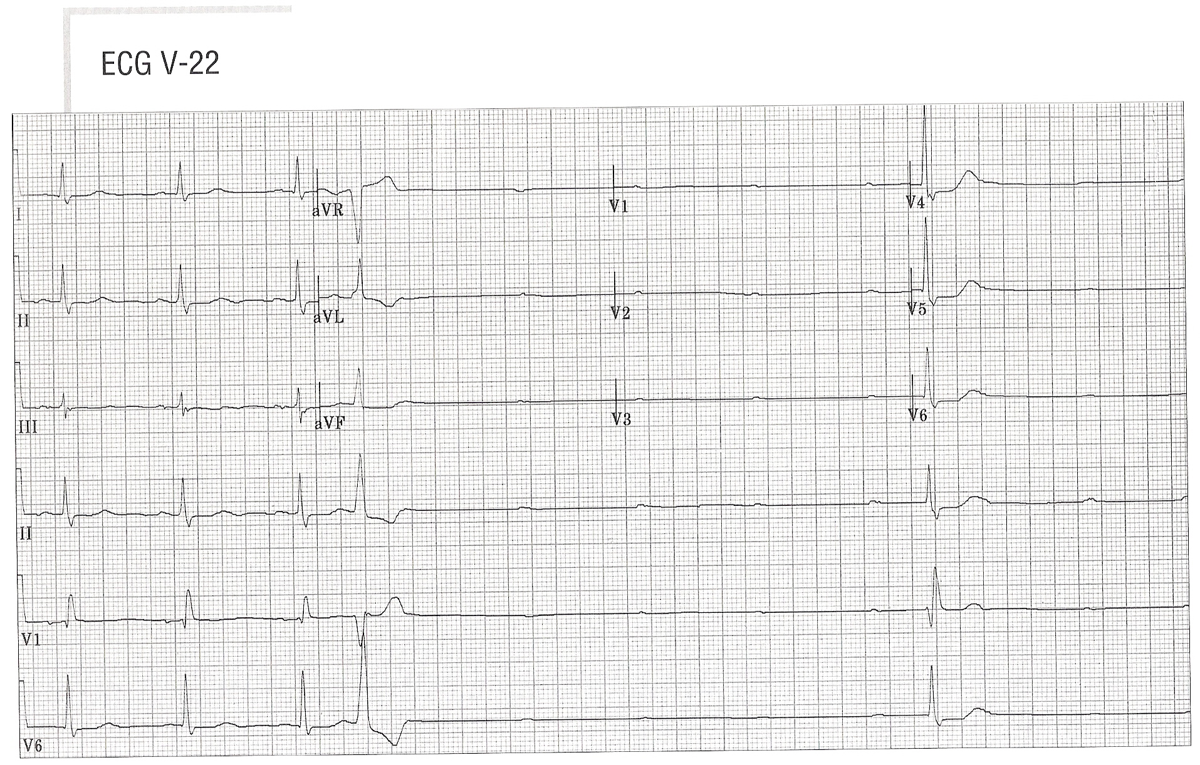
Realty check

Slide 67
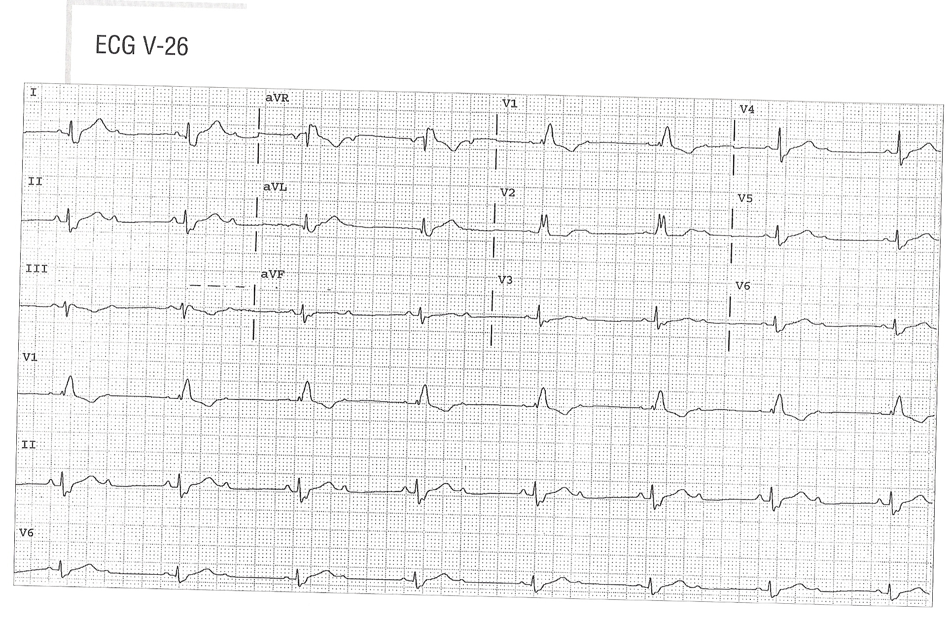
Realty check

Slide 68
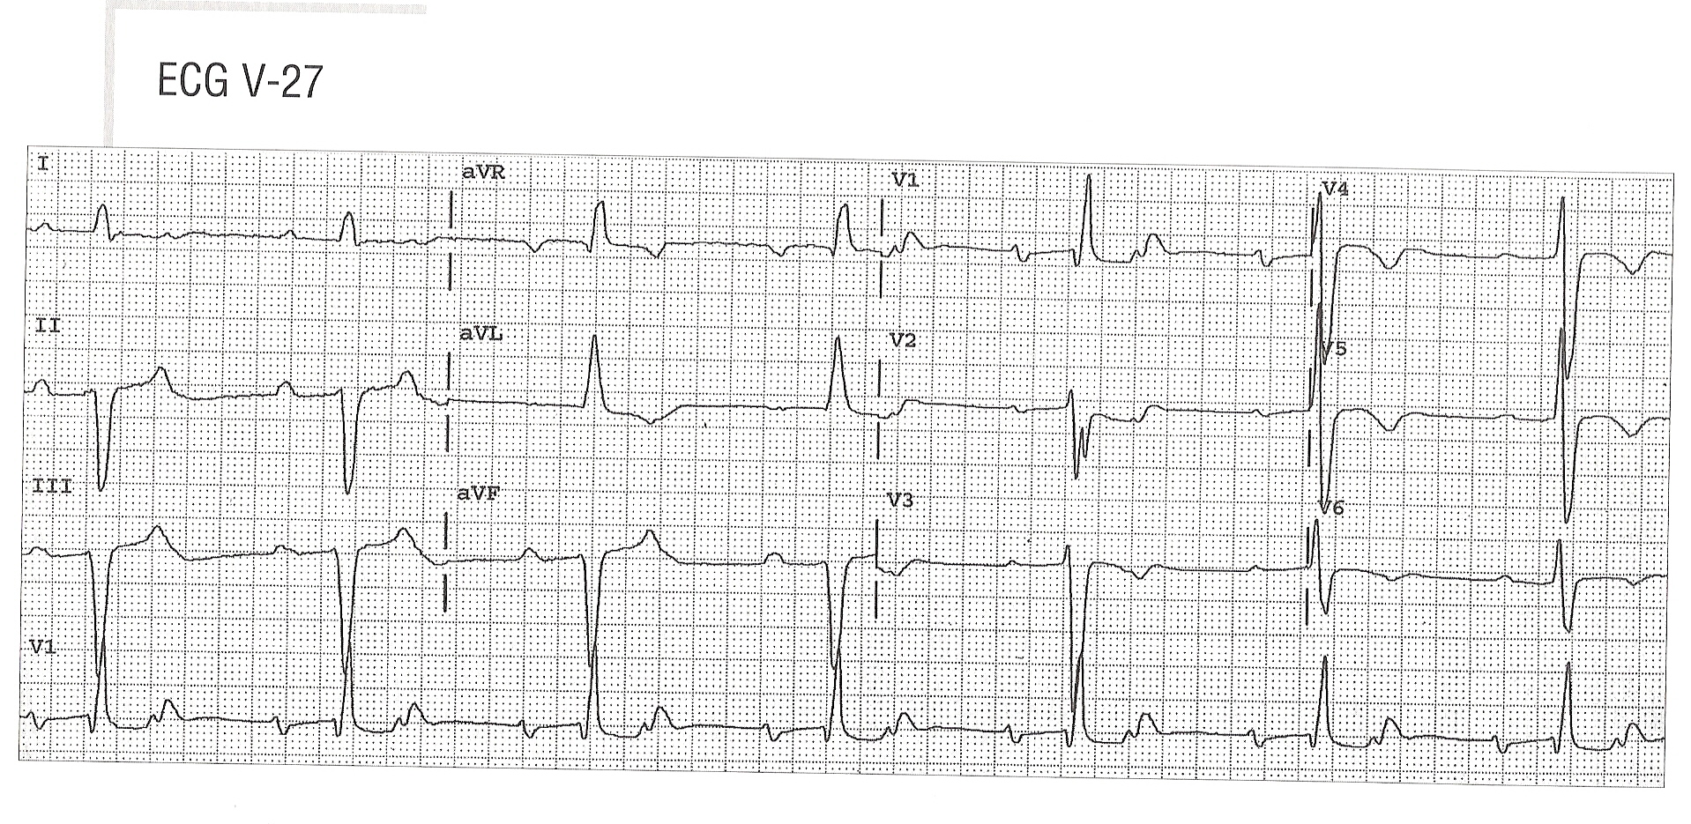
Realty check

Slide 69
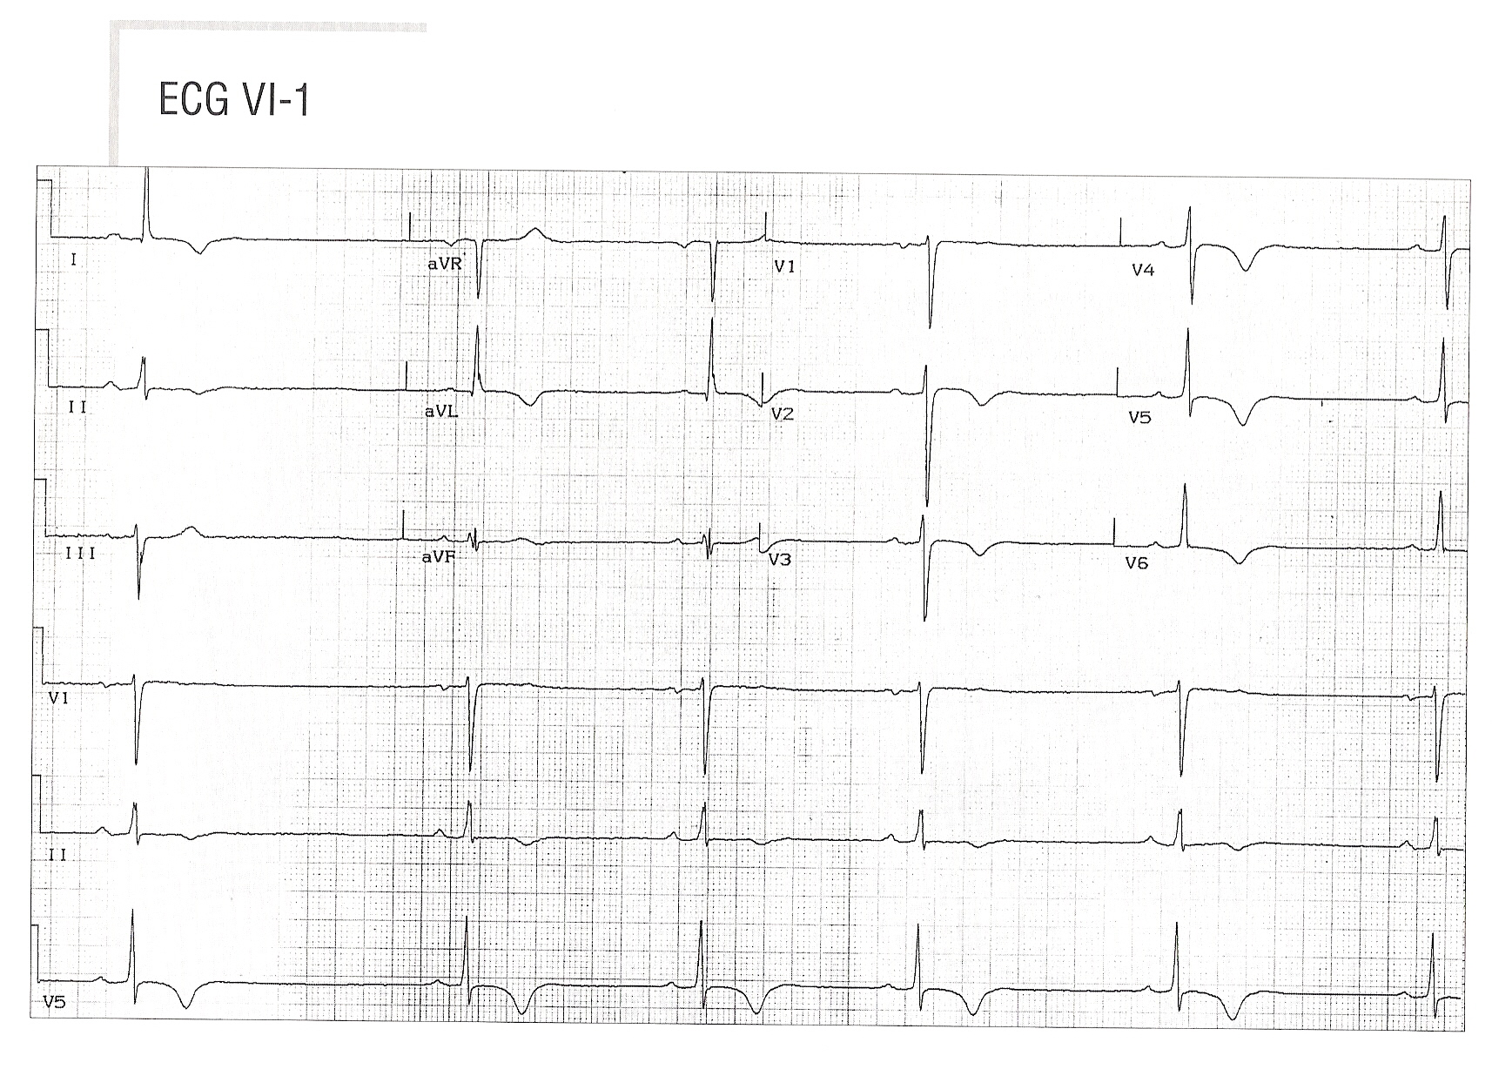
Realty check

Slide 70
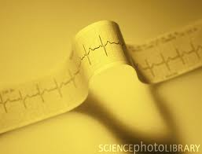
Part 2
Dysrhythmia

Slide 71
Outline
Definition
Mechanisms of tachyarrhythmia's
Differential diagnosis
Common examples
Approach to diagnosis

Slide 72
What are NCT?
Fast cardiac rhythms ( >100bpm)
QRS duration ≤120ms ( less than 2.5 small squares).
Originate from the atria or AV junction
If aberrant conduction is present ,the QRS will be long even though the arrhythmia originates above the AV junction.

Slide 73
SA
SVT
AV node
VT
His bundle
Bundle branches

Slide 74
Mechanisms of Tachyarrhythmia's

Slide 75
Mechanism
1) Accelerated automaticity
  Automatic impulse generation from unusual site or overtakes sinus node.
  2) Triggered activity
  Secondary depolarization during or after repolarization
3) Reentry

Slide 76
Automatic foci
SA
SVT
AV node
VT
His bundle
Bundle branches

Slide 77
Reentry
Most common mechanism ( around 90%)
3 prerequisites to develop reentry:
Available circuit
Difference in the refractory periods of the 2 limbs in the circuit
Slow enough conduction somewhere in the circuit

Slide 78
Reentry
reentry

Slide 79
Mechanisms….why know them?
Each mechanism may have unique features on the surface ECG.
Example: - Automaticity arrhythmias start & stop gradually.
- Reentry starts & stops abruptly
Impacts management

Slide 80
Differential diagnosis

Slide 81
Sinus tachycardia
SA nodal reentry tachycardia
Atrial tachycardia /PAT/MAT
Atrial flutter
Atrial fibrillation
AVNRT ( AV nodal reentrant tachycardia)
AVRT ( AV reentrant tachycardia)
Junctional tachycardia

Slide 82
AV nodal reentrant tachycardia ( AVNRT)

Slide 83
AVNRT
Most common SVT ( AF/Aflutter excluded).
Initiated by a PAC
Reentry at the level of the AV node
P waves are seen either immediately following the QRS or buried within it.
Ventricular rate can reach 280 bpm

Slide 84
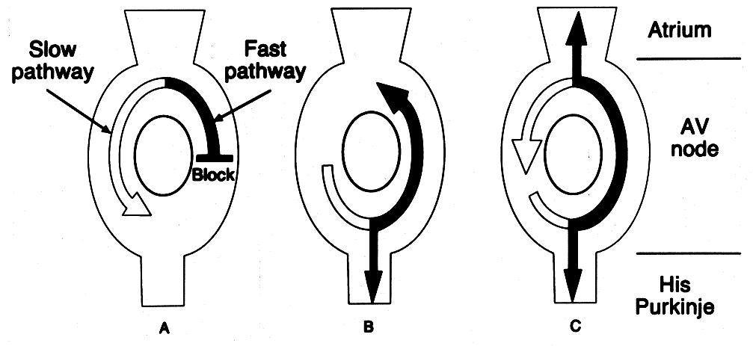
Mayo Clin Proc 1995; 70:371

Slide 85
AVNRT
Slow-fast verity is the most common, but the reverse could happen i.e. fast-slow
Slow-fast is mostly in adults
Triggered by a PAC
On ECG, a retrograde P wave ( short RP) manifest as :
- R’ in V1
- Pseudo S in inferior leads ( II,III, AVF)
- 2/3 of cases no P wave seen

Slide 86




Slide 87
AVRT
2nd most common SVT
Involves reentry between the atrium and ventricle with use of the AV node as the antegrade, slow pathway and an accessory AV connection as the retrograde, fast pathway.
Also known as “Orthodromic reciprocating tachycardia”

Slide 88
Terminology in use
Orthdromic tachycardia= conduction occurs in an antegrade fashion down the AV node.
Antidromic tachycardia= conduction occurs in a retrograde fashion up the AV node.

Slide 89

Initiation of Orthodromic
AV Reentrant Tachycardia
PAC
PAC
Atria
Atria
AP
AVN
Ventricles
Ventricles
PAC = premature atrial
complex (beat)
PAC = premature atrial
complex (beat)

Slide 90

Sustainment of Orthodromic
AV Reciprocating Tachycardia
Atria
Rate 150-250
beats per min
AP
AVN
Ventricles
Retrograde P’s fall
in the ST segment
with fixed, short RP

Slide 91

Sinus
beat
“Delta” Wave
Hybrid
QRS shape
PR < .12 s
AP
Fusion activation
of the ventricles
QRS ≥ .12 s

Slide 92
Atrial tachycardia
Most common long RP tachycardia
Rate 150-250 bpm
An AV nodal independent tachycardia
Can be associated with variable block

Slide 93

Differs from
AV nodal or
AV reentrant
SVT
RP intervals can be variable
RP often > PR
(Example slower than more common rate mof 150-250 beats per min)

Slide 94

Atrial Flutter.
Reentrant rhythm of the right atrium
Typical atrial rate is 300bpm
P waves have a characteristic “saw tooth” appearance

Slide 95

Atrial Flutter
II
4:1
2:1
V1

Slide 96

Atrial Flutter
V. rate
140-160
beats/min
2:1
Conduction
2:1 & 3:2
Conduction
1:1
Conduction

Slide 97

Atrial Fibrillation
Focal firing
or
multiple
wavelets
Chaotic, rapid
atrial rate at
400-600
beats per min

Slide 98

Atrial Fibrillation: Characteristic
“Irregularly Irregular” Ventricular Response
II
Rapid, undulating baseline (best seen in V1)
Most impulses block in AV node → Erratic conduction

Slide 99
How to make the diagnosis?

Slide 100
Is it a tachycardia?
Is it narrow or wide complex?
What is the shape/axis of the P wave?
What is the relationship of the P wave to the QRS?

Slide 101
Shape/axis of the P wave
Morphology of the p wave can aid in identifying the origin
Look at leads II and V1 , if upright in II, and biphasic in V1, then it’s likely from the SN or near to it.
If negative in II, and upright in V1 then it likely is from elsewhere (LA)

Slide 102
V1
II

Slide 103
Relationship to QRS
3 situations could be described:
1. P just precedes the QRS (Long RP)
2. P occurs simultaneously or immediately follows the QRS (Short RP)
3. No relation between P and QRS ( AV dissociation)

Slide 104

RP < ½ RR
RP > ½ RR

Slide 105
SVT
Irregular
Regular
A Fib
A Flutter
MAT
Short RP
Long RP
ST
SNRT
AT
Atypical AVNRT
Atypical AVRT
AVNRT
AVRT

Slide 106
Broad therapeutic approach to classify (NCT)

Slide 107
Classification
AV nodal dependant NCT
( AVNRT, AVRT)
AV nodal independent NCT
( AT, Flutter, ST)

Slide 108
Methods of increasing AV node stimulation
Vagotonic Maneuvers
  Carotid sinus massage
  Valsalva maneuver (bearing down)
  Facial ice pack (“diving reflex;” for kids)
Adenosine (6-12 mg I.V.)
If SVT “breaks,” a reentrant mechanism involving the AV node is likely
If atrial rate unchanged, but ventricular rate slows (#P’s > #QRS’s), SVT is atrial in origin

Slide 109
SVT termination
  AV nodal reentrant tachycardia
  AV reentrant tachycardia
No SVT termination (despite maximal attempts)
  Sinus tachycardia
  Atrial flutter or fibrillation
  Most atrial tachycardias (a minority are “adenosine-sensitive”)

Slide 110

AVNRT / AVRT

Slide 111

A. Flutter
Carotid Sinus Massage

Slide 112


Slide 113


Slide 114


Slide 115


Slide 116


Slide 117

Ventricular Tachycardia
Impulse is generated by the ventricle below bundle of His.
ECG findings:
1) Wide QRS complex with absent P wave.
2) HR > 100 BPM (REGULAR)

Slide 118


Premature Ventricular Contractions
The ventricles fire an early impulse which causes the heart to beat earlier causing irregularity in the heart rhythm.

Slide 119

Torsade De point
ECG findings:
1) Polymorphic wide complex (ventricular) tachycardia.
2) Looks like if QRSs are twisted around the isoelectric
line.

Slide 120

Ventricular Fibrillation
ECG findings:
Rapid, erratic electrical impulses.

Slide 121


