Slide 2
General Advise:
Maturity
Discipline
Commitment
Time management
Clinical sense
Your friends
Sources feedback
Your priority ??

Slide 3
Time Line
Group A | Group B | Group C
Surgery | Pediatrics | Medicine
Pediatrics | Medicine | Surgery
Medicine | Surgery | Pediatrics
Elective

Slide 4
Surgery

Slide 5
Introduction
10 hours/ Dr. Hamad
The best rotation of the year
Very well organized

Slide 6
Outline
Schedule: - 1 week of Lectures (#15), the whole group
- 5 weeks of GS
- 4 weeks of sub-specialties
Activities each week: - Sessions
- Clinic
- OR
- Round
Others: ER / BLS&ACLS / Clinical skills / Patient safety

Slide 7
Evaluation
Continuous assessment: (40 marks)
Attendance = 5
Clerking = 10
Mid-term MCQs = 25
DxR = No marks
Final: (60 marks)
MCQs = 20
OSCE = 40

Slide 8
Sources: Mid-term MCQs
60 – 100 Qs
Around 15 lectures (1st week)
Including ER tutorials
Sources:
Lectures & notes
First aid Surgery clerkship
Your 3rd year sources
Davidson (Must, at least read it)

Slide 9
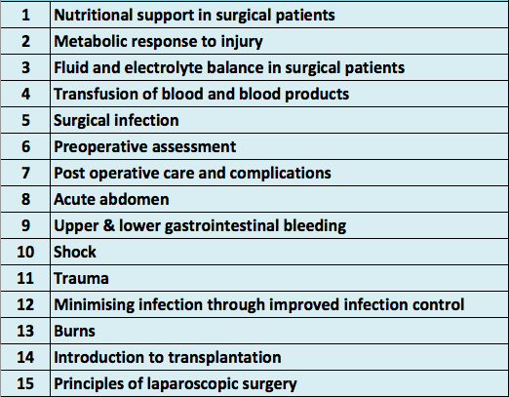

Slide 10
Sources: Final MCQs
Around 80 – 100 Qs
Not included mid-term lectures
Mostly clinical (scenario) based Qs
60% General surgery
40% Sub-specialist
Almost from sessions topics
Sources:
Sessions notes
Surgical recall
Your 3rd year sources
First aid surgical clerkship
Churchill
Davidson

Slide 11
Sources: OSCE
10 Stations
Tow parts:
Oral stations (#6) : mostly discussion and examination
Written stations (#4) : usually sub-specialist
Sources:
Previous OSCEs
Surgical recall and session notes ??

Slide 12
Pediatrics

Slide 13
Introduction
10 hours credit/ Dr. Hani Temsah

Slide 14
Outline
Schedule: - First 2 weeks of lectures (#28) ^the whole group
- Examination sessions ?!
Activities each week:
Tutorials: #10 (each 3 sub-groups together)
Rounds
Clinic
Case presentation
ER
Nursery
Others: Clinical skills / Patient safety

Slide 15
Evaluation
Continuous assessment: (40 marks)
Mid-term exam (MCQs & MEQs) = 25
Others = 25, which:
Log book: (11 marks)
- Clerking = 4 (# 3 cases) / How?
- Case presentations = 3 (# 3 cases)
- Observation of common cases and clinical signs = 2
- Clinical skills = 2
Attendance: 2 marks
DxR: 2 marks
Final : (60 marks)
MCQs & MEQs = 40
OSCE = 20

Slide 16
Sources: MCQs & MEQs
Mid-term :
MCQs = 20 marks (40 Qs)
MEQs = 5 marks ( 5 pictures, 2 Qs for each )
Final :
MCQs = 30 marks (60Qs)
MEQs = 10 marks (10 pic, 2 Qs for each)
Sources:
Lectures
Illustrated textbook of pediatrics
Kaplan (Book & videos)
MCQs & MEQs booklet
Previous MEQs
Pic from book (in dropbox folder)

Slide 17
Sources: OSCE
Budoor AlQudra’s booklet
Dr. Alhawasi’s Booklet
Old OSCE files

Slide 18
Medicine

Slide 19
Introduction

Slide 20
Outline
Schedule: Attached to 2 sub-specialty Units and consultants (every 5 weeks)
- CTU - GIT - Endocrine - Pulmonology
- ID - Nephro - Hema-onco - Rheumatology
- No cardio OR neuro
Activities each week:
Sign in & sign out at your department's secretary
Attend the morning meeting (1 per week)
Tutorials in Wednesday and Thursday afternoon
Cardio Or Neuro sessions in Wednesday from 10 to 12.
Clinical sessions in Sunday, Monday Or Tuesday afternoon (1 per week)
Your sub-specialty activity: Rounds, Clinic, meeting …..etc.
Others: ER On-call
Med 442 clerkship manual ??

Slide 21
Evaluation

Slide 22
Sources: Mid-term
Long case: 15 marks
Clerking & unit evaluation: 10 marks
1 clerking per week
Participation? Presentations?
Mini-CEX: 10 marks
2 each rotation
DxR: 5 marks
5 cases

Slide 23
Sources: MCQs
MCQs = 30 marks (50 Qs)
Cover all internal medicine
No single best source
Suggestions:
Lectures
Step up to medicine
Kaplan videos with lecture note?
Or Master the board? (Internal medicine Vs Step 2 CK)
Handbook of clinical Medicine by Oxford
MKSAP4

Slide 24
Sources: OSCE
OSCE = 30 Marks (8-9 Stations)
Could be:
Focused history taking with discussion.
Focused Clinical Station (Acute & office Medical emergency case or more stable case scenario).
Examination stations with discussion
Ethics station
Data Interpretation.

