Slide 1

Plain Chest Radiographs

Slide 2
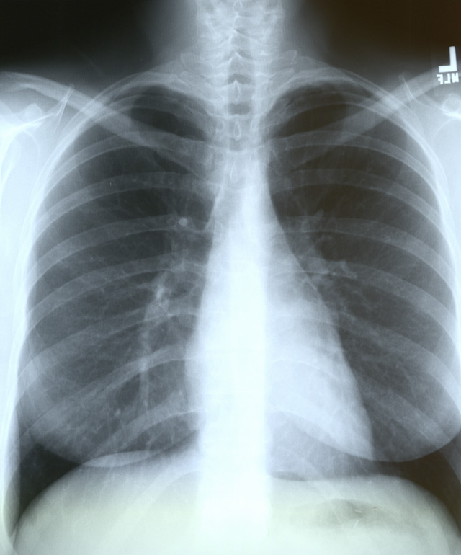

Slide 3
The 12-Step Program
}
1: Name
2: Date
3: Old films
4: What type of view(s)
5: Penetration
6: Inspiration
7: Rotation
8: Angulation
9: Soft tissues / bony structures
10: Mediastinum
11: Diaphragms
12: Lung Fields
Pre-read
}
Quality Control
}
Findings

Slide 4
Pre-Reading
1. Check the name
2. Check the date
3. Obtain old films if available
4. Which view(s) do you have?
  PA / AP, lateral, decubitus, AP lordotic

Slide 5
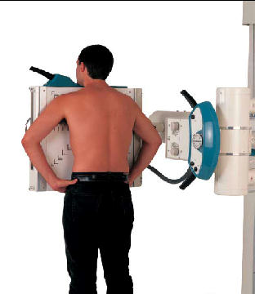
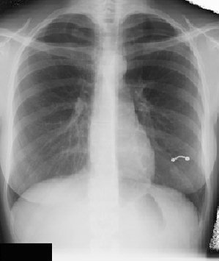
Techniques - Projection
P-A (relation of x-ray beam to patient)

Slide 6
Techniques - Projection (continued)
Lateral

Slide 7
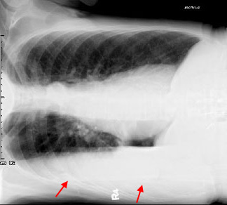
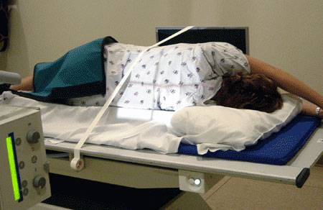
Techniques - Projection (continued)
Lateral Decubitus

Slide 8
Quality Control
5. Penetration
  Should see ribs through the heart
  Barely see the spine through the heart
  Should see pulmonary vessels nearly to the edges of the lungs

Slide 9
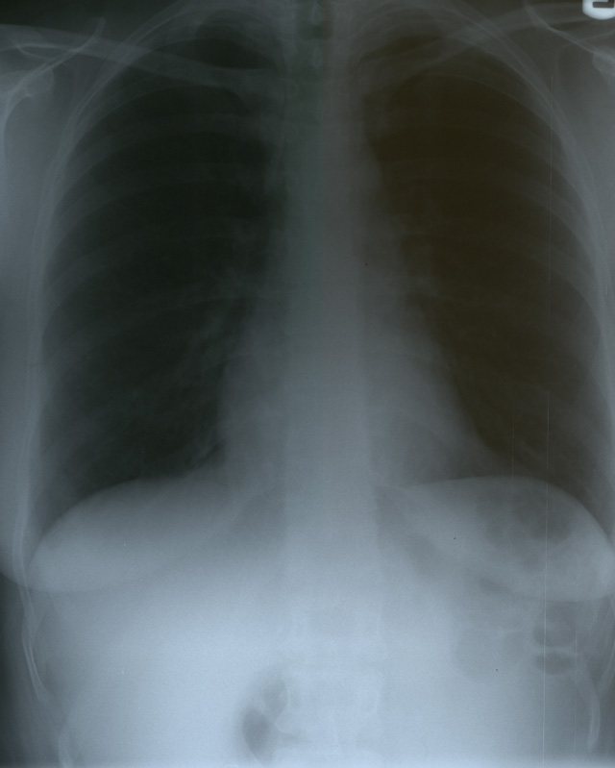
Overpenetrated Film
Lung fields darker than normal—may obscure subtle pathologies
See spine well beyond the diaphragms
Inadequate lung detail

Slide 10
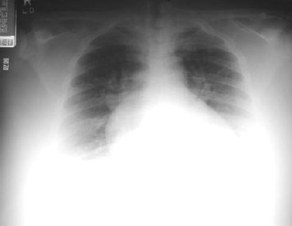
Underpenetrated Film
Hemidiaphragms are obscured
Pulmonary markings more prominent than they actually are

Slide 11
Quality Control
6. Inspiration
  Should be able to count 9-10 posterior ribs
  Heart shadow should not be hidden by the diaphragm
1
2
3
4
5
6
7
8
9
10

Slide 12
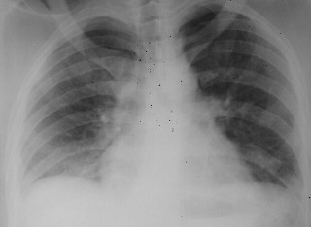
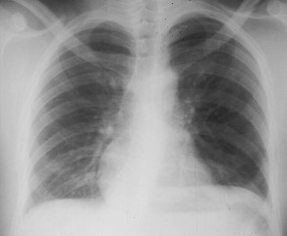
Poor inspiration can crowd lung markings producing pseudo-airspace disease
8
About 8 posterior ribs are showing
With better inspiration, the “disease process” at the lung bases has cleared
9
9-10 posterior ribs are showing

Slide 13
Quality Control
7. Rotation
  Medial ends of bilateral clavicles are equidistant from the midline or vertebral bodies

Slide 14
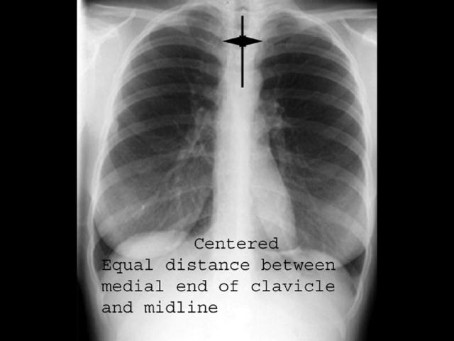
Rotation

Slide 16
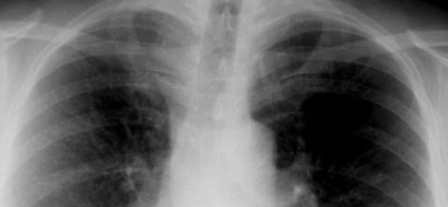
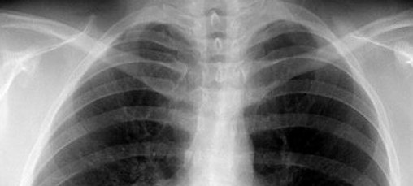
If spinous process appears closer to the right clavicle (red arrow), the patient is rotated toward their own left side
If spinous process appears closer to the left clavicle (red arrow),
the patient is rotated toward their own right side

Slide 17
Quality Control
8. Angulation
  Clavicle should lay over 3rd rib
1
2
3

Slide 18
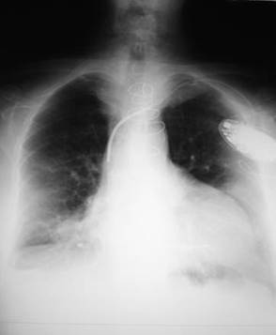
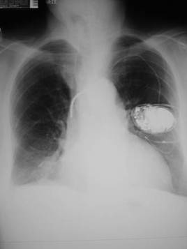
Pitfall Due to Angulation
Apical lordotic
Same patient, not lordotic
A film which is apical lordotic (beam is angled up toward head) will have an unusually shaped heart and the usually sharp border of the left hemidiaphragm will be absent

Slide 19
Findings
9. Soft tissue and bony structures
  Check for
    Symmetry
    Deformities
    Fractures
    Masses
    Calcifications
    Lytic lesions

Slide 20
Findings
10. Mediastinum
  Check for
    Cardiomegaly
    Mediastinal and Hilar contours for increase densities or deformities

Slide 21
Findings
11. Diaphragms
  Check sharpness of borders
  Right is normally higher than left
  Check for free air, gastric bubble, pleural effusions

Slide 22
Findings
12. The Lung Fields!
  To help you determine abnormalities and their location…
    Use silhouettes of other thoracic structures
    Use fissures

Slide 23
Lung Fields: Using Structures / Silhouettes
Silhouette / Structure
Contact with Lung
Upper right heart border/ascending aorta
Anterior segment of RUL
Right heart border
RML (medial)
Upper left heart border
Anterior segment of LUL
Left heart border
Lingula (anterior)
Aortic knob
Apical portion of LUL (posterior)
Anterior hemidiaphragms
Lower lobes (anterior)

Slide 24
Lung Fields: Using Structures / Silhouettes
Upper right heart border / ascending aorta
(anterior RUL)
Aortic knob
(Apical portion of LUL )
Upper left heart border
(anterior LUL)
Right heart border
(medial RML)
Left heart border
(lingula; anterior)
Anterior hemidiaphragms
(anterior
lower lobes)

Slide 25
Lung Fields: Fissures
The fissures can also help you to determine the boundaries of pathology
Major Oblique Fissure
Separates the LUL from the LLL
Right Major Fissure
Separates the RUL/RML from the RLL
Right Minor Fissure
Separates the RUL from the RML

Slide 26
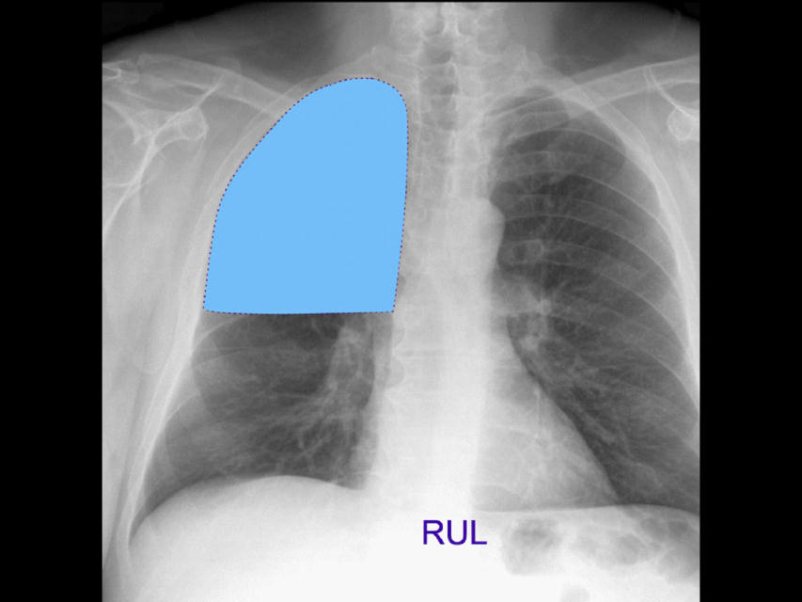
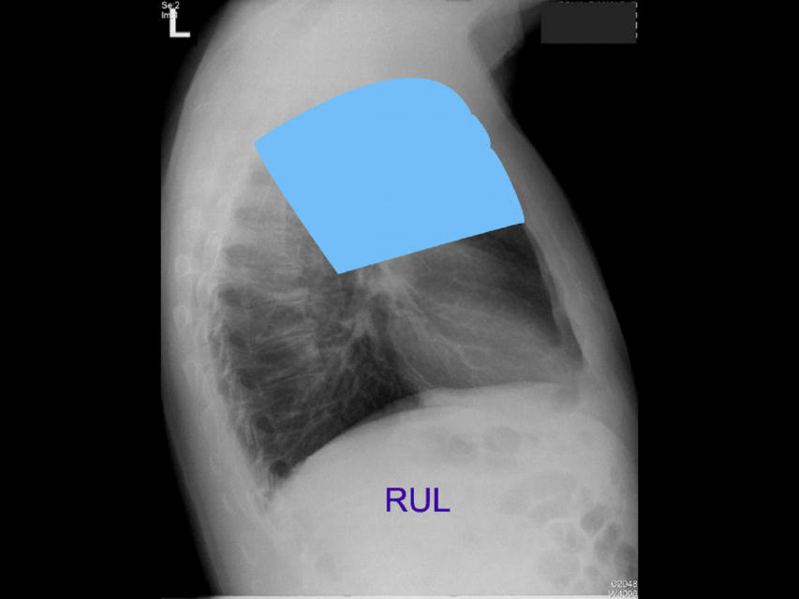
Lobes
Right upper lobe:

Slide 27
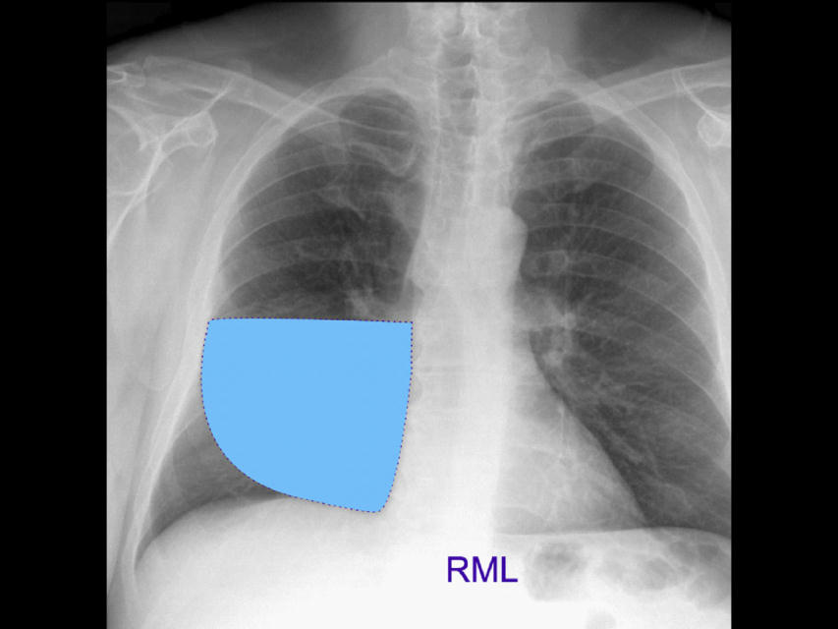
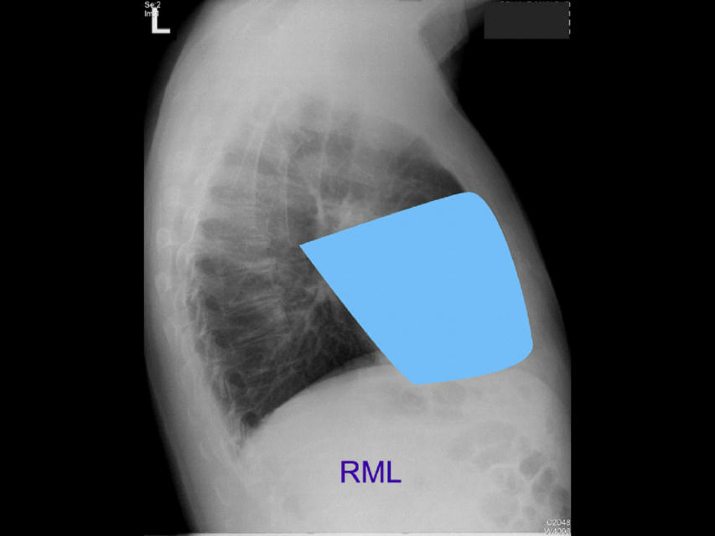
Lobes (continued)
Right middle lobe:

Slide 28
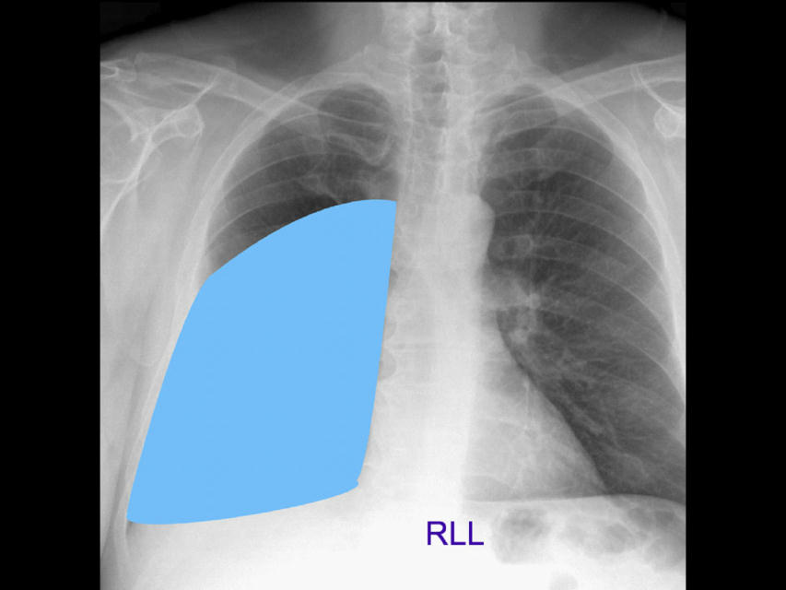
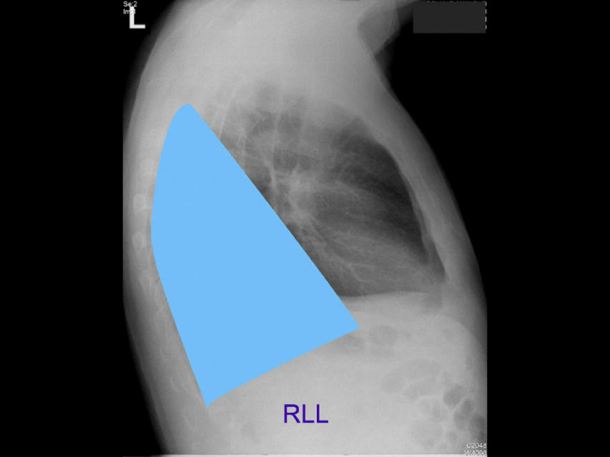
Lobes (continued)
Right lower lobe:

Slide 29
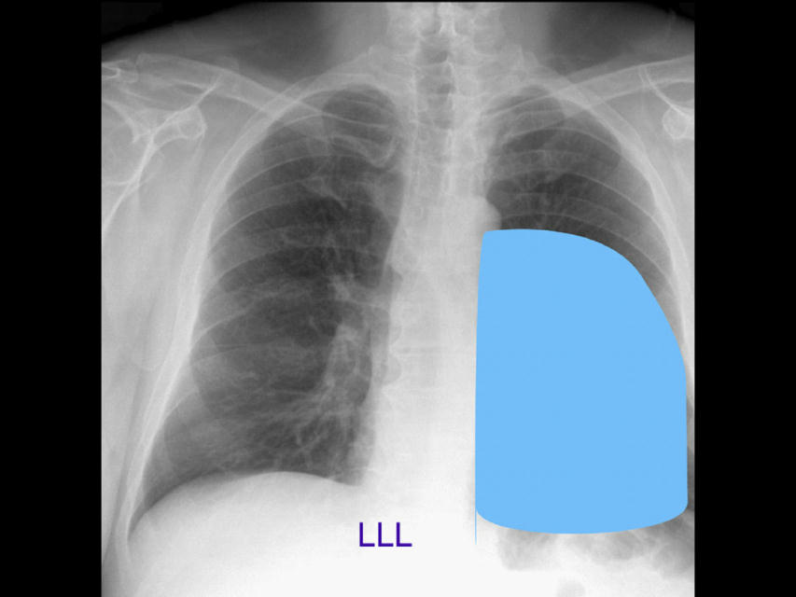
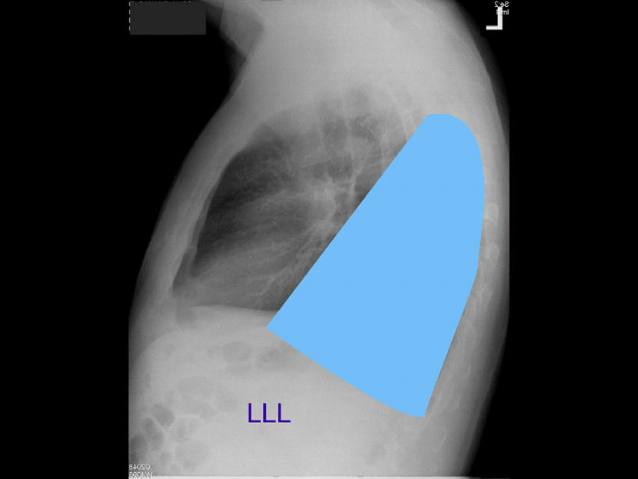
Lobes (continued)
Left lower lobe:

Slide 30
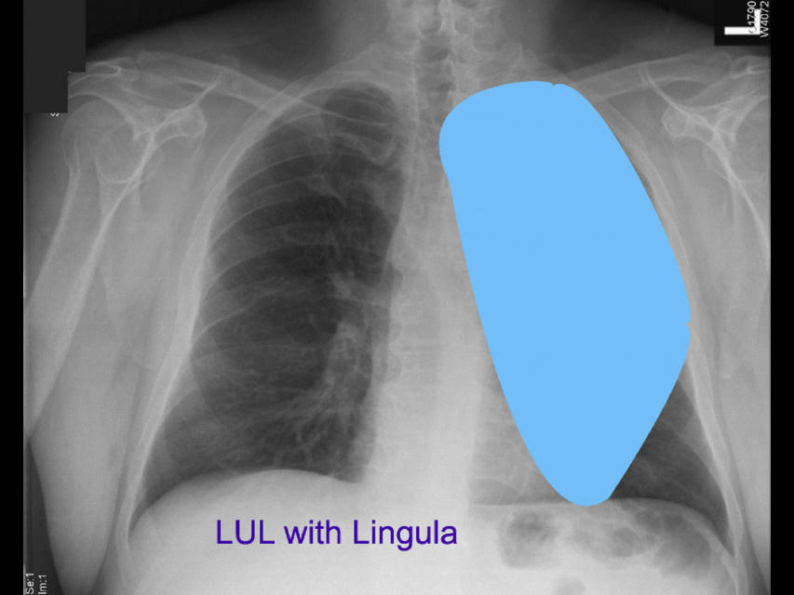
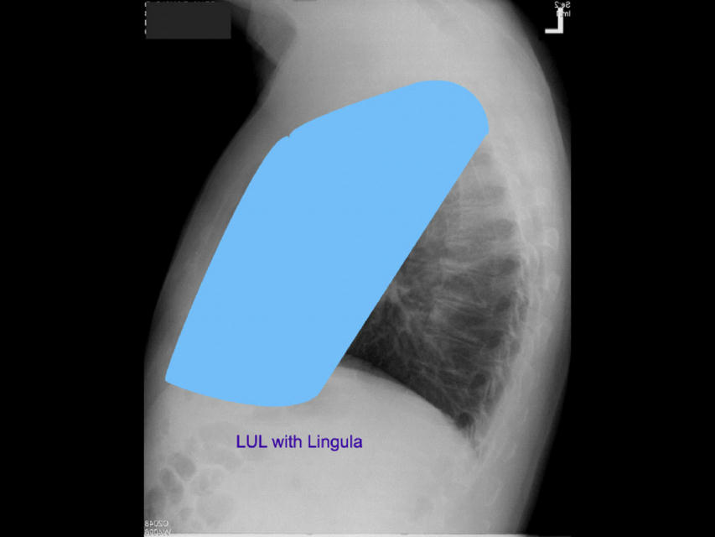
Lobes (continued)
Left upper lobe with Lingula:

Slide 31
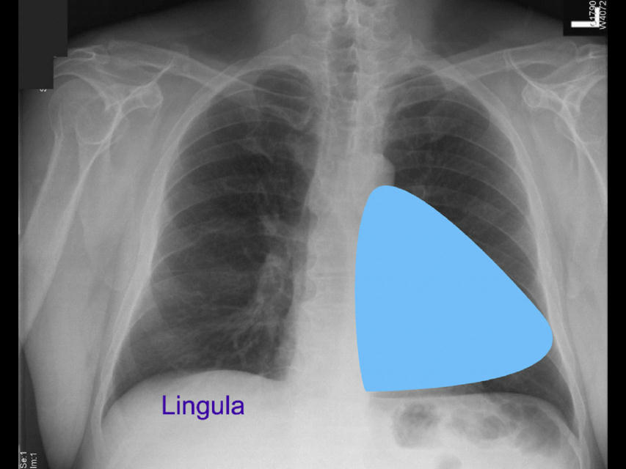
Lobes (continued)
Lingula:

Slide 32
Pleura
Layers:
Parietal
Visceral

Slide 33
Heart
Right border: Edge of (r) Atrium
3. Left border: (l) Ventricle + Atrium
4. Posterior border: Reft Ventricle
5. Anterior border: Right Ventricle

Slide 34
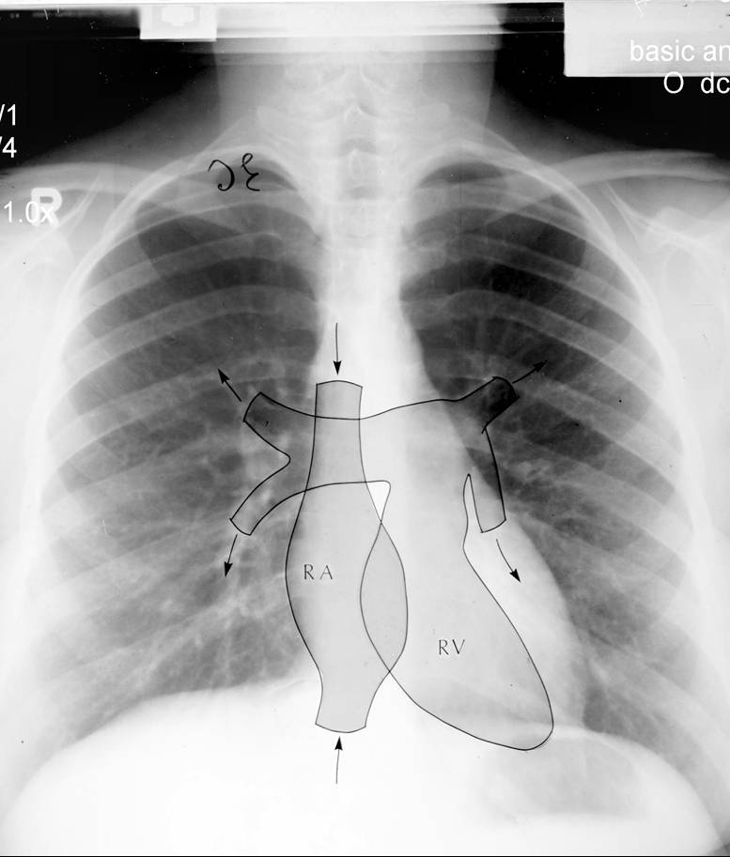
Heart (continued)

Slide 35
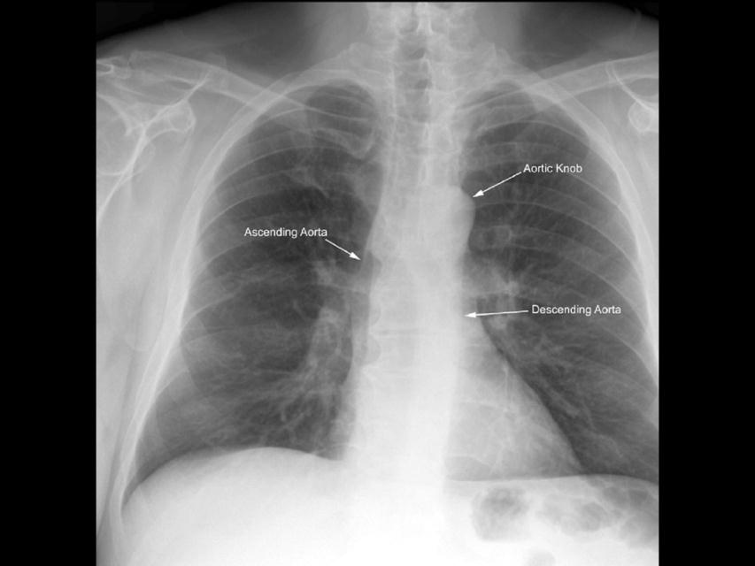

Heart (continued)

Slide 36
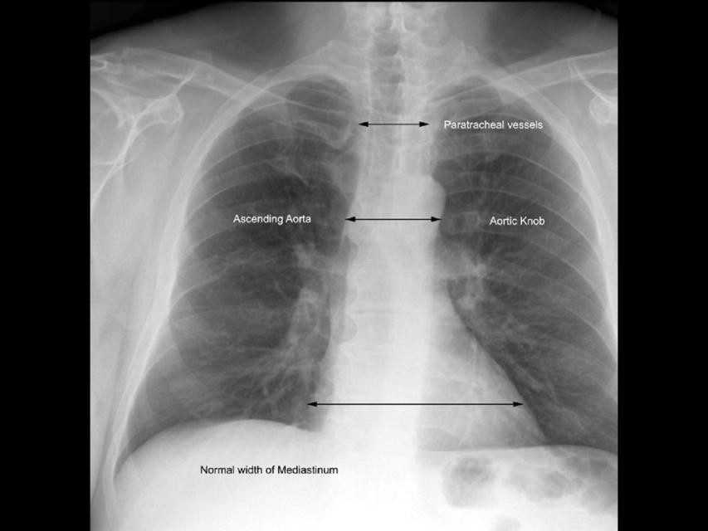
Mediastinum

Slide 37
Hilum
Made of:
1. Pulmonary Art.+Veins
2. The Bronchi
Left Hilum higher (max 1-2,5 cm)
Identical: size, shape, density

Slide 38
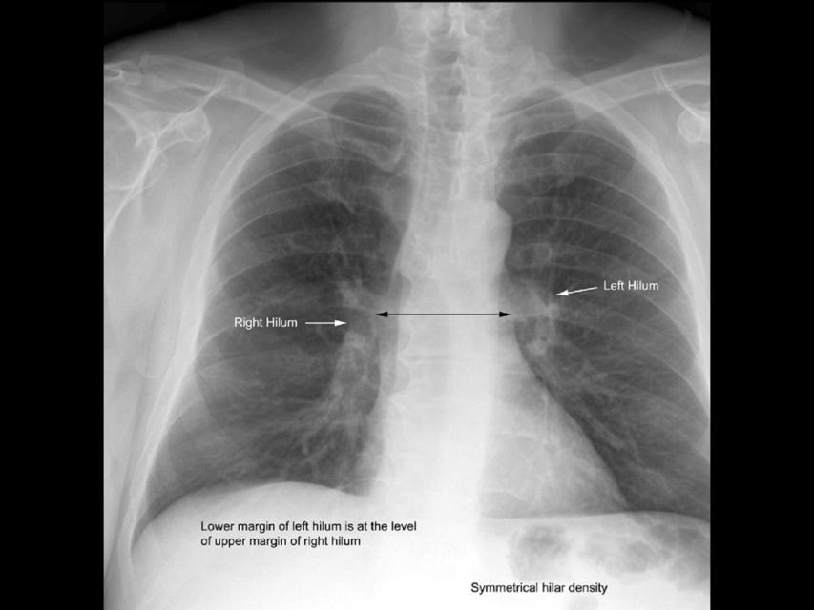
Hilum

Slide 39
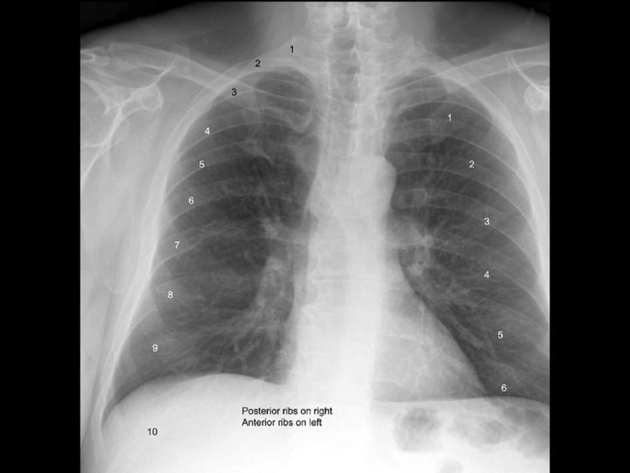
Ribs

Slide 40
Now for the Cases…
Remember… be systematic!

Slide 41
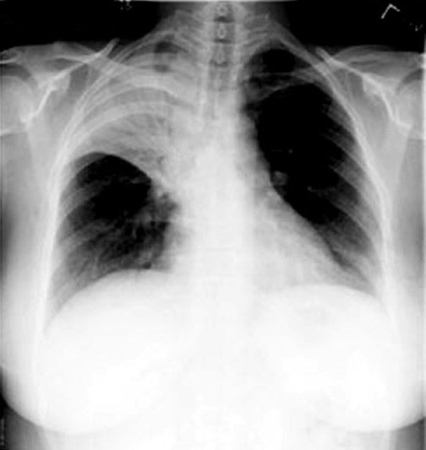
RUL pneumonia

Slide 42
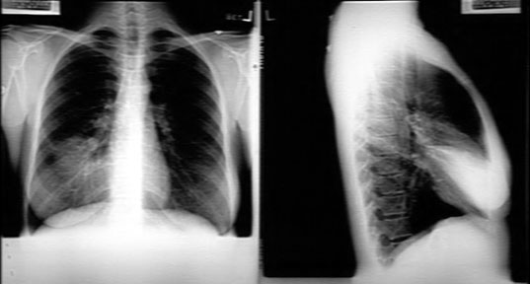
RML pneumonia

Slide 43
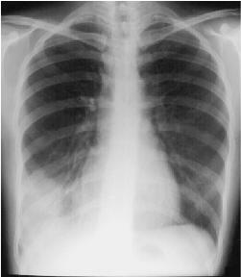
RLL pneumonia

Slide 44
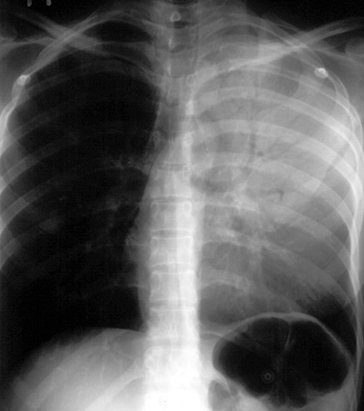
LUL pneumonia

Slide 45
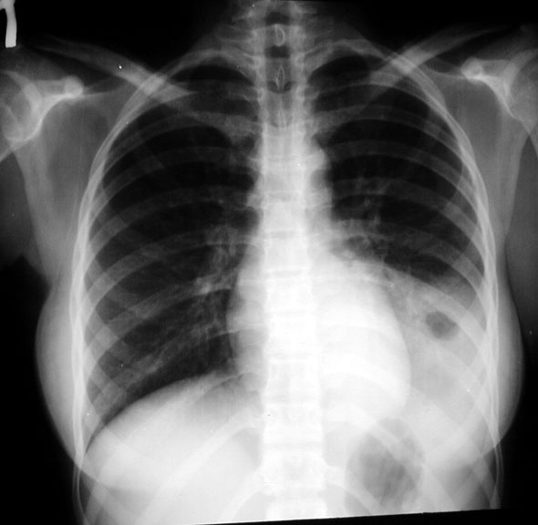
LLL pneumonia

Slide 46
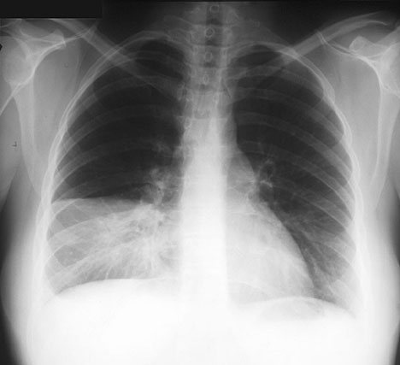
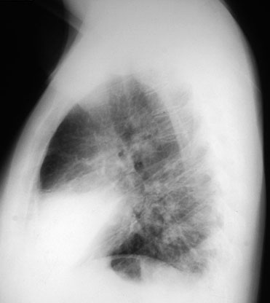
PA view: RML consolidation and loss of right heart silhouette
Lateral View: RML wedge shaped consolidation
RML pneumonia
Notes:
PA view of a patient with right middle lobe pneumonia, showing consolidation of the right middle lobe and loss of the right heart silhouette.
Lateral view of the same patient. The right middle lobe appears wedge-shaped on this view.

Slide 47
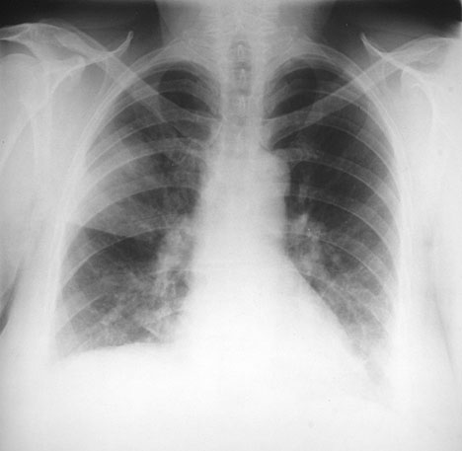
RUL infiltrate / consolidation, bordered by minor fissure inferiorly
Patchy LLL infiltrate that obscures the left hemidiaphragm; right and left heart borders obscured
RUL and LLL pneumonia
Notes:
Underpenetrated; right upper lobe pneumonia (bordered inferiorly by the minor fissure) and a more patchy left lower lobe pneumonia.

Slide 48
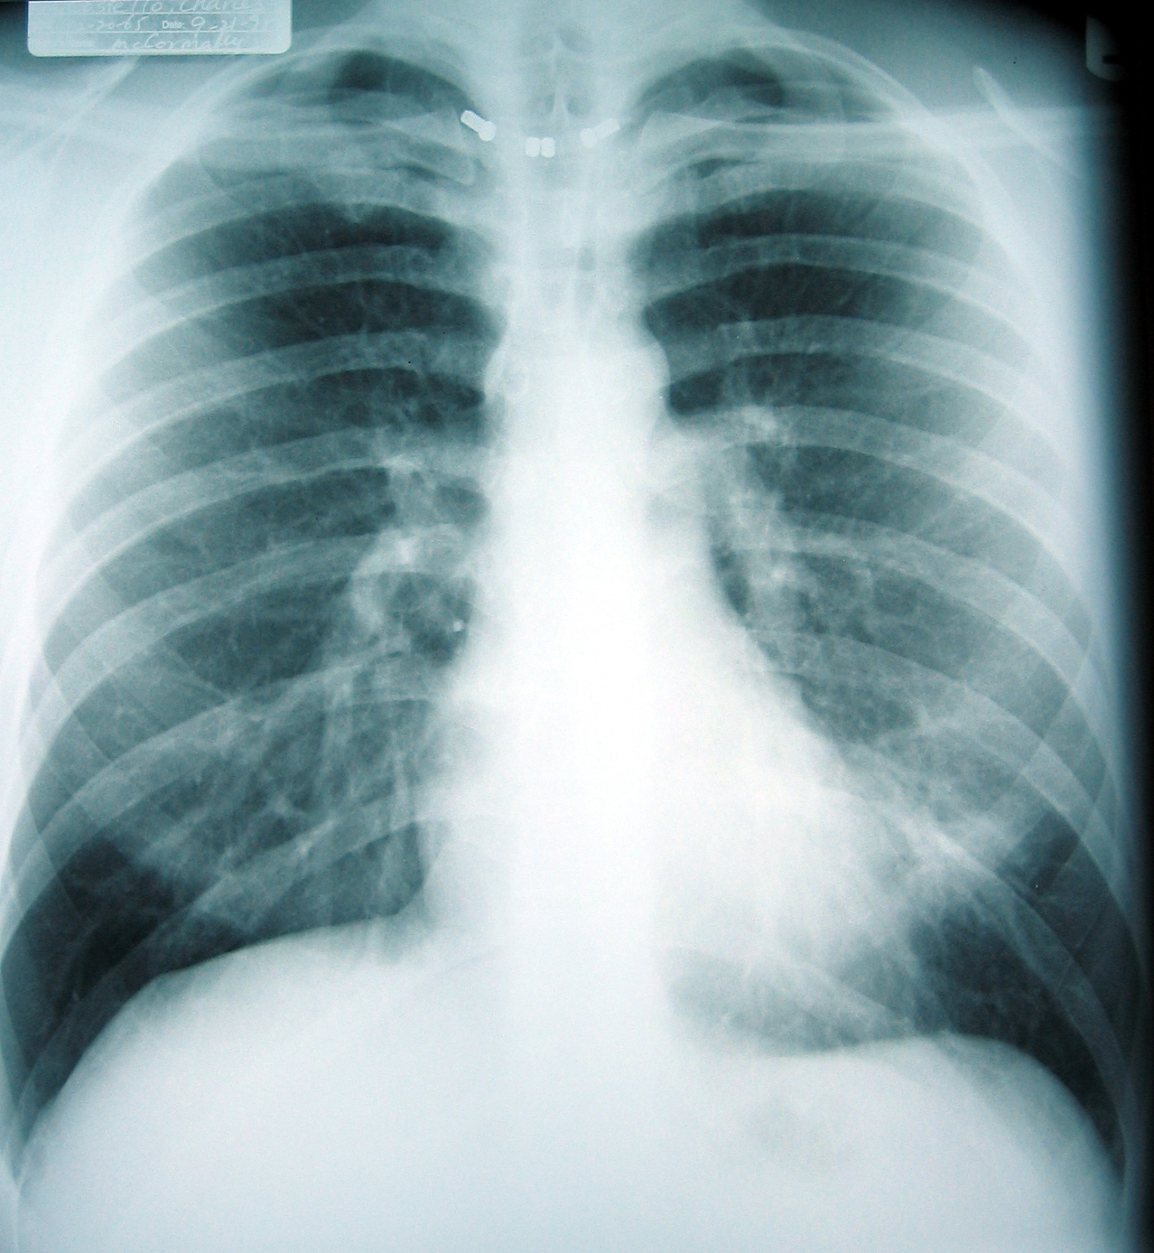
Underpenetrated; possible nonspecific obscuring of left heart border; mostly normal
Notes:
Some nonspecific obscuring of L heart border in an mildly underpenetrated film; ?? Breast implants?? mostly normal

Slide 49
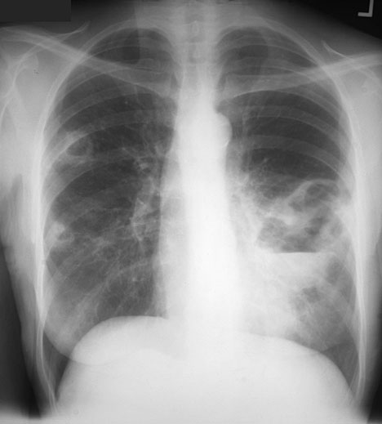
Multiple bilateral cavitary lesions with air-fluid levels c/w pulmonary abscesses
Tuberculosis
Notes:
Patient with multiple bilateral pulmonary abscesses, due to tuberculosis. Note the air-fluid levels within several of these cavitary lesions.

Slide 50
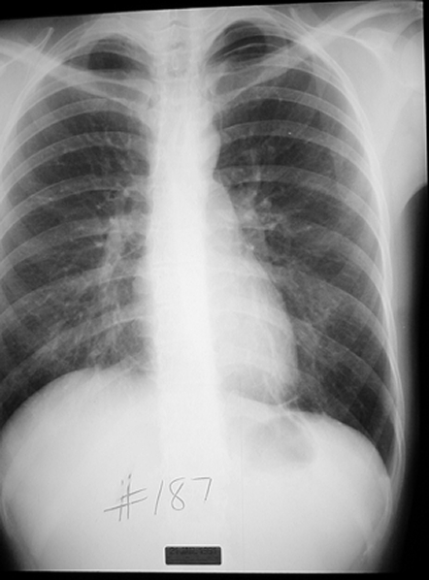
28 y/o female with sudden onset SOB while jogging this morning
Well demarcated paucity of pulmonary vascular markings in right apex
Left spontaneous pneumothorax
Notes:
This 28 y.o. female was jogging this morning when she experienced sudden onset of shortness of breath.
Diagnosis:
Left Spontaneous Pneumothorax
Trivia Question:
How much air is required to see a pneumothorax on a chest radiograph?
Answer:
About 500 ml
Not-so-trivia Question:
Besides pleural blebs featured in this case, what are some other causes of a pneumothorax?
Answer:
Bullae, emphysema and interstitial lung disease can also cause spontaneous pneumothoraces. Traumatic and iatrogenic causes include penetrating wounds, line placements, lung biopsies and mechanical ventilators.

Slide 51
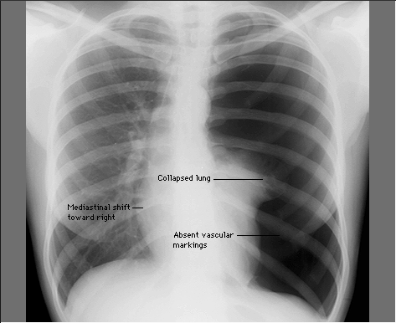

Slide 52
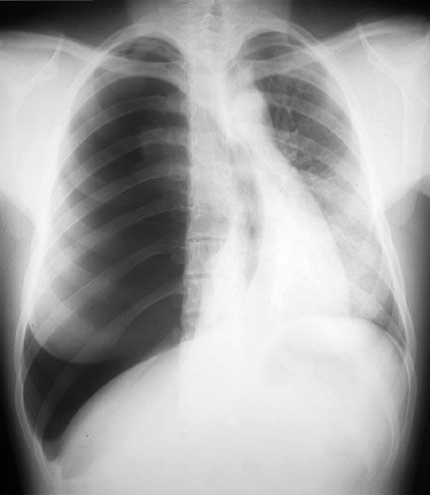

Slide 53
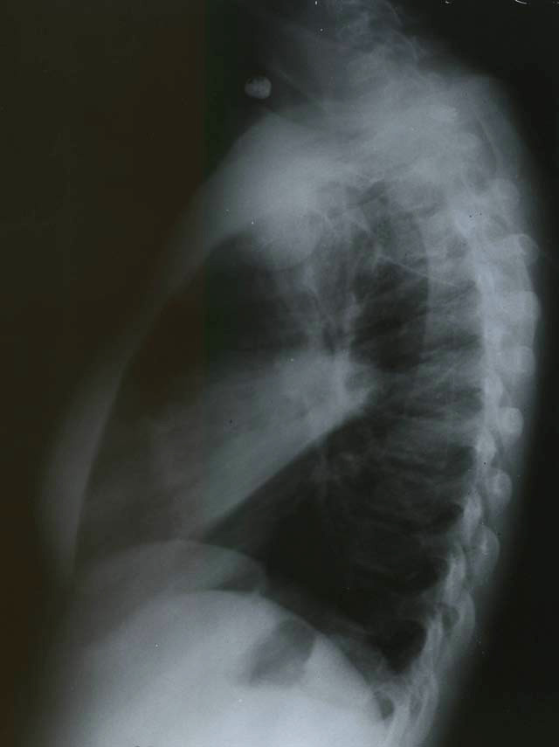
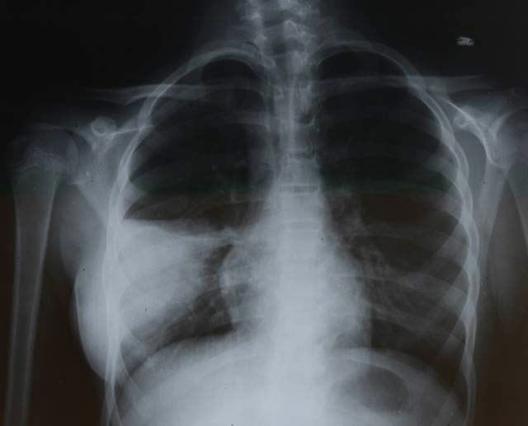
RML consolidation that appears wedge shaped on lateral view
RML pneumonia
Notes:
RML consolidation

Slide 54
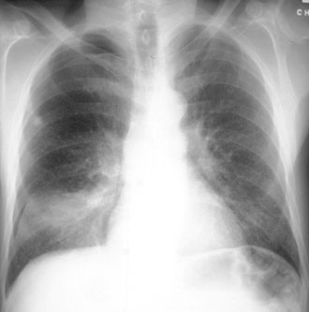
RLL infiltrate / consolidation
RLL pneumonia
Notes:
Plain film of pneumonia infiltrating the right lower lobe

Slide 55
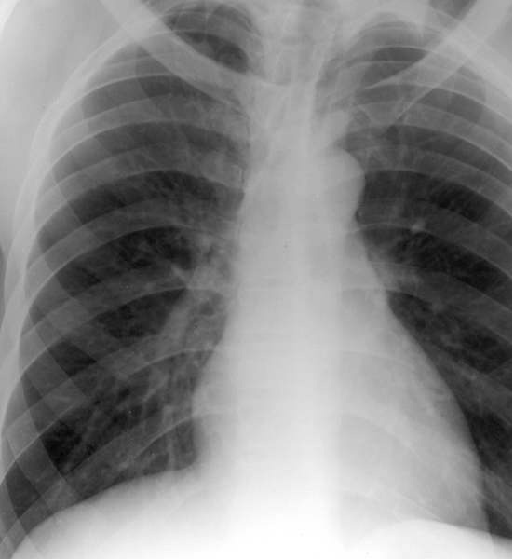
Increased vascular markings; otherwise normal
Notes:
Increased pulm vasc markings, otherwise normal

Slide 56
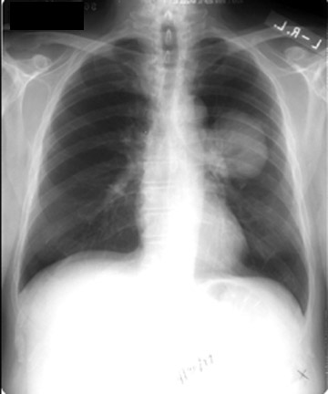
Hilar m l

Slide 57
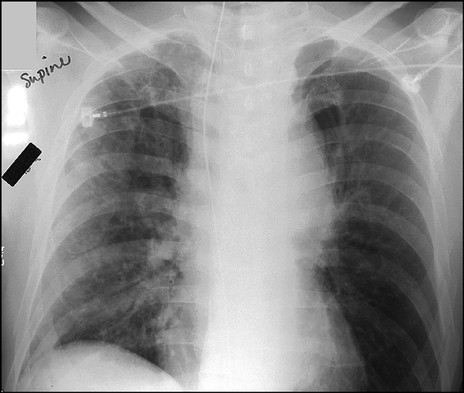
Patient BIBA to ER s/p airplane crash.
Widened mediastinum
Concern for aortic injury
Notes:
Widened mediastinum; concern for aortic injury (s/p airplane crash)

Slide 58
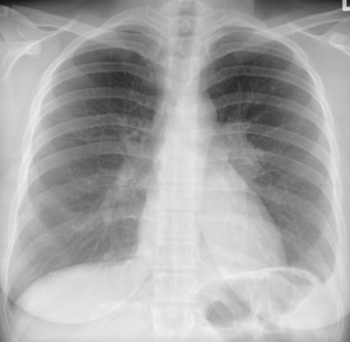
Hilar Lymphadenopathy - BL

Slide 59

Pleural Effusion

Slide 60

?

Slide 61

Heart failure

Slide 62

Pneumothorax

Slide 63

RUL collapse

Slide 64

Air under the diaphragm

Slide 65

Multiple Masses

Slide 66

Explain the prominence of the right atrium on this AP radiograph
Patient rotated to their right (left shoulder forward)
Notes:
explain the prominence of the right atrium on this AP radiograph :
The patient was rotated to their right (left shoulder forward) when the film was taken

Slide 67

Dilatation of the main pulmonary artery with decreased peripheral vascular markings
?? Pulmonary embolism ??
Notes:
There is dilatation of the main pulmonary artery with decreased peripheral vascular markings.

Slide 68


Obscuring of the right and left heart borders; infiltrate at the bases
Bilateral aspiration pneumonia
Notes:
Bilateral aspiration pna
Management: Antibiotics
First Line
Clindamycin 450-900 mg IV q8 hours
Alternative
Cefoxitin 2 grams IV q8 hours
Ticarcillin-Clavulanate (Timentin) 3.1 grams IV q6h
Piperacillin-Tazobactam (Zosyn) 3.375 g IV q6 hours

Slide 69

Diffuse bilateral fluffy interstitial infiltrates
Pneumocystis carinii pneumonia
Notes:
Diffuse bilateral Interstitial Infiltrates (80-95%) : Pneumocystis carinii Pneumonia
Management: Antibiotics
First Line treatment
Bactrim PO or IV (15 mg/kg of trimethoprim/day)
Adverse reactions occur in 40-60% within 3 weeks
Other agents (Bactrim intolerance)
Pentamidine 4 mg/kg/day IV or IM
Atovaquone 750 mg PO bid
Dapsone and Trimethoprim
Indicated for mild-moderate Pneumocystis
Fewer dose limiting adverse reactions
Primaquine and Clindamycin
Indicated for intolerance for other regimens

Slide 70


LUL pneumonia
Notes:
LUL pna

Slide 71

Severe pulmonary TB
Notes:
Severe pulmonary TB

Slide 72
Left lung opacity
Later diagnosed as lung cancer
Notes:
The chest x-ray shows a shadow in the left lung, which was later diagnosed as lung cancer

Slide 73

Cardiomegaly, increased pulmonary vascular markings, fluid in the horizontal fissure
CHF
Notes:
Cardiomegaly and pulmonary congestion with fluid in horizontal fissure.

Slide 74

Cavitating lesion

Slide 75

Miliary shadowing

Slide 76


Hiatus hernia

Slide 77

What do the arrows indicate?
Kerley B Lines
Short (1 -2 cm) white lines at the lung bases, perpendicular to the pleural surface representing distended interlobular septa

Slide 78
The 12-Step Program
}
1: Name
2: Date
3: Old films
4: What type of view(s)
5: Penetration
6: Inspiration
7: Rotation
8: Angulation
9: Soft tissues / bony structures
10: Mediastinum
11: Diaphragms
12: Lung Fields
Pre-read
}
Quality Control
}
Findings
Notes:
The point is to read radiographs SYSTEMATICALLY.
FYI: residents must review all X-rays and EKGs with a faculty member

Slide 79


Slide 80

Chest Tube, NG Tube, Pulm. artery cath

Slide 81

Dextrocardia

Slide 82

The End
Questions?

