Slide 1
Chronic Kidney Disease
Prof. Jamal Al Wakeel
Professor of Internal Medicine, Nephrology Consultant
Nephrology Unit, Department of Medicine

Slide 2
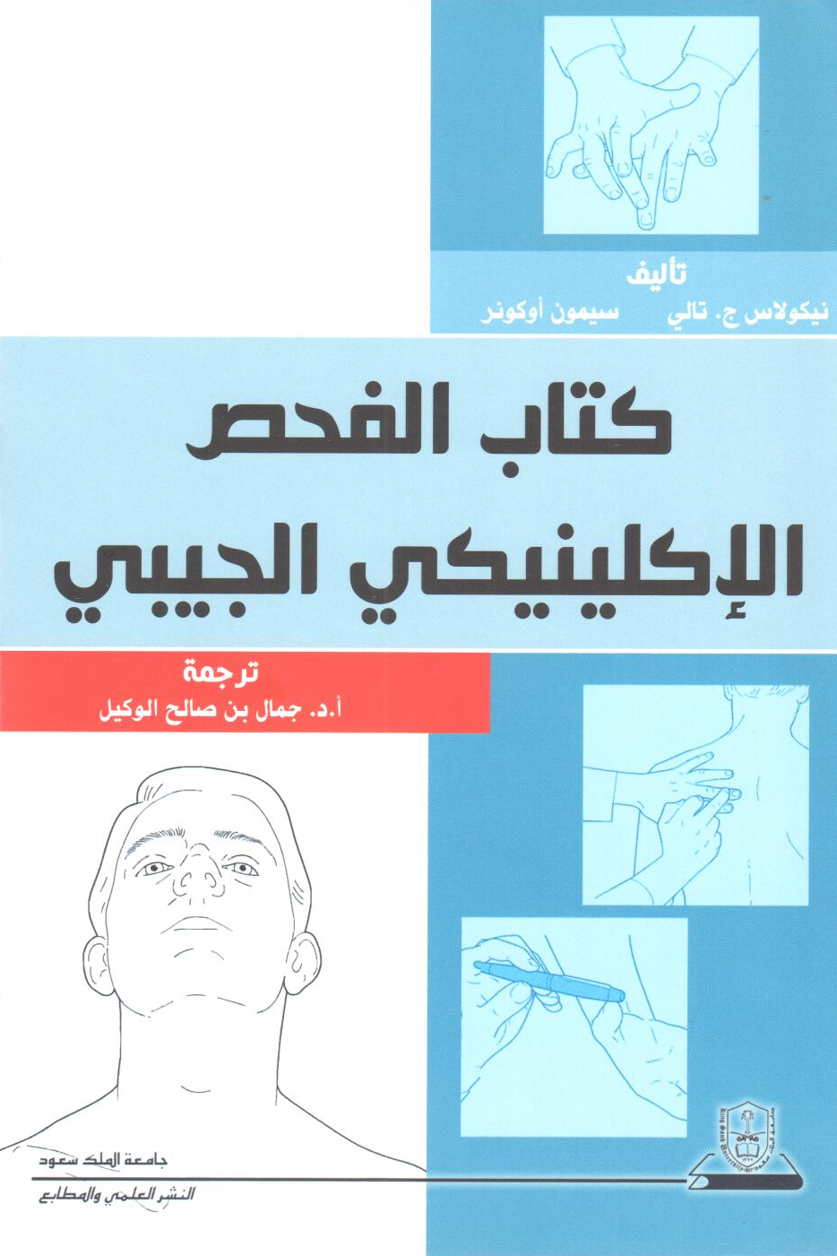
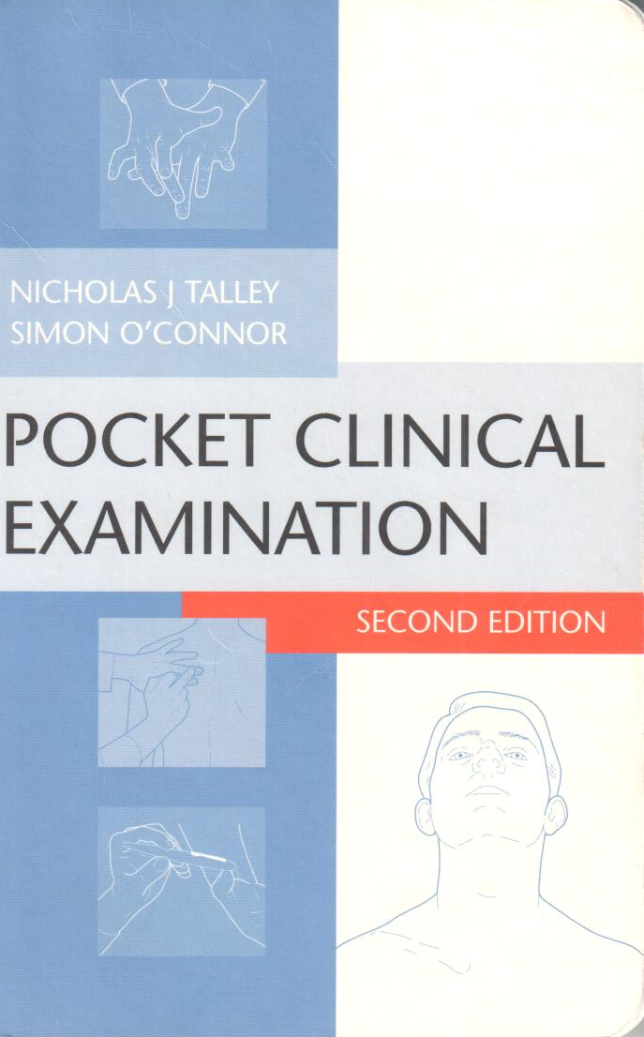

Slide 3
Chronic Kidney Disease
Objective
Epidemiology of CKD
Definition of CKD
Classification
Symptoms, signs and complications
Management of CKD

Slide 4
Case Study
55 yrs. old man with previous history of DM &hypertension came to Emergency with recurrent SOB for 2 week, he was treated by diuretic. Last investigation showed his Na 132,K6.1,urea 28 mmol/L &S Cr 380 μmol/L. The nurse recorded that his vital signs are:
BP – 190/105 mmHg
Pulse rate – 50 beats/min
What will your approach be for this case?

Slide 5
History
History of major complain
History of present illness
Duration
course of the disease
Associated symptoms
History of hypertension
History of system affected

Slide 6
History of uremia
History of weight loss in 6 months
↓ appetite
Nausea and vomiting
History of urinary symptom
Itchiness
Leg cramp

Slide 7
History
Systemic review
Past Medical illness
Surgical
Medication
Family
Social
Allergy

Slide 8
Examination

Slide 9
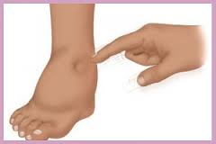
Examination
Posture
Look ill
BMI – 27 kg/m²
BP - 185/80 mmHg sitting both arm
Pulse rate – 50 beats/min
Breathing pattern
Pale
Edema
Mouth
Itching marks
Hand examination

Slide 10
Cardiovascular examination
JVP – 5cm
S1 + S2
ESM grade II at apex
No pericardial rub

Slide 11
Chest examination
Scratch mark in the back
Right side – stony dullness
↓TVF in right side
Bilateral basal crepitation
↓breathing sound at right side

Slide 12
Abdominal examination
Scratch mark
No organomegaly
No aortic or renal bruits
No suprapubic mass
No shifting dullness

Slide 13
CNS
Drowsiness
Fundus examination > diabetic retinopathy
No asthraxis
Normal power
Decrease Touch Sensation and vibration & sensation in both legs
Normal Coordination

Slide 14
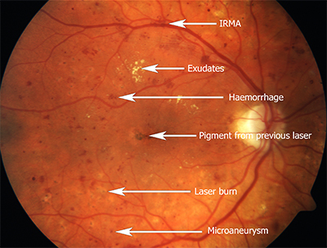
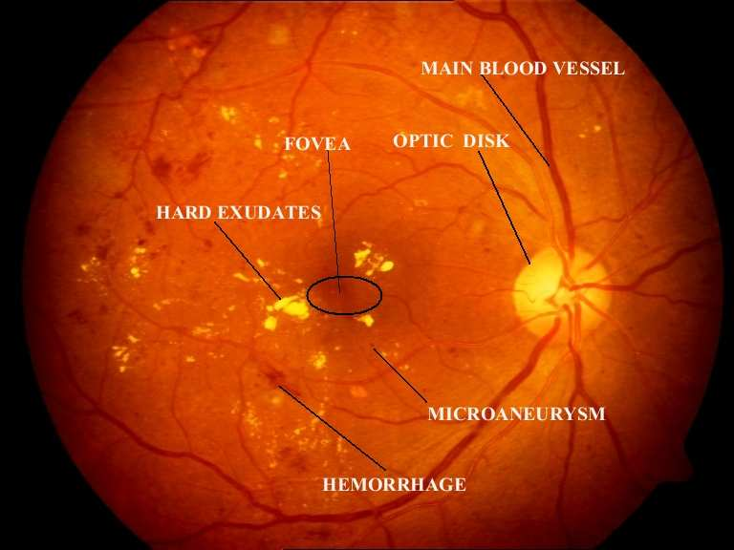
Diabetic Retinopathy

Slide 15
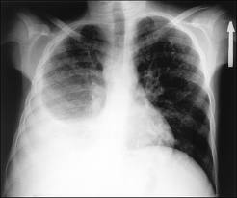
Clinical Diagnosis
CKD due to DM and HTN
Diabetic retinopathy
Hypertension Stage III
Anemia
Functional murmur
Itching
Right pleural effusion
Fluid overload with pulmonary edema
Bradycardia
Diabetic peripheral neuropathy

Slide 16
European Society of Nephrology Classification of Blood Pressure Levels
Category | Systolic blood pressure (mmHg) | Diastolic blood pressure (mmHg)
Optimal blood pressure | <120 | <80
Normal blood pressure | <130 | <85
High-normal blood pressure | 130-139 | 85-89
Grade 1 hypertension (mild) | 140-159 | 90-99
Grade 2 hypertension (moderate) | 160-179 | 100-109
Grade 3 hypertension (severe) | >/= 180 | >/= 110
Isolated systolic hypertension | >140 | <90

Slide 18
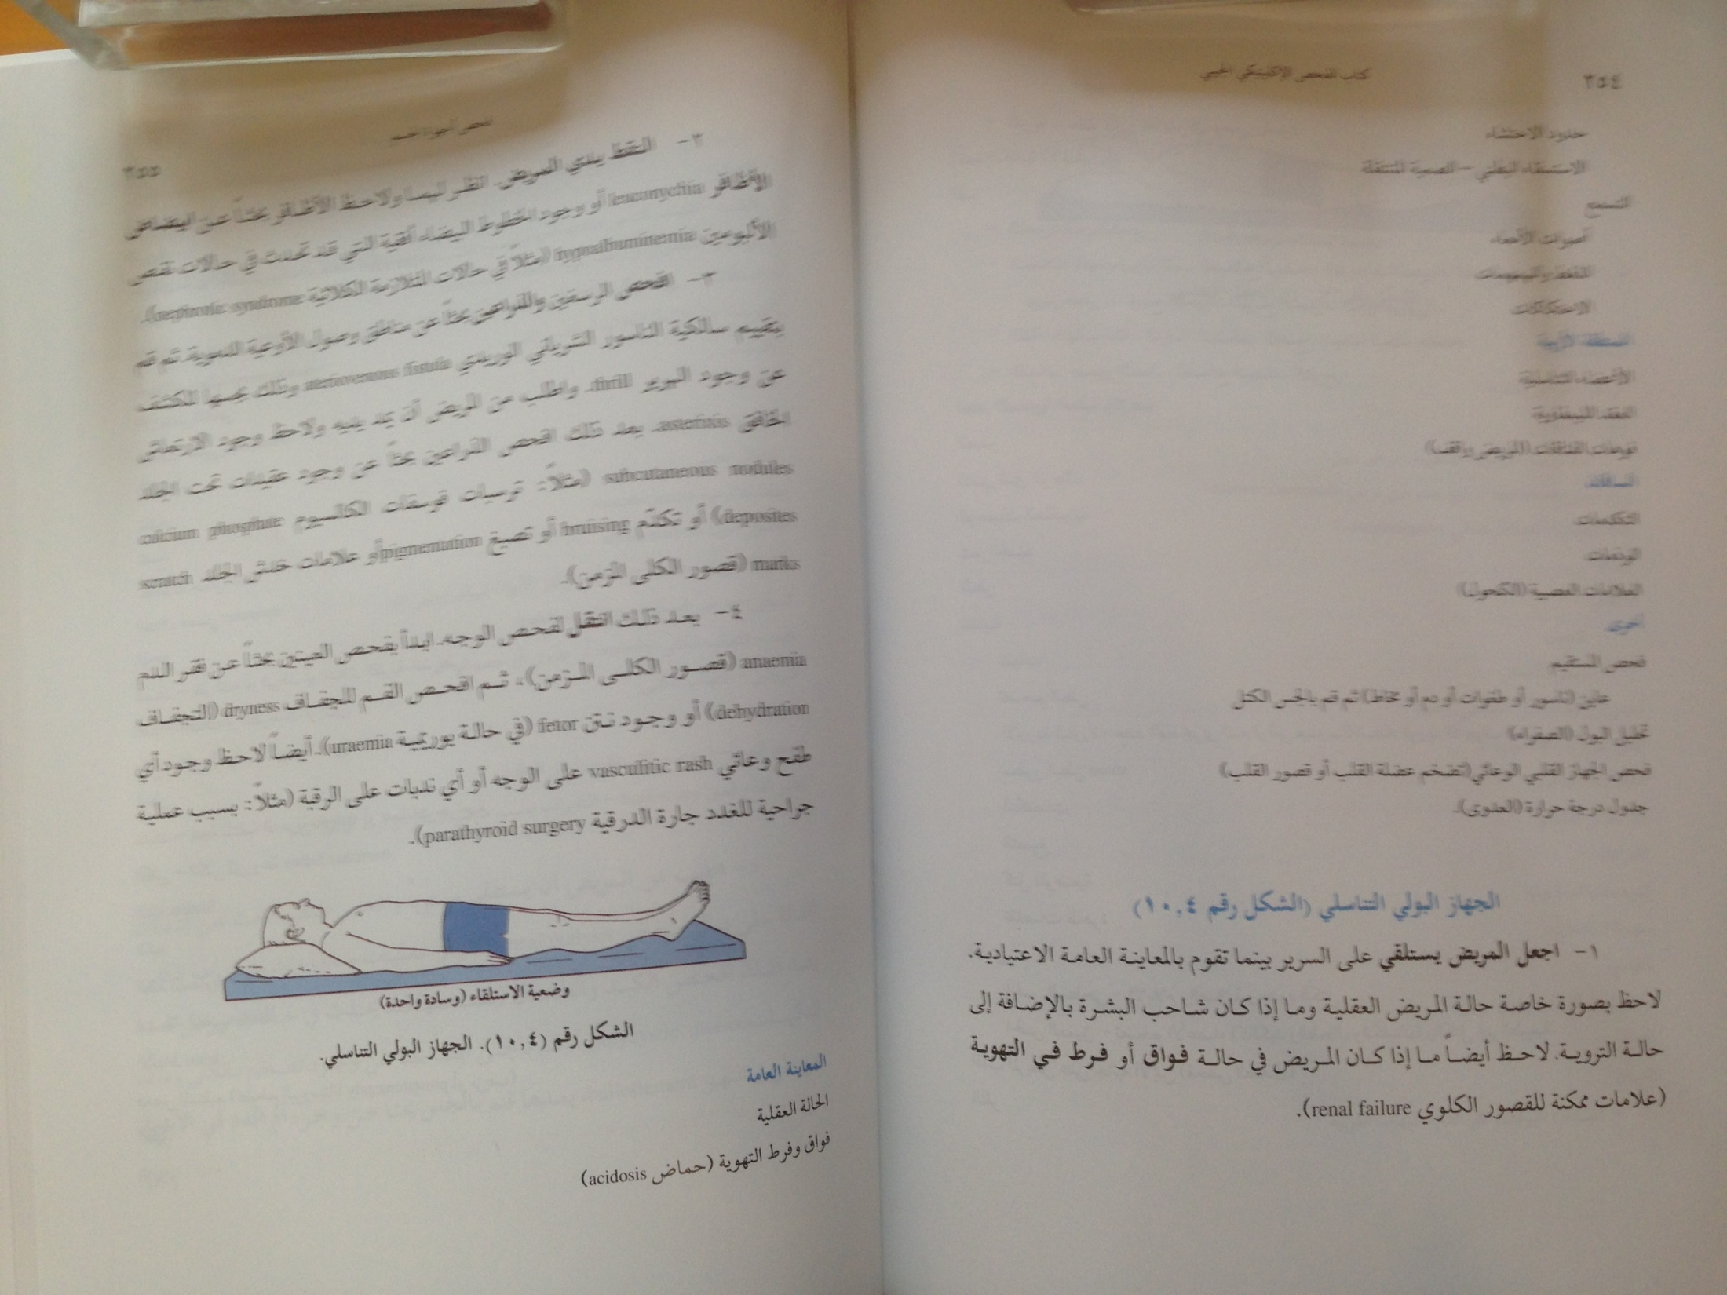

Slide 19
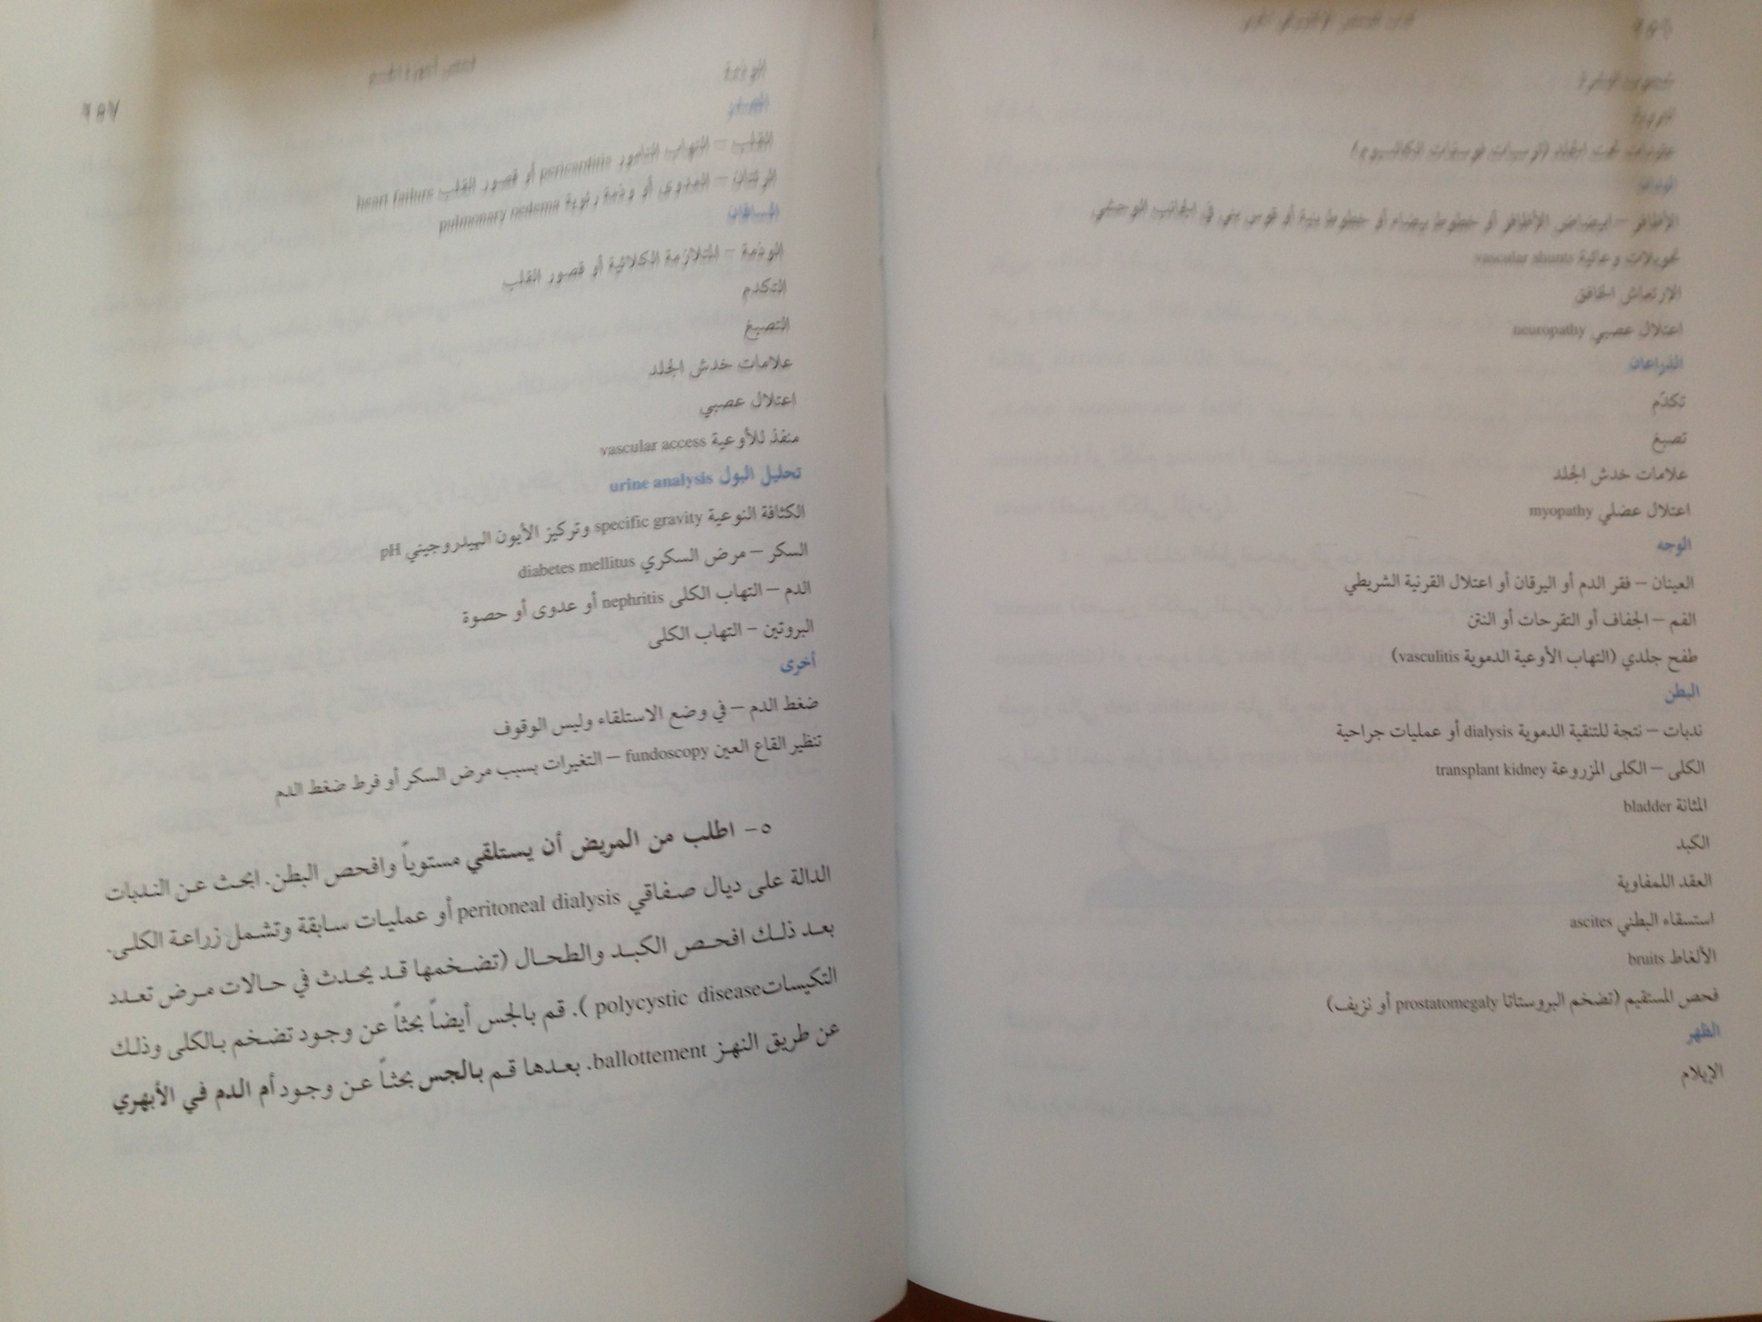

Slide 20
Investigation

Slide 21
Investigation
CBC
Hemoglobin –85g/L
WBC – 5,000/L
Platelet – 120,000/L
MCV – 82 fL
Biochemistry (Repeated)
NA – 132 mmol/L
K – 6.4 mmol/L
Cr – 320 μmol/L- eGFR =18 ml/min
Urea – 24 mmol/L

Slide 22
Investigation
Ca – 1.9 mmol/L
PO₄ – 3.9 mmol/L
Albumin – 29 g/L
Uric acid - 690 mmol/L
Bicarbonate 14 mmol/L
Chloride 105 mmol/L

Slide 23
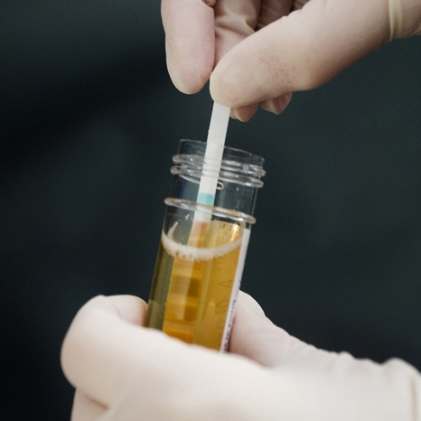
Investigations
Urine Analysis
pH - 6
Urine RBC = negative
WBC – 5 cu/L
Protein = ++ve
Specific gravity – 1010
Broad waxy cast
Urine albumin creatinine ratio
24 hour urine collection
Creatinine clearance
Proteinuria

Slide 24
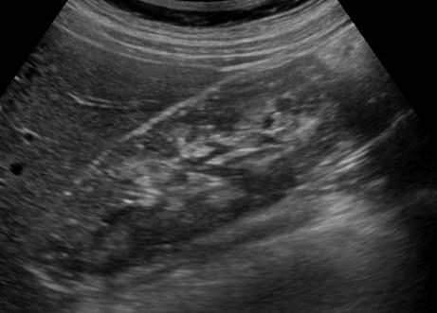
Investigation
Normal size kidneys – 12 cm
Normal Echogenicity

Slide 25
Diagnosis
CKD
- cause possible hypertension & DM Nephropathy
-stage G 4 (eGFR 18 ml/min)
A +3
Hyperkalemia
Metabolic acidosis –high anion gap
Anemia
Hypocalcemia
Hyperphosphatemia
Hyperuricemia
Diabetic Neuropathy and Retinopathy

Slide 26
Prevalence of CKD
CKD in aged ≥20 yrs is >10% -18%
. The prevalence of CKD increases with age:
4% at age 29-39 y
47% at age >70 y

Slide 27
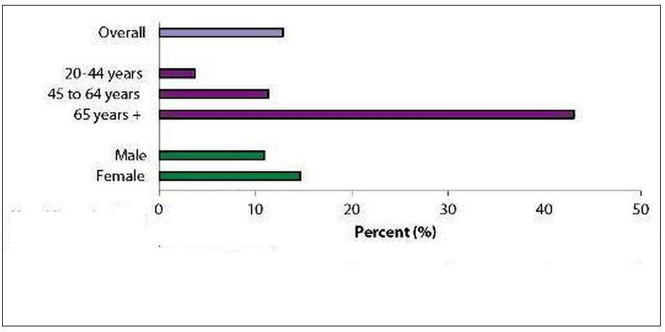
Prevalence of CKD

Slide 28
Prevalence of CKD
Prevalence of CKD in Saudi Arabia – 5-8%
Prevalence of ESRD in Saudi Arabia-19,527
Hemodialysis – 12,844
Peritoneal dialysis – 1,327
Renal Transplantation – 5,356

Slide 29
Dialysis Population-Current and Projected (1995-2015)
Saudi J Kidney Dis Transplant 2012;23 (4):881-889

Slide 30
Risk Factors CKD
Diabetes Mellitus 30%
Hypertension 25%
Old age 50%
Low GFR AKI
Obesity
Cardiovascular disease
NSAID
Family history
Smoking

Slide 31
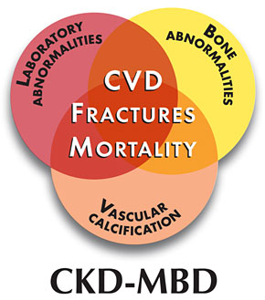
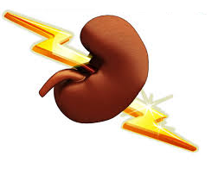
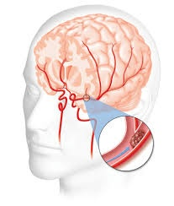
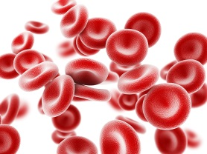
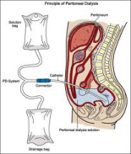
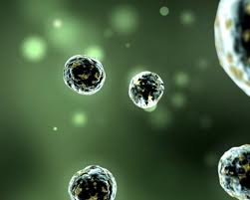
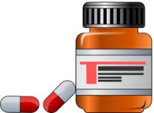
CKD Complications and Managements
Cardiovascular Disease
Mineral
and
Bone Disorder
Acute coronary syndrome
Heart failure
Heart rhythm disturbances
AKI
Stroke
Acidosis
pH
Anemia
ESRD
Infection
Drug Dosing
Recognized as the 9th leading cause of death in the United States

Slide 32
Mineral abnormalities of Chronic Kidney Disease (CKD)
↓GFR
↓25(OH) Vitamin D
↑Phosphorus
↑ FGF 23
↓1,25(OH) Vitamin D
↓Calcium
↑PTH

Slide 34
Chronic Kidney Disease
Kidney damage
Structural abnormalities
GFR < 60 ml/min/1.73 m²
Functional abnormalities
for ≥3 months
Criteria for CKD (either of the following present for >3 months)
Markers of kidney damage (one or more) | Albuminuria (AER ≥30mg/24 hours; ACR≥30mg/g [≥3mg/mmol])
 | Urine sediment abnormalities
 | Electrolyte and other abnormalities due to tubular disorders
 | Abnormalities detected by histology
 | Structural abnormalities detected by imaging
 | History of kidney transplantation
Decreased GFR | GFR <60 ml/min/1.73 m² (GFR categories G3a–G5)
Abbreviations: CKD, chronic kidney disease; GFR, glomerular filtration rate.

Slide 35
KDIGO recommendation -classified based on:
Cause
GFR category
Albuminuria category (CGA)

Slide 36
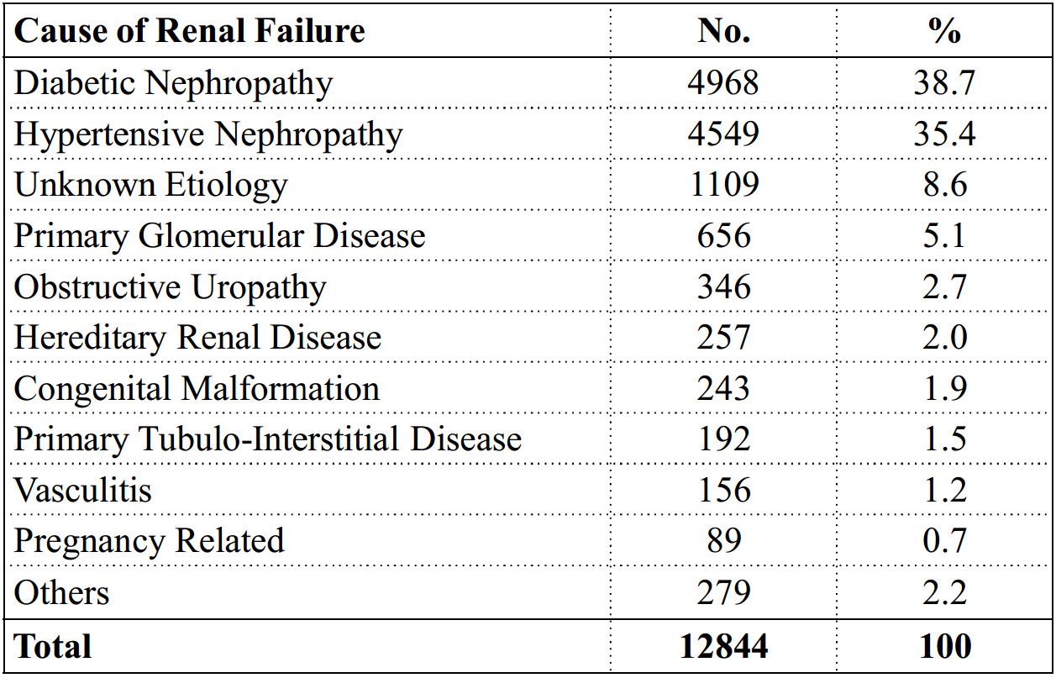
Causes of End-Stage Renal Disease in Hemodialysis Patients in Saudi Arabia- 2012

Slide 37
GFR Categories in CKD
GFR category | GFR (ml/min/1.73 m²) | Terms
G1 | > 90 | Normal or high
G2 | 60-89 | Mildly decreased*
G3a | 45-59 | Mildly to moderately Decreased
G3b | 30-44 | Moderately to Severely decreased
G4 | 15-29 | Severely decreased
G5 | <15 | Kidney failure
* Relative to young adult level
In the absence of evidence of kidney damage, neither GFR category G1 or G2 fulfill the criteria for CKD.

Slide 38
CKD Classification Estimation and Measurement of GFR
Estimate and/or Measure GFR
Filtration Markers (Endogenous)
Creatinine Clearance (CrCl)
eGFR equations
eCKD- EPI cr
eCKD-EPI-cyc
Filtration Markers (Exogenous)
Inulin, iothalamate, EDTA, diethylene triamine petaacetic acid, iohexol
Cystatin C
Cr CL is not measured GFR

Slide 39
CKD Classification Estimation and Measurement of GFR
Estimate and/or Measure GFR
Filtration Markers (Endogenous)
Creatinine Clearance (CrCl)
eGFR equations
eCKD- EPI cr
eCKD-EPI-cyc
Cystatin C

Slide 40
CKD Classification Estimation and Measurement of GFR
Cystatin C
Virtually found in all tissues and body fluids
Potent inhibitor of lysosomal proteinases
Important extracellular inhibitors of cysteine proteases

Slide 41
Calculators

Slide 42
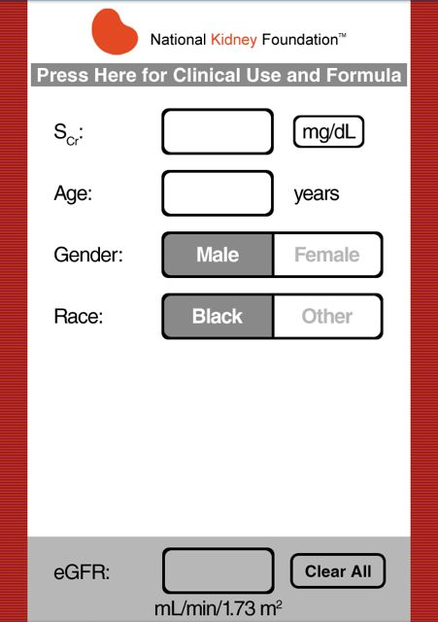
CKD – EPI Calculation

Slide 43
MDRD Calculation

Slide 44
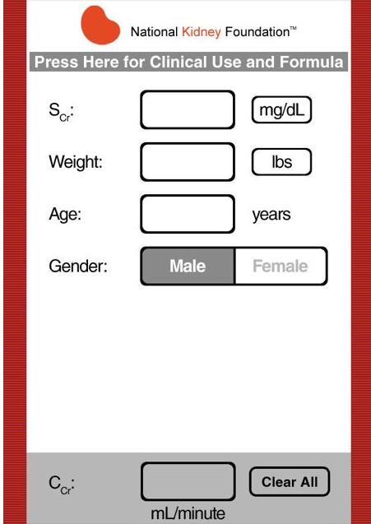
Cockcroft-Gault Formula GFR Calculation

Slide 45
Albuminuria categories as follows:
*note that where albuminuria measurement is not available, urine reagent strip results can be substituted
Albuminuria categories in CKD
Category | AER (mg/24 hours) | ACR (mg/mmol) | ACR (mg/g) | TERMS
 |  | approximate | equivalent
A1 | < 30 | <3 | <30 | Normal to mildly increased
A2 | 30-300 | 3-30 | 30-300 | Moderately increased*
A3 | >300 | >30 | >300 | Severely increased**
*Relative to young adult level
** Including nephrotic syndrome (albumin excretion usually > 2200 mg/24 hours
[ACR .2220/g; >220 mg/mmol])1
Kidney International Supplements (2013) 3, 5-14

Slide 46
Persistent albuminuria categories Description and range
Guide to Frequency of Monitoring
(number of times per year) by
GFR and Albuminuria Category
A1 | A2 | A3
Normal to Mildly Increased | Moderately Increased | Severely Increased
< 30 mg/g < 3 mg/mmol | 30-300 mg/g 3-30 mg/mmol | >300 mg/g >30 mg/mmol
GFR categories (ml/min/1.73 m² Description and Range
G1 | Normal or high | > 90 | 1 if CKD
G2 | Mildly decreased | 60-89 | 1 if CKD
G3a | Mildly to moderately Decreased | 45-59
G3b | Moderately to severely decreased | 30-44
G4 | Severely decreased | 15-29 |  | 3
G5 | Kidney Failure | <15
Green low risk (if no other markers of kidney disease, no CKD); Yellow: moderately increased risk; Orange: high risk; Red: very high risk.
Kidney International Supplements (2013) 3, 5-14

Slide 47
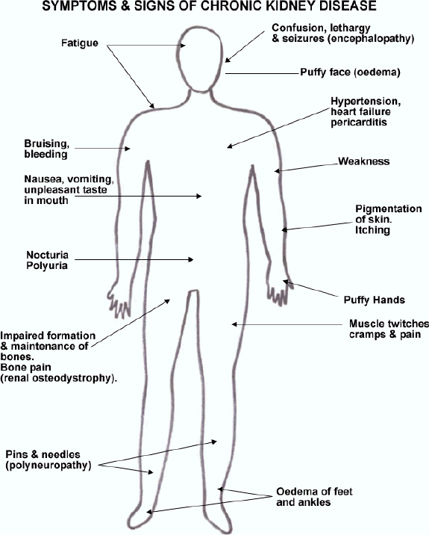
Signs and Symptoms
Hyperparathyrodism
,Epistaxis,
Anemia (Musocal pallor)
Plural effusion, plural edema
Bruising
Amenorrhea
Impotence Infertility

Slide 48
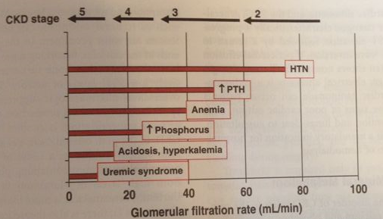
Glomerular Filtration Rate mL/min

Slide 49
Diagnosis of CKD
Basic Laboratory studies used in the diagnosis of CKD can include the following:
Complete blood count (CBC)
Biochemistries(Na, K, Urea, Cr, HCO₃, Ca, PO3, Uric, Albumin, Alk ph)
Urinalysis
24 hour urine collection Creatinine clearance and proteinuria
Urine albumin:creatinine ratio
Glucose
Lipid profile:
increased risk of cardiovascular disease

Slide 50
Diagnosis of CKD
Laboratory studies used in the diagnosis the cause of CKD
ANA
HBsAg
HCV.
C₃,C₄
HbA1c
Investigation used in the diagnosis the complications of CKD
PTH
VIT D₃
ECH
ECG

Slide 51
Diagnosis of CKD
Different
Acute Kidney Injury form
CKD
Reversible factors

Slide 52
Reversible Causes of Kidney Injury
Reversible Factors | Diagnostic Clues
Infection | Urine culture and sensitivity tests
Obstruction | Bladder catheterization, then renal ultrasound
Extracellular fluid volume depletion | Orthostatic blood pressure and pulse: ↓blood pressure and ↑pulse upon sitting up or standing from a supine position
Hypokalemia, hypercalcemia, and hyperuricemia (usually >15 mg/dL) | Serum electrolytes, calcium, phosphate, uric acid
Nephrotoxic agents | Drug history
Hypertension | Blood pressure, chest radiograph
Congestive heart failure | Physical examination, chest radiograph

Slide 53
Management of CKD
The medical care should:
Delaying or halting the progression of CKD
Treatment of the underlying condition
Treating the complications
Timely planning for long-term for RRT

Slide 54
BP control
Hyperlipidemia
Correct Acidosis
Diet
Protein, PO3 & salt
Prevention progress of CKD
Glycemic Control
Proteinuria& RAAS

Slide 55
Target HbA1c – KDIGO Clinical Practice Guideline for the Evaluation and Management of CKD - 2012
Individualize | Target HbA1c
Patient with comorbidities or limited life expectancy and risk of hypoglycemia | HbA1c >7.0%-8%
Young patient, recent Diabetes Mellitus | ~7.0%

Slide 56
Target Blood Pressure in CKD
Diabetics and Non-diabetics
Albuminuria | Target BP | Drug of choice
A1 <30 mg/d | ≤140/90 | CBC, Diuretic, RAAS
A2 >30 mg/d | ≤ 130/80 | ARB or ACE-I

Slide 57
Proteinuria control in CKD
Diabetics and Non-diabetics
Abumineria | Causes of Renal Disease | Drug of choice
A2 or >30-300 mg/d | DM | ARB or ACE-I
A3 or >300mg/d | Non DM CKD | ARB or ACE-I
Notes:
Recommend not using an angiotensinconverting
enzyme inhibitor (ACE-I) or an
angiotensin receptor blocker (ARB) for the
primary prevention of DKD in normotensive
Suggest using an ACE-I or an ARB in
normotensive patients with diabetes and
albuminuria levels >30 mg/g who are at high
risk of DKD or its progressionnormoalbuminuric patients with diabete

Slide 58
Renal Diet
Low salt diet – 3 g/day
Low potassium diet
(2g-2.5 g), half of normal intake
Low protein diet - 0.6 to 0.8 g/kg per day
Low phosphorous diet – 800 – 1000 mg/day
Water intake – daily water intake 2 L
Restricted Magnesium

Slide 59
CKD Management In Adults
Treatment of hyperlipidemia to target level
Avoidance of nephrotoxins including:
Intravenous (IV) radiocontrast media
Nonsteroidal anti-inflammatory agents (NSAIDs)
Aminoglycosides

Slide 60
CKD Management In Adults
Vaccination
Preserve both arm for fistula
Early refer to nephrologist

Slide 61
CKD Management In Adults
CKD-MBD:
Vitamin D supplements or vitamin D analogs are given only if:
Documented deficiency
To suppress elevated PTH

Slide 62
Treatment of Complications
Volume overload:
restrict SALT
loop diuretics
Metabolic acidosis:
oral alkali supplementation

Slide 63
Treatment of Complications
Anemia: hemoglobin level ↓10 g/dL –
check iron -iron Tablet or IV
erythropoiesis-stimulating agents (ESAs)
epoetin alfa
darbepoetin alfa
Methoxy polyethylene glycol-epoetin beta(Mircera)
Hyperkalemia
Low K Diet
Resonium Ca ,Na resonium
Hyperphosphatemia
dietary phosphate binders (Ca Carbonate,Ca Acetate,Sovlomier,lanthium)
dietary phosphate restriction
Hypocalcemia:
calcium supplements with or without calcitriol
Hyperparathyroidism:
Calcitriol
vitamin D analogs

Slide 64
Treatment of Complications
Uremic manifestations:
Long-term renal replacement therapy
hemodialysis,
peritoneal dialysis
renal transplantation

Slide 65
Indications for renal replacement therapy
Severe metabolic acidosis
Hyperkalemia
Intractable volume overload
Pericarditis
Uremic Symptoms
Encephalopathy
Failure to thrive and malnutrition
Peripheral neuropathy
Intractable gastrointestinal symptoms
In asymptomatic patients
GFR of 5-9 mL/min/1.73 m²

Slide 66
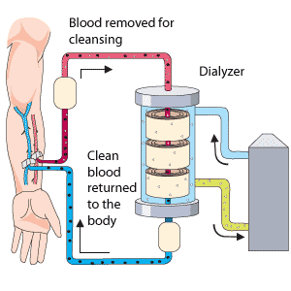
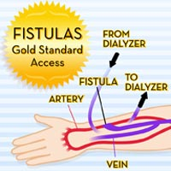
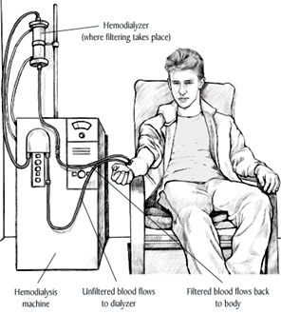
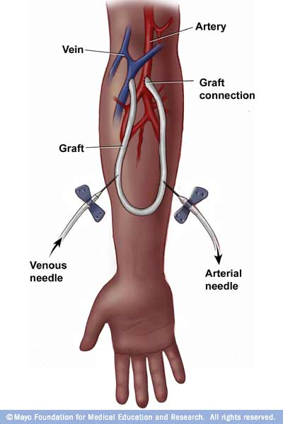
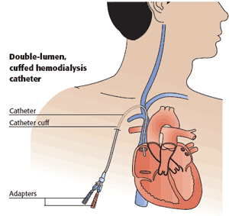
Hemodialysis

Slide 67
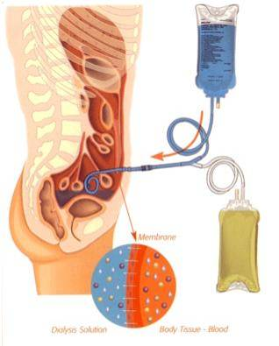
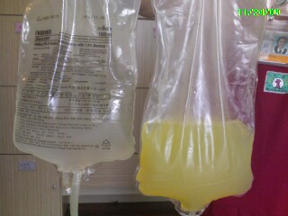
Peritoneal Dialysis

Slide 68
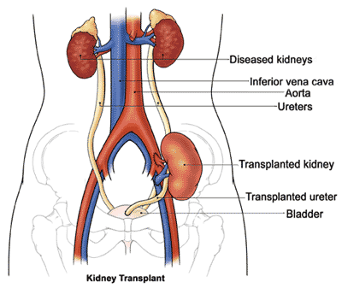
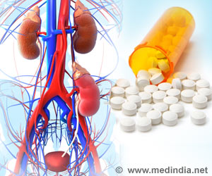
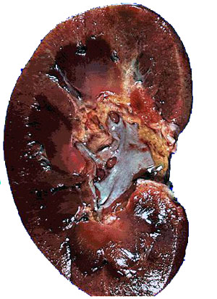
Renal Transplantation
Renal Transplant Medication
Renal Transplant Rejection

