Slide 1
CASE

Slide 2
45 YEARS OLD Saudi lady
Fatigue
Tiredness
Increased skin pigmentation

Slide 3
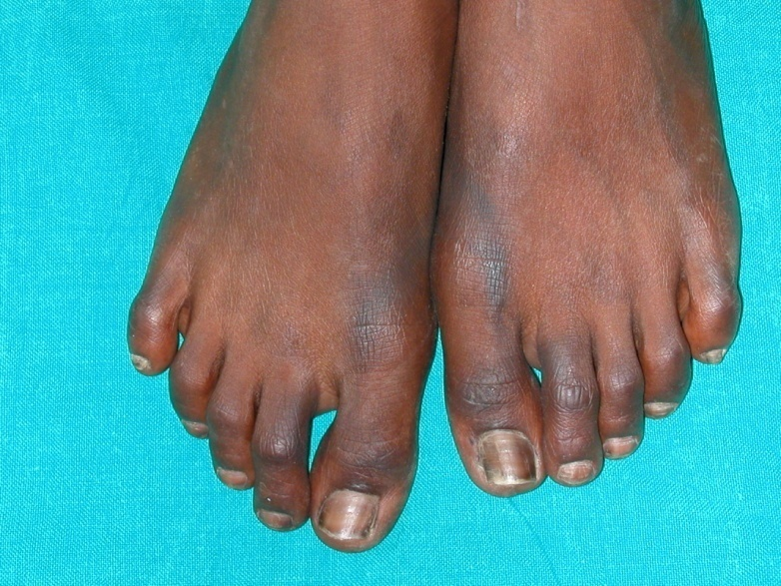

Slide 4
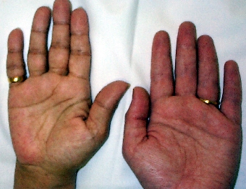

Slide 5
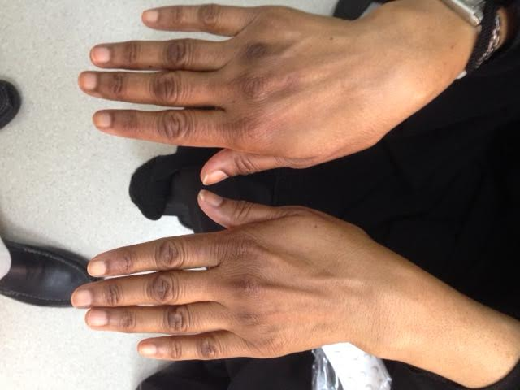

Slide 6
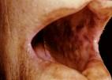

Slide 7
Typical electrolytes
Na 126
K 5.5
Cl 89
Bicarb 20

Slide 8
What about glucose ! ?

Slide 9
Causes of fasting hypoglycemia
EX
P
L
A
I
N

Slide 10
Fasting Hypoglycemia
Exogenous insulin or OHA
Pituitary disease
Liver disease
Addion’s disease
Insulinoma
Neoplasm

Slide 11
CBC
NEUTROPENIA
RELATIVE LYMPHOCYTOSIS
EOSINOPHILIA

Slide 12
TREATMENT
IV SALINE +GLUCOSE
IV STEROIDS

Slide 13
PREVENTION
Extra steroids at times of stress

Slide 14
CASE

Slide 15
35 YEARS OLD LADY ( post thyroid surgery)
Fever : 40c
Agitation
Tachycardia : 140 /min

Slide 16
MANAGEMENT
IODIDE : to block release of thyroid hormone
ANTI THYROID DRUGS : to prevent thyroid hormone synthesis
BETA BLOCKERS : to control signs and symptoms induced by increased sympathetic activity
STEROIDS : to prevent conversion of T4 to T 3
ANTI PYRETICS
SUPPORTIVE CARE

Slide 17
CASE

Slide 18
81 YEARS OLD LADY
FOUND IN COMA
TEMPERATURE : VERY LOW
PULSE : 45 /MIN

Slide 19
WHAT OTHER CLINICAL FINDINGS MAY BE FOUND
Dry skin
Loss of eyebrows
Big tongue
Look for a thyroidectomy scar

Slide 20
DO NOT FORGET BREATHING
HYPOVENTILATION IS A BIG PROBLEM
TYPICAL ABG’S :
PCO2 : HIGH
PO2 : LOW
PATIENTS MAY NEED ASSISSTED VENTILATION

Slide 21
sodium
Look for hyponatremia
High cholesterol
High CPK

Slide 22
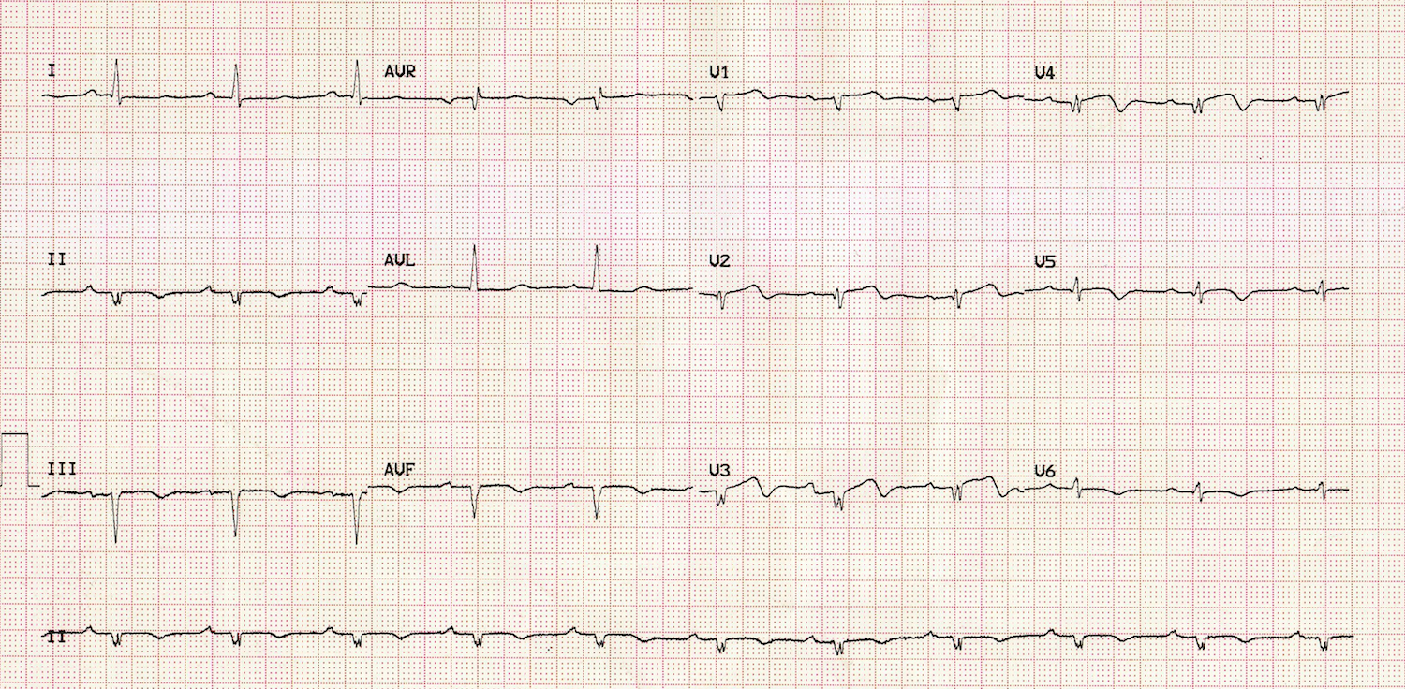
ECG : LOW VOLTAGE & BRADYCARDIA

Slide 23
TREATMENT OF MYXEDEMA COMA
VENTILATION
IV THYROXINE
IV STEROIDS
WARM PATIENT

Slide 24
SEVERE HYPOCALCEMIA
TETANY
CONVULSIONS ESP. IN THE YOUNG
ECG CHANGES ( QT INTERVAL)

Slide 25

PROLONGED QT INTERVAL

Slide 26
TREATMENT OF SEVERE HYPOCALCEMIA
IV CALCIUM GLUCONATE SLOWLY AND UNDER ECG MONITORING

