Slide 1
Approach to arthritis
DR.AFSAR SAYEEDA
MRCP,FRCP(UK)
CONSULTANT & HEAD,CTU
DEPT OF MEDICINE, KKUH

Slide 2
Outline
Rheumatological history and clinical examination
Inflammatory /non-inflammatory arthritis
Mono/ Oligo arthritis
Polyarthritis
Soft tissue rheumatism
Lab investigations
Synovial fluid analysis
Imaging

Slide 3
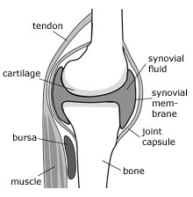
Normal Joint..

Slide 4
Evaluation of a patient with arthritis in rheumatology opd
Articular or non articular
Inflammatory or non inflammatory
Acute or chronic
Monoarticular or polyarticular
Extra articular signs

Slide 5
ARTICULAR
- Deep or diffuse pain.
Painful or limited range of movemnt - both active and passive
Swelling of joint
Crepitation.
Joint instability.
Locking of joint.
Deformity.
NONARTICLAR
localised pain
Point or local tenderness
Painful active movements but not on passive
Physical findings are remote from joint capsule.
swelling,crepitation,joint instability, deformity are rare.

Slide 6
arthritis
inflammatory
Non- inflammatory
Cardinal signs
Systemic symptoms
Stiffness- >1 hr
- prolon. rest
Lab evidences
ESR
CRP
NO signs
Stiffness-<60 mnt
- intermittent
-brief rest
Trauma,rept.use,
Degenerative,tumor

Slide 7
The Rheumatologic History
h/o presenting complaints - Onset
- progression
- distribution of disease
- stiffness
- aggravating or relieving factor
- diurnal variation
- other systemic feature
- functional disability
General systematic medical history.
Past medical and surgical history.
Family history.
Drug history.

Slide 8
Rheumatic disease signs
Swelling
Posture of joint
Deformity
Warmth
Redness
Tenderness
Limitation of joint movement
Crepitus
Stability
Function

Slide 9
Extra articular signs & symptoms
Constitutional symptoms
Skin rashes
Mucous membrane lesions
Ocular
Nails
Raynauds
Serositis

Slide 10
Chronology of complaints
ONSET- acute- < 6 wks eg.infectious arthritis
crystal arthropathy
reactive arthritis.
Chronic - >6 wks eg. Non inflamatory arthritis (OA)
Inflammatory arthritis(RA)
Fibromyalgia.
EVOLUTION – chronic eg.OA
intermittent eg. Crystal / lymes arthritis
migratory arthritis eg.Rheumaticfever,

Slide 11
Chronology of complaints
C. Extent of articular involvement
- Monoarticular (one joint involved)
- Oligo or pauciarticular (two or three joint)
- Polyarticular (> 3 joints)
D. Distribution of joint involvement
-symmetrical- upper and lower limb eg. RA, SLE
-Asymmetrical-eg. psoriatic arthritis,
spondyloarthropathy,
gout
-Involvement of axial skeletal-eg AS, OA,
RA(only cervical spine)

Slide 12
History and physical examination
no
Trauma/fracture
Soft tissue rheumatism
Is it articular
No
yes
Infectious arthritris
Crystal induced
Reactive arthritis
Acute
> 6 weeks
yes
Chronic
Chronic inflammatory arthritis
yes
no
Chronic noninflamatory arthritis
Signs of inflammation
yes
Joints involved
DIP, CMC1,Hip ,Knee joint
osteoarthritis
1-3
>3
yes
no
no
Psoriatic
Pauci JA
PCP,MCP/MTP
symmetrical
Osteonecrosis
Charcots joint
no
yes
Psoriatic
Reactive
Rheumatoid
SLE/Scleroderma

Slide 13
CAUSES:Mono/ oligo arthritis
Septic Arthritis–Bacteria,fungal,parasitic arthritis
Internal derangement or trauma –Meniscus Injury
–Ligament tears
- hemarthrosis
crystal-induced arthritis
Charcot joint
Psoariatic arthritis
Juvenile Rheumatoid Arthritis(pauci articular)
Mono art.presentation of c/c arthritis
Ischemic bone (avascular necrosis
Neoplasms –Villonodularsynovitis

Slide 14
Septic Arthritis: Risk Factors
Prosthetic hip joint.
Prosthetic knee joint.
Skin Infection.
Joint surgery.
Rheumatoid Arthritis.
Elderly patients over age 80 years old.
Diabetes Mellitus.
Intravenous drug use (unusual joints affected).
Large vein catheterization (unusual joints affected).

Slide 15
CAUSES OF SEPTIC ARTHRITIS
Young sexually active adults
  –Neisseria gonorrhoeae (most common)
    More common in women
  –Staphylococcus aureus
  –Streptococcus
Older adults
  –Staphylococcus aureus(50%)
  –Streptococcus species
-Gram Negative Bacilli

Slide 16
Signs and Symptoms
Rapid onset monoarticular joint inflammation
Joints affected in bacterial infection
    –Septic Knee (50% of cases),hip (children), ankle,
    - shoulder
Joints affected with intravenous Drug Abuse
–SI joint, SC joint.pubic symphysis,vertebral spaces

Slide 17
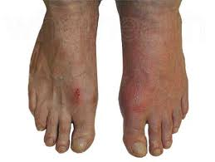
Gout: Uric Acid Crystals
RISK FACTOR
-Obesity
-Diabetes Mellitus
-Hyperlipidemia
-Hypertension
-Atherosclerosis
-Alcohol use
-Thiazide Diuretics
-Renal insufficiency
-Myeloproliferativedisease

Slide 18
GOUT :SIGN AND SYMPTOMS
Acute onset of lower extremity joint pain
  –First Metatarsophalangeal joint (great toe)
    - Affected in 50% of first gout attacks
Fever and chills
Joint Inflammation - Asymmetric joint involvement
        - May only involve one side with the first attack

Slide 19
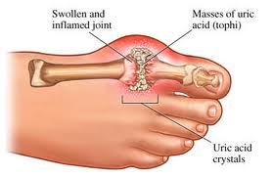
gouty arthritis

Slide 20
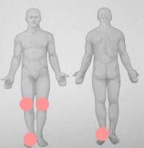
Gout
SynovialFluid
Polarizing Microscopy
Negatively birefringent Needle
shaped Uric Acid crystals
Gram Stain and Culture
Rule out Septic Arthritis

Slide 21
Polyarthritis

Slide 22
Polyarthritis
Acute Polyarthritis
- < 6 wks
- Viral
- Borrelia burgdorferi
Chronic Polyarthritis:
  - >6 weeks
  <60yrs age : RA, SLE, psoriatic arthritis,
  spondyloarthropathies
>60yrs age : crystal induced, OA

Slide 23
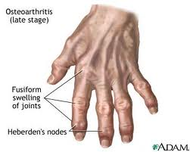
Osteoarthritis
  Most common form of arthritis.
  Associated functional.
  Impairment increases with age.
  Prevalence directly increases with age

Slide 24
PATHOPHYSIOLOGY
Primary lesion resides in the articular cartilage
  –Abnormal cartilage repair and remodeling
  –Chondrocytes proteolytic enzymes
destroy cartilage
    subchondral subchondral
    sclerosis cysts
Marginal osteophytes

Slide 25
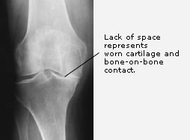
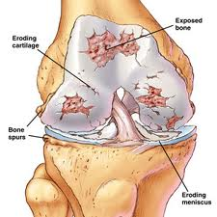
osteoarthritis

Slide 26
Sign and Symptoms
  Pain on motion that worsens with increasing joint usage
  Slowly progressive deformity and possibly pain
  No systemic manifestations
  Associated muscle spasm, contractures and atrophy
Symptoms uncommon before age 40
  Morning stiffness of short duration (<30 minutes)

Slide 27
Distribution of Osteoarthritis
Joints spared
–Wrist
–Metacarpal-phalangeal
(except thumb)
–Elbow
–Ankle
Joints commonly involved
  knee
  hip
  foot
  hand –DIP (Heberden'sNodes)
–PIP (Bouchard's Nodes)
–First CMC jt(thumb)
Cervical and lumbar spine

Slide 28
Rheumatoid Arthritis
Affects all ethnic groups
  Peak incidence 4-6th decades
  Most widely used criteria ACR
  Diagnosis is based on the clinical criterion and cant be made until symptoms present for several
  weeks
positive RF supports Diagnosis (20% are seronegative)

Slide 29
ACR Rheumatoid Arthritis Criteria
Need to have 4 of 7
Morning stiffness:-in and around the joint lasting 1 hr before maximal
improvement.
Arthritis of 3 or more joint area observed by the physician. 14 possible joint
area involved are rt &lt PIP,MCP, wrist, elbow, knee, ankle and MTP joint.
Arthritis of hand joints- wrist,mcp &pip joint.
Symmetrical arthritis.
Rheumatoid nodule.
Serum Rheumatoid factor.
Radiographic changes – erosion or bony decalcification in or adjacent to
involved joints.
Criteria 1 to 5 must be present for at least 6 wks
Criteria 2 to 5 must be observed by physician

Slide 30
New ACR/EULAR RA Criteria
RA can be classifiable or diagnosed with a score ≥6:
Joints (0–5)
  1 large joint 0
  2–10 large joints 1
  1–3 small joints (large jts excluded) 2
  4–10 small joints (large jts excluded) 3
  >10 joints (at least 1 small joint) 5
Serology (0–3)
  Negative RF and negative anti-CCP 0
  Low positive RF or anti-CCP 2
  High positive RF or anti-CCP 3
Symptom duration (0–1)
  <6 weeks 0
  ≥6 weeks 1
Acute phase reactants (APR) (0–1)
  Normal CRP and ESR 0
  Abnormal CRP or ESR 1
Aletaha D. Ann Rheum Dis 2010
Notes:
30
Goal Establish new criteria for classifying early RA Phase I RA patient data from
cohorts. Analyzed at start of MTX. Factor analysis developed 4 discreet domains:
serology, acute phase reactants, joint involvement and distribution, duration of
arthritis
Phase 2:
32 European and USA Rheumatologists, used consensus methodology to refine
factors / approach from phase I, using actual patient vignettes.
Criteria:
2 considered essential
evidence of synovitis
lack of other disease to explain findings
Patients with typical erosions would be classified as having RA.
4 other factors can also help lead to a diagnosis of RA:
pattern of involved joints (number, size, symmetry – 6 different groupings)
serology (either RF / anti-CCP; discussions ongoing about titer and cutoffs)
duration of arthritis (6 weeks as key cutoff point)
acute phase reactants (ESR / CRP > normal -local lab)
Final weighted scoring version presented at ACR2009

Slide 31
Guidelines for classification
Four of the seven criteri are required
to classify a pts is having RA.
Pts with two or more clinical diagnoses
are not excluded.

Slide 32
Distribution of Rheumatoid Arthritis
Affects small and large joints
Typically patient has symmetrical
inflammation in the wrists and/or
MCP joints
Spares DIP
Morning stiffness, inactivity
stiffness.
Acute, severe onset 10-15 %; subacute 20%

Slide 33
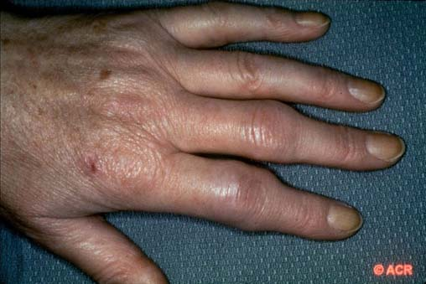
Acute Polyarthritis - RA

Slide 34
DEFORMITIES
Z deformity
Swan neck deformity
Boutonniere deformity
Acute hand deformity: fusiform swelling of fingers due to synovitis of PIPs

Slide 35
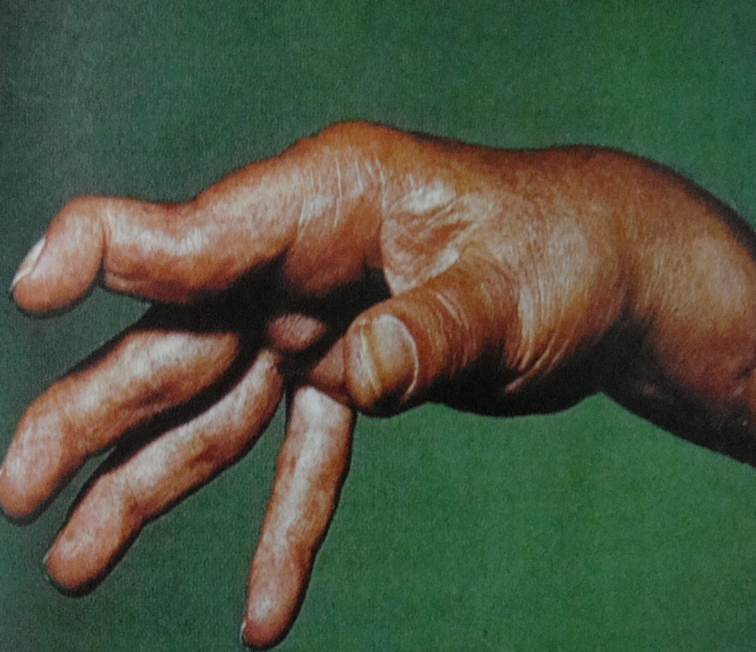
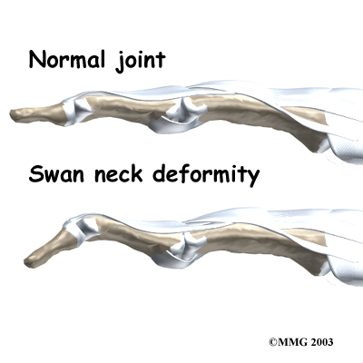
Deformity- ra
Swan neck deformity

Slide 36
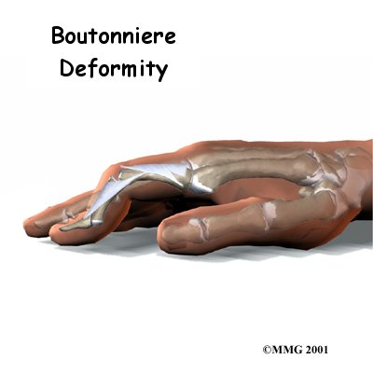

Slide 37
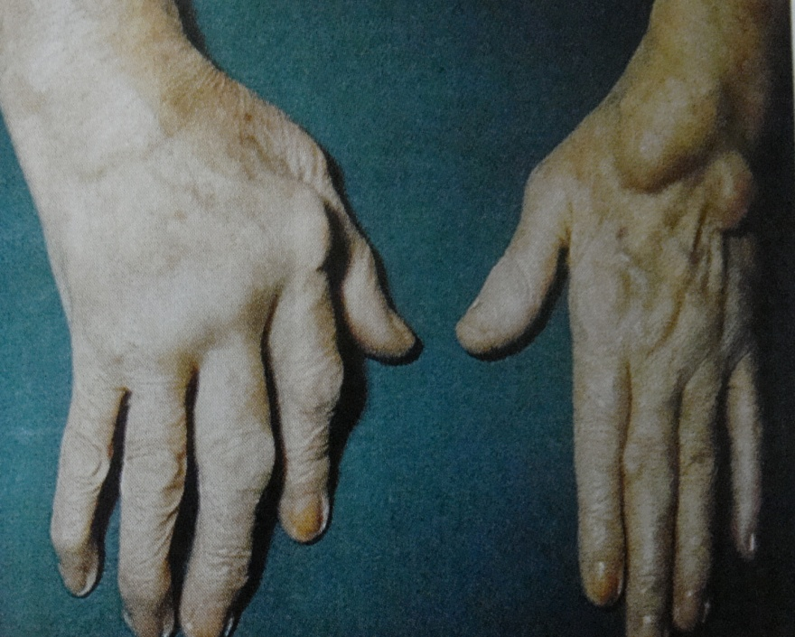
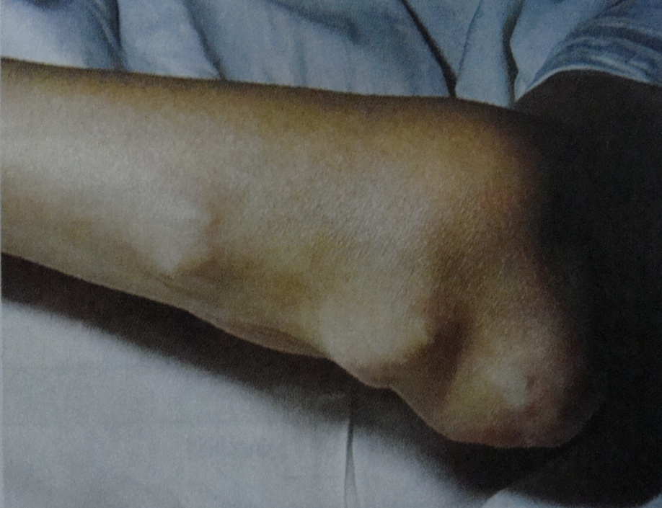
Z - deformity
Subcutaneous nodules

Slide 38
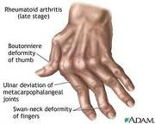

Slide 39
RF may be negative at onset and may remain negative in 15-20%!
RA is a clinical diagnosis, no laboratory test is diagnostic, just supportive!

Slide 40
Systemic erythematosus Lupus
Immune complex deposition disease, involving
many organs
Female:Male 10:1
ANA and other criterion will make the diagnosis

Slide 41
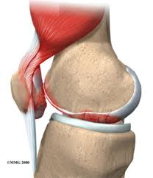
sle- non erosive arthritis
Musculoskeletal manifestation 90%.
Most have arthralgia.
May have acute inflammatory synovitis RA-like. Hand ,wrist & knee.
Soft tissue inv- myositis, tendonitis.
Do not develop erosions.
Other clinical features help with DD: malar rash, photosensitivity, rashes, alopecia, oral ulceration.

Slide 42
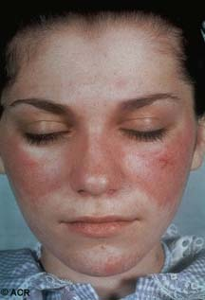
Butterfly Rash – SLE

Slide 43
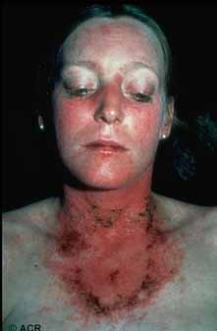
Photosensitivity

Slide 44
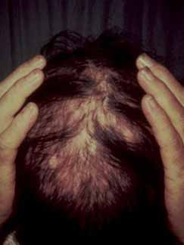
Alopecia - SLE

Slide 45
Criterion For Diagnosis of SLE
Need 4 out of 11 to make the diagnosis
MalarRash :Rash spares nasolabialfolds
Discoid Rash
Photosensitivity
Oral Ulcers: Painless observed by physician
Arthritis: Nonserosive 2 or > joints
Serositis: Pleuritis, Pericarditis
Renal Disorder: Proteinuria> o.5g/day or casts
Neurologic Disorder: seizures/ psychosis
HematologicDisorder: Hemolysis, Leukopenia<4000,
Lymphopenia <1500,Thrombocytopenia <100000
ANA
Immunologic disorder: Anti-DNA, Anti-Sm, APS

Slide 46
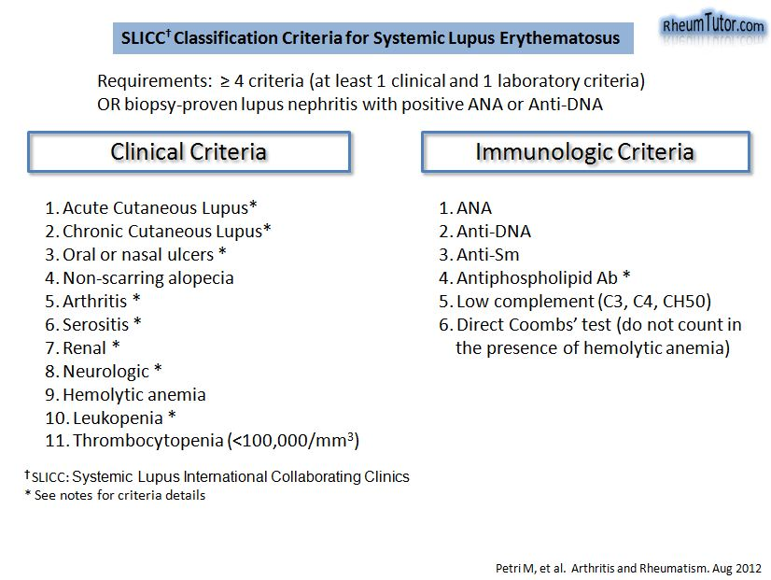

Slide 47
Arthritis of Rheumatic Fever
Etiology: Streptococcus pyogenes (group A); immune response to antecedent infection
Migratory polyarthritis, large joints: knees, ankles, elbows, wrists.
Major manifestations: carditis, polyarthritis, chorea, erythema marginatum, subcutaneous nodules.

Slide 48
Seronegative spondoarthropathies
Psoriatic arthritis
Reactive arthritis
Enteropathic arthritis
Ankylosing sponylosis

Slide 49
features of spondoarthropathies
Absence of RA Factor,subcut nodules
Sacroiliatis/spondylitis +
Assymetric peripheral joints
Extra articular- ocular,oral,skin,enthesitis
Familial aggregation
HLA-B27 +

Slide 50
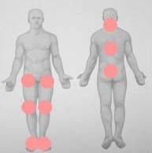
Distribution of spondoarthropathies
r
Asymmetric arthritis
Axial spine & lower limb joints
Soft tissues involvment
Bursitis,achilles tendonitis,epichondylitis,plantar fascitis

Slide 51
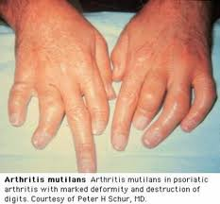
Psoriatic arthritis
Psoriasis precedes in 60-70%
Wright & Molls 5 patterns of arthropathy
Nail changes in 90%
INVOLVEMENT OF DIP joints
Dactylitis,enthesitis,tenosynovitis
Arthritis mutilans

Slide 52
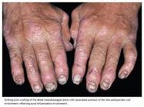
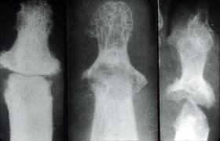
Psoriatic arthritis

Slide 53
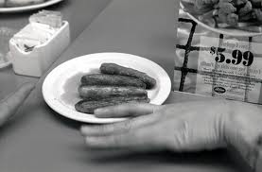
Reactive arthritis
Acute ,painful,assymetric
Knee,ankle ,ST,MT ,IP joints
Dactylitis
Constitutional symptoms
Tendonitis,enthesitis,fascitis
Ocular,muco-cutaneous lesions

Slide 54
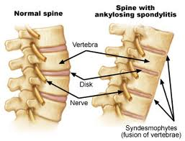
Ankylosing spondylitis
Sacroiliatis
Syndesmophytes
Bamboo spine
Inflamm. Backache
Age<50
Improves with exercise not with rest

Slide 55
Enteropathic arthritis
Ankylosing spondylitis
Peripheral arthritis-acute oligo & chronic polyarthritis
Joint invl same in UC &CD
Erosion and deformity rare

Slide 56
Soft tissue rheumatism
Most common cause of MSK pain
Enthesopathy,bursitis,tedonitis,tenosynovitis
Mostly associated with fibromyalgia
Improves with local steriod inj.

Slide 57
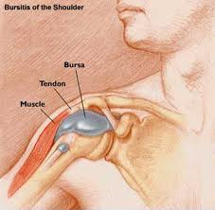
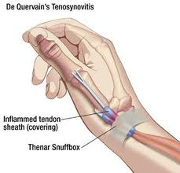
SOFT TISSUE RHEUMATISM

Slide 58
Lab investigations
Routine blood tests
ESR,CRP
Rheumatoid factor,CCP
ANA
Autoimmune antibodies
Complement levels

Slide 59
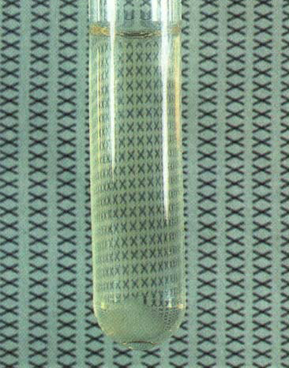
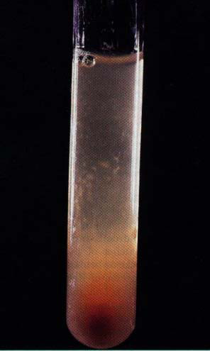
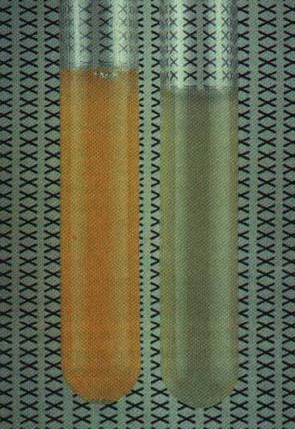
SYNOVIAL FLUID EXAMINATION

Slide 60
INTERPRETATION OF SYNOVIAL FLUID EXAMINATION
Appearance
Viscocity
WBC count
Crystal identification
Gram stain,culture if neded
Is the effusion is hemorrhagic?
Consider
Trauma or mechanical derangement
Coagulopathy
Neuropathic arthropathy
Strongly consider synovial fluid examination if
Monoarthritis
Trauma with joint effusion
Mono arthritis in a pt. with chronic arthritis
Suspicion of joint infection,crystal induced arthritis,heamarthrosi
Inflammatory or non inflammatory articular condition
Is wbc . 2000/ μl ?
Consider noninflamm. Condition
Osteoarthritis
Trauma
Other
Consider inflamm. Or septic arthritis
is the % PMNs.75% ?
Are crystals present?
Crystal identification for specific diagnosis
Gout or pseudogout
Consider noninflamm articular conditions
Osteoarthrutis
Trauma
other
Consider other inflamm. Or septic arthritides.gram stain ,culture
Is WBC .50000/μl ?
Probable inflamm arthritis
Possible septic arthritis

Slide 61
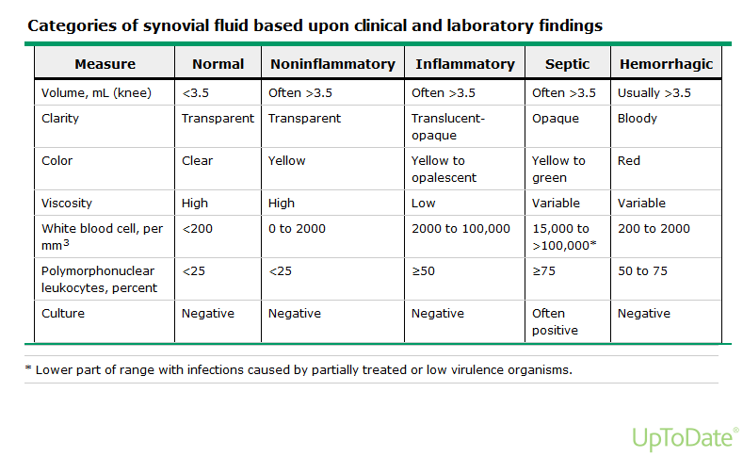

Slide 62
Diagnostic imaging
Plain X-ray- show soft tissue swelling,erosions
they are indicated in patients with a history of trauma or patients who have had symptoms for several weeks. Occasionally, unsuspected bony lesions, such as osteomyelitis or malignancy, may be detected.

Slide 63
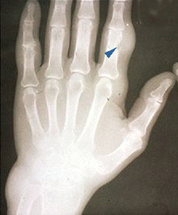

Slide 64
Ultrasonography
CT Scan

Slide 65
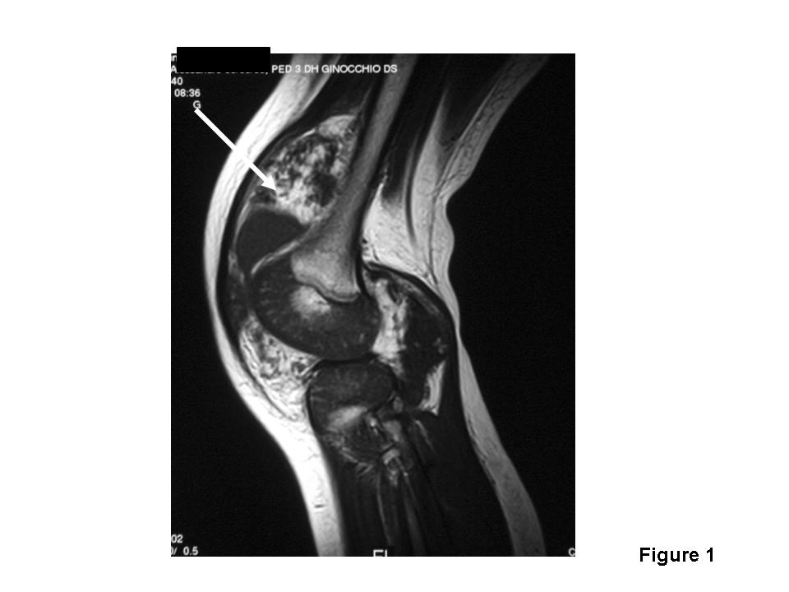
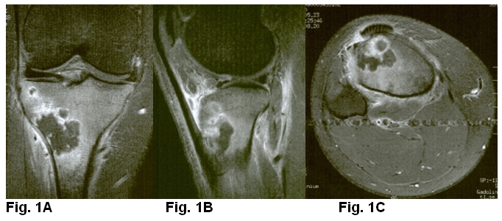
5-MRI:
Magnetic resonance imaging is superior in detecting ischemic necrosis, occult fractures, and meniscal and ligamentous injuries.

Slide 66
6-RADIONUCLIDE SCANS:
Radionuclide scanning can detect infection in deep-seated joints.
7- OTHERS:
Other diagnostic procedures, such as synovial biopsy or arthroscopy, may be useful to rule out deposition diseases (e.g., hemochromatosis, atypical infections) and intra-articular tumors.

Slide 67
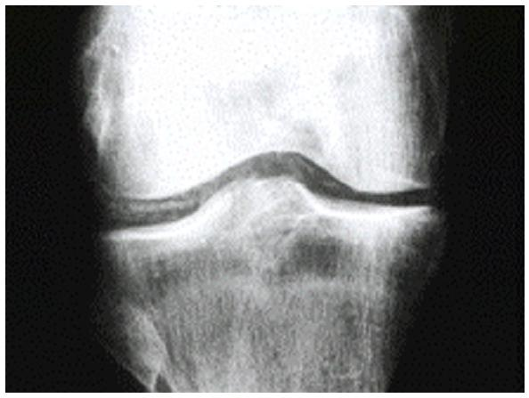
A 67 year old male presents with his first episode of knee pain and swelling together with the following x-ray.
Which of the following investigations is the next investigation indicated diagnostically?
(a) Thyroid function tests
(b) Serum urate
(c) Knee aspiration
(d) Serum iron
(e) Skeletal survey

Slide 68
Which of the following types of joint involvement is not seen in psoriatic arthritis?
(a) Symmetrical small joint arthropathy
(b) Jaccoud’s arthropathy
(c) Sacroiliitis
(d) Monoarthritis
(e) DIP joint arthropathy

Slide 69
ACUTE MONOARTHRITIS
IS SEPTIC UNTIL
PROVEN OTHERWISE !!

Slide 70
THANK YOU

