Slide 1
Obstructive Sleep Apnea
442 Med Course
Prepared by:
Prof. Ahmed BaHammam

Slide 2
Objectives
Obstructive Sleep Apnea
  List the symptoms and associated comorbid conditions seen with OSA.
  Define the polygraphic patterns associated with obstructive sleep disordered breathing.
  Describe the major treatments used for OSA.

Slide 3
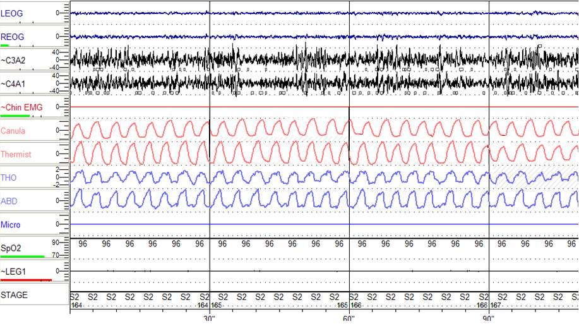
Normal Breathing

Slide 4
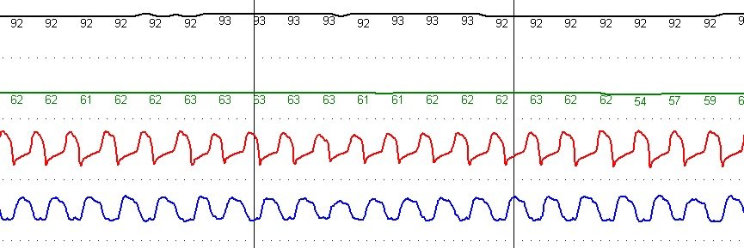
Representative Signal
Normal Breathing
Heart Rate
Nasal Airflow
Effort
← 30 sec epoch →
Oximetry

Slide 5
What is Sleep Disordered Breathing?
Is used to describe a group of disorders characterized by abnormalities of the respiratory pattern or ventilation during sleep.

Slide 6
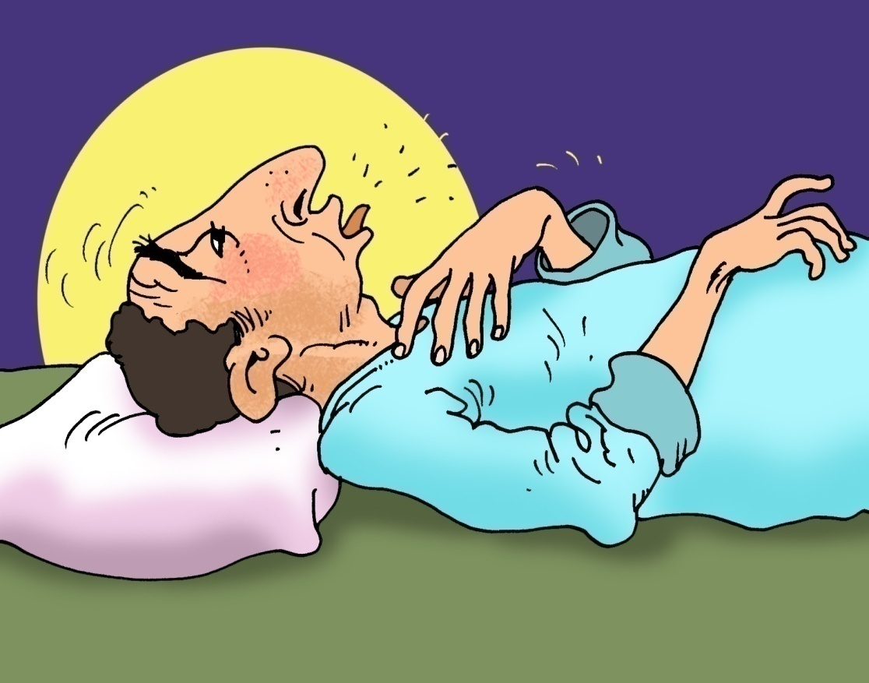
What is Sleep Apnea?
Defined as a cessation of airflow for a minimum of 10 seconds.

Slide 7
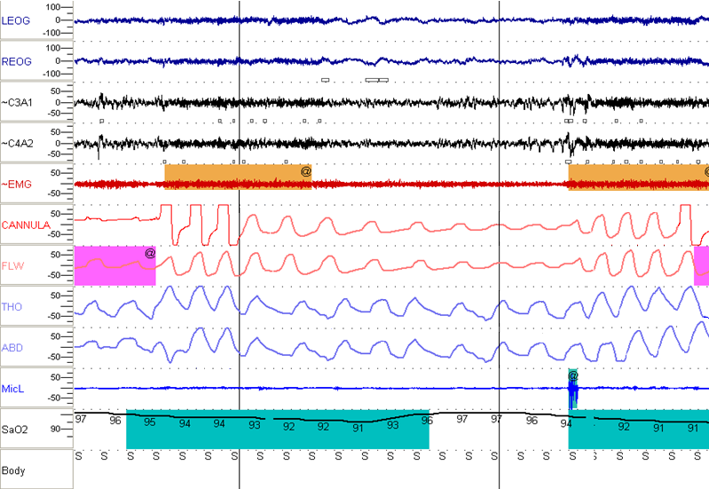
Hypopnea

Slide 8
Categories of Sleep Apnea
Obstructive Events
Central Events
Mixed Events

Slide 9
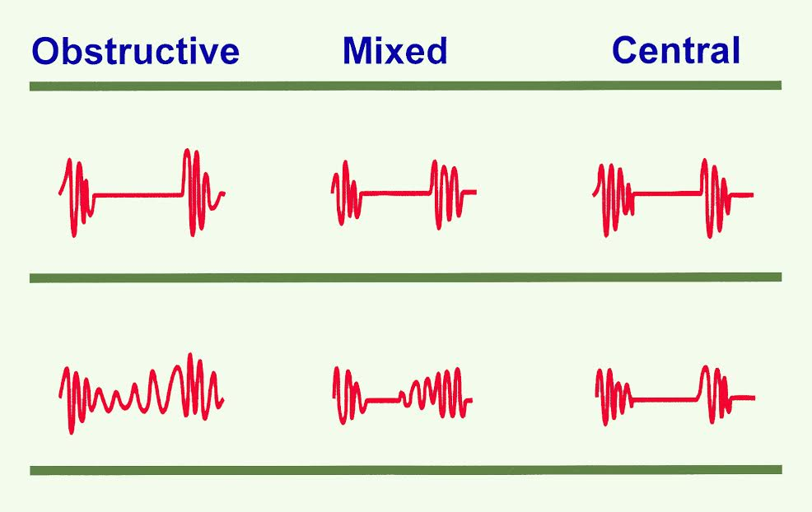
Apnea Patterns
Flow
Effort

Slide 10
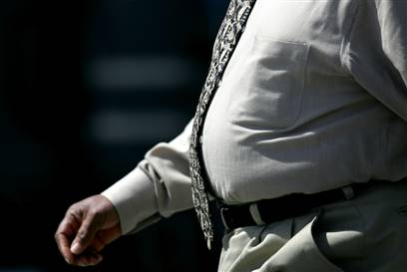
Is it familiar?

Slide 11
A.) What is OSA?
OSA was defined according to the International Classification of Sleep Disorders (ICSD 2013)
AHI ≥5 events/hour with evidence of respiratory effort during all or portion of the event associated with one of the following:
  excessive daytime sleepiness or unrefreshing sleep
  gasping or choking during sleep or
  witnessed apnea or loud snoring
  hypertension, a mood disorder, cognitive dysfunction, CAD, CVA, CHF, Afib, or type 2 DM
(ICSD), 3rd ed. 2013

Slide 12
A.) What is OSA?
OSA was defined according to the International Classification of Sleep Disorders (ICSD 2013)
OR
AHI ≥15 events/hr with evidence of respiratory effort during all or portion of the event
These often lead to:
    Acute derangements in blood gas disturbances.
    Surges of sympathetic activation.
    Periodic arousal from sleep (fragmented sleep).
(ICSD), 3rd ed. 2013

Slide 13
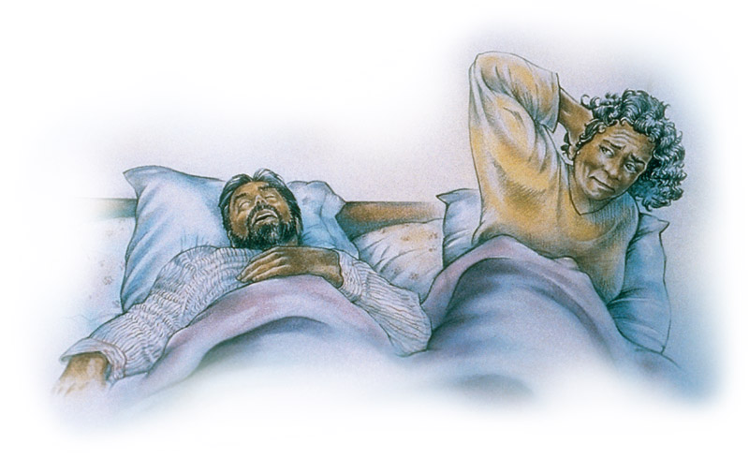
Clinical Features of OSA
Nocturnal Symptoms
Snoring
40% of men, 20% of women report habitual snoring
Associated with considerable social and marital hazard
2006 American Academy of Sleep Medicine

Slide 14
Young 4% Men AHI > 5
  USA 2% Women EDS
  N = 802 Age 36-60
Kripke
  USA
  N = 355
Olson
  Australia
  N = 2,202
Bearpark
  Australia
  N = 400
9% Men
5% Women
5% Men
1.2% Women
10% Men
7% Women
AHI > 15
0₂ sat 4%
Age 40-64
AHI > 15
Age 35-69
AHI > 10
Age 40-85

Slide 15
Prevalence in a Saudi Sample
Sharma et al³ (n=180) 80% Males | Heistand et al² (n=1506) M + F | Netzer et al¹ (n=744) M + F | Middle-aged Saudi Women (n=400) M | Middle-aged Saudi Men (n=578) M
-- | 49 | 48.9 ± 17.5 | 43.74 ― 6.31 | 44.6 ± 9.8 | Mean age
-- | 59.0% | 52.2% | 40.8 | 52.3% | Snoring
-- | 26.0% | 38.8% | 9.5% | 19.3% | Day time fatigue >3 time a week
-- | 32.0% | 19.9% |  | 29.6% | Drowsy driving
53% | 29.0% | 26.0% | 24.0% | 18.0% | HTN (known)
44.4% | Males 31% Females 21% | 37% | 39.0 | 32.8% | High risk
1. BaHammam et al. Saudi Med J 2008; 29: 423-426
2. BaHammam et al. Saudi Med J 2009; 30: 1572-76

Slide 16
Prevalence in a Saudi Sample
Sharma et al³ (n=180) 80% Males | Heistand et al² (n=1506) M + F | Netzer et al¹ (n=744) M + F | Middle-aged Saudi Women (n=400) M | Middle-aged Saudi Men (n=578) M
-- | 49 | 48.9 ± 17.5 | 43.74 ― 6.31 | 44.6 ± 9.8 | Mean age
-- | 59.0% | 52.2% | 40.8 | 52.3% | Snoring
-- | 26.0% | 38.8% | 9.5% | 19.3% | Day time fatigue >3 time a week
-- | 32.0% | 19.9% |  | 29.6% | Drowsy driving
53% | 29.0% | 26.0% | 24.0% | 18.0% | HTN (known)
44.4% | Males 31% Females 21% | 37% | 39.0 | 32.8% | High risk
1. BaHammam et al. Saudi Med J 2008; 29: 423-426
2. BaHammam et al. Saudi Med J 2009; 30: 1572-76

Slide 17
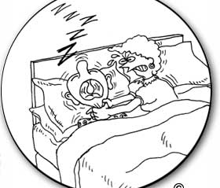
Otherwise snore and this will happen to you….
Or sleep alone….
www.corbett.com.au

Slide 18
Clinical Features of OSA
Daytime Sleepiness
  Differential diagnosis includes:
    Insufficient Sleep
    Medical and psychological disorders
    Medications

Slide 19
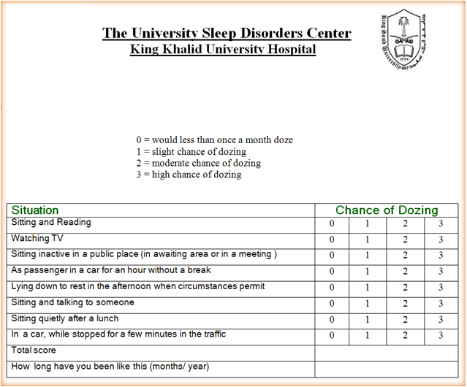

Screening Daytime Sleepiness
Epworth Sleepiness Scale

Slide 20

Screening Daytime Sleepiness
Epworth Sleepiness Scale

Slide 21
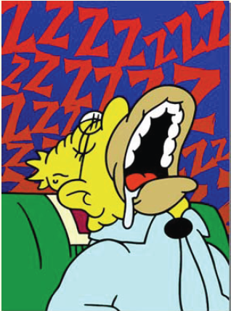
Clinical Features of OSA
Nocturnal Choking / Gasping
  Bed partners may recognize this more commonly than the patient.
Viner et al, Ann Int Med, 1991

Slide 22
What are the Risk Factors?

Slide 23
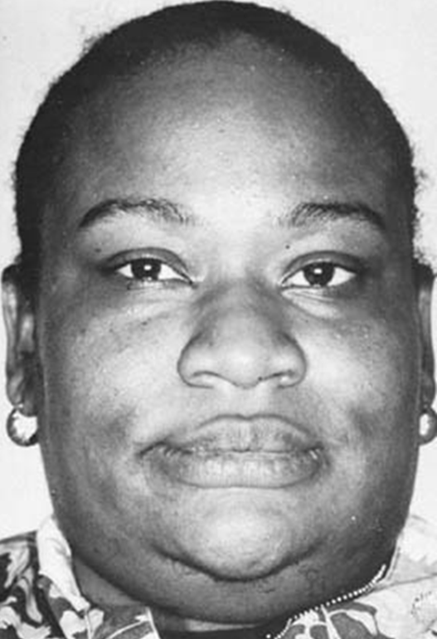
Risk Factors of OSA
Structural Abnormalities:
    Short Fat Neck

Slide 24
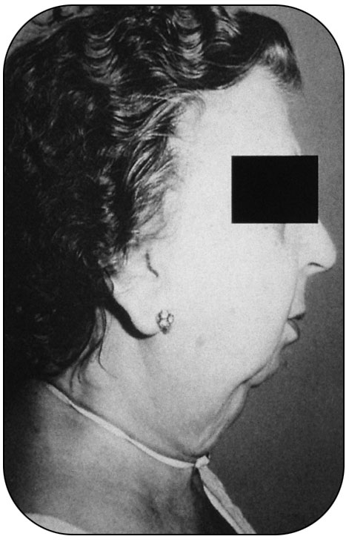
Risk Factors of OSA
Small Mandible
Guilleminault C et al. Sleep apnea Syndromes. New York: Alan R. Liss, 1978.

Slide 25
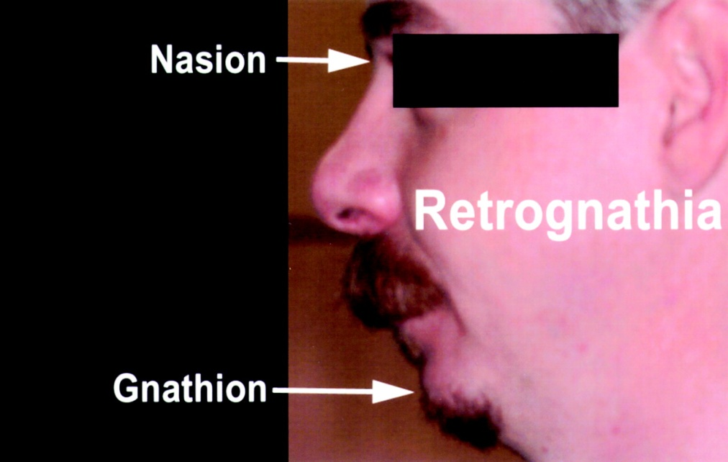
Risk Factors of OSA
Retrognathia

Slide 26
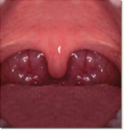
Risk Factors of OSA
Upper airway narrowing:
  Large tonsils / adenoids
Sleep Disorders & Sleep Apnea with Dr. Kushner, DDS
http://www.brownkushner.com/Sleep Apnea.pdf

Slide 27
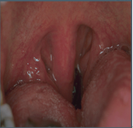
Cont..
(Upper airway narrowing)
Long uvula
Sleep Disorders & Sleep Apnea with Dr. Kushner, DDS
http://www.brownkushner.com/Sleep Apnea.pdf

Slide 28
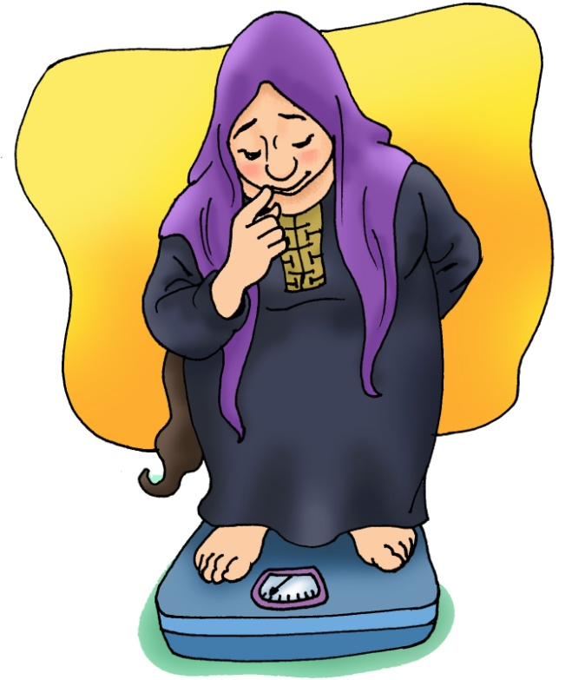
Risk Factors of OSA
Obesity
  Strongest risk factor for OSA.
  Present in >60% of patients referred for a diagnostic sleep evaluation.

Slide 29
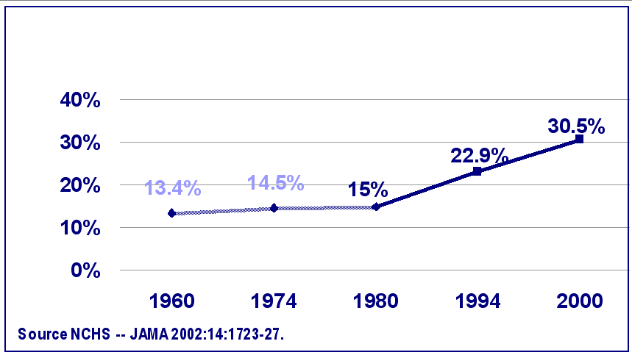
Twenty Years of Increasing Obesity
% Obesity

Slide 30
PREVALENCE OF OBESITY
IN SAUDI ARABIA
% of Subjects
(BMI ≥ 30 kg/m²)
Al-Nozha et al. SMJ 2005;26:824-829

Slide 31
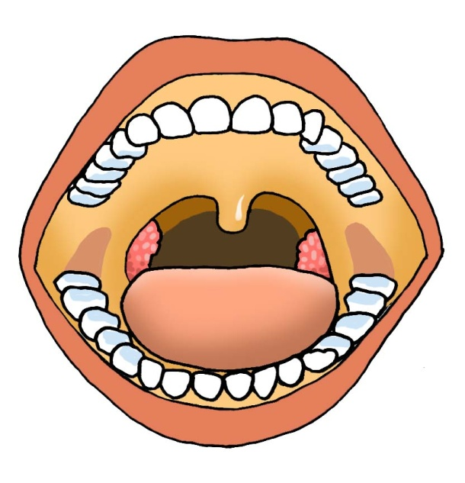
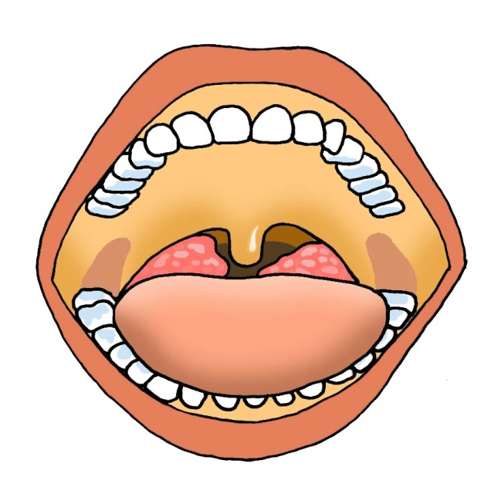
Patient Evaluation
Normal Airway
Obstructed Airway
Sleep Disorders & Sleep Apnea with Dr. Kushner, DDS
http://www.brownkushner.com/Sleep Apnea.pdf

Slide 32
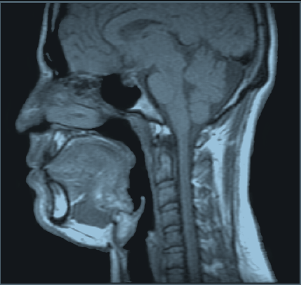
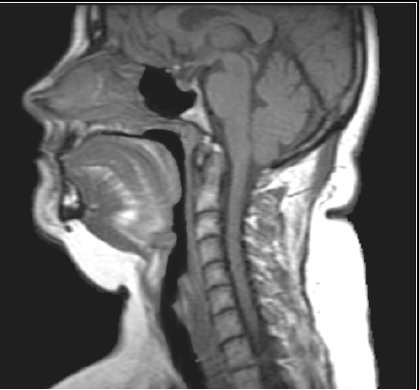
Sagittal Upper Airway
MRI Images
Normal
Apneic
(Schwab et al, Am J Respir Crit Care Med 152:1673, 1995)

Slide 33
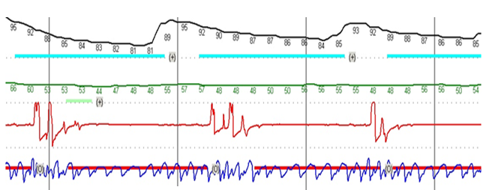
Representative Signals
OSA
Oximetry
Heart Rate
Nasal Airflow
Effort

Slide 34
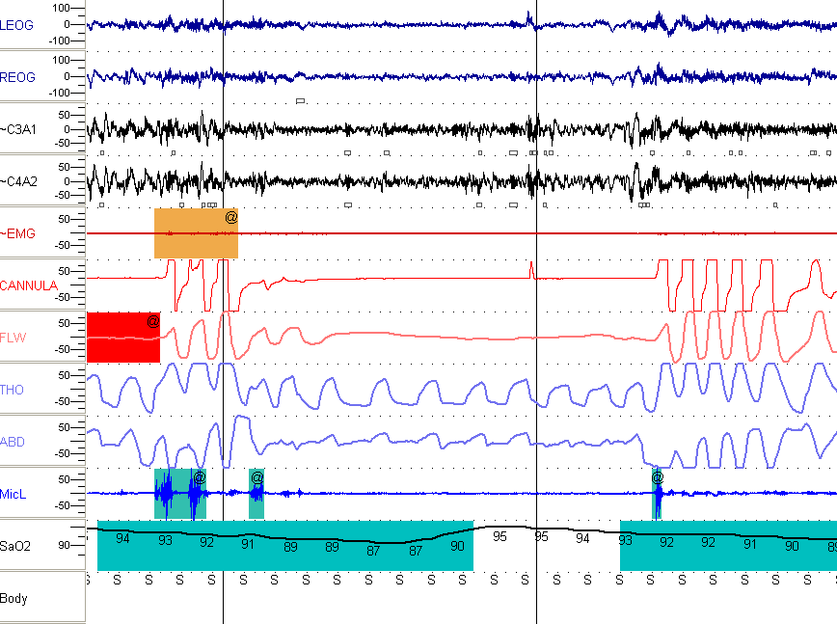

Slide 35
OSA and Medical Comorbidity
Obstructive Sleep Apnea
High Blood Pressure
Increased Insulin resistance (event in non diabetic patients)
Increased traffic and workplace accidents
Stroke
Memory problems and inability to think
Cardiac problems, Abnormal heart rhythms, heart attack and heart failure

Slide 36
Medical Complications of OSA
OSA is associated with:
  Systemic hypertension
  Pulmonary hypertension
  Cardiac arrhythmia
  Ischemic heart disease
  Stroke
  Insulin resistance and diabetes
  Renal impairment
  Impotence
  Cognitive impairment
  Depression

Slide 37
Does OSA cause HTN?

Slide 38
Two large epidemiological studies showed increasing odds ratios for the presence of hypertension related to the severity of OSA as defined by AHI after adjusting for age, sex and BMI (1, 2).
Neito et al. Association of sleep disordered breathing, sleep apnea, and hypertension in a large community-based study: Sleep Heart health Study. JAMA 2000; 238: 1829.
Peppard et al. Prospective study of the association between sleep disordered breathing and hypertension. N Engl J Med 2000; 342: 1378-1384.

Slide 39
AHI and HTN: SHHS n = 6123
Nieto et al. JAMA 2000; 283: 1829

Slide 40
Does OSA cause Stroke?

Slide 41
Does OSA cause stroke?
SHHS: Shahar E, et al. AJRCM 2001; 163: 19-25
  Cross sectional association between self reported CVD and OSAS
  Cohort of 6424 subjects who underwent PSG
  Odd ratio = 1.58 (AHI > 11/hr and AHI = 0-1.3) adjusted for age, race, sex, smoking status, self reported DM, Cholesterol, HDL

Slide 42
Does OSA cause IHD?

Slide 43
Does OSAS cause IHD
Several changes in OSA may affect the CVS:
  Nocturnal hyoxemia (Chest 2001; 119: 1985-1091)
  Increased sympathetic activity (Ann Intern Med 1976; 85: 714-719)
  Disturbed endothelial function (J hypertension 1996; 14: 577-584)
  Depressed baro-reflex sensitivity (Am J Respir Crit Care Med 1996; 154: 1490-1496)
  Increased platelet aggregability (Am J Respir Crit Care Med 1996; 153: 1972-1976)
  Increased vasoconstrictor sensitivity to angiotensin II (J Appl Physiol 2000; 89: 493-498)

Slide 44
.
Hypoxemia, hypercapnia
and hypocapnia
Do2; & CBF
Nocturnal & Diurnal HPT
& Wall tension
Alterations in CBF
&
Sleep apnea
&
Hypopnea
Multiple
Sympathetic
activity
Atherosclerosis
effects
Thrombosis
Platelet aggregation
Thrombosis
Coagulopathy
Inflammation
Inflammation
Adhesions molecules
Transcription factors

Slide 45
Prevalence of Cardiovascular Disease by AHI category in the Wisconsin Sleep Cohort Study (n = 1206)
18%
10%
6%
4%
N Engl J Med 2000; 342: 1378-1384

Slide 46
Pulmonary Hypertension
No difference between pulmonary hypertensive and normotensive OSA subjects with regard to nocturnal oxygenation and AHI (Am J Respir Crit Care Med 1999; 159: 1518; Respiration 2001; 68: 566)
Patients with PHTN are usally:
  Sleep hypoventilation
  Daytime hypoxemia
  Daytime hypercapnia
  (BaHammam et al. Resp Med 2005

Slide 47
Cardiac Arrhythmias
Most of the studies that investigate the association between arrhythmia and OSA have methodological imitations
The most frequent arrhythmias
  Severe sinus bradycardia
  Atrioventricular block

Slide 48
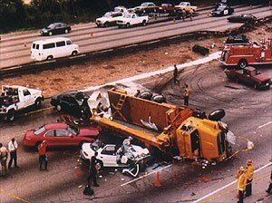
Car Accidents in SDB
The rate of traffic accidents among persons with OSA is 3-4 times the rate among persons without sleep apnea
NEJM 1999; 340: 881-883

Slide 49
Treatment
General Measures
These measures should be tried in all patients with OSDB:
    Weight loss
    Avoidance of alcohol & sedatives
    Sleep position
    Driving and operation of heavy machinery

Slide 50
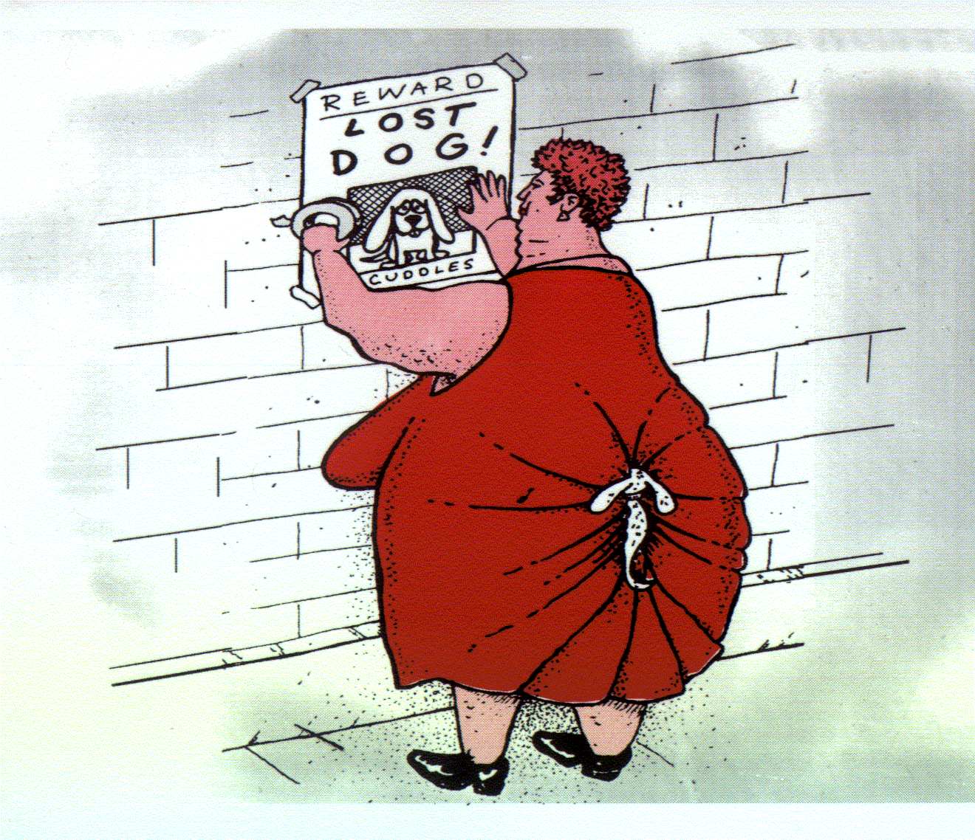
Weight Loss
Weight loss is like getting into heaven….. It is SIMPLE but it is not EASY.
Sleep in Health & Disease
www.sleepsa.com

Slide 51
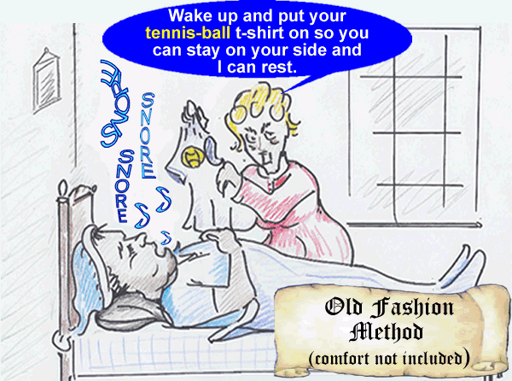
Positional Therapy
Try sleeping on the side.

Slide 52
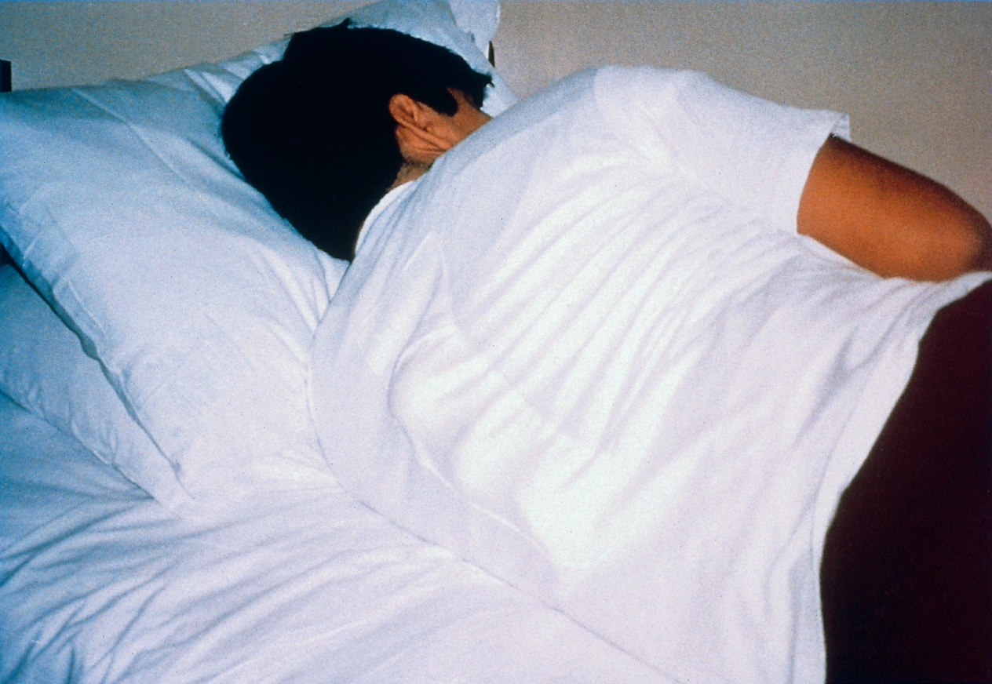
Sleep Position Training
2006 American Academy of Sleep Medicine

Slide 53
Specific Measures
Continuous Positive Airway Pressure (CPAP)
Intra – Oral Appliances
Surgical Treatment

Slide 54
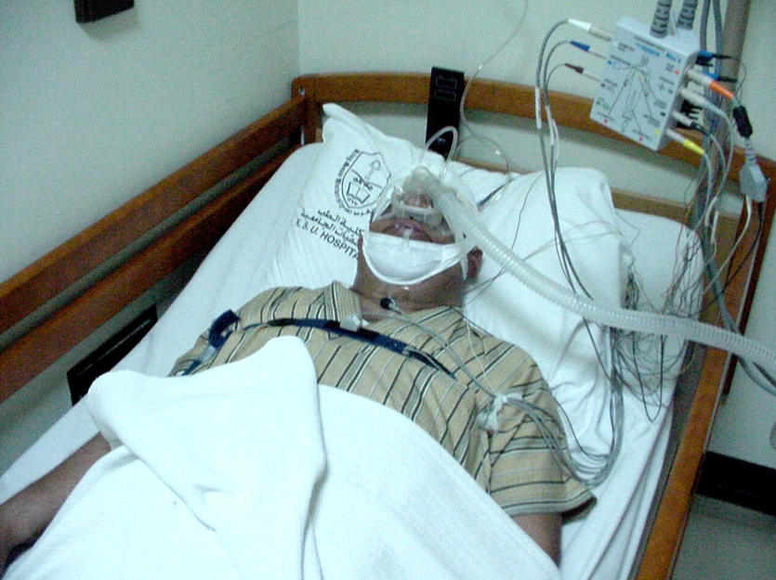
Continuous Positive Airway Pressure (CPAP)
Is the gold standard treatment

Slide 55
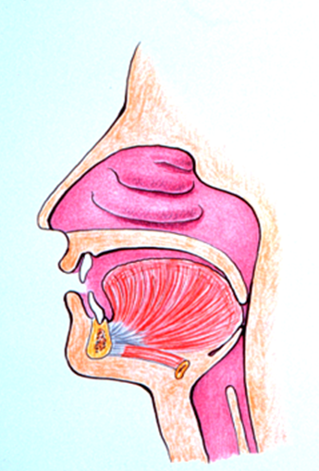
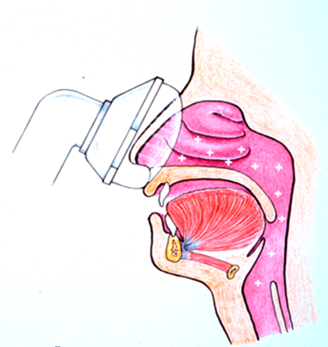
Continuous Positive
Airway Pressure
Before
After

Slide 56
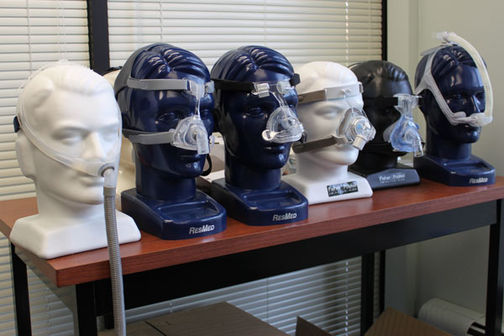

Slide 57
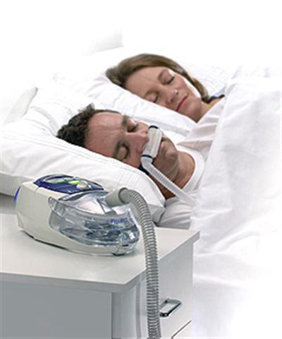
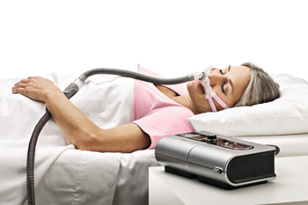
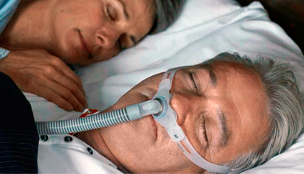
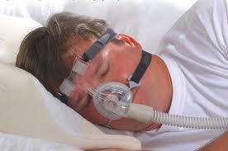

Slide 58
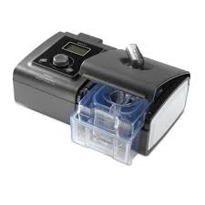

Slide 59
Benefits of CPAP
Improves quality of life even in mild OSA
Improves bed partner sleep
Improves daytime sleepiness
Decreases motor vehicle accident
Improves hypertension

Slide 60
Cont… (Benefits of CPAP)
Increases ejection fraction in systolic CHF
Improves insulin resistance
Decreases inflammatory markers
    CRP (C-reactive protein)

