Slide 1
What you need to know about CBC and coagulation profile
Dr. Khalid Alsaleh
MRCP,FACP,FRCPC,MSc

Slide 2
Slide credits to many contributors

Slide 3
CBC is one of the commonest investigation we use and you need to understand it.
Many items listed , some of them tell the same information in different way.
Most of the CBC now done in automated way

Slide 4
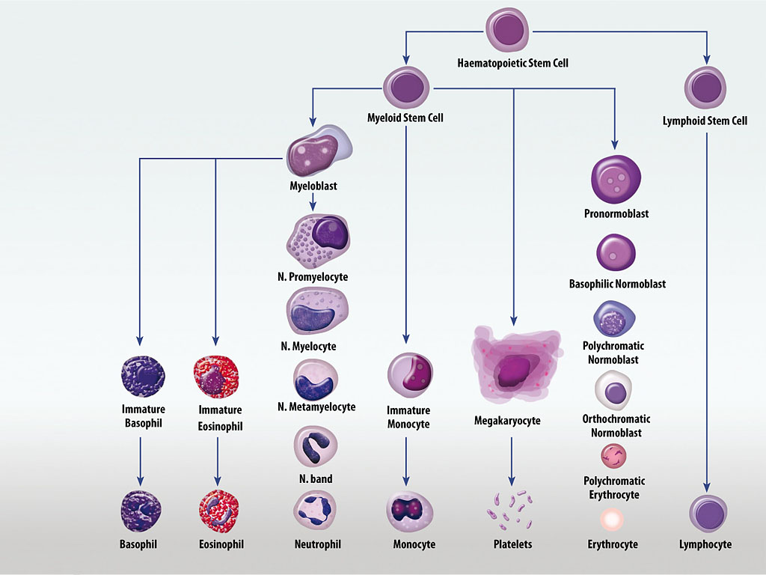
Haematopoiesis (Cell development)

Slide 5
WBC and diff
RBC
HB
Htc
MCV
MCH
MCHC
Plat and MPV
ESR
Blood film
RDW
Retics

Slide 6
Some formula for interest
MCV = Hct (L/L) 1,000/red cell count (10^12/L)
MCH = hemoglobin (g/L)/red cell count (10^12/L)
MCHC =hemoglobin (g/dl)/Hct (L/L)

Slide 7
Interpret results in clinical context
All haematology results need to be interpreted in the context of a thorough history and physical examination, as well as previous results.

Slide 8
History and clinical examination
Important features of history and clinical examination:
pallor, jaundice
fever, lymphadenopathy
bleeding/bruising
hepatomegaly, splenomegaly
frequency and severity of infections, mouth ulcers, recent viral illness
exposure to drugs and toxins
fatigue/weight loss

Slide 9
Low haemoglobin
Useful to use MCV to classify the anaemia
Microcytic, MCV < 80 fl
Normocytic, MCV 80 – 100 fl
Macrocytic, MCV > 100 fl

Slide 10
Microcytic Anaemia
The three most common causes for microcytic anaemia are:
Iron deficiency
Thalassaemia
Anaemia of Chronic disease

Slide 11
Normocytic anaemia
The causes of normocytic anaemia include:
Bleeding
Early nutritional anaemia (iron, B12, folate deficiencies)
Anaemia of renal insufficiency
Anaemia of chronic disease/chronic inflammation
Haemolysis
Primary bone marrow disorder

Slide 12
Macrocytic anaemia
Common causes:
Alcohol
Liver disease
B12 or folate deficiency
Thyroid disease
Some drugs (especially hydroxyurea)

Slide 13
High haemoglobin
⇧ Hb often accompanied by PCV
Can reflect decreased plasma volume (eg: dehydration, alcohol, cigarette smoking, diuretics) or
Increased red cell mass (eg polycythaemia)
This can be primary or secondary

Slide 14
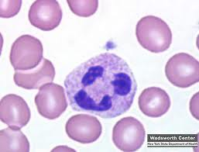
Neutrophils – Low
Significant levels
< 0.5 x 10⁹/L (high risk infection)
Most common causes
viral (overt or occult)
autoimmune/idiopathic
drugs
Red flags
person particularly unwell
severity
lymphadenopathy, hepatosplenomegaly

Slide 15
Neutrophils – High
Most common causes
infection/inflammation
Necrosis/malignancy
any stressor/heavy exercise
Drugs
CML
Red flags
person particularly unwell
Severity
presence of left shift or blast

Slide 16
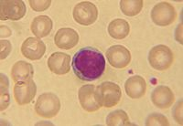
Lymphocytes
Lymphocyte – Low
not usually clinically significant
Lymphocyte – High
isolated elevated count not usually significant
Causes
acute infection (viral, bacterial)
smoking
hyposplenism
acute stress response
autoimmune thyroiditis
CLL

Slide 17
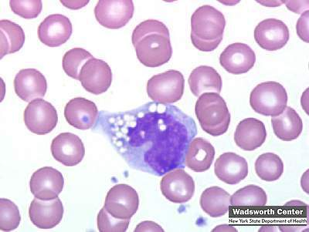
Monocytes
Monocytes – Low
not clinically significant
Monocytes – High
usually not significant
watch levels > 1.5 x10⁹/L more closely

Slide 18
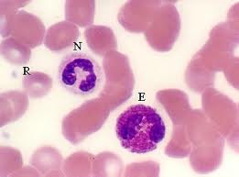
Eosinophils
Eosinophils – Low
no real cause for concern
Eosinophils – High
Most common causes:
allergy/atopy: asthma/hayfever
parasites (less common in developed countries)
Rarer causes:
Hodgkins
myeloproliferative disorders
Churg-Strauss syndrome

Slide 19
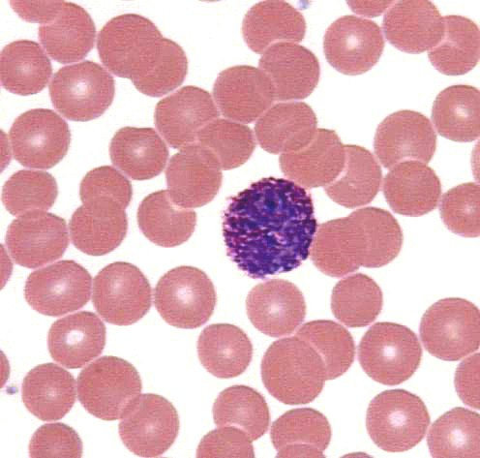
Basophils
Basophils – Low
difficult to demonstrate/no clinical significance.
Basophils – High Associated with
myeloproliferative disorders
other rare causes

Slide 20
Platelets – Low
Significant levels
< 100 x10⁹/L
Most common causes
viral infection
idiopathic thrombocytopenic purpura
liver disease
drugs
hypersplenism
autoimmune disease
Pregnancy
Artificial → confirm on blood film
Red flags
bruising
petechiae
signs of bleeding

Slide 21
Platelets – High
Significant levels
> 500 x10⁹/L
Most likely causes
reactive conditions eg infection, inflammation
pregnancy
iron deficiency
post splenectomy
essential thrombocythaemia

Slide 22
Coagulation Cascade

Slide 23
http://www.hopkinsmedicine.org/hematology/Coagulation.swf

Slide 24
Prolonged PT is seen in
Vitamin K deficiency
Warfarin therapy
Liver disease
Prolonged PTT is seen in
von Willbrand,
hemophilia
Heparin therapy
Antiphospholipid syndrome
Prolonged PT and PTT is seen in deficiencies of the final common pathway factors such as factor V, prothrombin, fibrinogen, or factor X. Liver disease, DIC.

Slide 25
Thank you

