Slide 1
Introduction to Pediatric Course
PED - 474
Professor Ibrahim H. Al Ayed,
Professor of Paediatrics, College of Medicine
King Saud University, Riyadh, Kingdom of Saudi Arabia

Slide 2
Introduction to Pediatric Course PED - 474
What is Pediatrics?
Course objectives specification
Teaching/Learning activities
Course dates
Course evaluation and assessment
Course books, resources, reference & websites
Class manners
Other matters

Slide 3
What is Pediatrics?
Introduction to Pediatric Course by Prof. I. Alayed
Pediatrics is a branch of medicine dealing with the health and medical care of infants, children and adolescents from birth up to the age of 18. The word “peadiatrics” means “healer of children”; they are derived from two Greek word: (pais = child) and (iatros = doctor or healer). Paediatrics is a relatively new medical specialty, developing only in the mid-19th century. Abraham Jacobi (1830 – 1919) is known as the father of paediatrics.

Slide 4
What does a pediatrician do?
Introduction to Pediatric Course by Prof. I. Alayed
A paediatrician is a child’s physician who provides not only medical care for children who are acutely or chronically ill but also preventive health services for healthy children. A peadiatrician manages physical, mental and emotional well-being of the children under their care at every stage of development, in both sickness and health.

Slide 5
Aims of Pediatrics
Introduction to Pediatric Course by Prof. I. Alayed
The aims of the study of paediatrics is to reduce infant and child rate of deaths, control the spread of infectious disease, promote healthy lifestyles for a long disease-free life and help ease the problems of children and adolescents with chronic conditions.
Paediatrics diagnose and treat several conditions among children including:
Injuries
Infections
Genetic and congenital conditions
Cancers
Organ diseases and dysfunctions

Slide 6
Introduction to Pediatric Course by Prof. I. Alayed
Paediatricians is concerned not only about immediate management of the ill child but also long term effects on quality of life, disability and survival. Paediatricians are involved with the prevention, early detection and management of problem including:
Developmental delays and disorders
Behavioral problems
Functional disabilities
Social stress
Organ diseases and dysfunctions

Slide 7
How does pediatrics differ from adult medicine?
Introduction to Pediatric Course by Prof. I. Alayed
Peadiatrics is different from adult medicine in more ways than one. The smaller body of an infant or neonate or a child is substantially different physiologically from that of an adult. So treating children is not like treating a miniature adult.
Congenital defects, genetic variance and developmental issues are of greater concern to pediatrician than physicians treating adults. In addition, there are several legal issues in paediatrics. Children are minors and in most jurisdictions, cannot make decisions for themselves. The issues of guardianship, privacy, legal responsibility and informed consent should be considered in every pediatric procedure.

Slide 8
The Seven Ages of Children
Newborn, neonate first month of life
Infancy 1 month to 1 year
Toddler 1 year to 3 years
Preschool child 3 – 5 years
School child 5 – 18 years
Child 0 – 15 years
Adolescent late 15 – 18 years

Slide 9
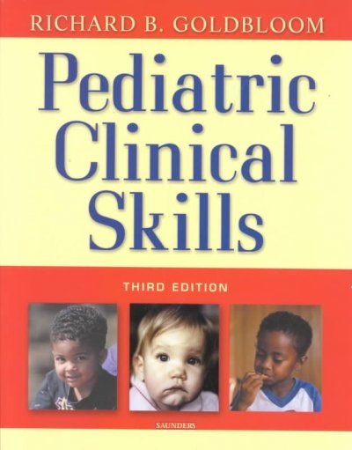
Introduction to Pediatric Course by Prof. I. Alayed

Slide 10
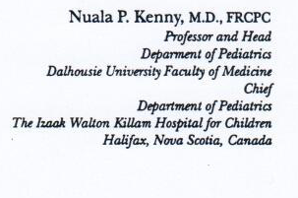
Introduction to Pediatric Course by Prof. I. Alayed
THE SCOPE OF PEDIATRICS
To some, pediatrics seems a difficult, demanding and sad specialty, one that deals largely with serious ill or dying babies and children. It seems frustrating to think of being unable to explain pain and suffering or to provide comfort to small children. Some see the suffering and disability of children as overwhelming and ask themselves why any physician would choose this career path.
To those of us who have been “called” to the practice of pediatrics, it is quite a different picture. True, there is incredible sadness at the death of a child. Often there is great frustration at being unable to do more for children whose lives are profoundly affected by disease and disability. But there is so much more. Pediatricians have an ability to learn from, laugh with, and be strengthen by children. Pediatrics forces us to stand in awe of children and their families in the face of enormous challenges. It is a truly wonderful world of medical practice.
Pediatrics is first the practice of the science of growth and development. It demands a deep appreciation of the unique nature of childhood and adolescent, the impact of disease on growth and development, and the effects of growth and development on the manifestation of disease. Interventions early in the child’s life have significant lifelong benefits, just as errors in judgment or ignorance about medical or developmental realities can have profound, lifelong negative effects. Nowhere else in the practice of medicine are the consequences so significant. They affect not only the child’s future physical health and function, but also the youngster’s sense of self-worth and later, in adulthood, personal integrity.

Slide 11
Introduction to Pediatric Course by Prof. I. Alayed
THE SCOPE OF PEDIATRICS
Pediatrics is uniquely dependent on, and committed to families. The family comes in many shapes and sizes, but it is the primary environment in which the child’s potential is nourished. Child health care depends largely on the story of illness and disability as told by parents. The child’s health is always the parent’s responsibility, but good pediatricians recognize that their job is to work in alliance with the family. When the family ability to deal with the health concerns of the children is exceeded, then health professionals assist and support families in their task.
Empowering families to car e for their children is a major task of pediatrics. It involves health education and health promotion, especially in light of increasing dependence on health professionals for all aspects of child health care. It also involves a respectful recognition that today many families assume extraordinary complex tasks in the care of their children. For that special group of children with chronic or major life-threatening illnesses, pediatricians become partners in care and advocates for increasing family support.

Slide 12
Introduction to Pediatric Course by Prof. I. Alayed
THE SCOPE OF PEDIATRICS
The commitment of pediatrics to families cover the entire spectrum, from providing health education to normal children to providing information, assistance and support for families that must assume enormous burdens of care related to major illness. That commitment must include advocacy and protection for the familial societal values that sustain a healthy family environment.
To be sure, pediatrics has its frustrations, such as children who are ill, in pain, dying or suffering the anguish that comes with learning to live with disease, deformity or disability.

Slide 13
Introduction to Pediatric Course by Prof. I. Alayed
THE SCOPE OF PEDIATRICS
But it is also a specialty whose practitioners marvel daily at the courage and determination of children to get on with the business of growing and developing.
Children are amazingly courageous. Trailing a forest of intravenous poles with abundant monitors and machinery, armies of children are pushed and pulled to the hospital playroom and gift shop. Following surgical procedures that would keep an adult horizontal for a week with nasogastric tubes and ventilator support, children rally overnight and display an incredible appetite for life. Developing an appreciation of their courage is a great gift to medical practitioners.
Children are unhesitatingly honest. No other patients are so direct and frank about their relationship with their physician. The pomp and circumstance that may color other specialties pales in the presence of a toddler who “needs to pee” in the middle of the professor’s masterful brilliance during ward rounds. Nowhere else is insensitivity and inappropriate behavior so disruptive of the physician–patient relationship. Children react sharply to condescension. They display an instinctive need to know the truth and they respond to any dissonance between family and professional reactions and what is told to them. While children’s need to know must be met in developmentally appropriate ways, a cardinal rule of pediatrics is “never lie to a child.” Following this rule can be difficult and requires delicacy, but truth us an essential element of the art of pediatrics.

Slide 14
Introduction to Pediatric Course by Prof. I. Alayed
THE SCOPE OF PEDIATRICS
Children are also incredibly funny. The atmosphere of a pediatric hospital differs from that of most adult health care facilities because children play and laugh among themselves and with those who care for them. Their laughter is the most potent therapy to caregivers.
Gone are the days when moderately ill children were cared for by parents and “really sick” children were hospitalized, attended exclusively by “professionals” (physicians and nurses). The practice of modern pediatrics sees parents coping with outpatient chemotheraphy , home ventilators, ambulatory peritoneal dialysis, and home enteral feeding. Paradoxically, almost every pediatric ward or institution also cares for inappropriately met, or who are in danger of abuse or neglect because of difficult, disturbed, or stressful family circumstances.
Pediatrics has emerged as a distinct medical specialty over the past century. The changing pattern of morbidity and mortality in children reflects advances in nutrition, hygiene, immunization and antibiotic therapy. Infectious disease, long the major cause of death in infancy and childhood, is no longer as great a threat as it once was. Advances in obstetrical and perinatal care have revolutionized newborn health and survival. But a “new pediatric morbidity” has emerged over the past decade, compromising issues that range from developmental and learning difficulties to concerns regarding abuse, neglect, depression, eating disorders, and suicide in adolescents.

Slide 15
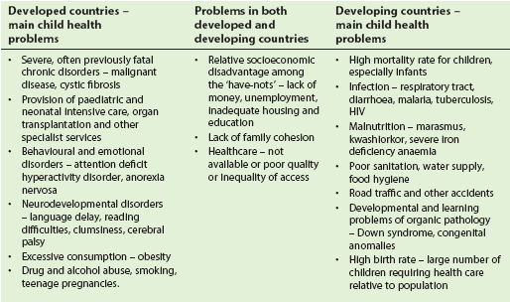
Introduction to Pediatric Course by Prof. I. Alayed
Contrast between main child health problems and associated factors in developed and developing countries

Slide 16
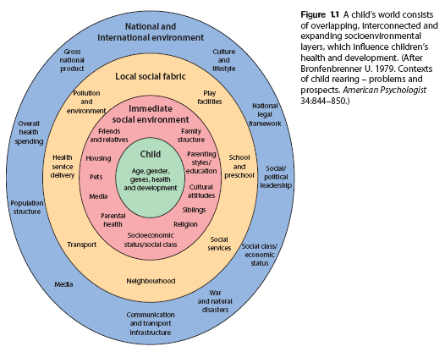
Introduction to Pediatric Course by Prof. I. Alayed

Slide 17
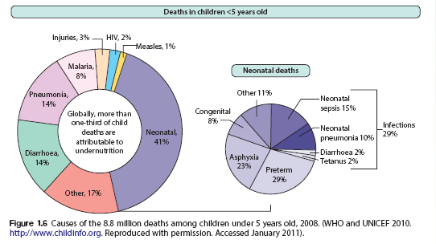
Introduction to Pediatric Course by Prof. I. Alayed

Slide 18
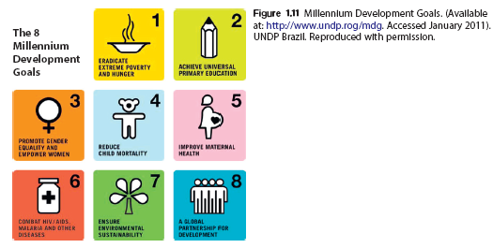
Introduction to Pediatric Course by Prof. I. Alayed

Slide 19
Course Objectives
Introduction to Pediatric Course by Prof. I. Alayed
General Objective
To graduate a physician who acquired adequate basic knowledge and skills in pediatrics, that will enable him/her to proceed into subsequent general practice, specialty training or research activities and to be aware of the personal qualities and attitudes required to care for children and their families. (e.g. empathy, concern, gentleness, etc.)
Specific objectives
By the end of this course, students will be able to
Acquire the knowledge related to community problems of child health.
Know the preventive aspects of childhood health problems and its implementation
Recognize urgent and emergency situations in pediatrics and be able to outline an appropriate initial plan of action to stabilize such patients.
Record and interpret a complete physical examination across all pediatric age group.
Identify and solve common clinical problems in pediatrics by providing a provisional diagnosis and appropriate differential diagnosis.
Outline a general plan of investigations and management of common pediatric problems, especially as they relate to Saudi Arabia.
Use and interpret the laboratory investigations to reach a diagnosis of common pediatric problems.
Recognize his limitations concerning management of pediatric patients and the need to consult and cooperate with others to provide optimum care.
Interact with children and their parents or relatives in a gentle, emphatic and appropriate manner.

Slide 20
Course components
Introduction to Pediatric Course by Prof. I. Alayed
Lectures
Tutorials
Clinical Examination Orientation
Clinical Teaching Sessions
Ward Rounds
Emergency Shifts
Outpatient clinic hours
Nursery orientation
Clerking

Slide 21
Course dates
Introduction to Pediatric Course by Prof. I. Alayed
Duration – 12 weeks
Dates – from 08/11/1436 (23 August 2015)
to 30/01/1437 (12 November 2015)
Week 1 to 3 – Lectures and Clinical Examination Orientation
Week 4 to 7 – Tutorials and Bedside Teaching
Week 7 – Mid-Cycle Examination Thursday (02/01/1437) 15 October 2015
Week 8 to 11 – Bedside Clinical Teaching and Other Activities
Week 12 – Final Written and Clinical Examination
Final Written Exam : Monday (27/01/1437) 09 November 2015
Final Clinical Exam (OSCE) : Thursday (30/01/1437) 12 November 2012

Slide 22
Course Evaluation & Assessment
Introduction to Pediatric Course by Prof. I. Alayed
Incourse & continuous assessment - 40 marks
Clerking - 4
Case Presentation - 3
Log book - 2
Professional Attitude - 2
Clinical Skills Lab - 2
DxR cases - 2__________________
Cont. Assessment -15
Mid-Cycle MCQ & MEQ -25 40 marks
Final Examination
MCQ & MEQ - 40 marks
Clinical Examination (OSCE) - 20 marks

Slide 23
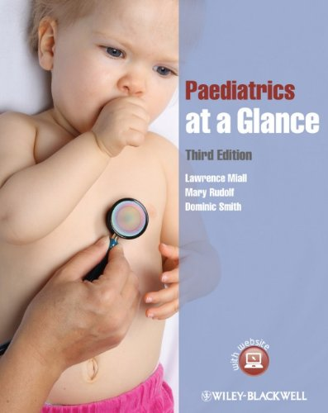
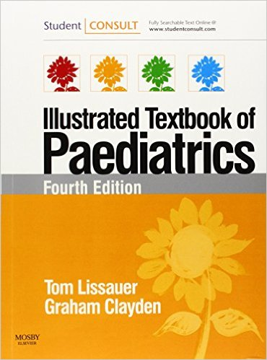
Course Books, Resources, References & Websites
Introduction to Pediatric Course by Prof. I. Alayed

Slide 24
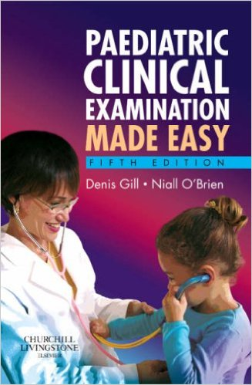
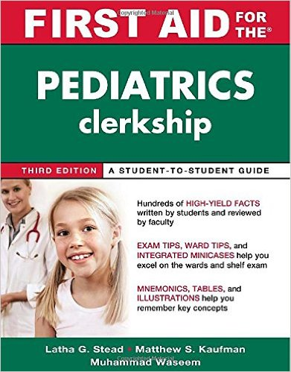
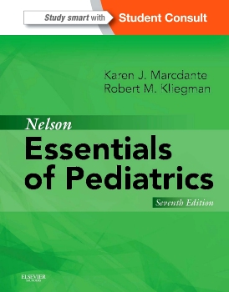
Introduction to Pediatric Course by Prof. I. Alayed

Slide 25
Introduction to Pediatric Course by Prof. I. Alayed
WEBSITES FOR STUDENT EDUCATION
WWW.COMPSED.ORG
ON LINE CASES
WWW.BRIGHTFUTURES.COM – (BRIGHT FUTURES CENTER FOR PEDIATRIC EDUCATION)
WWW.VIRTUALPEDIATRICHOSPITAL.ORG – (VIRTUAL HOSPITAL )
WWW.GENERALPEDIATRICS.COM
RADIOLOGY CASES IN PEDIATRIC EMERGENCY MEDICINE
WWW.LEARNPEDIATRICS.COM
WWW.PEDIATRICEDUCATION.ORG
WWW.MEDICALPPT.BLOGSPOT.COM

Slide 26
Introduction to Pediatric Course by Prof. I. Alayed
TEACHING CLASS MANNERS
Dear Students,
Please take note of the following manners & behaviors during teaching sessions (lecture or bedside teaching);
You have to comply with the agreed college dress code for students. Students wearing differently will not be allowed to attend the class.
Student should be seated in the class on time. Late comers will not be allowed to join class & will be regarded as absent.
Chewing gum, drinking, eating and inappropriate talking to colleagues disturbing the class is strictly prohibited.
Sick or sleepy students are not supposed to attend class. Permission or sick leave is a better alternative.
Bleeps and cellular phones are expected to be inactive during the class.
Teacher have the right not to grant permission for attending class and expected to send students away if none of the above manners were observed.

Slide 27
… Thank you …

