Slide 1
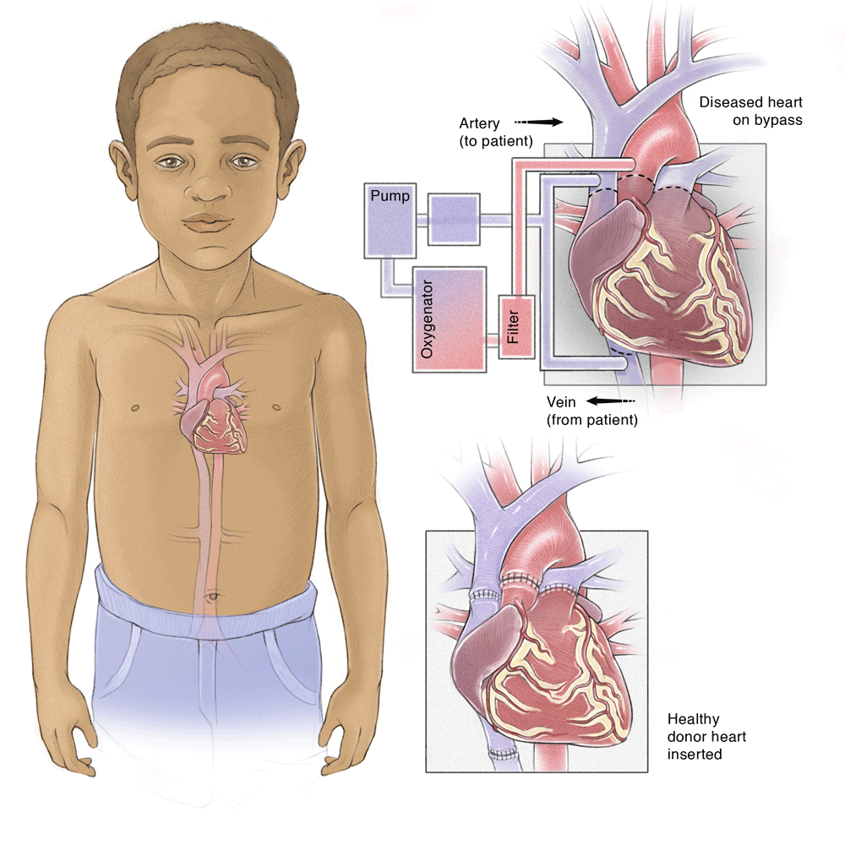
Pediatric CVS Exam
Ped 474 Course
2015/2016
Mohamad-Hani Temsah, M.D.

Slide 2
Objectives:
To Highlight differences in Pediatric CVS Exam versus Adults
To outline the P/E (Principals, Video, Manikin) in order to facilitate application in real patients during your Clinical Teachings
To share useful Hints!!

Slide 3
Introduction
Main differences between Pediatric & Adult CVS diseases:

Slide 4
Children are not just small adults
Some principles of examining children are similar to adult, but there are important differences!
Pattern of disease, the approach to the examination and content of the examination are quite different in children.
Examination changes as children develop and get older!
Sinus (respiratory) arrhythmia is much more prominent.
In child, heart occupies relatively more space in the thorax.
<7 years: apex beat is in 4th intercostal space to the L of midclavicular line.
Notes:
Eventually it is similar to examination in adults.

Slide 5
Aims / purposes of pediatric examination?
It is important to distinguish between:
The routine examination of well babies (to screen largely for abnormalities of growth and development).
The examination of ill babies (to establish the nature and cause and extent of any illness or injury).
The examination of children for other specific purposes such as, for example:
To establish fitness for education or certain activities
To examine for signs of disease

Slide 6
Step by Step
INTRODUCE SELF:

Slide 7
GENERAL INSPECTION
Position patient: lying
Well or unwell
Growth parameters
Dysmorphic syndromes/features
Scars
Chest asymmetry
Respiratory rate

Slide 8
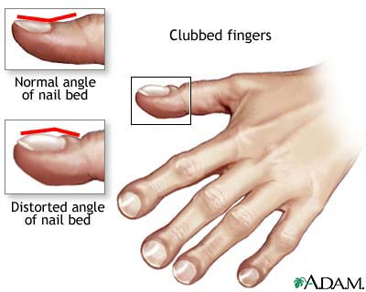
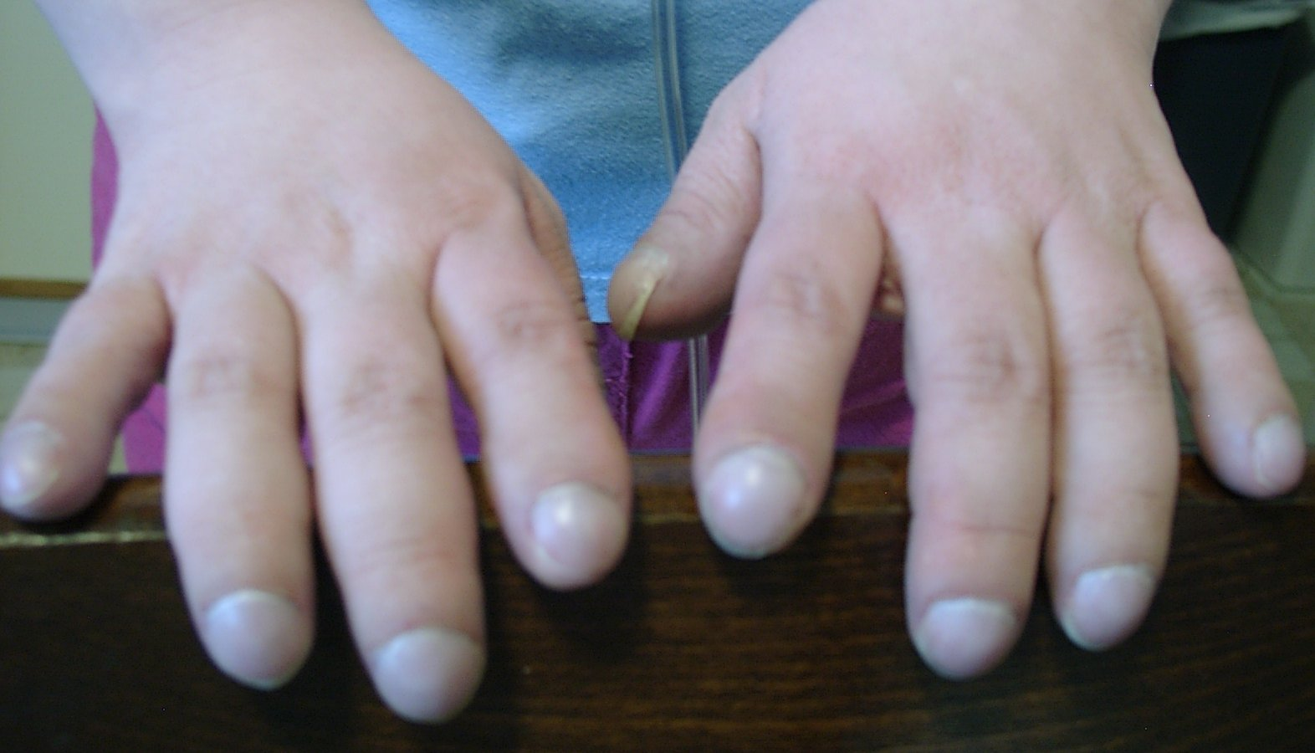
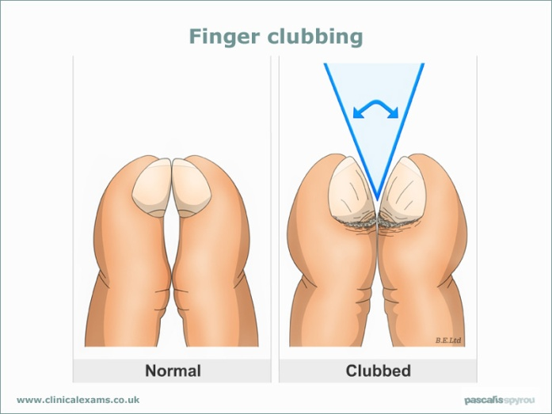
3. UPPER LIMBS
Nails
Clubbing
http://www.youtube.com/watch?v=aRwGxvnKSrA
Pulses
Blood pressure

Slide 9
4. HEAD AND NECK
Jugular venous pressure
Eyes
Conjunctival pallor (anaemia)
Scleral icterus (fragmentation haemolysis
with artificial valves)
Lips: cyanosis
Tongue: cyanosis
Teeth: caries

Slide 10
CHEST: Inspect
Scars
Symmetry
Apical pulsation

Slide 11
CHEST: Palpate
Apex position (beware dextrocardia)
(count down the ribs)
Heaves (parasternal, substernal, apical)
Thrills (suprasternal, supraclavicular)
Palpable pulmonary valve closure
(pulmonary hypertension)

Slide 12
CHEST: Auscultate
(use diaphragm initially, then bell)
Areas: apex, parasternal border, pulmonary, aortic areas; roll to left to accentuate mitral murmurs
Heart sounds (intensity, splitting)
Added sounds
Murmurs (systolic, diastolic or continuous, site of maximal intensity, character, grade)
Radiation of murmurs: axilla (mitral), neck (aortic), back (pulmonary, coarctation)
Variation of murmurs: sitting, inspiration, expiration
Maneuvers (if appropriate): Valsalva, exercise
Lung fields: adventitious sounds (LVF)

Slide 13
After this, palpate back for Sacral oedema (RVF)
Collaterals (if coarctation suspected; also check deep in axillae)

Slide 14
ABDOMEN
Liver: (palpate edge and measure span by percussion)
Enlarged (RVF)
Pulsatile (tricuspid incompetence)
Spleen:
Enlarged (SBE)

Slide 15
LOWER LIMBS
Inspection
Clubbing (if not already done)
Splinter haemorrhages (if not done)
Palpation
Ankle oedema (RVF)

Slide 16
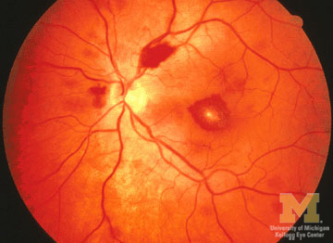
OTHER
Urinalysis: blood (SBE)
Temperature chart (SBE)
Fundoscopy for Roth spots if SBE seems likely

Slide 17
INVESTIGATIONS
After presenting a differential diagnosis, may request CXR/ECG or other tests to rule in or rule out the DDx

Slide 18
Examination Tips
Can establish rapport while checking cyanosis, dyspnea, cough.
Can examine teddy bear / toy first.
Best examination method by age:
Neonates, very young infants: on examining table
Up through preschool: lying sit on mother's lap
Adolescent: without family present.
Kids are impatient, so a systematic full examination may get difficult. Examine the most pertinent area first.
Record RR & HR first, before crying may start!!
ENT exam more likely to induce a cry so these go last.

Slide 19
The approach to the examination will be determined by the age, level of development and level of understanding of the child.
Inspection and observation are the most important parts of the examination.
Observations can be made whilst taking the history and establishing rapport.
Avoid waking sleeping children.
Approach the child at their level, if necessary kneel on the floor.

Slide 20
Start examining peripherally with hands and feet as this is less threatening.
Make the examination fun to help with their anxiety.
Make sure the child is comfortable, and that your hands, stethoscope and other instruments are warm.
Ask parents to assist with dressing or undressing children and be aware of sensitivities about this.
Wherever possible avoid unpleasant procedures (for example, rectal examination). These are seldom necessary and can put children off being examined for a lifetime!

Slide 21
The cardiovascular system
It may be a good idea to start the physical examination here, if the child is quiet and settled.
Letting the child remain seated/held on the parent's or carer's lap, will reassure them:
Begin by recording V/S, pulse rate, rhythm, strength and character.
Inspect then Palpate the anterior chest wall: apex beat site.
Any thrills or heaves?
Listen to the 1st heart sound, then the 2nd heart sound, then the sounds between these and then any murmurs between heart sounds.
Note the timing, character, loudness, site and distribution of any murmur.
Check if this is transmitted to the neck.

Slide 22
Putting Things Together:
https://www.youtube.com/watch?v=DvzPh-2BwrQ&list=PLPHYOKOlW_qwpRAbMunOlXhrv-3_kzQm1
https://www.youtube.com/watch?v=eBnzjerIHj0

Slide 23
Ref.
Examination Paediatrics: A Guide to Paediatric Training (Second Edition)
http://www.patient.co.uk/doctor/Paediatric-Examination.htm
http://www.clinicalexam.com/pda/peds_exam.htm

Slide 24
Best Wishes in Ped 474, and in YOUR Careers! Hani
mtemsah@ksu.edu.sa

