Slide 1
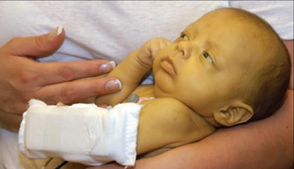
Neonatal Jaundice (Hyperbilirubinemia of The Newborn)

Slide 2
Objectives
By the end of this presentation, the student should be able to:
Describe bilirubin synthesis, transport, metabolism and excretion
Distinguish between physiological and pathological jaundice in the newborn infant
Mention the appropriate investigations for evaluating a jaundiced infant
Mention the strategies for prevention and treatment of jaundice

Slide 3
Neonatal Jaundice
A yellow discoloration of sclera & skin due to an increase in serum bilirubin
Jaundice usually appears in the newborn infant when serum bilirubin concentration exceeds 85 μmol/L
Neonatal jaundice occurs in the majority of infants (>50% of the term and 80% of the preterm infants)

Slide 4
Bilirubin Metabolism
Synthesis
From the breakdown of the heme molecule:
The hemoglobin (80% )
Nonerytheroid heme (cytochrome, myoglobin..) (20%)
The bilirubin produced is Unconjugated (indirect bilirubin)
Unconjugated bilirubin is lipid soluble (pass through BBB) but not water soluble

Slide 5
Bilirubin Metabolism
Transport
Unconjugated bilirubin is bound to albumin and carried via blood stream to hepatocytes
Hepatocytes uptake this Bilirubin and transport it intracellular where it is metabolized

Slide 6
Bilirubin Metabolism

Slide 7
Bilirubin Metabolism
Conjugation
Bilirubin is conjugated to glucoronic acid by the enzyme glucoronyl transferase
Conjugated bilirubin (Direct bilirubin) is water-soluble (pass in urine) but not lipid soluble

Slide 8
Bilirubin Metabolism
Excretion
Conjugated Bilirubin is excreted into bile
In the intestine
Flora changes it to stercobilinogen (Excreted in the stool)
Small amount of stercobilinogen is absorbed and excreted in urine as urobilinogen
Converted back to unconjugated bilirubin by the enzyme β glucouronidase then reabsorbed and return back to liver (enterohepatic circulation)

Slide 9
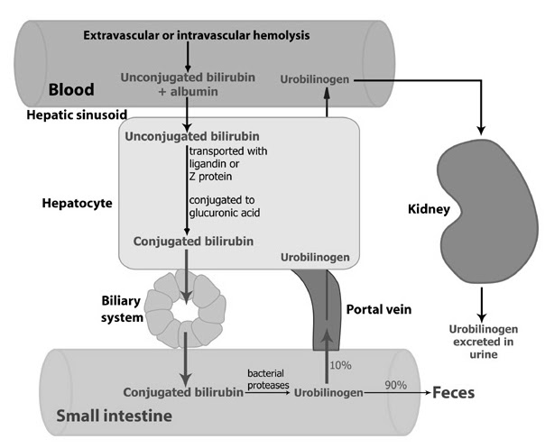
Bilirubin Metabolism Pathway

Slide 10
Pathogenesis
Unconjugated hyperbilirubinemia:
Defective conjugation
Increased production (hemolysis)
Increased bilirubin load (cephalhematoma)
Other unidentified mechanisms

Slide 11
Pathogenesis
Defective conjugation
Physiological Jaundice
Congenital hypothyroidism
Genetic enzyme deficiency (Crigler-Najjar syndrome)

Slide 12
Pathogenesis
Hemolysis
Immune hemolysis
Isoimmune (hemolytic disease of the newborn): Rh, ABO and minor groups.
Autoimmune (Maternal autoantibodies): maternal SLE
Non immune (Inherited hemolytic anemias) (G6PD,Spherocytosis, hemoglobinopathies)
Others: Infections, sepsis, DIC, vit. E deficiency , Drugs

Slide 13
Pathogenesis
Increased bilirubin load
Extravascular blood collection
Polycythemia
Dehydration
Increased enterohepatic circulation
Paralytic ileus
Hirschsprung’s disease
Intestinal stenosis or atresia

Slide 14
Pathogenesis
Uncertain mechanisms
Breast milk jaundice
Breast feeding jaundice
Some ethnic groups

Slide 15
Pathogenesis
Conjugated hyperbilirubinemia
Decreased excretion rate
Obstructive lesions
Congenital biliary atresia
Tumors or cyst
Inspissated bile
Metabolic and endocrine abnormalities
Hypothyroidism
Galactosemia

Slide 16
Pathogenesis
Mixed hyperbilirubinemia
Hepatocyte abnormalities
Sepsis
Intrauterine infections
Neonatal hepatitis
Hepatitis viruses
TORCH
Idiopathic hepatitis
Hypoxic insult

Slide 17
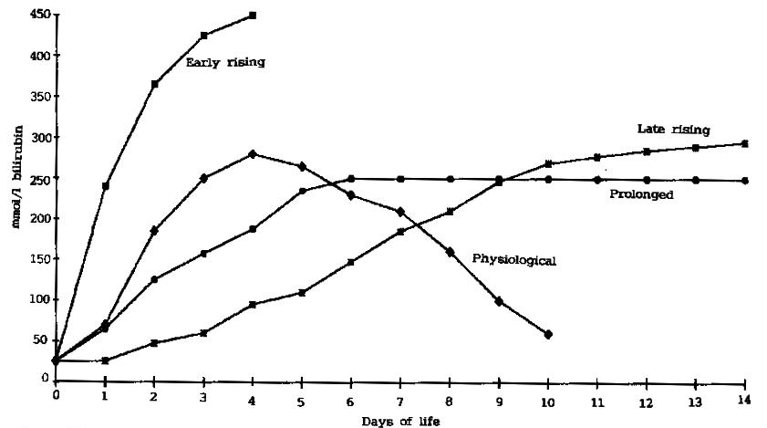
Pattern of neonatal jaundice
Severe hemolysis
Obstructive lesion
Biliary atresia
Neonatal hepatitis
Prematurity
Infection
Hypothyroidism
Breast milk jaundice
Crigler-Najjar
Physiological
Dehydration
Sepsis
Cephalohematoma
Polycythemia
Crigler-Najjar

Slide 18
Causes by the age of onset
At Birth Or Within 24h
Within The 1st Week
Hemolysis (Blood group incompatibility)
Congenital infection (TORCH)
Sepsis
Physiological jaundice
Congenital infection (TORCH)
Sepsis
Concealed hemorrhage
Crigler-Najjar syndrome

Slide 19
Causes by the age of onset
After The First Week
Persistent After The 2nd Week
Sepsis
Hepatitis
Biliary atresia
Breast milk jaundice
Hypothyroidism
Galactosemia
Inherited hemolytic anemia
Neonatal hepatitis
Biliary atresia
Inspissated bile syndrome

Slide 20
Bilirubin neurotoxicity
Caused by crossing of unconjugated bilirubin the BBB to the brain.
The level at which brain injury happens depends on
Maturity/Postnatal age
Binding capacity in the blood (Albumin concentration)
Associated risk factors (acidosis, infection, asphyxia…)
Kernicterus:
Yellowish staining of the brain tissue by bilirubin deposition associated with evidence of neuronal injury
Mostly affects basal ganglia, brain stem and cerebellar nuclei and anterior horn cells

Slide 21
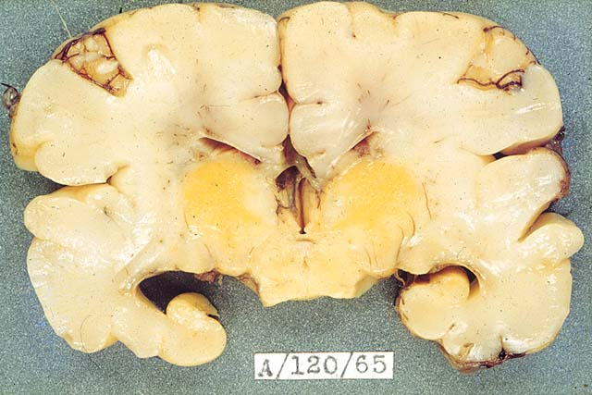
Kernicterus

Slide 22
Bilirubin neurotoxicity
Acute Encephalopathy
Chronic Encephalopathy
Three phases
Hypotonia, lethargy, high pitched cry and poor sucking
Extensors hypertonia, opithotonus, fever and seizures
Hypotonia replaces hypertonia in a week
Death may occur up the second phase
Athetosis
Sensorineural hearing deficit
Limited upward gaze
Dental dysplasia
Intellectual deficit

Slide 23
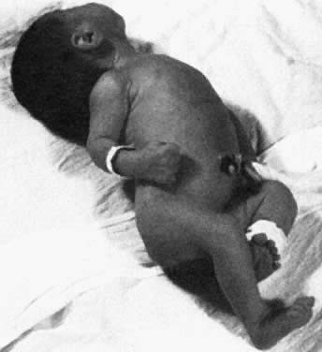
Kernicterus

Slide 24
Physiological jaundice
Due to:
Increased synthesis of bilirubin caused by the excessive RBCs load after delivery
Relative immaturity of the liver glucoronyl transferase
Onset usually on 2nd-3rd day
Disappear around day 7-10
Infant is usually healthy

Slide 25
Physiological jaundice
Exacerbating Factors
Prematurity
Polcythaemia
Dehydration
Breast feeding (usually higher by 50-65μmol/L than formula fed)
Laboratory
Rate of accumulation is less than 85μmol/L/day

Slide 26
Physiological jaundice
Treatment:
Maintain sufficient feeding
Serial measurements of serum bilirubin
Look for pathological causes if bilirubin level exceeds the expected for age
Phototherapy if needed

Slide 27
Phototherapy
Indicated if bilirubin level exceeds a set point
Exposure of infant to light with wave length around 450nm
Isomerization of bilirubin to nontoxic water soluble form
Eyes should be protected
Control for temperature and fluid balance is important

Slide 28
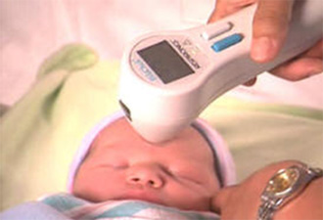
Management
Notes:
D. Side effects of phototherapy
1. Insensible water loss is increased in infants undergoing phototherapy, especially those under radiant warmers. The increase may be as much as 40% for term and 80% to 190% in premature infants. Incubators with servocontrolled warmers will decrease this water loss. Extra fluid must be given to make up for these losses (see Chap. 9).
2. Redistribution of blood flow. In term infants, left ventricular output and renal blood flow velocity decrease, whereas left pulmonary artery and cerebral blood flow velocity increase. All velocities return to baseline after discontinuation of phototherapy. In the preterm infant, cerebral blood flow velocity also increases and renal vascular resistance increases with a reduction of renal blood flow velocity. In ventilated preterm infants the changes in blood flow velocities do not return to baseline even after discontinuation of phototherapy. In addition, in preterm infants under conventional phototherapy, it has been shown that the usual postprandial increase in superior mesenteric blood flow is blunted. Fiberoptic phototherapy did not seem to affect the postprandial response. Although, the changes in cerebral, renal, and superior mesenteric artery blood flow with phototherapy treatment in preterm infants is of potential concern, no detrimental clinical effects due to these changes have been determined.
3. Watery diarrhea and increased fecal water loss may occur. The diarrhea may be caused by increased bile salts and UCB in the bowel.
4. Low calcium levels have been described in preterm infants under phototherapy.
5. Retinal damage has been described in animals whose eyes have been exposed to phototherapy lamps. The eyes should be shielded with eye patches. Follow-up studies of infants whose eyes have been adequately shielded show normal vision and electroretinography.
6. Tanning of the skin of black infants. Erythemia and increased skin blood flow may also be seen.
7. “Bronze baby” syndrome (see VII.B.3).
8. Mutations, sister chromatid exchange, and DNA strand breaks have been described in cell culture. It may be wise to shield the scrotum during phototherapy.
9. Tryptophan is reduced in amino acid solutions exposed to phototherapy. Methionine and histidine are also reduced in these solutions if multivitamins are added. These solutions should probably be shielded from phototherapy by using aluminum foil on the lines and bottles.
10. No significant long-term developmental differences have been found in infants treated with phototherapy compared with controls.
11. Phototherapy upsets maternal-infant interactions and therefore should be used only with adequate thought and explanation.

Slide 29
Phototherapy

Slide 30
Physiological vs. Pathological
 | Physiological | Pathological
Onset | 2nd-3rd day of life in term infants | At any time
Level of S. Bilirubin | Usually lower | Usually higher
Type of Bilirubin | Unconjugated | Any
Rate of increase | Slow increase (usually <85μmol/L/24h) | May be faster (usually >85μmol/L/24h)
Duration | Shorter (usually 7-10 days in the term and 14days in Preterm) | May be longer
Physical Exam and Lab. investigations | Normal, healthy infant | Abnormal

Slide 31
Breast MILK Jaundice
Conjugated hyperbilirubineamia beyound 2nd week of life
Disappears within 2 days if breast feeding is discontinued
May take up to 3 months to resolve completely
Due to (?) Postulated substance in human milk that inhibits enzymatic activity of glucoronyl transferase
Other pathologies need to be excluded
Treatment:
Temporary stoppage of breast feeding (not recommended)
Reassurance and follow up

Slide 32
Breast FEEDING Jaundice
May be related to decreased amount of milk consumed by the infant (breastfeeding failure )
More effective nursing may prevent early “starvation” in breastfed newborns and reduce the incidence of this type of jaundice

Slide 33
Hemolytic disease of the newborn
Is the hemolysis resulting from Rh or ABO incompatibility between the mother and the infant

Slide 34
Hemolytic disease of the newborn
Rh isoimmunization
Mother is Rh–ve and the fetus is Rh+ve
First pregnancy usually goes with no fetal problems
Mother is sensitized by fetal Rh+ve RBCs
Antibodies to Rh+ve RBCs is formed and it is transmitted to the fetus during second pregnancy
~ 1/100 pregnancies and not in every Rh-ve mother
May be prevented by AntiD administred to the mother

Slide 35
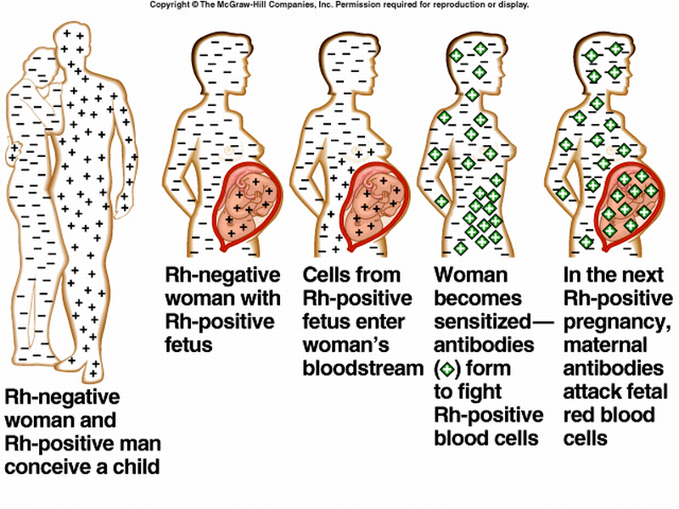
Hemolytic disease of the newborn

Slide 36
Hemolytic disease of the newborn
ABO incompatibility (milder disease)
The anti-A or Anti-B hemolysins (antibodies) present in a mother with blood group O is transferred to the fetus of A or B blood group
This results in hemolysis (most transferred antibodies can be neutralized by the baby)
1 in every 200 births
The first baby can be affected

Slide 37
Hemolytic disease of the newborn
Severe hemolysis manifestations
Hydrops fetalis
The most severe form
Often still birth with severe anemia and massive edema and ascitis
Icterus gravis neonatorum
Jaundice in the first 24hr, not at birth
Variable degree of hemolytic anemia
Hepatosplenomegaly
Gradual onset of anemia and slight jaundice in the first few days or weeks

Slide 38
Hemolytic disease of the newborn
Prevention
Anti-D within 72 hrs after delivery of Rh+ve child or abortion.
Management:
Life support
Establish diagnosis
Early phototherapy
Transfusion to restore normal hemoglobin level
Prevent dangerous rise of bilirubin hoping to prevent neurotoxicity (Exchange transfusion if needed)

Slide 39
Exchange transfusion
Indicated in
Kernictrus
Cord bilirubin >85μmol/L or
Cord hemoglobin <100 g/L
Rate of bilirubin rise > 8.5 μmol/L/hour
Unconjugated bilirubin level > 340 μmol/L at any age (at a lower level in presence of risk factor as prematurity, sepsis)
Double volume exchange transfusion

Slide 40
Exchange transfusion

Slide 41
Conjugated hyperbilirubinemia
Always pathological
Direct bilirubin >34μmol/L
Evaluation
Serum bilirubin
Liver function tests
Cultures (blood, urine,….)
Abdominal ultra sound
Isotopic scan (scintegraphy)
Liver biopsy

Slide 42
Conjugated hyperbilirubinemia
 | Neonatal hepatitis | Biliary atresia
Stool color | Intermittent pale | Persistent pale
Serum Bilirubin | Biphasic | Mainly conjugated
ALT, AST | Marked increase | Mild increase
Alk. Phosphatase | Mild increase | Marked increase
Liver scintegraphy | Sluggish uptake, Eventual excretion of isotope | Uptake is intact but excretion into intestine is absent
Liver biopsy | Inflammatory Infiltration, distorted lobular architecture and focal necrosis | Intact lobular architecture, bile ductular proliferation or paucity, perilobular edema and fibrosis

Slide 43
Conjugated hyperbilirubinemia
Treatment of chronic cholestasis
Treatment of the cause
Supportive
Fat soluble vitamins
Use of medium chain triglycerides-containing formula
Attention to micronutrients as Ca, Ph, Zinc
Surgical interference
Billiary atresia: Kasai operation´, Liver transplantation

Slide 44
THANK
YOU

