Slide 4
NB : the main Hormone responsible for growth is Growth Hormone

Slide 8
GH measurement : better measured at early morning or early evening

Slide 10
مهمه
انظر الكتاب ص 188 – 189
للرسمات اللي تشرح هذا السلايد
How to measure the height :
- By stadiometer → for 2y or older who can stand
- Intertometer (( tabeltop length )) → for < 2 y then for both use the Sentile chart to asses it )

Slide 11
المعادلات مهمه
حفظ
When you calculate the Midparental height Put it on the sentile chart ( as an expected target ) to asses the growth

Slide 12
NB : the avarage length of newborn is 50 cm

Slide 13
NB : the symphysis pubic divide the body to Upper and Lower segments

Slide 14
NBs
If the baby has U/L ratio less than normal → this indicate that the baby has short back = look for problems in this area
If the baby has U/L ratio more than normal → this indicate that the baby has short legs

Slide 15
Other ways than measurment
Use X-ray : Bone age (( skeletal maturation ))
→ Tanner Glather method
→ compare the x ray results to special atlas that show how the bone (( usually the hand )) should look at this age

Slide 16
Causes of Short Status
1- normal variant ( Famelial – Constitutional )
2- pathological
the child will be short and dismorphic
Has normal bone age – MCQ
Parent are normal but the child Is delayed (( the bone age is delayed )) – MCQ
the child will be short and disproportional
In endocrine type : the baby usually present short and obese (( bone age delayed )) – MCQ

Slide 18
90%
BA : bone age
CA : Actual age

Slide 19
Has normal bone age – MCQ

Slide 20
Parent are normal but the child Is delayed (( the bone age is delayed )) – MCQ

Slide 21
مهمه
انظر الكتاب ص 186 – 187
يوجد شرح مختصر لباقي الاسباب

Slide 27
Prader orichodometer : used to measure the testes size

Slide 33
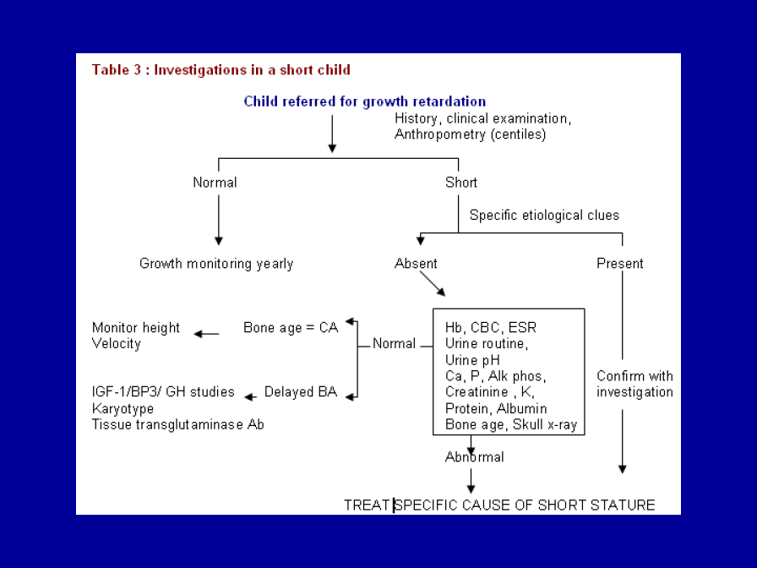

Slide 34
Cases
Case1 : Pt presented with short status and webing of the neck , pigon like chest and wide space nipples , Normal 46 XY
Diagnosis : Noonan syndrom
Case 2 : little girl 2 y old , presented short with large head and triangular face
→ Diagnosis : Silver Russle syndrom

Slide 36
Test for Celiac Dz

Slide 37
مهمه

Slide 39
NB : GH test randomly measure is not usefull
The Pt should be admitted o the hospital

Slide 44
Cases
Case 3 : 12 y short , 110 cm , wg : 50 kg , 97 sentile
3 causes :
Hypothyrodism
Cushing
Gh defecincy
3 investigations :
CBC
Thyroid function
Bone age
GH
IGF
Celiac Dz

Slide 45
Case 4 : 4 y old 75 cm , < 3 sd sentile , wh : 27 , parant normal
Causes :
Celiac dz : (( both wg and hg will be affected ))
Turner syndrom
Investigations :
Tissue transglutine
Karyptype
CBC
CXR
Bone age
Thyroid

Slide 47
MCQ

