Slide 5
NB : CGA : is gestational age + age ( in weeks ) outside the uterus
PCA : from conception التلقيح time to the present time ( accurate only in IVF ) PMA : from last menstruation to the present
NB : post natal day of life :Birthday is day 1
Postnatal age : Birthday is day 0

Slide 7
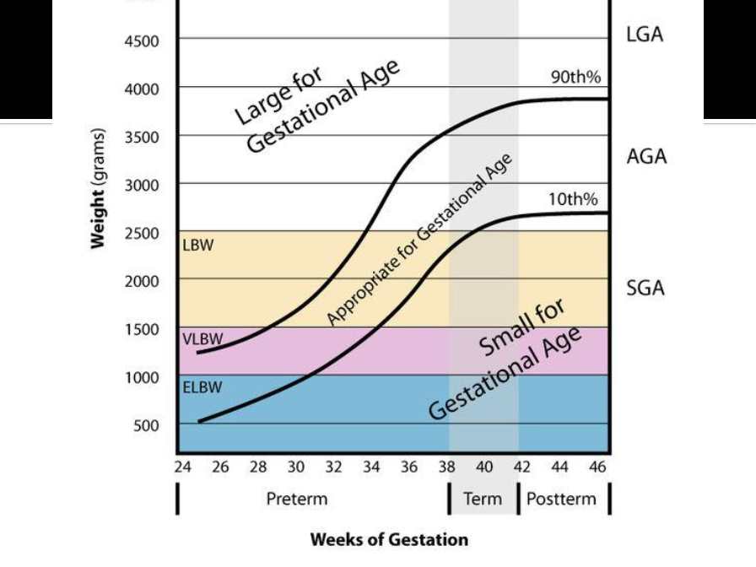

Slide 8
Of neonatal problems

Slide 9
مهمه

Slide 10
NB :cyanosis is : appearance of the deoxygenated blood
the Hg level should be normal so the cyanosis appear
Also the amount of the deoxygenated Hg should be 3 or more before the cyanosis is visible

Slide 11
The peripheral cyanosis is usually not significant as neonatal problem , it is usually occur as result of the environmental factors
It usually take hours m and some times days to disappear

Slide 13
It is always a red flag and should be investigated

Slide 18
MCQ
The physiological jaundice usually occur in the 2nd or 3rd day تفصل في محاضرات قادمه بشكل افضل

Slide 25
Remember : Surfactant function is : prevent the collapsing of the alveoli
Surfactant deficiency is common in Preterm Babies مهمه

Slide 27
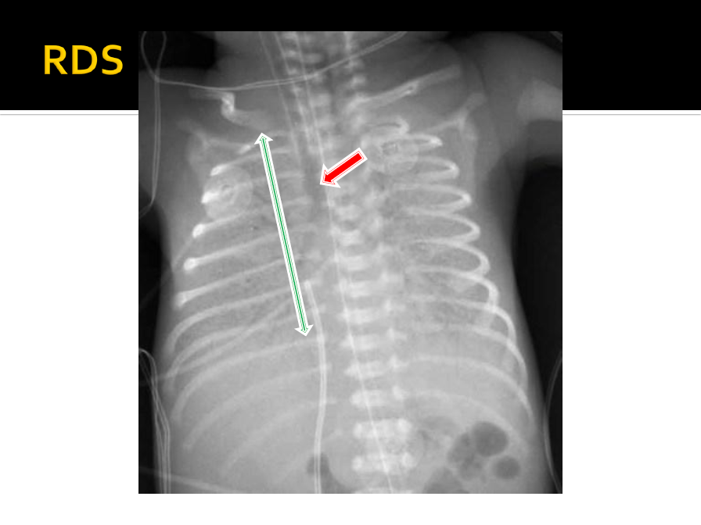
Radiological signs :
1- the lung span is shorter ( normally it is 8 rips ) 2- bronchogram
3- ground glass appearnce

Slide 29
NB : RDS should be differentiated from :
1
GBS pneumonia usually occur in mature babies always put in your mind RDS as differential diagnosis

Slide 30
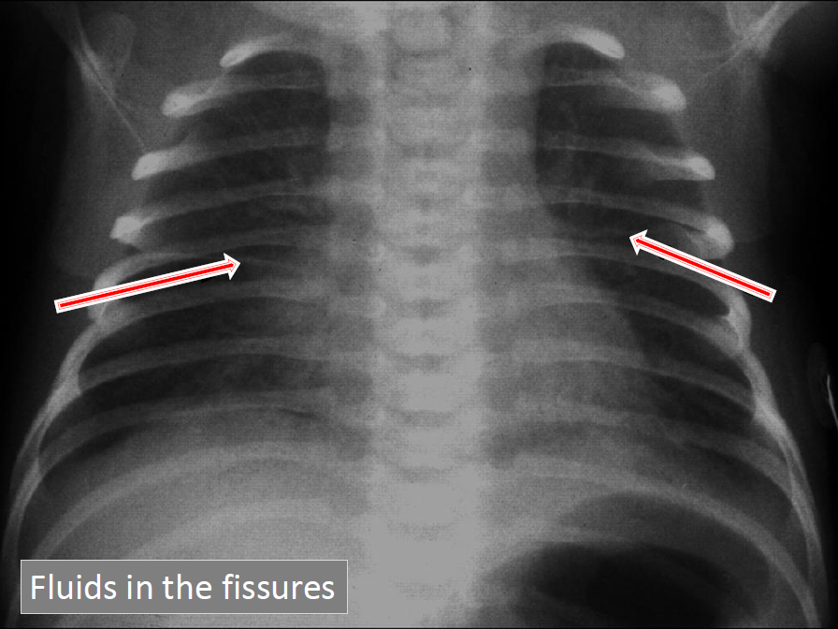

Slide 31
2
Pathophysilogy : the baby in this condition release the Meconium ( 1st bowel movement ) early in the uterus and with the 1st lung inspiration the baby will Aspirate it Rad appearance : similar to cystic fibrosis

Slide 32
3
If sever : chest tube + respiratory support
If not : respiratory support only

Slide 35
Dif : the content of the abdomen pass to the chest → lead to compression on the lung → end up by respiratory distress
Diagnosis :
Prenatal : by US
Post natal : intubate the baby to prevent the intestinal content from inflating
NB : it is more common in the left side

Slide 36
NB : it is more common in the left side

Slide 37
لم يشرح ولم يذكر الدكتور انه غير مطلوب

Slide 39
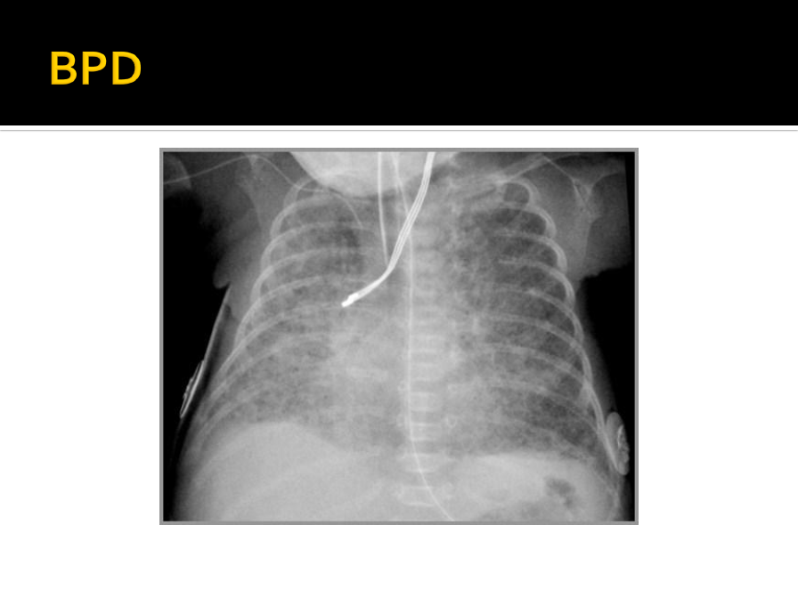

Slide 40
لم يشرح ولم يذكر الدكتور انه غير مطلوب

Slide 47
لم يشرح ولم يذكر الدكتور انه غير مطلوب

Slide 52
NB : IVH treatment :
Wait and see + prevention
NB : it divided to 4 grades according to the dilatation level

Slide 53
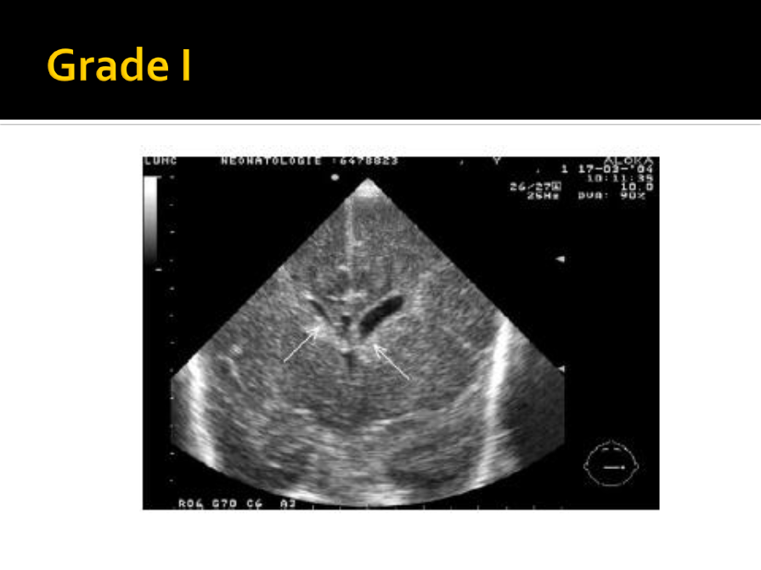

Slide 55
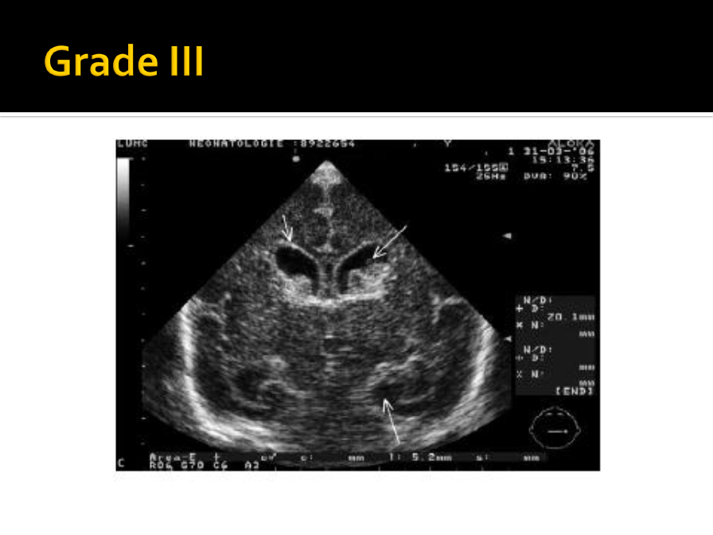

Slide 57
لم يشرح ولم يذكر الدكتور انه غير مطلوب

Slide 67
لم يشرح ولم يذكر الدكتور انه غير مطلوب

Slide 72
مهم

