Slide 2
لذلك سيتم الاستعانه بالكتاب

Slide 4
NB : the neonatal peroid is from Birth to 28 day

Slide 5
Causes :
انظر المحاضره 1 للتفاصيل

Slide 6
انظر المحاضره 1 للتفاصيل

Slide 7
Respiratory distress in term infants
Newborn infants with respiratory problems develop the following signs of respiratory distress:tachypnoea (>60 breaths/min)
laboured breathing, with chest wall recession (particularly sternal and subcostal indrawing) and nasal flaring
expiratory grunting
cyanosis if severe.
The causes in term infants are listed in Table 10.3.

Slide 8
Pulmonary
Common | Transient tachypnoea of the newborn
Less common | Meconium aspiration
 | Pneumonia
 | Respiratory distress syndrome
 | Pneumothorax
 | Persistent pulmonary hypertension of the newborn
 | Milk aspiration
Rare | Diaphragmatic hernia
 | Tracheo-oesophageal fistula (TOF)
 | Pulmonary hypoplasia
 | Airways obstruction, e.g. choanal atresia
 | Pulmonary haemorrhage
Non-pulmonary
 | Congenital heart disease
 | Intracranial birth trauma/encephalopathy
 | Severe anaemia
 | Metabolic acidosis

Slide 9
1

Slide 10
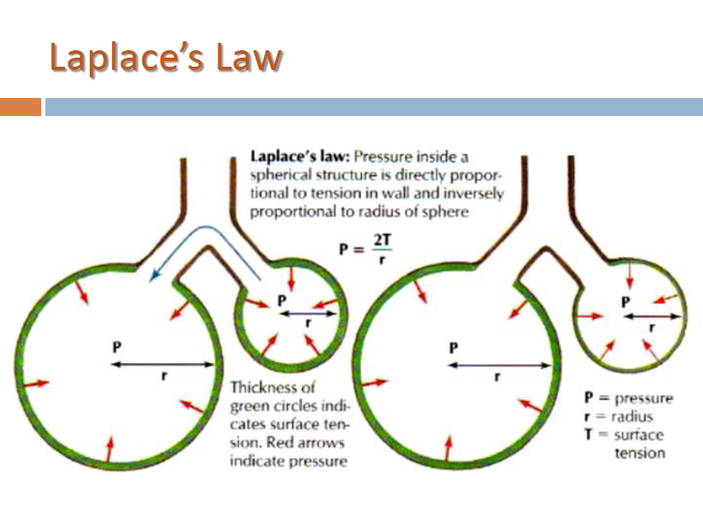
So , the surfactant decrease the surface tension in all alveoli So by that it decrease the pressure and help in making the alveoli open

Slide 11
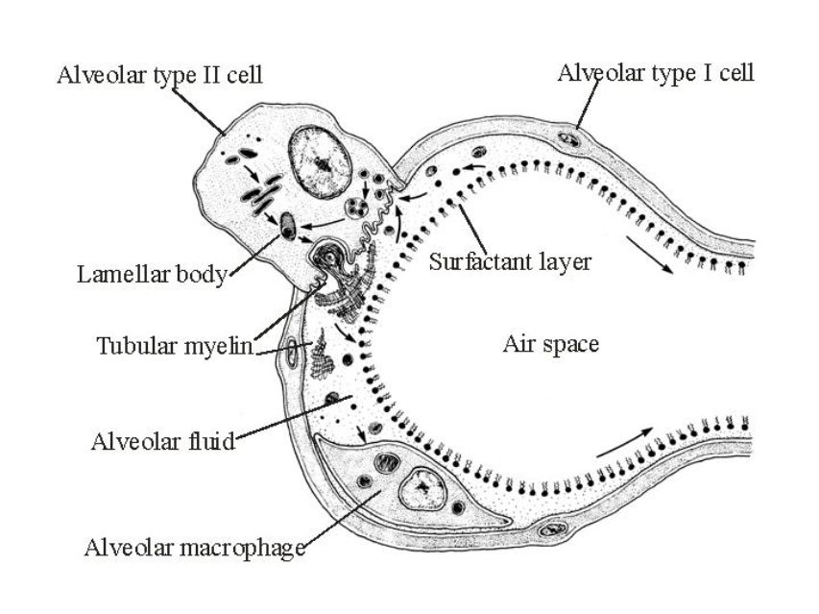
The surfactant deficiency is common in preterm babies

Slide 13
Risk factors : 1- prematurity 2- diabetic mother
It last for few days and it improve as the stress help the child to start producing surfactant
The grunting is due to closure of the vocal cord ass an attempt to increase the pressure
Ground glass appearance : because some alveoli are open and other are collapsed
Bronchogram : appearance of the air tubes on the opacity of the lung

Slide 14
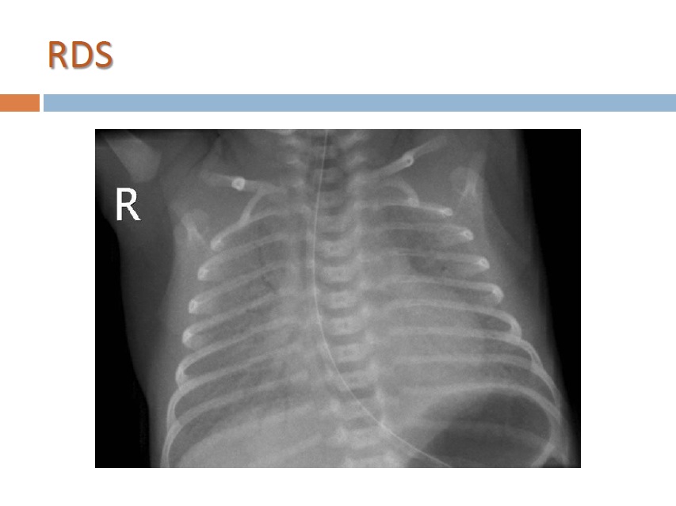

Slide 15
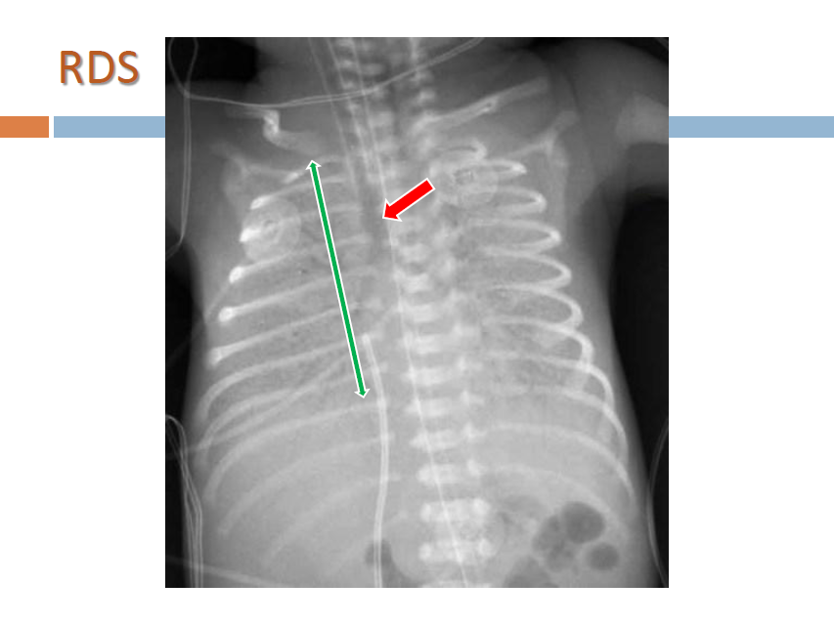

Slide 16
Nb : we give Abx because Pneumonia ( which will be explained later ) has exactly the same clinical pic of RDS So we treat with Abx
مهمه

Slide 17
2
Prolonged rupture of the membranes, chorioamnionitis and low birthweight predispose to pneumonia. Infants with respiratory distress will usually require investigation to identify any infection. Broad-spectrum antibiotics are started early until the results of the infection screen are available.

Slide 18
3
This is by far the commonest cause of respiratory distress in term infants. It is caused by delay in the resorption of lung liquid and is more common after birth by Caesarean section. The chest X-ray may show fluid in the horizontal fissure. Additional ambient oxygen may be required. The condition usually settles within the first day of life but can take several days to resolve completely. This is a diagnosis made after consideration and exclusion of other causes.

Slide 19
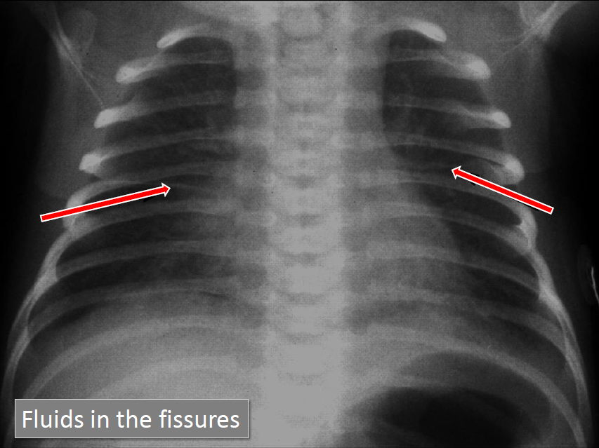

Slide 20
4
Meconium is passed before birth by 8-20% of babies.
It is rarely passed by preterm infants, and occurs increasingly the greater the gestational age, affecting 20-25% of deliveries by 42 weeks. It may be passed in response to fetal hypoxia. At birth these infants may inhale thick meconium.
Asphyxiated infants ( risk factor (IMP)) may start gasping and aspirate meconium before delivery. Meconium is a lung irritant and results in both mechanical obstruction and a chemical pneumonitis, as well as predisposing to infection.
In meconium aspiration the lungs are over-inflated, accompanied by patches of collapse and consolidation. There is a high incidence of air leak, leading to ( complications IMP ) pneumothorax and pneumomediastinum.
Artificial ventilation is often required. Infants with meconium aspiration may develop persistent pulmonary hypertension of the newborn which may make it difficult to achieve adequate oxygenation despite high pressure ventilation . Severe meconium aspiration is associated with significant morbidity and mortality.

Slide 22
This condition might complicate to pnemothorax
Management : O2 , Abx , ventilator

Slide 23
5
A pneumothorax may occur spontaneously in up to 2% of deliveries. It is usually asymptomatic but may cause respiratory distress.
Pneumothoraces also occur secondary to meconium aspiration, respiratory distress syndrome or
as a complication of ventilation.
Management : if mild : observation + support
if sever ( tension pneumothorax ) : chest tube

Slide 24
6
This occurs in about 1 in 4000 births. Many are now diagnosed on antenatal ultrasound screening.
In the newborn period, it usually presents with failure to respond to resuscitation or as respiratory distress. In most cases, there is a left-sided herniation of abdominal contents through the posterolateral foramen of the diaphragm. The apex beat and heart sounds will then be displaced to the right side of the chest, with poor air entry in the left chest.
Vigorous resuscitation may cause a pneumothorax in the normal lung, thereby aggravating the situation. The diagnosis is confirmed by X-ray of the chest and abdomen (Fig. 10.21).
Management : Once the diagnosis is suspected, a large nasogastric tube is passed and suction is applied to prevent distension of the intrathoracic bowel( IMP – 1st step ) . After stabilisation, the diaphragmatic hernia is repaired surgically, but in most infants with this condition the main problem is pulmonary hypoplasia - where compression by the herniated viscera throughout pregnancy has prevented development of the lung in the fetus. If the lungs are hypoplastic, mortality is high.

Slide 25
In accidents Or in obese people

Slide 27
7

Slide 28
2
Mostly iatrogenic مهمه
And the child will be undergrowth and predispose to respiratory problems
1st choice is prevention : by decrease the supportive methods to the minimum
If it occur support the baby with O2 and try to reduce the inflammation

Slide 29
On X ray it is similar to Cystic fibrosis

Slide 30
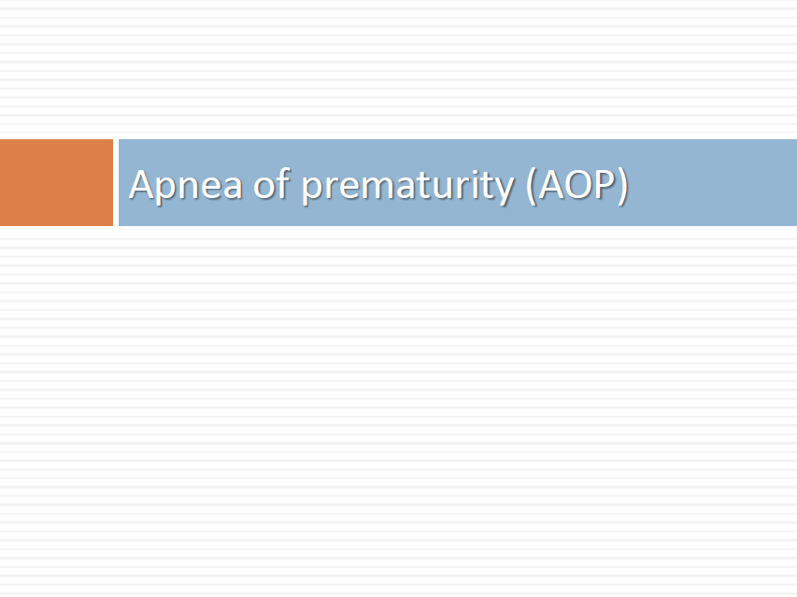
8

Slide 36
9
It occur in premature babies due to immature Respiratory center
It improve by it self and do not need intervention

