Slide 2
Formula=Breast milk?!
Do you really believe it?
Notes:
2

Slide 3
A crucial question
Is infant formula really very near to, or almost like breastmilk?
No!
Even now, formula is only superficially similar to breastmilk
There is no question about this!
Notes:
3

Slide 4
Is formula almost like breast milk?
How can it possibly be?
We don’t really know what is in breastmilk
There is no such thing as a standard breastmilk
Even the formula companies admit that not all babies need exactly the same stuff and, of course, will use this notion to market their formulas (special formulas for special babies)
At the same time convincing us that their formula is virtually the same as breastmilk
But different and better than the formulas of their competitors, which are also virtually the same as breastmilk
Notes:
4

Slide 5
Breast milk varies
From woman to woman
Depending on the baby’s gestational age
With the mother’s diet
With the time of day
With the length of time after birth
During a single feeding
With which breast is offered first
With the time of the mother’s menstrual cycle
With the number of previous pregnancies
Depending on how the milk is obtained
Notes:
5

Slide 6
Human Milk
The defining characteristic of the class Mammalia is the ability to produce milk, an externally secreted fluid designed specifically to nourish the young.
It is a unique complex fluid with a composition that is species specific.
It is the most appropriate source of nutrition for the infant up to the age of 6 months.
It is rich in nutrients needed for the growth of the newborn, and in non-nutritional bioactive components such as the maternal antibodies, chemical mediators, vitamins, enzymes and some types of white blood cells in breast milk (particularly in colostrum) augment the action of the baby’s immune system.
This unique fluid evolves to meet the changing needs of the baby during growth and maturation.

Slide 7
Breast Anatomy

Slide 9
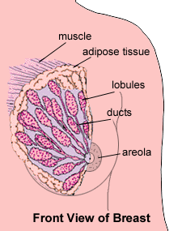
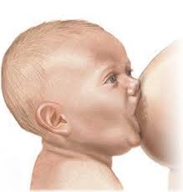

Slide 10
Types of Breast Milk
There are broadly three types of breast milk :
1- Colostrum;
It is the first stage of breast milk that is produced after birth and lasts for several day after child birth.
It has a yellowish to cream colored thick appearance.
It is high in protein especially antibodies( that provide protection to the newborn against infection) , vitamines( especially fat soluble vitamines) , minerals but very low in fat compared to mature breast milk .
2- Transitional milk;
It occurs after colostrum stage and lasts for approximately two weeks until it is replaced by mature milk.
The transitional milk contains high levels of fat, lactose, and vitamins to help the baby regain any weight lost after birth .
- It contains more fat and lactose than colostrum and has water-soluble vitamins.
3- Mature milk ; - It is the final milk that is produced and lasts throughout lactation.
-Ninety percent is water, which is necessary to maintain hydration of the infant. The other 10% is made up of carbohydrates, proteins, and fats, which are necessary for both growth and energy.
-There are two types of mature milk: foremilk and hindmilk.

Slide 11
Types of Mature Breast Milk
During each breastfeeding session, the baby should receive two types of mature milk, the foremilk and the hindmilk to ensure that the baby is receiving adequate nutrition to grow and develop properly.
The foremilk (the milk "in front"); is produced at the beginning of each feeding. It contains water, vitamins, and protein.
The hindmilk ; is pushed out latter , it is heavier , richer in lipid and CHO.

Slide 12
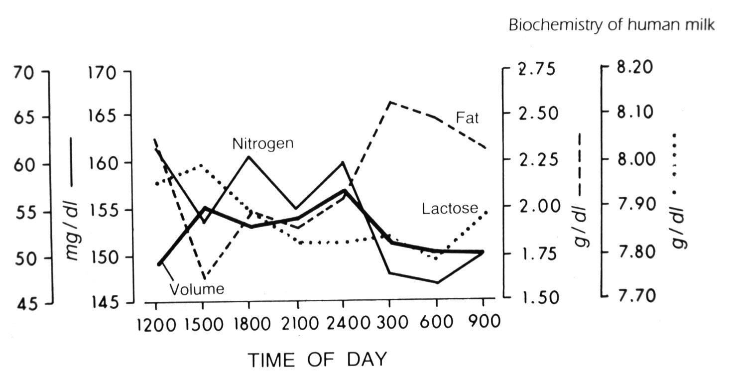
Diurnal variation of breast milk
Notes:
12

Slide 13
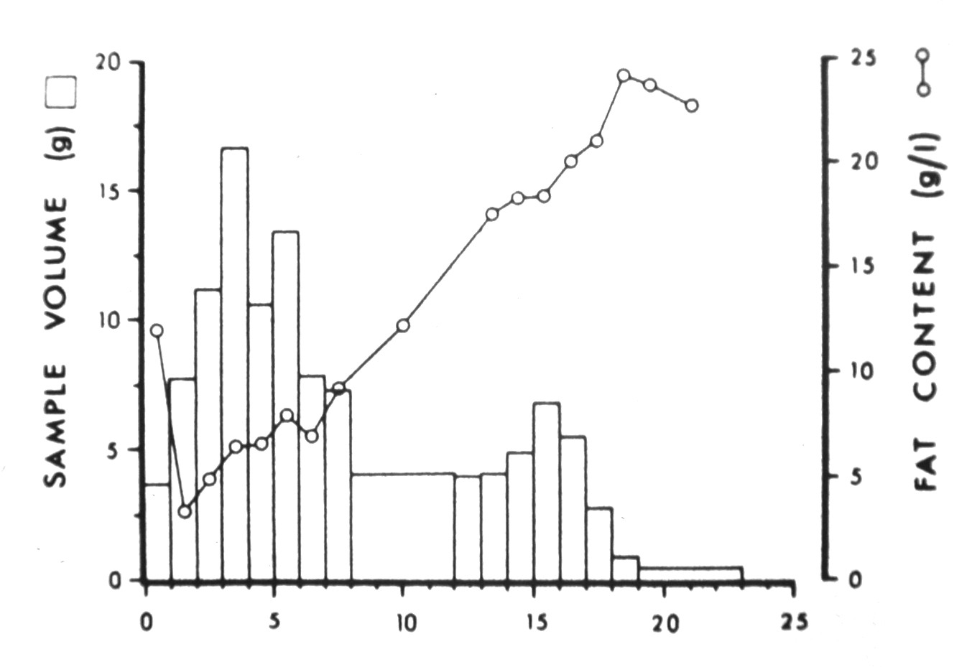
Variation in fat content during a single feeding
Notes:
13

Slide 14
Composition of Mature Milk
Mature milk contains on average:
Energy; (670-750 kcal / liter) .
Lipids (38 g / liter) - The main lipids found in human breast milk are the triacyl-glycerols, phospholipids, and fatty acids including essential fatty acids. Maternal diet does not affect the amount of fat in milk but does affect the types of fat. Cholesterol is present in breast milk but not in formulas.
Casein (2.5 g / liter) - protein - Casein or curds are proteins with low solubility which complex with calcium. These are present in breast milk in much lower concentration than in cow's milk.
Whey (0.64 g / liter) - protein - the whey proteins are located in the clear liquid left behind when clotted milk stands. The largest components are alpha-lactalbumen, lactoferrin, lyzozyme, albumen and immunoglobulins.
Nonprotein Nitrogen is used in amino acid synthesis and includes the nitrogen in urea, creatine, creatinine, uric acid and ammonia. Peptides, such as epidermal growth factor, somatomedin - C and insulin are also present in this fraction. Nucleotides such as cytidine monophosphate are derived from nucleic acids and play an important role in the immune system and protein synthesis.
Lactose (70 g / liter) carbohydrate - Lactose is the major carbohydrate in breast milk. It is composed of galactose and glucose. Lactose concentration in breast milk increases over the duration of breastfeeding.

Slide 15
Composition of Mature Milk

Slide 16
Proteins in Mature Milk
Proteins account for approximately 75 % of the nitrogen-containing compounds in breast milk
Casein (2.7%)of milk .
It is the main protein in mature human milk.
Casein or curds are proteins with low solubility and are negatively charged.
It complexes with calcium thus promoting its absorption.
These are present in breast milk in much lower concentration than in cow's milk.
Whey(0.6%) of milk. -
whey proteins are located in the clear liquid left behind when clotted milk stands. The largest components are alpha-lactalbumen, lactoferrin, lyzozyme, albumen and immunoglobulins.
Notes:
Casein: Ca phosphate, mag & citrate aggregate and give milk its white appearance. Casein’s phosphopeptides keep Ca soluble to facilitate absorption.
Whey: include serum proteins, enzymes, immunoglobulins, vitamins-, mineral- and hormone-binding proteins are components of whey.

Slide 17
The immunologic components of mature milk
While awaiting endogenous maturation of the baby's own immunologic systems, various immunologic and bioactive milk components act synergistically to provide a passive immunologic support system from the mother to her infant in the first days to months after birth.
The immunologic components include ;
Immunoglobulins ; Human milk contains all of the different antibodies (M, A, D, G, E), but secretory immunoglobulin A (sIgA) is the most abundant .
lactoferrin,; which binds to iron, thus making it unavailable to pathogenic bacteria;
lysozyme , which enhances sIgA bactericidal activity against gram-negative organisms;
Mucins adhere to bacteria and viruses and help eliminate them from the body.
Leukocytes; with the transition from colostrum to mature milk, the percentage of macrophages increases from 40-60% of the cells to 80-90% .

Slide 18
Enzymes in mature milk
Human milk contains various enzymes ;
- Some are specific for the biosynthesis of milk in the mammary gland (eg, lactose synthetase, fatty acid synthetase, thioesterase),
Others are specific for the digestion of proteins, fats, and carbohydrates that facilitate the infant's ability to break down food and to absorb human milk (such as lipase, and protease, amylase)
Certain enzymes also serve as transport moieties for other substances, such as zinc, selenium, and magnesium.
Some have antimicrobial activity such as lysozyme.
the enzyme lysozyme which inhibits the growth of many bacterial species by
disrupting the bacterial cell wall, more specifically, the proteoglycan layer

Slide 19
Cont.
In addition,
casein may inhibit the adhesion of various bacteria at different epithelial sites.
Lactalbumin is part of an enzyme complex that synthesizes lactose, and upon modification
seems to contribute to the apoptosis of malignant cells.

Slide 20
Vitamins & Minerals
Fat soluble vitamin A, D E & K
Water soluble vitamins in general are present ,their
content reflective of the mother’s diet .
Low vitamine B₁₂ is seen in women who are vegetarians, malnourished or have had gastric bypass .
Minerals ; The most important salts are calcium, sodium, potassium and magnesium, calcium representing the predominating mineral.
Notes:
Vitamin A: Content in colostrum is ~double that of mature milk
Yellow color from beta-carotene
Vitamin D: Most as 25-OH₂ vitamin D
Content reflective of mother’s exposure to sun
Needs to be supplemented to 400 IU beginning at 2 mos as per AAP.
Vitamin E: Level linked to milk’s fat content
Level not adequate to meet needs of preterm infants
Vitamin K: ~5% of breastfed infants at risk for K deficiency based on clotting factors
Infants who did not receive K injection at birth may be deficient
Water soluble in general: Content reflective of mother’s diet
Vitamin most likely to be deficient is B₆
Vitamin B₁₂ and folate: Bound to whey proteins
Low B₁₂ seen in women who:
have hypothyroidism or latent pernicious anemia
are vegans or malnourished
have had gastric bypass
Minerals contribute to osmolality (solute concentration per kg or solvent).
Content related to growth of infant
Concentration decreases over 1st 4 months, except for magnesium
Bioavailability: Most have high bioavailability. Good b/c required less from mom.
Exclusively breastfed infants have very low risk of anemia despite low iron content of human milk
Zinc: Bound to protein & highly available
Rare defect in mammary gland uptake of zinc may cause zinc deficiency that appears as diaper rash
Other trace minerals: Fluoride is only mineral not affected by mother’s diet. As per ADA, baby may need fluoride supp.

Slide 21
Milk Carbohydrates
Lactose;
Is the principal carbohydrate of human milk .
Oligosaccharides;
Second dominant CHO
Prevent binding of pathogenic microorganisms to gut, which prevents infection & diarrhea.
Notes:
Other CHO include: glucose, polysaccharides, oligosacchrides, protein-bound CHO.
Oligo: A medium-length CHO containing lactose on one end. low osmolality, stimulates bifidus bacteria, inhibits e. coli. (FOS).

Slide 22
Lipid
More than 98% of the fat in breastmilk is in the form of triglycerides.
Short-chain fatty acids (carbon chain length � 8) are only present in trace amounts.
Oleic acid (18:1) and palmitic acid (16:0) are the most abundant fatty acids in breastmilk .
cholesterol
(LCP) fatty acids(18- to 22-carbon length) are needed for brain and retinal development of the infant.

Slide 23
Colostrum is a wonderful fluid
More Na, K, Cl, protein, fat-soluble vitamins
More minerals
Rich in immunoglobulins, especially SIgA
Rich in cells (100,000-5,000,000 leukocytes per ml)
Higher percentage of fat is docosahexaenoic (DHA), arachidonic and linolenic acids
Notes:
23

Slide 24
Notes:
24

Slide 25
In addition, colostrum…
Facilitates establishment of L. bifidus flora in GI tract
Facilitates expulsion of meconium
Is the best “treatment” for preventing and treating hypoglycaemia and hyperbilirubinaemia
Notes:
25

Slide 26
What’s missing in breastmilk?
Iron?
No, there is just the right amount of iron in breastmilk
Together with the stores the baby gets during pregnancy, at birth especially with delayed clamping of the cord, probably there is enough to keep the baby iron sufficient for up to 6 to 9 months
Bean counters, be careful (amounts of breastmilk babies get, the amount of protein, iron etc)
Vitamin D?
Breastmilk does not need to supply vitamin D
Notes:
26

Slide 27
What about iron?
The following is the abstract of an article that was published in the American Journal of Human Biology 2014:26;10-17
It questions the basic assumption that what might be "normal" for the artificially fed baby should be considered normal for the breastfed baby

Slide 28
Here is the abstract
Recently, there has been considerable debate regarding the appropriate amount of iron fortification for commercial infant formula. Globally, there is considerable variation in formula iron content, from 4 to 12 mg iron/L. However, how much fortification is necessary is unclear. Human milk is low in iron (0.2–0.5 mg/L), with the majority of infant iron stores accumulated during gestation. Over the first few months of life, these stores are depleted in breastfeeding infants.

Slide 29
Here is the abstract (continued)
This decline has been previously largely perceived as pathological; it may be instead an adaptive mechanism to minimize iron availability to pathogens coinciding with complementary feeding. Many of the pathogens involved in infantile illnesses require iron for growth and replication. By reducing infant iron stores at the onset of complementary feeding, infant physiology may limit its availability to these pathogens, decreasing frequency and severity of infection.

Slide 30
vitamin D.
All babies need vitamin D. Artificially fed babies have vitamin D already added artificially to the milk at the factory. Breastfed babies unable to get adequate sunshine exposure should receive supplementation

Slide 31
What’s missing from formula?
What about colostrum?
Where do I buy Similostrum?
Enfalostrum?
Good Startostrum?
Notes:
31

Slide 32
Which formula is closest to which colostrum?
Notes:
32

Slide 33
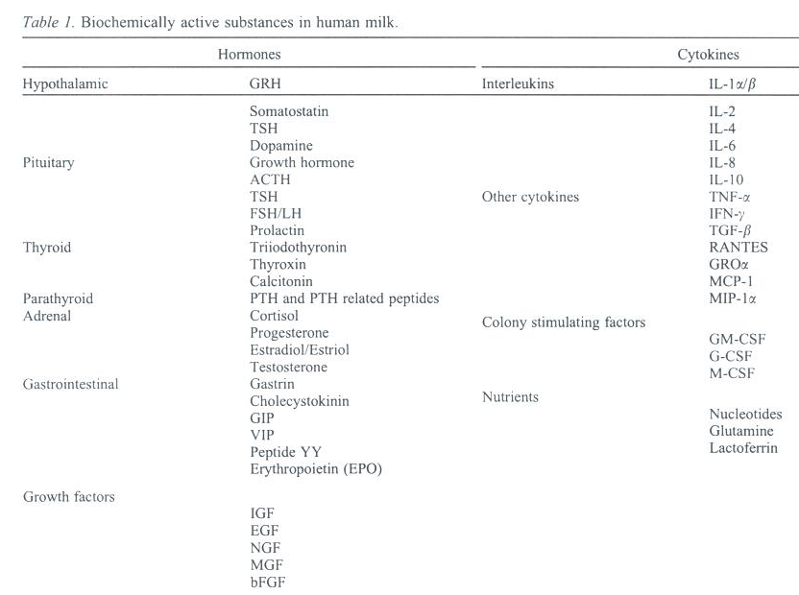
Notes:
33

Slide 34
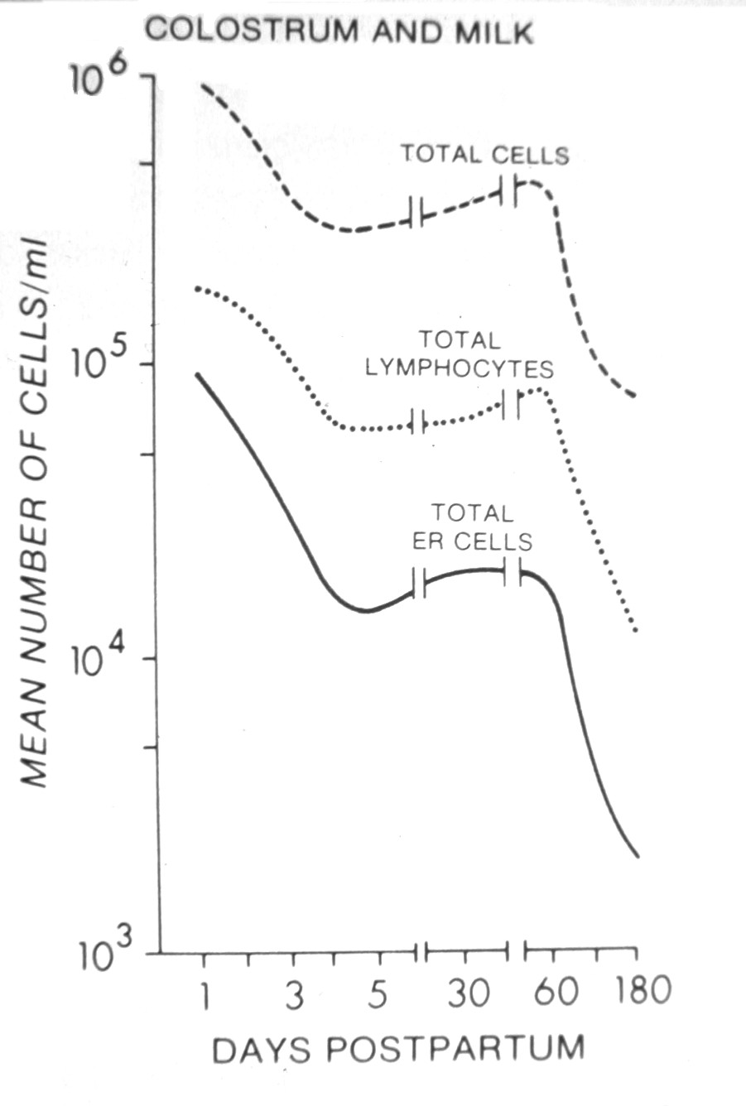
Notes:
34

Slide 35
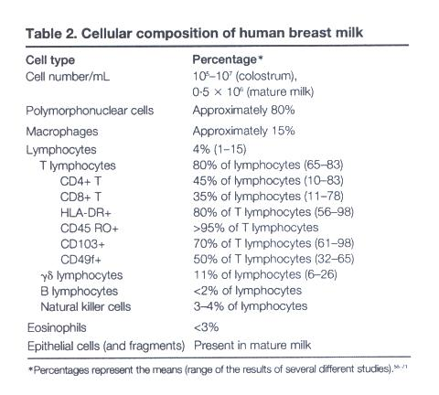
Notes:
35

Slide 36
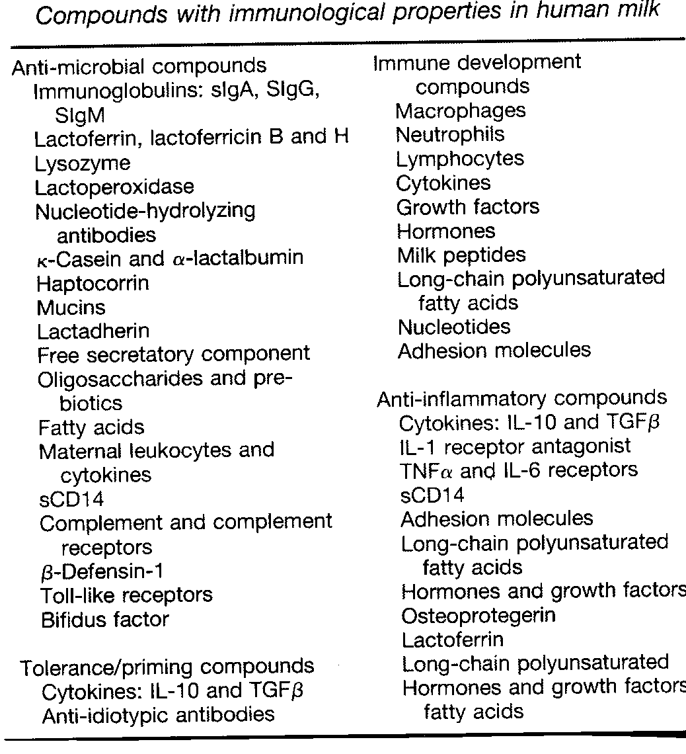
Immune Factors in Breastmilk
Comparison of Human Milk and Formula
August 8, 2013 in Why Breast is BestNo Comments
Notes:
36

Slide 37
And these are not even all of the immune factors which are present in breastmilk, but absent from formulas
Notes:
37

Slide 38
STEM CELLS.

Slide 39
It was discovered seven years ago that human breast milk also contains a kind of stem cell. The question was whether The above now demonstrate that as in humans, mouse milk contains cells that express stem cell markers. These studies in mice provide the first evidence of migration and integration of breastmilk stem cells to organs of the neonate.
April 2014 The FASEB Journal vol. 28 no. 1 Supplement 216.4

Slide 40
Breastmilk made to measure
Notes:
40

Slide 41
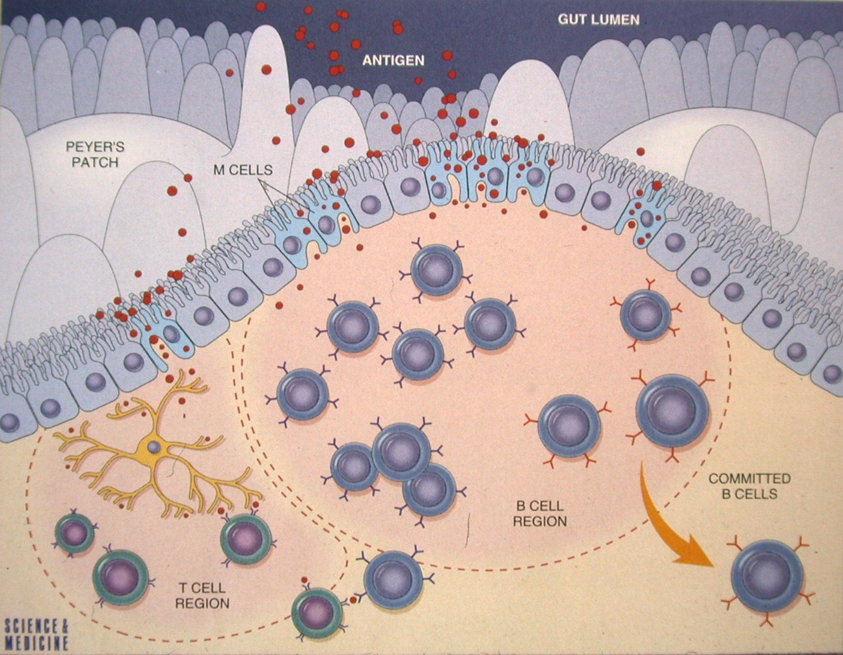
Notes:
41

Slide 42
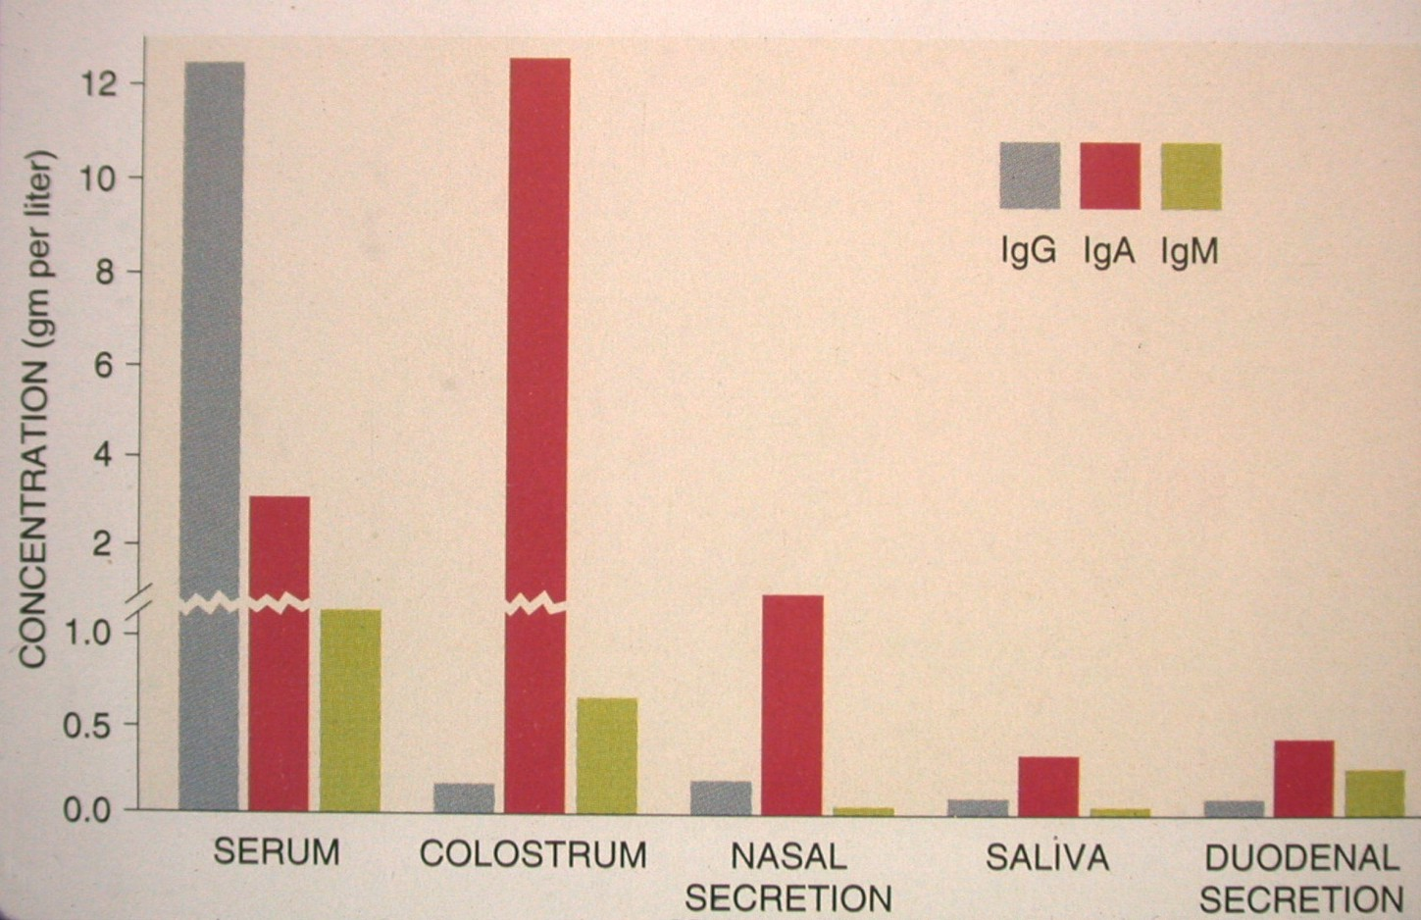
Notes:
42

Slide 43
Do maternal antibodies pass on auto-immune disease to the baby?
The predominant immunoglobulin in human milk is secretory IgA, but there is no evidence that secretory IgA is a pathogenic antibody in autoimmune disease
In any case, secretory IgA is not absorbed via the gastrointestinal tract
There is no evidence that IgG in human milk is absorbed into the circulation of the infant
IgM is also excluded from the infant’s circulatory system

Slide 44
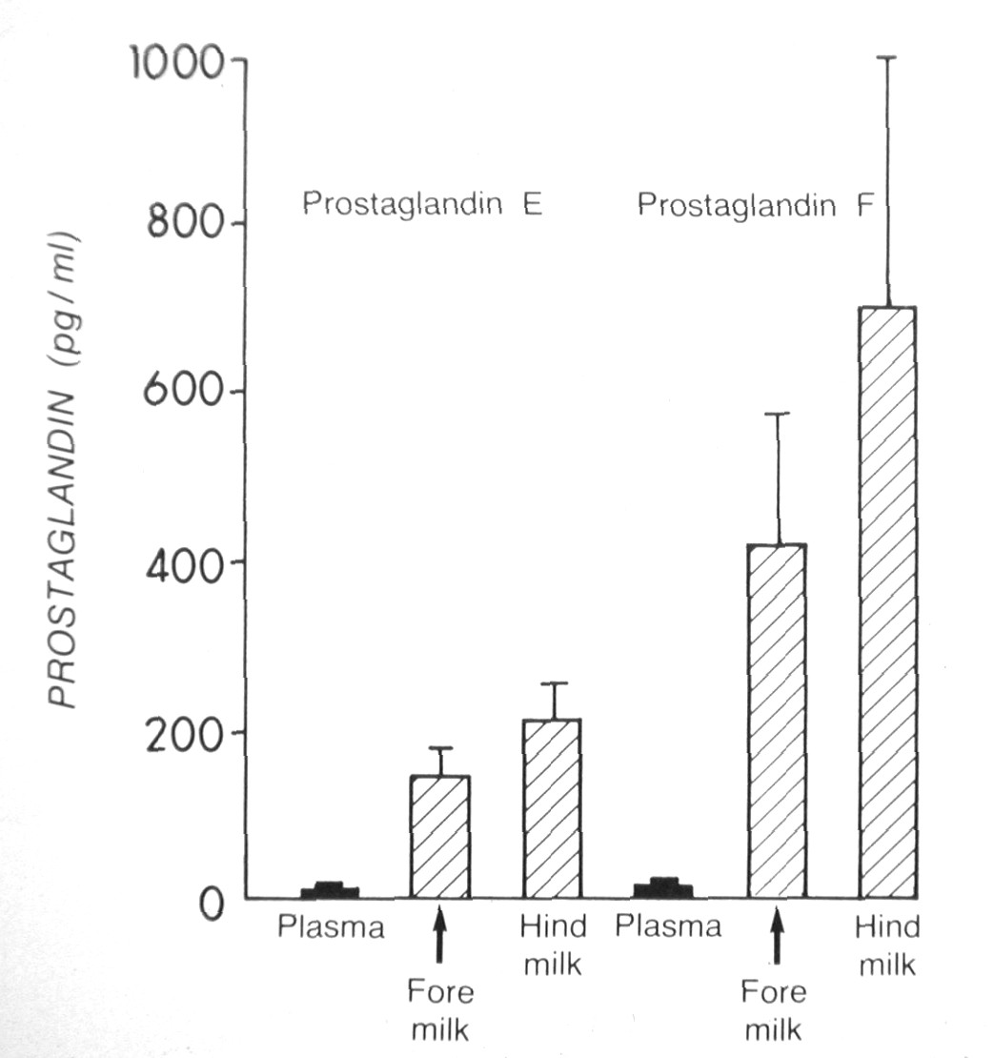
Notes:
44

Slide 45
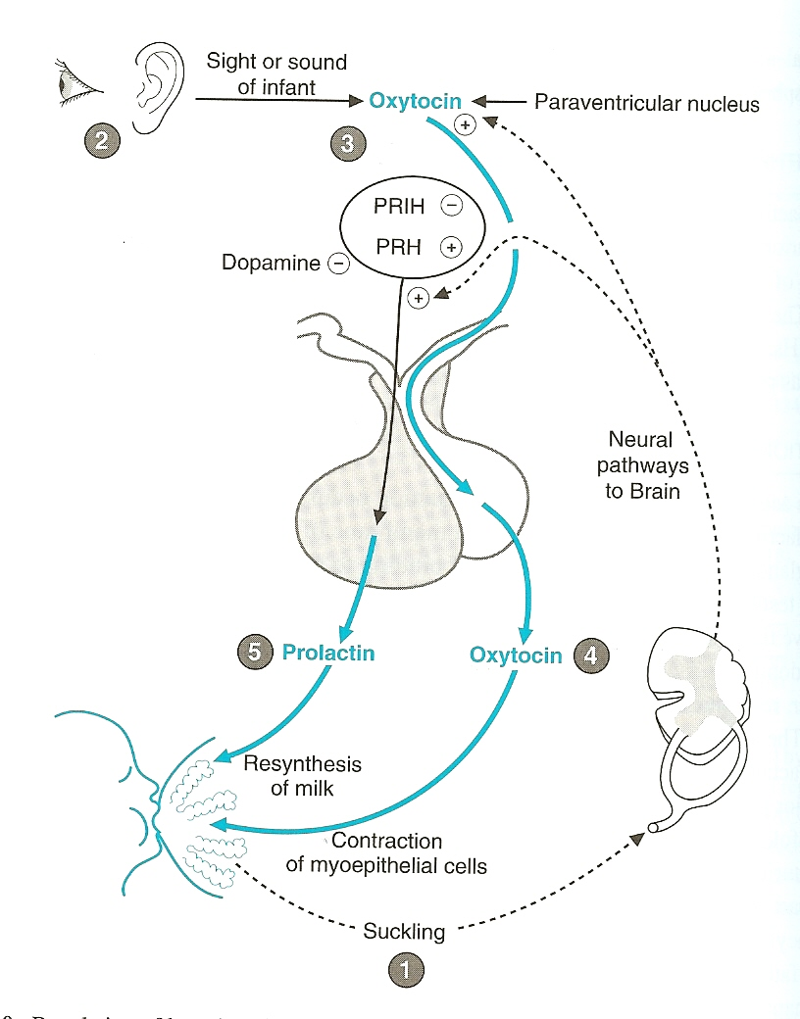
Stimulation of milk production
Milk ejection is promoted by ;
1-neurogenic stimulant (stimulated by suckling)
2-hormonal reflex (oxytocin)

Slide 46
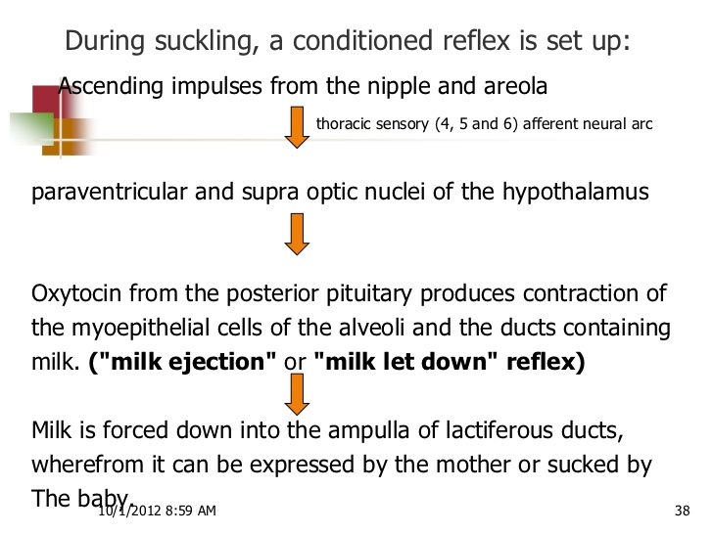
Physiology of lactation

Slide 47
Formula contains the same amount of protein as breastmilk, really?
Breastmilk contains at about 3 months after birth, 8 to 10 g/L of protein
This is somewhat less than most formulas (most contain 12-15 g/L or more)
But:
Up to 60-65% (about 5 g/L) of the protein in breastmilk is lactoferrin, which is not absorbed from the gut!
About 6% (0.5 g/L) of the protein is immunoglobulin, which is also not absorbed from the gut!
So only at most, 4.5 g/L of protein
→Babies can’t grow on this amount, but they do!
→formula contains way too much protein (3.5x more)
Notes:
47

Slide 48
What about S100B protein?
S100B is an acidic calcium-binding protein of the EF-hand family, characterized by the most common calcium binding motif of a helix-loop-helix structure
The protein encoded by this gene is a member of the S100 family of proteins containing 2 EF-hand calcium-binding motifs. S100 proteins are localized in the cytoplasm and/or nucleus of a wide range of cells, and involved in the regulation of a number of cellular processes such as cell cycle progression and differentiation. It may be important to brain development
Notes:
48

Slide 49
altered expression of this gene have been implicated in several neurological, neoplastic, and other types of diseases, including Alzheimer's disease, Down's syndrome, epilepsy, amyotrophic lateral sclerosis, melanoma, and type I diabetes. [provided by RefSeq, Jul 2008]
Present in much higher concentrations in breastmilk than in formula (and higher in mature breastmilk than in colostrum)

Slide 50
Stem cells in breastmilk
See:
Cregan MD, Fan Y, Applebee, A, et al. Identification of nestin-positive putative mammary stem cells in human breastmilk Cell Tissue Res (2007) 329:129–136
Notes:
50

Slide 51
Is it good or bad?
Breastmilk is full of immune factors
Immune factors in breastmilk work by lining the mucous membranes of the baby’s body and prevent pathologic bacteria from entering the baby’s body
When the baby spits up, immune factors line the babies upper respiratory tract and upper gut twice, once on the way down, again on the way up
So if the baby aspirates breastmilk?
formula=breastmilk?
Notes:
51

Slide 52
All this is very nice, but does it make a difference to the baby?
You bet it does!
The studies are all there, but so many people prefer not to believe them because they don’t want to believe them (my baby was formula fed and he’s a PhD)
As soon as one study comes out doubting the results of many studies, we hear “You see? Formula is just as good!”
Studies showing risks of formula are never as well done as studies showing no risk…
Remember, if studies showing risks of formula feeding are not perfect, the burden of proof that there is no risk to formula is on those who say it’s okay
Notes:
52

Slide 53
Formula: a heavy metal cocktail
Notes:
53

Slide 54
Too much…
Too much aluminum
Cow milk formula 100x
Soy formula up to 2000x
Too much manganese
Too much lead
Too much cadmium
Too much iron
Notes:
54

Slide 55
Errors in infant formulas
Notes:
55

Slide 56
Recalls of infant formulas
1978
Enfamil contaminated with E. coli
1979
SMA recalled (improper homogenization)
Neomulsoy and CHO free caused hypochloremic alkalosis
1980
Soyalac contained too much Vitamin D
Enfamil recalled (sour, green, curdled)
Notes:
56

Slide 57
Just one study
CONCLUSIONS: Breastfeeding is protective against SIDS, and this effect is stronger when breastfeeding is exclusive. The recommendation to breastfeed infants should be included with other SIDS risk-reduction messages to both reduce the risk of SIDS and promote breastfeeding for its many other infant and maternal health benefits. Pediatrics 2011;128:103–110
A study completely ignored it seems

Slide 58
In fact…
No evidence that simply adding DHA and ARA to formula gives the benefit it’s supposed to
These PUFA’s need to be added in correct proportions, and they are not absorbed from formula in the same way as they are from breastmilk
Studies do not support any benefit when added to formula
See http://cornucopia.org/DHA/DHA_FullReport.pdf
Notes:
58

Slide 59
Notes:
59

Slide 60
FDA ALERTS PUBLIC REGARDING RECALL OF POWDERED INFANT FORMULA (November 1, 2002): see http://www.fda.gov/bbs/topics/NEWS/2002/NEW00849.html
Notes:
60

Slide 61
Aside from many recalls of formulas over the years…
For those who are fond of exotic foods…
Interesting food that has been found in infant formulas:
Rat hair
Beetle parts and beetle larvae
Pieces of glass
Melamine—due to adulteration of milk by greedy people
Notes:
61

Slide 62
Risks for the mother
Ovarian cancer
Endometrial cancer
Breast cancer
Osteoporosis
Iron deficiency
Delayed involution of the uterus
Notes:
62

Slide 63
Breast cancer
Women who breastfeed are less likely to develop breast cancer
Collaborative Group on Hormonal Factors in Breast Cancer. Breast cancer and breastfeeding: collaborative reanalysis of individual data from 47 epidemiological studies in 30 countries, including 50,302 women with breast cancer and 96, 973 women without the disease Lancet 2002;360:187-195
This study brings together >80% of the worldwide epidemiological data on breast cancer and breastfeeding
Notes:
63

Slide 64
More maternal risks
Difficulty with weight loss
Disempowerment
Increased difficulty in attachment with baby
Cost
Notes:
64

Slide 65
Type 2 diabetes
Stuebe AM, Rich-Edwards JW, Willett WC, et al. Duration of lactation and incidence of type 2 diabetes J Am Med Assoc 2005;294:2601-2610
“Longer duration of breastfeeding was associated with reduced incidence of type 2 diabetes in 2 large cohorts of women”
Notes:
65

Slide 66
Metabolic syndrome
Ram K, Bobby P, Hailpern S, et al. Duration of lactation is associated with lower prevalence of the metabolic syndrome in midlife—SWAN, the study of women’s health across the nation Am J Obstet Gynecol 2008;198:268.e1-268.e6
“Duration of lactation is associated with lower prevalence of MetSyn in a dose-response manner in midlife, parous women”
Notes:
66

Slide 67
What is metabolic syndrome?
The metabolic syndrome is a clustering of the metabolic abnormalities:
Insulin resistance, dyslipidemia, hypertension, and obesity
Women with metabolic syndrome are at increased risk of diabetes mellitus, major cardiovascular events, and increased all-cause mortality
Notes:
67

Slide 68
Risks to society
Formula as an environmental hazard
Loss of contraceptive effect
Loss of security, stable beginning for the child
Notes:
68

Slide 69
Notes:
69

Slide 70
Notes:
70

Slide 71
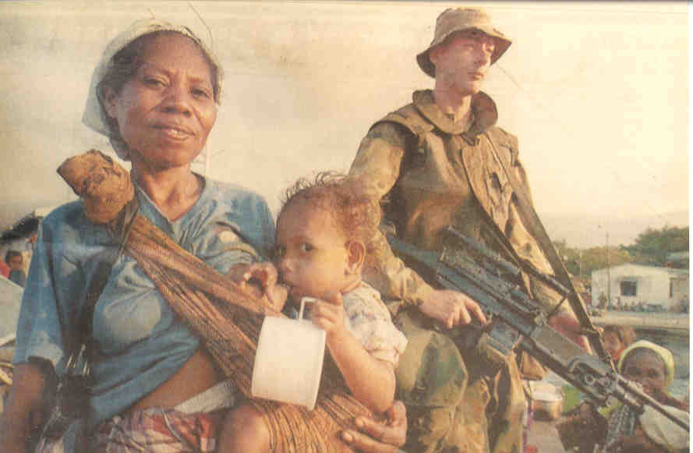
Notes:
71

Slide 72
Notes:
72

Slide 73
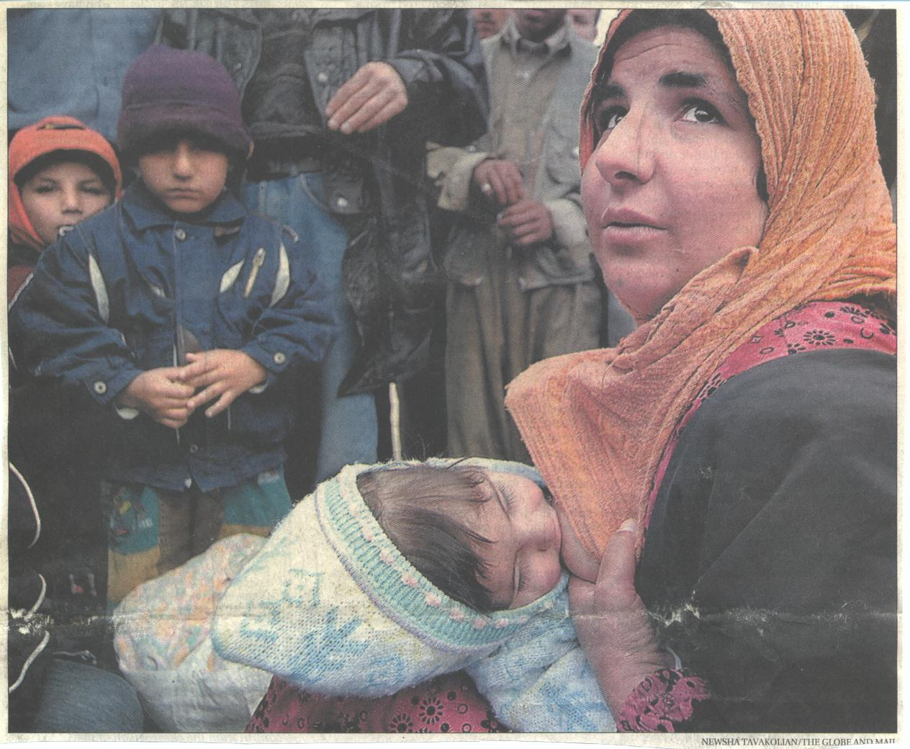
Notes:
73

Slide 74
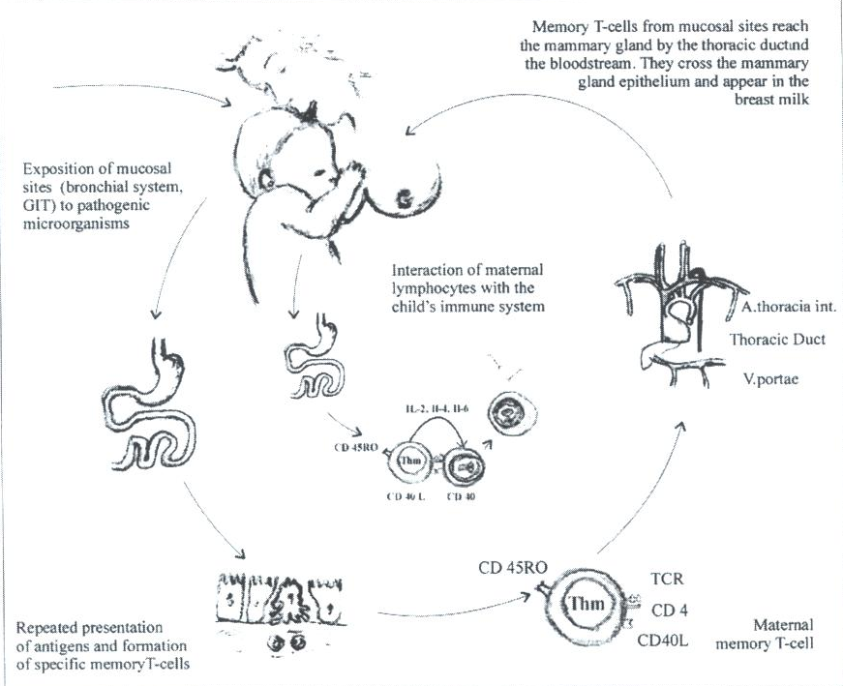
Notes:
74

Slide 75
Notes:
75

Slide 76
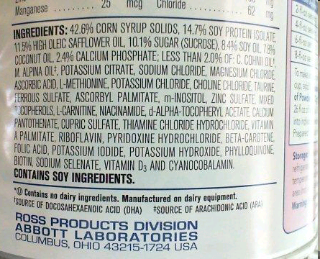
Notes:
76

Slide 77
إلى متى المتاجرة بأرواح أطفالنا؟؟

