Slide 1
SURGICAL COURSE
451
DR . HAMAD AL-QAHTANI
Associate Professor & Consultant Hepatobiliary Surgeon

Slide 2

Discussion points
Duration of the course
Surgery
  A- General surgery
  B- Subspecialty
Week's schedule
Checklist and Objectives of the course
References
Examination
  It test the following competencies :
  Contents of the OSCE
Teaching
Teaching staff
Marking
Attendance

Slide 3

Duration of the course
11 weeks
  1 week : lectures in the principles of surgery , from 8 am – 3 pm
  9 weeks : clinical rotation
  1 week : Final written and OSCE

Slide 4
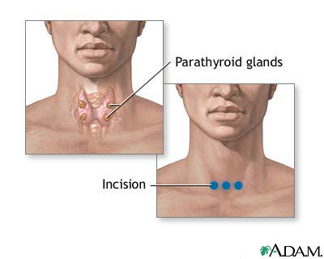
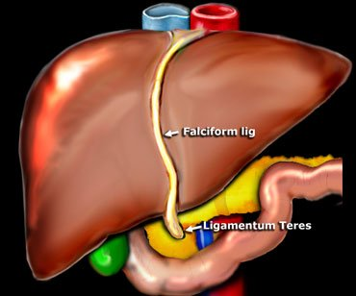
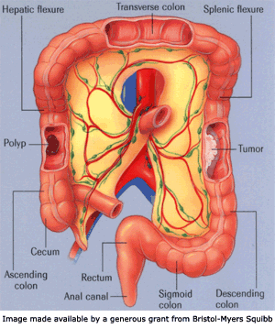
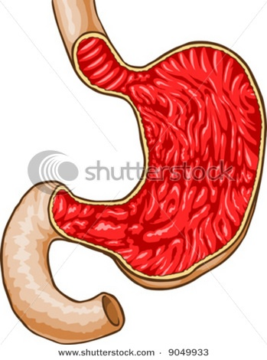
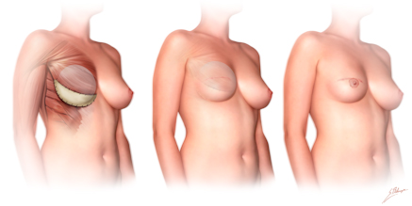
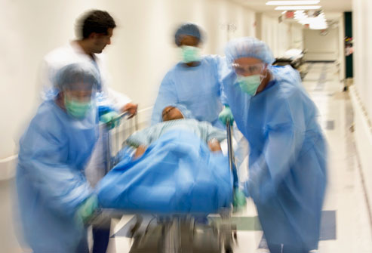
A- General surgery
Breast and Endocrine Surgery
Upper GIT Surgery
Hepatobiliary Surgery
Colorectal Surgery
Emergency Surgery

Slide 5
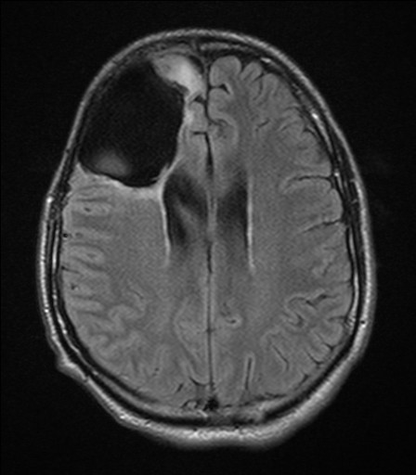

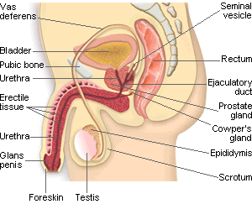
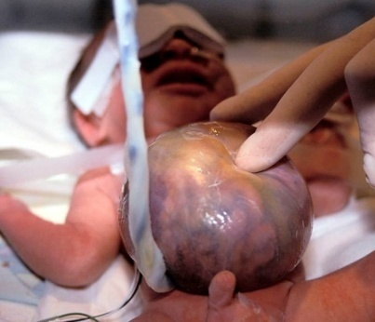
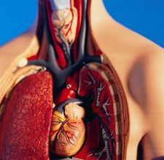
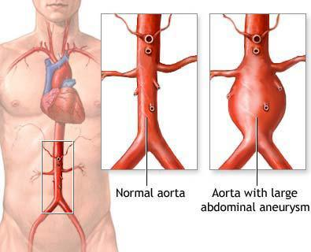
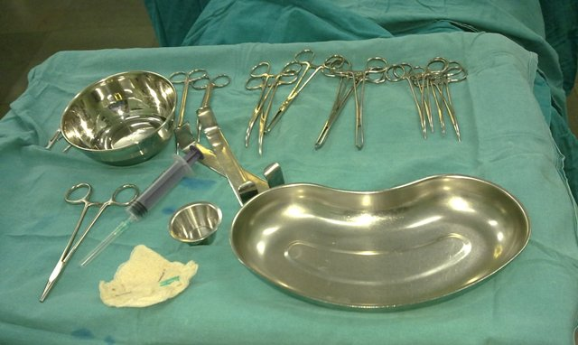
B- Subspecialty
Urology
Neurosurgery & Plastic Surgery
Pediatric Surgery & Thoracic Surgery
Vascular & cardiac surgery
BLS , Instruments , skills lab

Slide 6

Week's schedule
PM | AM
OR | OR | Sunday
Acute abdomen Prof. salamah | Pancreatitis Dr. Hamad Al-Qahtani | Monday
Preparation for grandround | GIT bleeding Dr. Akeely | Tuesday
OR | OR | Wednesday
Intestinal obstruction (SR) | Ground Round | Thursday

Slide 7
Checklist and Objectives of the course

Slide 8
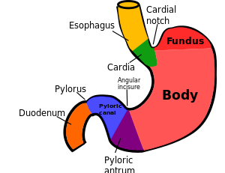
Acute gastrointestinal hemorrhage
Approach to the Patient with Acute Gastrointestinal Hemorrhage | • Initial Assessment • Risk Stratification • Resuscitation • History and physical examination • Localization • Therapy

Slide 9
Acute upper gastrointestinal Hemorrhage | • Clinical presentation • Diagnosis • Specific causes • Treatment ( Medical , Endoscopic and surgical )

Slide 10
Acute lower gastrointestinal Hemorrhage | • Clinical presentation • Diagnosis ( colonoscopy , Radionuclide scanning and Mesenteric Angiography ) • Specific causes • Treatment ( Medical , Endoscopic and surgical )

Slide 11
Acute lower gastrointestinal Hemorrhage from an obscure source | • Diagnosis ( Endoscopy , Angiography , small bowel endoscopy , Video capsule endoscopy ) • Treatment

Slide 12
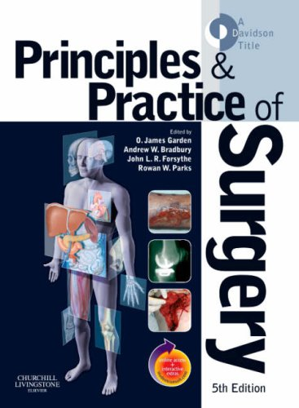
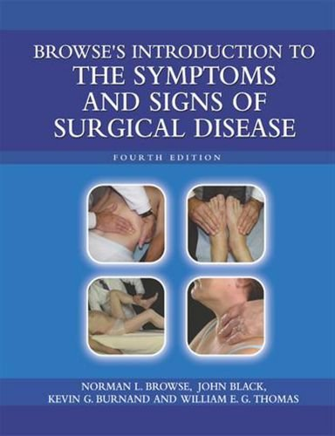
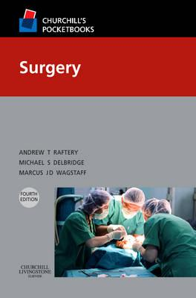
References
1) Clinical skills
Browse ' introduction to the symptoms and signs of surgical diseases
2) Clinical Surgery
Principles & practice of surgery – Davidson
3) Pocketbook
churchill's

Slide 13


Slide 14

1) Written mid-cycle exam by the end of the 5th week of the cycle
60 -100 MCQs
From the lectures that has been given in the 1st week -
Recall and scenario based MCQs

Slide 15
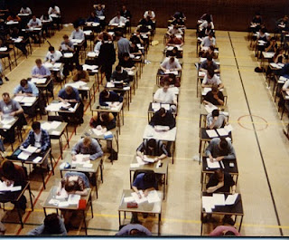
2) Written Final Exam , on the 11th week of the cycle
60-100 MCQs
From the tutorials , round , references
Recall and scenario based MCQs

Slide 16
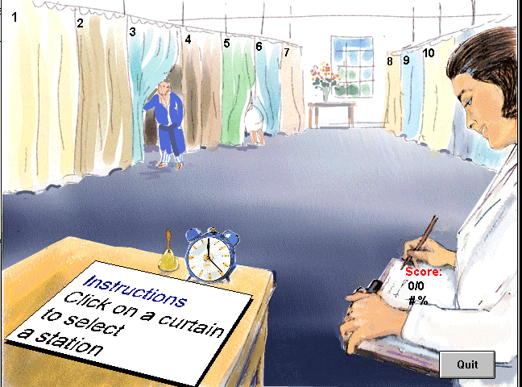
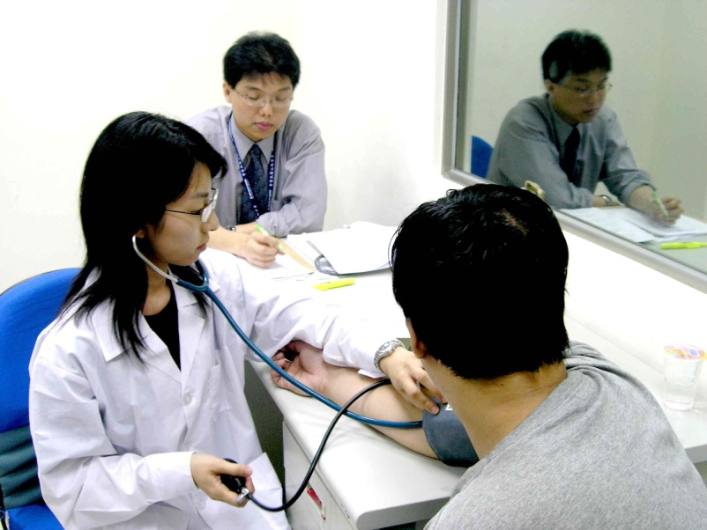
3) OSCE on the 11th week of the cycle
10 – 11 stations
5 station general surgery
5-6 stations subspecialty

Slide 17

It test the following competencies :
Clinical skills
Diagnosis and differential diagnosis
Ordering and interpreting investigations
Guidelines of management of common surgical disease

Slide 18

Contents of the OSCE
Patients
Simulated patients
Manncans
Photos and pictures
Imaging ( X-Ray , CT scan , MRI , Angiogram )
Investigation results
Instruments

Slide 19

Teaching
1) Tutorials
2) Morning round
3) Outpatient clinic (OPD)
4) Operation theater (OR)

Slide 20

Teaching staff
Academic staff
Consultants
Senior Registrars
Registrar

Slide 21


Marking
30 % written Mid-cycle exam
5 % Participation in the tutorials
25 % Final written exam
40 % OSCE

Slide 22

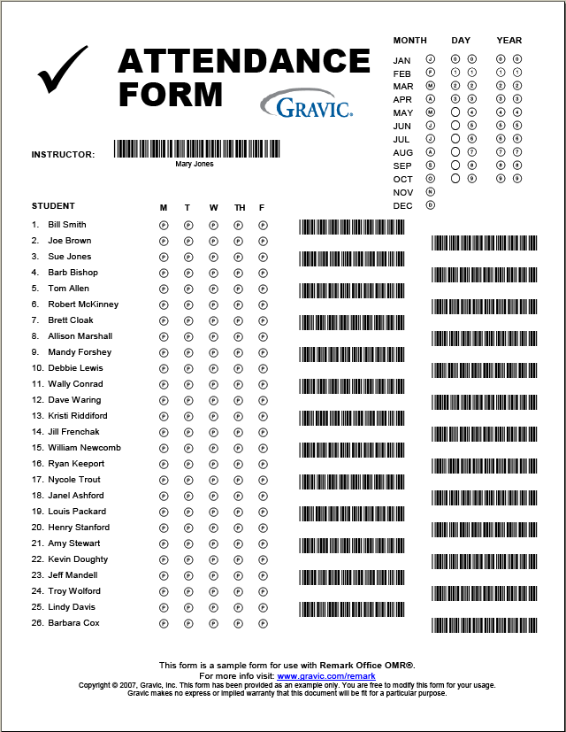
Attendance

Slide 23


