Slide 2
Preanesthesia evaluation and preparation of patient
Dr. Mansoor Aqil
Prof. and Consultant
Department Of Anaesthesia
King Saud University Riyadh

Slide 3
Goals of preoperative assessment
History and physical examination
Decision regarding optimization to avoid cancellation
Educate patient about anesthesia, pain management and perioperative care
Choose anesthetic plan in discussion with patient
Informed consent
Advise relevant tests and consultations if needed
To detect the patient who may require special care in post op
To determine medical risk factors and reduce it.

Slide 4
Preoperative Patient Questionnaire*

Slide 5
Preoperative Patient Questionnaire*
Have you any allergies?
Have you had an anesthetic in the last two months?
Have you or your relatives had any problems with a previous anesthetic?
Do U have any other disease?
Are U on any medicine regularly?
Notes:
200 patients
if no to all questions no benefit of H&P or labs

Slide 6
Anesthesia evaluation comprises
Patient history and medical records
Patient interview
Physical examination
Laboratory tests
Consultations
Preparation

Slide 7
When and where
Days before schedule date in preoperative clinic
Day before schedule date as inpatient
Re-evaluation on admission and before anesthesia

Slide 8
Mortality related to anaesthesia
Approx 1:26,000 anaesthetics
One third of deaths are preventable
Causes
Inadequate patient preparation
Inadequate postoperative management
Wrong choice of anaesthetic technique
Inadequate crisis management

Slide 9
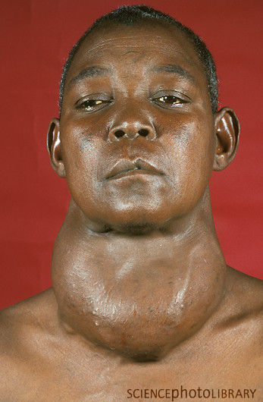
Presenting complaint
Why does the patient need an operation now?
What are the pathophysiological consequences?
Presenting symptoms?
e.g. thyroid mass
Local - stridor, SVC obstruction
Systemic - hypo/hyperthyroidism

Slide 10
Other medical conditions
Other problems that may affect
Perioperative morbidity and mortality?
Cardiac disease
Respiratory disease
Arthritis
Endocrine disorders - diabetes, obesity etc
Do they need optimization?

Slide 11
Respiratory system assessment
Asthma
COPD
HISTORY
Onset
Duration
Progress
Dyspnoea I.II.III.IV

Slide 12
SMOKING
RISK FACTORS
Increases the risk of coughing,
Bronchospasm, or
Other airway problems during the operation.
Ideally should be stopped 6 weeks before surgery

Slide 13
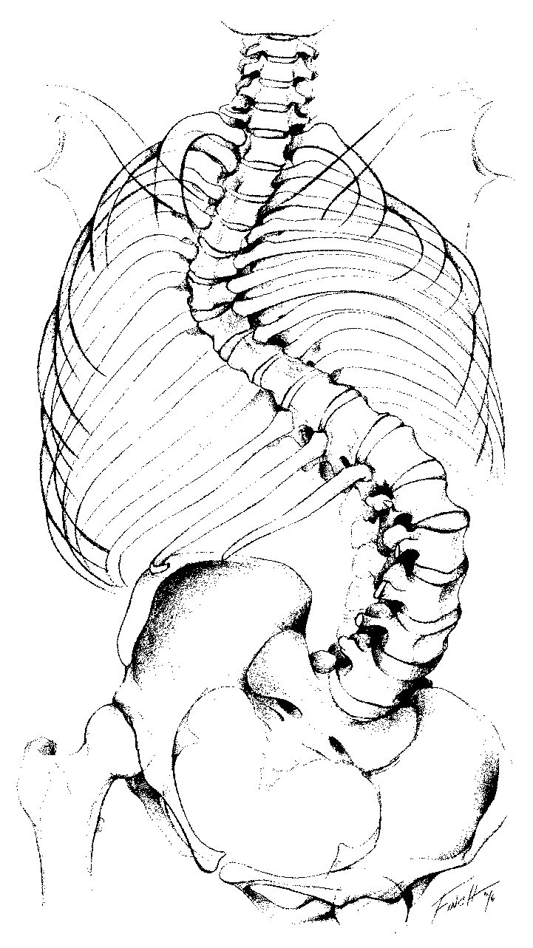
Respiratory system assessment
RISK FACTORS
Chest wall deformity
Major abdominal surgeries
Thoracic surgery
Morbid obesity

Slide 14
CVS ASSESMENT
H/O Angina
H/O dyspnoea
Repeated hospital admissions
Look for risk factors
Diabetes Mellitus
Hypertension
Syncope attacks
Peripheral Vascular disease

Slide 15
Classification of Angina Pectoris Canadian Cardiovascular Society Functional
Class I: Angina with strenuous or prolonged exertion
Class II: Angina with moderate exertion
Class III: Can only lightly exert oneself
Class IV: Angina with ANY activity or at rest

Slide 16
What is the patients functional capacity?

Slide 17
MET | Functional Levels of Exercise
1 | Eating, working at a computer, dressing
2 | Walking down stairs or in your house, cooking
3 | Walking 1-2 blocks
4 | Raking leaves, gardening
5 | Climbing 1 flight of stairs, dancing, bicycling
6 | Playing golf, carrying clubs
7 | Playing singles tennis
8 | Rapidly climbing stairs, jogging slowly
9 | Jumping rope slowly, moderate cycling
10 | Swimming quickly, running or jogging briskly
11 | Skiing cross country, playing full-court basketball
12 | Running rapidly for moderate to long distances
1 MET = 3.5 mL of O2/Kg/min

Slide 18
Functional capacity Duke Activity Status Index
1–4 METS (Eating, dressing, walking around house, dishwashing)
4–10 METS (Climbing stairs—1 flight, walking level ground 6.4 km/hr, running short distance, game of golf)
≥10 METS (Swimming, singles tennis, football)
MET=metabolic equivalent.
1 MET = 3.5 mL of O2/Kg/min

Slide 19
Anaesthetic history/assessment
Other systems
Renal
Liver
Diabetes
Psychiatric problem
FAMILY HISTORY

Slide 20
PREVIOUS ANAESTHETICS
Previous surgical procedure
Anesthesia Type
Difficult airway
Difficult IV access
Any Complications
Allergy
PONV
Malignant hyperpyrexia

Slide 21
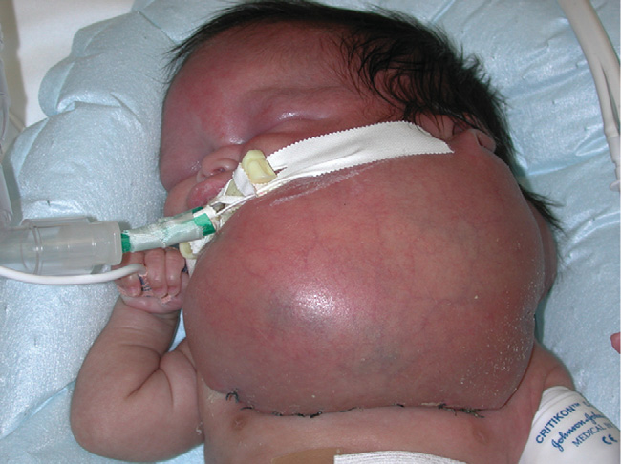
Airway assessment
Best done by an anaesthetist
Certain features of concern
Small mouth
Poor dentition
Limited neck mobility
Scars/surgery/anatomical abnormalities
Obesity

Slide 22
Mouth opening

Slide 23
Thyro-mental distance

Slide 24
Scars/surgery/anatomical abnormalities

Slide 25
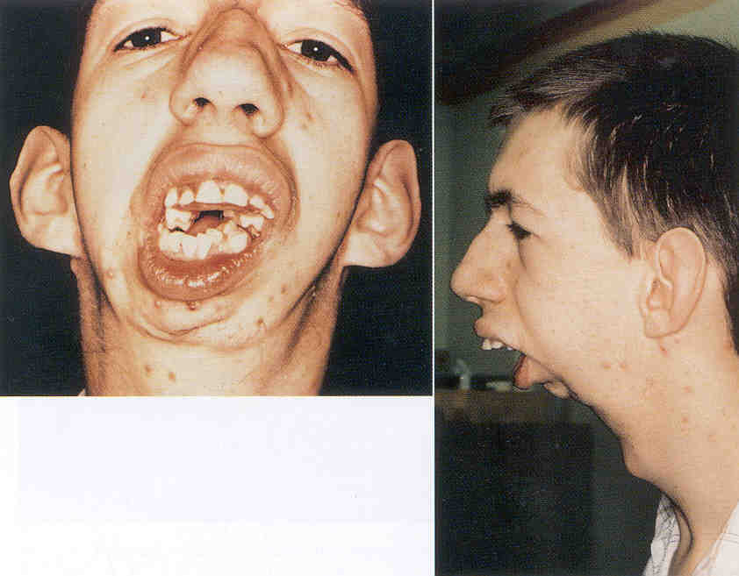
Why would this man’s airway be difficult to manage?

Slide 26
Why would this man’s airway be difficult to manage?

Slide 27
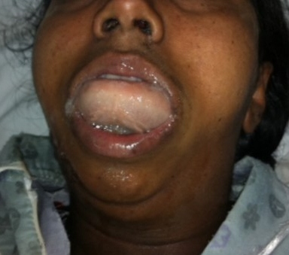
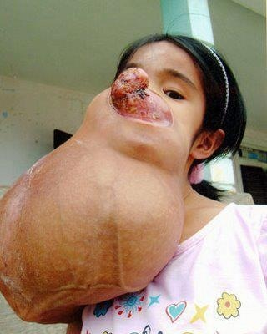

Slide 30
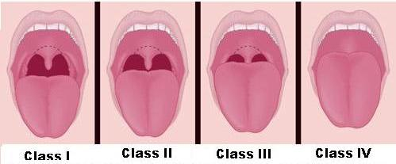
Mallampati classification
Class I: Soft palate, uvula, fauces, pillars visible.
Class II: Soft palate, uvula, fauces visible.
Class III: Soft palate, base of uvula visible.
Class IV: Only hard palate visible

Slide 31
Relation between Mallampati classification and Cormack Lehane classification
Grade 1 Grade 2 Grade 3 Grade 4

Slide 32
Laboratory testing ASA The Task Force
Preoperative tests should not be ordered routinely
Preoperative tests may be ordered, required, or performed on a selective basis for purposes of guiding or optimizing perioperative management.
This may result in unnecessary OR delays, cancellations, and potential patient risk through additional testing and follow-up.

Slide 33
The patient's physical condition ASA's six-point system
P2. Patient with mild systemic disease. (Mortality0.27-0.4%).
P3. Patient with severe systemic disease that limits normal activity. (Mortality 1.8-4.3%).
P4. Patient with severe systemic disease that is life-threatening. (Mortality 7.8-23%).
P5. Moribund (dying) patient who is not expected to survive without an operation. (Mortality 9.4-51%).
P6. Brain-dead patient whose organs are being removed for donation.
For emergent operations, you have to add the letter ‘E’ after the classification
P1. Normal healthy patient. (Mortality 0.06-0.08%).

Slide 34
Relationship between ASA status and mortality

Slide 35
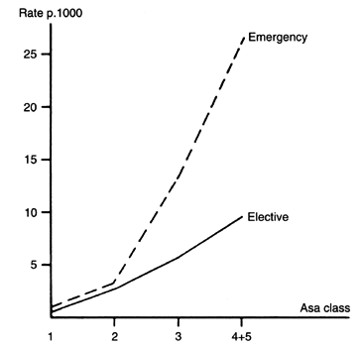
Anesthesia Risk and emergency surgery

Slide 36
Surgical risk Surgery-specific risks
Low risk surgeries (<1% cardiac risk)
Endoscopic procedures
Superficial biopsies
Cataracts
Breast surgery

Slide 37
Surgery-specific risks
Intermediate risk (<5% cardiac risk)
Intraperitoneal and intrathoracic
Carotid endarterectomy
Head and neck
Orthopedic
Prostate

Slide 38
Surgery-specific risks
High risk (>5% cardiac risk)
Emergency major operations
Especially in the elderly
Aortic or major vascular surgery
Craniotomy
Extensive operations with large volume shifts or blood loss.

Slide 39
Preoperative evaluation algorithm
Minor predictors
Advanced age
Abnormal ECG
Rhythm other than sinus
Low functional capacity
Uncontrolled hypertension
Notes:
Clinical predictors of increased perioperative risk
ECG: LVH, LBBB, ST-T abnormality
Rhythm: e.g. atrial fibrillation

Slide 40
Preoperative evaluation algorithm
Intermediate predictors
Mild angina pectoris (class 1 or 2)
Prior MI
Compensated or prior heart failure
Diabetes mellitus
Renal insufficiency
Notes:
Prior MI either by history or Q-waves
Renal: Cr>2.0 mg/dL

Slide 41
Preoperative evaluation algorithm
Major predictors
Acute or recent MI
Unstable or severe angina
Decompensated heart failure
High-grade A-V block
Severe valvular disease
Arrhythmias
Notes:
Recent MI is between one week and one month. Acute MI is within 7 days.
Arrhythmias: syptomatic ventricular arrhythmia, or SVT with uncontrolled ventricular rate

Slide 42
ACC Preoperative Assessment Guidelines

Slide 43
Emergency surgery
yes
Proceed surgery. Optimize medical management
ACC Preoperative Assessment Guidelines

Slide 44
Emergency surgery
No
yes
Active cardiac condition
Severe angina, recent MI, decompensated heart failure, significant arrythmia, severe valvular heart disease
Treat the cardiac condition
ACC Preoperative Assessment Guidelines

Slide 45
Emergency surgery
No
Active cardiac condition
No
yes
Proceed surgery.
Low risk surgery
Low risk surgeries (<1% cardiac risk)
Endoscopic procedures
Superficial biopsies
Cataracts
Breast surgery
ACC Preoperative Assessment Guidelines

Slide 46
Emergency surgery
No
Active cardiac condition
No
Low risk surgery
 | Intermediate risk (<5% cardiac risk) Intraperitoneal and intrathoracic Carotid endarterectomy Head and neck Orthopedic Prostate | High risk (>5% cardiac risk) Emergency major operations Especially in the elderly Aortic or major vascular surgery Craniotomy Extensive operations with large volume shifts or blood loss. Low risk surgeries (<1% cardiac risk) Endoscopic procedures Superficial biopsies Cataracts Breast surgery
No
Good functional status
>4 MET
yes
Proceed surgery.
ACC Preoperative Assessment Guidelines

Slide 47
Emergency surgery
ACC Preoperative Assessment Guidelines
No
 | Intermediate risk (<5% cardiac risk) Intraperitoneal and intrathoracic Carotid endarterectomy Head and neck Orthopedic Prostate | High risk (>5% cardiac risk) Emergency major operations Especially in the elderly Aortic or major vascular surgery Craniotomy Extensive operations with large volume shifts or blood loss. Low risk surgeries (<1% cardiac risk) Endoscopic procedures Superficial biopsies Cataracts Breast surgery
Active cardiac condition
No
Low risk surgery
Assess number of risk factors
0= Proceed with surgery
0-2= Consider risk modification,
Consider perioperative beta blockers,
Consider non invasive stress testing if change in management
>3 = Consider non invasive stress testing + consider perioperative beta blockers
Consider coronary revascularization
No
Good functional status
>4 MET
No
Clinical risk factors
Diabetes
IHD
CHF
CVA
CRF
All other situations

Slide 48
Preparation of patient
TAKE CONSCENT
EXPLAIN RISKS
OFFER CHOICES OF ANESTHESIA AND PAIN MANAGEMENT
NPO orders
Premedication

Slide 49
Perioperative medications
Take all usual medications
Anti-hypertensives
Beta blockers
Statins
Think about discontinuing/replacing
Aspirin
Anticoagulants
Diabetic medications
MAOIs

Slide 50
ASA fasting guidelines
Ingested Material Minimum Fasting Period
Clear liquids ?
Breast Milk ?
Infant Formula ?
Non-human milk ?
Light meal ?

Slide 51
ASA fasting guidelines
Ingested Material Minimum Fasting Period
Clear liquids 2hrs
Breast Milk 4hrs
Infant Formula 6hrs
Non-human milk 6hrs
Light meal 6hrs

Slide 52
PREMEDICATION
PURPOSE :
To allay anxiety,
Reduce anesthetic drugs requirements
Causes retrograde and ante grade amnesia
Reduce need of intraoperative analgesia
Drugs : Benzodiazepines, Narcotics, Antiemetic etc

Slide 54
Summary
History and physical most important assessors of disease and risk
ASA and functional status good predictors of risk
Lab tests have some usefulness
Lab tests add little in low risk patients
May add false + ves
Add expense

Slide 55
Questions

