Slide 1
Esophageal disease

Slide 2
Outlines
Case1 :Esophageal Cancer
Diagnosis
Management
Case2 : Achalasia
Diagnosis
Management
Case3 : GERD
Diagnosis
Management

Slide 3
Case1: Esophageal disease
65 years old complaining of dysphagia.
How will approach him?

Slide 4
Esophageal disease
History and clinical examination:

Slide 5
History
onset
duration
site
progression
associated symptoms
Odynophagia
Cough
hoarseness

Slide 6
Clinical examination
Lymphadenopathy

Slide 7
Investigations
CBC
CXR
ECG

Slide 8
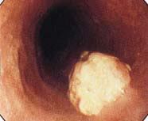
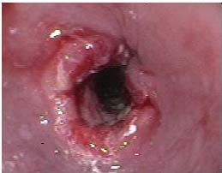
Specific Investigations
-Upper GI endoscopy

Slide 9
Upper GI endoscopy
Location
Size
Obstructing?
Biopsy

Slide 10
The contrast study
Location
Size
Obstructing?

Slide 11
Staging
- TNM staging by doing CT (cap)

Slide 12
Treatment
Conservative
Surgical

Slide 13
Types of esophageal cancer
Adenocarcinoma
Squamous carcinoma

Slide 14
Conservative management
Nutritional status support
Endoscopic dilatation &stenting
TPN
Gastrostomy tube
Chemo radiotherapy

Slide 15
Surgical management
Esophagectomy:
Trans hiatal esophagectomy
Transthoracic esophagectomy

Slide 16
Achalasia
30 years old complaining of dysphagia.
How will approach him?

Slide 17
Achalasia
History and clinical examination:

Slide 18
History
Onset
Duration
Site
Progression
Associated symptoms

Slide 19
Clinical examination
Unremarkable

Slide 20
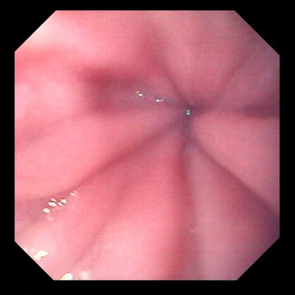
Investigations
Upper GI endoscopy

Slide 21
The contrast study
Bird’s beak or Rat’s tail
Obstructing?
Regular stricture edges

Slide 22
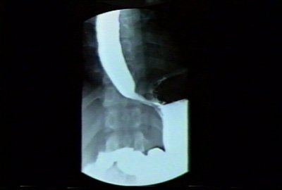
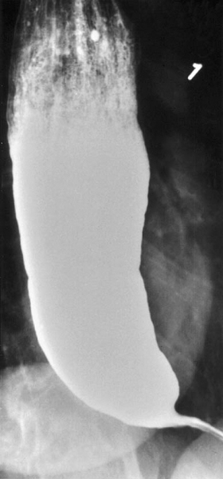
Contrast study

Slide 23
Specific investigation
Manometry study:
High LES pressure
Aperstalises
Fail of LES relaxation

Slide 24
Treatment
Conservative
Surgical

Slide 25
Conservative management
Pneumatic dilatation
Calcium channel blockers
Botulinum toxin injection

Slide 26
Surgical management
Laparoscopy or laparotomy and Heller myotomy

Slide 27
Case 3: Esophageal disease
30 years old complaining of heartburn and regurgitations.
How will approach him?

Slide 28
Esophageal disease
History and clinical examination:

Slide 29
History
Onset
Duration
Associated symptoms
Has he treated before
Responding to medications

Slide 30
Clinical examination
Unremarkable

Slide 31
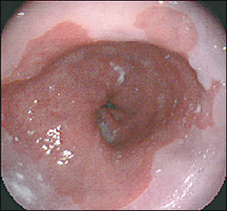
Investigations
Upper GI endoscopy

Slide 32
Contrast study
Barium swallow:
Reflux of the material to the esophagus

Slide 33
Specific investigation
Ambulatory 24 h PH monitoring
Demester score >14.7

Slide 34
Treatment
Conservative
Surgical

Slide 35
Conservative management
Changing life style
PPI

Slide 36
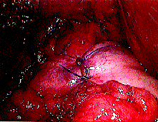
Surgical management
Laparoscopy or laparotomy and Nissen fundoplication

Slide 37
Complications of GERD
Esophagitis
Peptic stricture
Barrit esophagus :The most serious one as it consider as a pre malignancy (intestinal metaplasia in the lower esophagus).

Slide 38
Thank you

