Slide 1
MULTIDISCIPLINARY APPROACH TO OBESITY
Mohammed Al-Naami FRCSC, FACS
Consultant General and Bariatric Surgeon, KSU, KKUH, HMG

Slide 2
Objectives
Identify obesity as a chronic disease and growing public health issue.
Discuss some important etiological factors
Discuss important associated co-morbidities
Discuss some disturbances of metabolism and metabolic factors
Assessment (History, Physical, and investigations)
Non-surgical and surgical management of obesity

Slide 3
WHAT IS OBESITY?
A disease of excess fat storage with multiple co-morbidities
Chronic
Fatal
Costly
Genetically related
Multifactorial

Slide 4
BMI AND OBESITY
Healthy weight 18–25
Overweight > 25–30
Obese > 30
Class I 30–35
Class II 35–40
Class III 40–50
Super obese (Class IV) 50–60
Super/Super obese (Class V) > 60

Slide 5
Content
-Epidemiology
-Etiology
-Co-morbidity.
-Assessment (Hx, EX, INVST.)
-Treatment

Slide 6
Epidemiology
In 1997 the WHO formally recognized obesity as a global epidemic.
WHO latest study indicate that globally in 2005:
approximately 1.6 billion adults (age 15+) were overweight;
and at least 400 million adults were obese.
WHO further study that by 2015, approximately 2.3 billion adults will be overweight and more than 700 million will be obese.

Slide 7
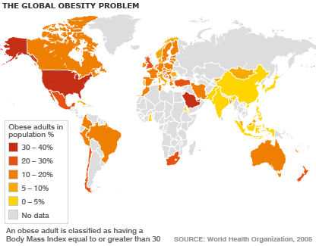

Slide 8
The prevalence trend in the KSA
Prevalence | Gender | Al-Nuaim et al. >13000 adults 1996 | Al-Nozha et al. >17000 adults 2005
Overweight BMI = 25-30 | Males Females | 29% 27% | 42.4% 31.8%
Obesity BMI = 30-40 | Males Females | 16% 24% | 26.4% 44%

Slide 9
Etiology
Multifactorial disorder
Genetics
polygenic, each gene having a small contribution in the presence of precipitating environmental factors
morbid obesity has a stronger genetic component than moderate level of excess overweight
Energy imbalance
Diet
obesity is associated with increased food consumption
Intake of excess dietary fat has been implicated as a major cause of obesity
Exercises
Astrong link exists between physical inactivity and weight gain

Slide 10
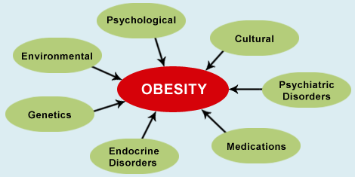
Etiology

Slide 11
Etiology
Endocrine Disorders
Hypothyroidism.
Cushing’s syndrome.
Polycystic ovarian syndrome.
Hypothalamic insufficiency.
pancreatic insulinoma

Slide 12
Etiology
Medications:
Cortisone
Antidepressants
Antipsychotics, e.g. MAOIs
Oral contraceptives
Insulin
Sulfonylurea

Slide 13
Etiology
Psychiatric causes:
Major depression.
Binge eating disorders
Bulimia nervosa

Slide 14
Major Co-Morbidities
Type II Diabetes Mellitus
Hypertension
Cardiovascular disease/Stroke
Dyslipidemia
Obstructive Sleep apnea/hypoventilation syndrome
Degenerative joint disease (DJD)
Infertility/Polycystic ovary syndrome

Slide 15
Other Co-Morbidities
Depression
Gastroesophageal reflux disease (GERD)
Gallstones
Urinary stress incontinence
Amenorrhea/Dysmenorrhea
Cancer
Males(Colon, Kidney, Prostate, Gallbladder)
Females (Breast, Kidney, Endometrium, Colon, Gallbladder)

Slide 16
PSYCHOLOGICAL CONCERNS
Low self-esteem is common.
Depression is very common.
Suicidal thoughts

Slide 17
PHYSICAL CONCERNS
Clothing choice
Tying shoelaces
Furniture incapacity
Seats in theaters, planes, and buses
Restaurant booths
Toilet and shower cubicles
Personal hygiene (limits of reach)

Slide 18
ECONOMIC CONCERNS
Employment discrimination
Getting hired
Promotions
Special projects or accounts
Education discrimination
Selection in schools and universities

Slide 19
SOCIAL CONCERNS
Weight harassment and prejudice
Studies show that society has low respect for the morbidly obese, almost as for alcoholics and drug addicts
Many have a limited number of friends
Marriage is less common
Social deprivation

Slide 20
MORTALITY FACTS
Obesity worsens health and quality of life and shortens life expectancy
Recent studies concluded that obesity in adulthood is associated with a decrease in life expectancy of about seven years in both men and women
After smoking, it’s the second-leading preventable cause of death

Slide 21
Disturbance of Metabolism
Imbalance between energy intake and expenditure
Daily energy requirement = 25-30 kcal/day
Basal energy expenditure (BEE) = 60%
Themic effect of food (TEF) = 10-15%
Energy expenditure of physical activity (EEPA) = 25-30%

Slide 22
Factors affecting energy imbalance
Genetic predisposition 80%
Muscles Mass
Aging
Physiological stress
Type of food (Proteins, Carbohydrates, and Fat)
Physical activity and personality
Sedentary life

Slide 23
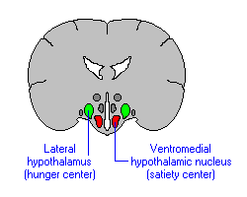
Biological Control of Energy Intake
Hunger Center (Increases Appetite):
Ghrelin (2001)
Leptin deficiency and/or resistance (1997)
Insulin deficiency and/or resistance
Endoconnabinoids - Anandamide 2-AG
Satiety Center (Decreases Appetite):
Leptin
Insulin
Adiponectin
Resistin
Cholecystokinin (CCK)
Gut Hormones ( GLP, PY, NPY, PYY) and vagal nerve stimulation

Slide 24
The Multisiciplinary Team
Daily: Consultations:
Obesity Coordinator * Pulmonologist
Dietician * Psychiatrist
Psychologist * Physical Therapist
Internist/Endocrinologist * Radiologist
Surgeon * General Practitioner
Gastroenterologist * Others as needed
Anesthesiologist

Slide 25
MEDICAL ASSESSMENT
Some patients are “healthy” without any recognized illnesses. They are unhappy, so they seek medical attention in an effort to lose weight, improve their quality of life and help their self-image.
Other patients are already being treated for one or more of the co morbid conditions arising from obesity.
The medical assessment includes a complete history, physical examination and lab investigations.

Slide 26
History
Age of onset of obesity
Pattern of weight gain and loss since puberty.
Diet and exercise habits.
Life events (lifestyle changes) such as marriage, pregnancy, illness, relationship problems, job change or a family death.
Past history (co-morbidities, surgery, injury, etc.)
Family history:
Of obesity (degree of relatives).
Metabolic syndrome

Slide 27
History
Social History:
Smoking, alcohol, job , social engagement
Drugs history:
Present and previous medications for any problem.
Past or present use of weight loss medications.
Systemic Review:
Chronic headache/migrain (pseudotumor cerebri), GERD, urinary incontinence, menstrual history

Slide 28
Physical Examination
Physical examination should target signs or conditions that predispose to or are complications of obesity
Mild hirsutism in women --------- PCOS.
Large neck size --------------------Sleep apnea.
Thyroid tenderness or goiter -----Hypothyroidism.
Dry or coarse skin and hair --------Hypothyroidism.
Slowed reflexes ---------------------Hypothyroidism.
Proximal muscle weakness ---------Cushing’s syndrome, Hypothyroidism.
Skin striae ------------ Cushing syndrome’s, steroid use.

Slide 29
BMI
BMI provides a measure of total body fat based on height and weight that applies to both adult men and women
BMI = weight (kg) / [ height (m) ]²

Slide 30
Other Measures
Waist to hip ratio (> 0.85 F, > 0.9 M)
Body composition measurements
Fat of 32% + Females; 25%+ males indicate obesity

Slide 31
BMI Range | Weight Classification | Risk of Illness
Less than 18.5 | Underweight | Increased
18.5 – 24.9 | Ideal weight | Normal
25 – 29.9 | Overweight | Increased
30 – 39.9 | Obese | High
40 – 50 | Morbid obese | Very high
50 Or greater | Super obese | Extremely high

Slide 32
Investigations
Cholesterol , Triglycerides, HDL, LDL
CBC, Hematocrit
TSH
AM Cortisol
Serum iron
Uric acid
Hemoglobin A1c*
Blood glucose

Slide 33
Investigations
Additional Tests :
ECG and echo (age>45, cardiac disease)
Chest X-ray (age>45, COPD, smoking)
Endoscopy ( to rule out GERD, PUD)
Pulmonary function tests and sleep apnea tests
U.S. abdomen (liver echotexture/size, gallstones)

Slide 34
National institutes of health guidelines for treatment of overweight and obesity
Surgery | Endoscpballoon | Pharmacotherapy | Behavior modifica | BMI range
No | No | No | Yes* | 25-26.9
No | No | Yes* | Yes* | 27-29.9
No | Yes | Yes | Yes | 30-34.9
No/Yes* | Yes | Yes | Yes | 35-39.9
Yes | No/Yes* | No | Yes | 40 or more
comorbidities present *

Slide 35
Behavior Modification
Avoid circumstances that trigger eating
A preplanned list of grocery shopping
Do not watch TV while eating
Eat slowly
Follow a balanced diet
Make exercise tools upfront

Slide 36
Diet
Low-calorie diets :
Energy deficit ranging from 500 to 1000 kcal/day.
Low fat diet.
Helps losing 0.5 kg/week that lead to 10% weight loss over 6 months.
Very low-calorie diets (VLCDs):
High protein diet with less fat & no carbohydrates.
Energy is less than 800 kcal/day.
Helps losing 1 – 1.5 kg/week.

Slide 37
Exercise
Patients should be screened for cardiovascular and respiratory adequacy
Moderate intensity exercise: (walking, swimming, biking)
Is of greatest value for subjects who are obese.
Ultimate minimum goal:
45-60 minutes of continuous aerobic exercise 5-7 times per week to lose weight
30-60 minutes of continuous aerobic exercise 3-5 times per week to prevent long term weight regain.
Benefits:
Helps build muscle mass.
Increases metabolic activity of the whole-body mass.
Reduces body-fat proportions.

Slide 38
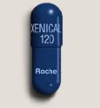
Pharmacotherapy
Lasts for several years
Weight will increase again after cessation of the drugs in most cases
If no significant weight reduction in at least 3 months, stop the drug
Currently tow drugs are used:
1- Sibutramine (Reductil)
2- Orlistat (Xenical)
3- Metformin (Glucophage)

Slide 39
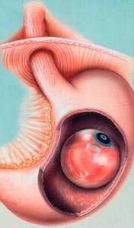
Intra-gastric Balloon
Aim is to reduce the volume of the stomach
Leading to early satiety , less caloric intake, and subsequently weight loss
Can be performed as an out-patient basis.
Short to medium term solution with variable results
For mild obesity (BMI 25-30) who failed to reduce weight
Or super obesity (MBI>55) who are at risk from surgery and/or anesthesia
Contraindications:
Eating Disorders
Large hiatus hernia
Esophagitis/Gastritis/PUD
Previous gastric surgery
Prediction of poor compliance
Complications:
Hypersensitivity to the balloon material
Severe nausea and vomiting first 3 days
Balloon rupture
Balloon migration and small bowel obstruction

Slide 40
BARIATRIC SURGERY: AN UPDATE
Mohammed Al-Naami FRCSC, FACS
Department of Surgery, KKUH, KSU
Consultant General and Bariatric Surgeon, HMG

Slide 41
Objectives
Recognize the indications for bariatric surgery
Describe current bariatric techniques and share results of surgery
Review health benefits of bariatric surgery

Slide 42
Surgical Interventions
Criteria:
Age between 18-60 years.
BMI above 40 or 35 with co-morbidity
An efficient conservative treatment strategy tried.
The patient is cooperative and willing to follow postoperative diet instructions
Pt. must be psychologically stable
No endocrine cause for obesity

Slide 43
Contraindications to Surgery
High risk for cardiac complications
Poor myocardial reserve (congestive heart failure)
Significant COPD or respiratory dysfunction
Non-compliance with medical treatment
Significant psychological and/or eating disorders
Other relative ( e.g. not fitting surgical criteria)
Predictors of high mortality include:
( Wt.>200kgs, male, old age, inexperienced surgeon, ASA >III)

Slide 44
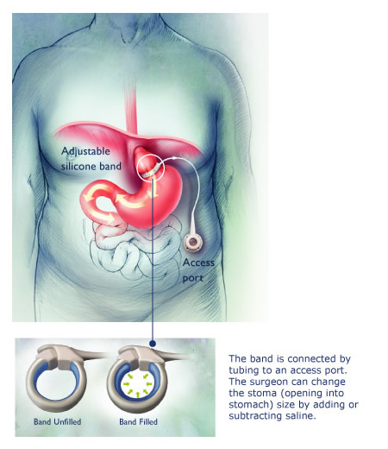
Adjustable Gastric Banding

Slide 45
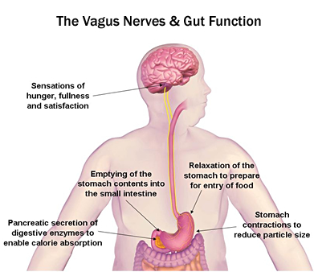
Adjustable Gastric Banding
Mechanism of action:
It relies on reducing the volume of the stomach, which produces an earlier sense of fullness via vagal stimuli of satiety center

Slide 46
Adjustable Gastric Banding
Advantages:
50% loss of excess body weight.
Exercise adds 10% more of loss.
Reduce obesity and related comorbidities (50%)
Fully reversible.
No cutting or stapling of the stomach.
Short hospital stay.
Quick recovery.
Adjustable without further surgery.
No malabsorption issues.
Fewer life-threatening complications.

Slide 47
Adjustable Gastric Banding
Complications:
Band slippage / Pouch dilatation (5%).
Esophageal dilatation/ dysmotility.
Erosion of the band into the gastric lumen (0.5%).
Port site pain/infection.
Port displacement.
Infection of the fluid within the band.
Mortality (0.05%)

Slide 48
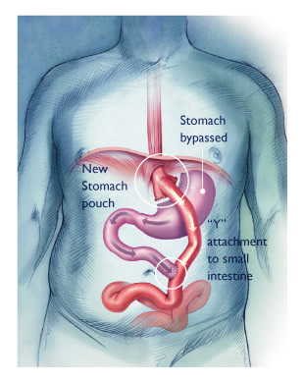
Gastric Bypass Procedure

Slide 49
Gastric Bypass Procedure
Advantages:
The oldest bariatric procedure (Gold Standard)
Both restrictive and malabsorptive
>70% reduction of Excess Body Weight
Long-term weight stability
The best for treating co-morbid diseases especially:
DM (>80%) 4. Hypercholestrolemia (65%)
GERD (>75%) 5. Obstructive Sleep Apnea (75%)
HTN (70%)

Slide 50
Gastric Bypass Procedure
Complications:
Anastomotic leak (1.5%) and related mortality (0.5%)
Circular stapler related anastomotic stricture (10%)
Marginal ulceration bleeding or perforation (1%)
Dumping syndrome
Life-long supplemental vitamins and minerals
Nutritional deficiencies (iron, calcium, Vit. B12, folate)
Gallstones: due to rapid weight loss.
Complications of abdominal surgery: Infection, hernia, bowel obstruction (2-5%)… etc.

Slide 51
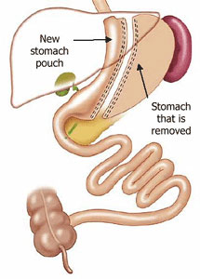
Sleeve Gastrectomy

Slide 52
Sleeve Gastrectomy
Advantages:
Early satiety and low appetite
Stomach functions normally allowing food to be emulsified, just in smaller amounts.
No dumping syndrome because the pyloric portion of the stomach is left intact.
Simpler and less operative time than bypass surgery
Excess Body Weight Loss (60%)
Improvement in co-morbidities (range of 65%)

Slide 53
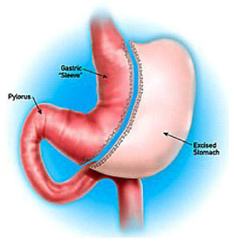
Sleeve Gastrectomy
Complications:
leakages along the staple line (5%)
Bleeding along the staple line (10%)
Gastroesophageal reflux disease
Gallstones
Gastric stricture/fistula

Slide 54
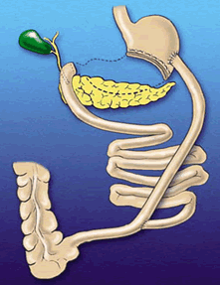
Biliopancreatic Diversion Procedure
Invented by Scopinaro 1979
Purely malabsorptive
Advantages:
Reduces about 95% of excess body weight
Cures DM II and other metabolic
disorders (95)%
Disadvantages:
Malnourishment
Protein deficiency
High doses of multivitamins and minerals
Diarrhea, anemia, osteoporosis, gallstones, liver failure

Slide 55
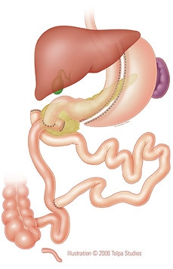
Biliopancreatic Diversion and Duodenal Switch (BPD&DS)
Restrictive and malabsorptive
Invented by Marceau and Hess (1980s)
Done laparoscopically by Gagner 1999
Advantages :
Cure of DM II and other metabolic
disorders by 98%
No dumping syndrome
Less peptic and stomal ulcerations
Most surgeons recommend it for superobese
patients or following other failed procedures
Disadvantages:
The most complicated technically
High postoperative complication rates
metabolic deficiencies like BPD

Slide 56
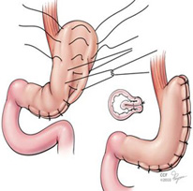
Gastric Plication Surgery
Invented by the Iranian Surgeon Talebpour in early 2000
It is a restrictive procedure similar to the
sleeve gastrectomy
Still considered experimental
Advantages:
Less leak and bleeding rates
Reversible
EWL = 40-70%
Disadvantages:
Technical accuracy is difficult
Vomiting
Gastric wall necrosis

Slide 57
IMPACT OF CHANGE
In most patients, bariatric surgery resolve obesity co-morbidities (e.g. LRYGBP): including
Type 2 diabetes–83 percent
Obstructive sleep apnea–85 percent
Hypertension–75 percent
Dyslipidemia–more than 93 percent are improved/resolved

Slide 58
Bariatric Surgery Beats Standard Therapy in Obese Diabetics
Author | Medical Therapy | Roux-en-Y Gastric Bypass | Laparoscopic sleeve Gastrectomy | Bilopancreatic Diversion
Schauer et al. N Eng J Med 2012 RCT 150 patients over 12 months | 12% | 42% | 37%
Mingrone et al. N Eng J Med 2012 RCT 60 patients over 24 months | <6.5% | 75% |  | 95%

Slide 59
IMPACT OF CHANGE
Lower morbidity and mortality rates compared to morbidly obese controls, mostly due to lower cardiovascular risk. However, post op related mortality are mostly related to leaks with delayed intervention and DVT/PE.
Gastric bypass patients have 89 percent lower mortality rates compared to morbidly obese controls in the five years following the procedure.
The reduction in co-morbidity rates leads to significantly lower healthcare economic utilization and cost.

Slide 60
SUMMARY
Obesity is an increasing chronic disease
Surgical treatment is the only proven method of achieving long-term weight control for the morbidly obese, when all other therapies have failed.
Compare benefits and risks of surgery.
Surgically induced weight loss in morbid obesity:
Improves or resolves co-morbidities
Decreases mortality risk
Decreases the risk of developing new health-related conditions
Reduces healthcare utilization and direct healthcare costs

Slide 61
THANK YOU

