Slide 1
SHOCK

Slide 2
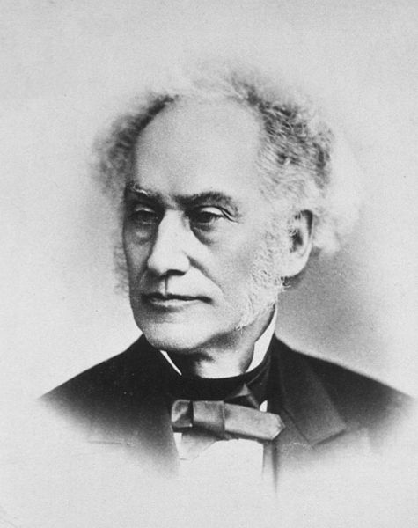
What is shock ?
Samuel D. Gross defined shock as ‘‘the rude unhinging of the machinery of life.’’

Slide 3
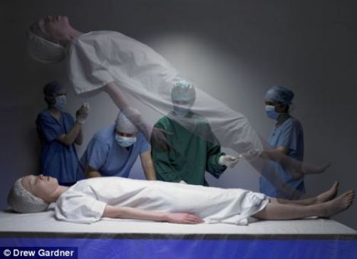
What is shock ?
A transition between life and death

Slide 4
What is shock ?
Can we define shock as hypotension?

Slide 5
What is shock ?
Shock is defined as a life-threatening condition characterized by inadequate delivery of oxygen and nutrients to vital organs relative to their metabolic demand
mortality rates exceed 20%

Slide 6
Classification
Categories of shock ?

Slide 7
Classification
Hematologic
Neurologic
Vasogenic
Cardiogenic

Slide 8
Causes That Require Primarily the Infusion of Volume
Classification

Slide 9
Classification
Hemorrhagic shock
Traumatic
Gastrointestinal
Body cavity
Hypovolemia
Gastrointestinal losses
Dehydration from insensible losses
Third-space sequestration from inflammation

Slide 10
Stage | Vital Signs | Signs and Symptoms | Pathophysiology
Compensated | Normal blood pressure Normal to slightly é heart rate Tachypnea Delayed capillary refill | Cool hands and feet Pale mucous membranes Restlessness, anxiety Oliguria | Vasoconstriction maintains blood flow to essential organs, but tissue ischemia occurs in less essential areas
Decompensated | Blood pressure decreasing Tachycardic >120/min Tachypneic > 30-40/min | Waxen, cool, clammy skin Pale or cyanotic mucus membranes Profound weakness Metabolic (lactic) acidosis Anxiety Absent or êperipheral pulses | Blood pressure decreases as the vascular tone decreases. Dysfunction to all organs is imminent. Anaerobic metabolism ensues, causing lactic acidosis.
Irreversible | Profound hypotension | Lactate > 8mEq/L | Metabolic acidosis causes postcapillary sphincters to open and release stagnant and coagulated blood. Excessive potassium and acid causes dysrhythmias. Cellular damage is irreversible.

Slide 11
Causes That Require Improvement in Pump Function by Either Infusion of Inotropic Support or Reversal of the Cause of Pump Dysfunction
Classification

Slide 12
Classification
Myocardial ischemia
Coronary artery thrombosis
Arterial hypotension with hypoxemia
Cardiomyopathy
Acute myocarditits
Chronic diseases of heart muscle (ischemic, diabetic, infiltrative, endocrinologic, congenital)
Cardiac rhythm disturbances
Atrial fibrillation with rapid ventricular response
Ventricular tachycardia Supraventricular tachycardia

Slide 13
Classification
Hypodynamic septic shock
Overdose of negative inotropic drug
Beta-blocker
Calcium channel antagonist overdose
Structural cardiac damage
Traumatic (e.g., flail mitral valve)
Ventriculoseptal rupture
Papillary muscle rupture

Slide 14
Causes That Require Volume Support and Vasopressor Support
Classification

Slide 15
Classification
Hyperdynamic septic shock
Anaphylactic shock
Central neurogenic shock
Drug overdose

Slide 16
Problems That Require Immediate Relief from Obstruction to Cardiac Output
Classification

Slide 17
Classification
Pulmonary embolism
Cardiac tamponade
Pneumothorax
Valvular dysfunction
Acute thrombosis of prosthetic valve
Critical aortic stenosis
Congenital heart defects in newborn (e.g., closure of
patent ductus arteriosus with critical aortic coarctation)
Critical idiopathic subaortic stenosis (hypertrophic obstructive cardiomyopathy)

Slide 18
Approach to undifferentiated shock

Slide 19
History of trauma?
Search for:
1. Hemorrhagic shock
2. Tension pneumothorax 3. Cardiac tamponade
4. Cardiac injury
YES
NO
Evidence of gastrointestinal hemorrhage, vomiting, or diarrhea?
YES
Volume resuscitate
NO
1. Begin treatment for sepsis syndrome
2. Search for source of infection
3. Consider drawing thyroid function tests
Fever or hypothermia?
YES
NO
1. Treat for cardiogenic shock from myocardial ischemia
2. Consider massive pulmonary embolism with right ventricular
strain effect
Electrocardiographic evidence for ischemia or chest pain with major risk factors for coronary artery disease?
YES

Slide 20
Evaluate or treat for ingestion of negative inotropic drug
Draw thyroid function tests
Consider treatment for addisonian crisis or steroid withdrawal
Unexplained bradycardia with hypotension?
yes
NO
Unexplained hypoxemia?
Rule out pulmonary embolism
YES
NO
Volume resuscitate
Emergent abdominal computed tomography or surgical consultation to evaluate for peritoneal inflammation or vascular rupture
Abdominal or low back pain?
YES
NO
Wheezing with hives or skin flushing?
YES
Treat for anaphylaxis

Slide 21
EARLY DETECTION OF SHOCK
Why is it important?

Slide 22
Quantitative Resuscitation
Resuscitating patients to predefined physiologic endpoints indicating that systemic perfusion and vital organ function have been restored
first described in 1988

Slide 23
Quantitative Resuscitation
significantly reduce mortality and morbidity rates in ED patients with severe sepsis or septic shock (early goal directed therapy)
importance of the first 6 hours of resuscitation.

Slide 24
Monitoring Perfusion Status
The basics:
Electrocardiography
pulse oximetry
BP

Slide 25
Monitoring Perfusion Status
Arterial pressure monitoring line
Accurate
When using vasoactive agents
Central venous pressure
8-12 (10-15 when ventilated)
Goal-directed resuscitation
Improves outcome in patients with septic shock
Vasoactive agents
Urine output
1 mL/kg/hr in persons without renal disease

Slide 26
Monitoring Perfusion Status
pulmonary artery catheter
remains controversial
Insufficient data have been published to support the use or avoidance of PACs in ED populations
5 RCT’s investigating the management of critically ill patients with a PAC ,none have found a benefit in terms of survival or length of stay

Slide 27
Ventilation
RSI is the preferred method of airway control in most patients with shock

Slide 28
Hemorrhagic Shock
Ensure adequate ventilation/oxygenation
Provide immediate control of hemorrhage, when possible (e.g., traction for long bone fractures, direct pressure)
Initiate judicious infusion of isotonic crystalloid solution (10–20 mL/kg)
With evidence of poor organ perfusion and 30-minute anticipated delay to hemorrhage control, begin packed red blood cell (PRBC) infusion (5–10 mL/kg)

Slide 29
Hemorrhagic Shock
With suspected central nervous system trauma or Glasgow Coma Scale score <9, immediate PRBC transfusion may be preferable as initial resuscitation fluid
Treat coincident dysrhythmias (e.g., atrial fibrillation with synchronized cardioversion)

Slide 30
Cardiogenic Shock
Ameliorate increased work of breathing; provide oxygen and positive end-expiratory pressure (PEEP) for pulmonary edema
Begin vasopressor or inotropic support; norepinephine (0.5 mg/min) and dobutamine (5 mg/kg/min) are common empirical agents

Slide 31
Cardiogenic Shock
Seek to reverse the insult (e.g., initiate thrombolysis, arrange percutaneous transluminal angioplasty)
Consider intra-aortic balloon pump counterpulsation for refractory shock

Slide 33
Systemic Inflammatory Response Syndrome (SIRS)
Two or more of the following:
1. Temperature >38° C or <36° C 2. Heart rate >90 beats/min 3. Respiratory rate >20 breaths/min or Paco2 <32 mm Hg 4. While blood cell count >12,000/mm3, <4000/mm3, or
>10% band neutrophilia

Slide 34
Severe Sepsis
SIRS with suspected or confirmed infection and associated with organ dysfunction or hypotension; organ dysfunction may include presence of lactic acidosis, oliguria, or altered mental status

Slide 35
Septic Shock
SIRS with suspected or confirmed infection with hypotension despite adequate fluid resuscitation; septic shock should still be diagnosed if vasopressor therapy has normalized blood pressure

Slide 36
Summary
Ensure adequate oxygenation; remove work of breathing
Administer 20 mL/kg of crystalloid

Slide 37
Summary
Begin antimicrobial therapy; attempt surgical drainage or débridement
Begin PRBC infusion for hemoglobin < 8 g/dL If volume restoration fails to improve organ perfusion, begin vasopressor support; initial choice includes dopamine, infused at 5–15 mg/kg/min, or norepinephrine, infused at 0.5 mg/min

