Slide 1
ECG med 442
Bradycardia
Dr. Ahmad S. Hersi, MBBS. MSc. FRCPC
Professor of Cardiac Sciences
Consultant Electrophysiologist

Slide 2
Bradyarrhythmia
Sinus bradycardia
SA node disease
AV node disease

Slide 3
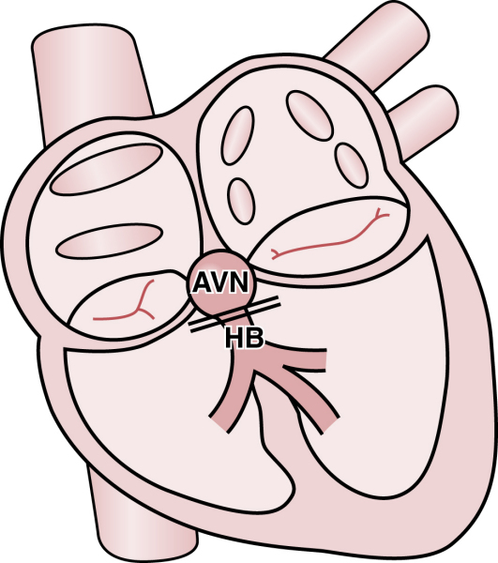

Slide 4
Sinus bradycardia

Slide 5
Heart Block
1^{st○}
Constant PR prolongation without drop beat.
2^{nd○}
Mobitz1: Progressive PR prolongation + drop beat.
Mobits2: Constant PR prolongation + drop beat.
3^{rd ○}
Complete dissociation between P and QRS.

Slide 6
1st HB

Slide 7
2nd HB Mobitz type-1

Slide 8
2nd HB Mobitz type-2

Slide 9
2nd HB Mobitz type-2

Slide 10
3rd HB

Slide 11
3rd HB

Slide 12
Some Conditions That May Cause Temporary AV Conduction Impairment
Autonomic factors (increased vagal tone with vasovagal syncope or sleep apnea). Trained athletes at rest may show a prolonged atrioventricular (AV) interval and even AV Wenckebach with sinus bradycardia that resolve with exercise.
Medications (especially, beta blockers; digoxin, certain calcium channel blockers) and electrolyte abnormalities (especially hyperkalemia)
Acute myocardial infarction, especially inferior (see text discussion)
Inflammatory processes (e.g., myocarditis, rheumatic fever, lupus)
Certain infections (e.g., Lyme disease, toxoplasmosis)

Slide 13
Some Causes of Permanent AV Conduction System Damage
Acute myocardial infarction, especially anterior wall
Infiltrative diseases (e.g., amyloid, sarcoid, lymphomas)
Degeneration of the conduction system, usually with advanced age (Lenègre’s disease) or associated with cardiac calcification around the aortic and mitral valves (Lev’s disease)
Hereditary neuromuscular diseases (e.g., myotonic dystrophy, Kearns-Sayre syndrome, Erb’s dystrophy)
Iatrogenic damage to the conduction system as the result of valve surgery or arrhythmia ablations in the area of atrioventricular (AV) node and His bundle; ethanol septal ablation for obstructive hypertrophic cardiomyopathy

Slide 14
2nd HB

Slide 15
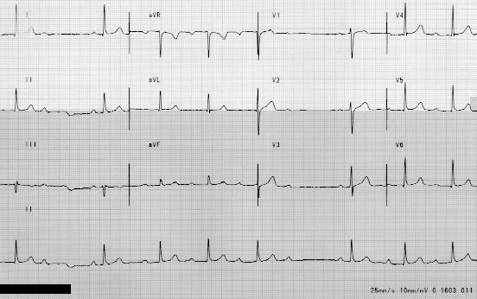
Realty check

Slide 16
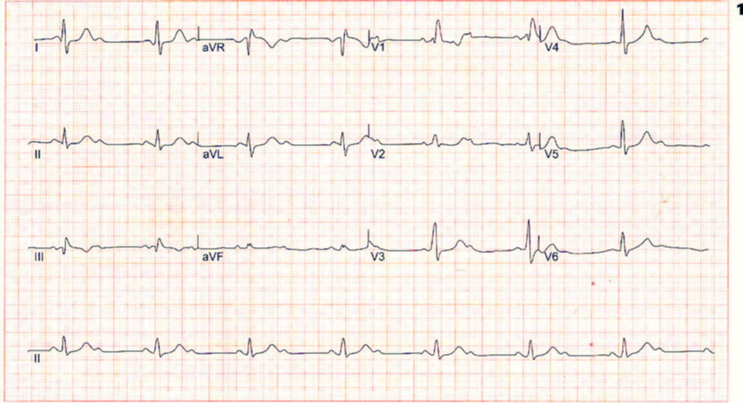
Realty check

Slide 17
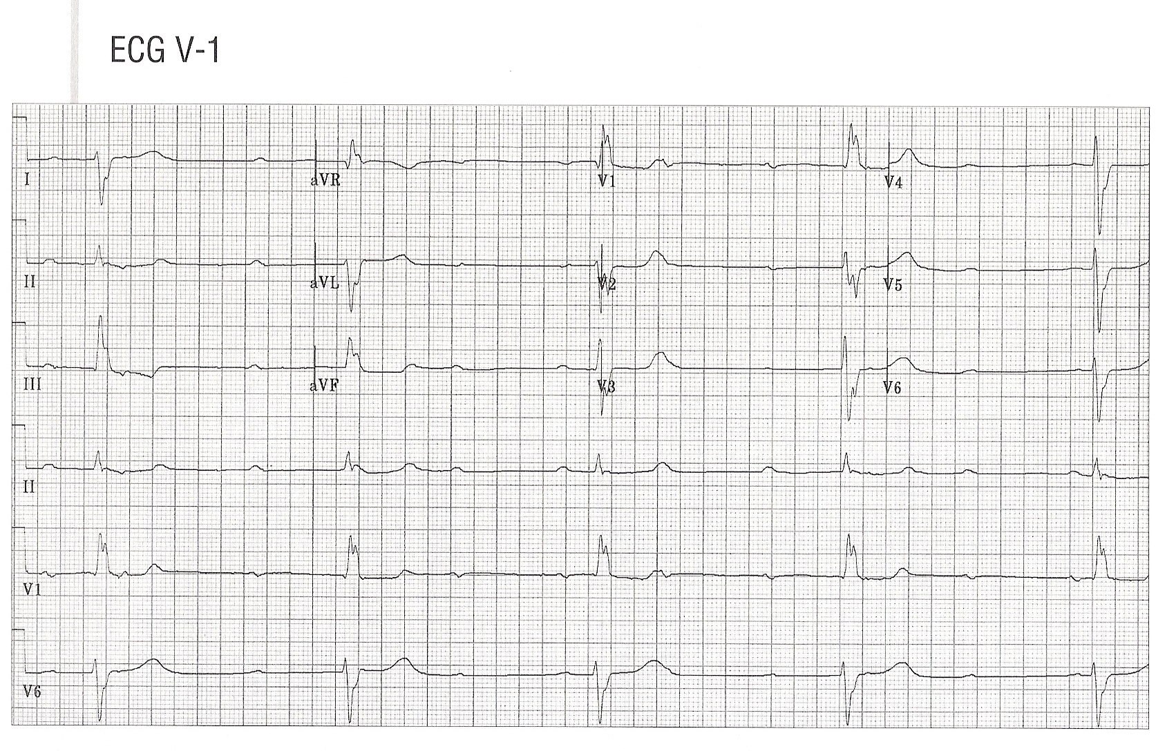
Realty check

Slide 18
Realty check

Slide 19
Realty check

Slide 20
Realty check

Slide 21
Realty check

Slide 22
Realty check

Slide 23
Realty check

