Slide 1
Approach to Management of Hypertension
Prof. Abdulkareem Al-Suwaida, MD, FRCPC, MSc
442- 2016

Slide 2
Outline of The Lecture
Prevalence of HTN in KSA
Diagnosis of Hypertension
Evaluation and Risk Assessment
Screening for Secondary Causes of HTN
Management
Life style modifications
Drug therapy

Slide 3
PREVELANCE OF HYPERTENSION
Hypertension is a leading risk factor for death in the Kingdom of Saudi Arabia.
Hypertension accounted for about one fourth of total deaths from cardiovascular and circulatory diseases.
The prevalence of HTN is 25% among individuals 15–64 years old in Saudi Arabia
40% of Saudis (15–64 years old), had borderline hypertension
* Institute for Health Metrics and Evaluation (IHME), “GBD arrow Diagram, Saudi Arabia. Risk of deaths.1990–2010,” IHME, University of Washington, Seattle, Wash, USA, 2013
* The Global Burden of Disease 2010 (GBD 2010)

Slide 4
Percent distribution of HTN Awarness among hypertensive Saudi aged 15 years or older, 2013.
42%
58%

Slide 5
Percent distribution of diagnosis and treatment status among hypertensive Saudi aged 15 years or older, 2013.
13%
39.4%
47.6%

Slide 6
Case Study
Mr. M is a 48-year-old teacher who sees you occasionally for upper respiratory tract infections.
He has no significant past medical history is taking no medicines has no known allergies is a regular smoker. Father has hypertension & IHD.
You noticed that his Pulse rate 78, regular blood pressure (BP) 148/94 mmHg. Ht 170 cm and weight 98 Kg.
Does Mr. M have hypertension?

Slide 7
Criteria for the diagnosis of hypertension and recommendations for follow-up
Hypertension can be diagnosed using one of the following three strategies:
1. Ambulatory blood pressure monitoring (ABPM)
2. Home blood pressure monitoring
3. Office-based blood pressure measurements

Slide 8
Criteria for the diagnosis of hypertension
Office-based blood pressure measurements
High BP readings in at least three visits (>=140/90 mm Hg), spaced over a period of one week or more.
One reading is enough if hypertensive emergency or SBP>= 180 or DBP >=110.

Slide 9
Criteria for the diagnosis of hypertension
Ambulatory blood pressure monitoring (ABPM)
a 24-hour average BP greater than or equal to 130/80 mmHg

Slide 10
Criteria for the diagnosis of hypertension
Home blood pressure monitoring
at least 12 to 14 measurements;
morning and evening measurements taken, over a period of one week;
BP greater than or equal to 135/85 mmHg.

Slide 11
Hypertension Definitions
Prehypertension – systolic 120 to 139 mmHg or diastolic 80 to 89 mmHg.
Stage 1 hypertension - clinic readings ≥140/90 mm Hg and ABPM/HBPM ≥135/85 mm Hg.
Stage 2 hypertension - clinic readings ≥160/100 mm Hg and ABPM/HBPM ≥150/95 mm Hg.

Slide 12
His average ABPM readings is 145/90 mm Hg
Which of the following is the most accurate clinical assessment of his present situation?
A. Pre-Hypertension
B. White coat hypertension
C. Stage 1 hypertension
D. Stage 2 hypertension
E. Hypertensive Emergency

Slide 13
What would you do next?

Slide 14
Evaluation of patients with documented HTN:
Look for clues for secondary causes of high BP.
Identify CV risk factors or concomitant disorders.
Assess for target organ damage and CVD.

Slide 15
Causes of Secondary Hypertension
Chronic kidney disease
Primary aldosteronism
Renovascular disease
Sleep apnea
Drug-induced causes
Steroid therapy and Cushing’s syndrome
Pheochromocytoma
Coarctation of the aorta
Thyroid or parathyroid disease

Slide 16
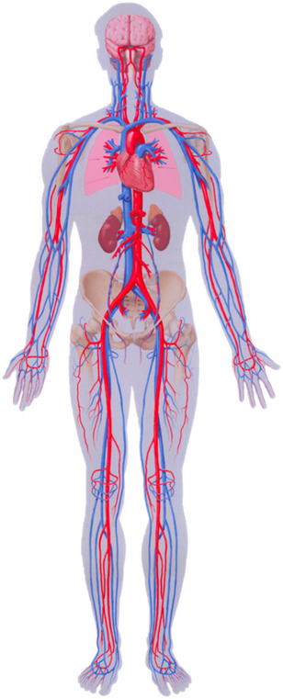
Assessment of the overall cardiovascular risk and Search for target organ damage
Cerebrovascular disease
transient ischemic attacks
ischemic or hemorrhagic stroke
vascular dementia
Hypertensive retinopathy
Left ventricular dysfunction
Left ventricular hypertrophy
Coronary artery disease
myocardial infarction
angina pectoris
congestive heart failure
Chronic kidney disease
hypertensive nephropathy (GFR < 60 ml/min/1.73 m2)
albuminuria
Peripheral artery disease
intermittent claudication
ankle brachial index < 0.9

Slide 17
Routine Laboratory Tests
Preliminary Investigations of patients with hypertension
Urinalysis
Blood chemistry (potassium, sodium and creatinine)
Fasting glucose
Fasting or Non Fasting lipid profile
Standard 12-leads ECG
Optional tests
Urinary albumin excretion or albumin/creatinine ratio
Limited Echo for LVH

Slide 18
Case Study (continue)
Laboratory Findings:
Urine: No Protein, No RBC & No WBC
EKG: LVH
Na 140
K 3.9
FBS 12 mmol/l
Creatinine 105 umol/l
Cholesterol 6.9 (LDL 5.4, HDL 1.1)
Triglycerides 2.8
Hb 18.1

Slide 19
Diagnosis of Mr. M
Stage 1 HTN, Obese with Diabetes and Hyperlipidemia.

Slide 20
Benefits of Lowering BP
Average Percent Reduction
Stroke incidence 35–40%
Myocardial infarction 20–25%
Heart failure 50%

Slide 21
How low should you go?
What drugs and doses should you use?
How many medications will you need?

Slide 22
?
Which of the following is most appropriate BP goal in this patient?
<125/75
<130/80
<140/90
<150/100

Slide 23
What BP should I aim to get Mr. M to?

Slide 24
Evidence Based Goals 2016
< 140/90 for < 60 Year-old
< 150/90 for >=60 Year-old

Slide 25
Evidence Based Goals 2016
High Risk: SBP <120 and DBP NA
DM: SBP<130 and DBP<80

Slide 26
Goals of therapy in JNC8 & Euro Guidelines
Maximum reduction in long-term total risk of cardiovascular morbidity and mortality:
Smoking
Life style modification
Lipid
Diabetes
Blood pressure

Slide 27
Effect of Long-Term Modest Reductions in CV Risk Factors
10% Reduction in BP
+
10% Reduction in Total-C
=
45% Reduction in CVD
Emberson et al. Eur Heart J. 2004;25:484-491.

Slide 28
?
According to Guidelines, This patient should be treated by ...
a. Pharmacological treatment only
b. Lifestyle modification only
c. Pharmacological treatment & Lifestyle modification
d. Just Stop Smoking

Slide 29
BLOOD PRESSURE (Repeated Readings)
Stage 1
Stage 2
OD, CKD stage≥ 3 or DM
Life Style
Life style + Drug Treatment

Slide 30
?
Which of the following is the most appropriate recommendation to start his antihypertensive regimen?
Amlodipine 5 mg daily
Irbesartan 150 mg daily
Hydrochlorothiazide 12.5 mg daily
Furosamide 20 mg daily

Slide 31
Treatment of Adults with Systolic/Diastolic Hypertension without Other Compelling Indications
TARGET <140/90 mmHg
Lifestyle modification
therapy
Thiazide
Long-acting
CCB
Beta- blocker*
ACEI
ARB
A combination of 2 first line drugs may be considered as initial therapy if the blood pressure is >20 mmHg systolic or >10 mmHg diastolic above target
*BBs are not indicated as first line therapy for age 60 and above
ACEI, ARB and direct renin inhibitors are contraindicated in pregnancy and caution is required in prescribing to women of child bearing potential
Notes:
31

Slide 32
Impact of Lifestyle Therapies on Blood Pressure in Hypertensive Adults
Intervention | Intervention | SBP/DBP
Reduce sodium intake | -1800 mg/day sodium Hypertensive | -5.1 / -2.7
Weight loss | per kg lost | -1.1 / -0.9
Aerobic exercise | 120-150 min/week | -4.9 / -3.7
Dietary patterns | DASH diet Hypertensive | -11.4 / -5.5
Padwal R et al. CMAJ 2005;173;(7);749-751
Notes:
32
Note: the extent of blood pressure change from each intervention should not be compared because the participants, the type and duration of intervention, and the basic design of the trials differed substantially.

Slide 33
Lifestyle Therapies in Adults with Hypertension: Summary
Intervention |  | Target
Reduce foods with added sodium |  | < 2300 mg /day
Weight loss |  | BMI <25 kg/m²
Alcohol avoidance
Physical activity |  | 30-60 minutes 4-7 days/week
Dietary patterns |  | DASH diet
Smoking cessation |  | Smoke free environment
Waist circumference |  | Men <102 cm Women <88 cm
Increase Potassium |  | Be careful in CKD/>4.5/ACE/Arb
Notes:
33
Note: the extent of blood pressure change from each intervention should not be compared because the participants, the type and duration of intervention, and the basic design of the trials differed substantially.

Slide 34
Hypertension with Other Compelling Indications
Indications | Preferred anti HTN
Recent MI | Beta-blocker and ACEI or ARB
Stable angina | ACE, B-blocker Long-acting CCB
Systolic dysfunction | ACEI and Diuretics
Stroke or TIA | ACEI / diuretic combination
LVH | ACEI, ARB, CCB, Thiazide
DM | ACE or ARB

Slide 35
Compelling and possible contra-indications

Slide 36
Management of Hypertensive Emergencies

Slide 37
Hypertensive Urgency
“Severe elevation of blood pressure”
Generally DBP >115-130
No progressive end organ damage
Notes:
RISK OF IMMINENT TARGET ORGAN DAMAGE ALTHOUGH INJURY HAS NOT YET OCCURRED
NO EVIDENCE BASED DATA EXISTS TO GUIDE PRACTITIONER
IN MANY CASES CLINICIANS MAY BE FORCED TO INITIATE ANTI-HTN TREATMENT WITHOUT BEING CERTAIN OF DIAGNOSTIC CLASSIFICATION

Slide 38
Hypertensive Emergency
Severe elevation in blood pressure in the presence of acute or ongoing end-organ damage.

Slide 39
Target Organs

Slide 40
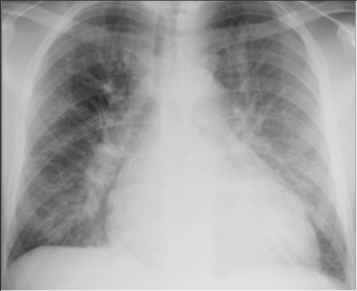
Cardiac Emergencies
Acute CHF
Acute coronary insufficiency
Aortic dissection

Slide 41
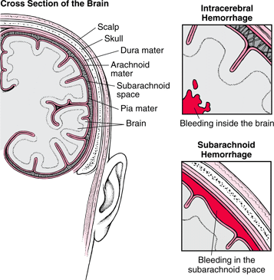
Hypertensive Emergency Key Points
CNS Emergencies
Hypertensive encephalopathy
Intracerebral or subarachnoidal hemorrhage
Thrombotic brain infarction with severe HTN

Slide 42
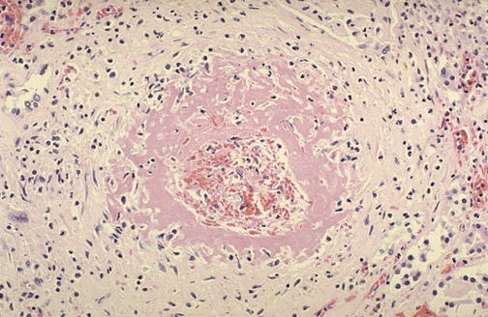
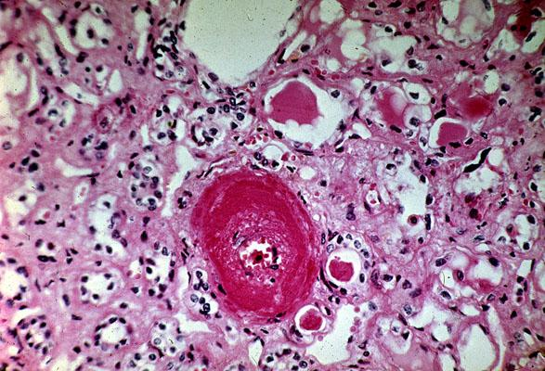
Hypertensive Emergency Key Points
Renal Emergencies
Rapidly progressive renal failure

Slide 43
Fundoscopy/ Neuro
Hemorrhages
Exudates
Papillodema
Notes:
COTTON WOOL EXUDATES
PAPILLEDEMA

Slide 44
Urgency vs. Emergency
Distinguishing between hypertensive emergency and urgency is a crucial step in appropriate management

Slide 45
Urgency vs. Emergency
Urgency
No need to acutely lower blood pressure
May be harmful to rapidly lower blood pressure
Death not imminent
Emergency
Immediate control of BP essential
Irreversible end organ damage or death within hours
Notes:
MAIN CAUSE IS OF HYPERTENSIVE URGENCY IS MEDICATION NON-COMPLIANCE SO GENERALLY FIND OUT WHY NOT TAKING AND RESTART OR CHOOSE NEW AGENTS.

Slide 46
Goals of Treatment

Slide 47
HTN Urgencies: Goals of Therapy
No proven benefit of rapid BP reduction in asymptomatic patients
Goal BP <160/110 mm Hg over several hours, oral therapy
Initial BP fall less than 25% in first six hours
can be managed using oral antihypertensive agents in an outpatient or same-day observational setting
Ensure follow-up: Long-term management

Slide 48
HTN Urgencies: Therapy
The calcium channel blocker nicardipine, 30 mg, q 8 hours until the target BP
Labetolol, the starting dose is 200 mg orally, which can be repeated every 3 to 4 hours
Clonidine is a central sympatholytic a 0.1 to 0.2 mg loading dose followed by 0.05 to 0.1 mg every hour until target BP is achieved (Max 0.7 mg).

Slide 49
Hypertensive Emergency
ICU with close monitoring
IV and Short acting medications
Avoid sublingual or IM
Arterial line
Prevent end organ damage
NOT normalize BP
Exceptions??

Slide 50
Goals of Treatment
Within 1-2 hrs
Lower MAP 20-25%
CONTROLLED
IV titratable meds
Notes:
As an aside…always do what your surroundings will allow. Nursing availability, med. availability. Till with NTG in flash pulmonary edema.

Slide 51
Complications for rapid BP Reduction in Severe Hypertension
Widening Neurologic Deficits
Retinal ischemia and Blindness
Acute MI
Deteriorating renal function

Slide 52
Pharmacotherapy

Slide 53
Given by continuous infusion
Antihypertensive Drugs for Hypertensive Crisis
Sodium nitroprusside
Nitroglycerin
Nicardipine
Labetalol
Esmolol
Fenoldapam

Slide 54
Questions

