Slide 1
Chronic Kidney Disease
Prof. Jamal Al Wakeel
Professor of Internal Medicine, Nephrology Consultant
Nephrology Unit, Department of Medicine

Slide 2
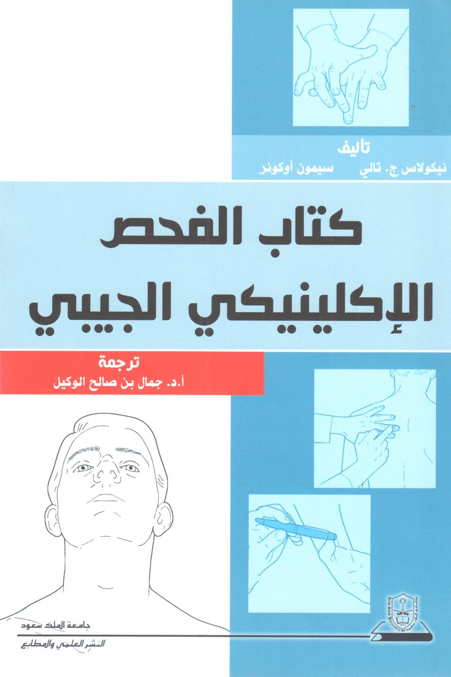
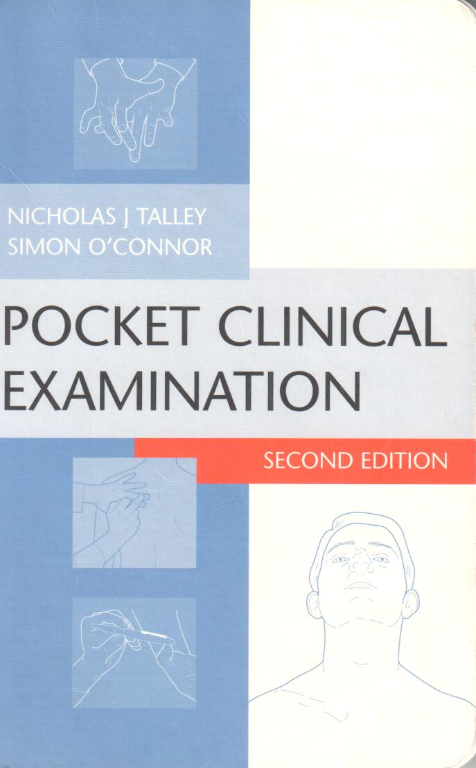

Slide 3
Chronic Kidney Disease
Objective
Epidemiology of CKD
Definition of CKD
Classification
Symptoms, signs and complications
Management of CKD

Slide 4
Case Study
55 yrs. old man with previous history of DM &hypertension came to Emergency with recurrent SOB for 2 week, he was treated by diuretic. Last investigation showed his Na 132,K6.1,urea 28 mmol/L &S Cr 380 μmol/L. The nurse recorded that his vital signs are:
BP – 190/105 mmHg
Pulse rate – 50 beats/min
What will your approach be for this case?

Slide 5
History
History of major complain
History of present illness
{ Site ,Onest ,Duration, character , course ,severity ,aggravating,reliving factors ,radiation,associated symptoms, system involve }
History of hypertension(cause,duration,control, medication,complicarion)
Diabetus mellitus
Systemic review

Slide 6
History of uremia
History of weight loss in 6 months
↓ appetite
Nausea and vomiting
History of urinary symptom
Itchiness
Leg cramp

Slide 7
History
Systemic review
Past Medical illness
Surgical
Medication
Family
Social
Allergy

Slide 8
Examination

Slide 9
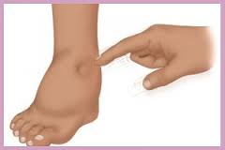
Examination
Posture
Look ill
BMI – 27 kg/m²
BP - 185/80 mmHg sitting both arm
Pulse rate – 50 beats/min
Breathing pattern
Pale
Edema
Mouth
Itching marks
Hand examination

Slide 10
Cardiovascular examination
JVP – 5cm
S1 + S2 + S3
ESM grade II at apex
No pericardial rub

Slide 11
Chest examination
Scratch mark in the back
Right side – stony dullness
↓TVF in right side
Bilateral basal crepitation
↓breathing sound at right side

Slide 12
Abdominal examination
Scratch mark
No organomegaly
No aortic or renal bruits
No suprapubic mass
No shifting dullness

Slide 13
CNS
Drowsiness
Fundus examination > diabetic retinopathy
No asthraxis
Normal power
Decrease Touch Sensation and vibration & sensation in both legs
Normal Coordination

Slide 14
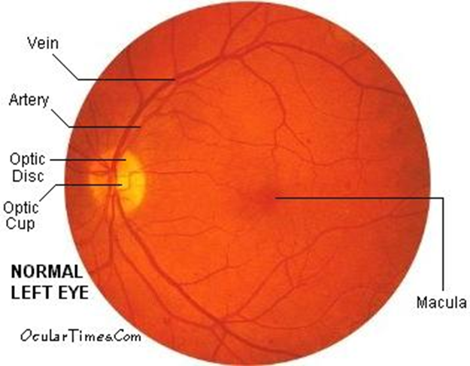
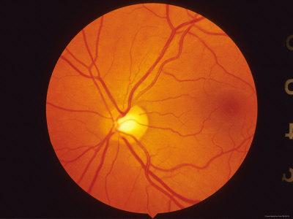
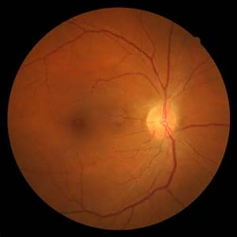
Fundus examination

Slide 16
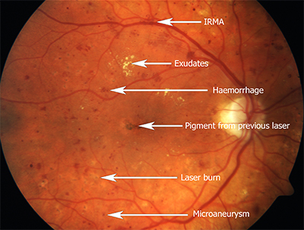
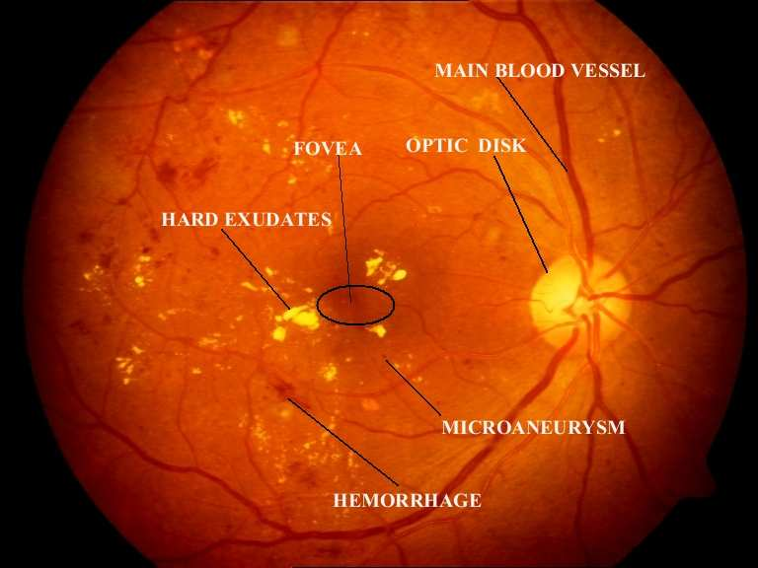
Diabetic Retinopathy

Slide 18
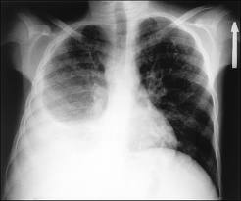
Clinical Diagnosis
CKD due to DM and HTN
Diabetic retinopathy
Hypertension Stage III
Anemia
Functional murmur
Itching
Right pleural effusion
Fluid overload with pulmonary edema
Bradycardia
Diabetic peripheral neuropathy

Slide 19
European Society of Nephrology Classification of Blood Pressure Levels
Category | Systolic blood pressure (mmHg) | Diastolic blood pressure (mmHg)
Optimal blood pressure | <120 | <80
Normal blood pressure | <130 | <85
High-normal blood pressure | 130-139 | 85-89
Grade 1 hypertension (mild) | 140-159 | 90-99
Grade 2 hypertension (moderate) | 160-179 | 100-109
Grade 3 hypertension (severe) | >/= 180 | >/= 110
Isolated systolic hypertension | >140 | <90

Slide 21
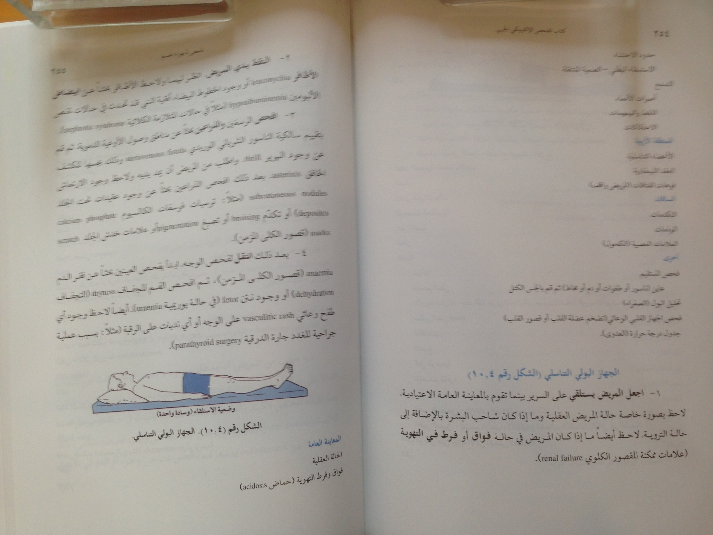

Slide 22
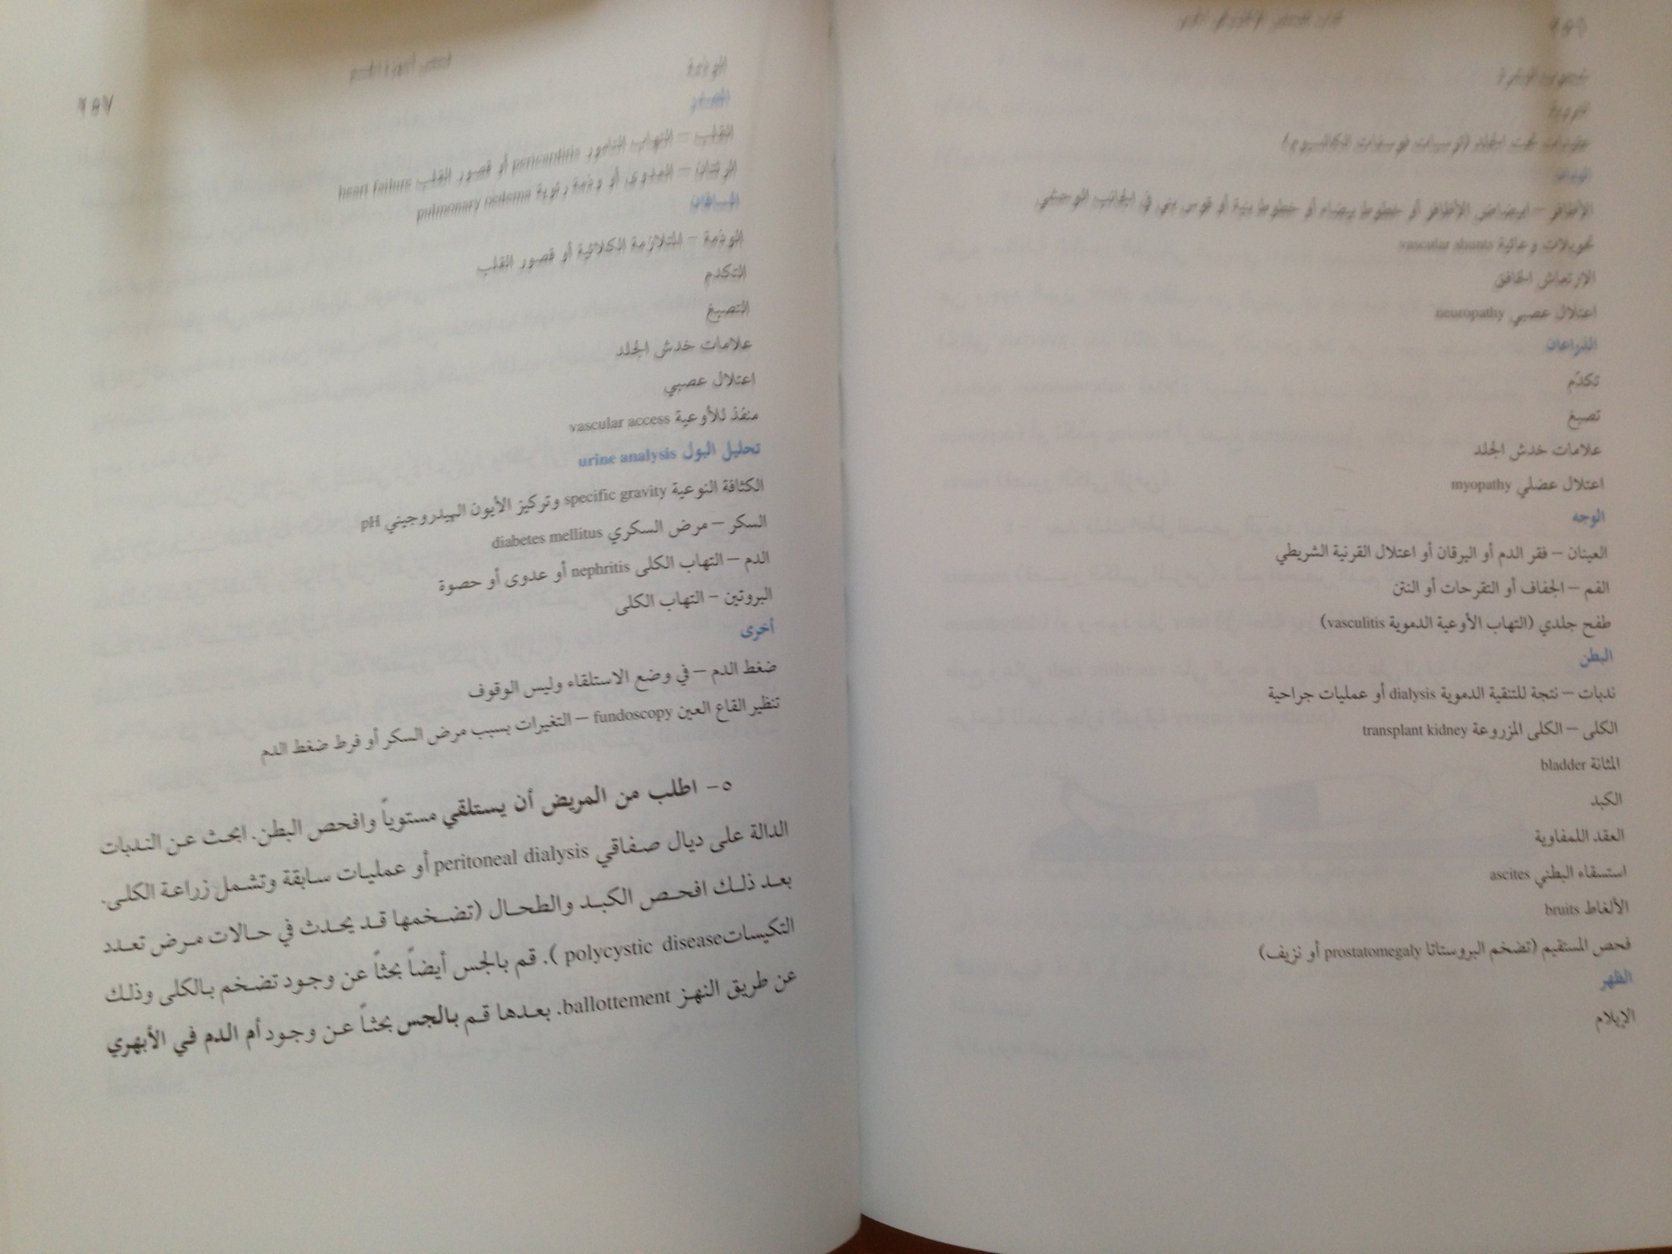

Slide 23
Investigation

Slide 24
Investigation
CBC
Hemoglobin –85g/L
WBC – 5,000/L
Platelet – 120,000/L
MCV – 82 fL
Biochemistry (Repeated)
NA – 132 mmol/L
K – 6.4 mmol/L
Cr – 320 μmol/L- eGFR =18 ml/min
Urea – 24 mmol/L

Slide 25
Investigation
Ca – 1.9 mmol/L
PO₄ – 3.9 mmol/L
Albumin – 29 g/L
Uric acid - 690 mmol/L
Bicarbonate 14 mmol/L
Chloride 105 mmol/L

Slide 26
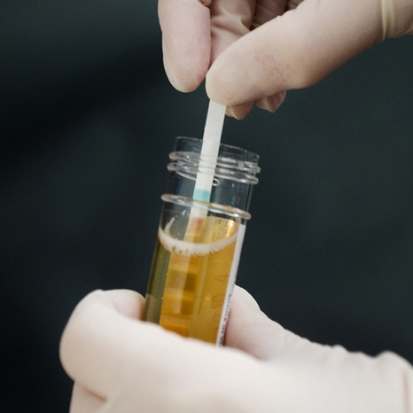
Investigations
Urine Analysis
pH - 6
Urine RBC = negative
WBC – 5 cu/L
Protein = ++ve
Specific gravity – 1010
Broad waxy cast
Urine albumin creatinine ratio
24 hour urine collection
Creatinine clearance
Proteinuria

Slide 27
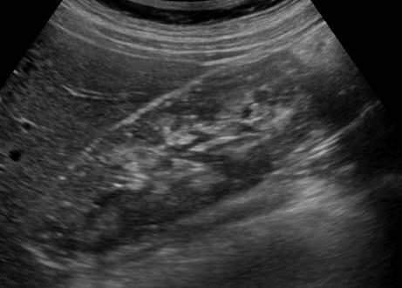
Investigation
Normal size kidneys – 12 cm
Normal Echogenicity

Slide 28
Diagnosis
CKD
- cause possible hypertension & DM Nephropathy
-stage G 4 (eGFR 18 ml/min)
A +3
Hyperkalemia
Metabolic acidosis –high anion gap
Anemia
Hypocalcemia
Hyperphosphatemia
Hyperuricemia
Diabetic Neuropathy and Retinopathy

Slide 29
Prevalence of CKD
CKD in aged ≥20 yrs is >10% -18%
. The prevalence of CKD increases with age:
4% at age 29-39 y
47% at age >70 y

Slide 30
Risk Factors CKD
Diabetes Mellitus 30%
Hypertension 25%
Old age 50%
Low GFR AKI
Obesity
Cardiovascular disease
NSAID
Family history
Smoking

Slide 32
KDIGO recommendation -classified based on:
Cause
GFR category
Albuminuria category (CGA)

Slide 33
Chronic Kidney Disease
Kidney damage
Structural abnormalities
GFR < 60 ml/min/1.73 m²
Functional abnormalities
for ≥3 months
Criteria for CKD (either of the following present for >3 months)
Markers of kidney damage (one or more) | Albuminuria (AER ≥30mg/24 hours; ACR≥30mg/g [≥3mg/mmol])
 | Urine sediment abnormalities
 | Electrolyte and other abnormalities due to tubular disorders
 | Abnormalities detected by histology
 | Structural abnormalities detected by imaging
 | History of kidney transplantation
Decreased GFR | GFR <60 ml/min/1.73 m² (GFR categories G3a–G5)
Abbreviations: CKD, chronic kidney disease; GFR, glomerular filtration rate.

Slide 34
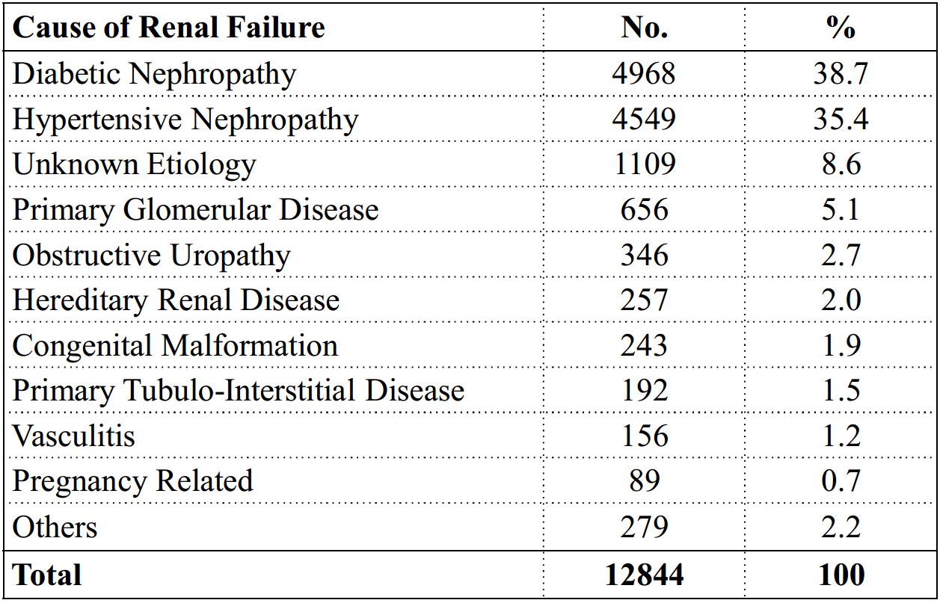
Causes of End-Stage Renal Disease in Hemodialysis Patients in Saudi Arabia- 2012

Slide 35
GFR Categories in CKD
GFR category | GFR (ml/min/1.73 m²) | Terms
G1 | > 90 | Normal or high
G2 | 60-89 | Mildly decreased*
G3a | 45-59 | Mildly to moderately Decreased
G3b | 30-44 | Moderately to Severely decreased
G4 | 15-29 | Severely decreased
G5 | <15 | Kidney failure
* Relative to young adult level
In the absence of evidence of kidney damage, neither GFR category G1 or G2 fulfill the criteria for CKD.

Slide 36
CKD Classification Estimation and Measurement of GFR
Estimate and/or Measure GFR
Filtration Markers (Endogenous)
Creatinine Clearance (CrCl)
eGFR equations
eCKD- EPI cr
eCKD-EPI-cyc
Cystatin C

Slide 37
CKD Classification Estimation and Measurement of GFR
Cystatin C
Virtually found in all tissues and body fluids
Potent inhibitor of lysosomal proteinases
Important extracellular inhibitors of cysteine proteases

Slide 38
Calculators

Slide 39
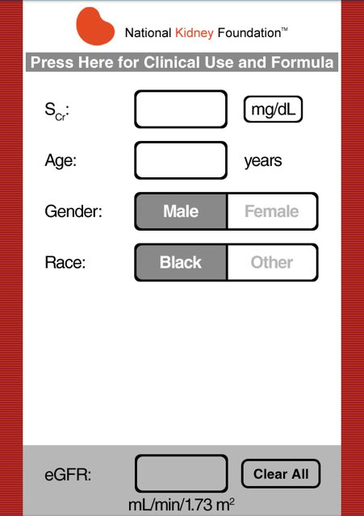
CKD – EPI Calculation

Slide 40
MDRD Calculation

Slide 41
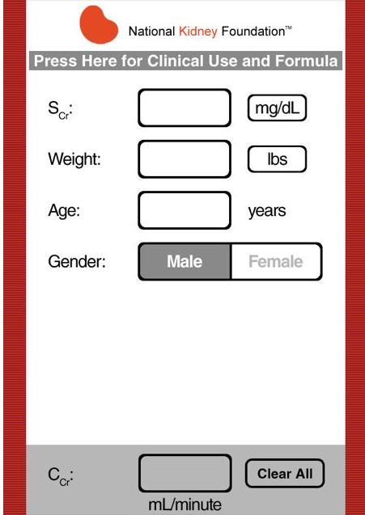
Cockcroft-Gault Formula GFR Calculation

Slide 42
Albuminuria categories as follows:
*note that where albuminuria measurement is not available, urine reagent strip results can be substituted
Albuminuria categories in CKD
Category | AER (mg/24 hours) | ACR (mg/mmol) | ACR (mg/g) | TERMS
 |  | approximate | equivalent
A1 | < 30 | <3 | <30 | Normal to mildly increased
A2 | 30-300 | 3-30 | 30-300 | Moderately increased*
A3 | >300 | >30 | >300 | Severely increased**
*Relative to young adult level
** Including nephrotic syndrome (albumin excretion usually > 2200 mg/24 hours
[ACR .2220/g; >220 mg/mmol])1
Kidney International Supplements (2013) 3, 5-14

Slide 43
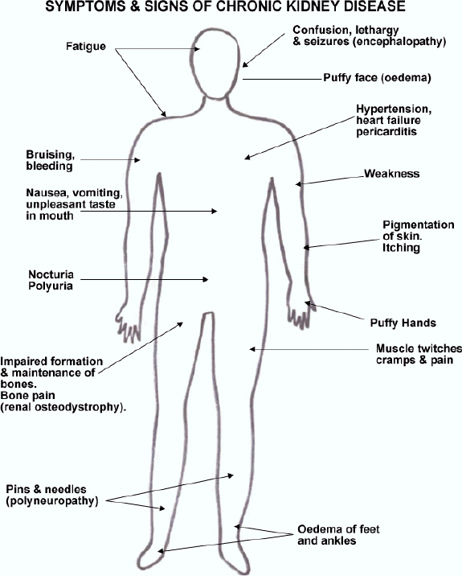
Signs and Symptoms
Hyperparathyrodism
,Epistaxis,
Anemia (Musocal pallor)
Plural effusion, plural edema
Bruising
Amenorrhea
Impotence Infertility

Slide 44
Diagnosis of CKD
Basic Laboratory studies used in the diagnosis of CKD can include the following:
Complete blood count (CBC)
Biochemistries(Na, K, Urea, Cr, HCO₃, Ca, PO3, Uric, Albumin, Alk ph)
Urinalysis
24 hour urine collection Creatinine clearance and proteinuria
Urine albumin:creatinine ratio
Glucose
Lipid profile:
increased risk of cardiovascular disease

Slide 45
Diagnosis of CKD
Laboratory studies used in the diagnosis the cause of CKD
ANA
HBsAg
HCV.
C₃,C₄
HbA1c
Investigation used in the diagnosis the complications of CKD
PTH
VIT D₃
ECH
ECG

Slide 46
Diagnosis of CKD
Different
Acute Kidney Injury form
CKD
Reversible factors

Slide 47
Management of CKD
The medical care should:
Delaying or halting the progression of CKD
Treatment of the underlying condition
Treating the complications
Timely planning for long-term for RRT

Slide 48
BP control
Hyperlipidemia
Correct Acidosis
Diet
Protein, PO3 & salt
Prevention progress of CKD
Glycemic Control
Proteinuria& RAAS

Slide 49
Treatment of Complications
Volume overload:
restrict SALT
loop diuretics
Metabolic acidosis:
oral alkali supplementation

Slide 50
Treatment of Complications
Anemia: hemoglobin level ↓10 g/dL –
check iron -iron Tablet or IV
erythropoiesis-stimulating agents (ESAs)
epoetin alfa
darbepoetin alfa
Methoxy polyethylene glycol-epoetin beta(Mircera)
Hyperkalemia
Low K Diet
Resonium Ca ,Na resonium
Hyperphosphatemia
dietary phosphate binders (Ca Carbonate,Ca Acetate,Sovlomier,lanthium)
dietary phosphate restriction
Hypocalcemia:
calcium supplements with or without calcitriol
Hyperparathyroidism:
Calcitriol
vitamin D analogs

Slide 51
Target Blood Pressure in CKD
Diabetics and Non-diabetics
Albuminuria | Target BP | Drug of choice
A1 <30 mg/d | ≤140/90 | CBC, Diuretic, RAAS
A2 >30 mg/d | ≤ 130/80 | ARB or ACE-I

Slide 52
Renal Diet
Low salt diet – 3 g/day
Low potassium diet
(2g-2.5 g), half of normal intake
Low protein diet - 0.6 to 0.8 g/kg per day
Low phosphorous diet – 800 – 1000 mg/day
Water intake – daily water intake 2 L

Slide 53
Treatment of Complications
Uremic manifestations:
Long-term renal replacement therapy
hemodialysis,
peritoneal dialysis
renal transplantation

Slide 54
Indications for renal replacement therapy
Severe metabolic acidosis
Hyperkalemia
Intractable volume overload
Pericarditis
Uremic Symptoms
Encephalopathy
Failure to thrive and malnutrition
Peripheral neuropathy
Intractable gastrointestinal symptoms
In asymptomatic patients
GFR of 5-9 mL/min/1.73 m²

Slide 55
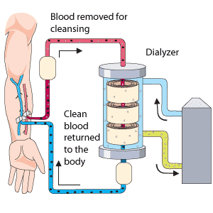
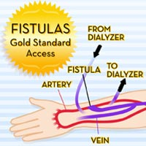
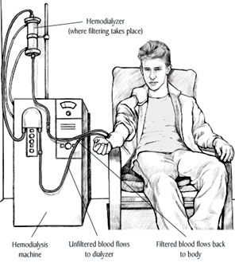
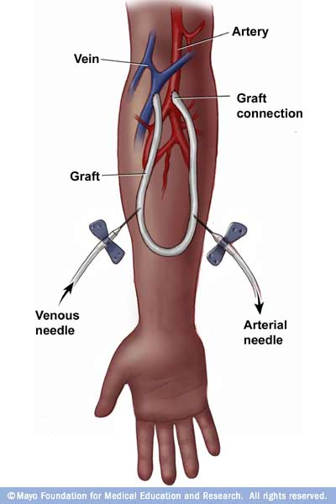
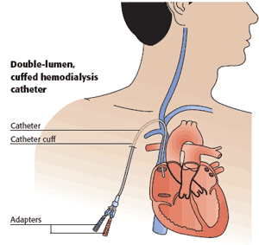
Hemodialysis

Slide 58
Proteinuria control in CKD
Diabetics and Non-diabetics
Abumineria | Causes of Renal Disease | Drug of choice
A2 or >30-300 mg/d | DM | ARB or ACE-I
A3 or >300mg/d | Non DM CKD | ARB or ACE-I
Notes:
Recommend not using an angiotensinconverting
enzyme inhibitor (ACE-I) or an
angiotensin receptor blocker (ARB) for the
primary prevention of DKD in normotensive
Suggest using an ACE-I or an ARB in
normotensive patients with diabetes and
albuminuria levels >30 mg/g who are at high
risk of DKD or its progressionnormoalbuminuric patients with diabete

