Slide 1
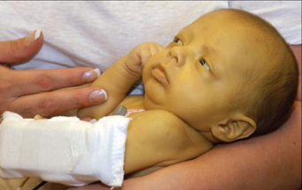
NEONATAL JAUNDICE Hyperbilirubinemia of The Newborn
Khalid Altirkawi, M.D
Assistant Professor, Pediatrics
King Saud University
Riyadh, Saudi Arabia
2017

Slide 2
Disclaimer
This presentation is meant to guide students when rotating in the NICU.
It is not to replace the recommended textbooks.
Khalid Altirkawi, MD

Slide 3
Objectives
By the end of this presentation, students should be able to:
Describe the metabolic pathways of bilirubin.
Differentiate between physiological and pathological types of neonatal jaundice.
Tell the appropriate diagnostic tests for evaluating jaundiced infants.
Mention the strategies for prevention and treatment of neonatal jaundice.

Slide 4
Introduction
Neonatal Jaundice:
A yellow discoloration of skin and sclera due to an increased concentration of serum bilirubin.
Usually appears in the newborn infant when serum bilirubin concentration > 85 μmol/L.
Occurs in the majority (>50% term and 80% preterm) of infants

Slide 5
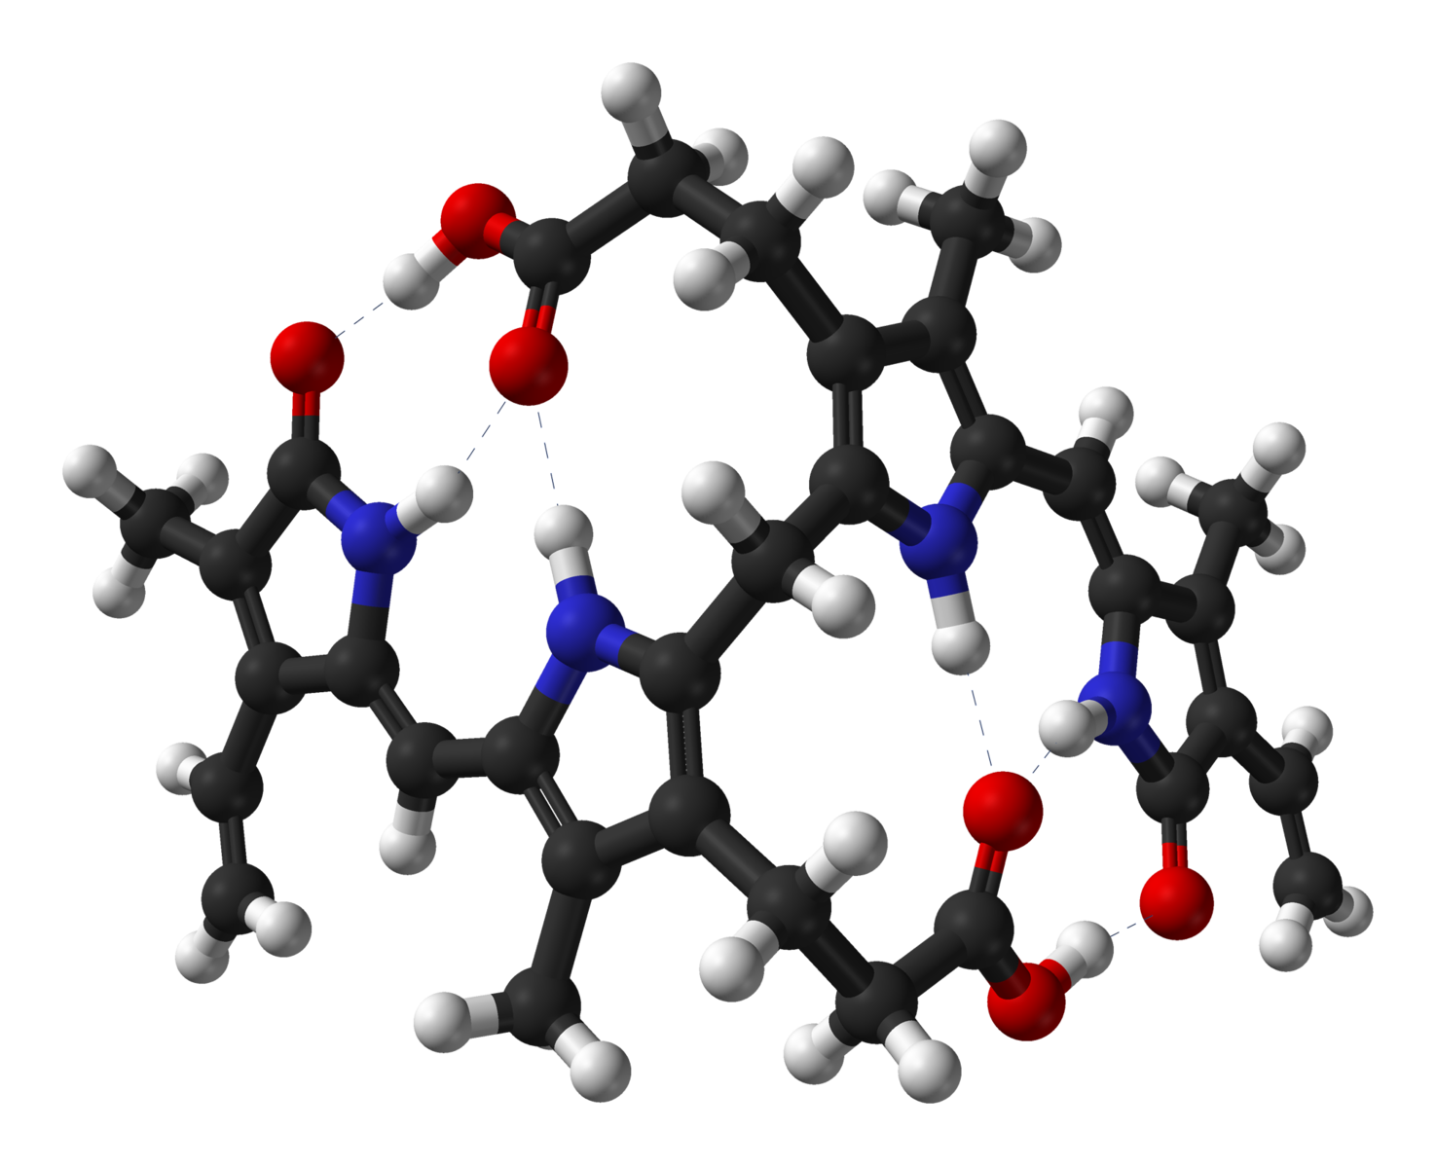
Metabolic
Pathways

Slide 6
Bilirubin Metabolism
Synthesis
From the breakdown of the heme molecule:
The hemoglobin … … ... ... ... ... ... ... ... … … ... ... (80%)
Nonerytheroid heme (cytochrome, myoglobin..) … (20%)
Bilirubin produced is
Unconjugated (indirect).
Lipid soluble (pass through BBB.

Slide 7
Bilirubin Metabolism
Transport
Unconjugated bilirubin is bound to albumin and carried to liver.
Hepatocytes uptake this Bilirubin and transport it intracellular where it is metabolized

Slide 8
Bilirubin Metabolism

Slide 9
Bilirubin Metabolism
Conjugation
Bilirubin is conjugated to glucoronic acid by the enzyme glucoronyl transferase
Conjugated bilirubin (Direct) is water-soluble (pass in urine) but not lipid soluble

Slide 10
Bilirubin Metabolism
Excretion
Conjugated Bilirubin is excreted into the bile
Under the effect of the intestinal flora
Enzyme β glucouronidase unconjugates it.
Bilirubin urobilinogin stercobilin (~85%, in the stool)
Urobilin (reabsorbed into blood) (~1% in the urine)
Some is reabsorbed and transported back to liver (~15%, Enterohepatic circulation)

Slide 11
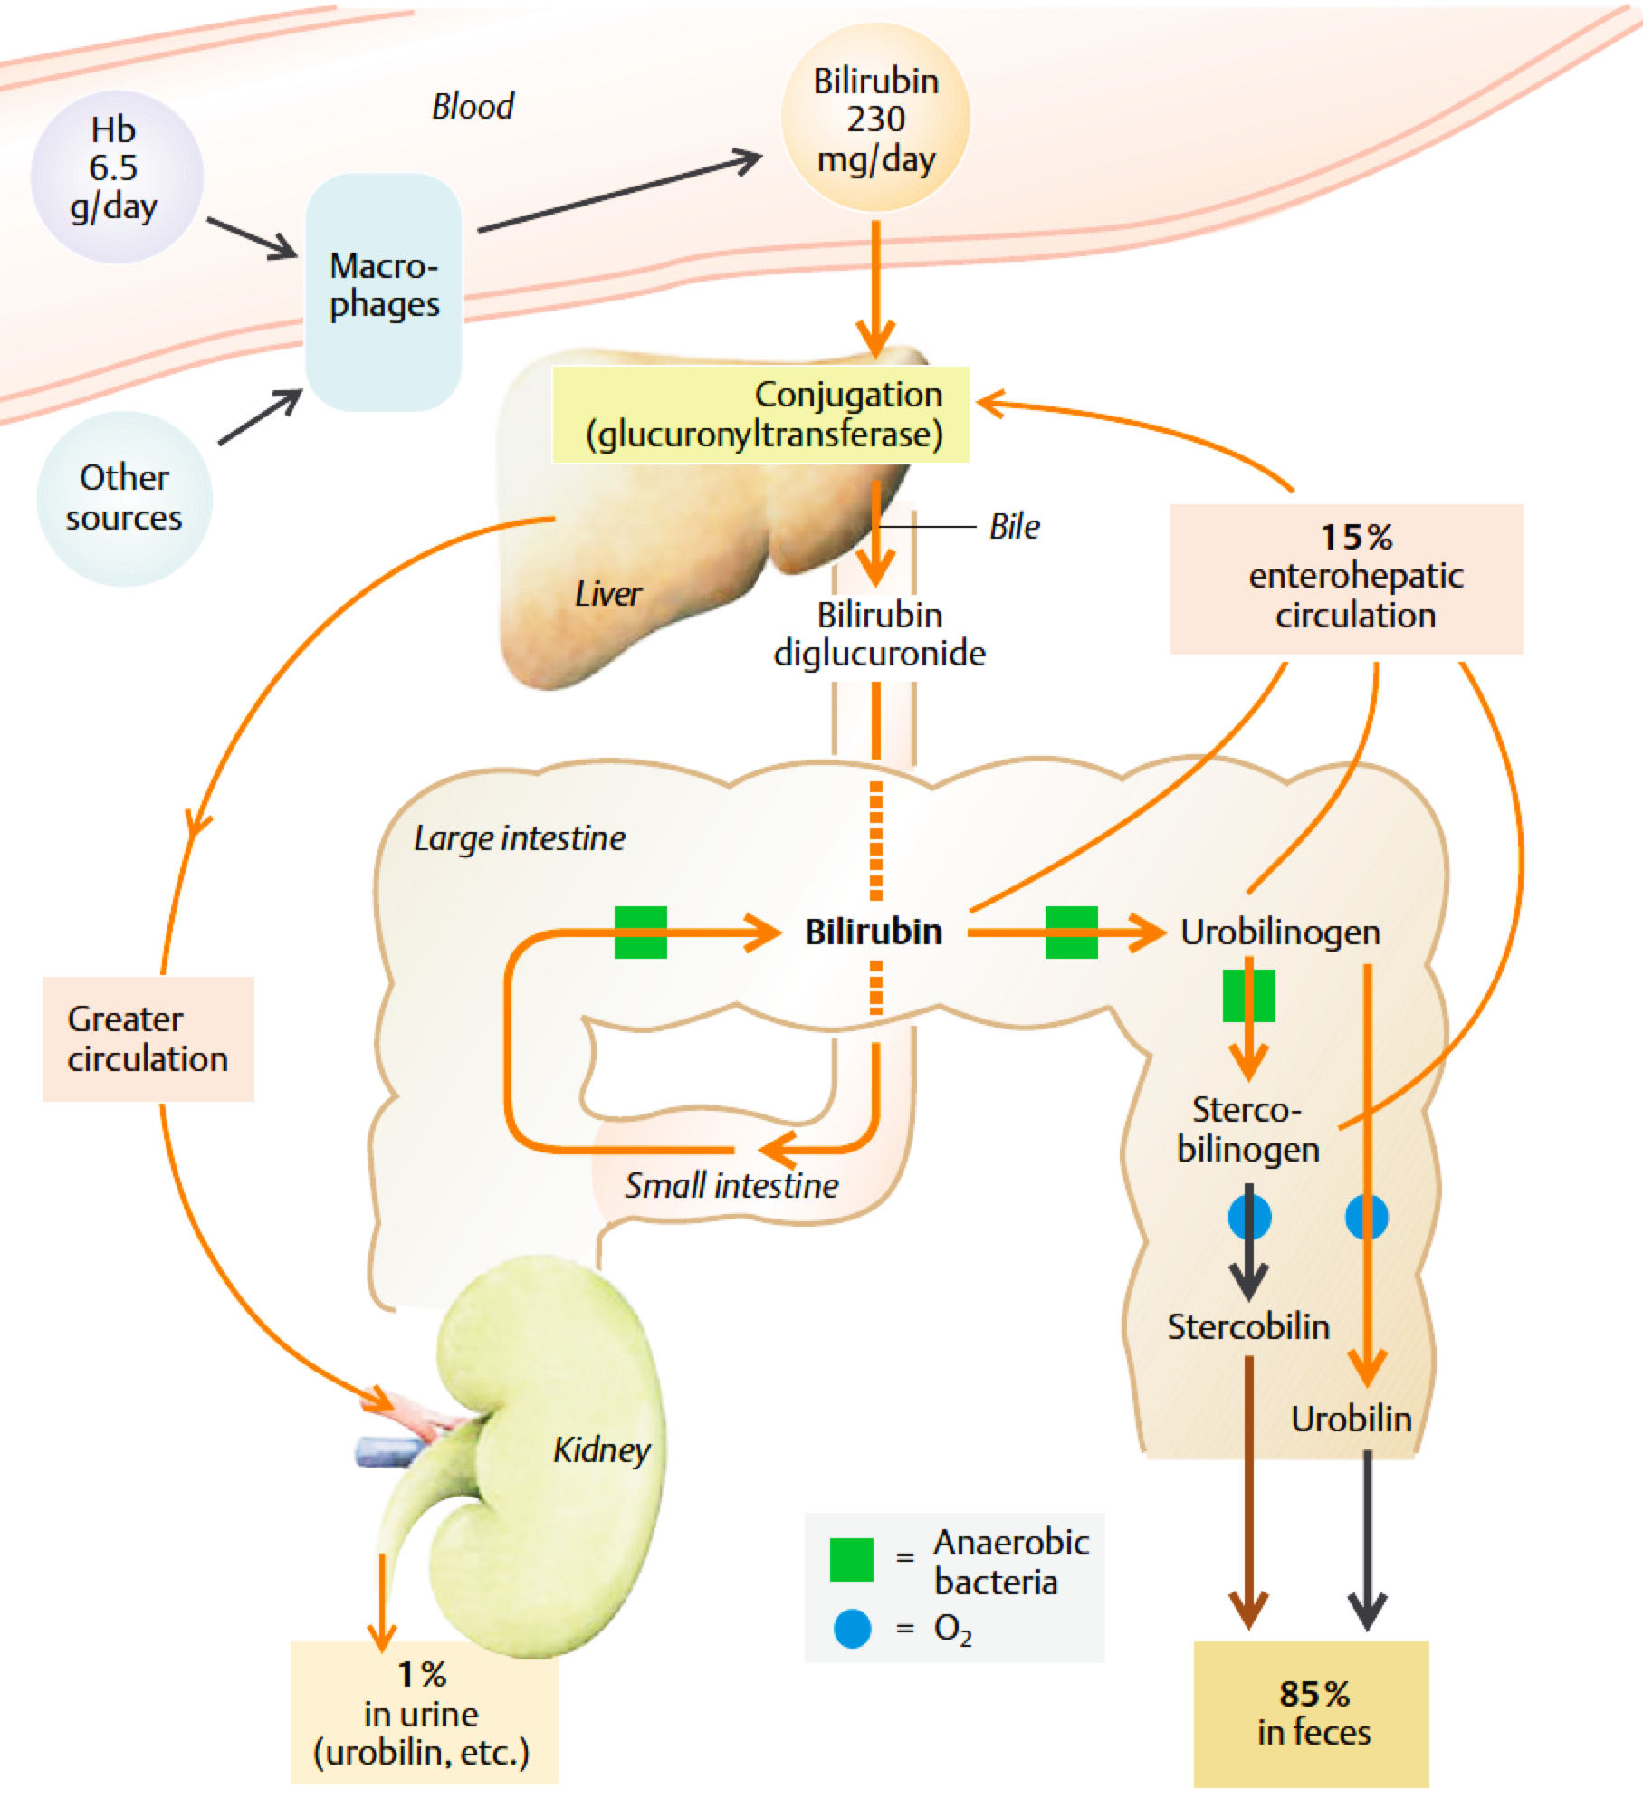
BILIRUBIN Metabolism Pathways

Slide 12
Pathogenesis

Slide 13
Pathogenesis
Unconjugated hyperbilirubinemia:
Defective conjugation
Increased production (e.g. hemolysis)
Increased bilirubin load (e.g. cephalhematoma)
Other unidentified mechanisms

Slide 14
Pathogenesis
Defective conjugation
Physiological Jaundice
Congenital hypothyroidism
Enzyme deficiency (e.g. Crigler-Najjar syndrome)

Slide 15
Pathogenesis
Increased production (Hemolysis)
Immune
Iso-immune (hemolytic disease of the newborn)
Auto-immune (Maternal auto-antibodies): e.g. SLE
Non immune
Inherited hemolytic anemias (e.g. hemoglobinopathies, G6PD, Spherocytosis)
Others: Vitamin E deficiency, Drugs, Infections, sepsis, DIC.

Slide 16
Pathogenesis
Increased bilirubin load
Extravascular blood collection
Polycythemia
Dehydration
Increased enterohepatic circulation
Paralytic ileus
Hirschsprung’s disease
Intestinal stenosis or atresia

Slide 17
Pathogenesis
Uncertain mechanisms
Breast milk jaundice
Breast feeding jaundice
Some ethnic groups

Slide 18
Pathogenesis
Conjugated hyperbilirubinemia
Decreased excretion rate
Obstructive lesions
Congenital biliary atresia
Tumors or cyst
Inspissated bile
Metabolic and endocrine abnormalities
Hypothyroidism
Galactosemia

Slide 19
Pathogenesis
Mixed hyperbilirubinemia
Hepatocyte abnormalities
Sepsis
Intrauterine infections
Neonatal hepatitis
Hepatitis viruses
TORCH
Idiopathic hepatitis
Hypoxic insult

Slide 20
Clinical
Presentations

Slide 21
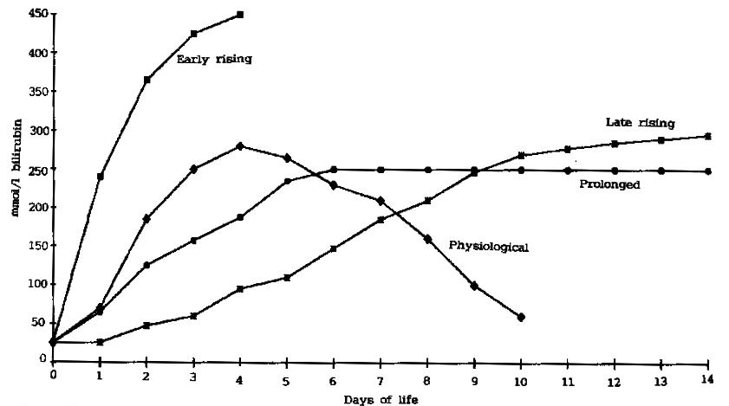
Patterns of neonatal jaundice
Severe hemolysis
Obstructive lesion
Biliary atresia
Neonatal hepatitis
Prematurity
Infection
Hypothyroidism
Breast milk jaundice
Crigler-Najjar
Physiological
Dehydration
Sepsis
Cephalohematoma
Polycythemia
Crigler-Najjar

Slide 22
Causes by the age of onset
At Birth or Within 24h
Within The 1st Week
Hemolysis (Blood group incompatibility)
Congenital infection (TORCH)
Sepsis
Physiological jaundice
Congenital infection (TORCH)
Sepsis
Concealed hemorrhage
Crigler-Najjar syndrome

Slide 23
Causes by the age of onset
After The 1st Week
Persistent After 2nd Week
Breast milk jaundice
Sepsis
Hepatitis
Biliary atresia
Hypothyroidism
Galactosemia
Inherited hemolytic anemia
Neonatal hepatitis
Biliary atresia
Inspissated bile syndrome

Slide 24
Physiological vs. Pathological
 | Physiological | Pathological
Onset | 2nd-3rd day of life | At any time
Level of Bilirubin | Usually lower | Usually higher
Type of Bilirubin | Unconjugated | Any
Rate of increase | Slow increase (usually <85μmol/L/24h) | May be faster (usually >85μmol/L/24h)
Duration | Shorter (7-10 days in the term & 14 days in the Preterm) | May be longer
Physical Exam and Lab. tests | Normal, healthy infant | Abnormal

Slide 25
Unconjugated
Hyperbilirubinemia

Slide 26
Physiological jaundice
Due to:
Increased synthesis (excessive RBCs load)
Relative immaturity of hepatic glucoronyl transferase
Onset usually on 2nd-3rd day
Disappear around day 7-10
Infant is usually healthy

Slide 27
Physiological jaundice
Exacerbating Factors
Prematurity
Polycythemia
Dehydration
Breast feeding (usually higher by 50-65 μmol/L than formula fed)
Laboratory
Rate of accumulation is < 85μmol/L/day

Slide 28
Physiological jaundice
Treatment:
Maintain sufficient feeding
Serial measurements of serum bilirubin
Look for pathological causes if bilirubin level exceeds the expected for age
Phototherapy if needed

Slide 29
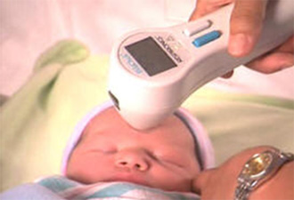
Management
Notes:
Side effects of phototherapy
1. Insensible water loss is increased in infants undergoing phototherapy, especially those under radiant warmers. The increase may be as much as 40% for term and 80% to 190% in premature infants. Incubators with servocontrolled warmers will decrease this water loss. Extra fluid must be given to make up for these losses (see Chap. 9).
2. Redistribution of blood flow. In term infants, left ventricular output and renal blood flow velocity decrease, whereas left pulmonary artery and cerebral blood flow velocity increase. All velocities return to baseline after discontinuation of phototherapy. In the preterm infant, cerebral blood flow velocity also increases and renal vascular resistance increases with a reduction of renal blood flow velocity. In ventilated preterm infants the changes in blood flow velocities do not return to baseline even after discontinuation of phototherapy. In addition, in preterm infants under conventional phototherapy, it has been shown that the usual postprandial increase in superior mesenteric blood flow is blunted. Fiberoptic phototherapy did not seem to affect the postprandial response. Although, the changes in cerebral, renal, and superior mesenteric artery blood flow with phototherapy treatment in preterm infants is of potential concern, no detrimental clinical effects due to these changes have been determined.
3. Watery diarrhea and increased fecal water loss may occur. The diarrhea may be caused by increased bile salts and UCB in the bowel.
4. Low calcium levels have been described in preterm infants under phototherapy.
5. Retinal damage has been described in animals whose eyes have been exposed to phototherapy lamps. The eyes should be shielded with eye patches. Follow-up studies of infants whose eyes have been adequately shielded show normal vision and electroretinography.
6. Tanning of the skin of black infants. Erythemia and increased skin blood flow may also be seen.
7. “Bronze baby” syndrome.
8. Mutations, sister chromatid exchange, and DNA strand breaks have been described in cell culture. It may be wise to shield the scrotum during phototherapy.
9. Tryptophan is reduced in amino acid solutions exposed to phototherapy. Methionine and histidine are also reduced in these solutions if multivitamins are added. These solutions should probably be shielded from phototherapy by using aluminum foil on the lines and bottles.
10. No significant long-term developmental differences have been found in infants treated with phototherapy compared with controls.
11. Phototherapy upsets maternal-infant interactions and therefore should be used only with adequate thought and explanation.

Slide 30
Phototherapy
Indicated if bilirubin level exceeds a set point
Exposure of infant to light with wave length around 450 nm
Isomerization of bilirubin to nontoxic water soluble form
Eyes should be protected
Control for temperature and fluid balance is important

Slide 31
Phototherapy

Slide 32
Breast MILK Jaundice
Unconjugated hyperbilirubineamia beyond 2nd week of life
Disappears within 2 days of breast feeding discontinuation
May take up to 3 months to resolve completely
Due to (?) a substance in human milk that inhibits the activity of glucoronyl transferase
Treatment:
Reassurance after exclusion of other pathologies
Stoppage of breast feeding is NOT recommended

Slide 33
Breast FEEDING Jaundice
May be related to decreased amount of milk consumed by the infant (breast-feeding failure )
More effective nursing may prevent early “starvation” in breastfed newborns and reduce the incidence of this type of jaundice

Slide 34
Hemolytic
Disease of The Newborn
Notes:
Hemolysis due to Rh or ABO incompatibility between mother and fetus

Slide 35
Hemolytic disease of the newborn
Rh isoimmunization
Mother is Rh–ve abd the fetus is Rh+ve
First pregnancy usually goes with no fetal problems
Mother is sensitized by fetal Rh+ve RBCs
Antibodies to Rh+ve RBCs is formed and it is transmitted to the fetus during second pregnancy
~ 1/100 pregnancies and not in every Rh-ve mother
May be prevented by Anti-D administered to the mother

Slide 36
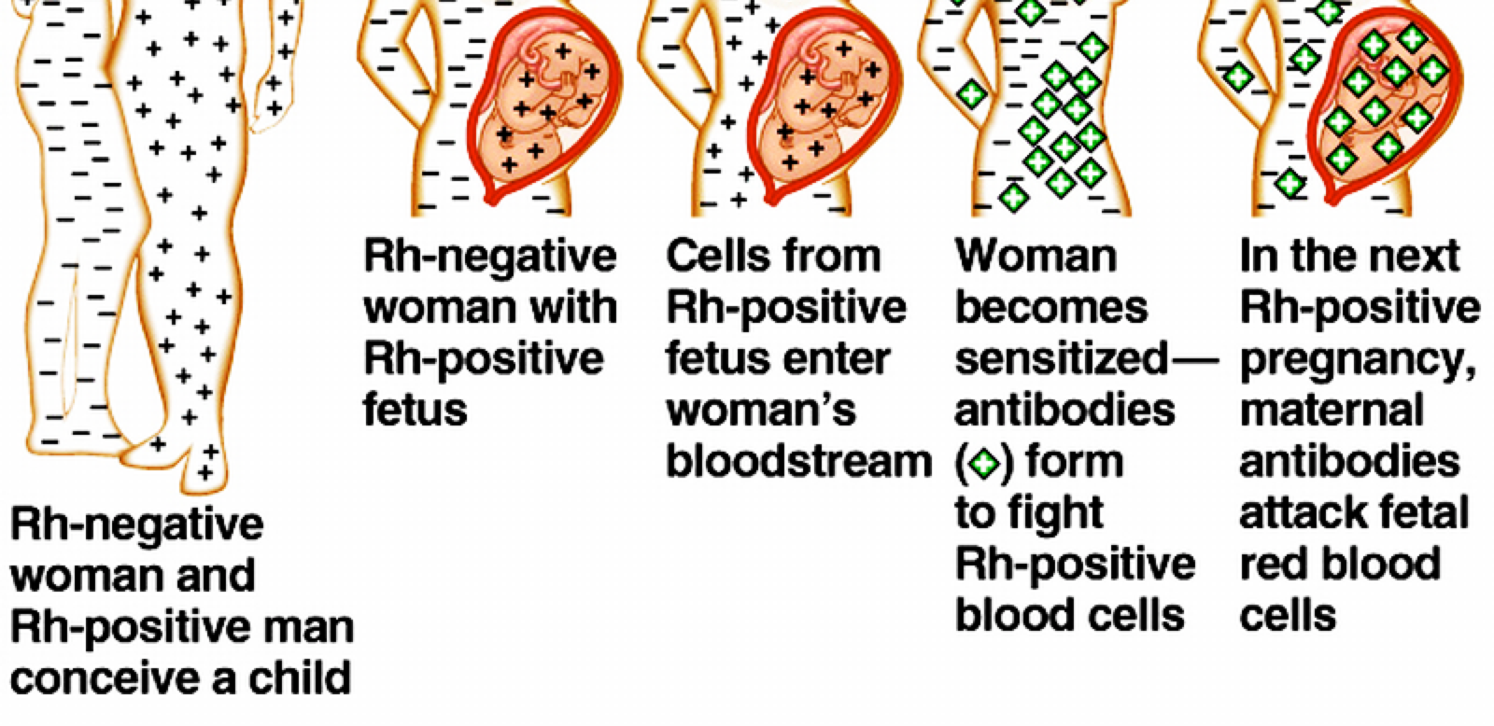
Hemolytic disease of the newborn
Pathogenesis of Hemolytic Disease of The Newborn

Slide 37
Hemolytic disease of the newborn
ABO incompatibility (milder disease)
The anti-A or Anti-B hemolysins (antibodies) present in a mother with blood group O is transferred to the fetus of A or B blood group
This results in hemolysis (most transferred antibodies can be neutralized by the baby)
1 in every 200 births
The first baby can be affected

Slide 38
Hemolytic disease of the newborn
Severe hemolysis manifestations
Hydrops fetalis
The most severe form
Often still birth with severe anemia and massive edema and ascitis
Icterus gravis neonatorum
Jaundice in the first 24hr, not at birth
Variable degree of hemolytic anemia
Hepatosplenomegaly
Notes:
A milder form manifests with gradual onset of anemia and slight jaundice in the first few days or weeks

Slide 39
Hemolytic disease of the newborn
Prevention
Anti-D within 72 hrs after delivery of Rh+ve child or abortion.
Management:
Life support
Establish diagnosis
Early phototherapy
Transfusion to restore normal hemoglobin level
Exchange transfusion if needed.

Slide 40
Exchange transfusion
Indicated in
Kernictrus
Cord bilirubin >85μmol/L or
Cord hemoglobin <100 g/L
Rate of bilirubin rise > 8.5 μmol/L/hour
Unconjugated bilirubin level > 340 μmol/L at any age (at a lower level in presence of risk factor such as sepsis)
Double volume exchange transfusion

Slide 41
Exchange transfusion

Slide 42
Bilirubin
Neurotoxicity
Notes:
Hemolysis due to Rh or ABO incompatibility between mother and fetus

Slide 43
Bilirubin neurotoxicity
Cause:
Crossing of unconjugated bilirubin to the brain.
The level at which injury happens depends on:
Maturity/Postnatal age
Binding capacity in the blood (S. Albumin)
Associated risk factors (acidosis, infection, asphyxia…)

Slide 44
Bilirubin neurotoxicity
Acute Encephalopathy
Chronic Encephalopathy
Three phases
Hypotonia, lethargy, high pitched cry and poor sucking
Extensors hypertonia, opithotonus, fever and seizures
Hypotonia replaces hypertonia in a week
Death may occur up the second phase
Athetosis
Sensorineural hearing deficit
Limited upward gaze
Dental dysplasia
Intellectual deficit

Slide 45
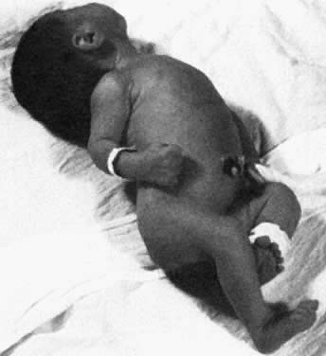
Kernicterus
Notice:
Opithotonus position and fisted hands

Slide 46
Bilirubin neurotoxicity
Kernicterus:
Yellowish staining of the brain tissue by bilirubin deposition
Associated with evidence of neuronal injury
Mostly affects basal ganglia, brain stem and cerebellar nuclei and anterior horn cells

Slide 47
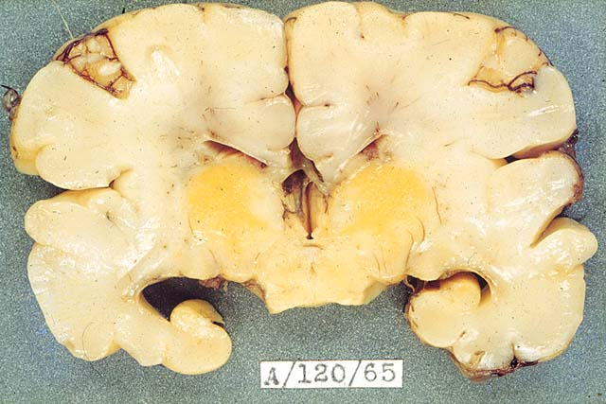
Bilirubin neurotoxicity / Kernicterus

Slide 48
Conjugated
Hyperbilirubinemia
Notes:
Hemolysis due to Rh or ABO incompatibility between mother and fetus

Slide 49
Conjugated hyperbilirubinemia
Always pathological
Direct bilirubin >34μmol/L
Evaluation
Serum bilirubin
Liver function tests
Cultures (blood, urine,….)
Abdominal ultra sound
Isotopic scan (scintegraphy)
Liver biopsy

Slide 50
Conjugated hyperbilirubinemia
 | Neonatal hepatitis | Biliary atresia
Stool color | Intermittent pale | Persistent pale
Serum Bilirubin | Biphasic | Mainly conjugated
ALT, AST | Marked increase | Mild increase
Alk. Phosphatase | Mild increase | Marked increase
Liver scintegraphy | Uptake: Sluggish Excretion of isotope: happens eventually | Uptake: Intact Excretion of Isotope into intestine is absent
Liver biopsy | Inflammatory Infiltration. Distorted lobular archit-ecture. Focal necrosis | Intact lobular architecture. Bile ductular proliferation or paucity. Perilobular edema & fibrosis

Slide 51
Conjugated hyperbilirubinemia
Treatment of chronic cholestasis
Treatment of the cause
Supportive
Fat soluble vitamins
Use of MCT-containing formula
Attention to micronutrients as Ca, Ph, Zinc
Surgical interference
Biliary atresia: Kasai operation, Liver transplantation

Slide 52
Please send your feedback to:
kaltirkawi@ksu.edu.sa

