Slide 1
CHRONIC DIARRHEA IN CHILDREN
Asaad M. A. Abdullah Assiri
Professor of Pediatrics &
Consultant Pediatric Gastroenterologist
Department of Pediatrics
King Khalid University Hospital
يوجد
Cases
مهمه باخر المحاضره

Slide 2
OBJECTIVES
Know how to evaluate a child who has chronic diarrhea, including appropriate elements of history, physical examination, stool analysis, and blood testing.
Be familiar with the many disorders that cause chronic diarrhea, both with and without failure to thrive.
Know the therapies for the many causes of chronic diarrhea.

Slide 3
Introduction
Recurrent, chronic, infantile diarrhea with malnutrition, causes the death of 4.6 million children globally each year. In the last 25 years, the following specific preventive measures have reduced further the number of infants who have this condition.

Slide 4
Introduction (cont.)
renewed emphasis on breastfeeding
reduction in the use of partial starvation regimens during diarrheal episodes and
increased availability of age-appropriate infant food for children living in poverty

Slide 5
PATHOPHYSIOLOGY
Osmotic diarrhea is caused by a failure to absorb a luminal solute, resulting in secretion of fluids and net water retention across an osmotic gradient.
Secretory diarrhea occurs when there is a net secretion of electrolyte and fluid from the intestine without compensatory absorption.

Slide 6
PATHOPHYSIOLOGY
Intestinal dysmotility typically occurs in the setting of intact absorptive abilities. Intestinal Transit time is decreased, the time allowed for absorption is minimized, and fluid is retained within the lumen.
Inflammatory diarrhea may encompass all of the above pathophysiologic mechanisms.

Slide 7
Congenital Chloride Diarrhea A Study in Arab Children
1- Congenital diarrhea
J Clin Gastroenterol 1994; 19(1):36-40
Maternal polyhydrammics
Prematurity

Slide 10
Abdominal Distention
Diarrhea

Slide 11
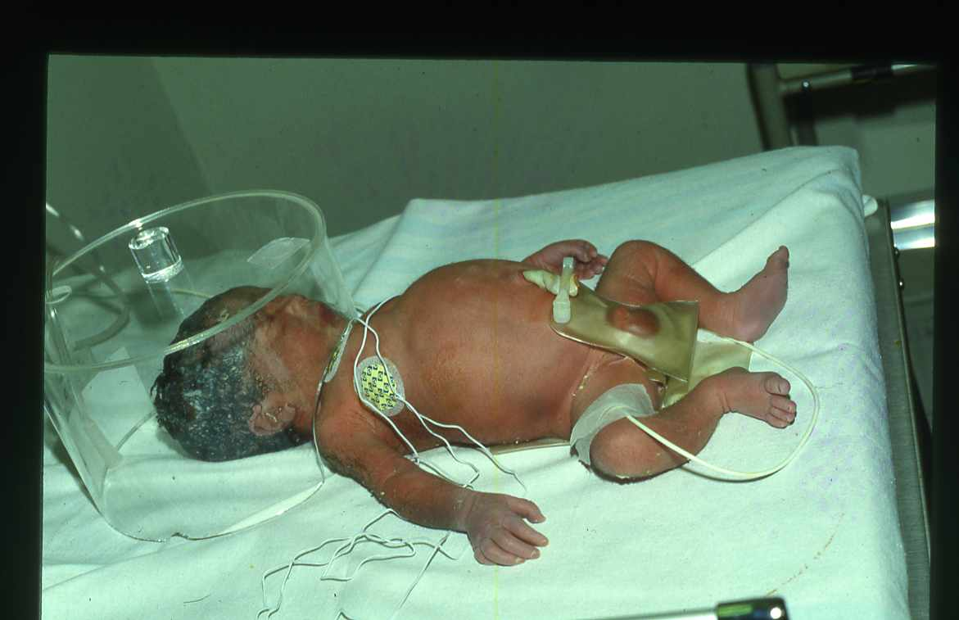

Slide 13
A- Congenital Chloride Diarrhea
Types :
قراءه فقط
Rare
Hypokalemia, hypochloremic
Metabolic alkalosis
Fecal chloride greater than
Fecal sodium and potassium

Slide 14
Phenotype Gene Relationships
قراءه فقط
Location | Phenotype | Phenotype MIM Number | Gene / Locus | Gene / Locus MIM Number
7q31.1 | Chloride diarrhea, congenital, Finnish type | 214700 | SLC26A3 | 126650

Slide 15
TREATMENT
قراءه فقط
Na + Kcl supplement

Slide 16
B- Congenital Sodium Diarrhea
It is caused by a defect in a jejunal sodium/proton exchange that results in severe watery diarrhea.
Polyhydramnios – first manifestation of CSD
Hyponatremia
Metabolic Acidosis
An autosomal recessive disease.

Slide 17
Congenital Sodium Diarrhea
DISEASE | GENE | LOCATION | FUNCTION
Congenital Sodium Diarrhea | SPINT2* | 19q13.1 | Serine – protease inhibitor

Slide 18
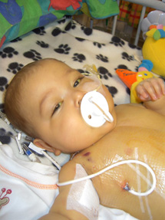
C- Microvillous Atrophy-Inclusion Disease (Familial Microvillous Atrophy)
Watery diarrhea despite patients NPO
Clinical forms are:
Congenital the onset of the diarrhea in the first week of life
Late onset when diarrhea start after neonatal period

Slide 19
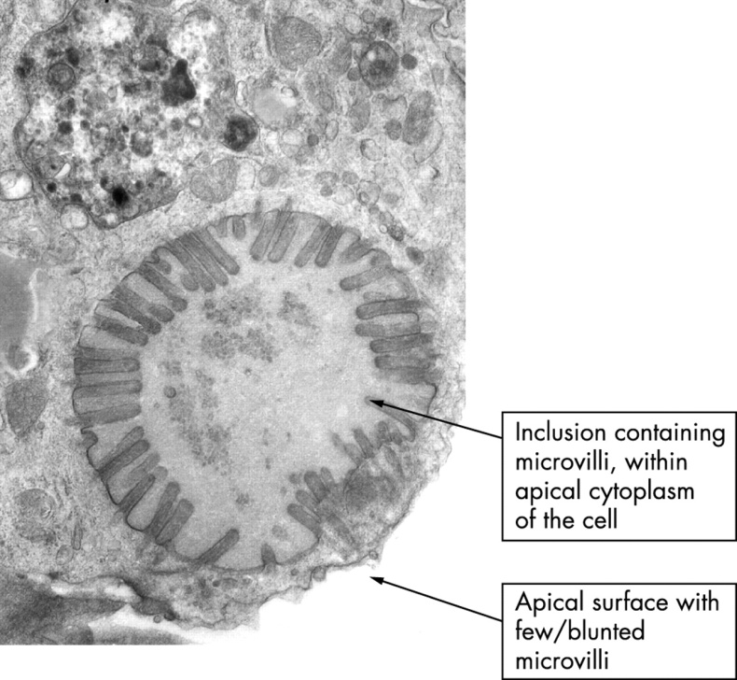
Microvillous Atrophy-Inclusion Disease (Familial Microvillous Atrophy)
Diagnosis is based on the finding of villus atrophy and intracytoplasmic inclusions lined by intact microvilli in intestinal biopsy material

Slide 20
Familial Microvillous Atrophy: A Clinicopathological Survey of 23 cases
A. D. Philips and *J. Schmitz
Journal of Pediatric Gastroenterology and Nutrition
1992;14:380-396

Slide 21
Microvillous Atrophy – Inclusion Disease (Familial Microvillous Atrophy)
DISEASE | GENE | LOCATION | FUNCTION
Microvillous Inclusion Disease | MY05B | 18q21 | Intracellular protein trafficking

Slide 22
Microvillus Inclusion Disease
Rx: TPN + intestinal transplant

Slide 23
D- Intestinal Epithelial Dysplasia (Tufting Enteropathy)

Slide 24
Definition
Intestinal epithelial dysplasia (IED), is also known as tufting enteropathy.
A congenital enteropathy presenting with early-onset severe intractable diarrhea and persistent villous atrophy.

Slide 25
Epidemiology
Prevalence can be estimated around 1/50,000 – 100,000 live births in Western Europe.
Prevalence is higher in countries with high degree of consanguinity.

Slide 26
Clinical description, associated disorders and diagnostic criteria
Watery diarrhea within the first days after birth.
Stool volumes may be as high as 100-200 ml/kg.
Growth is impaired.
No past history of hydramnios suggesting congenital chloride diarrhea or sodium malabsorption.
Affected children are reported to have dysmorphic features.

Slide 28
Clinical description, associated disorders and diagnostic criteria
Malformations observed includes esophageal atresia, choanal atresia, or imperforated anus.
Nonspecific punctuated keratitis is observed in more than 60% of patients.

Slide 29
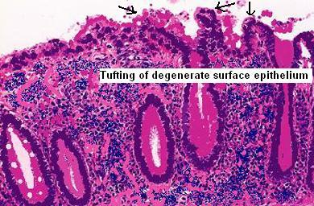
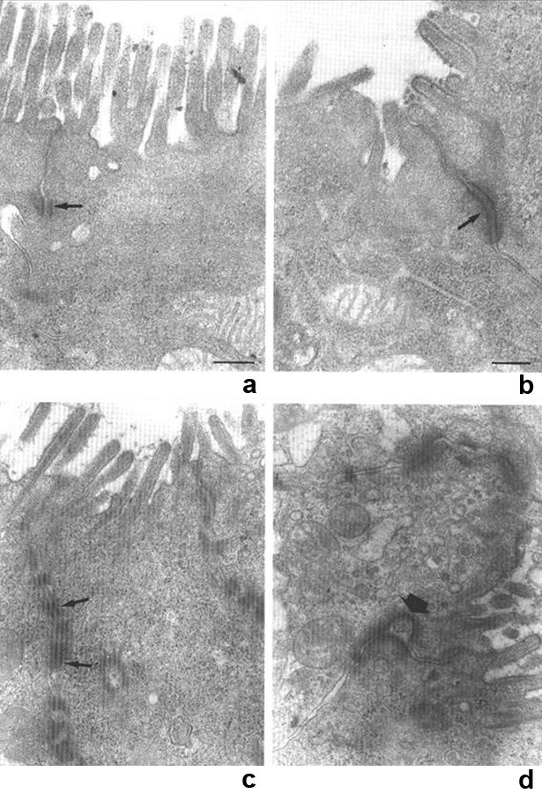
Histological presentation
Villous atrophy
Epithelium
Abnormalities are localized mainly in the epithelium, includes disorganization of surface enterocytes with focal crowding.
Specific features
Focal enterocyte crowding observed in crypt epithelium.
Crypts are dilated with features of pseudo cysts.

Slide 30
TREATMENT
- Total parenteral nutrition
- Intestinal transplantation

Slide 31
E - ENTERERIC ANENDOCRINOSIS
Enteric Anendocrinosis also known as Congenital Malabsorptive Diarrhea is caused by mutations in neurogenin-3 and is associated with a paucity of enteroendocrine cells in the pancreas and intestine. It is characterized by an osmotic diarrhea and later development of insulin-deficient diabetes, without anti-islet cell antibodies.

Slide 32
2- Autoimmune Enteropathy
Severe protracted watery diarrhea during infancy or toddlerhood.
Diarrhea may be isolated or may occur in, association with diabetes mellitus as part of the IPEX syndrome (Immune dysregulation, Polyendocrinopathy and Enteropathy, X-linked), associated with mutations in the FOXP3 gene.
IPEX is characterized by chronic diarrhea, which usually begins in infancy, dermatitis, autoimmunie endocrinopathy (diabetes mellitus, thyroiditis).

Slide 33
Autoimmune polyendocrine syndrome, also known as autoimmune polyendocrinopathy-candidiasis ectodermal dystrophy (APECED), is one of several autoimmune disorders caused by mutations in the autoimmune regulator gene (AIRE).
Features: hypoparathyroidism, adrenal insufficiency, and about 25% of patients develop autoimmune enteritis
Circulating antibodies to enterocytes anti-smooth, antithyroid and islet-cell antibodies.

Slide 34
TREATMENT
Total parenteral nutrition
Prednisone
Cyclosporine
Azathioprine
Intestinal transplant

Slide 36
3- Glucose-Galactose Malabsorption
Other name : mono sacaraids Malabsorption
Autosomal recessive inheritance
Specific defect on active transport system in small intestine
DISEASE | GENE | LOCATION | FUNCTION
Glucose- galactose Malabsorption | SLC5A1 (SGLT1) | 22q13.1 | Na+/ glucose cotransporter

Slide 37
Early onset
Watery diarrhea
Dehydration and metabolic acidosis
The diarrhoea ceases within one hour of removing the oral intake of lactose, glucose, and galactose.
The diarrhoea returns with introduction of lactose, glucose and galactose.
Fructose is mandatory →So Formula containing Fructose is the treatment for those babies مهمه

Slide 38
4

Slide 39
Developmental Lactase Deficiency
Other name : Di Sacarides malabsoption
The relative lactase deficiency observed among preterm infants of less than 34 weeks gestation.
The immature gastrointestinal tract, lactase and other disacharidases are deficient until at least 34 weeks gestation.

Slide 40
Congenital Lactase Deficiency
A rare disorder in only a few infants.
Affected newborn infants present with intractable diarrhea as soon as human milk or lactose-containing formula is introduced.
Small intestinal biopsies reveal normal histologic characteristics but low or completely absent lactase concentrations.
Life-threatening because of dehydration and electrolyte losses.
Treatment is simply removal and substitution of lactose from the diet with a commercial lactose-free formula.

Slide 41
Congenital Lactase Deficiency
DISEASE | GENE | LOCATION | FUNCTION
Congenital Lactase Deficiency | LCT | 2q21 | Lactase-phlorizin hydrolase activity

Slide 42
Primary Lactase Deficiency
Relative or absolute absence of lactase.
Develops in childhood at various ages in different racial groups.
The most common cause of lactose malabsorption and lactose intolerance.

Slide 45
Secondary Lactase Deficiency
Results from small bowel injury such as:
Acute gastroenteritis
Persistent diarrhea
Small bowel overgrowth
Cancer chemotherapy
Other causes of injury to the small intestinal mucosa
Present at any age but is more common in infancy.

Slide 46
Treatment
is relatively simple and aimed at reducing or eliminating lactose, by eliminating it from the diet or by “predigesting” it with supplemental lactase-enzyme replacement. Calcium must be provided by alternate nondairy dietary sources or as a dietary supplement to individuals who avoid milk intake.

Slide 48
5- Congenital Sucrase - Isomaltase Deficiency

Slide 50
Congenital Sucrase - Isomaltase Deficiency
Autosomal recessive trait
Introduction of sucrose to the diet
DISEASE | GENE | LOCATION | FUNCTION
Sucrase – Isomaltase Deficiency | EC 3.2.1.48 | 3q25-q26 | Isomaltase-sucrase

Slide 52
Congenital Sucrase - Isomaltase Deficiency
Watery diarrhea
Abdominal distension
Older children irritability
Growth may be normal

Slide 53
TREATMENT
Avoid sucrose or fructose- containing diet or supplement with:
SACROSIDASE

Slide 54
6- Infectious Diarrhea Duration of Uncomplicated Viral Diarrhea
 | Duration
Agent | Average (d) | Range (d)
Rotavirus | 6* | 1 to 10
Enteric adenoviruses | 11 | 1 to 22
Astrovirus | 5 | 1 to 8
Torovirus | 5 | 1 to 5
Norwalk-like | 2 | 1 to 4

Slide 57
Bacterial Causes of Chronic Diarrhea
Organism | Sources | Duration
Aeromonas sp | Untreated water | 1 wk to 1 yr
Campylobacter sp | Raw poultry, diarrheic animals, unpasteurized milk, birds, water, ferrets | 5 days to chronic
Clostridium difficile | Antibiotic use; can be nosocomial | 10% have relapses
Plesiomonas shigelloides | Untreated water, shellfish | 2 wks to mos
Salmonella sp | Poultry, fecal-oral, water | 5 d to mos in infants
Yersinia enterocolitica | Handling of raw pig intestines (chitterlings) | 3 wk to 3 mos

Slide 58
Bacterial Diarrheas
Non-typhoidal Salmonella infection
Aeromonas and Plesiomonas
Yersinia

Slide 59
Bacterial Diarrheas
Escherichia Coli (E-Coli)
Enteric pathotypes of E-Coli diarrhea may evolve to a chronic course مهمه due to persistent injury to the bowel.
Enterotoxic and mucosa-adherent E-Coli cause a watery diarrhea. May lead to prolonged diarrhea due to mucosal damage of persistence of the primary infection.
Enterohemorrhagic pathotype that produces toxin causes acute colitis and the hemolytic-uremic syndrome.

Slide 60
Parasitic Causes of Chronic Diarrhea
Organism | Sources | Duration
Giardia lamblia | Diapered infants, fecal-oral, water supplies | 2 wks to yrs
Cryptosporidium parvum | Child care, petting zoos, swimming pools | 1 to 2 wk w/ occasional reports of 6 wk
Cyclospora cayetanensis | Raspberries from Central America, water, unpasteurized apple cider | 1 wk to 1 mo or more
Entamoeba histolytica | Fecal-oral, water | Weeks
Isospora belli | Fecal-oral, water | Chronic
Strongyloides stercoralis | Developing countries, Appalachia,fecal-oral | Chronic
Blastocystis hominis | Uncertain if a pathogen

Slide 61
Signs and Symptoms of Giardiasis
Diarrhea (64 to 100%) → non bloody مهمه
Malaise, weakness (72 to 97%)
Abdominal distention (42 to 97%)
Flatulence (35 to 97%)
Abdominal cramps (44 to 81%)
Nausea (14 to 79%)
Foul-smelling, greasy stools (15 to 79%)
Anorexia (41 to 73%)
Weight loss (53 to 73%)
Vomiting (14 to 35%)
Walterspiel JN, et al. Giardia and giardiasis Prog Clin Parasitol 1994;4:1-26.

Slide 62
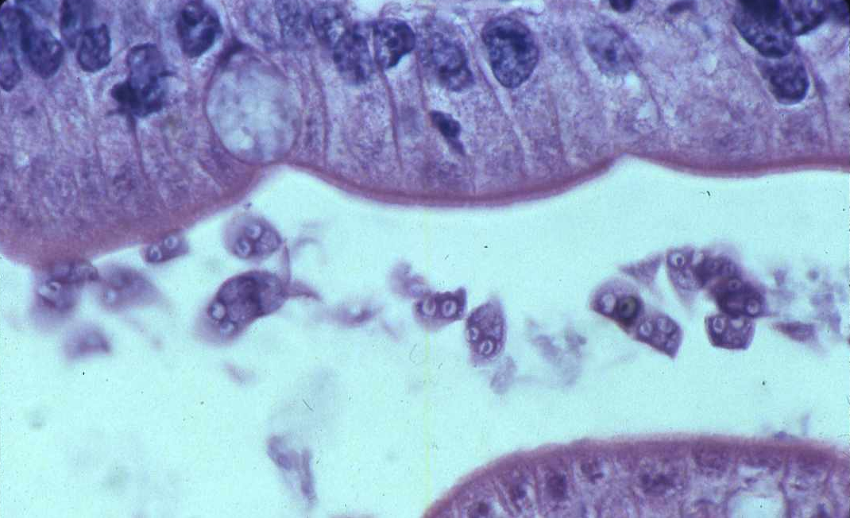
Giardia Lamblia
Rare presentations of Giardiasis include anasarca (protein-losing enteropathy).
Diagnosis can be done by miscroscopic examination of feces.
Organism sometimes is seen in intestinal biopsies.

Slide 63
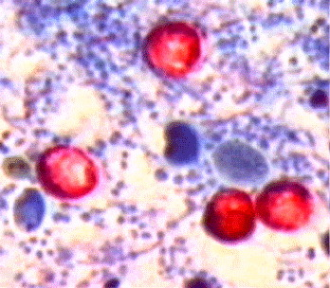
Cryptosporidium Parvum
The infection results from ingestion of the organism from fecal contamination of the hands.
Giardia-Cryptosporidium antigen tests have better sensitivity.

Slide 64
Cyclospora Cayetanensis
A unicellular coccidian parasite recognized in 1979.
Chronic diarrhea with severe weight loss in immunocompromised individuals.
Sources include contaminated water and food.
Diagnosis is based on identification of oocysts in fecal specimens.

Slide 65
7- Intractable Diarrhea of Infancy (IDI)
IDI is also known as:
Postenteritis enteropathy
Protracted diarrhea of infancy
Secondary disaccharidase deficiency
Enteric infection and associated compromise of intake and absorption lead to variable loss of digestive and absorptive capacity in infants. مهمه

Slide 66
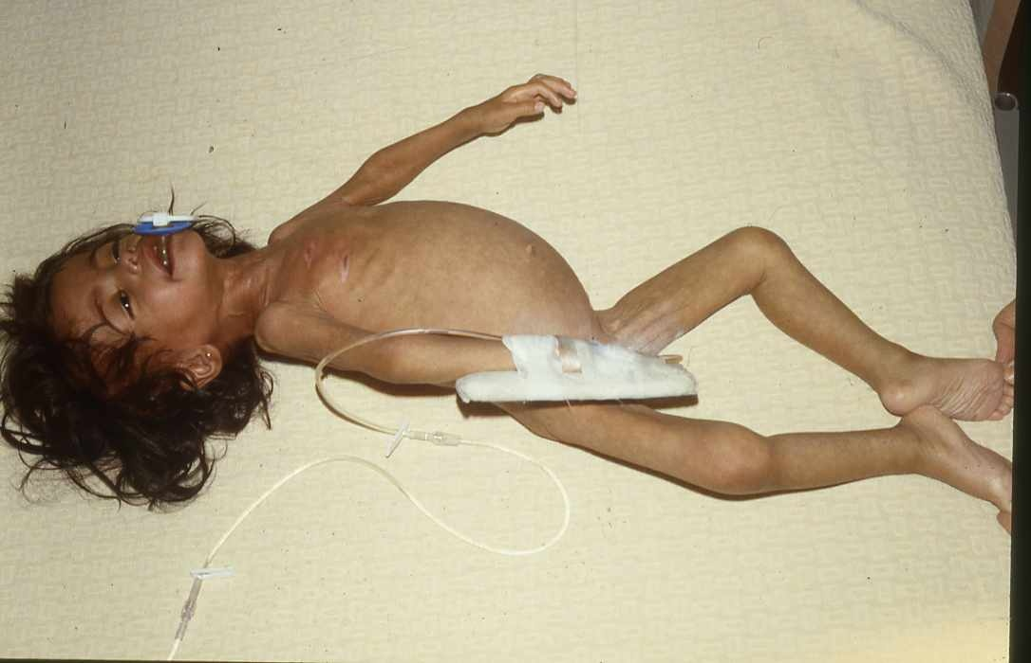
Intractable Diarrhea of Infancy (IDI)
Recurrent episodes of diarrhea and failure to regain weight in an infant.
Pt presented with sever wg loss and diarrhea مهمه

Slide 67
Suspicion should be raised further by the absence of breastfeeding, administration of diluted or clear liquid feedings, restriction of intake in a misguided effort to reduce diarrhea or vomiting.

Slide 68
Treatment
Lactose free-sucrose free formula
IV hydration for short period
If no improvement total parenteral nutrition

Slide 69
8- Immune deficiency diseases (IDD)
Chronic diarrhea is a common complication of IDD
Evaluation should include examination of lymph nodes, spleen, skin and peripheral blood smear.
NB : it usually associated with recurrent chest infection and Atypical infections or pus formation

Slide 70
Diarrhea in Immunodeficiency Diseases
Condition | Diarrhea Type/Onset
Human immunodeficiency virus infection | 30% have diarrhea or malabsorption. Cryptosporidia and Giardia are common. In the absence of proven infection, elevated serum VIP suggests hormonal cause.
Severe combined immunodeficiency syndrome (Raq1, Raq2, JAK3, ZAP-70, Omenn S) | 50% have protracted diarrhea with onset in early infancy; cryptosporidia and prolonged rotavirus.
X-linked agammaglobulinemia | Onset late in first year up to age 5. Campylobacter jejuni, Giardia.
Hyper lgM immunodeficiency | 50% have protracted diarrhea. Cryptosporidia are common. Tonsils and other lymphoid organs are enlarged.

Slide 71
Diarrhea in Immunodeficiency Diseases (cont.)
Condition | Diarrhea Type/Onset
Common variable immunodeficiency | Giardia and Campylobacter jejuni are common.
Chronic granulomatous disease | Mild watery to severe bloody diarrhea. <2 years old, Crohn like colitis.
Wiskott-Aldrich syndrome | Bloody diarrhea at birth; inflammatory bowel disease-like course.
Major histocompatibility complex class II deficiency | Death in infancy due to diarrhea/ malabsorption; 96% have diarrhea with proven and unproven infections, including Giardia, cryptosporidia, Candida sp, Salmonella sp, Cytomegalovirus.

Slide 72
Diarrhea in Immunodeficiency Diseases (cont.)
Condition | Diarrhea Type/Onset
Selective lgA deficiency | Possible increased sign of chronic giardiasis.
Immunodysregulation, polyendocrinopathy, enteropathy, X-linked syndrome | Intractable diarrhea in first year.

Slide 73
9- Dietary Protein Enteropathy
Age at onset | Dependent on age of exposure to antigen Cow’s milk and soy: up to 2 years failure to thrive
Proteins implicated | Cow’s milk, soy, cereal, egg, fish
Pathology | Variable small bowel villous injury and increased crypt length; often patchy, sub-total intraepithelial lymphocytes; few eosinophils

Slide 74
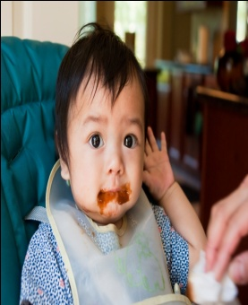
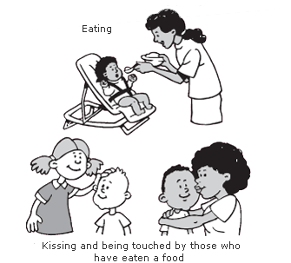
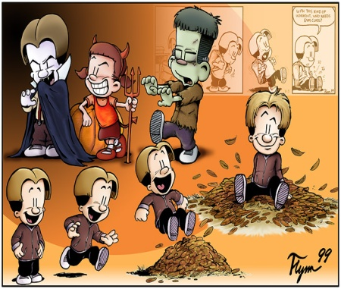
Dietary Protein Enteropathy
Manifestations | Diarrhea Malabsorption Failure to thrive Emesis Abdominal distensions Anemia Edema Hypoproteinemia Protein-losing enteropathy Anti-endomysium antibody negative Radiographic: small bowel edema Food challenge: vomiting and/or diarrhea in 40 to 72 hours

Slide 75
Treatment | Strict elimination of offending antigen
Natural History | Most cases resolve in 2 to 3 years

Slide 76
10 - Celiac Disease
Age of onset | Dependent on timing of gluten introduction typically more than 6 months
Proteins implicated | Wheat, rye, barley, possibly oats
Pathology | Extensive villous atrophy Elongated crypt length Increased intraepithelial lymphocytes
Genetics | HLA-DQ2 (and DQ8) associated مهمه
Natural History | Illness is life-long

Slide 77
Celiac Disease (cont.)
Manifestations | Chronic diarrhea Abdominal distension Failure to thrive / growth failure Complications of malabsorption Abdominal pain Associated diseases: dermatitis herpetiformis, diabetes mellitus, thyroid disease, Down syndrome, IgA deficiency Pt will have patchie as sign of VitK def
Treatment | Gluten elimination

Slide 78
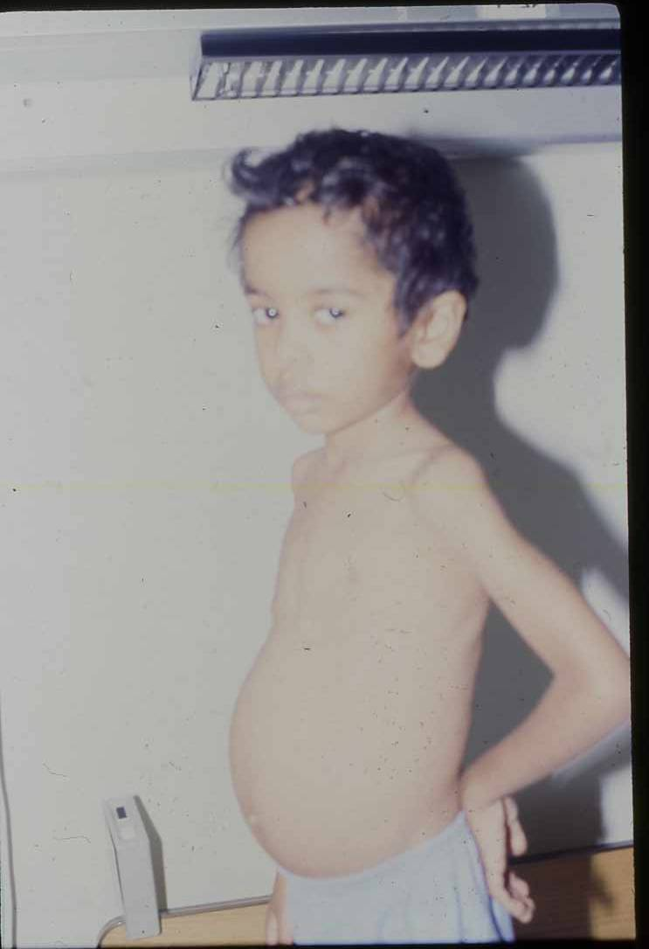
Show sign of protein deficiency

Slide 79
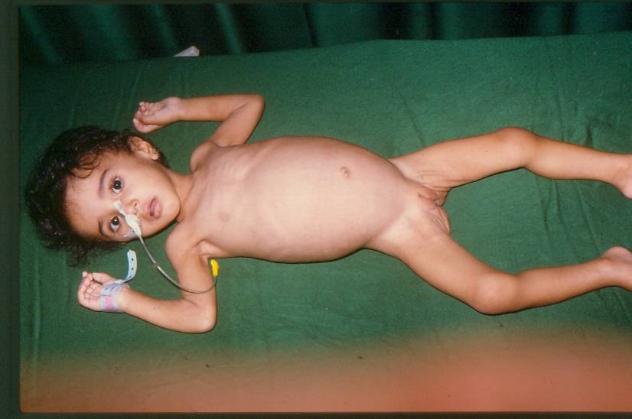

Slide 80
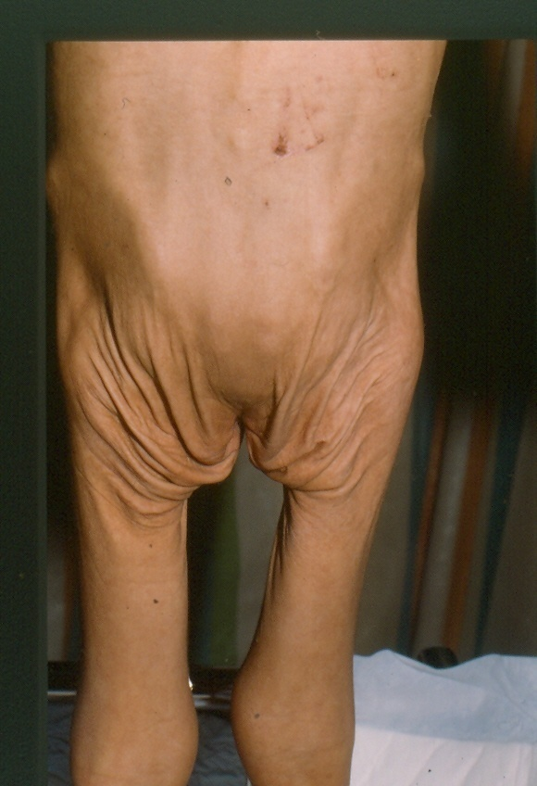

Slide 81
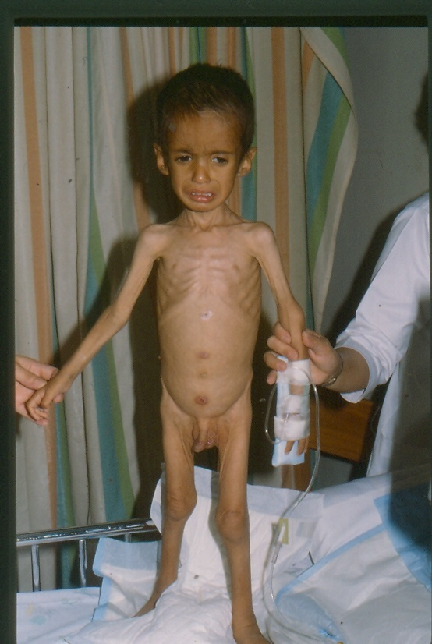

Slide 83
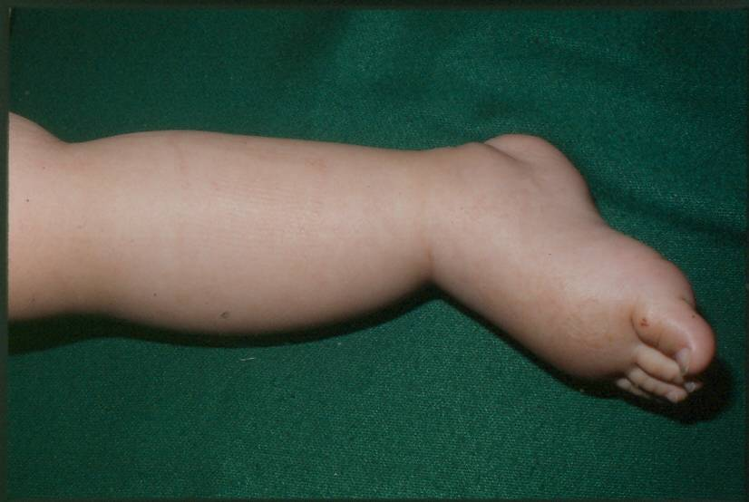

Slide 84
Diagnosis of Celiac Disease (New criteria)
1) Positive anti-issue transglutaminase or endomysium antibodies. ( by serology)
2) Villous atrophy on small bowel biopsy.
الشريحه مهمه جدا

Slide 85
Diagnosis of Celiac Disease (Old criteria)
Biopsy | Histologic findings | Management
First | Compatible with diagnosis | Gluten-free diet initiated on trial basis, and clinical response observed
Second | Recovery documented | Gluten challenge subsequently administered
Third | Relapse documented | Lifelong gluten-free diet recommended
85

Slide 86
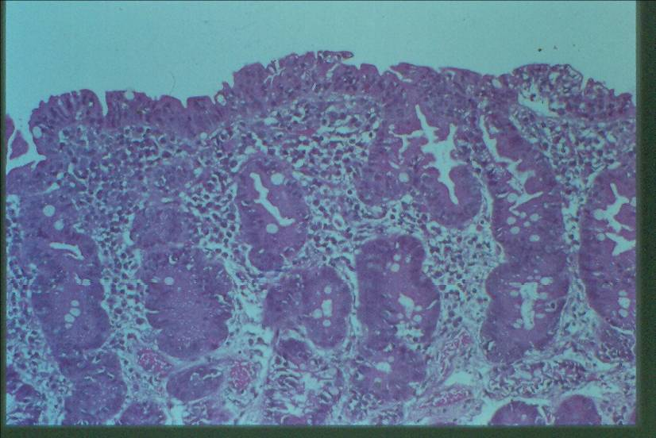

Slide 87
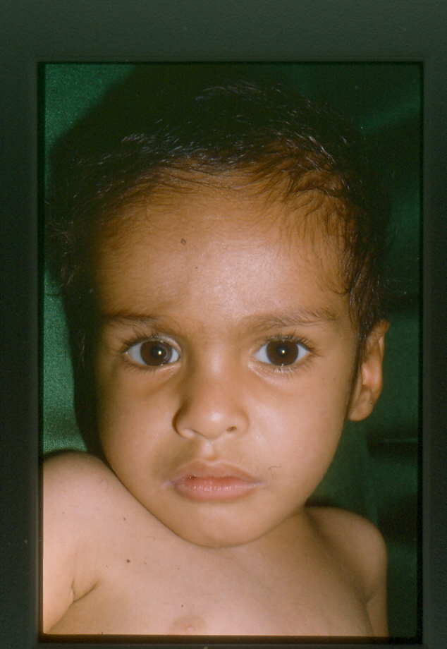

Slide 88
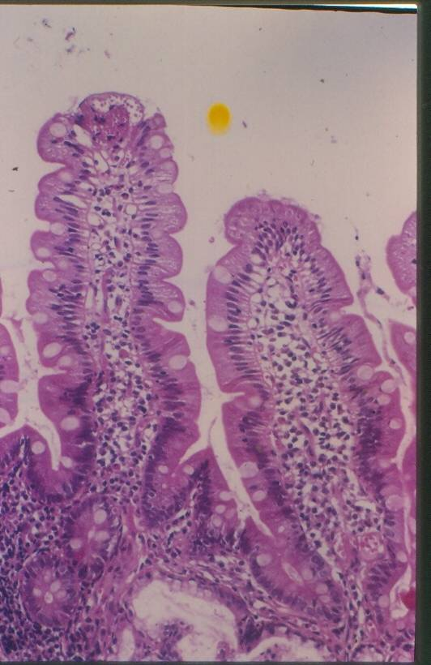

Slide 89
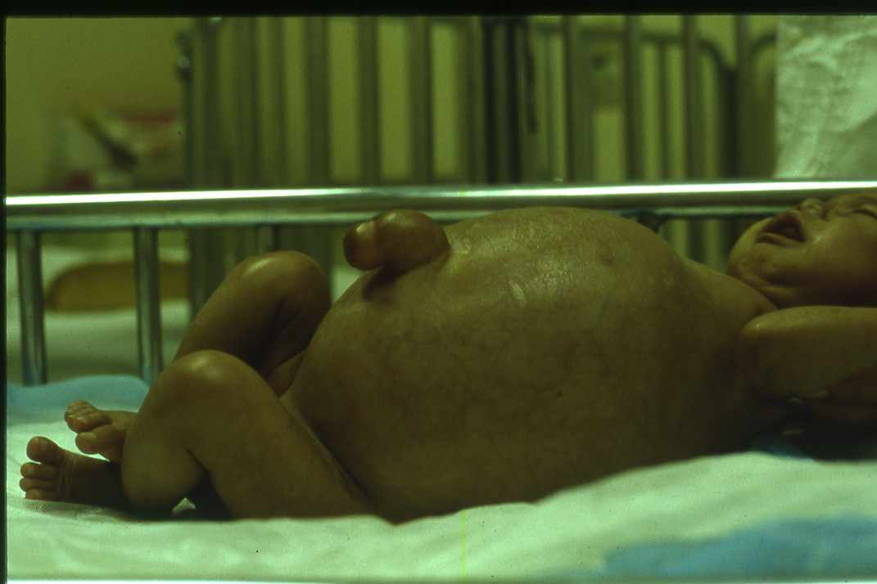
11- Intestinal Lymphangiectasia
Disorder of the intestinal lymphatics Impaired fat absorption Protein-losing enteropathy Primary (familial) Secondary to fibrosis Hypo-albuminemia Hypogammaglobulinemia Low lymphocyte count | Chylous ascites Systemic infections Generalized lymphatic abnormalities

Slide 90
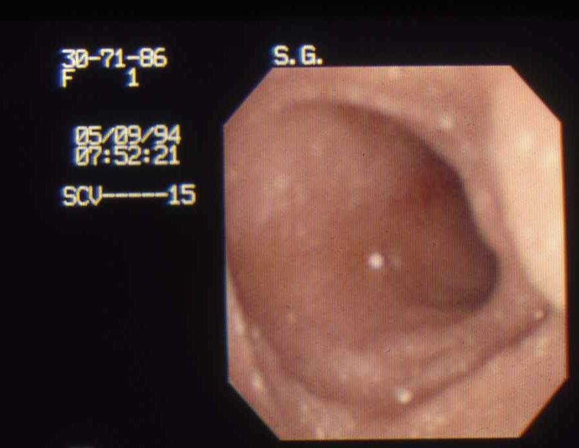
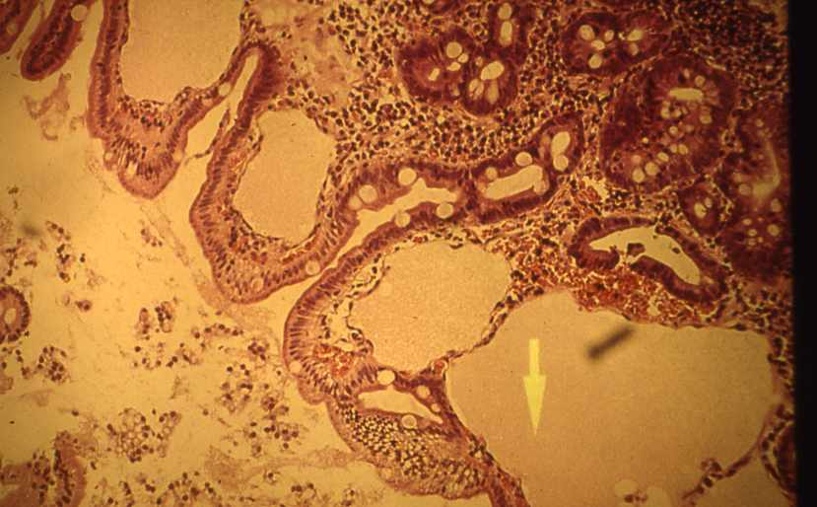
Intestinal Lymphangiectasia
Biopsy confirms lymphangiectasia Characteristic lymphatic dilatation Follow-through demonstrate oedema of the intestine Protein loss by Cr-labeled albumin

Slide 91
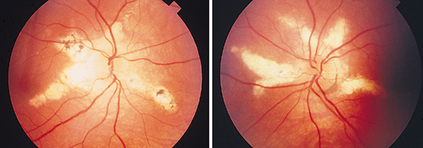
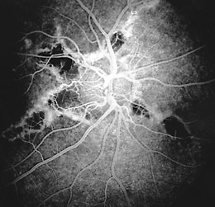
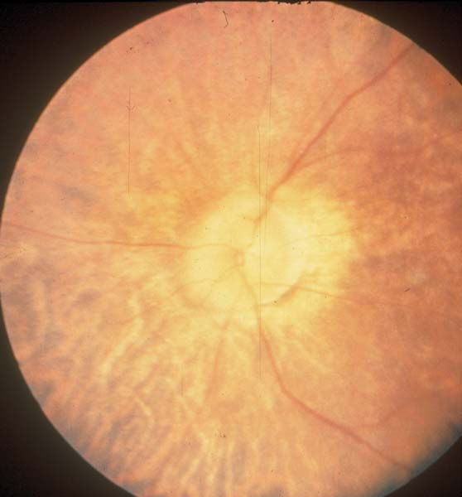
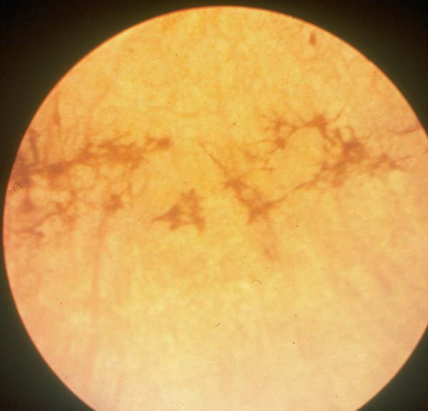
12- Abetalipoproteinemia
DISEASE | GENE | LOCATION | FUNCTION
Abetalipoproteinemia | MTP | 4q22 | Transfer lipids to apolipoprotein B
Autosomal recessive trait Fat malabsorption failure to thrive Ataxia and retinitis pigmentosa Markedly decreased plasma levels of cholesterol triglycerides and phospholipids

Slide 92
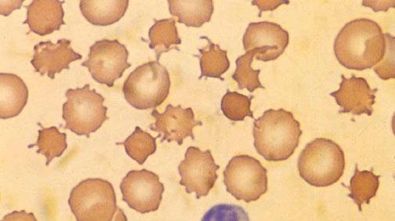
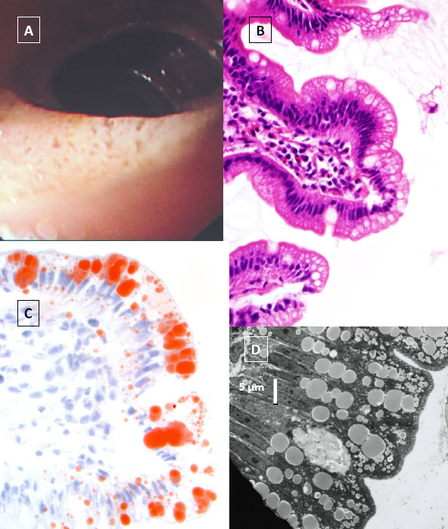
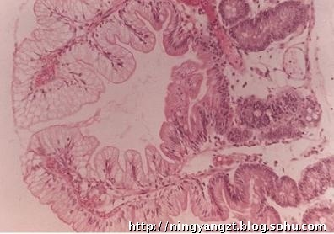
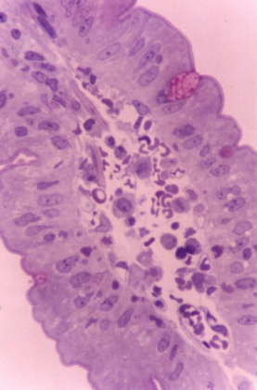
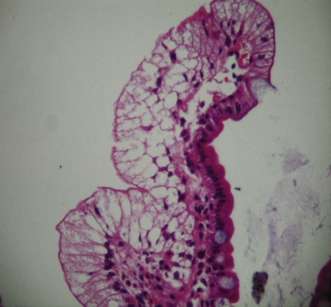
Abetalipoproteinemia
Acanthocytosis Small intestinal biopsy Normal villous architecture Fat droplets in the enterocytes Low-fat diet with medium-chain triglycerides Vitamins A, D, E and K

Slide 93
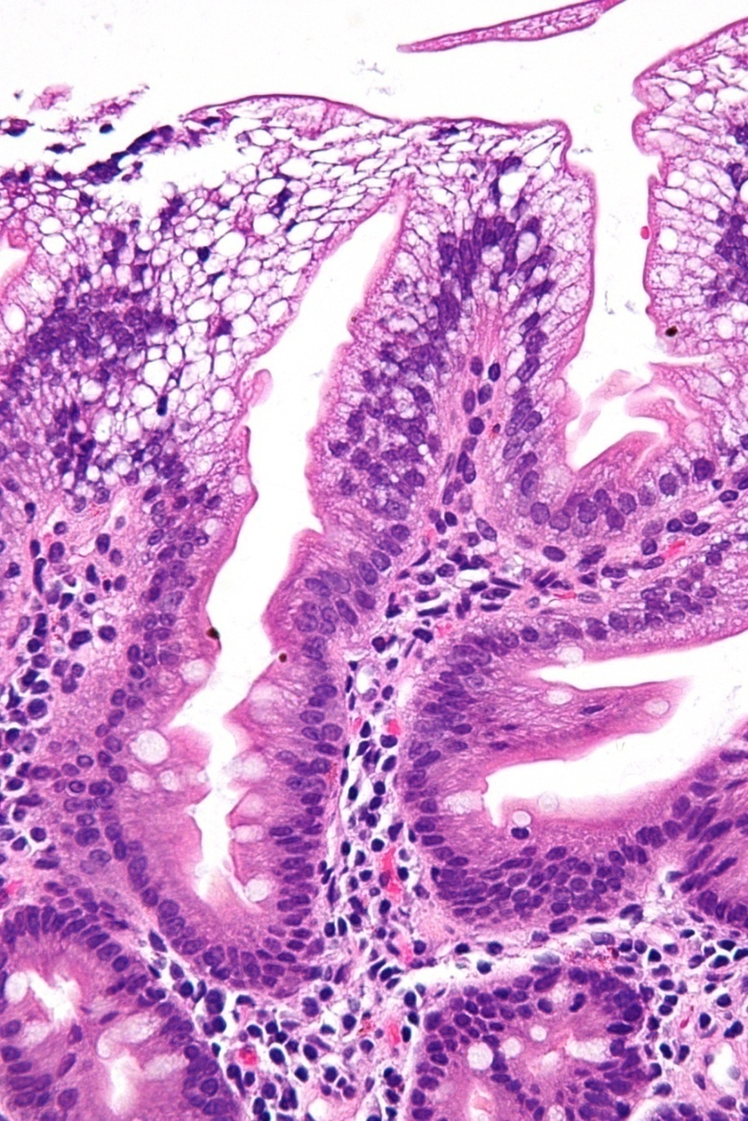
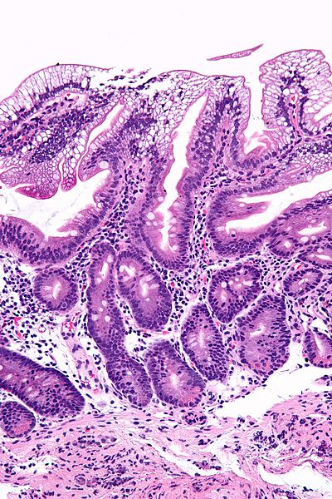

Slide 94
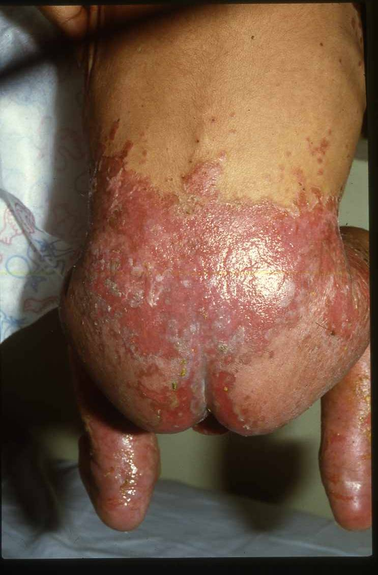
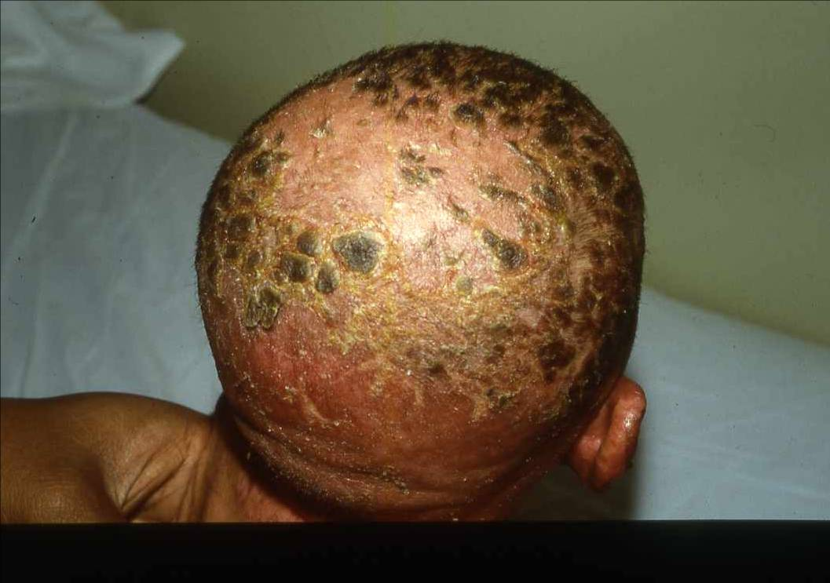
13- Acrodermatitis Enteropathica
DISEASE | GENE | LOCATION | FUNCTION
Acrodermatitis Enteropathica | SLC39A4 | 8q24.3 | Zn²⁺ transporter
Recessive
Chronic diarrhea and failure to thrive
Dermatitis involving perioral and perianal regions
Alopecia مهمه
Low plasma zinc levels مهمه
Alkaline phosphatase is low

Slide 95
Treatment
zinc sulfate 150 mg/d orally

Slide 96
14- Cystic fibrosis
DISEASE | GENE | LOCATION | FUNCTION
Cystic Fibrosis | CFTR | 7q31.2 | cAMP-dependent Cl⁻ channel
Autosomal recessive
Gene localized to the long arm of chromosome 7
Most common mutation F508 delta
This mutation is found in about 70% of patients with cystic fibrosis
1000 different mutations have been described
Neonatal screening
Immunoreactive trypsins (IRT) in blood
Gene probes for the common mutations are used
Baby is homozygous for CF gene (CF)

Slide 97
Mainly affect the Respiratory and the GI systems
The baby will have non bloody diarrhea + distention

Slide 99
In the neonatal period, with intestinal obstruction; meconium ileus
With recurrent or persisting cough often associated with wheeze
Malabsorption; large, pale, bulky and offensive stools
Failure to thrive
Rectal prolapse
Rarely, heat stroke
Sweat chloride concentration is ↑
Staphylococcus + pseudomonas aeruginosa
Physiotherapy
Enzyme replacement
Hot weather
↑ fluid and salt intake
Complications of SF :
- Bowel perforation - Hepatic Failer - Respiratory failer
99

Slide 100
15- Short Gut Syndrome مهم
Surgical resection of the small intestine
Volvulus
Adhesions
Show watery diarrhea مهمه

Slide 101
Vasoactive Intestinal Polypeptide- Secreting Tumors
Pediatric:
Ganglioneuroma
Ganglioneuroblastoma
Pheochromocytoma
Mastocytoma
Non-beta cell hyperplasia
Medullary thyroid carcinoma

Slide 102
VIPoma and WDHA
Vasoactive intestinal polypeptide (VIP)
Chronic, high-volume, watery diarrhea, hypokalemia, and alkalosis (WDHA).
Age range from 1 to 3 year olds.
VIP is strikingly elevated, or imaging studies that show a mass in the adrenal gland or along sympathetic ganglia in abdomen or thorax

Slide 103
16- Chronic Nonspecific Diarrhea (CNSD) موضوع مهم جدا / Irritable Bowel Syndrome (IBS)
Symptoms
Onset: 6 to 18 months of age
Loose, explosive bowel movement containing food particles
Bowel movement frequency: 6 to 12/d
Growth: Normal مهمه + normal Wg (if not on restrictive diet)
Red Flags (Not Compatible with CNSD/IBS)
Hematochezia or melena
Persistent fever
Weight loss or growth arrest
Anemia

Slide 104
Chronic Nonspecific Diarrhea (CNSD)/ Irritable Bowel Syndrome (IBS)
Diet:
Restrict apple juice (trial only)
Restrict lactose (trial only)
Laboratory Studies:
tTg or EMA
Fecal Giardia antigen
Therapy:
Reassurance
Lifestyle modifications
Avoidance of restrictive diets

Slide 105
Differential Diagnosis Between Ulcerative Colitis and Crohn’s Disease
Feature Involvement Small bowel Extensive Lower ileum Colon Rectum Anus Distribution of lesions Roentgenologic features Pathologic changes | Ulcerative colitis ----- 5% to 10% 100 % 95% 5% Continuous Superficial ulcers, loss of haustration, no skip areas, shortening Diffuse mucosal disease | Crohn’s disease 10% 90% 75% 50% 85% Segmental Serpiginous ulcers, thumprinting, skip areas, string sign Focal transmural disease granulomas
105

Slide 106
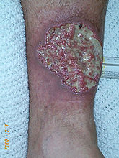

Slide 107
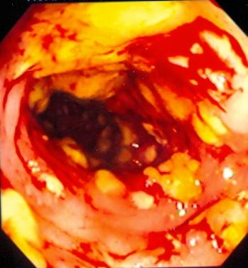
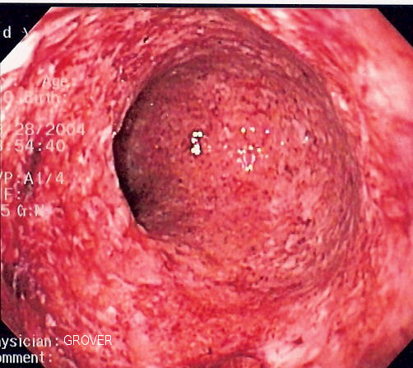
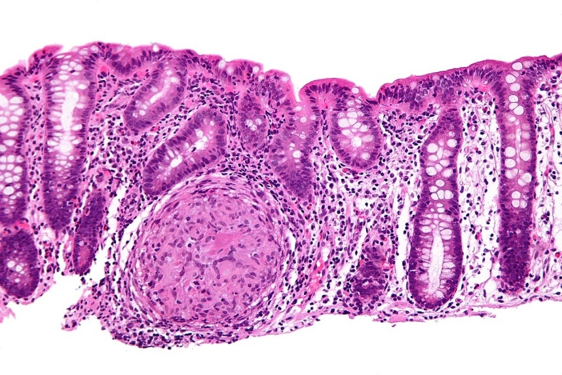

Slide 108
Differential Diagnosis Between Ulcerative Colitis and Crohn’s Disease
Feature Relative incidence of symptoms Rectal bleeding (gross) Diarrhea Pain Anorexia Weight loss Growth retardation Extraintestinal manifestations | Ulcerative colitis Common Often severe Less frequent Mild or moderate Moderate Usually mild Common | Crohn’s disease Rare Moderate or even absent Almost always Can be severe Severe Often pronounced Common

Slide 109
Plan of Investigation in Children with Chronic Diarrhea
Investigation | Clinical Diagnosis for which indicated
Identification of bacterial, viral and protozoal agent in stool | Infectious enteritis
Stool PH and reducing substances; breath H2 excretion; oral sugar tolerance tests | Carbohydrate malabsorption
Stool electrolyte | Chloride losing diarrhea
Lymphocyte count & immunoglobulin, profile; macrophage function, serum opsonic activity | Immunodeficiency, intestinal lymphangiectasia
Celiac Serology | Celiac Disease
Sweat chlorides; pancreatic function tests | Cystic fibrosis and other pancreatic deficiency disorders
Duodenal intubation | Bacterial overgrowth, excess deconjugated bile salts, enteric infections

Slide 110
Plan of Investigation in Children with Chronic Diarrhea (cont.)
Investigation | Clinical Diagnosis for which indicated
Intestinal Biopsy | Milk protein allergy by pre and post milk challenge histology Celiac disease, lymphangiectasia
Urinary catecholamines; immunoassay for VIP | Secretory tumors
Serum zinc | A crodermatitis enteropathica
Lipid profile | A beta liproteinemia
PT, PTT | Vitamin K malabsorption
Stool fat | Fat malabsorption
Alpha-1-antitrypsin in stool | Protein loosing enteropathy
Barium studies | Surgical disorders, inflammatory bowel disease
Colonoscopy | Inflammatory bowel disease

Slide 111
Differential Diagnosis of Prolonged Diarrhea of Infancy مهمه
Congenital chloride diarrhea
Congenital Sodium Diarrhea
Microvillus inclusion disease
Tufte enteropathy
Autoimmune enteropathy
Carbohydrate malabsorption
Cow milk protein allergy
Celiac disease
Intractable diarrhea in infancy
Enteric infection
Immunodeficiency disease
Intestinal Lymphangectasia
A-beta-lipoproteinemia
Congenital short gut (malrotation)
VIPoma
Acrodermatitis enteropathica
Cystic Fibrosis
Chronic Non-Specific Diarrhea
IBD

Slide 112
TREATMENT CONSIDERATION
I. MALNUTRITION
Sufficient calories should be provided to allow for catch-up weight gain. When oral intake is inadequate or malabsorption precludes adequate intake, continuous enteral feedings or parenteral nutrition maybe necessary.
Micronutrient and Vitamin supplementation are part of nutritional rehabilitation:
Vitamin A
Zinc
Folic Acid
Copper
Selenium
Deficiencies in these micronutrients can impair the function of the immune system.

Slide 113
II. MEDICATIONS
1. PROBIOTICS
Administration of probiotic bacteria and the administration if antibiotics
The utility if treatment with antibiotics is unclear.
2. ANTIDIARRHEAL DRUGS
Children with protracted diearrhea
Important side effects: sedation and risk for toxic megacolon
Prolong excretion of the organism or promote the development of hemolytic-uremic syndrome in patients infected with enterohemorrhagic E. coli.

Slide 114
3. SOMATOSTATIN
Treatment may be directed at modifying specific pathophysiologic processes.
In severe secretory diarrheas for instance: neuroendocrine tumors microvillous inclusion disease and enterotoxin-induced severe diarrhea

Slide 115
Summary
The differential diagnosis for chronic diarrhea in children is broad. Pediatric clinicians can narrow these possible diagnoses beginning with a detailed history and physical examination.
Particular attention should be paid to growth measurements to distinguish between chronic diarrhea with and without associated growth failure.

Slide 116
Summary
Understanding the four basic pathophysiologic mechanisms of diarrhea also may aid in making a diagnosis. The four categories are osmotic, secretory , dysmotility associated, and inflammatory.
Although specific therapies vary for each disease, the importance of maintaining nutrition demands particular emphasis. Whatever the cause of the diarrhea, each patient requires adequate caloric intake to allow healing of the initial insult, or at least take to support the child while pursuing diagnostic and therapeutic interventions.

Slide 117
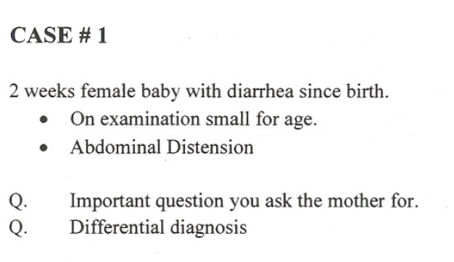
A1 : About the stool : odor – color – watery or bulky – blood ? – frequency – constipation – associated symptoms
Family hx – nutrional Hx – age of onset – symptoms of allergy ( cough – wheezing – sneezing – redness )
A2 : DDX :
1- congenital
2- malabsorbtion
3- Acquired : ex infection , nutrional

Slide 118
A1- : About the stool : odor – color – watery or bulky – blood ? – frequency – constipation – associated symptoms
Family hx – nutrional Hx – age of onset – symptoms of allergy ( cough – wheezing – sneezing – redness )
A2 : DDX :
1- cow milk protien allergy الاقرب
2- infection

Slide 119
A1: same as previous
A2: DDX :
1- short bowel syndrom
2- infection ( always DDX of any diarrhea > 2 weeks at any age )

Slide 120
A1 : same + medication Hx when she was in the ER
NB : Gastroinestiniotist caused by :
Bacterial infe
Viral infe
Parasite infe
Food poisoning
A2 : Diagnosis :
post gastroinestisit syndrome الاقرب
Infection

Slide 121
A1 : same + nutrional Hx : type of food intake – if mother suspect type of food does the symptoms improve when she stop it
A2 : DDX :
1- Celiac Dz
2- Gluten sensitivity enteropathy
3- food allergy
4- infection

Slide 122
NB : associated symptoms with diarrhea (( always ask about:
- allergy symptoms :
Respiratory symptoms
Fever
Cough ( to exclude Immunodeficiency Dz )
A1 : same
A2 : DDX :
Cystic fibrosis ( both GI and Respiratory are affected )
Immunodeficiency ( both GI and Respiratory are affected )
Infection

Slide 123
This case is very common and it called Toddler diarrhea (Chronic Nonspecific Diarrhea (CNSD) ) and it is related to increase bowel movement → reassure the family

Slide 124
DDX:
- IBD
- Infection

Slide 125
Constepation
Commenst cause is food malpractice and high intake of fatty food with low Veg
NB : constipation is the commonest cause of blood in the stool
Treatment : give high veg intake – low fat and soft drinks
NB : comments cause of constipation from day are :
Hair spurng disease
Cystic fibrosis

Slide 126
Thank You!!!

