Slide 1
Electrolyte disorders

Slide 2
Case
• 34 y/o F, c/o weakness, nausea, dyspnea for several weeks, much worse past few days, no fever, occasional vomiting, some abdominal discomfort, no cough.
• BP 120/80, HR 120, afebrile, RR 24, diaphoresis
• Lungs occasional basilar crackle, abdomen soft, not tender, card regular, no murmer, no rub
• IV, O2, monitor….EKG

Slide 3
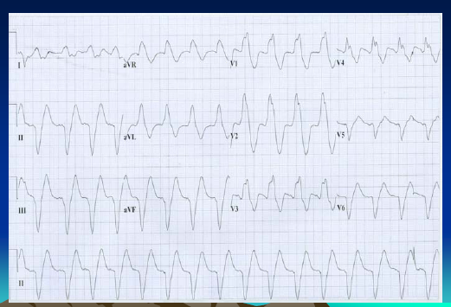

Slide 4
Empirically treated with NaHCO3 with
Narrowing of QRS
Stat K+ 8.6, previously healthy now with
ARF, acidosis

Slide 5
Physiology, total body balance, and pathophysiology of potassium
All disorders of potassium occur because of abnormal potassium handling in one of three ways:
1- Problems with potassium intake
2- Problems with distribution of potassium between the intracellular and extracellular spaces
3- Problems with potassium excretion

Slide 6
The rate of change in extracellular K+ levels is more important than the absolute K+ level in determining severity of symptoms and risk for deterioration, so symptoms are unreliable predictors of absolute K+ values.
Workup of any patient whose history suggests potassium

Slide 7
Clinical manifestations of hyperkalemia
the organ systems affected are cardiac, neuromuscular, and gastrointestinal.
Patients often complain of only vague feelings of not feeling well, gastrointestinal symptoms, or generalized weakness

Slide 8
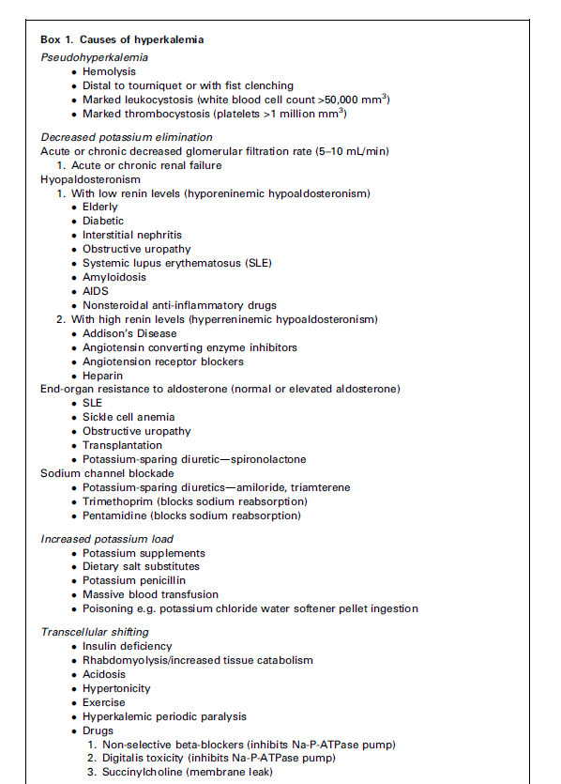
Etiologies of hyperkalemia

Slide 9
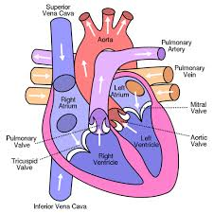
K+ k+k+
K+K+K+
K+K+K+
K+K+K+
K+K+K+
K+K+K+

Slide 10
Hyperkalemia = EKG

Slide 11
Emergency hyperkalemia = wide QRS

Slide 12
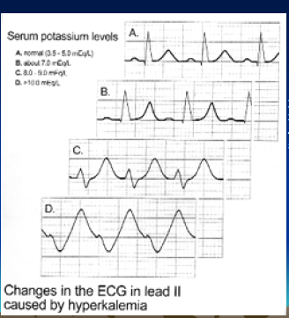
ECG changes
1. Tall peaked T waves(5.5-6.5)
2. P-R prolongation
3. Loss of p wave (6.5-7.5)
4. Widening of QRS (>8.0)
5. Sine Wave

Slide 13
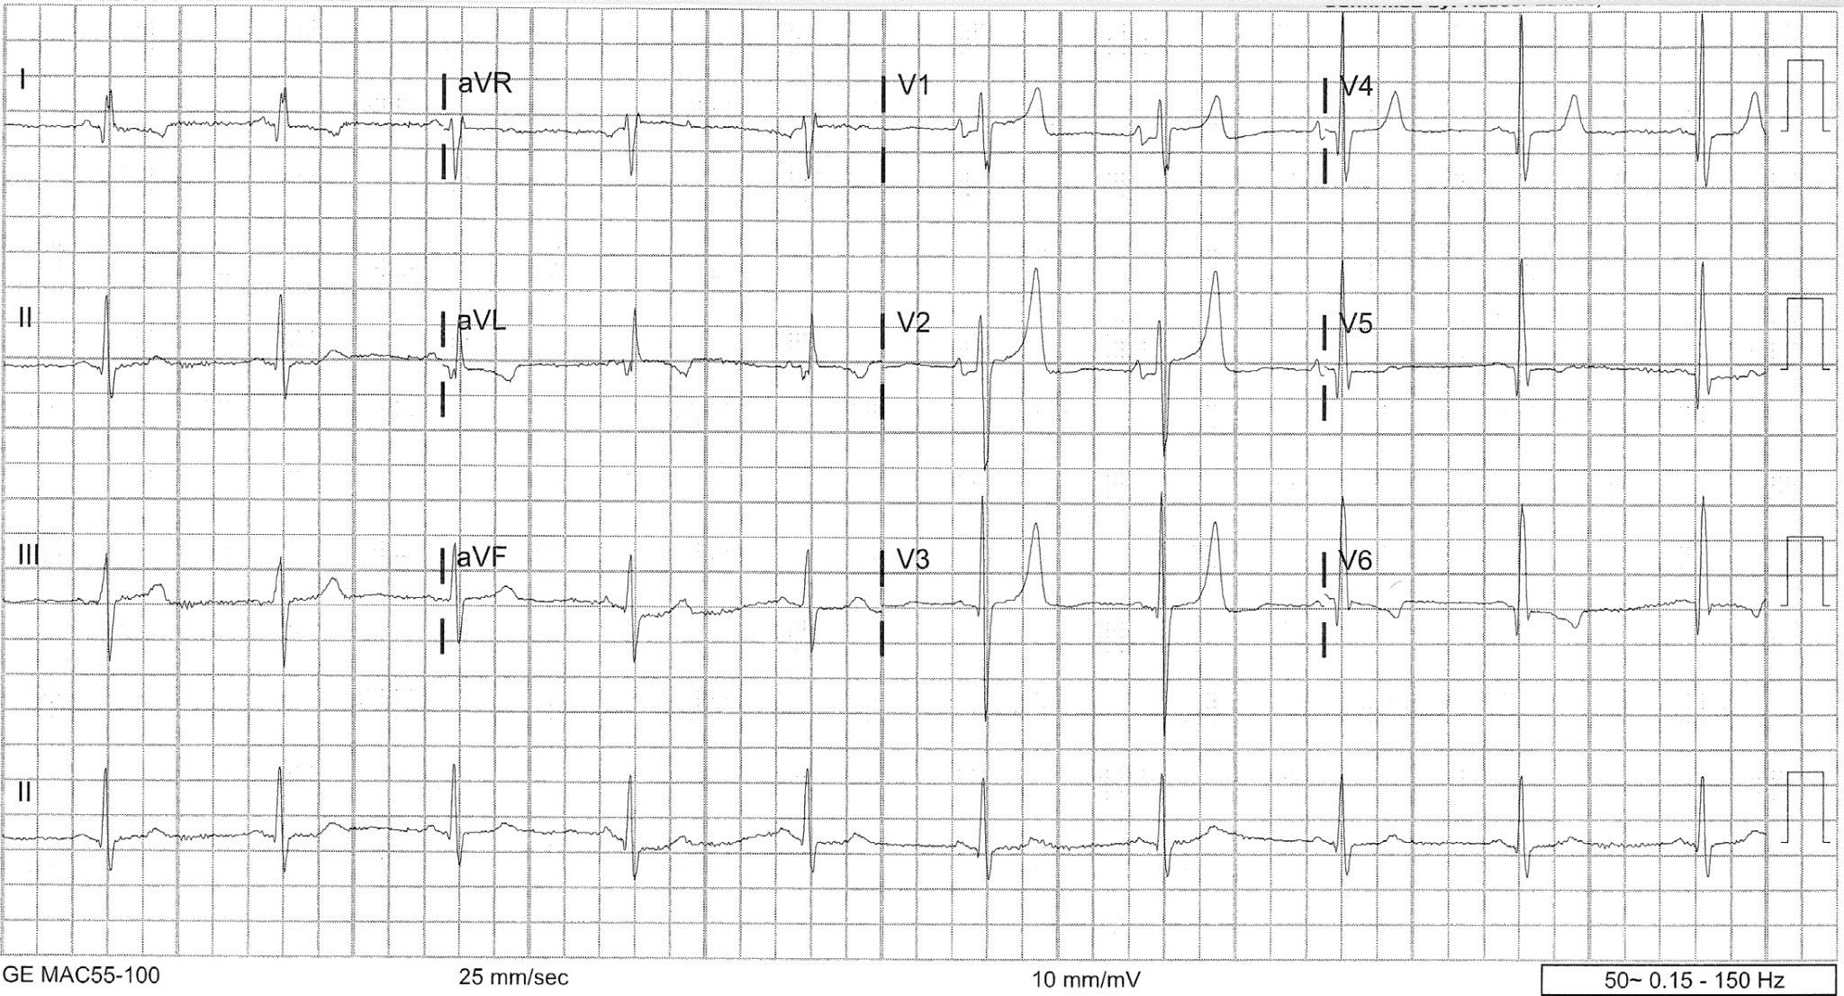

Slide 14
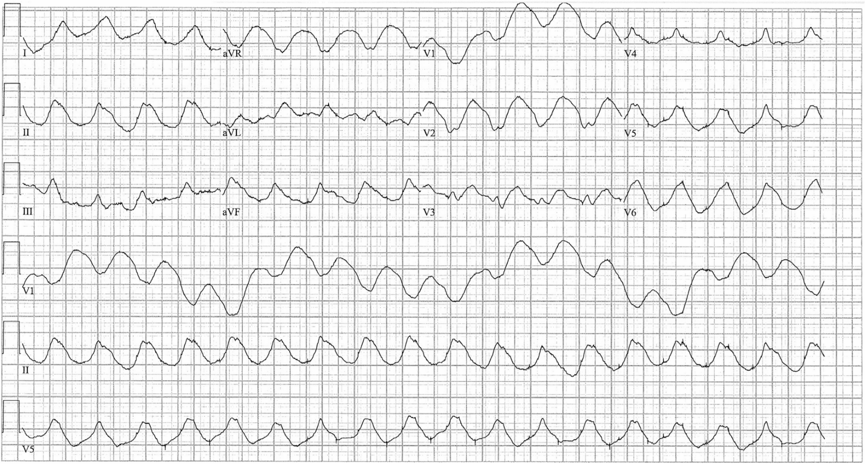

Slide 15
Treatment of hyperkalemia includes
Cardiac membrane stabilization
Transcellular shifts
Total body potassium elimination

Slide 16
Table 1
Treatment of hyperkalemia
Magnitude
of K
D
Duration
Time to Onset
Reduction
of Effect
(
mEq/L
Medication
Dose
(
min
)
(
h
)
Caveats
)
Calcium
1
–2 g
Immediate
No effect
0.5–1
May potentiate
(10
mL
1
)
on K
arrhythmias in
digoxin toxicity
Extravasation
can cause tissue
damage and
phlebitis
b
-
Agonists
20
mg
Within
0.5–1.5
,,
2
–
6
1
–
Patients taking
(
Albutero)l
30
nonselective
b
-
blockers may
be resistant to
2
,
5
this effect
Tremors, anxiety
Insulin
10
units
15
0.6–1.2
2
–
6
,
Give with
–
30
Dextrose 50%;
monitor glucose
closely for
hypoglycemia
Patients with
ESRD are more
susceptible to
hypoglycemia
because of
decreased
excretion of
insulin
Loop
15
1
–
3
,
Not effective in
diuretics
patients with
(
Lasix,
ESRD who no
Bumex)
longer make
urine
Dialysis
N/A
Immediate
1
–
2
,
2
–
6
,

Slide 17
Changes in practice
Sodium bicarbonate is not an indicated therapy; can consider its use in acidotic patients with hyperkalemia
Do not give Kayexalate
In cases of cardiac arrest due to hyperkalemia, perform prolonged CPR until K+ level is corrected; the patient should not be pronounced dead until their K+ level is normalized

Slide 18
Next steps
Repeat serial K+ measurements to monitor for rebound hyperkalemia
Prevent recurrence
Avoid potentiating medications
Determine and treat underlying cause
Failure to excrete enough K+ to maintain a balance
Transcellular shifts
Suspect measurement error in otherwise normal patients and repeat laboratory analysis before initiating treatment

Slide 19
Case
• 32 y/o F c/o several weeks of increasing muscle weakness, generalized. No N/V, no fever, no vision or speech problems, no other complaints, able to ambulate short distanceswith assist.
• PMH: neg
• Px: VSS, exam benign except strength 3/5 throughout, symmetric, CN intact
• Labs remarkable for K+ 1.9, total CK 1560

Slide 20
Box 6 Disorders causing hypokalemia
Excessive loss GI tract Diarrhea Laxative abuse Fistula Ileostomy Renal Increased Na1 delivery to the distal nephron High-sodium diet Drugs (eg, penicillins) Increased urinary flow Hyperglycemia Mannitol High-volume IV normal saline Activation of Na-K ATPase Hypomagnesemia Renal tubular acidosis types 1 and 2 Liddle syndrome High aldosterone levels Primary Conn syndrome Cushing syndrome Secondary Hypovolemia (eg, vomiting) Bartter syndrome Gitelman syndrome Excessive licorice intake (with glycyrrhizic acid, not sold in the United States) Cutaneous Excessive sweating Extensive burns Transcellular shift Alkalosis Hypernatremic hypokalemic paralysis Thyrotoxic periodic paralysis Other Low dietary intake (when chronic) Data from Refs.^{2–4,13}

Slide 21
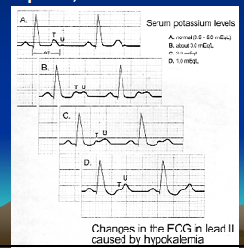
Hypo K S&S and ECG changes
Usually nonspecific—weakness, muscle pain, rhabdomyolosis
EKG Changes of HypoK
1) Loss of T waves
2) U waves
3) Prolonged QT
4) Arrhythmias—
Atrial—PSVT, afib
Torsades, PVCs, VT, VF
5) NSST, T wave changes

Slide 22
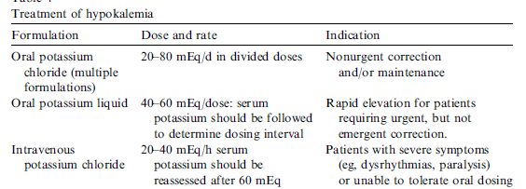
Treatment of Hypo K

Slide 23
Treatment of symptomatic hypokalemia consists of repletion with potassium chloride
Intake by mouth in pill or liquid forms
IV
Max rate 10 to 20 mEq/h
Push rapidly over 5 to 10 minutes in cases of cardiac arrest or impending arrest (VFib, Vtach)

Slide 24
Next steps
Repeat serial K+ measurements to monitor for recurrence and prevent overcorrection
Remember to replete Mg along with K+

Slide 25
Prevent recurrence
Avoid potentiating medication
Determine and treat underlying cause
Increased K+ losses from the body
GI
Renal
Cutaneous
Transcellular shifts
Decreased K+ intake

Slide 26
Hyponatremia
Hyponatremia is defined as a serum sodium concentration less than 135 mEq/L
Approximately 4% of adult medicine patients encountered in the emergency department have hyponatremia
Approximately 15% of adult patients admitted to the hospital have hyponatremia
Patients with hyponatremia have up to 33% higher mortality compared with normonatremic patients, with an overall mortality of 3% to 29%.

Slide 27
The risk of mortality is associated with other underlying illnesses such as heart disease, pneumonia, and liver disease
No correlation with the severity of hyponatremia and the risk of increased mortality.

Slide 28
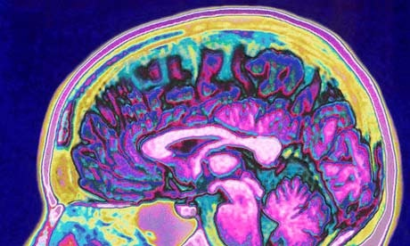
sodium

Slide 29
Sodium Brain

Slide 30
Signs and Symptoms
Range from mild to severe: some patients are asymptomatic, others present with seizures.
Typically related to the level and rapidity of sodium change and to the presence and degree of cerebral edema.
Patients begin to have headache, nausea, vomiting, restlessness, anorexia, muscle cramps, lethargy, and confusion.

Slide 31
The brain attempts to adapt quickly to hyponatremia by losing other intracellular solutes to decrease the chance of cerebral edema, which then becomes a factor in treatment.
Most patients with symptomatic hyponatremia have some sort of neurologic complaint

Slide 32
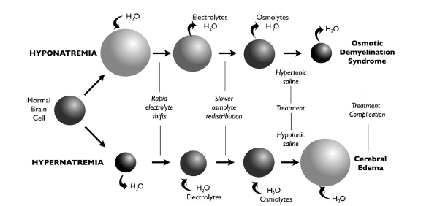

Slide 33
Sodium less than 125 mEq/L :
Nausea, headache, myalgia, generalized malaise, and depressed deep tendon reflexes
sodium below 115 to 120
Lethargy, confusion, disorientation, agitation, depression, psychosis, and eventually seizures, coma, and death

Slide 34
Evaluation and Diagnosis
What is the first test you will order if sodium is low ?

Slide 35
Serum osmolality
If osmolality low true hyponatremia
If osmolality normal or high false hyponatremia

Slide 36
What other test then you will order?
Urine electrolyte
Urine osmolality

Slide 37
If hyponatremia is true what you will do next?

Slide 38
Asses the brain of patient
If brain is ok chronic hyponatremia
If brain is bad acute hyponatremia

Slide 39
Asses the brain of patient
If brain is ok chronic hyponatremia no aggressive tr.
If brain is bad acute hyponatremia aggressive tr.

Slide 40
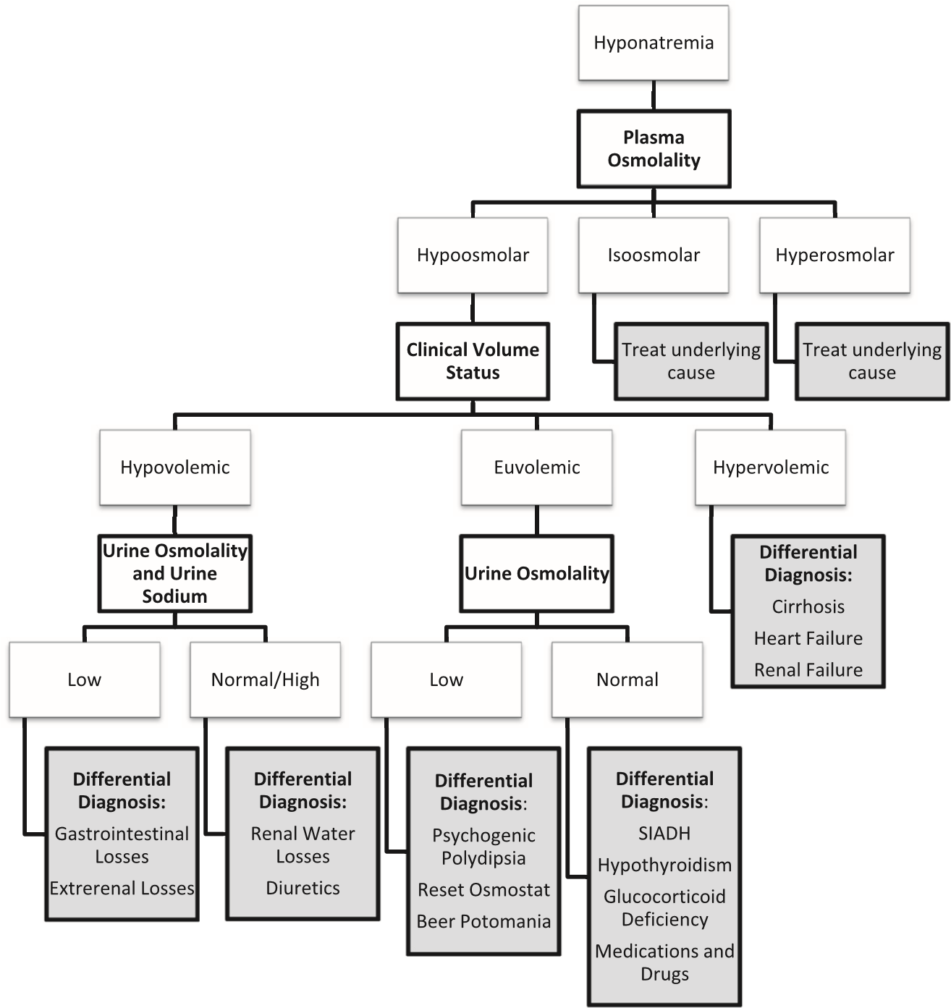
Evaluation and Diagnosis

Slide 41
Hypovolemic hyponatremia
Hypovolemic hyponatremia is a loss of TBW and sodium.
Presents with signs and symptoms suggestive of dehydration, including low blood pressure, nausea, vomiting, and tachycardia.
Examples of extrarenal water losses include diarrhea, vomiting, pulmonary losses, heat exposure, sweating, biliary drains, high-output gastrointestinal fistulas, third-space losses such as burns, or pancreatitis

Slide 42
Examples of renal water losses include overzealous diuretic use, renal tubular acidosis, renal failure, and mineralocorticoid deficiency
Patients with renal water losses tend to have high urinary sodium, whereas patients with extrarenal water losses have low urinary sodium.

Slide 43
Hypervolmic hyponatremia
Causes:
Chronic renal failure
Congestive heart failure
Cirrhosis.

Slide 44
Euvolemic hyponatremia
Patients with euvolemic have normal total body sodium levels, have slightly decreased intravascular volume, without clinical signs of symptoms of dehydration.

Slide 45
Common cause of euvolemic hyponatremia :
The syndrome of inappropriate ADH (SIADH)
Water intoxication caused by psychogenic polydipsia.
Hypothyroidism
Adrenal disease
Excessive pain, stress, nausea
Many types of medications

Slide 46
The most common cause of euvolemic hyponatremia is the syndrome of inappropriate ADH (SIADH).
Causes of SIADH are :
Central nervous system
Pulmonary
Carcinoma causes

Slide 47
Table 3
Common causes of SIADH
Category
Cause of SIADH
Malignancy
Bladder carcinoma
Duodenal carcinoma
Ewing sarcoma
Head or neck carcinoma
Leukemia
Lymphoma
Mesothelioma
Pancreatic carcinoma
Pulmonary carcinoma
Prostatic carcinoma
Sarcoma
Thymoma
Ureteral carcinoma
Pulmonary
Acute respiratory failure
Asthma
Cystic fibrosis
Empyema
Pneumonia
Pneumothorax
Positive pressure ventilation
Tuberculosis
Central nervous system
Acute intermittent porphyria
Acute psychosis
Agenesis of corpus callosum
Atrophy of cerebrum or cerebellum
Brain abscess
Brain tumors
Cavernous sinus thrombosis
Cerebrovascular accidents
Delirium tremens
´
Guillain-Barre
syndrome
Encephalitis
Head trauma
Hydrocephalus
Meningitis
Multiple system atrophy
Neonatal hypoxia
Rocky Mountain spotted fever
Subarachnoid hemorrhage
(
continued on next page
)

Slide 48
Table 4
Common medications or classes of medications that may cause hyponatremia
Angiotensin-Converting Enzyme
Acetaminophen
Inhibitors
Antiaggregant
ADH
Barbiturates
b
-
Blockers
Carbamazepine
Carboplatin
Cisplatin
Clofibrate
Colchicine
Cyclophosphamide
Desmopressin
Haloperidol
Isoproterenol
Loop diuretics
Monoamine oxidase inhibitors
Morphine
Nicotine
Nonsteroidal antiinflammatory drug
Opioids
Oxcarbazepine
Oxytocin
Phenothiazines
Proton pump
Psychotropics
Selective serotonin
inhibitors
reuptake inhibitors
Sodium valproate
Sulfonylureas
Thiazide diuretics
Tolbutamide
Tricyclic antidepressants
Venlafaxine
Vinca alkaloids
Vincristine

Slide 49
Treatment
Unstable patients :
In a patient who is actively seizing, or has respiratory arrest caused by hyponatremia, a bolus of hypertonic saline, given as 3% normal saline (NS) at a dose of 2 mL/kg (maximum 100 mL) should be given.
The bolus should be given over 10 to 60 minutes and can be repeated once if severe symptoms are still evident.
A bolus of 2 mL/kg increases the serum sodium level by approximately 2 mEq/L.

Slide 50
For the unstable hyponatremic patient, give 2 mL/kg of 3% NS up to 100 mL over 10 minutes
This may be repeated once if the patient continues to be unstable.

Slide 51
Stable patients:
Based on the volume status of the patient.
In patients with hypovolemic hyponatremia, intravascular repletion of volume is paramount.
In patients with hypervolemic or euvolemic hyponatremia, fluid restriction or removal of excess fluid dictates care.

Slide 52
The goals of treatment are to increase serum sodium levels and to not exceed a correction rate of 10 mEq/L to 12 mEq/L in the first 24 hours, with some experts suggesting not to exceed 6 mEq/L in the first 24 hours.
Focus on the cause of hyponatremia and direct their efforts to correcting that medical condition, rather than aggressively treating the hyponatremia.

Slide 53
Treatment of hypovolemic hyponatremia
Volume expansion.
Underlying problem causing the hypovolemic hyponatremia must be corrected, including the removal of any medications that may be contributing.

Slide 54
Once the patient is clinically euvolemic, the sodium level must be reassessed.
If there continues to be a sodium imbalance, the clinician must then direct their attempts at correcting the sodium level as is appropriate.
The initial fluid used for resuscitation is 0.9% NS in the form of fluid boluses

Slide 55
Treatment of patients with hypervolemic and euvolemic hyponatremia
Sodium and water restriction, occasionally with adjunctive use of furosemide or another loop diuretic in specific situations.
Optimization of the underlying medical condition usually corrects the hyponatremia.
Special attention must be placed on correction of hypokalemia, because repletion of potassium also increases the serum sodium level

Slide 56
Cerebral Edema

Slide 57
Osmotic Demyelination Syndrome
Osmotic demyelination syndrome is the iatrogenic irreversible clinical syndrome of neurologic symptoms that occurs after too rapid of a correction of serum sodium
This severe complication is caused by exceeding corrections greater than 12 mEq/L in 24 hours, 25 mEq/L in 48 hours, or inadvertent hypernatremia during correction of hyponatremia

Slide 58
Symptoms of osmotic demyelination syndrome include :
Fluctuating levels of consciousness or confusion,
Behavioral changes
Dysarthria
Mutism
Dysphagia
Seizures
Locked-in state
Quadriparesis.

Slide 59
The possibility of the syndrome should not prevent a clinician from aggressively treating symptomatic patients with hyponatremia.
Most neurologic symptoms associated with hyponatremia are from cerebral edema and herniation, so patients with symptomatic hyponatremia require immediate treatment.

Slide 60
Without prompt treatment, patients may progress to severe seizures, coma, or death; the risk to the patient outweighs the risk of osmotic demyelination syndrome when they are severely symptomatic

Slide 61
Hypernatremia
Hypernatremia is defined as serum sodium level greater than 145 mEq/L and is less common than hyponatremia.
Most commonly, hypernatremia occurs in hospitalized patients, but it can also occur in approximately 0.2% of patients who present to the emergency department

Slide 62
Occurs in patients with impaired thirst mechanisms, or inability to acquire adequate free water, such as in the elderly, infants, or otherwise impaired individuals (eg, patients on a ventilator, in a coma)

Slide 63
Signs and Symptoms
During hypernatremia, brain cells shrink substantially as water moves into the extracellular space.
This situation can cause intracerebral hemorrhage as a result of tearing of cerebral blood vessels.
Include decreased left ventricular contractility, hyperventilation, impaired glucose use, muscle cramps, and rhabdomyolysis.
Patients may present with lethargy, weakness, or restlessness

Slide 65
Neurologic examination may show increased tone, nuchal rigidity, brisk reflexes, myoclonus, asterixis, chorea, or seizures.
If not assessed and treated appropriately, the patient may progress to seizures, coma, or death

Slide 66
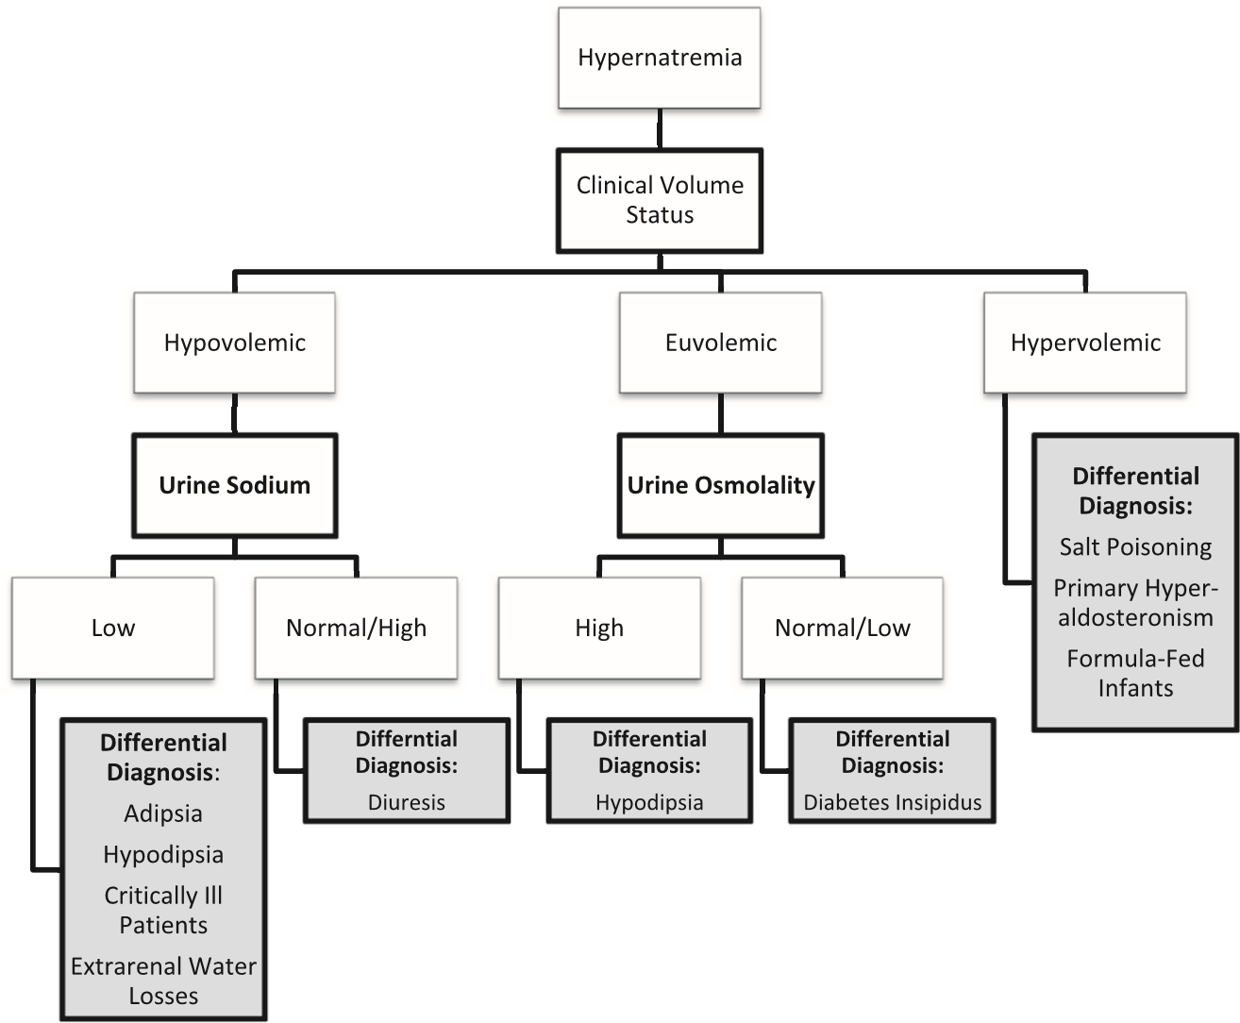
Evaluation and Diagnosis

Slide 67
Treatment
Unstable patients :
Acute hypernatremia carries mortality between 28% and 70%.
Symptoms most often are caused by the rapidity of change of sodium level, not necessarily the overall deficit; therefore, sodium correction should occur over roughly the same time period that it occurred

Slide 68
The fear of cerebral edema should be displaced by the clinician when treating the patient with acute hypernatremia; idiogenic osmoles, organic molecules that attempt to maintain brain cell hydration, have not had time to appear in brain cells, and the risk of cerebral edema with fast correction is minimal compared with the mortality and morbidity associated with acute hypernatremia

Slide 69
Correction of hypernatremia should be initiated with isotonic fluids and should occur over a minimum of 48 hours.
The serum sodium level should not decrease by more than 8 to 15 mEq/L in any 8-hour period if the patient is symptomatic.
Overly rapid correction of hypernatremia with the use of hypotonic fluids may lead to seizures, permanent brain damage, or death

Slide 70
If the patient with hypernatremia shows evidence of dehydration, fluid resuscitation should take first priority, and the patient should be provided with adequate amounts of intravenous fluid to restore plasma volumes.

Slide 71
The serum sodium must be closely monitored to prevent correction from happening too quickly and leading to additional neurologic problems.
Approximately half of the water deficit should be provided in the first 12 to 24 hours, and the other half should be provided over the next 24 hours.

Slide 72
If correction occurs too rapidly, or if the patient begins to show symptoms of cerebral edema or hyponatremia, the clinician should immediately stop treatment of hypernatremia, and treat the patient as if they have hyponatremia with fluid restriction or addition of electrolytes/saline to the fluid infusion

Slide 73
Key point
Unstable patients with hypernatremia should receive isotonic fluids, with a goal to lower the serum sodium by 8 mEq/L to 15 mEq/L over the first 8 hours.

Slide 74
Stable patients :
Chronic or slowly occurring hypernatremia does not cause as many symptoms and does not carry as high mortality, because of the presence of idiogenic osmoles.
Because of the brain’s self-preservation strategy by production of idiogenic osmoles that allows relative maintenance of brain cell hydration

Slide 75
Rapid restoration of serum sodium levels to normal in patients with chronic hypernatremia may cause cerebral edema caused by these organic molecules
In the asymptomatic patient, correction of the serum sodium level should occur slowly, at a rate no greater than 0.5 mEq/L/h and no more than 8 mEq/L to 15 mEq/L per day.

Slide 76
The specific causes of hypernatremia also have specific treatments tailored to the nature of the serum sodium excess.
In cases of accidental excess sodium excretion, removal of sodium is the goal of treatment.
If the patient is asymptomatic and has normal renal function, then the clinician may wait for natural excretion, which should not cause large shifts in brain cell hydration status

Slide 77
If renal function is impaired, then excess sodium needs to be removed through phlebotomy or dialysis.
In patients with adipsia or hypodipsia, whether primary or secondary, patient, family, and caregiver education is paramount.
The patient, family, or caregiver needs explanation about sensible and insensible water losses, the need for replacement daily of these losses, and how to monitor and accurately adjust water needs on a day-to-day basis

Slide 78
KEY POINT
Stable patients with hypernatremia should have serum sodium corrected by 8 mEq/L to 15 mEq/L per day until the sodium has normalized.

Slide 79
Summary
hyponatremia is often caused by a defect in water excretion, whereas hypernatremia is often caused by a defect in thirst regulation or water acquisition.
Because of dreaded neurologic complications, the imbalance in the serum sodium should be corrected in approximately the same time frame as it initially occurred.

Slide 80
Overly rapid correction may cause osmotic demyelination syndrome in patients with hyponatremia, or cerebral edema in patients with hypernatremia
Narrow control of the disorder of sodium balance should be the goal of the clinician

Slide 81
Calcium
20 to 30% of patients with cancer experience hypercalcemia during the course of their disease, and malignancy accounts for more than 30% of emergency department visits for hypercalcemia.
Conversely, hypocalcemia is found in 88% of patients in intensive care units

Slide 82
Calcium is the most abundant mineral in the human body.
Ninety-nine percent of total body calcium resides in bone, of which 99% is in the mineral phase and 1% is rapidly exchangeable.
Approximately half of total serum calcium is bound to proteins, mainly albumin and globulins.
The normal ionized calcium concentration in serum is 1.1 to 1.4 mmol/L (4.5–5.6 mg/dL).

Slide 83
MAINTAINING HOMEOSTASIS
PTH controls the concentration of ionized calcium in the blood and extracellular fluid.
Low calcium levels trigger PTH release, which promotes bone mineral dissolution and increases renal reabsorption of calcium.

Slide 84
PTH also increases renal hydroxylation of inactive vitamin D to calcitriol (1,25[OH]₂), the hormonally active form of vitamin D, which then enhances gastrointestinal absorption of dietary calcium. Increased serum calcium and calcitriol levels inhibit PTH secretion from the parathyroid glands.

Slide 85
Calcitonin is a thyroid hormone released in response to high calcium concentrations.
As opposed to PTH, calcitonin inhibits bone resorption of calcium and renal reabsorption of calcium and phosphate

Slide 86
PATHOPHYSIOLOGY OF CALCIUM
Occur with disruptions in the hormonal regulation by PTH, calcitonin, and vitamin D as well as diseases of the intestine, kidney, and bone.
Glucocorticoids stimulate PTH synthesis and release
A variety of malignancies produce PTH-related peptide (PTHrP)

Slide 87
Hypercalcemia
Definition and classification
Normal serum calcium concentration is 8.5 to 10.5 mg/dL. Hypercalcemia is defined as a total serum calcium (Ca_{total}) concentration greater than 10.5 mg/dL or an ionized calcium (Ca_{ionized}) greater than 1.4 mmol/L (5.6 mg/dL). Hypercalcemia can be classified by severity.

Slide 88
Mild hypercalcemia is Ca_{total} 10.5 to 11.9 mg/dL or Ca_{ionized} 1.4 to 2.0 mmol/L (5.6–8.0 mg/dL).
Moderate hypercalcemia is Ca_{total}12.0 to 13.9 mg/dL or Ca_{ionized} 2.0 to 2.5 mmol/L (8–10 mg/dL).
Severe hypercalcemia is Ca_{total} 14 mg/dL or more or Ca_{ionized} more than 2.5 mmol/L (>10 mg/dL).

Slide 89
Cause
Malignancy and hyperparathyroidism account for more than 80% of cases of hypercalcemia.
In malignancy, hypercalcemia can result from :
(1) direct osteolysis by metastatic disease²⁰ (eg, breast cancer, multiple myeloma);
(2) production of circulating factors, such as PTHrP, which stimulate osteoclastic resorption of bone;
(3) increased production of calcitriol, which stimulates gastrointestinal absorption of calcium (eg, Hodgkin lymphoma²⁴).

Slide 90
Hyperparathyroidism is most commonly caused by a benign adenoma that autonomously secretes PTH.

Slide 91
Secondary hyperparathyroidism is caused by diffuse hyperplasia of the parathyroid gland in response to hypocalcemia or hyperphosphatemia.
Tertiary hyperparathyroidism often results from secondary hyperparathyroidism resulting from years of chronic kidney disease, causing hyperplastic glands to become unresponsive to calcium levels over time.²⁵

Slide 92
Other causes of hypercalcemia include :
Thyrotoxicosis
Granulomatous disease
Medications
Total parenteral nutrition
Immobilization
Wide variety of medications

Slide 93
Signs and symptoms :
Vague, nonspecific symptoms usually develop when the Ca_{total} concentration is greater than 12 mg/dL.
Severity of symptoms is related to not only the absolute calcium level but also the rate of increase in serum calcium

Slide 94
Hypercalcemia affects nearly every organ system in the body but particularly the central nervous system and kidneys.
Neurologic symptoms
Fatigue
Depression
Weakness
Confusion and can progress to hallucination, disorientation, hypotonicity, seizures, and coma.

Slide 95
Renal effects include nephrolithiasis; calcium deposition can lead to nephrogenic diabetes insipidus as well as acute kidney injury. gastrointestinal manifestations, such as anorexia, nausea, vomiting, and constipation, as well as nonspecific musculoskeletal tenderness

Slide 96
Cardiovascular signs and symptoms of hypercalcemia vary.
Calcium has a positive inotropic effect until levels reach more than 15 mg/dL, at which time myocardial depression ensues.
The QT interval typically shortens, and the PR and QRS intervals are prolonged when the serum calcium concentration is more than 13 mg/dL

Slide 97
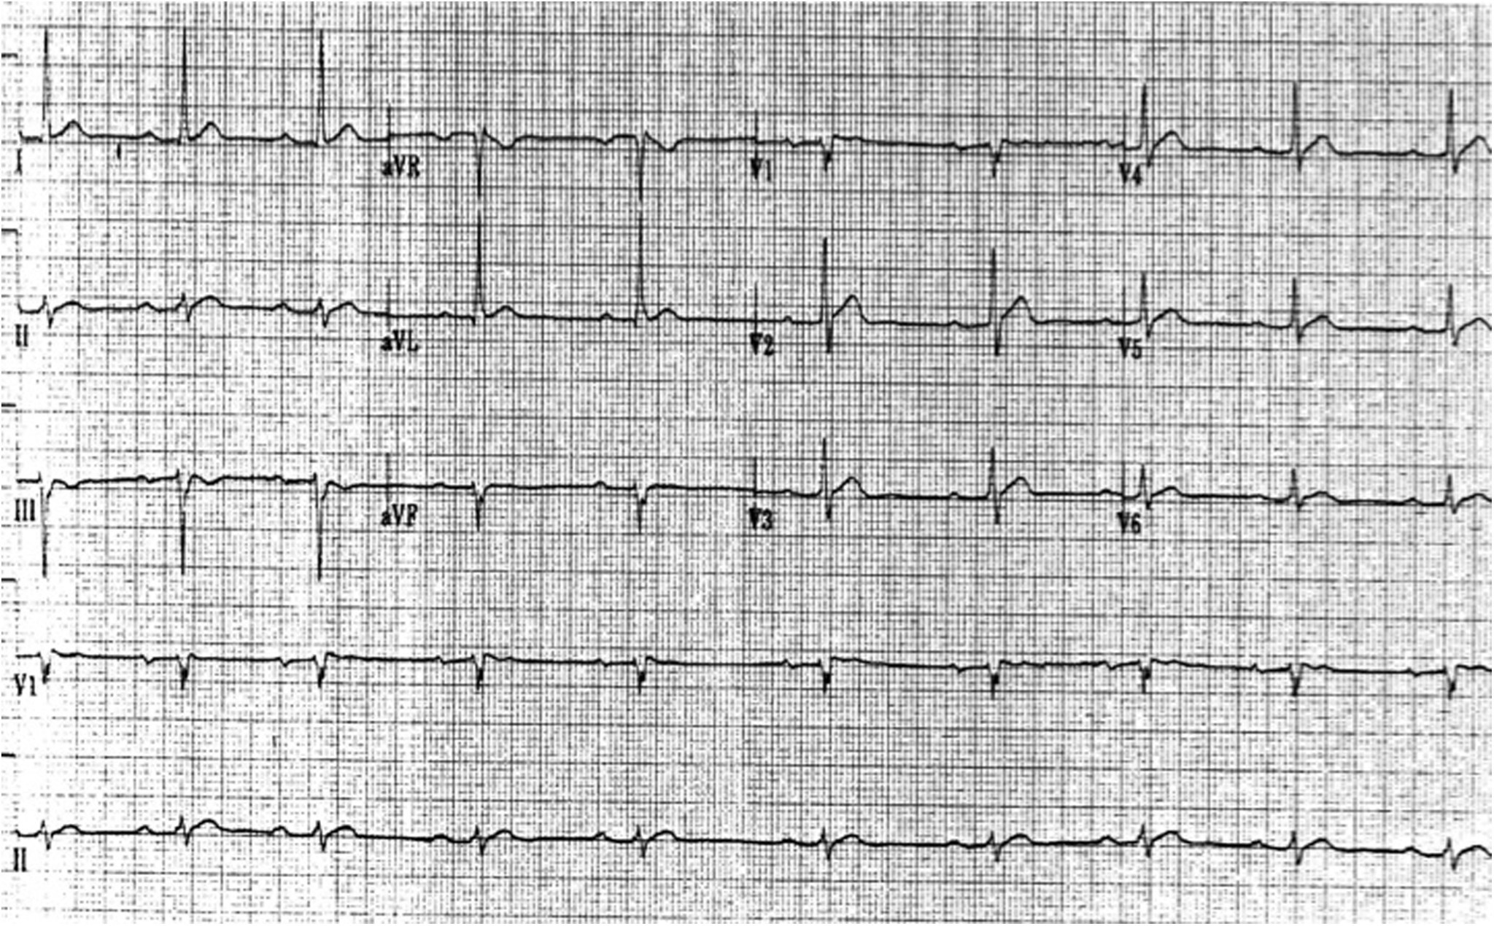

Slide 98
Many patients with hypercalcemia develop hypokalemia, further contributing to dysrhythmia risk.
Atrioventricular block may develop and progress to complete heart block and even cardiac arrest when Ca_{total} is 15 to 20 mg/dL.

Slide 99
Management
The treatment of hypercalcemia depends on the severity of symptoms and the underlying cause.
1- volume repletion with isotonic sodium chloride is an effective short-term treatment
2- loop diuretics can be administered to block sodium and calcium reabsorption, thereby facilitating renal excretion of calcium
3- Bisphosphonates
4- Calcitonin
5- elimination of inciting medications as well as a decrease in dietary calcium intake
6- peritoneal dialysis and hemodialysis

Slide 100
Hypocalcemia
Definition and classification :
Hypocalcemia is defined as a Ca²¹_{total} concentration of less than 8.5 mg/dL or a Ca_{ionized} concentration of less than 1.1 mmol/L (4.5 mg/dL).
Because half of serum calcium is bound to albumin, a low Ca_{total} level could simply reflect hypoalbuminemia but not the serum level of the metabolically active ionized calcium.

Slide 101
Causes :
True hypocalcemia warrants a more thorough search into the underlying cause.
PTH deficiency from hypoparathyroidism can be hereditary or acquired.
Acquired hypoparathyroidism may result from neck irradiation, parathyroidectomy, infiltrative disease, or autoimmune disease.
PTH receptor or downstream signaling abnormalities cause PTH resistance or pseudohypoparathyroidism

Slide 102
Severe hypomagnesemia and vitamin D deficiency also cause hypocalcemia by their effects on PTH.
Because phosphate avidly binds calcium, hyperphosphatemia (eg, from rhabdomyolysis) can cause acute hypocalcemia.
Acute pancreatitis can be associated with hypocalcemia primarily by precipitation of calcium soaps in the abdomen..

Slide 103
Medications associated with hypocalcemia include :
1- chemotherapeutic drugs
2- anticonvulsants
3- foscarnet
4- sodium phosphate preparations
5- proton pump inhibitors
6- histamine-2 receptor blockers
7- citrate in transfused blood products
8- intravenous bicarbonate.
9- acute respiratory alkalosis

Slide 104
Signs and symptoms :
Most patients with mild hypocalcemia are asymptomatic.
Symptom severity is related to the rapid rate of change.
The most specific symptoms of hypocalcemia are perioral numbness and carpopedal spasms of the hands and feet.
In some patients, these spasms can progress to tetany.

Slide 105
Chvostek and Trousseau signs highlight the neuromuscular hyperexcitability of these patients.
The Chvostek sign is the facial muscle spasm elicited by tapping the facial nerve.
The Trousseau sign is described as a carpopedal spasm seen withinflation of a sphygmomanometer cuff.

Slide 106
In addition, patients can present with irritability, confusion, hallucinations, movement disorders, and seizures.
Acute hypocalcemia can lead to syncope, congestive heart failure, and angina because of diminished myocardial contractility.
QT prolongation leading to ventricular arrhythmias can also be seen

Slide 107
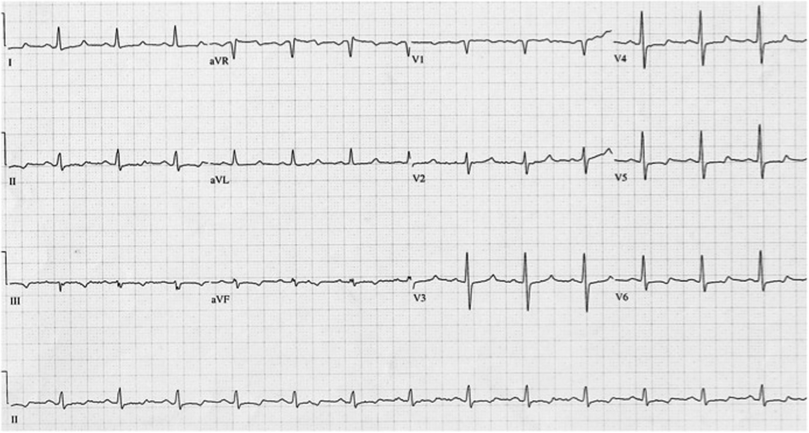
ECG Changes

Slide 108
Management :
Treatment of hypocalcemia depends on the cause, severity, and presence of symptoms.
Intravenous calcium is indicated only in the setting of symptomatic hypocalcemia and should not be given to patients with hyperphosphatemia because of the risk of precipitation.

Slide 109
Intravenous calcium comes in the form of calcium gluconate (a 10-mL vial = 94 mg of elemental calcium) or calcium chloride (a 10-mL vial = 273 mg of elemental calcium).

Slide 110
Calcium chloride is sclerotic to veins and, thus, should be given via central venous access, unless patients are in an emergency situation.
Oral calcium repletion can be given to patients with asymptomatic or mild hypocalcemia.
Vitamin D supplementation might be required to increase calcium absorption

Slide 111
Patients taking loop diuretics may need to be changed to thiazide diuretics to decrease urinary calcium excretion.
For effective correction of hypocalcemia, concomitant hypomagnesemia should be treated.

