Slide 1
Management of Ischemic Heart Disease (IHD)
Dr Tarek Elhussein MD, FRCP, FASE
Director, Adult Cardiology Fellowship Program
Assisstant professor of Medicine & Cardiac Sicences Consultant cardiology & echocardiography
King Fahad Cardiac Centre – KSU

Slide 2
Introduction
Coronary heart disease (CHD) is the most common form of heart disease
An estimated 330 000 people have a myocardial infarct each year
Approximately 1.3 million people have angina each year

Slide 3
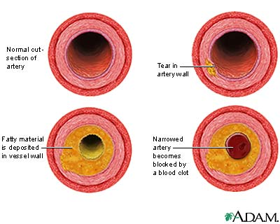
Introduction
Disease of the coronary arteries is almost always due to atheroma and its complications
particularly thrombosis

Slide 4
Myocardial Ischemia
Results when there is an imbalance between myocardial oxygen supply and demand
Most occurs because of atherosclerotic plaque with in one or more coronary arteries
Limits normal rise in coronary blood flow in response to increase in myocardial oxygen demand

Slide 5
Oxygen Carrying Capacity
The oxygen carrying capacity relates to the content of hemoglobin and systemic oxygenation
When atherosclerotic disease is present, the artery lumen is narrowed and vasoconstriction is impaired
Coronary blood flow cannot increase in the face of increased demands and ischemia may result

Slide 7
Ischaemic Heart Disease
Angina
Stable
Unstable
Prinzmetal’s
Myocardial Infarction
NSTEMI
STEMI

Slide 8
Clinic pathological correlation
Clinical Problem | Pathology
Stable angina | Ischaemia due to fixed atheromatous stenosis of one or more coronary arteries
Unstable angina | Ischaemia caused by dynamic obstruction of a coronary artery due to plaque rupture with superimposed thrombosis and spasm
Myocardial infarction | Myocardial necrosis caused by acute occlusion of a coronary artery due to plaque rupture and thrombosis
Heart failure | Myocardial dysfunction due to infarction or ischaemia
Arrhythmia | Altered conduction due to ischaemia or infarction
Sudden death | Ventricular arrhythmia, asystole or massive myocardial infarction

Slide 9
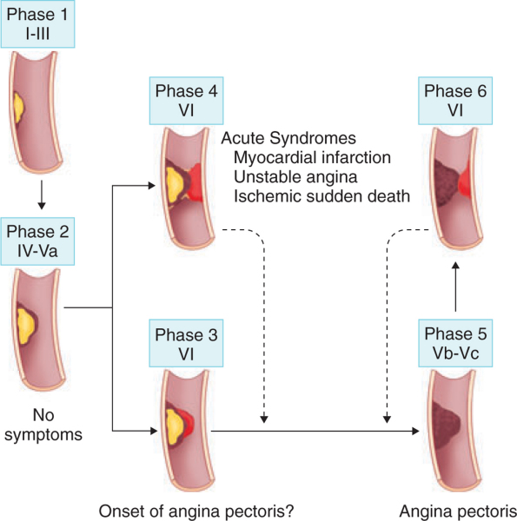

Slide 10
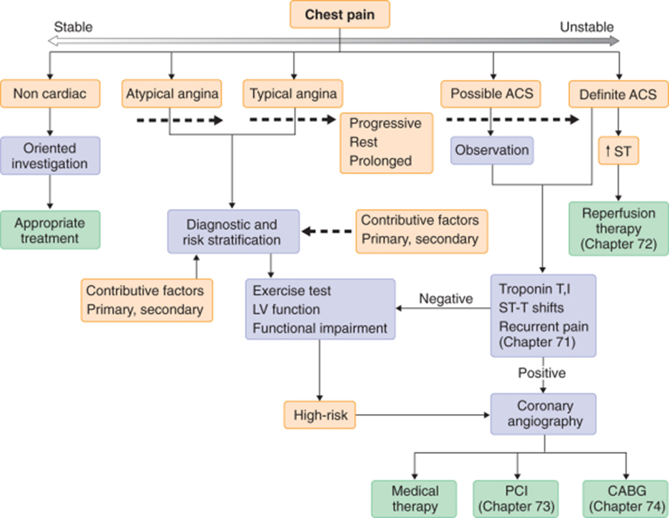
Evaluation of Chest pain

Slide 11
Acute Coronary Syndromes
 | Stable Angina | Unstable Angina | STEMI | NSTEMI
Character of pain | Exertional pain | Rest pain | Rest pain | Rest pain
Relievers | Responds to GTN | No GTN effect | No GTN effect | No GTN effect
Enzymes | Normal | Normal | Elevated | Elevated
ECG | Often normal | Often ST depression | ST segment elevation | No ST segment elevation

Slide 12
Angina
When ischemia results it is frequently accompanied by chest discomfort: Angina Pectoris
In the majority of patients with angina, development of myocardial ischemia results from a combination of fixed and vasospastic stenosis

Slide 13
Chronic Stable Angina
May develop sudden increase in frequency and duration of ischemic episodes occurring at lower workloads than previously or even at rest
Known as unstable angina: up to 70% patients sustain MI over the ensuing 3 months

Slide 14
Angina: cont
Patients with mild obstruction coronary lesions can also experience unstable angina
>90% of Acute MI result from an acute thrombus obstructing a coronary artery with resultant prolonged ischemia and tissue necrosis

Slide 15
Treatment of Angina
Treatment of Chronic Angina is directed at minimizing myocardial oxygen demand and increasing coronary flow
Where as in the acute syndromes of unstable angina or MI primary therapy is also directed against platelet aggregation and thrombosis

Slide 16
Epidemiology
Modifiable Factors: hyperlipidemia- ^ LDL (<130 normal) or low HDL (>60 normal), Hypertension, cigarette smoking and diabetes, obesity, BMI of >30
Non-Modifiable Factors: advanced age, male sex, family medical history: male <55 y/o, female <65 y/o
Other: sedentary lifestyle and stressful emotional stress

Slide 17
Quality
Tightness, squeezing, heaviness, pressure, burning, indigestion or aching sensation
It is rarely “PAIN”
Never: sharp, stabbing, prickly, spasmodic, or pleuritic
Lasts a few seconds < 10 minutes
Relieved by NTG s/l
Levine Sign: clench fist to sternum

Slide 18
Signs & Symptoms accompany Angina
Dyspnea, nausea, diaphoresis resolve quickly after cessation of angina
Angina is a diffuse sensation rather than discrete

Slide 19
Ischemic Heart Disease
Imbalance between Myocardial oxygen supply and demand = Myocardial hypoxia and accumulation of waste metabolites due to atherosclerotic disease of coronary arteries

Slide 20
Stable Angina
Stable Angina: chronic pattern of transient angina pectoris precipitated by physical activity or emotional upset, relieved by rest with in few minutes
Temporary depression of ST segment with no permanent myocardial damage

Slide 21
Angina Pectoris
Angina Pectoris: uncomfortable sensation in the chest or neighboring anatomic structures produced by myocardial ischemia

Slide 22
Variant Angina
Typical anginal discomfort usually at rest
Develops due to coronary artery spasm rather than increase myocardial oxygen demand
Transient shifts of ST segment – ST elevation

Slide 23
Unstable Angina
Increased frequency and duration of Angina episodes, produced by less exertion or at rest = high frequency of myocardial infarction if not treated

Slide 24
Silent Ischemia
Asymptomatic episodes of myocardial ischemia
Detected by electrocardiogram and laboratory studies

Slide 25
Myocardial Infarction
Region of myocardial necrosis due to prolonged cessation of blood supply
Results from acute thrombus at side of coronary atherosclerotic stenosis
May be first clinical manifestation of ischemic heart disease or history of Angina Pectoris

Slide 26
Precipitants
Exertion: walking, climbing stairs, vigorous work using arms, sexual activity
Vasoconstriction: extremities, increased systemic vascular resistance, increased in myocardial wall tension and oxygen requirements
Myocardial Ischemia displays a circadian rhythm threshold for Angina it is lower in morning hours.

Slide 27
Physical Examination
Arcus senilis, xanthomas, funduscopic exam: AV nicking, exudates
Signs and symptoms: hyperthyroidism with increased myocardial oxygen demand, hypertension, palpitations
Auscultate carotid and peripheral arteries and abdomen: aortic aneurysm
Cardiac: S4 common in CAD, increased heart rate, increased blood pressure

Slide 28
Ischemia
Myocardial ischemia may result in papillary muscle regurgitation
Ischemic induced left ventricular wall motion abnormalities may be detected as an abnormal precordial bulge on chest palpation
A transient S3 gallop and pulmonary rales = ischemic induced left ventricular dysfunction

Slide 29
Diagnostic Tests
Blood tests include serum lipids, fasting blood sugar, Hematocrit, thyroid (anemias and hyperthyroidism can exacerbate myocardial ischemia
Resting Electrocardiogram: CAD patients have normal baseline ECGs
pathologic Q waves = previous infarction
minor ST and T waves abnormalities not specific for CAD

Slide 30
Electrocardiogram
Electrocardiogram: is useful in diagnosis during cc: chest pain
When ischemia results in transient horizontal or downsloping ST segments or T wave inversions which normalize after pain resolution
ST elevation suggest severe transmural ischemia or coronary artery spasm which is less often

Slide 31
Exercise Stress Test
Used to confirm diagnosis of angina
Terminate if hypotension, high grade ventricular disrrhythmias, 3 mm ST segment depression develop
(+): reproduction of chest pain, ST depression
Severe: chest pain, ST changes in 1st 3 minutes, >3 mm ST depression, persistent > 5 minutes after exercise stopped
Low systolic BP, multifocal ventricular ectopy or V- tach, ST changes, poor duration of exercise (<2 minutes) due to cardiopulmonary limitations

Slide 32
Other Diagnostic Tests
Radionuclide studies
Myocardial perfusion scintigraphy
Exercise radionuclide ventriculography
Echocardiography
Ambulatory ECG monitoring
Coronary arteriography

Slide 33
Management Goals to reduce Anginal Symptoms
Prevent complications – myocardial infarction, and to prolong life
No smoking, lower weight, control hypertension and diabetes
Patients with CAD – LDL cholesterol should achieve lower levels (<100)
HMG-COA reductase inhibitors are effective

Slide 35
Pharmacologic Therapy
Therapy is aimed in restoring balance between myocardial oxygen supply and demand
Useful Agents: nitrates, beta-blockers and calcium channel blockers

Slide 36
Nitrates
Reduce myocardial oxygen demand
Relax vascular smooth muscle
Reduces venous return to heart
Arteriolar dilators decrease resistance against- which left ventricle contracts and reduces wall tension and oxygen demand

Slide 37
Nitrates: cont
Dilate coronary arteries with augmentation of coronary blood flow
Side effects: generalized warmth, transient throbbing headache, or lightheadedness, hypotension
ER if no relief after X2 nitro's: unstable angina or MI

Slide 38
Problems with Nitrates
Drug tolerance
Continued administration of drug will decrease effectiveness
Prevented by allowing 8 – 10 hours nitrate free interval each day.
Elderly/inactive patients: long acting nitrates for chronic antianginal therapy is recommended
Physical active patients: additional drugs are required

Slide 39
Beta Blockers
Prevent effort induced angina
Decrease mortality after myocardial infarction
Reduce Myocardial oxygen demand by slowing heart rate, force of ventricular contraction and decrease blood pressure

Slide 40
Beta -1
Block myocardial receptors with less effect on bronchial and vascular smooth muscle- patients with asthma, intermittent claudication

Slide 41
Beta-Agonist blockers
With partial B-agonist activity:
Intrinsic sympathomimetic activity (ISA) have mild direct stimulation of the beta receptor while blocking receptor against circulating catecholamines
Agents with ISA are less desirable in patients with angina because higher heart rates during their use may exacerbate angina
not reduce mortality after AMI

Slide 42
Beta-blockers
Duration of beta-blockers depends on lipid solubility
Accounts for different dosage schedules

Slide 43
Contraindications
Symptomatic CHF, history of bronchospasm, bradycardia or AV block, peripheral vascular disease with s/s of claudication

Slide 44
Side Effects
Bronchospasm (RAD), CHF, depression, sexual dysfunction, AV block, exacerbation of claudication, potential masking of hypoglycemia in IDDM patients

Slide 45
Calcium Channel Blockers
Anti-anginal agents prevent angina
Helpful: episodes of coronary vasospasm
Decreases myocardial oxygen requirements and increase myocardial oxygen supply
Potent arterial vasodilators: decrease systemic vascular resistance, blood pressure, left ventricular wall stress with decrease myocardial oxygen consumption

Slide 46
Calcium Channel Blockers
Secondary agents in management of stable angina
Are prescribed only after beta blockers and nitrate therapy has been considered
Potential to adversely decrease left ventricular contractility
Used cautiously in patients with left ventricular dysfunction

Slide 47
Drug Selection
Chronic Stable Angina: beta blocker and long acting nitrate or calcium channel blocker (not verapamil: bradycardia) or both.
If contraindication to BB a CCB is recommended (bronchospasm, IDDM, or claudication) any of CCB approved for angina are appropriate.

Slide 48
Drugs
Verapamil and Cardizem is preferred because of effect on slowing heart rate
Patients with resting bradycardia or AV block, a dihydropyridine calcium blocker is better choice
Patients with CHF: nitrates preferred amlodipine should be added if additional therapy is needed

Slide 49
Drugs
Primary coronary vasospasm: no treatment with beta blockers, it could increase coronary constriction
Nitrates and CCB are preferred
Concomitant hypertension: BB or CCB are useful in treatment
Ischemic Heart Disease & Atrial Fibrillation: treatment with BB, verapamil or Cardizem can slow ventricular rate

Slide 50
Combination Therapy
If patients do not respond to initial antianginal therapy – a drug dosage increase is recommended unless side effects occur.
Combination therapy: successful use of lower dosages of each agent while minimizing individual drug side effects

Slide 51
Combination Therapy Include:
Nitrate and beta blocker
Nitrate and verapamil or cardizem for similar reasons
Long acting dihydropyridine calcium channel blocker and beta blocker
A dihydropyridine and nitrate is often not tolerated without concomitant beta blockade because of marked vasodilatation with resultant head ache and increased heart rate

Slide 52
Combinations
Beta blockers should be combined only very cautiously with verapamil or cardizem because of potential of excessive bradycardia or CHF in patients with left ventricular dysfunction

Slide 53
Other methods
Patients with 1 – 2 vessel disease with normal left ventricular function are referred for catheter based procedures
Patients with 2 and 3 vessel disease with widespread ischemia, left ventricular dysfunction or DM and those with lesions are not amendable to catherization based procedures and are referred for CABG

Slide 54
PCI vs CABG

Slide 55
Metal stents

Slide 56
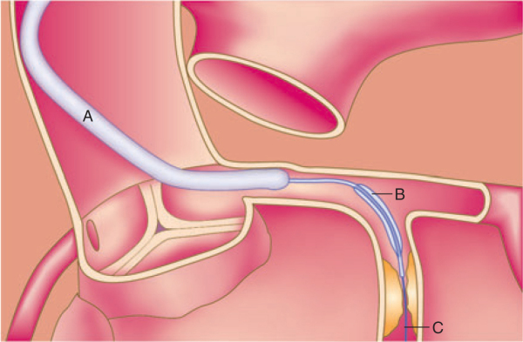
PCI

Slide 57
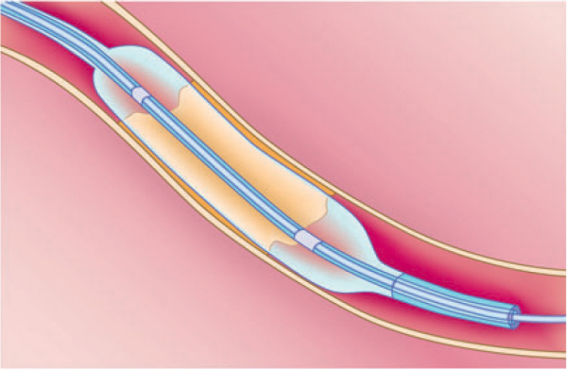
PCI

Slide 58
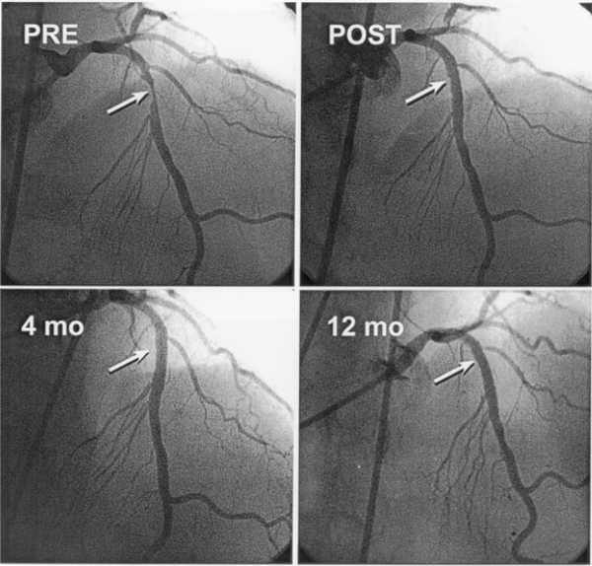
Pre & post PCI

Slide 59
Acute Coronary Syndromes
Unstable Angina
Non-ST-Segment Elevation MI (NSTEMI)
ST-Segment Elevation MI (STEMI)
Similar pathophysiology
Similar presentation and early management rules
STEMI requires evaluation for acute reperfusion intervention

Slide 60
Diagnosis of Acute MI STEMI / NSTEMI
At least 2 of the following
Ischemic symptoms
Diagnostic ECG changes
Serum cardiac marker elevations

Slide 61
Diagnosis of Angina
Typical angina—All three of the following
Substernal chest discomfort
Onset with exertion or emotional stress
Relief with rest or nitroglycerin
Atypical angina
2 of the above criteria
Noncardiac chest pain
1 of the above

Slide 62
Diagnosis of Unstable Angina
Patients with typical angina - An episode of angina
Increased in severity or duration
Has onset at rest or at a low level of exertion
Unrelieved by the amount of nitroglycerin or rest that had previously relieved the pain
Patients not known to have typical angina
First episode with usual activity or at rest within the previous two weeks
Prolonged pain at rest

Slide 63
Unstable Angina
NSTEMI
STEMI
Non occlusive
thrombus
Non specific
ECG
Normal cardiac
enzymes
Occluding thrombus
sufficient to cause
tissue damage & mild
myocardial necrosis
ST depression +/-
T wave inversion on
ECG
Elevated cardiac
enzymes
Complete thrombus
occlusion
ST elevations on
ECG or new LBBB
Elevated cardiac
enzymes
More severe
symptoms

Slide 64
Acute Management
Initial evaluation & stabilization
Efficient risk stratification
Focused cardiac care

Slide 65
Evaluation
Occurs simultaneously
Efficient & direct history
Initiate stabilization interventions
Plan for moving rapidly to indicated cardiac care

Slide 66
Chest pain suggestive of ischemia
Immediate assessment within 10 Minutes
Initial labs
and tests
Emergent care
History & Physical
12 lead ECG
Obtain initial cardiac enzymes
electrolytes, cbc lipids, bun/cr, glucose, coags
CXR
IV access
Cardiac monitoring
Oxygen
Aspirin
Nitrates
Establish diagnosis
Read ECG
Identify complications
Assess for reperfusion

Slide 67
Focused History
Aid in diagnosis and rule out other causes
Palliative/Provocative factors
Quality of discomfort
Radiation
Symptoms associated with discomfort
Cardiac risk factors
Past medical history -especially cardiac
Reperfusion questions
Timing of presentation
ECG c/w STEMI
Contraindication to fibrinolysis
Degree of STEMI risk

Slide 68
Targeted Physical Examination
Examination
Vitals
Cardiovascular system
Respiratory system
Abdomen
Neurological status
Recognize factors that increase risk
Hypotension
Tachycardia
Pulmonary rales, JVD, pulmonary edema,
New murmurs/heart sounds
Diminished peripheral pulses
Signs of stroke

Slide 69
ECG assessment
ST Elevation or new LBBB
STEMI
ST Depression or dynamic
T wave inversions
NSTEMI
Non-specific ECG
Unstable Angina

Slide 70
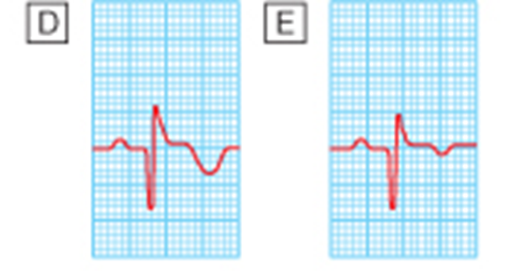
ECG changes with MI

Slide 71
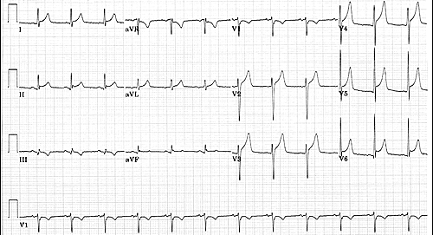
Normal or non-diagnostic ECG

Slide 72
ST Depression or Dynamic T wave Inversions

Slide 73
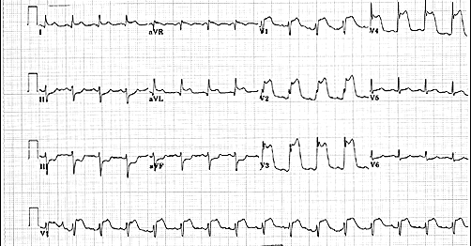
ST-Segment Elevation MI

Slide 74
New LBBB
QRS > 0.12 sec
L Axis deviation
Prominent S wave V1-V3
Prominent R wave 1, aVL, V5-V6
with t-wave inversion

Slide 75
Cardiac markers
Troponin ( T, I)
Very specific and more sensitive than CK
Rises 4-8 hours after injury
May remain elevated for up to two weeks
Can provide prognostic information
Troponin T may be elevated with renal dz, poly/dermatomyositis
CK-MB isoenzyme
Rises 4-6 hours after injury and peaks at 24 hours
Remains elevated 36-48 hours
Positive if CK/MB > 5% of total CK and 2 times normal
Elevation can be predictive of mortality
False positives with exercise, trauma, muscle dz, DM, PE

Slide 76
Cardiac markers

Slide 77
Risk Stratification
Based on initial
Evaluation, ECG, and
Cardiac markers
STEMI
Patient?
YES
NO
- Assess for reperfusion
- Select & implement reperfusion therapy
- Directed medical therapy
UA or NSTEMI
- Evaluate for Invasive vs. conservative treatment
- Directed medical therapy

Slide 78
Cardiac Care Goals
Decrease amount of myocardial necrosis
Preserve LV function
Prevent major adverse cardiac events
Treat life threatening complications

Slide 79
STEMI cardiac care
STEP 1: Assessment
Time since onset of symptoms
90 min for PCI / 12 hours for fibrinolysis
Is this high risk STEMI?
KILLIP classification
If higher risk may manage with more invasive rx
Determine if fibrinolysis candidate
Meets criteria with no contraindications
Determine if PCI candidate
Based on availability and time to balloon rx

Slide 80
Fibrinolysis indications
ST segment elevation >1mm in two contiguous leads
New LBBB
Symptoms consistent with ischemia
Symptom onset less than 12 hrs prior to presentation

Slide 81
Absolute contraindications for fibrinolysis therapy in patients with acute STEMI
Any prior ICH
Known structural cerebral vascular lesion (e.g., AVM)
Known malignant intracranial neoplasm (primary or metastatic)
Ischemic stroke within 3 months EXCEPT acute ischemic stroke within 3 hours
Suspected aortic dissection
Active bleeding or bleeding diathesis (excluding menses)
Significant closed-head or facial trauma within 3 months

Slide 82
STEMI cardiac care
STEP 2: Determine preferred reperfusion strategy
Fibrinolysis preferred if:
<3 hours from onset
PCI not available/delayed
door to balloon > 90min
door to balloon minus door to needle > 1hr
Door to needle goal <30min
No contraindications
PCI preferred if:
PCI available
Door to balloon < 90min
Door to balloon minus door to needle < 1hr
Fibrinolysis contraindications
Late Presentation > 3 hr
High risk STEMI
Killup 3 or higher
STEMI dx in doubt

Slide 83
Medical Therapy MONA + BAH
Morphine (class I, level C)
Analgesia
Reduce pain/anxiety—decrease sympathetic tone, systemic vascular resistance and oxygen demand
Careful with hypotension, hypovolemia, respiratory depression
Oxygen (2-4 liters/minute) (class I, level C)
Up to 70% of ACS patient demonstrate hypoxemia
May limit ischemic myocardial damage by increasing oxygen delivery/reduce ST elevation

Slide 84
Nitroglycerin (class I, level B)
Analgesia—titrate infusion to keep patient pain free
Dilates coronary vessels—increase blood flow
Reduces systemic vascular resistance and preload
Careful with recent ED meds, hypotension, bradycardia, tachycardia, RV infarction
Aspirin (160-325mg chewed & swallowed) (class I, level A)
Irreversible inhibition of platelet aggregation
Stabilize plaque and arrest thrombus
Reduce mortality in patients with STEMI
Careful with active PUD, hypersensitivity, bleeding disorders

Slide 85
Beta-Blockers (class I, level A)
14% reduction in mortality risk at 7 days at 23% long term mortality reduction in STEMI
Approximate 13% reduction in risk of progression to MI in patients with threatening or evolving MI symptoms
Be aware of contraindications (CHF, Heart block, Hypotension)
Reassess for therapy as contraindications resolve
ACE-Inhibitors / ARB (class I, level A)
Start in patients with anterior MI, pulmonary congestion, LVEF < 40% in absence of contraindication/hypotension
Start in first 24 hours
ARB as substitute for patients unable to use ACE-I

Slide 86
Heparin (class I, level C to class IIa, level C)
LMWH or UFH (max 4000u bolus, 1000u/hr)
Indirect inhibitor of thrombin
less supporting evidence of benefit in era of reperfusion
Adjunct to surgical revascularization and thrombolytic / PCI reperfusion
24-48 hours of treatment
Coordinate with PCI team (UFH preferred)
Used in combo with aspirin and/or other platelet inhibitors
Changing from one to the other not recommended

Slide 87
Additional medication therapy
Clopidodrel (class I, level B)
Irreversible inhibition of platelet aggregation
Used in support of cath / PCI intervention or if unable to take aspirin
3 to 12 month duration depending on scenario
Glycoprotein IIb/IIIa inhibitors (class IIa, level B)
Inhibition of platelet aggregation at final common pathway
In support of PCI intervention as early as possible prior to PCI

Slide 88
Additional medication therapy
Aldosterone blockers (class I, level A)
Post-STEMI patients
no significant renal failure (cr < 2.5 men or 2.0 for women)
No hyperkalemis > 5.0
LVEF < 40%
Symptomatic CHF or DM

Slide 89
STEMI care CCU
Monitor for complications:
recurrent ischemia, cardiogenic shock, ICH, arrhythmias
Review guidelines for specific management of complications & other specific clinical scenarios
PCI after fibrinolysis, emergent CABG, etc…
Decision making for risk stratification at hospital discharge and/or need for CABG

Slide 90
Unstable angina/NSTEMI cardiac care
Evaluate for conservative vs. invasive therapy based upon:
Risk of actual ACS
TIMI risk score
ACS risk categories per AHA guidelines
Low
High
Intermediate

Slide 91
Low
risk
Intermediate
risk
High
risk
Chest Pain center
Conservative therapy
Invasive therapy

Slide 92
Invasive therapy option UA/NSTEMI
Coronary angiography and revascularization within 12 to 48 hours after presentation to ED
For high risk ACS (class I, level A)
MONA + BAH (UFH)
Clopidogrel
20% reduction death/MI/Stroke – CURE trial
1 month minimum duration and possibly up to 9 months
Glycoprotein IIb/IIIa inhibitors

Slide 93
Conservative Therapy for UA/NSTEMI
Early revascularization or PCI not planned
MONA + BAH (LMW or UFH)
Clopidogrel
Glycoprotein IIb/IIIa inhibitors
Only in certain circumstances (planning PCI, elevated TnI/T)
Surveillence in hospital
Serial ECGs
Serial Markers

Slide 94
Secondary Prevention
Disease
HTN, DM, HLP
Behavioral
smoking, diet, physical activity, weight
Cognitive
Education, cardiac rehab program

Slide 95
Secondary Prevention disease management
Blood Pressure
Goals < 140/90 or <130/80 in DM /CKD
Maximize use of beta-blockers & ACE-I
Lipids
LDL < 100 (70) ; TG < 200
Maximize use of statins; consider fibrates/niacin first line for TG>500; consider omega-3 fatty acids
Diabetes
A1c < 7%

Slide 96
Secondary prevention behavioral intervention
Smoking cessation
Cessation-class, meds, counseling
Physical Activity
Goal 30 - 60 minutes daily
Risk assessment prior to initiation
Diet
DASH diet, fiber, omega-3 fatty acids
<7% total calories from saturated fats

Slide 97
Thank You

