Slide 1

Acute Ischemic Stroke
Yousef Mohammad MD., MSc., FAHA
Associate Professor of Neurology
King Saud University

Slide 2
The High Socioeconomic
Cost of Stroke
Morbidity and Mortality
A leading cause of serious, long­term disability
A second to only heart disease in causing death world-wide
According to the WHO 15 million people worldwide suffer a stroke each year
30-day mortality is 8-12%
Notes:
2

Slide 3
The High Socioeconomic
Cost of Stroke
For survivors aged > 65 years:
50% have hemiparesis
30% are unable to ambulate
19% are aphasic
35% are depressed
26% resides in nursing home

Slide 4
Thrombolytic Treatment of Acute Ischemic Stroke
Prior to two decades ago, no treatment was offered for acute stroke victims because of the misconception that arterial occlusion in the brain leads to irreversible necrosis and dead tissue within minutes
Stroke was wrongly named Cerebrovascular Accident (CVA)
Stroke care was focused on supportive care, stroke prevention and rehabilitation

Slide 5
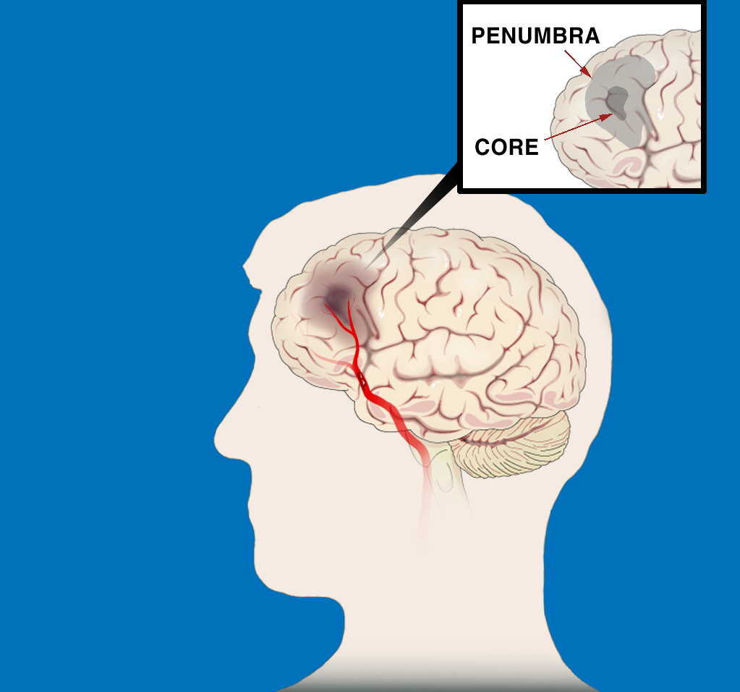
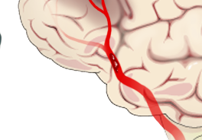
ISCHEMIC STROKE PATHOPHYSIOLOGY
The First Few Hours
“TIME IS BRAIN:
SAVE THE PENUMBRA”
Penumbra is zone of reversible ischemia around core of irreversible infarction—salvageable in first few hours after
ischemic stroke onset
Penumbra
Core
Clot in Artery

Slide 6
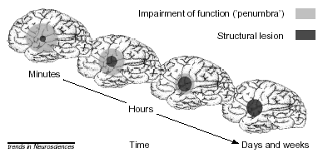

Slide 7
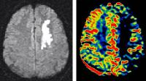
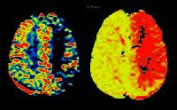
Perfusion/Diffusion MRI
Diffusion rCBV MTT

Slide 8
Penumbra
In every ischemic stroke there is ischemic core and penumbra
Penumbra is the region of tissue at risk of being recruited into the ischemic core
Ischemic Penumbra presents a Window of Opportunity

Slide 9
Tissue Plasminogen Activator (t-PA)
t-PA, which is clot specific, degrades the Plasminogen to Plasmin which in turn break apart the fibrin and the clot dissolves
In the late 80’s, t-PA was proven effective for coronary artery occlusion and acute MI and became the standard of care for acute MI

Slide 10
National Institute of Neurological Disorders and Stroke (NINDS) Trial
624 acute stroke patients were randomized to either Placebo or 0.9mg/kg of IV rt-PA within 3 hours from the stroke onset.
Primary outcome: complete or nearly complete neurological recovery at 3 months after stroke

Slide 11
National Institute of Neurological Disorders and Stroke (NINDS) Trial
Outcome | IV t-PA | Placebo
MRS < 1 | 39% | 26% (P=.019)
Mortality | 21% | 17%
ICH | 6.4% | 0.6%

Slide 12
National Institute of Neurological Disorders and Stroke (NINDS) Trial:
Those treated with IV rt-PA were 30% more likely to have no or only minor disability at 3 months post stroke
Absolute risk reduction of poor outcome in the t-PA patients is 13%
OR for favorable outcome (MRS 0-1) in the t-PA patients 1.9
No difference in mortality between the two groups
6.4% symptomatic hemorrhage in the t-PA group compared to 0.6% in the Placebo group

Slide 13
National Institute of Neurological Disorders and Stroke (NINDS) Trial
Based on the NINDS trial results, the FDA in 1996 approved IV t-PA for the treatment of acute ischemic stroke within 3 hours from stroke onset.

Slide 14
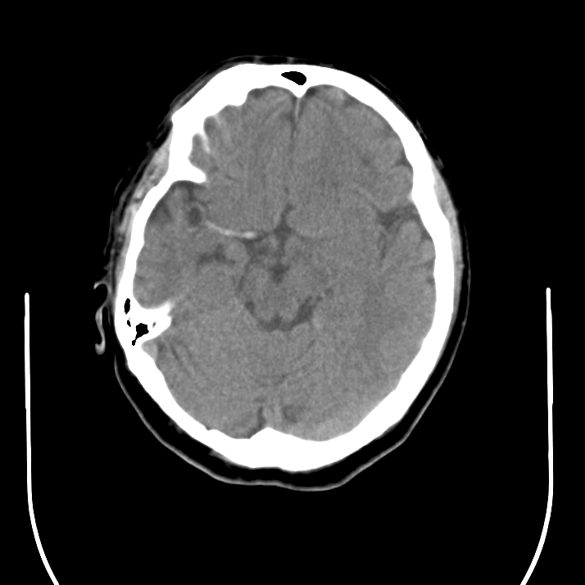
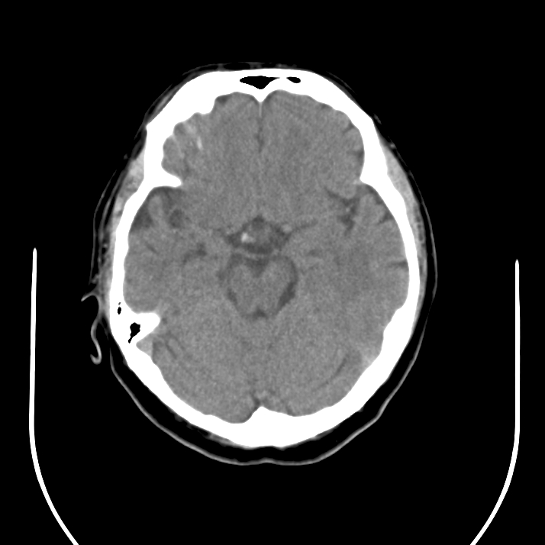
CT Prior to IV t-PA
CT Post IV t-PA

Slide 15
Pharmacological re-canalization
European Cooperative Acute Stroke Study (ECASS II):
Acute stroke patients were treated with either 0.9 mg/kg rt-PA or Placebo within 6 hours after stroke onset
Results showed increase intracerebral hemorrhage and worse outcome in the t-PA group

Slide 16
European Cooperative Acute Stroke Study (ECASS III)
A total of 821 acute stroke patients were treated with either 0.9 mg/kg rt-PA or Placebo within 4.5 hours of the stroke symptoms onset
Additional exclusion criteria to the NINDS trial include age >80, oral anticoagulant, NIHSS > 25, CT showing > 1/3 MCA infarct, and history of both stroke and diabetes

Slide 17
European Cooperative Acute Stroke Study (ECASS III)
Outcome | t--PA | Placebo
MRS < 2 | 54.4% | 45.2% P=0.04
Mortality | 7.7% | 8.4% P=0.68
Hemorrhage | 2.4% | 0.2% P=0.008

Slide 18
European Cooperative Acute Stroke Study (ECASS III)
Absolute risk reduction of poor outcome is 7%
A second pooled analysis including ECASS and EPITHET showed consistent results
The AHA,ASA, and ESA endorsed the use of alteplase within 4.5 hours of the symptoms onset

Slide 19
Outcome with IV-t-PA:
Odds Ratios for Favorable Outcome
Time Odds Ratio 95% (CI) Interval
0-90 2.8 1.8 - 4.5
91-180 1.5 1.1 - 2.1
181-270 1.4 1.1 - 1.9
271-360 1.2 0.9 - 1.5

Slide 20
AIS ED STROKE CARE 24/7:
1-H EVALUATION, 1-H INFUSION
I. Triage–10 min
  Review t-PA criteria
  Page acute stroke team
  Draw pre t-PA labs*
II. Medical Care–25 min
  Place O2 , 2 NS IVs
  Obtain BP, weight, NIHSS
  Obtain 12-lead ECG
  Send patient to CT
III. CT & Labs–45 min
  Obtain lab results
  Read CT
  Return pt to ED
IV. Treatment–60 min
  Start IV t-PA
  Monitor for ICH sxs
    HTN, headache
    N/V, ↓ neuro status
*CBC, platelets, PT/INR, PTT, chem 7, cardiac panel

Slide 21
Tissue Plasminogen Activator (t-PA)
These results were confirmed in subsequent post marketing observational studies:
58,353 IV t-PA treated patients from “Get with the guidelines stroke registry showed faster onset to treatment (15 minutes increments) is associated:
Reduced mortality (OR 0.96, 95% CI 0.95-0.98)
Reduced sICH (OR 0.96, 95% CI 0.95-0.98)
Increased favorable outcome (OR 1.04, 95% CI 1.03-1.05)

Slide 22
Tissue Plasminogen Activator (t-PA)
The introduction of t-PA 2 decades ago marked the end of one era dominated by nihilism, in which stroke was considered untreatable, and the beginning of another

Slide 23
Acute Stroke Treatment
Despite supporting data on the efficacy and safety of IV t-PA, it remains substantially underutilized:
Only <1% of acute stroke patients receive thrombolysis in U.S in 2006 (Mohammad et al. ISC)
Recent analysis on IV t-PA utilization showed a steady increase from 1.4% in 2004 to 3.4% in 2009
Main reason for under utilization, patients present beyond 4.5 hours from symptoms onset

Slide 24
Tissue Plasminogen Activator (t-PA)
Challenges to the utilization of t-PA include:
Narrow eligibility and treatment window
Risk of hemorrhage
Perceived lack of efficacy in large vessel occlusion
Limited pool of stroke expertise in the community

Slide 25
Tissue Plasminogen Activator (t-PA)
Challenges
Large vessel occlusion predicts large infarct size and is associated with poor outcome (46%)
Limited efficacy in large vessel occlusion

Slide 26
Tissue Plasminogen Activator (t-PA) Challenges
IV t-PA in large vessel occlusion
Patients with hyperdense
Which is indicative of large
Vessel occlusion respond
Poorly to IV t-PA (70-84%
Have poor outcome)

Slide 27
Tissue Plasminogen Activator (t-PA)
Occluded Vessel | Recanalization (TIMI 2 & 3)
M2 MCA | 31%
M1 MCA | 32%
TICA | 4%
BA | 4%
Bhatia et al

Slide 28
Tissue Plasminogen Activator (t-PA)
IV t-PA is easy access, quick, non-invasive and of low cost.
Limited efficacy in Large Vessel Occlusion

Slide 29
Endovascular thrombolysis for LVO
Rational
Intra-arterial and mechanical thrombolytic offers direct instillation of thrombolytics and direct mechanical probing of the clot
Drawbacks of Endovascular thrombolysis include invasiveness, cost and time delay

Slide 30
Mechanical Recanalization
Mechanical Embolus Removal in Cerebral Ischemia (MERCI) Trial:
An open label non-randomized study that evaluated the safety and efficacy of clot removal by the MERCI retriever.
  141 patients with intracranial large vessel occlusion treated within 8 hours

Slide 31
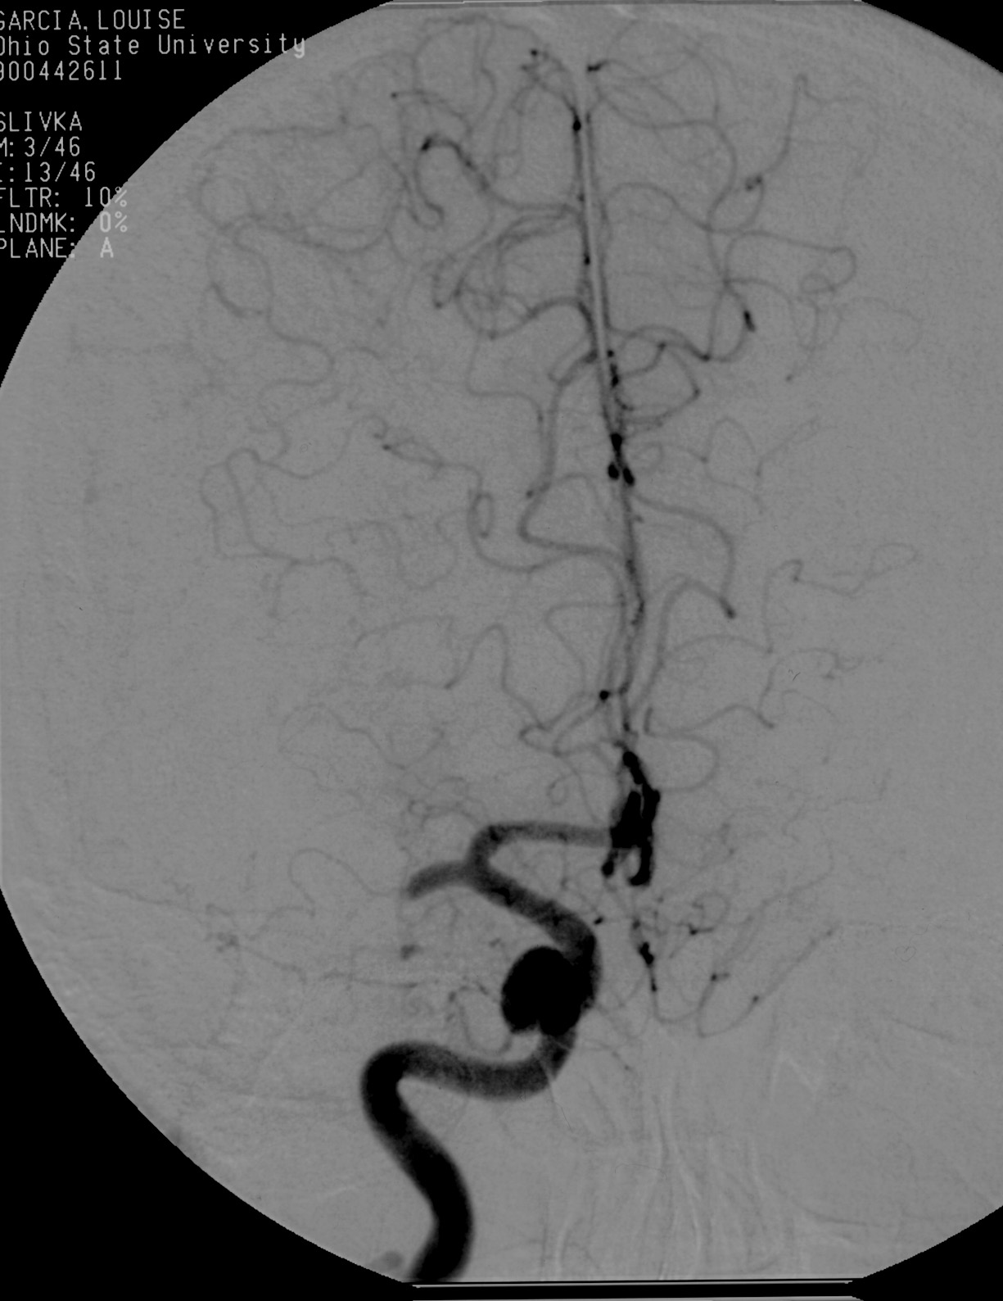
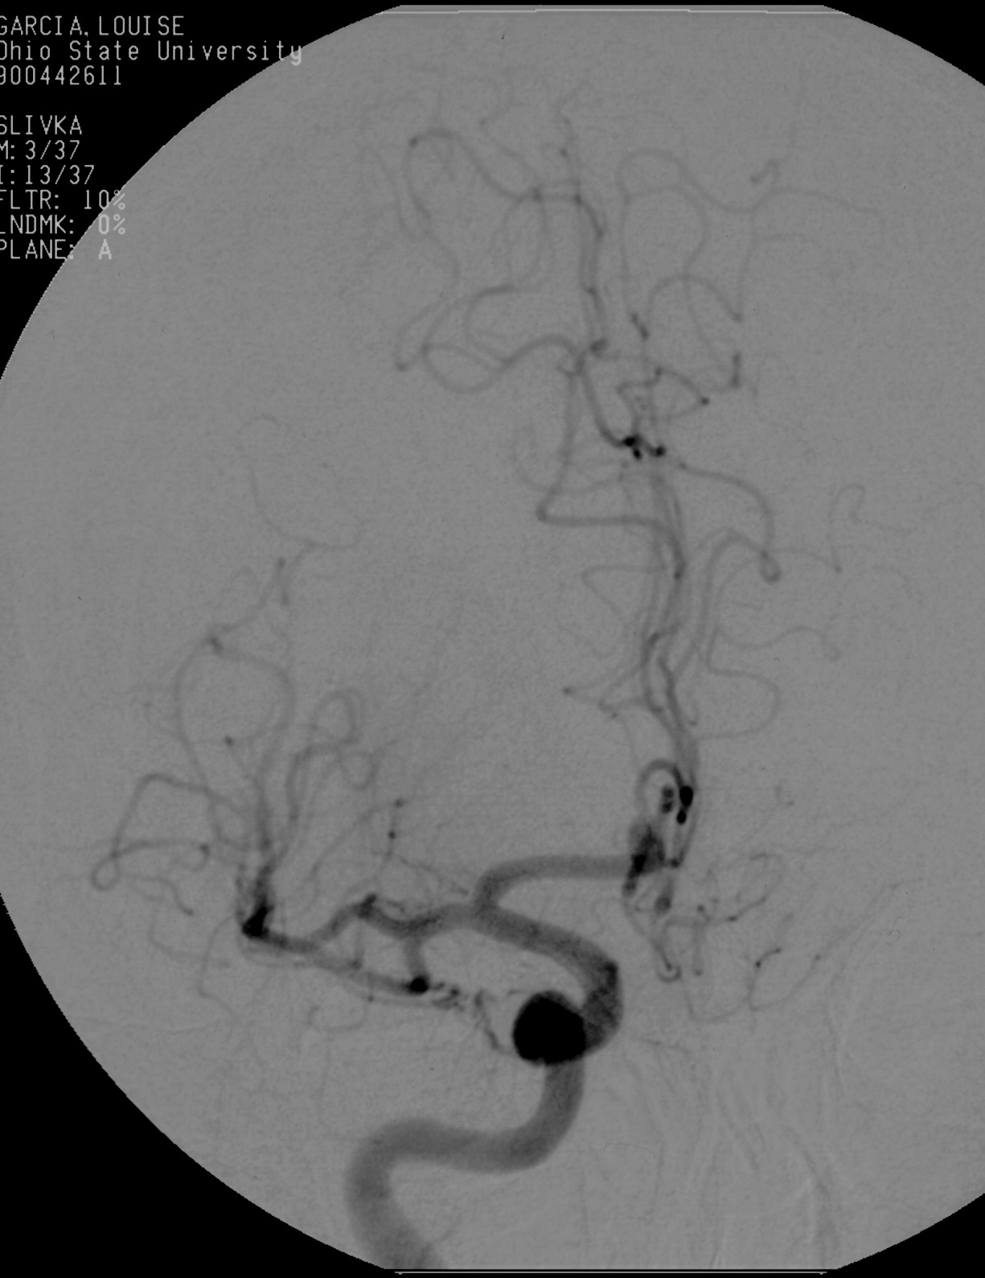
Thrombolysis

Slide 32
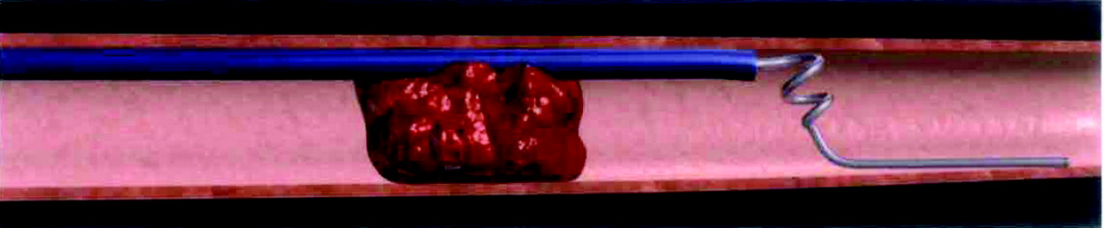


After the microcatheter transverses the thrombus, the first loops of the Merci Retriever are delivered distal to the occlusion site
Pierre Gobin, Y. et al. Stroke 2004;35:2848-2854
Copyright ©2004 American Heart Association

Slide 33

The Merci Retriever is pulled back at the contact of the thrombus, additional loops are delivered within the thrombus, and the Merci Retriever is torqued to ensnare the thrombus
Pierre Gobin, Y. et al. Stroke 2004;35:2848-2854
Copyright ©2004 American Heart Association

Slide 34
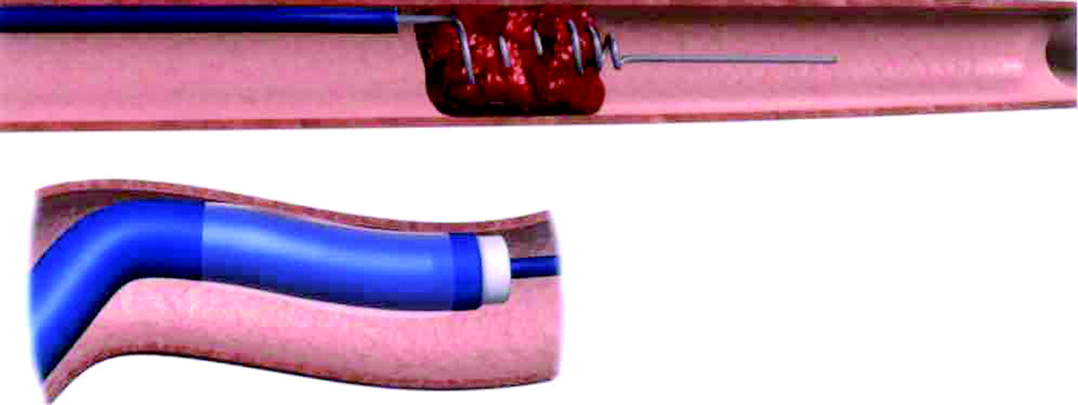
The balloon of the balloon guide catheter (BGC) (insert) is inflated to control antegrade flow, and the Merci Retriever is pulled back with the ensnared thrombus toward the tip of the BGC where it is aspirated
Pierre Gobin, Y. et al. Stroke 2004;35:2848-2854
Copyright ©2004 American Heart Association

Slide 35
Thrombolysis

Slide 36
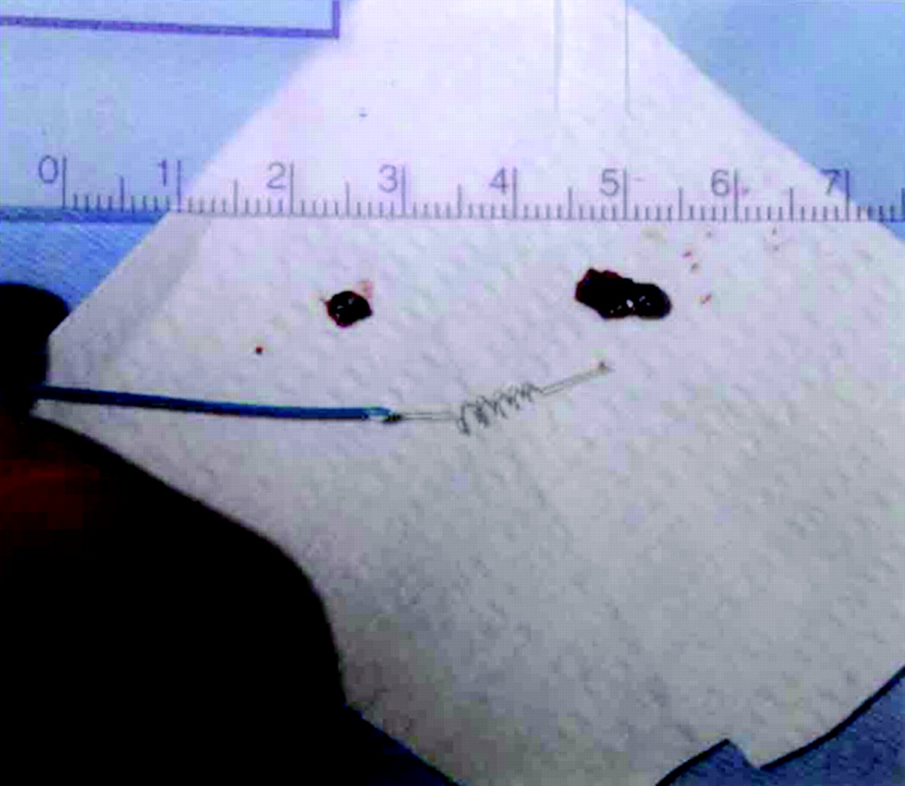
Photograph showing the Merci Retriever and the 2 thrombi, which were retrieved in case 9
Pierre Gobin, Y. et al. Stroke 2004;35:2848-2854
Copyright ©2004 American Heart Association

Slide 37
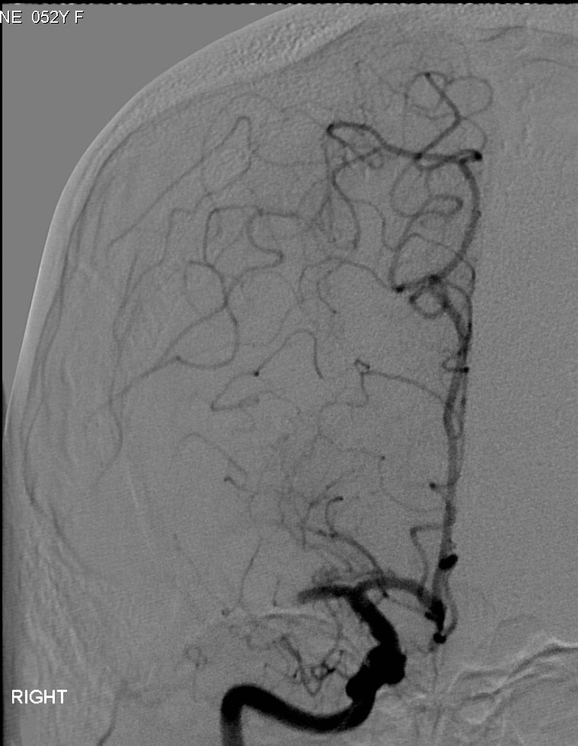
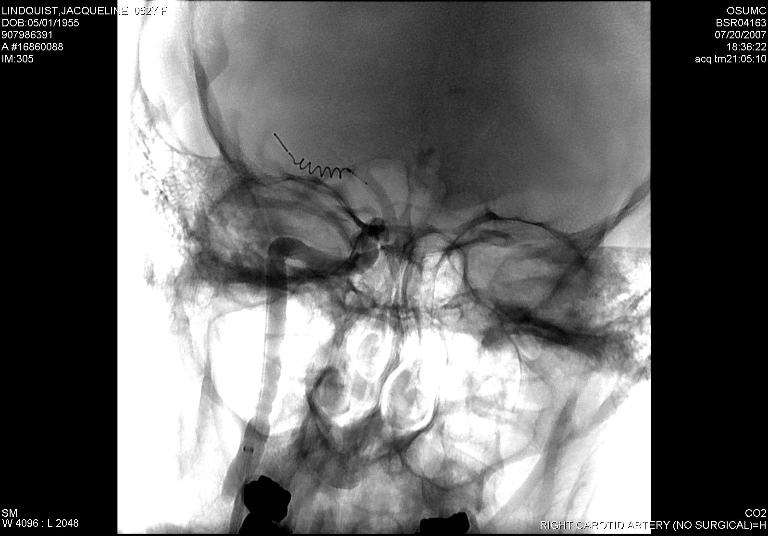
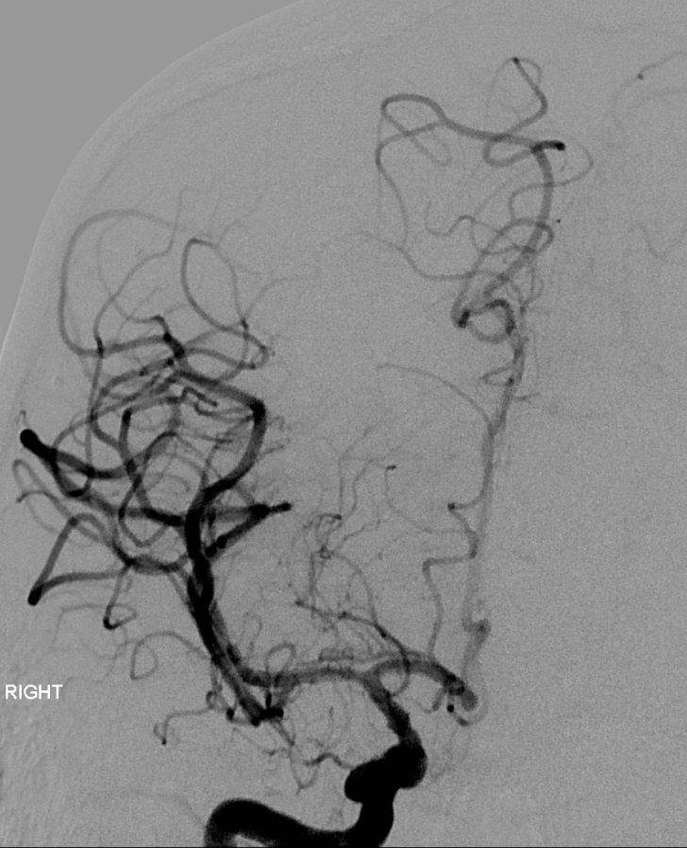
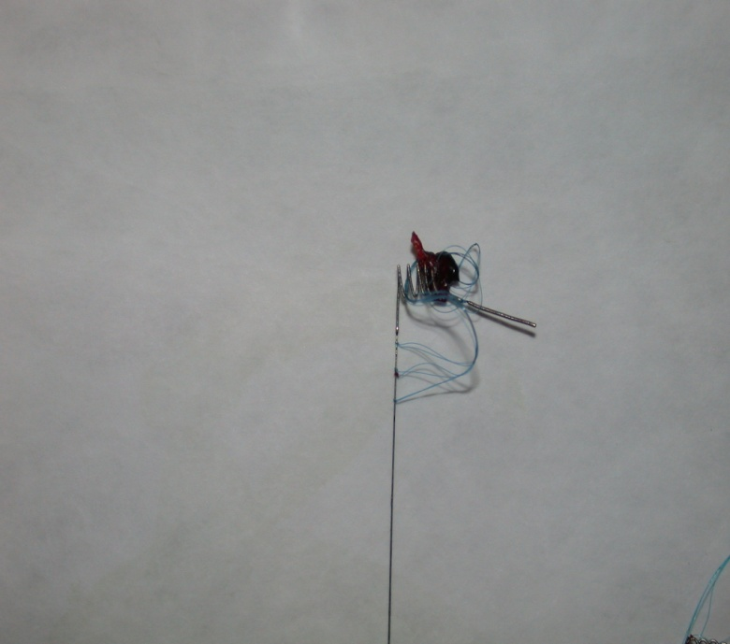
MERCI retriever
Embolectomy performed using a MERCI retriever device can also result in successful recanalization. The patient presented here had significant clinical improvement following MERCI assisted embolectomy.
MERCI retriever in MCA
LICA angiogram showing MCA occlusion (arrow)
Tip of MERCI device with removed thrombus (arrows)
Complete recanalization

Slide 38
Acute Stroke Treatment: Mechanical Thrombolysis
Mechanical Embolus Removal in Cerebral Ischemia (MERCI) Trial:
  Recanalization: 48% (19% PROACT control)
  Complications: 7% (emboli, dissection, SAH)
  Good outcome: 28% (46% recanalized, 10% occluded)
  Mortality: 43% (32 recanalized, 54% occluded)
  Symptomatic hemorrhage occurred in 5%.

Slide 39
Mechanical Embolus Removal in Cerebral Ischemia (MERCI) Trial:
Recan | MRS <2 | Complication | Mortality | sICH
48% | 28% | 7% | 43% | 5%

Slide 40
Mechanical Recanalization
Mechanical Embolus Removal in Cerebral Ischemia (MERCI) Trial:
Based on the MERCI trial results, the FDA in 2005 approved the MERCI retriever for removing clot within 8 hours of stroke symptoms.

Slide 41
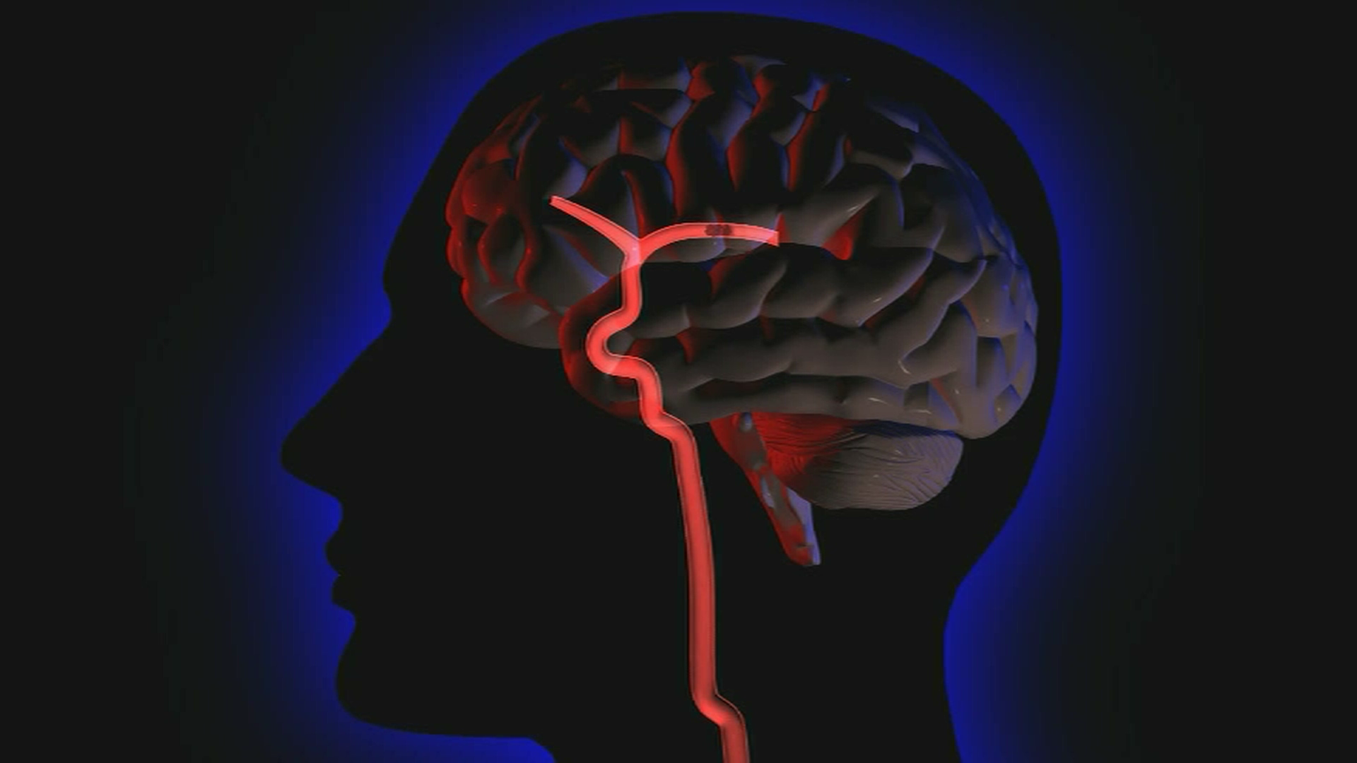
Penumbra

Slide 42
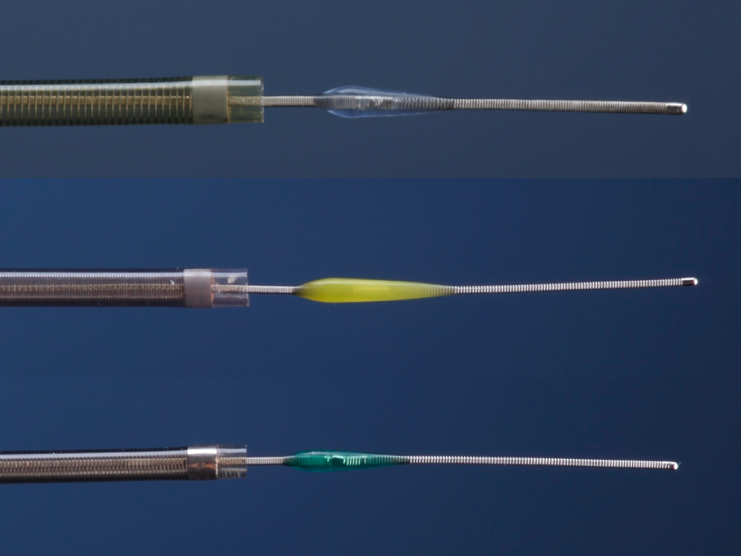
Penumbra microcatheters, shown here with separator wires, are available in sizes ranging from 2.3 French to 4 French. This device uses aspiration assisted by a separator wire to suction out thrombus.
ADVANTAGES
Can be used in some patients with contraindications to thrombolysis
8-hour window
Initial data indicates higher revasculariztion rates relative to other methods.
Preliminary data shows better outcome at 90 days relative to other devices show
DISADVANTAGES
Vessel tortuosity precludes use
Distal vessels not reachable
Operator experience
Higher rate of symptomatic intra-cerebral hemorrhage

Slide 43
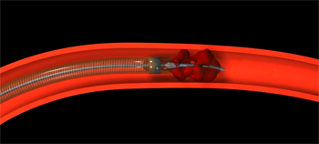
Penumbra

Slide 44
Penumbra
Trial Design
Prospective, single arm, multi-center
Enrolled 125 patients at 24 international centers
Patients in the trial presented within 8 hours from symptoms onset, had an NIHSS >8 and had complete occlusion of a large intracranial vessel

Slide 45
Penumbra
Recanal | Hemorr | >4 NIHSS Imp | MRS<2 | Mortal
81.6% | 11.2% | 57.8% | 25% | 26%

Slide 46
Endovascular Thrombolysis vs IV t-PA
Randomized Phase 3 trial:
IMS III
Synthesis Expansion
MR Rescue

Slide 47
Endovascular Thrombolysis vs IV t-PA
IMS III
A randomized study to assess the efficacy and safety of IV t-PA combined with mechanical thrombolysis compared with IV t-PA alone, in acute stroke patients presenting within 3 hours of the symptoms onset
The primary outcome was a MRS of <2 (indicating functional independence) at 90 days

Slide 48
Endovascular Thrombolysis vs IV t-PA
IMS III
Outcome | IV t-PA | IV t-PA/MT
MRS <2 | 38.7% | 40.8%
Mortality | 21.6% | 19.1% P=0.52
sICH | 5.9% | 6.2% P=0.83

Slide 49
Endovascular Thrombolysis vs IV t-PA
Synthesis Expansion
362 patients with acute ischemic stroke within 4.5 hours of symptoms onset, were randomized to endovascular therapy (IA t-PA, mechanical disruption or retrieval or a combination of these approaches) or IV t-PA
Primary outcome is MRS < 0-1 (indicating survival free of disability)

Slide 50
Endovascular Thrombolysis vs IV t-PA
Synthesis Expansion
Outcome | IV t-PA | ET
MRS 0-1 | 34.8% | 30.4% (OR 0.71; 95% CI 0.44-1.41)
Mortality | Same
sICH | 6% | 6%

Slide 51
Endovascular Thrombolysis vs IV t-PA
MR Rescue
A randomized, controlled, open label blinded outcome, multicenter trial in North America.
Patients presenting with 8 hours of symptoms onset and received t-PA for LVO were randomized to mechanical thrombolysis (MERCI or Penumbra)
Primary outcome MRS <2

Slide 52
Endovascular Thrombolysis vs IV t-PA
MR RESCUE
Outcome | IV t-PA | t-PA/MT
Mean MRS | 3.9 | 3.9 P=0.99
Mortality | Same | NS
sICH | Same | NS

Slide 53
Endovascular Thrombolysis vs IV t-PA
Despite a sound pathophysiologic rationale and promising results from non-randomized studies, treatment of patients with endovascular therapy has not been proven to be superior in improving outcome compared to IV t-PA

Slide 54
Endovascular Thrombolysis
Stent-retriver technology (2nd generation devices for mechanical thrombolysis):
Solitaire Device
Trevo Stent-retrieveer

Slide 55
Endovascular Thrombolysis
Stent-retriever
They work by temporally deploying a stent that captures the thrombus and at the same time instantly restores blood flow to the affected brain territory by displacing the clot peripherally against the artery wall

Slide 56
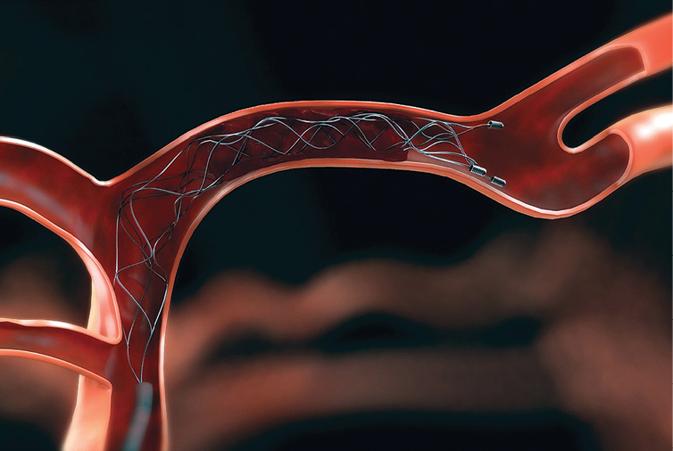
Solitaire Device

Slide 57
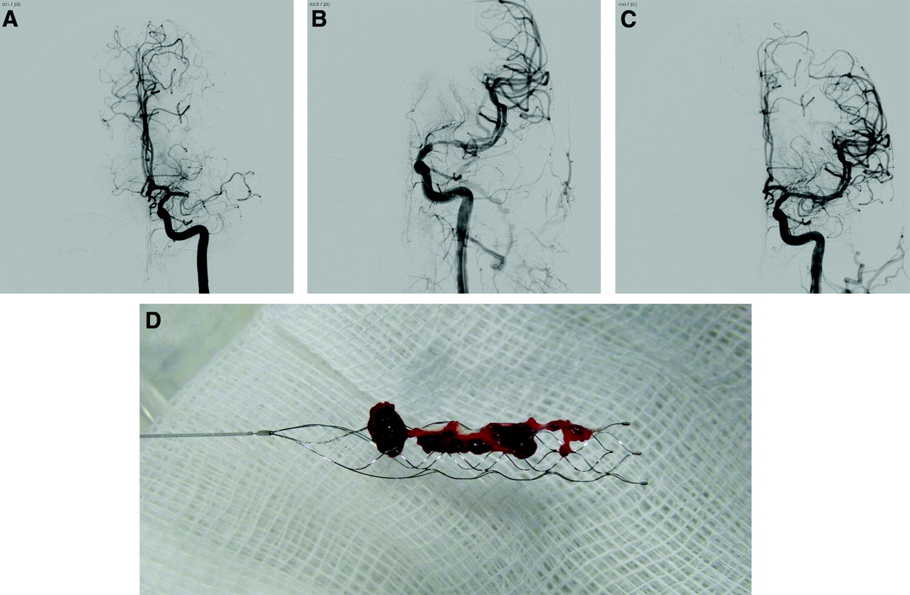
Solitaire Device

Slide 58
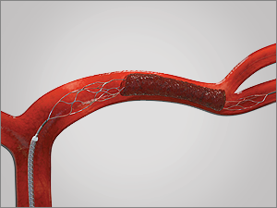
Trevo Stent-retiever

Slide 59
Stent-retriever
A review of prospective trials related to mechanical thrombolysis since 1999 showed a significant improvement in recanalization over the last 2 decades
Stent-retrievers achieved successful recanalization in around 85% compared 50% in the first generation devices

Slide 60
Stent-retrievers
SWIFT study is a multi-center RCT comparing Solitaire to MERCI retriever

Slide 61
Stent-retriever
SWIFT Study
Outcome | MERCI | Solitaire
Recanalization | 24% | 61%
MRS < 2 | 33% | 58%
Mortality | 38.2% | 17.2% P=0.02

Slide 62
Mechanical Thrombolysis
Assessment and recommendation of the current status of MT by the Endovascular society:
Fast and complete recanalization is the most important factor for good outcome
Recent studies showed stent-retrievers are superior to the old devices in achieving a quick and complete rercanalization
In the 3 failed randomized studies (IMS III, MR Rescue, and Synthesis) only 5% of the patients utilized the Stent-retriever

Slide 63
Acute Stroke Treatment
5 recent randomized clinical trials assessing the efficacy and safety of stent retriever in acute ischemic stroke:
MR CLEAN
ESCAPE
EXTEND-IA
SWIFT ORIME
REVASCAT

Slide 64
MR CLEAN
METHODS
Patient presenting with acute ischemic stroke from large artery occlusion confirmed by vessel image were randomized, within 6 hours from the symptoms onset, to either usual care or endovascular treatment utilizing stent retriever

Slide 65
MR CLEAN
METHODS
Primary outcome was the modified Rankin scale score which ranges from 0 (no symptoms to 6 (death)

Slide 66
MR CLEAN
RESULTS
500 patients at 16 medical centers in Netherlands (233 assigned to EV treatment and 267 to usual care
There was an absolute difference of 13.5 % points (95% CI, 5.9 to 21.2) in the rate of functional dependence (MRS 0-2) in favor of EV treatment (32.6% vs 19.1%)
No difference in mortality or intracerebral hemorrhage
N Engl J Med. 2015; 372: 11-20

Slide 67
ESCAPE
METHODS
Patients presenting with acute ischemic stroke from large artery occlusion were randomized, within 12 hours of symptoms onset, to either standard care or EV treatment

Slide 68
ESCAPE
METHODS
Patients with a large infarct core or poor collaterals on CT angiogram were excluded
The primary outcome was the modified Rankin scale score which ranges from 0 (no symptoms) to 6 (death)

Slide 69
ESCAPE
RESULTS
The trial was stopped early because of efficacy
At 22 centers worldwide, 316 participants were enrolled
The rate of functional independence (MRS 0-2) was increased in the intervention (53% vs 29.3%); [OR 2.6; CI 1.7 to 3.8; P<0.001]
Mortality was reduced in the EV group (10.4% vs 19%; P=0.04
N Engl J Med. 2015; 372: 1019-1030

Slide 70
EXTEND-IA
METHODS
Patients presenting with acute ischemic stroke from large artery occlusion were randomized, within 4.5 hours from the symptoms onset, to either t-PA plus EV treatment or t-PA alone
Patients with large infarct core on CT perfusion were excluded

Slide 71
EXTEND-IA
METHODS
The coprimary outcome were reperfusion at 24 hours and early neurologic improvement
Secondary outcome included the functional score on the MRS which ranges from 0 (no symptoms to 6 (death)

Slide 72
EXTEND-IA
RESULTS
The trial was stopped because of efficacy after 70 patients undergone randomization
Reperfusion was achieved in 100% of the EV group compared to only 37% in the t-PA alone group (P<0.001)
EV treatment increased early neurologic improvement at 3 days (80% vs 37%, P=0.002)

Slide 73
EXTEND-IA
RESULTS
EV treatment improved functional outcome at 90n days (71% vs 40%, P=0.001)
No significant differences in rates of death or ICH in the 2 groups
N Engl J Med. 2015; 372: 1009-1018

Slide 74
SWIFT PRIME
METHODS
Patients with acute ischemic stroke due to large artery occlusion were randomized, within 6 hours from the symptoms onset, to either t-PA alone or t-PA plus EV treatment using stent retriever

Slide 75
SWIFT PRIME
METHODS
Patients with a large infarct core or poor collaterals on CT angiogram were excluded
The primary outcome was the severity of global disability at 90 days, as assessed by the MRS which ranges from 0 (no symptoms) to 6 (death)

Slide 76
SWIFT PRIME
RESULTS
The study was stopped early because of efficacy
At 39 centers, 196 patients underwent randomization
EV treatment with stent retriever plus t-PA reduced disability at 90 day (P<0.001)

Slide 77
SWIFT PRIME
RESULTS
The rate of functional independence (MRS 0-2) was higher in the EV group (60% vs. 35%, P<0.001)
There was no difference in 90 day mortality (9% vs. 12%, P=0.50) or symptomatic ICH (0% vs 3%, P=0.12)
N Engl J Med. 2015; 372: 2285-2295

Slide 78
REVASCAT
METHODS
Patients with acute ischemic stroke from large artery occlusion were randomized, within 8 hours from the symptoms onset, to either EV plus t-PA or t-PA alone
The primary outcome was the severity of global disability at 90 days as measured by the MRS which ranges from 0 (no symptoms) to 6 (death)

Slide 79
REVASCAT
RESULTS
Enrollment was halted early after positive results for thrombectomy were reported from earlier similar trials
EV treatment reduced the severity of disability and led to higher rates of functional independence (MRS 0-2); 43.7% vs 28%
No differences in the rates of mortality and ICH
N Engl J Med. 2015: 372: 2296-2306

Slide 80
Acute Ischemic Stroke
Conclusion
IV t-PA, within 4.5 hours from the symptoms onset of acute ischemic stroke, is affective and the standard of care
Endovascular treatment using stent retriever, within 6 hours from the onset of stroke symptoms, is effective and the standard of care

