Slide 1

ECG med 443
Ahmad Hersi

Slide 2
Outlines
EKG : waves, intervals, and segments.
EKG leads
How to read an EKG

Slide 3
EKG : waves, intervals, and segments.

Slide 4
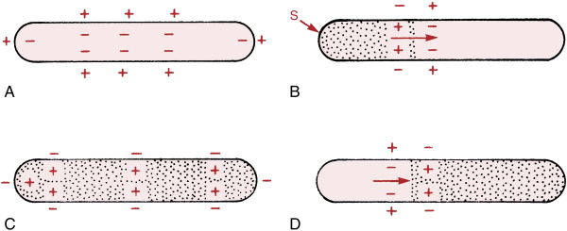
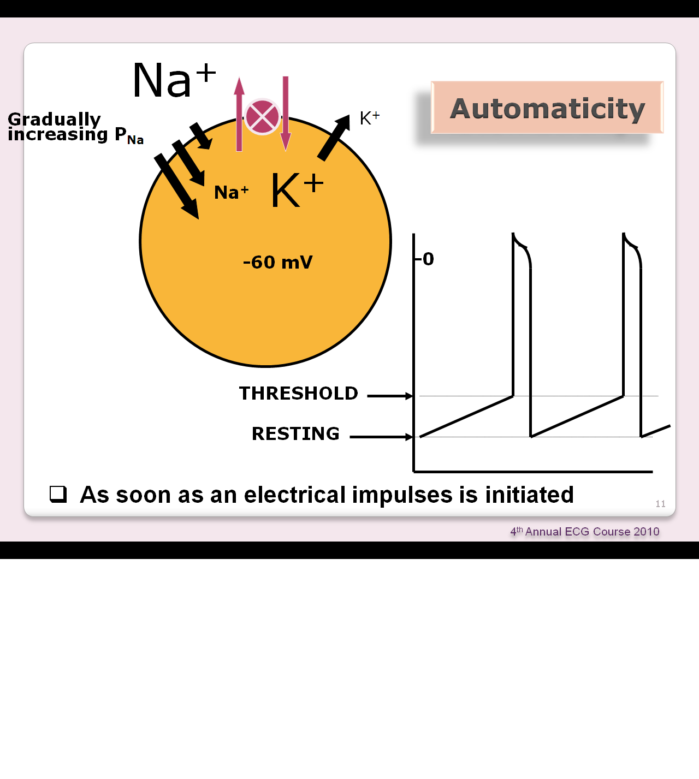
Depolarization and Repolarization

Slide 5
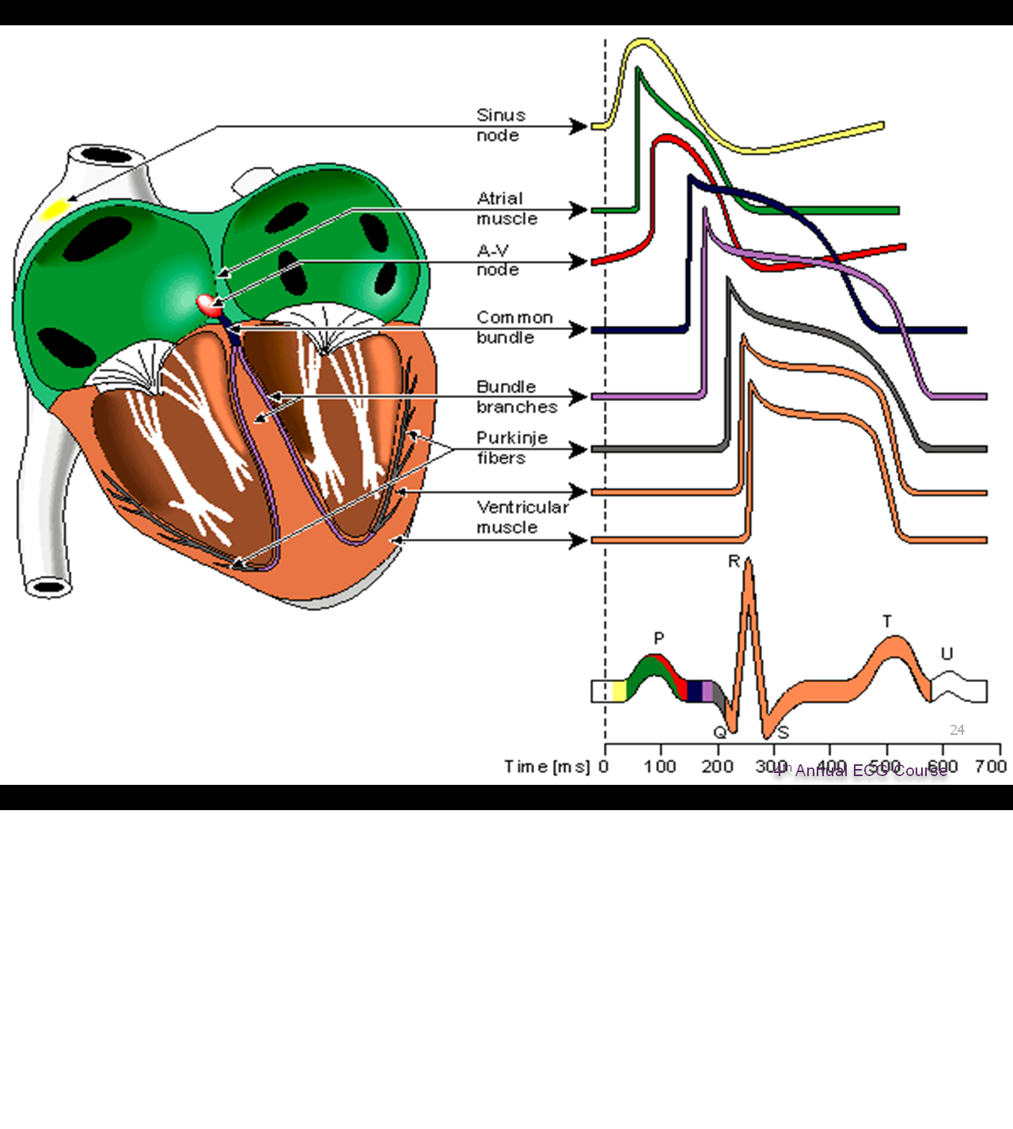

Slide 6
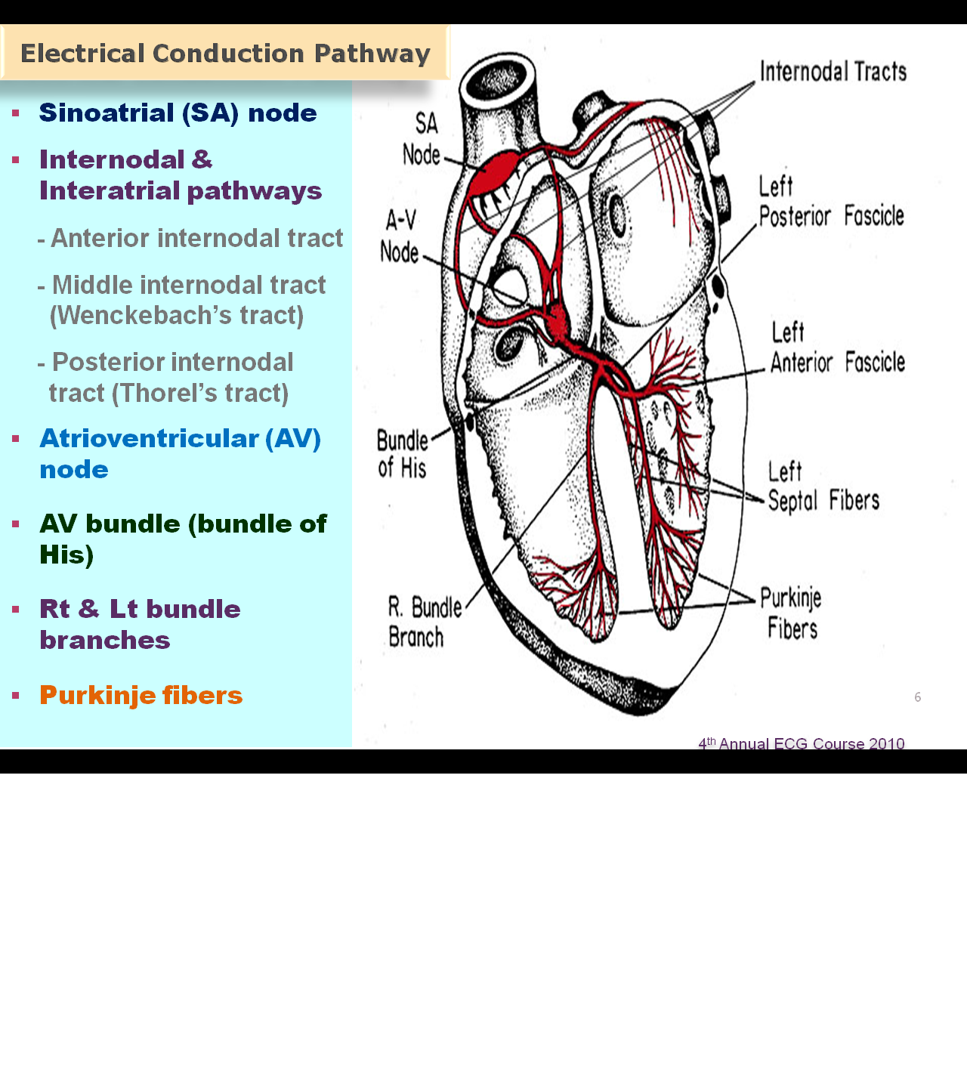
The conduction system

Slide 7
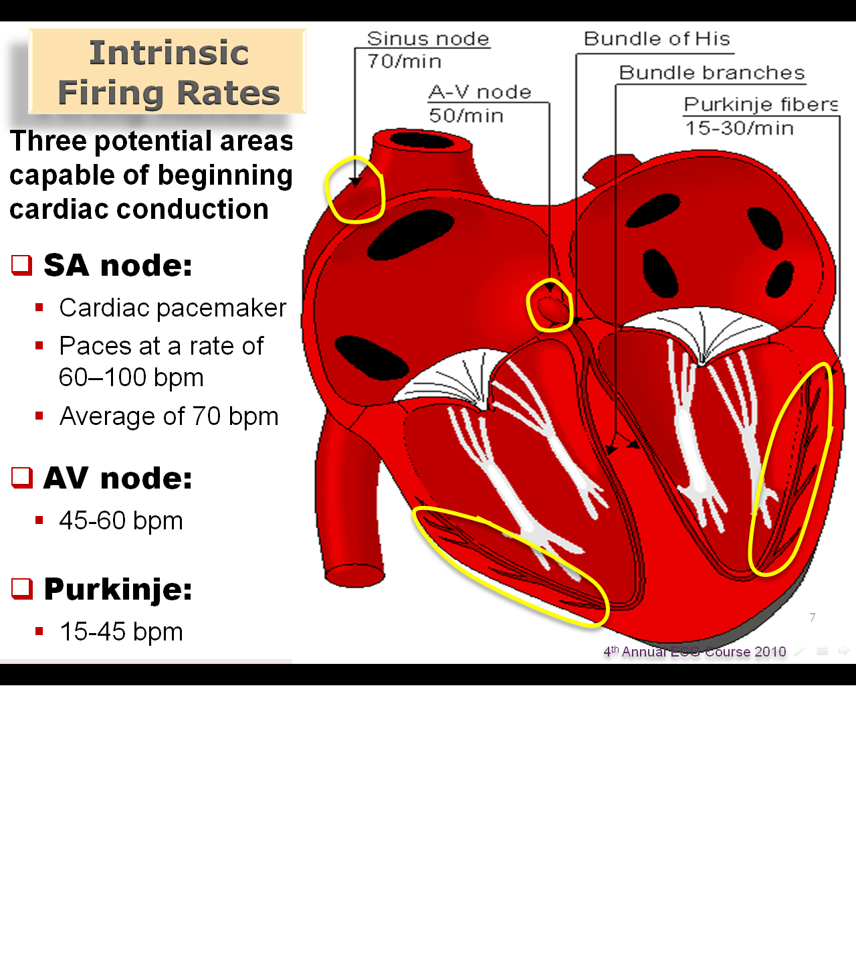

Slide 8
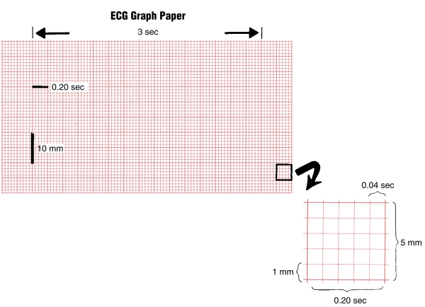

Slide 9
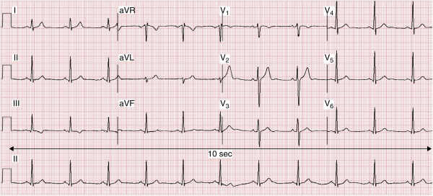
12 Leads EKG

Slide 10
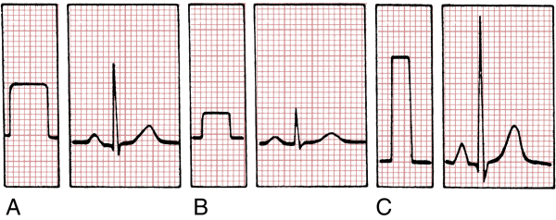

Slide 11

Waves

Slide 12
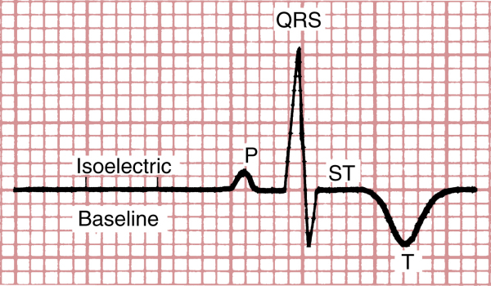
Waves

Slide 13
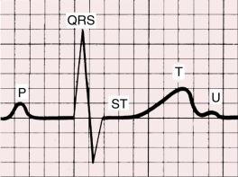
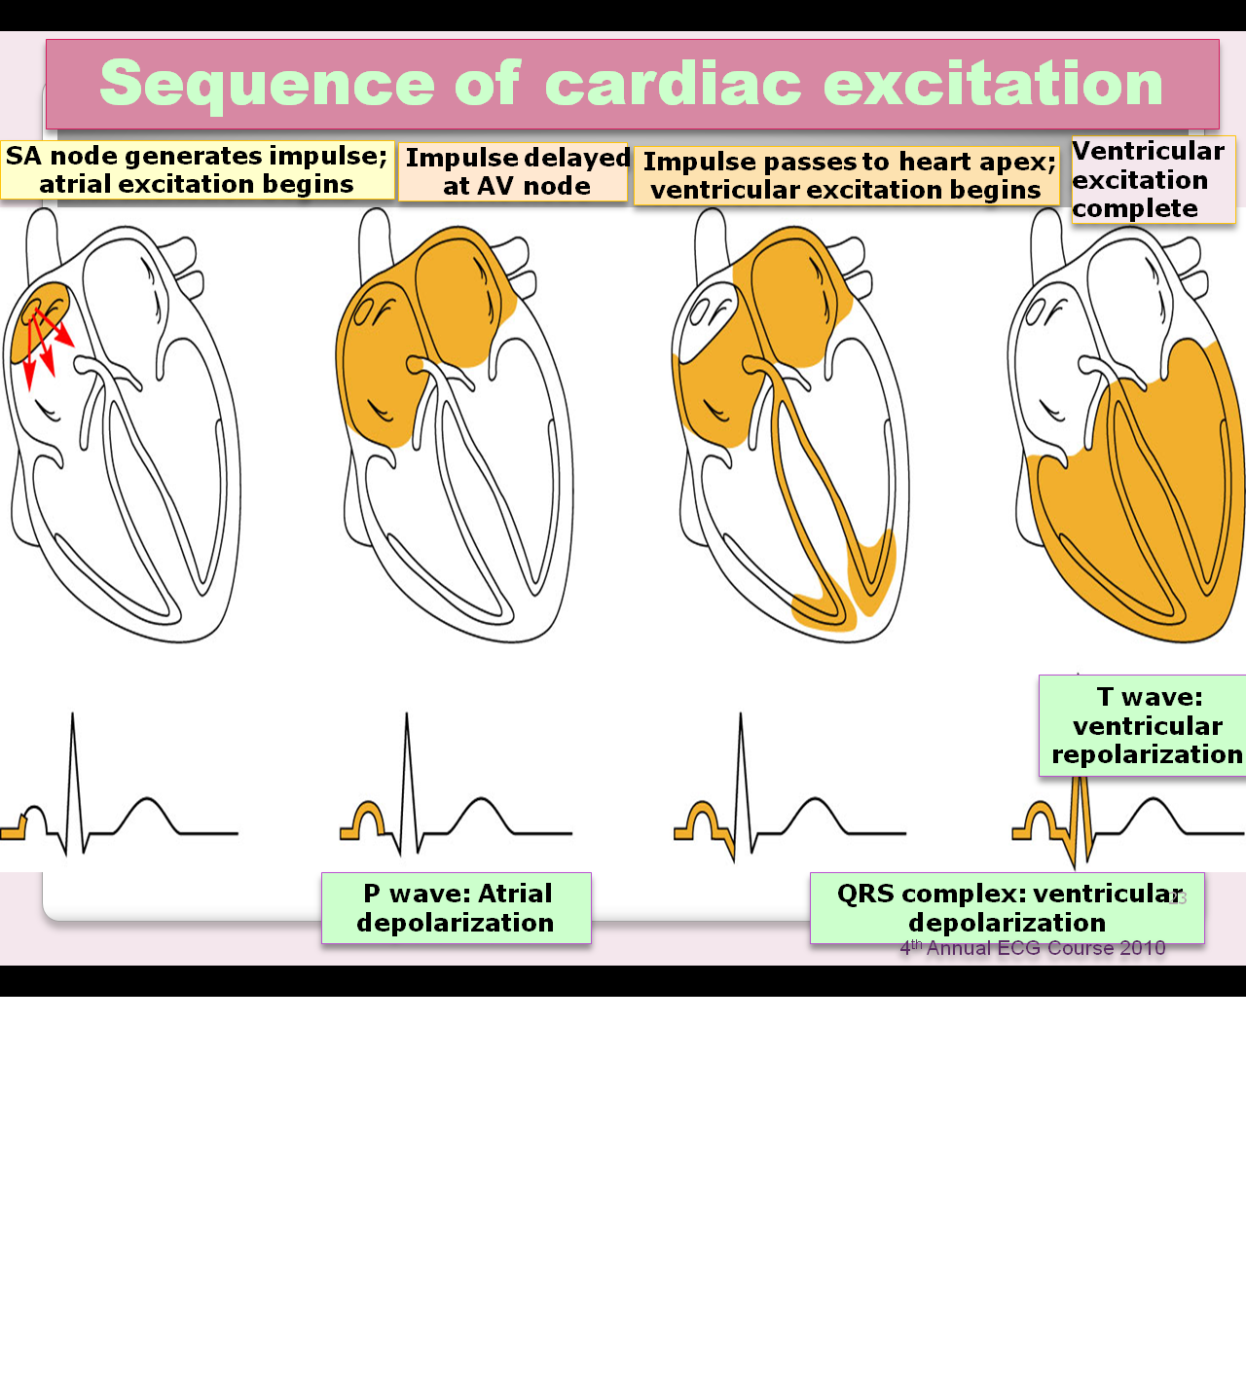
P-Wave

Slide 14
P-wave

Slide 15
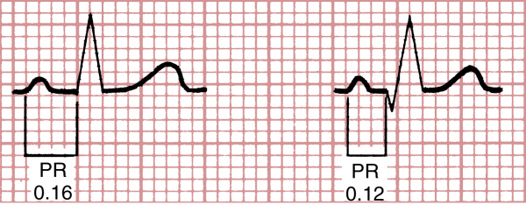
PR-interval

Slide 16
PR-Interval

Slide 17

QRS complex

Slide 18
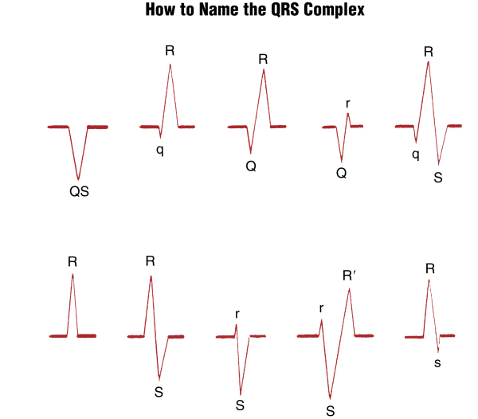
QRS complex
QRS

Slide 19
QRS

Slide 20
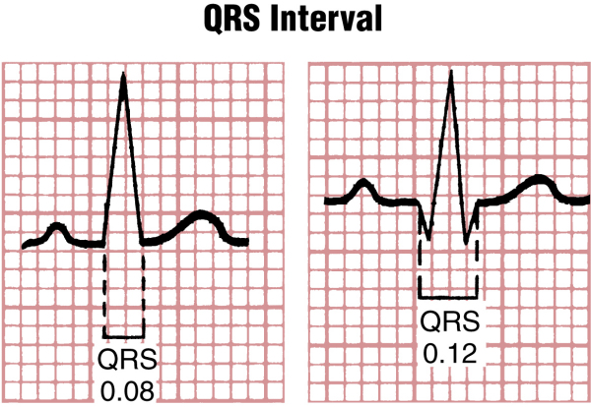
QRS complex

Slide 21
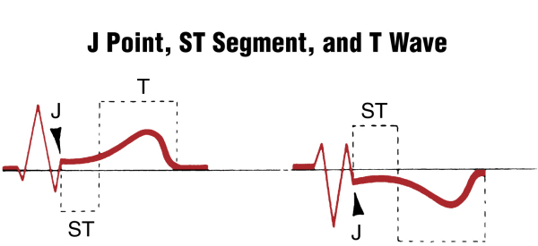
ST segment and T wave

Slide 22
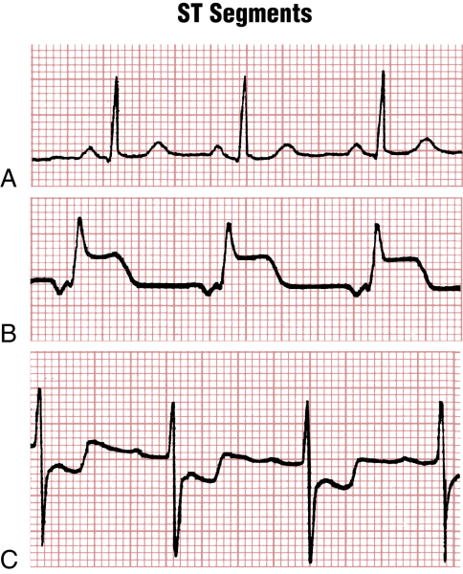
ST segment and T wave

Slide 23
ST-Segment

Slide 24
T-wave

Slide 25
U-wave

Slide 26
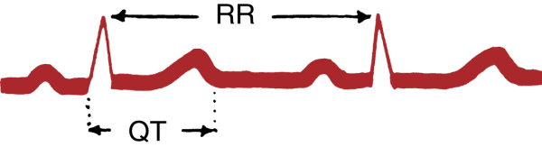
QT interval

Slide 27
QT-Interval

Slide 28
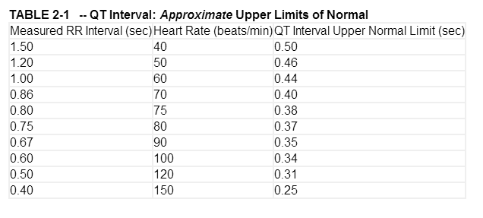

Slide 29
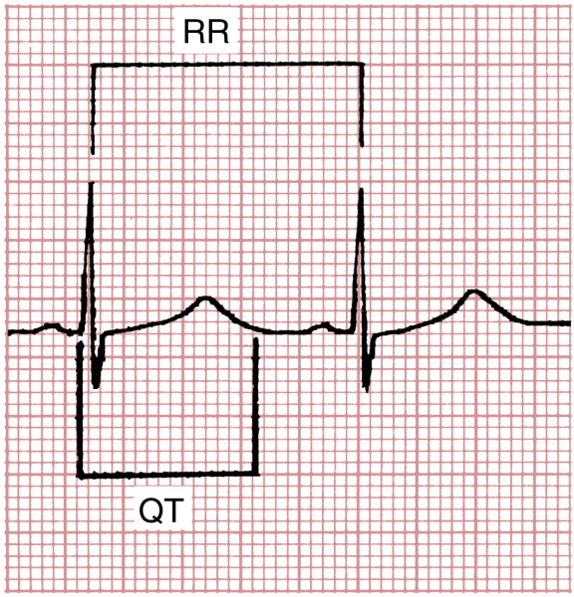
Prolonged QT interval

Slide 30
EKG leads

Slide 31
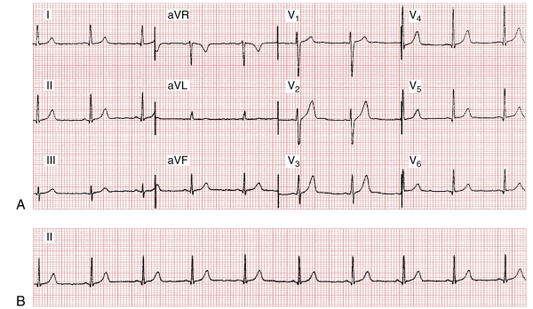
EKG

Slide 32
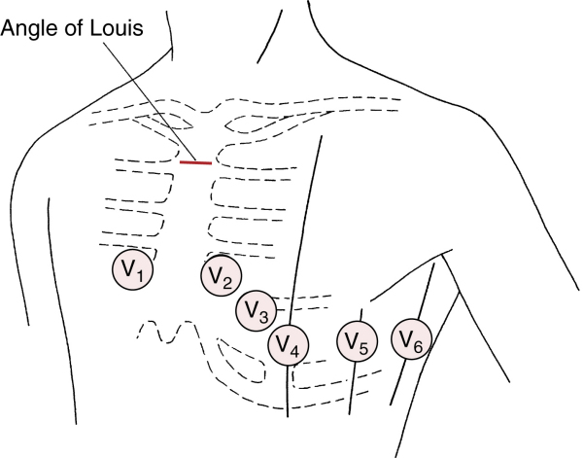
Chest leads

Slide 33
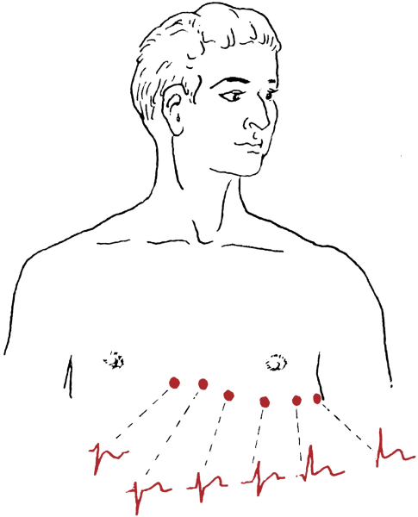
Chest leads

Slide 34
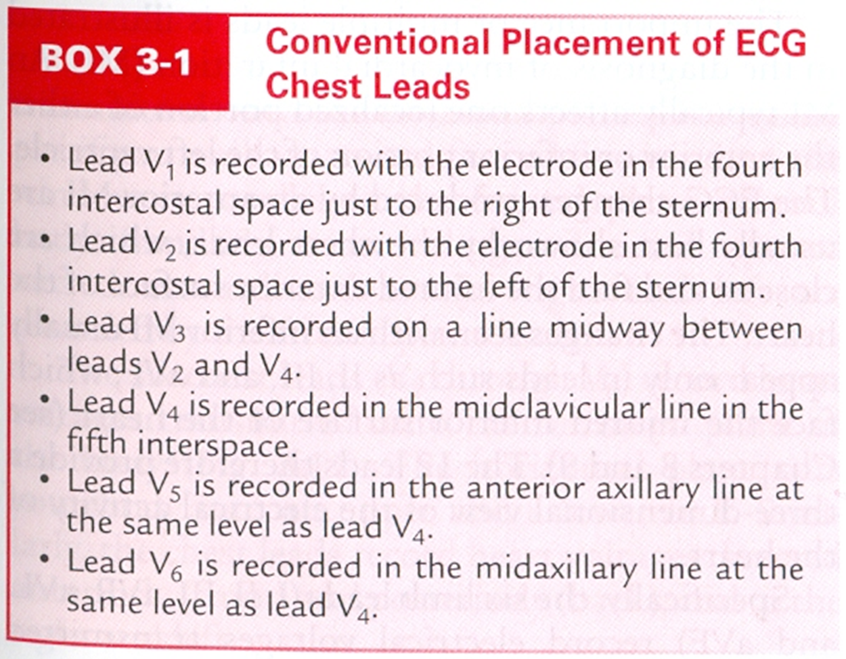

Slide 35
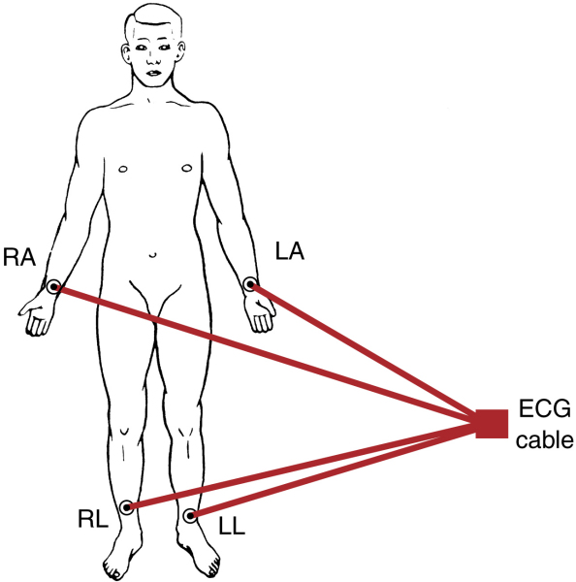
Limb leads

Slide 36
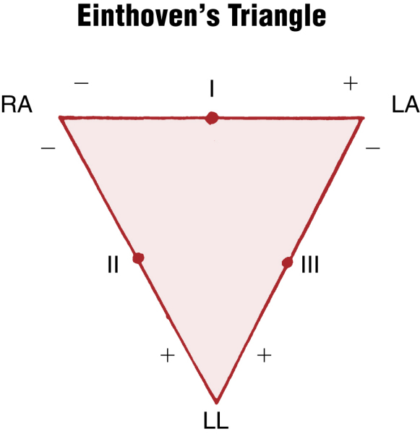

Slide 37
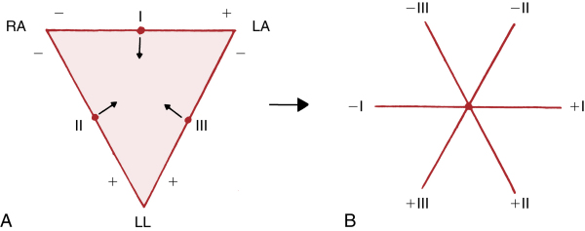

Slide 38
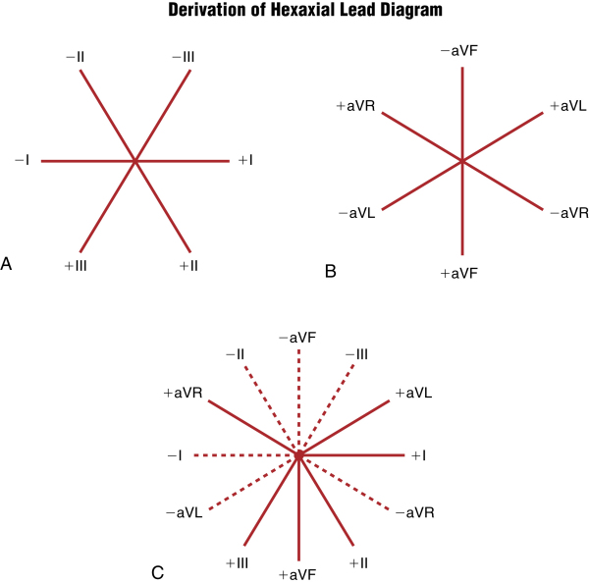

Slide 39
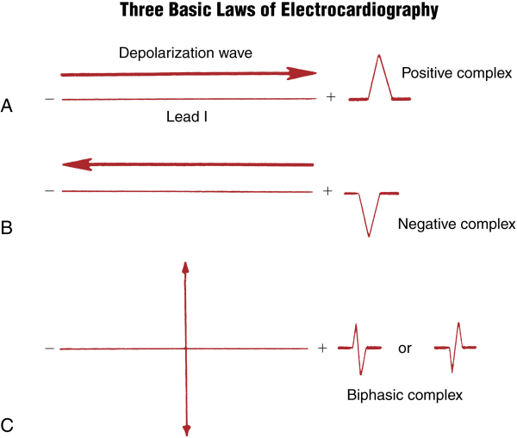

Slide 40
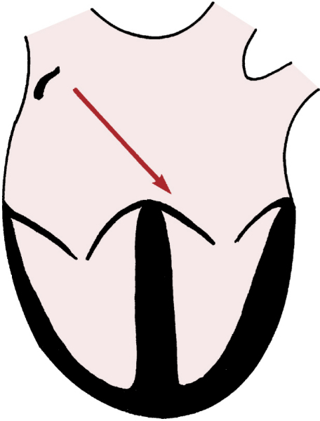

Slide 41
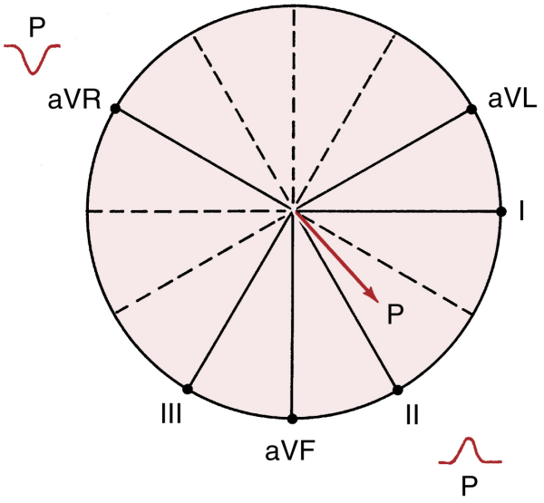
P-wave axis

Slide 42
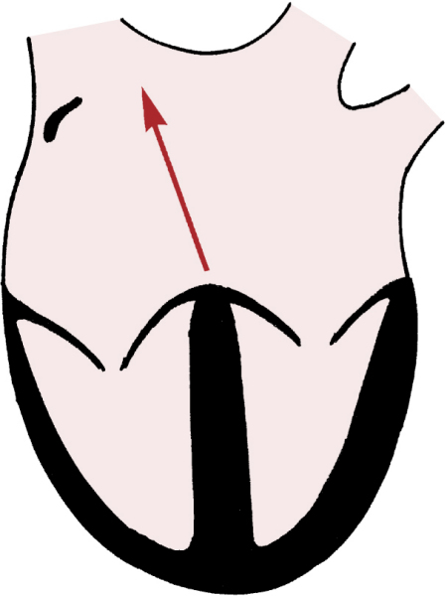

Slide 43
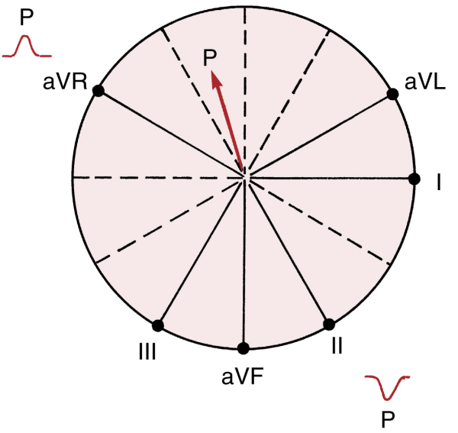

Slide 44
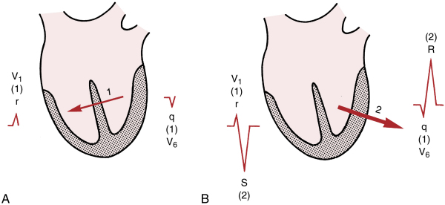
Chest leads

Slide 45
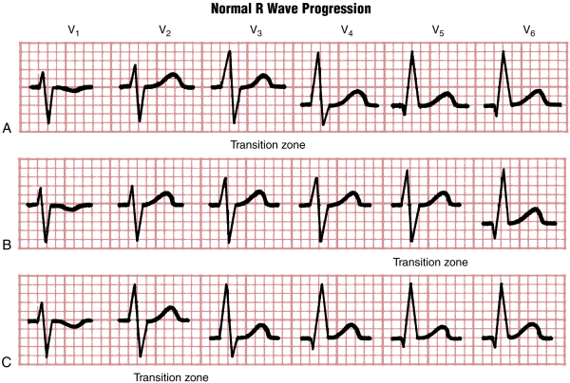
Chest leads

Slide 46
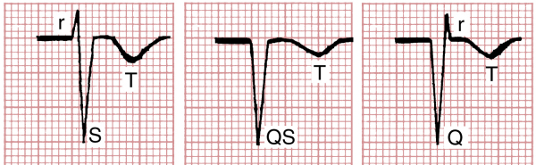
aVR

Slide 47
How to read an EKG

Slide 48
How to read an EKG
Rate
Rhythm
Axis
Waves and intervals

Slide 49
Rate
Normal sinus rate: (60-100).
Tachycardia: >100.
Bradycardia: <60.

Slide 50
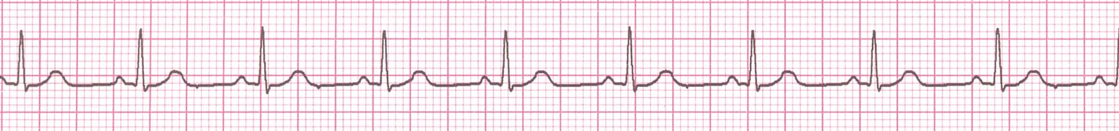
How to Calculate Rate
300/No. of large squares R-R.
1500/No. of small squares R-R.
No. of (R) waves in the strip×6.
300›››150 ›››75 ›››60 ›››55

Slide 51
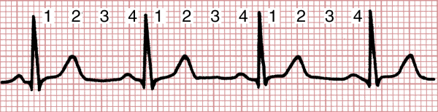
Rate

Slide 52
Heart Rate

Slide 53
Heart Rate

Slide 54

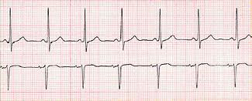
Rhythm
LEDA II: Positive P wave preceding each QRS.
V1: Biphasic P wave.
Lead II
V1

Slide 55
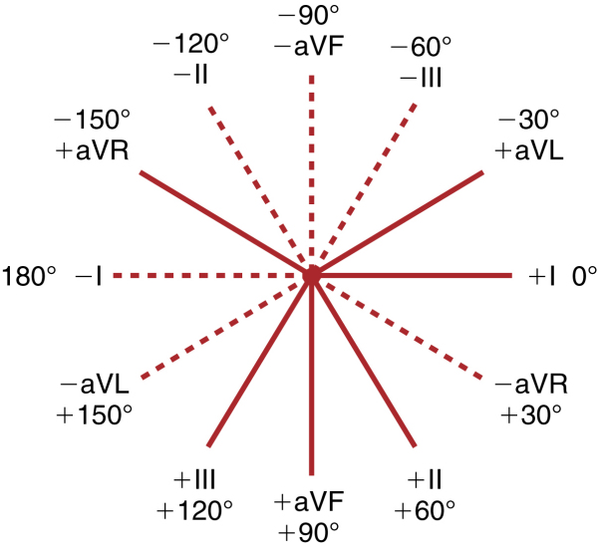
AXIS

Slide 56
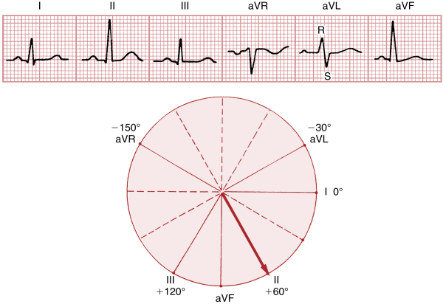
AXIS

Slide 57
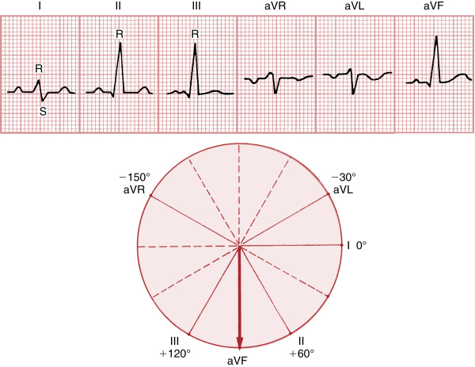
AXIS

Slide 58
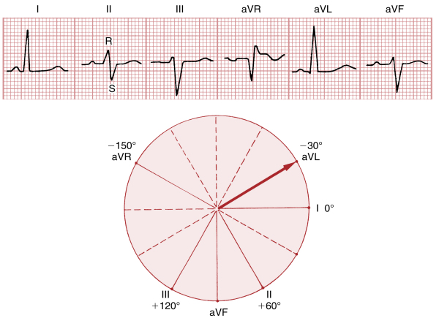
AXIS

Slide 59
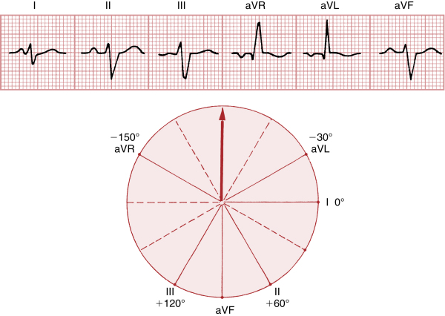
AXIS

Slide 60
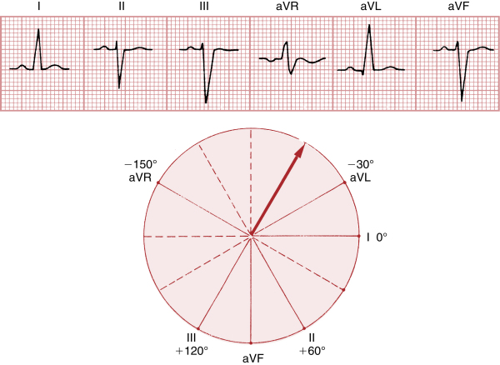
AXIS

Slide 61
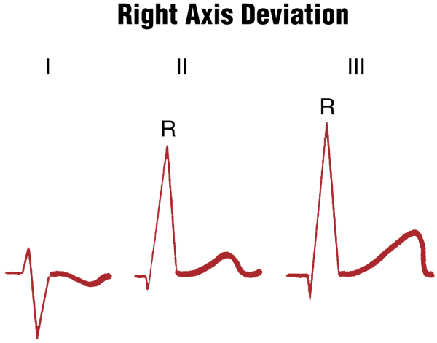
AXIS

Slide 62
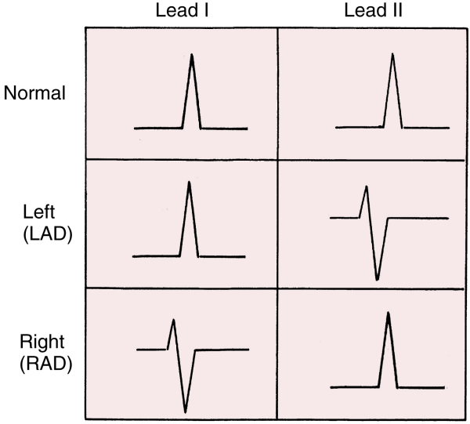
AXIS

Slide 63
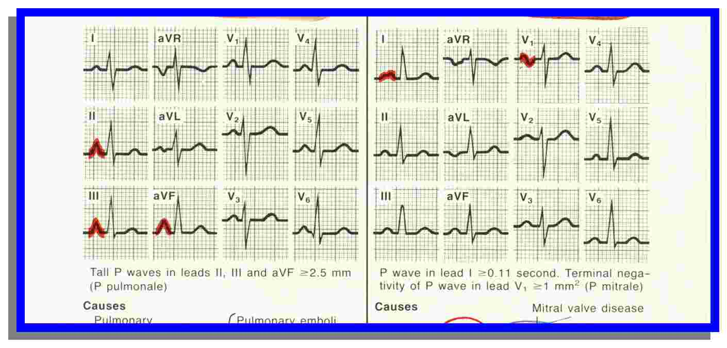
Right Atrial Enlargement

Slide 64
Left Atrial Enlargement

Slide 65
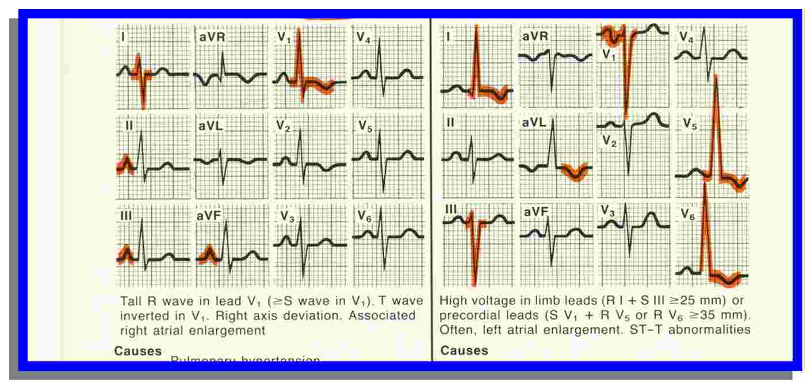
Left Ventricular Hypertrophy
*
*
*
*

Slide 66
Right Ventricular Hypertrophy

Slide 67
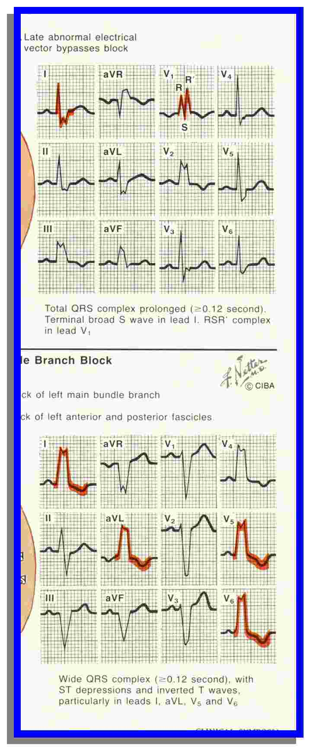
LBBB

Slide 68
RBBB

Slide 69
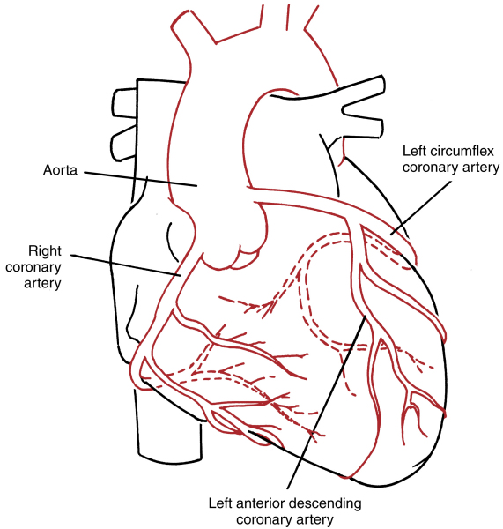

Slide 70

Morphology of STE
Concave shape STE – non AMI causes
AMI causes – usually demonstrate convex/straight STE

Slide 71


Distribution

Slide 72


Slide 73


Slide 74


Slide 75


Slide 77


Slide 78


Slide 79


Slide 80


Slide 81


Slide 83


