Slide 1
How to recognize
critically ill-children
Dr. Fahad Alsohime
PICU Consultant
King Saud University Medical City

Slide 2
LEARNING OUTCOME
Considerations in pediatric emergency
Pediatric assessment
Respiratory distress and failure
Recognition and management of shock

Slide 3
BREATHING CONSIDERATIONS
Respiratory illnesses are common
Cardiac arrests are frequently caused by hypoxia
EFFORT & EFFICACY

Slide 4
CIRCULATION CONSIDERATIONS
Blood Volume in Pediatrics is lower than Adults

Slide 5
FLUID AND ELECTROLYTE BALANCE
Larger body surface ratio
Higher metabolic rate
More susceptible to dehydration and electrolyte losses
- Perspiration e.g. sweat, respiration
- Fever
- GI losses
More susceptible to hypothermia when ill

Slide 6
RAPID ASSESSMENT
Initial visual and auditory assessment
Appearance Muscle tone
Interaction/consolability
Gaze
Speech/cry

Slide 7
PRIMARY ASSESSMENTS
Airway
Breathing
Circulation
During each step of evaluation, watch for any life-threatening abnormality. Treat any abnormality before moving on to the next evaluation

Slide 8
AIRWAY
Look for movement of chest and abdomen
Listen for breath sounds and air movements
Feel the movement of air at the nose and mouth
Clear?
Maintainable?
Not maintainable?

Slide 9
AIRWAY: How to open
Head-tilt-chin-lift

Slide 10
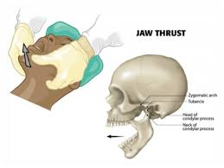
AIRWAY: How to open
Jaw thrust

Slide 11
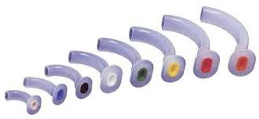
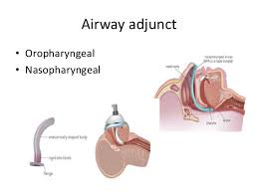
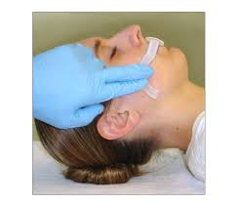
AIRWAY: How to open
Suctioning
Nasopharyngeal airway
Oral airway

Slide 12
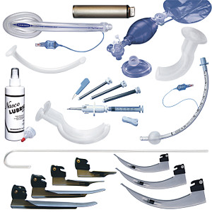
AIRWAY: Advanced measures
(if airway not maintanable)
Bag and mask ventilation
Endotracheal intubation
Cricothyrotomy
CPAP

Slide 13
BREATHING
Respiratory rate
Respiratory effort
Airway and lung sounds
Pulse oximetry
Normal?
Respiratory distress?
Respiratory failure?

Slide 14
NORMAL RESPIRATORY RATE
TACHYPNOEA Breaths per minute | AGE
> 50 | Infant ( < 1 year)
> 40 | Toddler ( 1 to 3 year)
>34 | Preschooler ( 4 to 5 year)
>30 | School age ( 6 to 12 year)
> 16 | Adolescent ( 13 to 18 year)

Slide 15
Breathing : Abnormal Rate
Tachypnoea: Breathing more rapid than normal
RESPIRATORY DISTRESS?
Bradypnoea: Breathing slower than normal
Usually irregular
Impending RESPIRATORY FAILURE
Apnoea: Stop breathing for 20 seconds
With bradycardia, cyanosis or pallor
RESPIRATORY FAILURE

Slide 16
BREATHING: RESPIRATORY EFFORT
Nasal flaring
Chest recessions
Head bobbing
See saw/ Paradoxical breathing
Respiratory distress or failure?

Slide 17
Breathing: Airway and lung sounds
Adequate breath sounds?
Equal?
Abnormal breath sounds?
Stridor } Upper airway obstruction
Wheeze/Rhonchi } Lower airway obstruction
Grunting } Lung tissue disease
Crepitations

Slide 18
CIRCULATION
Cardiovascular function
Skin color and temperature
Heart Rate
Hear Rhythm
Blood pressure
Pulses ( peripheral and central)
Capillary refill time
Adequate?
Shock?

Slide 19
End-organ perfusion
Brain perfusion (mental status
Renal perfusion (urine output)

Slide 20
HEART RATE
Varies (age, activity, clinical condition)
Tachycardia (beats per minute) | AGE
> 160 | < 1 year
> 150 | < 2 years
> 130 | 2 years
> 120 | 4 years
> 115 | 6 years
> 110 | 8 years
> 110 | 10 years

Slide 21
BLOOD PRESSURE
Calculation for Expected Systolic Blood Pressure
50th centile = 85 + (2 x age in years) mmHg
5th centile = 65 + (2 x age in years) mmHg
Hypotension if below this value

Slide 22
PULSES
Central
Peripheral
Weak pulses:
Sign of shock?
Impending arrest

Slide 23
CAPILLARY REFILL TIME (CRT)
Normal CRT <2 sec
Prolonged CRT in shock & hypothermia
In warm septic shock CRT may be normal

Slide 24
SKIN COLOR & TEMPERATURE
Pallor
Mottling
Cyanosis

Slide 25
END- ORGAN FUNCTION
Brain perfusion (mental status)
Altered consciousness/Irritability/Lethargy
Pupillary dilatation
Unconsciousness
Renal perfusion (urine output)
Oliguria

Slide 26
SHOCK
Compensated Uncompensated
Tachycardia
Reduced pulse volume
Prolonged CRT >2 secs
Cold hands & feet
Blood pressure normal
Blood pressure
LATE SIGNS!

Slide 27
SUMMARY
Physiological functions and needs of children differ from adults, hence consider different resuscitation requirements
Structured assessment is mandatory to make thorough conclusion.
Respiratory failure is the commonest cause of cardiorespiratory deterioration in children.
Low blood pressure is a late sign of children in shock

