Slide 1
FAILURE TO THRIVE
IBRAHIM AL AYED
PROFESSOR OF PEDIATRICS
PEDIATRICIAN & GENERAL CONSULTANT

Slide 2
What does a child need to grow ?
Foods
Hormones
LOVE
Good Genes
Good Start
(intrauterine)
absence of disease, infection, &stress

Slide 3
GROWTH GUIDELINES
WEIGHT-
Birth weight is regained by the 14th day.
During the first 3 months, the average gain is about 1 kg/month (about ½ to 1 oz/ day).
Birth weight doubles at about 4 months, triples at 12 months, quadruples at 24 months.
By six month, the average gain per month is 0.5kg.
During the second year, the average gain per month is 0.25 kg.
After age 2, the average annual increment is 2.3 kg
(5 lb) until the adolescent growth spurt.

Slide 4
GROWTH GUIDELINES
HEIGHT –
Average birth length is 50cm (20 in).
By the end of the first year, birth length increases by 50%.
Birth length doubles by 4 years.
Birth length triples by 13 years.
Average annual growth is 5 cm (2 in) or better per year.

Slide 5
GROWTH GUIDELINES
A nice rule of thumb for head circumference is the 3 & 9 rule. A newborn has a head circumference of 35 cm, a 3 month has a circumference of 40 cm, a 9 month has a circumference of 45 cm, a 3 year old has a circumference of 50 cm, and a 9 year old has a circumference of 55 cm.

Slide 6
FTT - definition
FTT could be defined as an:
Infant’s growth deviated from an established pattern of age-appropriate growth.
Regardless of the anthropometric indicator and cut off value selected, accurate interpretation of the growth data is dependent up serial measurements and not one point in time.

Slide 7
Failure to thrive
Most pathological explanations for failure to thrive can be broken up into of the following groups:
Inadequate caloric intake
Inadequate absorption
Increased metabolism
Defective utilization

Slide 8
Failure to thrive
Inadequate caloric intake
Incorrect preparation of formula (too diluted, too concentrated).
Unsuitable feeding habits (food fads, excessive juice)
Behavior problems affecting eating
Poverty and food shortages
Neglect
Disturbed parent-child relationship
Mechanical feeding difficulties (oromotor dysfunction, congenital anomalies, central nervous system damage, severe reflux)

Slide 9
Failure to thrive
Inadequate absorption
Celiac disease
Cystic fibrosis
Cow’s milk protein allergy
Vitamin or mineral deficiencies (acrodermatitis enteropathica, scurvy)
Biliary atresia or liver disease
Necrotizing enterocolitis or short-gut syndrome

Slide 10
Failure to thrive
Increased metabolism
Hyperthyroidism
Chronic Infection (human immunodeficiency virus or other immunodeficiency, malignancy, renal disease).
Hypoxemia (congenital heart defects, chronic lung disease)

Slide 11
Failure to thrive
Defective utilization
Genetic abnormalities (trisomies 21, 18, and 13)
Congenital infections
Metabolic disorders (storage diseases, amino acid disorders).

Slide 12
FTT – Illingworth Clinical Wisdom
Proper measurement of weight and height is an essential part of the supervision of a child’s well-being.
Measurements of the weight and height must be accurate-taking into account, for instance, the common inaccuracy of weighing scales.
Figures for comparison must be valid ones. Secular changes and differences between one country and another must be recognized.
Single measurements are better than nothing, but serial measurements on a centile chart are far more important. Changes in position on the centile chart, especially if there is a slowing of growth velocity, are of the greatest importance.
* The normal child R.S. Illingworth

Slide 13
FTT – Illingworth Clinical Wisdom
Children have different growth rhythms – often a familial feature. Some have slow or rapid periods of growth; some grow slowly at first and then have an unexpected spurt of growth.
The assessment of a child’s growth demands a thorough knowledge of the normal, the normal variations and the reasons for the variations, so that one considers whether action is necessary.
Accurate assessment can only be based on the basis of a careful history and examination, consideration of all the factors which may have affected growth and interpretation of the results.
* The normal child R.S. Illingworth

Slide 14
FTT – Illingworth Clinical Wisdom
Maximum growth is not necessarily the optimum. Far more important than the child’s continued but unchanging variation from the average on the centile chart is his well-being, abundant energy, freedom from infection and freedom from lassitude.
The average is not the same as the normal. Variation from the usual growth is often merely a familial feature, or only reflects the size at birth. What is abnormal for one child is not necessarily abnormal for another. But the greater the variation from the average, the less likely is the child to be ‘normal’.
A child may be very different from the average weight and height of his fellows, and yet be normal.
* The normal child R.S. Illingworth

Slide 15
FTT - History
Generally, children who fail to thrive have nutritional inadequacies.
The history and physical examination initially should focus on these problems, with special attention to feeding disorders and vomiting.
Review of specific dietary practices, formula preparations, and feeding techniques, including caregiver/child interaction, is imperative.

Slide 16
FTT – Labs & Assessment
It is cost-effective and appropriate to limit the laboratory evaluation, but it is reasonable to consider diagnostic studies that have further implications for health, such as sweat chloride determination, blood lead level, or parameters of immune function, or to employ other special testing (eg., tuberculin skin testing or HIV status) in children at risk.
Results of the history may guide the selection of further studies such as stool analysis for malabsorption and oval/parasites, metabolic profiles, and radiographic procedures.
Psychological and development assessment should be undertaken once any acute medical condition has been identified and addressed.

Slide 17
FTT
FTT is best considered a physical sign of undernutrition and not a clinical syndrome caused by “organic” or “nonorganic” factors
Infants and young children may cross major percentile lines on growth curves during a normal course of growth. Therefore, documentation of weights or lengths falling off of growth channels is not, by itself, proof of FTT.

Slide 18
FTT
It is unclear how many children have adverse neurodevelopmental outcomes from FTT.
Extensive laboratory screening is of little utility in the evaluation of FTT.
Certain children who appear to have FTT may be biologically programmed to be smaller and thinner than most children. Insulin resistance may be a mechanism, and aggressive nutritional intervention may put these children at risk of developing metabolic syndrome

Slide 19
Table 1: Classification of Under nutrition
Nutritional States | Wt./Age | Ht. | Wt. Ht.
Acute | ↓ | N | ↓
Chronic | ↓ | ↓ | N
Acute or Chronic | ↓ | ↓ | ↓

Slide 20
AVERAGE GAINS IN WEIGHT AND LENGTH IN THE FIRST FIVE YEARS OF LIFE
Age | Weight | Length
0 – 1 week | 10% loss
1- 2 weeks | Birth weight regain
2 weeks – 5 months | 150 – 200 grams/week
5 months | Birth weight doubled | 1.3 x birth length
5 months – 1 year | Wt. gain velocity declines
1 year | Birth weight trebled | 1.5 x birth length
1 – 2 years | 2 -3 kg/year | 11 – 12 cm./year
2 – 5 years | 2kg/year | Birth length doubled at about age 4.

Slide 21
A staging system for malnutrition
 | Weight for age¹ | Height for age ² (stunting) | Weight for height ³ (wasting)
Normal | > 90% of median | >95% of median | > 90% of median
Mild malnutrition | 75% - 90% | 90% - 95% | 81% - 90%
Moderate malnutrition | 60% - 74% | 85% - 89% | 70%- 80%
Severe malnutrition | <60% | <85% | <70%

Slide 22
What is normal growth?
AGE | Median daily weight gain (grams) | Recommended daily allowance (kcal/kg/d)*
0-3 months | 26-31 | 108
3-6 months | 17-18 | 108
6-9 months | 12-13 | 98
9-12 months | 9 | 98
1-3 years | 7-9 | 102
4-6 years | Approximately 6 | 90
*National Research Council, Food and Nutrition Board; Recommended Daily Allowance.
Washington, DC. National Academy of Sciences, 1989.

Slide 23
Why isn’t this baby growing?
Age on onset | Diagnostic considerations
Before birth (IUGR, prematurity) | Especially in “symmetric” IUGR, consider prenatal infections, congenital syndromes, teratogenic exposures (anticonvulsants, alcohol, etc.).
Neonatal | Incorrect formula preparation; failed breastfeeding; neglect; poor feeding interactions; metabolic chromosomal, or anatomic abnormally (less common).
3-6 months | Underfeeding (possibly associated with poverty); improper formula preparation; milk protein intolerance’ oral-motor dysfunction; celiac disease; HIV infection; cystic fibrosis; congenital heart disease.
7 -12 months | Autonomy struggles; overly fastidious parent; oral-motor dysfunctions; delayed introduction of solids; intolerance of new foods.
After 12 months | Coercive feeding; highly distractible child; distracting environment; acquired illness; new psychosocial stressor (divorce, job loss, new sibling, death in the family, etc.)

Slide 24
Medical causes of inadequate intake that may be overlooked
Infectious: Giardiasis other parasites (e.g., nematodes) Chronic UTI, Chronic sinutis
Mechanical: Adenoid hypertrophy, Dental lesions, Vascular slings, GE reflux with esophagitis
Neurologic: Oral-motor dysfunction (gagging, tactile hypersensitivity).
Toxic/metabolic: Lead toxicity, Iron deficiency, Zinc deficiency
Gastrointestinal: Celiac disease, Malabsorption (various causes), Chronic constipation.

Slide 25
Diagnostic red flags for FFT
History | Diagnostic consideration | Investigation
Spitting, vomiting | Gastroesophageal reflux | Upper GI series, Ph probe, esophagoscopy
Abdominal distension, cramping, diarrhea | Malabsorption (e.g., cystic fibrosis, celiac disease, lactase deficiency) | D-xylose test, stool fat, antigliadin titer or biopsy, swear chloride.
Travel to or from developing country; homeless, overcrowded, or living in shelter | Parasitosis (especially giardia), TB inadequate access to cooking facilities and refrigeration | Stool O & P, duodenal biopsy, string test, PPD
Snoring, periodic breathing during sleep, restless sleep, noisy or mouth breathing | Adenoid hypertrophy | Lateral neck film (soft tissues and airway)
Symptoms of asthma, bronchitis | Chronic aspiration, cystic fibrosis. | Chest film, radionuclide scan for aspiration, sweat chloride*
Polyuria, polydypsia, polyphagia | Diabetes | Blood glucose
Frequent (minor) infections | HIV, other immune deficiency | Serologic tests, immunoglobulins, * PPD with control for anergy*
* May be abnormal secondary to malnutrition

Slide 27
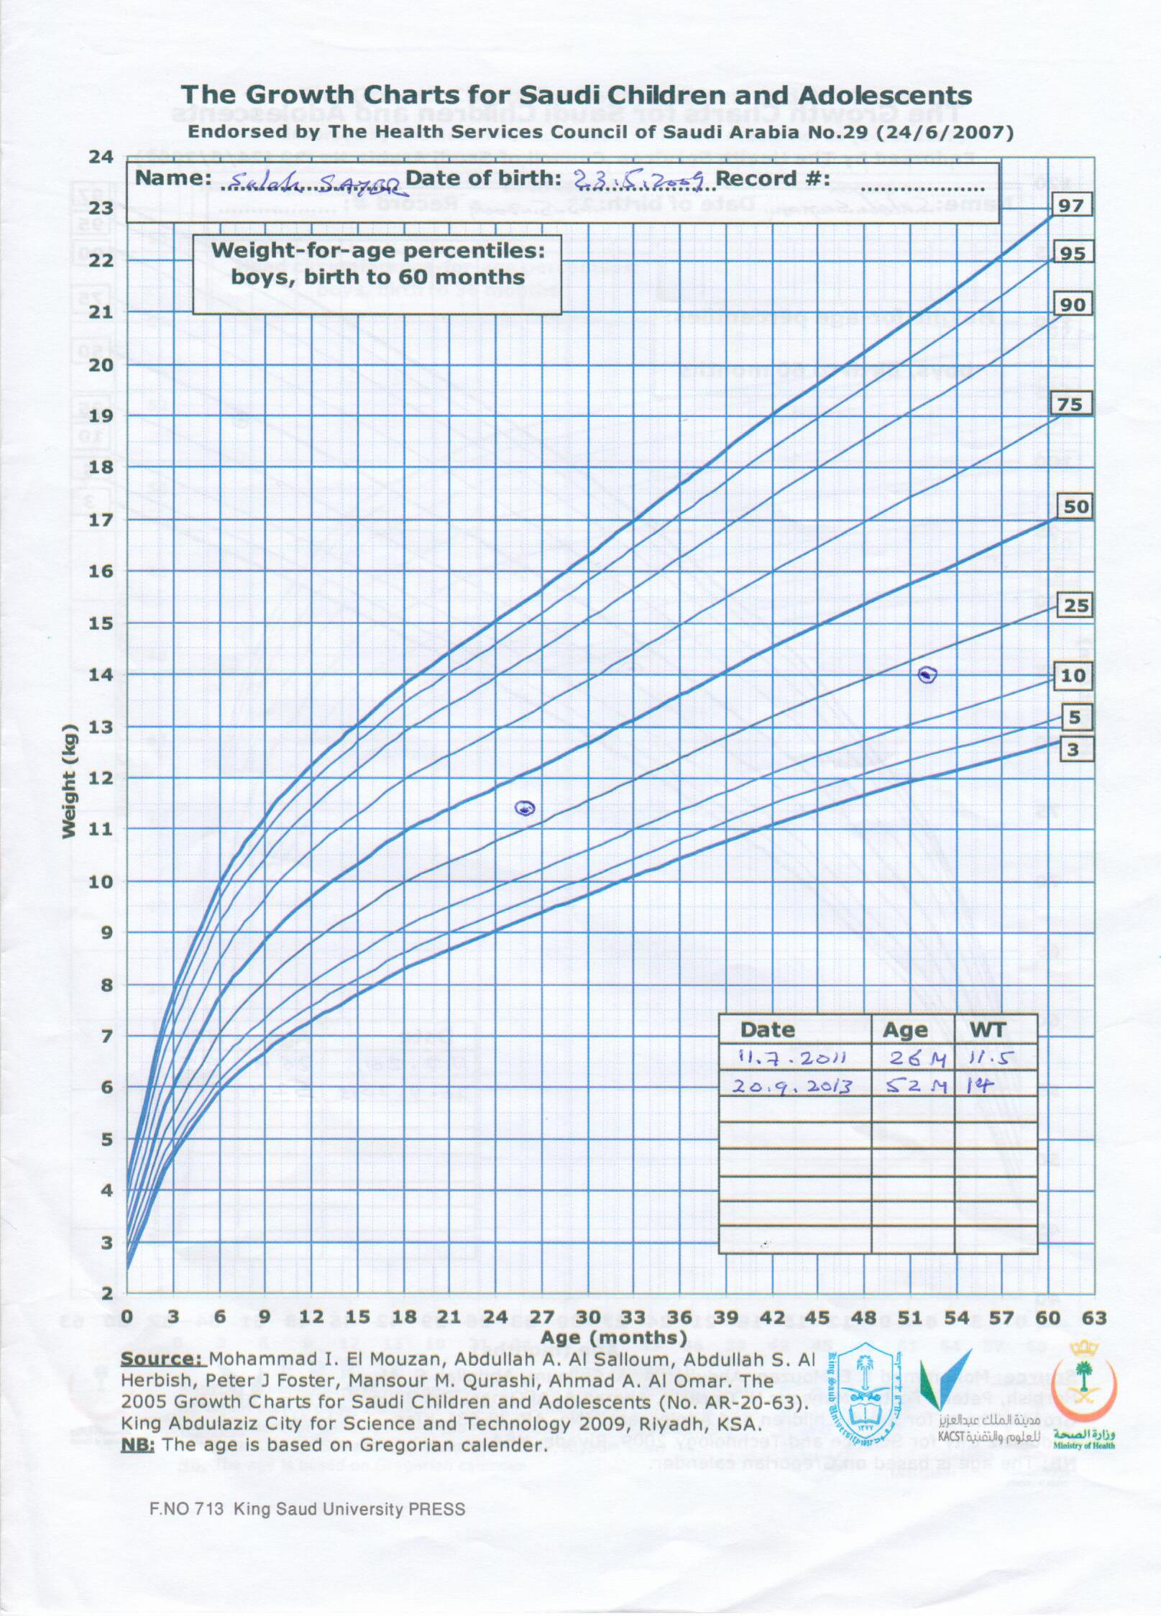

Slide 28
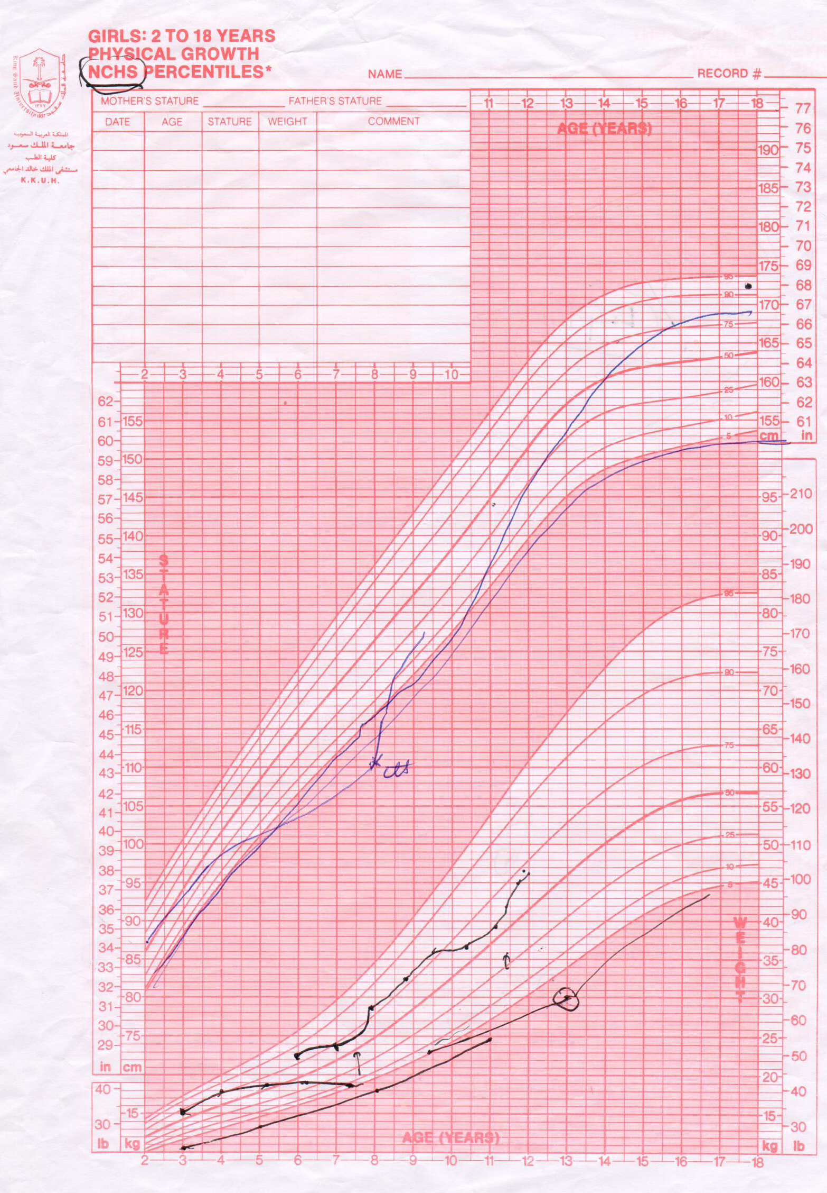

Slide 29
THANK YOU

