Slide 1
Pediatric Seizures
Ali H. Alwadei, MD, FRCPC
KKUH, KSU
25 Sep 2017

Slide 2
OUTLINE
APPROACH
  Key elements in the evaluation of an individual who has seizures
  Main features of febrile seizures
  Key differences between epileptic and nonepileptic seizures
  Secondary (provocative) causes
  Physical exam
BASIC
Definitions
  Seizure
  Convulsion
  Epilepsy
  Epilepsy syndrome
Pathophysiology
Classification
Salient clinical features of the main childhood epilepsy syndromes
Management
  Acute management of seizure and SE.
  Long term management and prophylactic therapy.
  AEDs.
  Common comorbidities in epilepsy syndromes.

Slide 3
OUTLINE
APPROACH
  Key elements in the evaluation of an individual who has seizures
  Main features of febrile seizures
  Key differences between epileptic and nonepileptic seizures
  Secondary (provocative) causes
  Physical exam
BASIC
Definitions
  Seizure
  Convulsion
  Epilepsy
  Epilepsy syndrome
Pathophysiology
Classification
Salient clinical features of the main childhood epilepsy syndromes
Management
  Acute management of seizure and SE.
  Long term management and prophylactic therapy.
  AEDs.
  Common comorbidities in epilepsy syndromes.

Slide 4
OUTLINE
APPROACH
  Key elements in the evaluation of an individual who has seizures
  Main features of febrile seizures
  Key differences between epileptic and nonepileptic seizures
  Secondary (provocative) causes
  Physical exam
BASIC
Definitions
  Seizure
  Convulsion
  Epilepsy
  Epilepsy syndrome
Pathophysiology
Classification
Salient clinical features of the main childhood epilepsy syndromes
Management
  Acute management of seizure and SE.
  Long term management and prophylactic therapy.
  AEDs.
  Common comorbidities in epilepsy syndromes.

Slide 6
OUTLINE
APPROACH
  Key elements in the evaluation of an individual who has seizures
  Main features of febrile seizures
  Key differences between epileptic and nonepileptic seizures
  Secondary (provocative) causes
  Physical exam
BASIC
Definitions
  Seizure
  Convulsion
  Epilepsy
  Epilepsy syndrome
Pathophysiology
Classification
Salient clinical features of the main childhood epilepsy syndromes
Management
  Acute management of seizure and SE.
  Long term management and prophylactic therapy.
  AEDs.
  Common comorbidities in epilepsy syndromes.

Slide 7
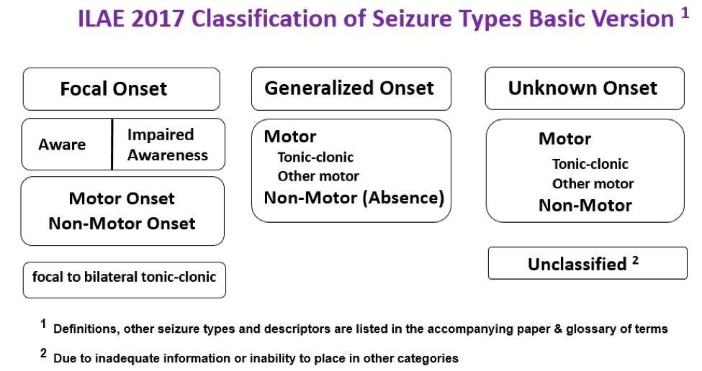

Slide 8
OUTLINE
APPROACH
  Key elements in the evaluation of an individual who has seizures
  Main features of febrile seizures
  Key differences between epileptic and nonepileptic seizures
  Secondary (provocative) causes
  Physical exam
BASIC
Definitions
  Seizure
  Convulsion
  Epilepsy
  Epilepsy syndrome
Pathophysiology
Classification
Salient clinical features of the main childhood epilepsy syndromes
Management
  Acute management of seizure and SE.
  Long term management and prophylactic therapy.
  AEDs.
  Common comorbidities in epilepsy syndromes.

Slide 9
Epilepsy Syndrome
Refers to ‘‘a complex of symptoms and signs that define a unique epileptic condition.’’
Denotes specific constellations of
clinical seizure type(s)
EEG findings
Other characteristic clinical features, such as
  Age at onset
  Course of epilepsy
  Associated neurologic and neuropsychological findings
  Underlying pathophysiologic or genetic mechanisms.

Slide 10
Popular pediatric epilepsy syndromes
Neonatal
BNFS
BNIS
Ohtahara
EME
Infantile
BIFE
IS (WS)
Dravet
Doose
Childhood
BECTS
CAE
LKS
LGS
Juvenile
JAE
JME
RE
ADNFLE

Slide 11
https://www.youtube.com/watch?v=obbg1BFt26Q

Slide 12
https://www.youtube.com/watch?v=b7DRAv-lY24

Slide 13
OUTLINE
APPROACH
  Key elements in the evaluation of an individual who has seizures
  Main features of febrile seizures
  Key differences between epileptic and nonepileptic seizures
  Secondary (provocative) causes
  Physical exam
BASIC
Definitions
  Seizure
  Convulsion
  Epilepsy
  Epilepsy syndrome
Pathophysiology
Classification
Salient clinical features of the main childhood epilepsy syndromes
Management
  Acute management of seizure and SE.
  Long term management and prophylactic therapy.
  AEDs.
  Common comorbidities in epilepsy syndromes.

Slide 14
OUTLINE
APPROACH
  Key elements in the evaluation of an individual who has seizures
  Main features of febrile seizures
  Key differences between epileptic and nonepileptic seizures
  Secondary (provocative) causes
  Physical exam
BASIC
Definitions
  Seizure
  Convulsion
  Epilepsy
  Epilepsy syndrome
Pathophysiology
Classification
Salient clinical features of the main childhood epilepsy syndromes
Management
  Acute management of seizure and SE.
  Long term management and prophylactic therapy.
  AEDs.
  Common comorbidities in epilepsy syndromes.

Slide 15
OUTLINE
APPROACH
  Key elements in the evaluation of an individual who has seizures
  Main features of febrile seizures
  Key differences between epileptic and nonepileptic seizures
  Secondary (provocative) causes
  Physical exam
BASIC
Definitions
  Seizure
  Convulsion
  Epilepsy
  Epilepsy syndrome
Pathophysiology
Classification
Salient clinical features of the main childhood epilepsy syndromes
Management
  Acute management of seizure and SE.
  Long term management and prophylactic therapy.
  AEDs.
  Common comorbidities in epilepsy syndromes.

Slide 16
OUTLINE
APPROACH
  Key elements in the evaluation of an individual who has seizures
  Main features of febrile seizures
  Key differences between epileptic and nonepileptic seizures
  Secondary (provocative) causes
  Physical exam
BASIC
Definitions
  Seizure
  Convulsion
  Epilepsy
  Epilepsy syndrome
Pathophysiology
Classification
Salient clinical features of the main childhood epilepsy syndromes
Management
  Acute management of seizure and SE.
  Long term management and prophylactic therapy.
  AEDs.
  Common comorbidities in epilepsy syndromes.

Slide 17
OUTLINE
APPROACH
  Key elements in the evaluation of an individual who has seizures
  Main features of febrile seizures
  Key differences between epileptic and nonepileptic seizures
  Secondary (provocative) causes
  Physical exam
BASIC
Definitions
  Seizure
  Convulsion
  Epilepsy
  Epilepsy syndrome
Pathophysiology
Classification
Salient clinical features of the main childhood epilepsy syndromes
Management
  Acute management of seizure and SE.
  Long term management and prophylactic therapy.
  AEDs.
  Common comorbidities in epilepsy syndromes.

Slide 18
ABCD

Slide 19
Child is still seizing

Slide 20
General Approach to Epilepsies
Stabilize (ABCD) → Hx → Ex → W/up
Aim to confirm seizure activity rather than seizure mimicker then try to further classify:
  Clinical classification: focal onset vs bilateral
  Etiologic class, more difficult
  Syndrome if possible. Much more difficult by history alone.

Slide 21
General Approach to Epilepsies
Identification of a specific syndrome is important to define the best treatment and accurately prognosticate long-term outcome.
Most syndromes recognized in epilepsy are genetic and developmental disorders that begin in the pediatric years.

Slide 22
Hx
Age and sex. Handedness.
FHx: if +ve ? genetic versus metabolic. Maybe autoimmune.
Social Hx: ? Sz mimicker. Occupation.
Perinatal Hx: e.g. HIE
Developmental: helpful.
Vaccination and relation to Sz onset
PMHx: may help in Dx and also in Rx plan (selection of AED).
Meds (current and previous)
Allergies

Slide 23
Age at onset
Age dependent onset implies many complicated interactions between genes and environment

Slide 24
HPI
  Age at 1st Sz ( onset)
  Aura and triggers (crying or head trauma).
  Relation to sleep
  Sz onset and types (semiology) Focal vs Generalized.
  Sz Frequency
  Sz Duration
  Eyes open versus closed
  Cyanosis
  Urinary/Fecal incontinence
  Tongue Biting
  Post-Ictal
  R/O Sz imitators ( see DDx)
  Previous work up

Slide 25
Psychic Aura

Slide 26
DDx
VITAMINES

Slide 27
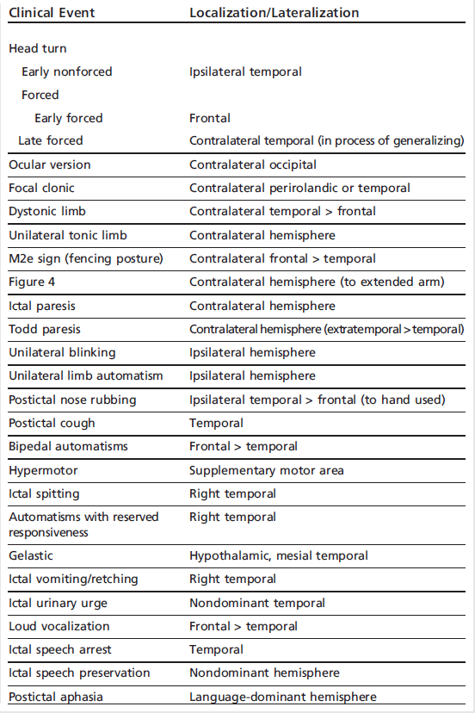
Localization and Lateralization of Ictal Seizure
Semiology

Slide 28
Exam
Full neuro exam including:
  Head C.
  Neuro-Cutaneous Stigmata
May help localize
Usually not helpful in epilepsy

Slide 29
W/up
EEG ( sensitivity, SD, prolonged)
blood and urine:
  SMA10
  S. glucose
  Metabolic: LFTs, ammonia, lactate, urine AASA, HCO3, biotinidase,
  Chromosomal analysis. CGH micro-array
  Toxic screening
  WES/WGS
CSF: Glucose ratio, Glycine ratio, AA. La, Pyr, NTs, Folate metabolites, etc
MRI: 3-Tesla magnet. With MRS.

Slide 30
NL EEG variants

Slide 31
MRI
Performing an MRI is important particularly when focal epilepsies are suspected.
MRI has been shown to be superior to CT as the overall resolution for potential epileptogenic lesion detection is superior.
many patients with epilepsy do not have identifiable lesions on MRI

Slide 32
Common examples include:
  mesial temporal sclerosis (MTS)
  primary brain neoplasms
  remote trauma
  stroke
  developmental abnormalities

Slide 33
DDx

Slide 34
Events Favoring Epileptic Sz

Slide 35
Events Favoring PNES

Slide 36
DDx

Slide 37
OUTLINE
APPROACH
  Key elements in the evaluation of an individual who has seizures
  Main features of febrile seizures
  Key differences between epileptic and nonepileptic seizures
  Secondary (provocative) causes
  Physical exam
BASIC
Definitions
  Seizure
  Convulsion
  Epilepsy
  Epilepsy syndrome
Pathophysiology
Classification
Salient clinical features of the main childhood epilepsy syndromes
Management
  Acute management of seizure and SE.
  Long term management and prophylactic therapy.
  AEDs.
  Common comorbidities in epilepsy syndromes.

Slide 38
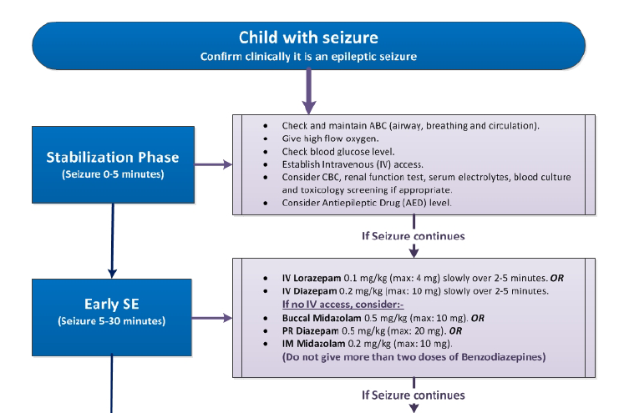

Slide 39
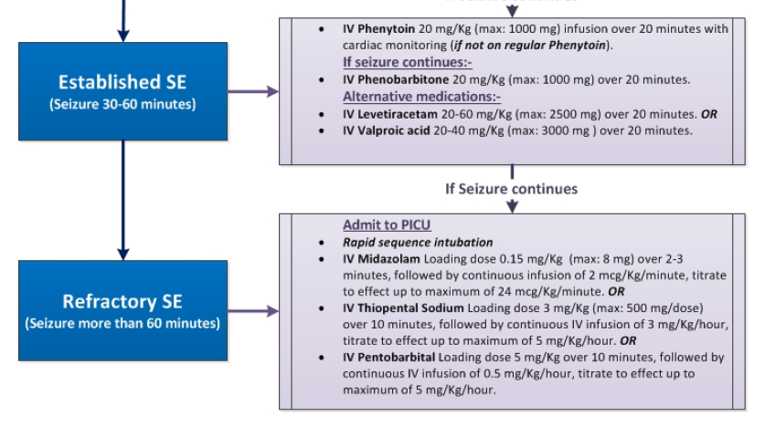

Slide 40
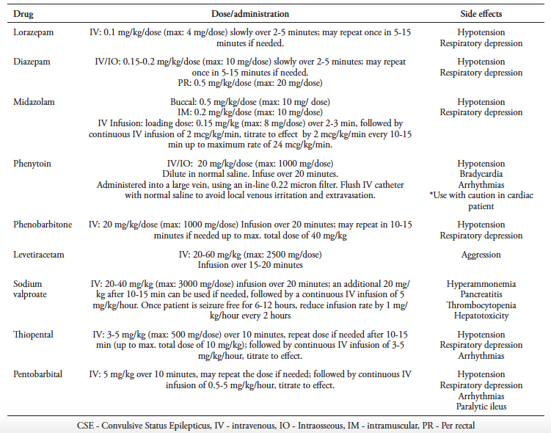

Slide 41
OUTLINE
APPROACH
  Key elements in the evaluation of an individual who has seizures
  Main features of febrile seizures
  Key differences between epileptic and nonepileptic seizures
  Secondary (provocative) causes
  Physical exam
BASIC
Definitions
  Seizure
  Convulsion
  Epilepsy
  Epilepsy syndrome
Pathophysiology
Classification
Salient clinical features of the main childhood epilepsy syndromes
Management
  Acute management of seizure and SE.
  Long term management and prophylactic therapy.
  AEDs.
  Common comorbidities in epilepsy syndromes.

Slide 42
OUTLINE
APPROACH
  Key elements in the evaluation of an individual who has seizures
  Main features of febrile seizures
  Key differences between epileptic and nonepileptic seizures
  Secondary (provocative) causes
  Physical exam
BASIC
Definitions
  Seizure
  Convulsion
  Epilepsy
  Epilepsy syndrome
Pathophysiology
Classification
Salient clinical features of the main childhood epilepsy syndromes
Management
  Acute management of seizure and SE.
  Long term management and prophylactic therapy.
  AEDs.
  Common comorbidities in epilepsy syndromes.

Slide 43
OUTLINE
APPROACH
  Key elements in the evaluation of an individual who has seizures
  Main features of febrile seizures
  Key differences between epileptic and nonepileptic seizures
  Secondary (provocative) causes
  Physical exam
BASIC
Definitions
  Seizure
  Convulsion
  Epilepsy
  Epilepsy syndrome
Pathophysiology
Classification
Salient clinical features of the main childhood epilepsy syndromes
Management
  Acute management of seizure and SE.
  Long term management and prophylactic therapy.
  AEDs.
  Common comorbidities in epilepsy syndromes.

