Slide 1
Tips in Patient History and Physical Examination
Prof. Abdullah S. Al-Jarallah, MD.
Consultant Pediatric Cardiologist
KFCC, KSU-Riyadh

Slide 2
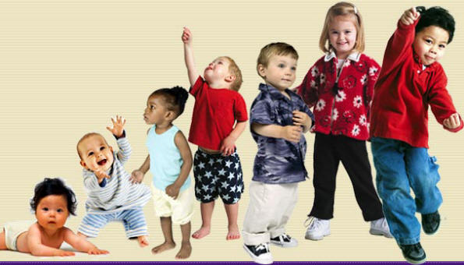

Slide 3
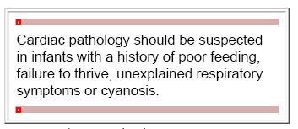

Slide 4
History
Demographic Data:
Name: Hosp No:
Age: DOB:
Sex:
Referring Hosp or clinic:
Care giver:
Complaint:
Detailed chronological events
Systemic review

Slide 5
History (cont)
Past medical history
Prenatal:
Infection? radiation drugs antenatal care and ultrasound
Natal:
Where? When? apgar score
Post-natal:
when discharged home? why? first visit when? and who?

Slide 6
History (cont)
Previous admissions and illnesses
Medications:
Cardiac non-cardiac
who give it
Allergies
Drugs environment
Immunization:
Nutrition:

Slide 7
History (cont)
Growth and development:
Social history:
Income transport home situation
help to mom
School
Family history:
Pedigree similar case Cardiac diseases
Impact on the family

Slide 8
Examination
General appearance:
higher functions
distress cyanosis pallor clubbing dysmorphic features activity monitors lines
reaction parents attitude....
Growth chart:

Slide 9
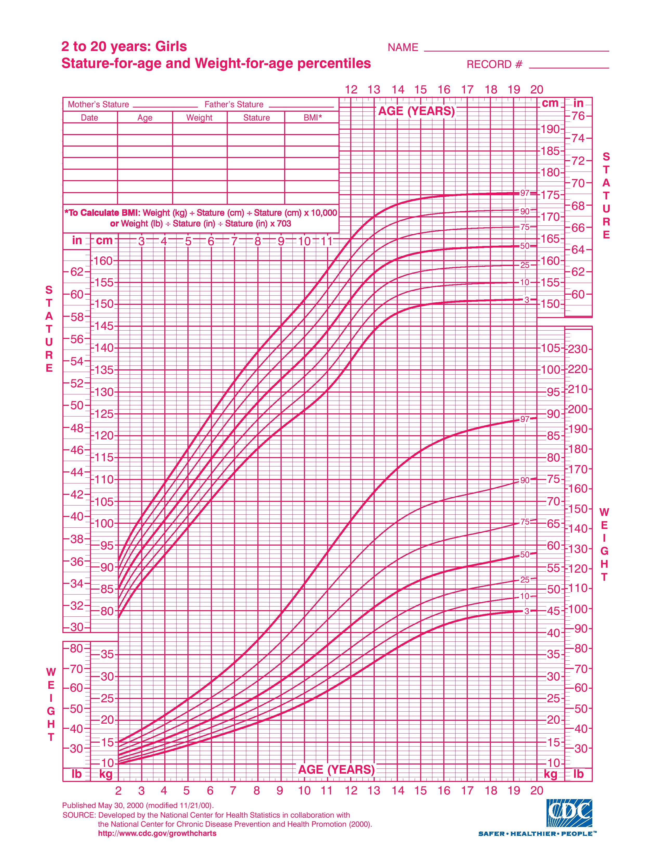
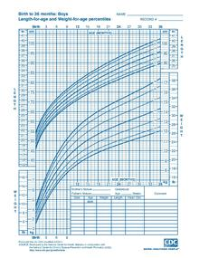

Slide 10
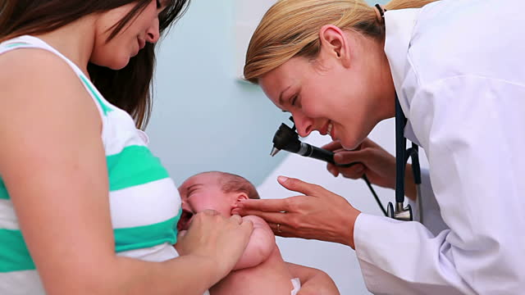

Slide 11
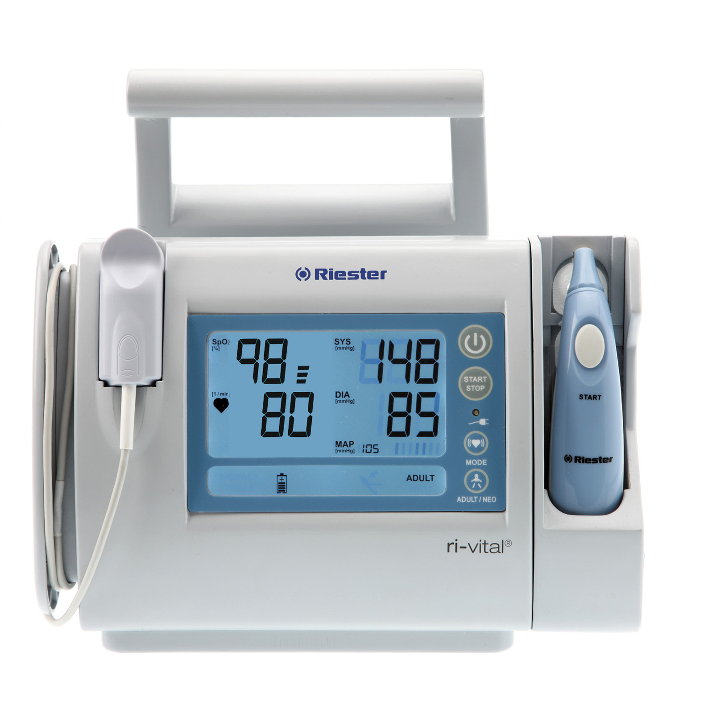
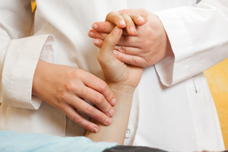
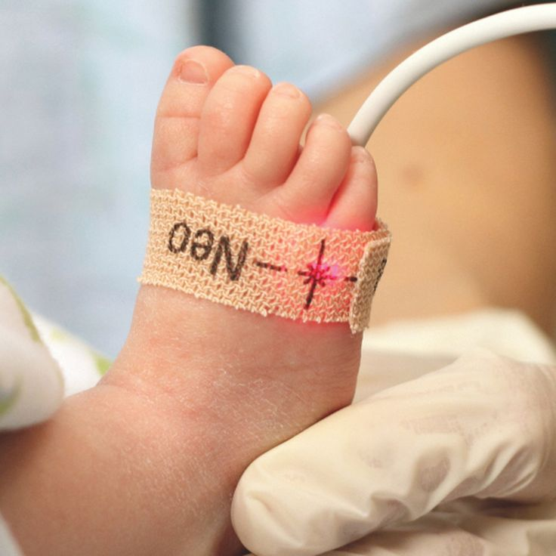
Examination (cont)
Vital signs:
Pulse all four limbs:
Blood pressure all four limbs:
Pulse Oxymetry:

Slide 12
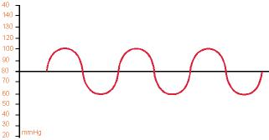
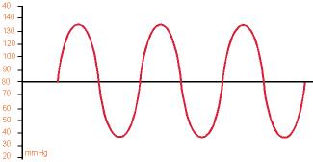
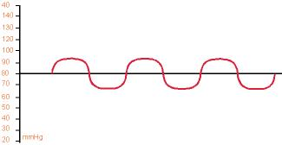
Pulses: Pulses are the result of difference between systolic and diastolic status of the vasculature. Increase in the difference between systole and diastole results in a more pronounced pulse.

Slide 13
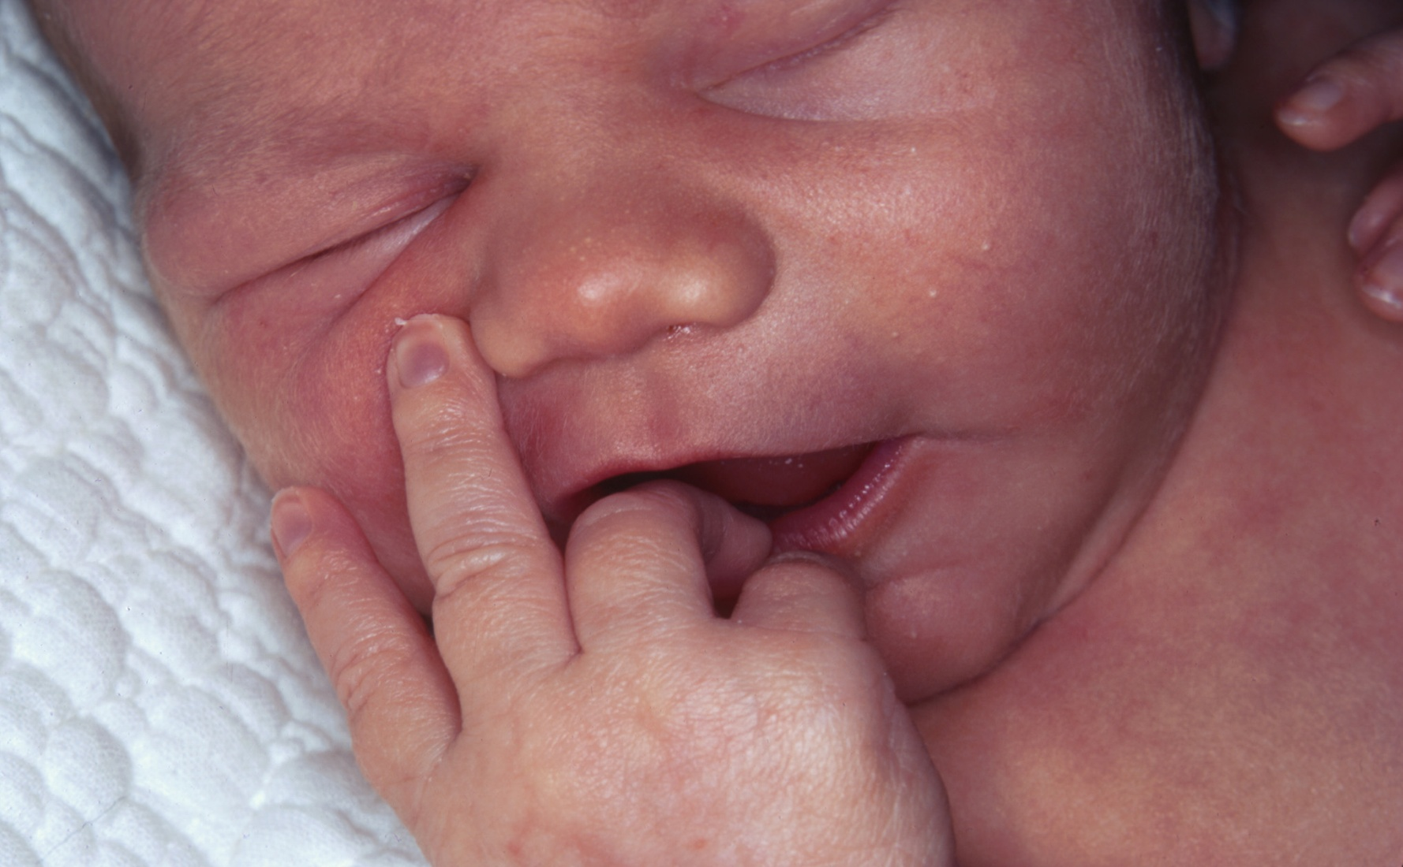
Cyanosis: This is best determined by examining the patient in sunlight. Artificial light may alter patient color.

Slide 14
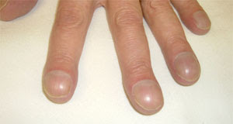
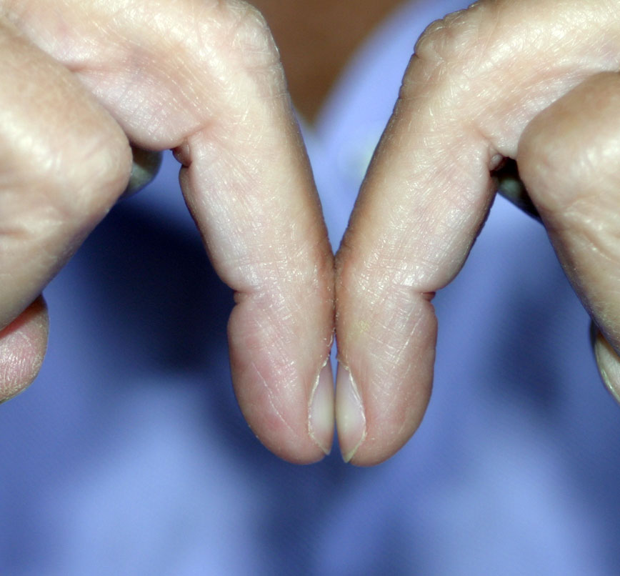
Clubbing: This is enlargement of the tips of digits caused by hypoxia to peripheral tissue due to poor cardiac output and/or cyanosis. Peripheral tissue compensate by forming more capillaries to improve oxygenation, this results in swelling of the peripheries of digits.

Slide 15
Formulas and General Rules Children over 1 year old
Rough Approximations
Pulse or Heart Rate HR
Infant Pulse: 160
Preschool Pulse: 120
Adolescent Pulse: 100
Systolic Blood Pressure (SBP
Infant SBP: 80
Preschool SBP: 90
Adolescent SBP: 100
Respiratory Rate RR
Infant RR: 40
Preschool RR: 30
Adolescent RR: 20

Slide 16
Formulas and General Rules Children over 1 year old
Formulas (Systolic Blood Pressure)
)Median SBP = 90 mmHg + (2 x Age in years)
Minimum SBP = 70 mmHg + (2 x Age in years)

Slide 18
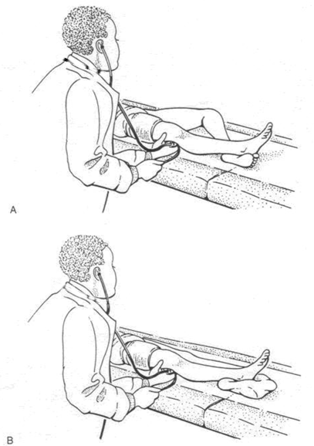

Slide 19
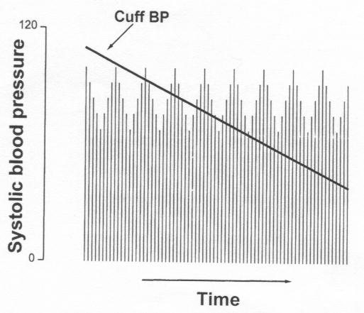

Slide 21
Examination (cont)
Cardiovascular:
Inspection:
Palpation:
Percussion?
auscultation
1st and 2nd heart sounds
3rd (gallop) and 4th
murmur: site, phase, duration, radiation, intensity, grade
clicks
bruit: liver, renal, brain

Slide 22
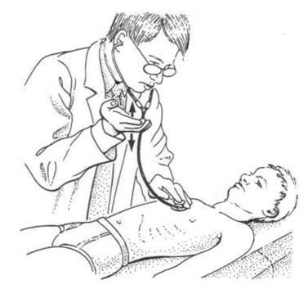

Slide 23
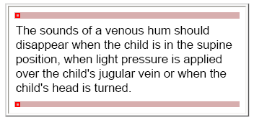

Slide 24
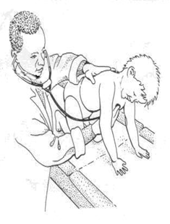

Slide 25
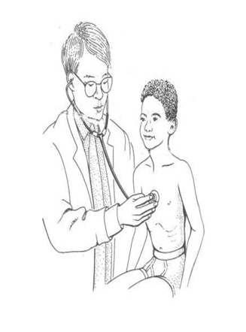

Slide 26
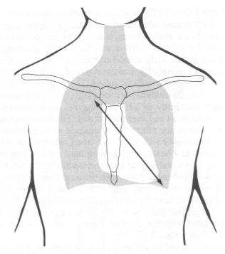

Slide 27
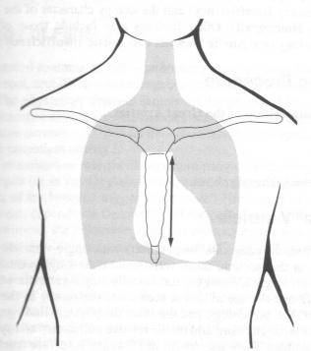

Slide 28
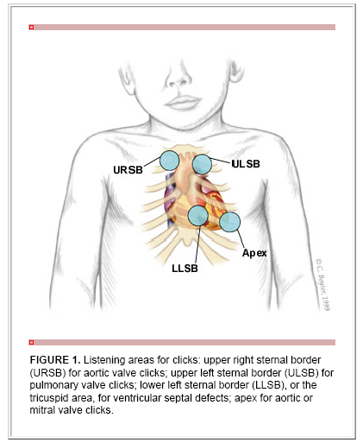

Slide 30
Maneuvers with auscultation
Supine, sitting and standing:
Increase pre-load in supine.........exaggerating flow murmurs
Valsalva maneuver:
Increase intensity of MVP
Decrease intensity of innocent heart murmurs
Respiratory cycle
Inspiration......increase blood flow to right heart
Expiration........increase blood flow to left heart

Slide 31
Epidemiology
Overall Murmur Prevalence:
50% of all children
Innocent murmurs more common than pathologic 10:1
Age of murmur onset related to pathology
Murmur onset at 24 hours of life: 8% pathologic
Murmur onset at 6 months of life: 14% pathologic
Murmur onset at 12 months of life: 2% pathologic

Slide 32
Etiologies: Innocent Murmurs
Still's Murmur ( Aortic Vibratory Systolic)
Most common innocent murmur
Venous Hum of late infancy and early childhood
Second most common innocent murmur
Septal hypertrophy due to myocardial fat deposition
Resolves over six months
Pulmonary Flow Murmur
Neonatal Pulmonary branch murmur
Physiologic PPS
Supraclaviculr murmur

Slide 33
Still's Murmur
First described by Dr. George Still (1909)
Epidemiology
Common in children ages 2 to 8 years old
Signs
Low to medium frequency, mid-Systolic Murmur
Intensity: Grade II-III of VI (variable)
Location: near apex
Character
Vibratory, harmonic, musical, twanging, groaning
Provocative conditions and positions (increased murmur)
Supine position
Fever
Anemia
Differential Diagnosis
Ventricular Septal Defect
Left ventricular outflow obstruction
Hypertrophic Cardiomyopathy
Course
Innocent murmur

Slide 34
Etiologies: Pathologic Murmurs
Ventricular Septal Defect (VSD) 38%
Atrial Septal Defect (ASD) 18%
Pulmonary Valve Stenosis 13%
Pulmonary Artery Stenosis 7%
Aortic Valve Stenosis 4%
Patent Ductus Arteriosus (PDA) 4%
Mitral Valve Prolapse 4%
Others 4%

Slide 35
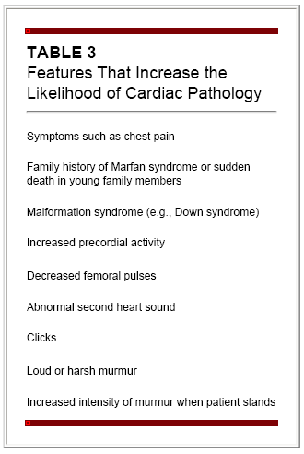

Slide 36
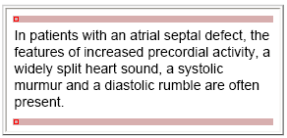
Example:

Slide 37
Examination (cont)
The back
Deformities thrill murmur
Neck:
JVP , visible pulsation and thrill,
web neck short
Liver and spleen:
Respiratory:
Air entry asymmetry wheezes
basal crepetations

Slide 38
Examination (cont)
Abdomen:
masses scars ..etc
Skin:
rashes neurofibromatosis heamangiomas depigmentations ..etc
CNS:
Cranial nerves
motor sensory
cerebellar function

Slide 39
Examination (cont)
Muscle-skeletal:
Muscular dystrophy Joints deformity swellings pains
HEENT:
microcephaly, shunts....
Eyes: squint, cataract...
Ears: deafness, deformities, tags throat obstruction, adenoids, tracheostomy

Slide 40
Provisional Diagnosis
after history 1,2,3...
limit it after examination to 1,2,3
Your differential diagnosis:
1-…………………..
2-…………………..
3-…………………..

Slide 41
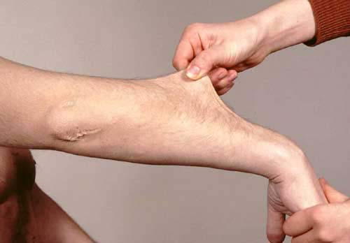
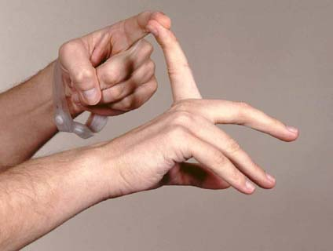
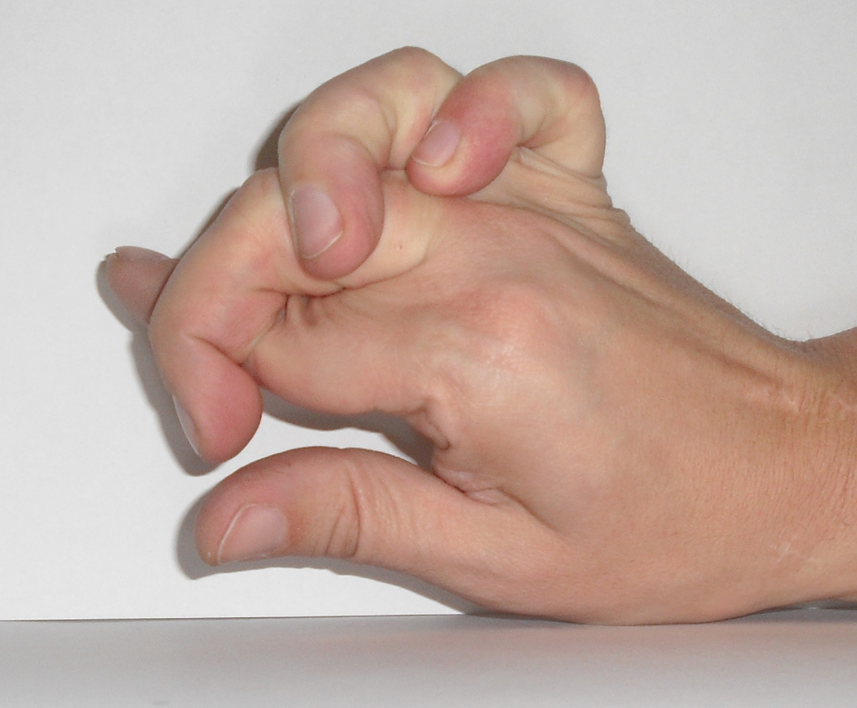
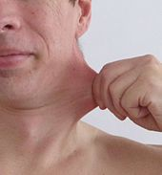
Ehlar danlos

Slide 42
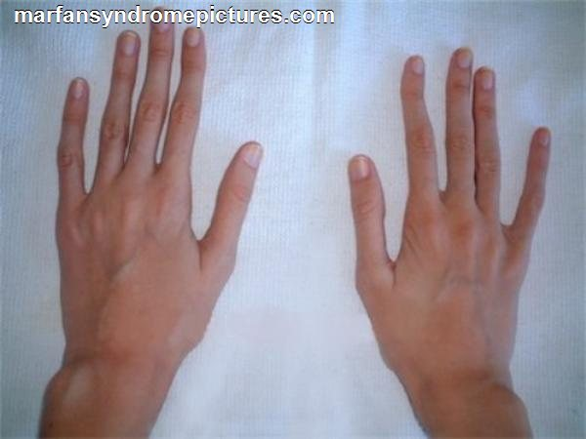
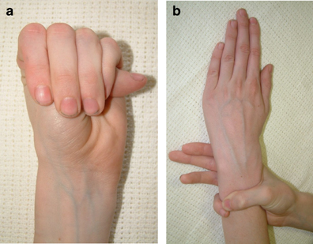
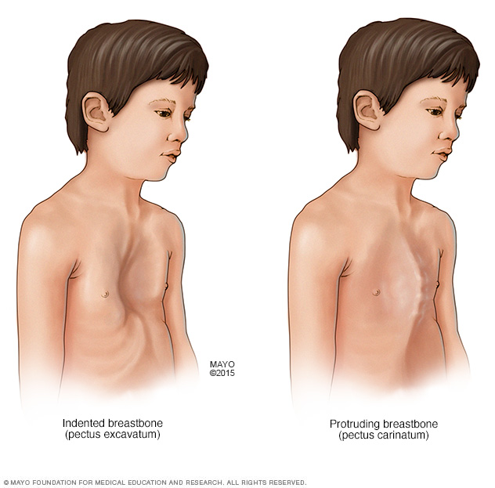
Marfan

Slide 43
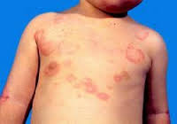
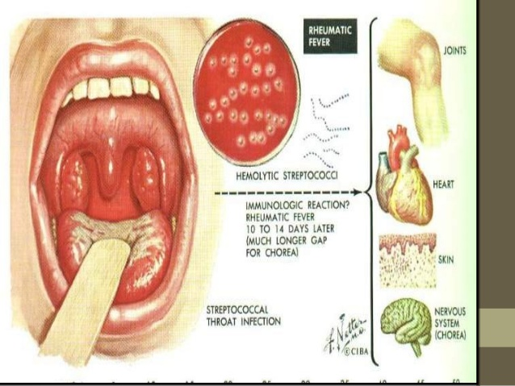
RH Fever

Slide 44
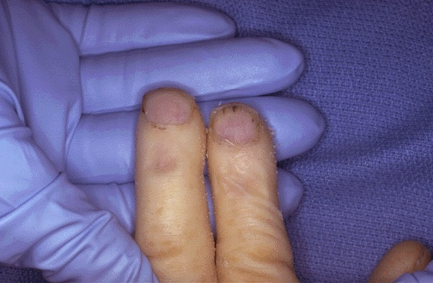

Slide 45
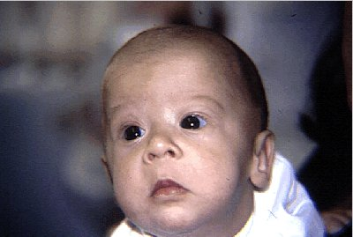

Slide 46
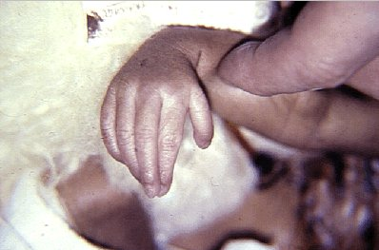
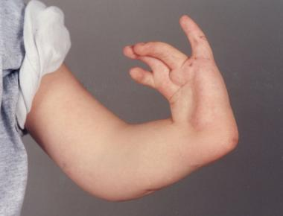
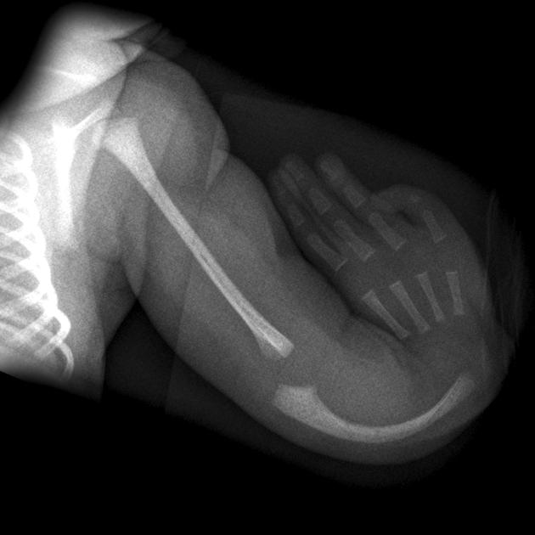
Holt Oram

Slide 47
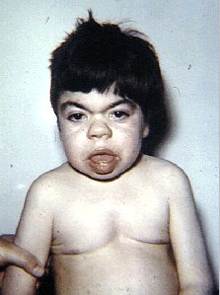
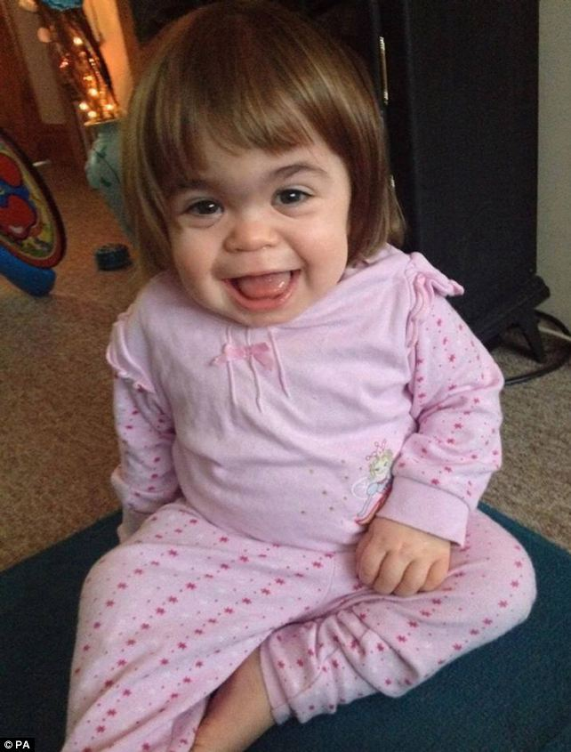
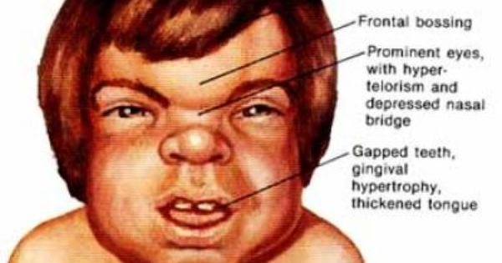
MPS (Hurler's)

Slide 48
Investigation
Plan what investigation will help you:
ECG,
CXR,
ECHO,
CATH
Others.
Explain to the child and his family what is going on

Slide 49
