Slide 1
Chromosomal disorders
Farouq Ababneh, MD
Geneticist

Slide 2
Human being begins life as a fertilized ovum ( zygote), a diploid cell from which all the cells of the body [estimated at about 100 trillion (100 x10¹² )] in number are derived by a series of dozens or even hundreds of mitoses.
Mitosis is obviously crucial for growth and differentiation, but it takes up only a small part of the life cycle of a cell.
The period between two successive mitoses is called interphase, the state in which most of the life of a cell is spent.
In fact, some cell types, such as neurons and red blood cells, do not divide at all once they are fully differentiated

Slide 4
A simplified representation of the essential steps in meiosis, consisting of one round of DNA replication followed by two rounds of chromosome segregation, meiosis I and meiosis II.

Slide 7
Spermatogenesis
Sperm are formed in the seminiferous tubules of the testes after sexual maturity is reached.
The tubules are lined with
spermatogonia, which are in different stages of differentiation. These cells have developed from the primordial germ cells by a long series of mitoses.
The last cell type in the developmental
sequence is the primary spermatocyte, which undergoes meiosis I to form two haploid secondary spermatocytes.

Slide 8
Spermatogenesis
Secondary spermatocytes rapidly undergo meiosis II, each forming two spermatids, which differentiate without further division into sperm.
In humans, the entire process takes about 64 days.
The enormous number of sperm produced, typically about 200 million per
ejaculate and an estimated 10¹² in a lifetime, requires several hundred successive mitoses.

Slide 9
Oogenesis
In contrast to spermatogenesis, which is initiated at puberty and continues throughout adult life,
oogenesis begins during prenatal development.
The ova develop from oogonia.
Each oogonium is the central cell in a developing follicle.
By about the third month of prenatal development, the oogonia of the embryo have begun to develop into primary oocytes, most of which have already entered prophase of meiosis I.

Slide 10
Oogenesis
The process of oogenesis is not synchronized, and both early and late stages coexist in the fetal ovary.
There are several million oocytes at the time of birth, but most of these degenerate, and only about 400 eventually mature and are ovulated.
The primary oocytes have all nearly completed prophase I by the time of birth, and those that do not degenerate remain arrested in that stage for years, until ovulation as part of a woman's menstrual cycle.

Slide 11
Abnormalities of Chromosome Number
Diploid: (2n) 46, XX or 46, XY
Haploid: (n) 23 chromosomes
Triploid: (3n) (69,XXX or 69,XXY)
Tetraploid: (4n) (92,XXXX or 92,XXYY)
Heteroploid: a chromosome complement with any chromosome number other than 46.
Euploid: An exact multiple of the haploid chromosome number (n).
Aneuploidy is the most common and clinically significant type of human chromosome disorder, occurring in at least 5% of all clinically recognized pregnancies.
Most aneuploid patients have either:
Trisomy (three instead of the normal pair of a particular chromosome) or,
Monosomy (only one representative of a particular chromosome).

Slide 12
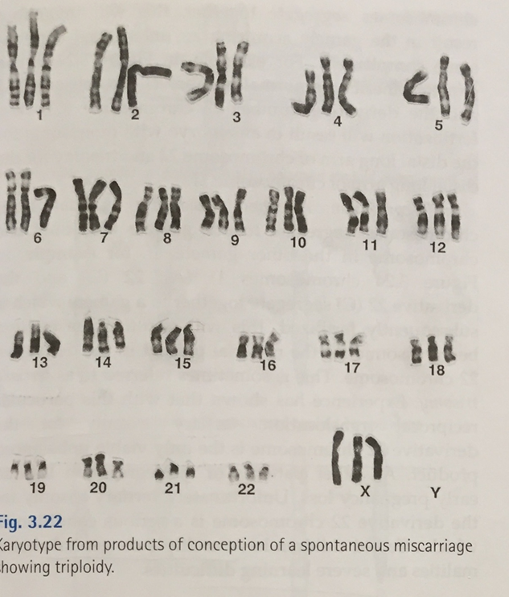

Slide 13
Down Syndrome
Down syndrome, or trisomy 21, is by far the most common and best known of the chromosome disorders and is the single most common genetic cause of moderate mental retardation.
About 1 child in 800 is born with Down
Syndrome.

Slide 14
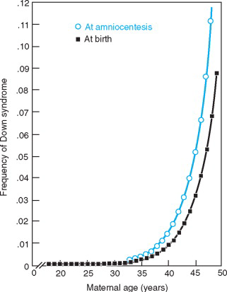

Slide 15
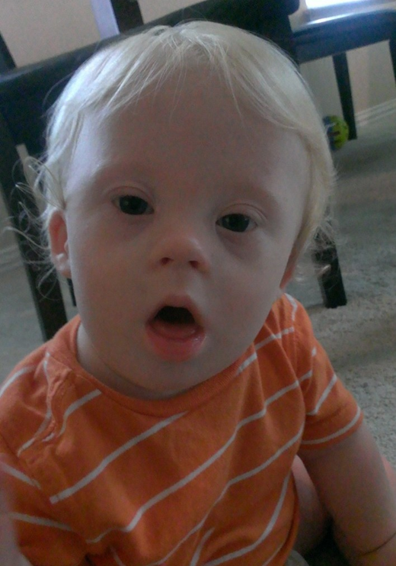

Phenotype
Down syndrome can usually be diagnosed at birth or shortly thereafter by its dysmorphic features, which vary among patients but nevertheless produce a distinctive phenotype.
Hypotonia may be the first abnormality noticed in the newborn.
Characteristic dysmorphic facial features
Short in stature and have brachycephaly with a flat occiput.
The neck is short, with loose skin on the nape.
The eyes have Brushfield spots around the margin of the iris.
The hands are short and broad, often with a single transverse
Palmar crease (“simian crease”) and incurved fifth digits, or clinodactyly.

Slide 16
The Chromosomes in Down Syndrome

Slide 17
Trisomy 21
In about 95% of all patients, Down syndrome involves trisomy for chromosome 21 (meiotic nondisjunction of the chromosome 21 pair).
The meiotic error responsible for the trisomy usually occurs during maternal meiosis (about 90% of cases), predominantly in meiosis I,
About 10% of cases occur in paternal meiosis, usually in meiosis II.

Slide 19
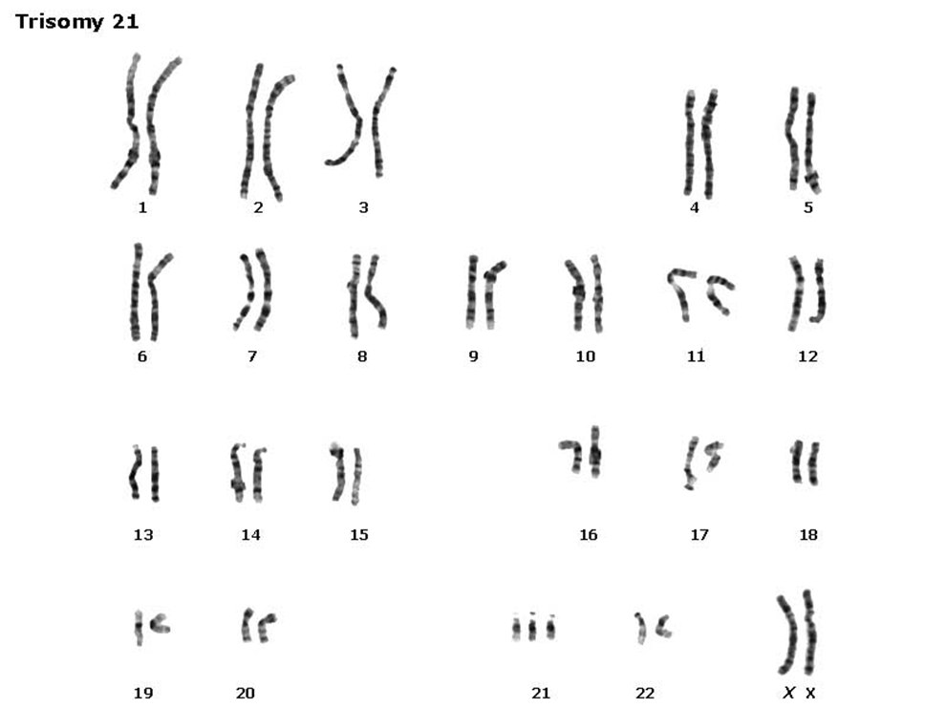

Slide 20
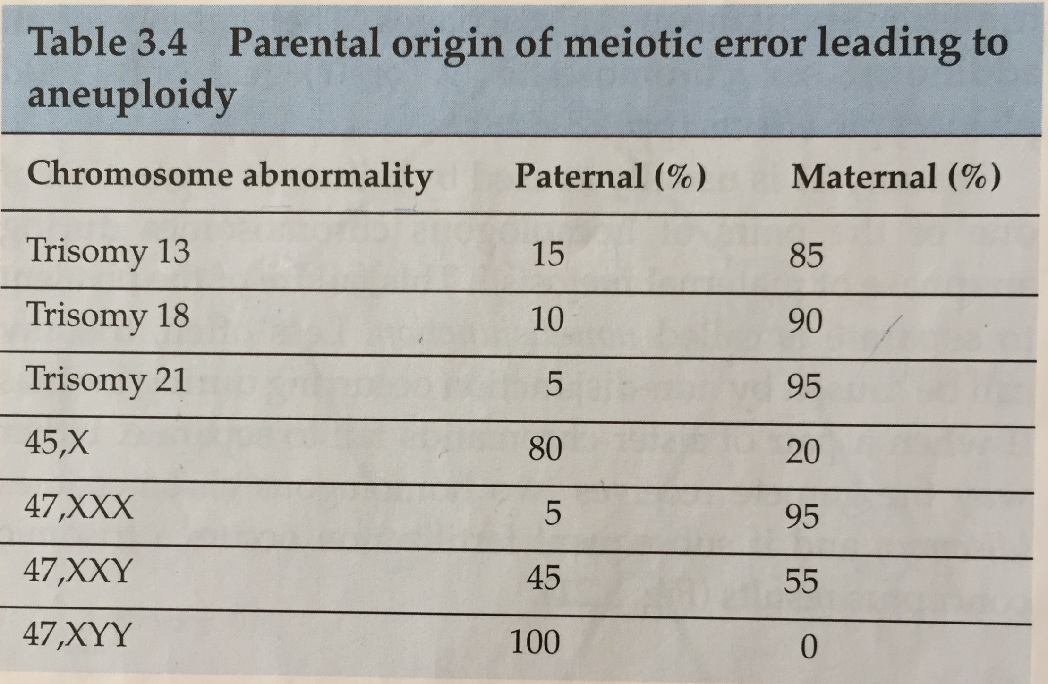

Slide 21
Robertsonian Translocation
About 4% of Down syndrome patients have 46 chromosomes, one of which is a Robertsonian translocation between chromosome 21q and the long arm of one of the other acrocentric chromosomes (usually chromosome 14 or 22).

Slide 22
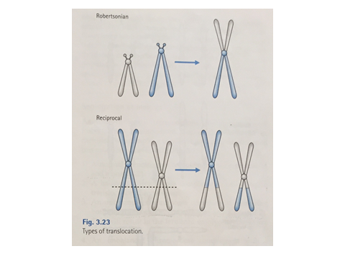
Robertsonian Translocation
The translocation chromosome replaces one of the normal acrocentric chromosomes.
The karyotype of a Down syndrome patient with a Robertsonian translocation between chromosomes 14 and 21 is therefore:
46,XX,rob(14;21)(q10;q10),+21
46,XY,rob(14;21)(q10;q10),+21

Slide 24
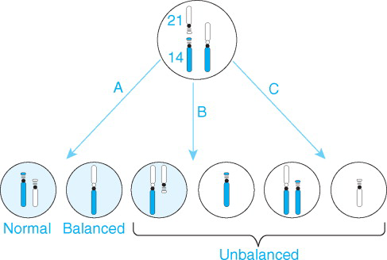

Slide 25
Mosaic Down Syndrome
About 2% of Down syndrome patients are mosaic, usually for cell populations with either a normal or a trisomy 21 karyotype.
The phenotype may be milder than that of typical trisomy 21, but there is wide variability in phenotypes among mosaic patients, possibly reflecting the variable proportion of trisomy 21 cells in the embryo during early
development.

Slide 26
Etiology of Trisomy 21
The high percentage of all cases of trisomy 21 in which the abnormal gamete originated during maternal
meiosis I suggests that something about maternal
meiosis I is the underlying cause.
Because of the increased risk of Down syndrome
to older mothers, one obvious possibility is the “older egg” model.”
It has been suggested that the older the oocyte, the
greater the chance that the chromosomes will fail to
disjoin correctly.

Slide 27
Next
Trisomy 18

Slide 28
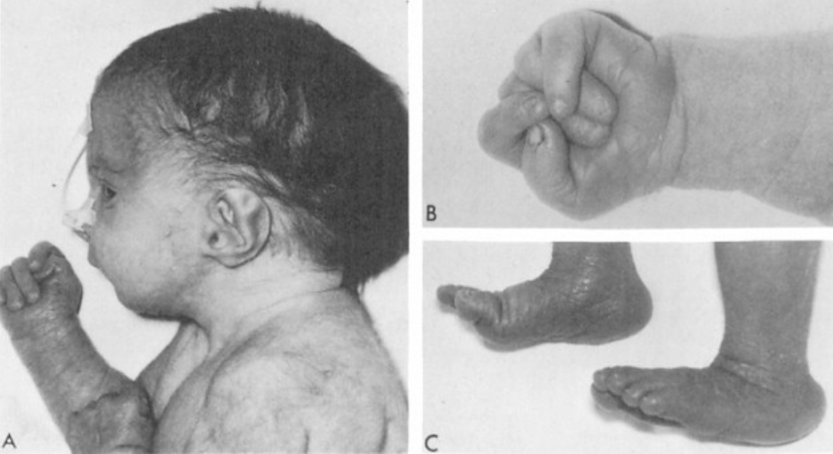
Trisomy 18
The features of trisomy 18 always include:
Mental retardation
Failure to thrive
Severe malformation of the heart.
Hypertonia is a typical finding.
Prominent occiput
Jaw recedes
Low-set and malformed ears.
The sternum is short.
The fists clench in a characteristic way, the 2d and 5th digits overlapping the 3d and 4th.
The feet have a “rocker-bottom” appearance

Slide 29
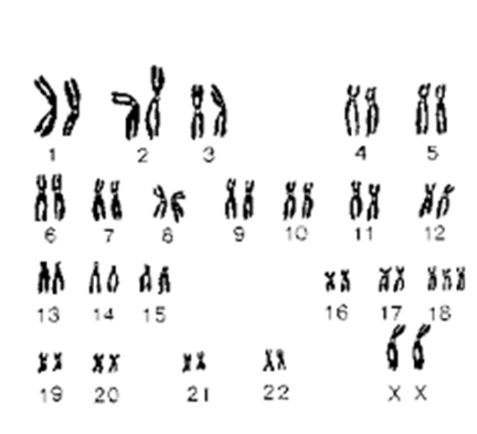
Trisomy 18

Slide 30
Next
Trisomy 13

Slide 31
Trisomy 13
Growth retardation and severe mental retardation .
Severe central nervous system malformations such as arhinencephaly and holoprosencephaly.
The forehead is sloping.
Microcephaly and wide open sutures.
Eye anomalies like microphthalmia, iris coloboma, or even absence of the eyes.
The ears are malformed.
Cleft lip and cleft palate .
Postaxial polydactyly.
Clench with the second and fifth digits overlapping the third and fourth, as in trisomy 18.
Rocker-bottom feet.
Simian creases.
Congenital heart defects (in particular, VSD and PDA)
Urogenital defects, including cryptorchidism in males, bicornuate uterus and hypoplastic ovaries in females, and polycystic kidneys.
Of this constellation of defects, the most distinctive are the general facial appearance with cleft lip and palate and ocular abnormalities, polydactyly, the clenched fists, and rocker-bottom feet.

Slide 32
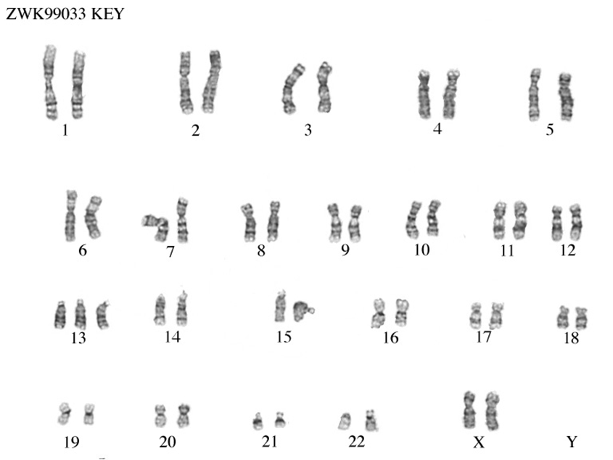
Trisomy 13

Slide 33
Next
Klinefelter Syndrome (47,XXY)

Slide 34
Klinefelter Syndrome (47,XXY)
The patients are tall and thin and have relatively long legs.
They appear physically normal until puberty when signs of hypogonadism become obvious.
Puberty occurs at a normal age, but the testes remain small, and secondary sexual characteristics remain underdeveloped.
Gynecomastia is a feature; because of this, risk of breast cancer is 20 to 50 times that Of 46,XY.
The Klinefelter patients are almost always infertile.
In adulthood, persistent androgen deficiency may result in decreased muscle tone, a loss of libido, and decreased bone mineral density.
The incidence is at least 1 in 1000 male live births

Slide 35
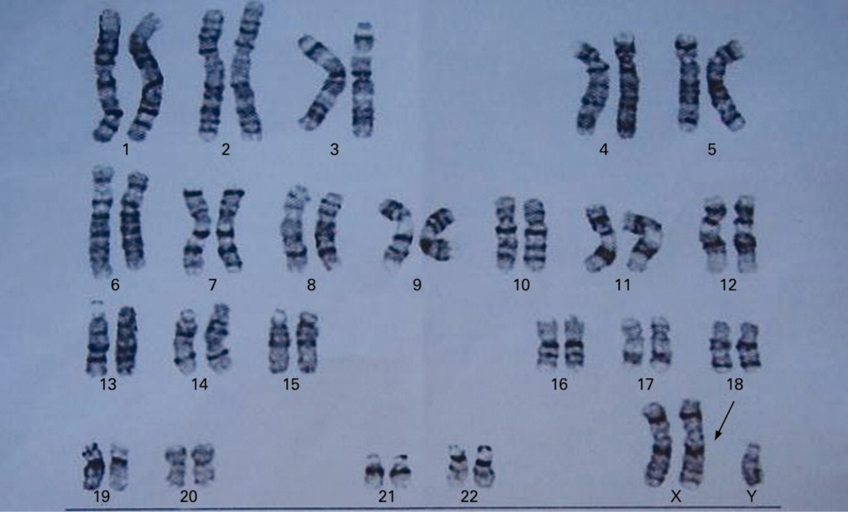

Slide 36
47,XYY Syndrome
Among all male live births, the incidence of the 47,XYY karyotype is about 1 in 1000.
The 47,XYY chromosome constitution is not associated with an obviously abnormal phenotype
Males with this karyotype cannot be distinguished from normal 46,XY males.
They have normal intelligence and are not dysmorphic.
Tall.
Fertility is usually normal.
No particularly increased risk that a 47,XYY male will have a chromosomally abnormal child.
About half of 47,XYY boys require educational intervention as a result of language delays and reading and spelling difficulties.
Attention deficits, hyperactivity, and impulsiveness have been well documented in XYY males.
The origin of the error that leads to the XYY karyotype must be paternal nondisjunction at meiosis II, producing YY sperm.

Slide 37
Trisomy X (47,XXX)
Incidence of 1 in 1000 female births.
Somewhat above average in stature, are not abnormal phenotypically.
Develop pubertal changes at an appropriate Age.
They are usually fertile.
With a somewhat increased risk of chromosomally abnormal offspring.
Significant deficit in performance on IQ tests, and about 70% of the patients have some learning problems.
Almost all cases result from errors in maternal meiosis, and of these, the majority are in meiosis I.
There is an effect of increased maternal age.

Slide 38
What else
Turner Syndrome

Slide 39
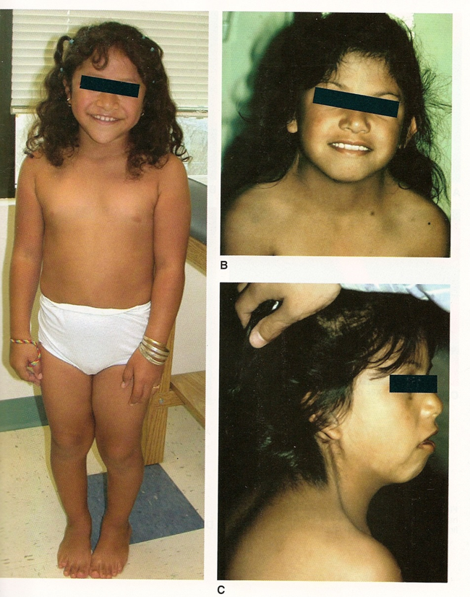
Turner Syndrome (45,X and Variants)
Females with Turner syndrome can often be identified at birth by their distinctive phenotypic features.
The incidence 1 in 4000 female live births.
Short stature, gonadal dysgenesis.
Characteristic unusual faces, webbed neck, low posterior hairline, broad chest with
Widely spaced nipples.
Renal anomalies.
Cardiovascular anomalies.
At birth, infants with edema of the dorsum of the foot and hand.

Slide 40
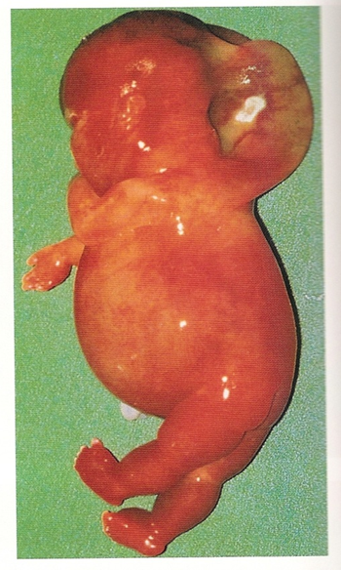
Turner Syndrome (45,X and Variants)
Lymphedema may be present in fetal life, causing cystic hygroma.

Slide 41
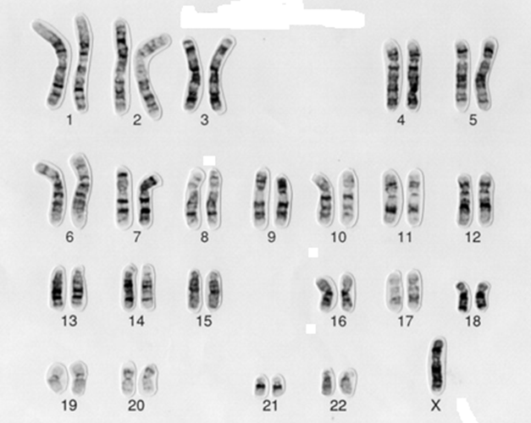

Slide 42
Cri du Chat Syndrome
This deletion syndrome was given its common name because crying infants with this disorder sound like a mewing cat.
The facial appearance, is distinctive: Microcephaly
Hypertelorism
Epicanthal folds
Low-set ears sometimes with preauricular tags
Micrognathia.
Moderate to severe mental retardation
Heart defects.

Slide 43
Abnormalities of Chromosome Structure

Slide 44
