Slide 1
Genetic and Chromosomal Disorders
Majid Alfadhel
MD, MHSc, SSC-Ped, ABHS(CH), FCCMG
Geneticist and Pediatrician

Slide 2
Genetics
Clinical Genetics (dysmorphology)
Biochemical Genetics (metabolic)
Clinical
Molecular
Cytogenetics
Clinical
Molecular
Biochemical

Slide 3
Types of Genetics Disorders
Chromosomal: Down Syndrome, Turner Syndrome
Single Gene: IEM, neurogenetics, haematological disorders etc..
Complex: Birth defects, most cancers

Slide 4
# of Genetics Disorders
OMIM STATISTICS | # 6 months ago | #Now
Phenotype known, molecular known | 4274 | 4,876
Phenotype known, molecular unknown | 1682 | 1,613
Other, mainly phenotypes with suspected mendelian basis | 1847 | 1,790
Total | 7803 | 8279

Slide 5
Cell

Slide 6
3

Slide 7
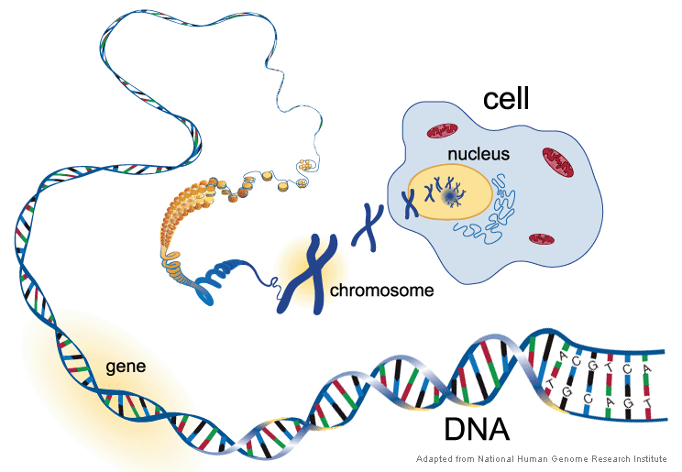

Slide 8
Cytogenetics
Study of Chromosome structure, function & behavior.

Slide 9
The Chromosomes
Greek for “Colored bodies where ”Chrom- Coloured, Soma- Body.
Chromosome is the organised (Packed) form of DNA.
Two sister chromatid held together by centromere.
Centromere divides a chromosome into the:
p (short)
q (long)

Slide 10
Chromosome
Telomer
p
Centromer
Bands
q
Telomer

Slide 11
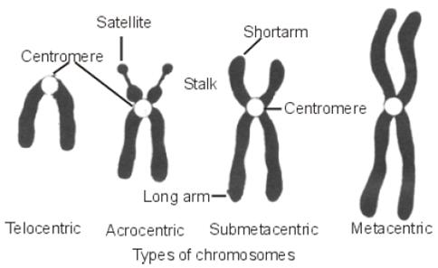
Chromosome Classification
Depending on the position of the centromere chromosomes are classified into: metacentric, submetacentric & acrocentric.

Slide 12
Normal Human Chromosome
Human Chromosomes Complement in a somatic cell
46 (23 pairs)
Autosomes Gonosomes
(22 pairs) (1 Pair)
1- 22 XX or XY

Slide 13
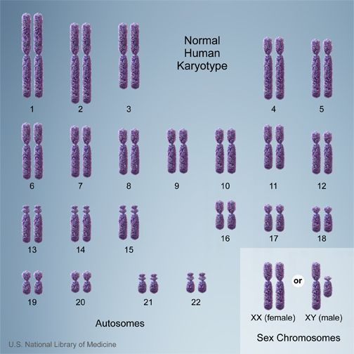
Karyotype Analysis
Chromosomes are further grouped into A → G
Notes:
All individual have the same autosomes but differ in the sex chromosomes. In a karyotype; chromosomes are arranged and further grouped into 7 groups based on their length and centromere position.

Slide 14
Classification of Chromosomal Disorders
CHROMOSOMAL DISORDERS
NUMERICAL
STRUCTURAL

Slide 15
Numerical Abnormalities
NUMERICAL ABNORMALITIES
ANEUPLOIDY
POLYPLOIDY
MOSAICISM
TRISOMY
MONOSOMY
TRIPLOIDY
TETRAPLOIDY
SOMATIC
GERMLINE

Slide 16
Aneuploidy
It means an abnormal number of chromosomes that are not an exact multiple of the haploid number (chromosome set.)
The antonym is euploid.
Classically, aneuploidy refers to presence of supernumerary copies of whole chromosome (Trisomy) or the absence of chromosomes (monosomy)

Slide 17
Aneuploidy
Mechanism: non-disjunction or Anaphase lag during cell division.
First meiotic division (MI) - anaphase lag.
Second meiotic division (MII).
Post Zygotic Mitotic (PZM).
Uniform or mosaic.

Slide 18
Trisomies
Down syndrome (trisomy 21)
Edward syndrome (trisomy 18)
Patu syndrome (trisomy13 )

Slide 19
Trisomy 21
47,XX,+21

Slide 20
Trisomy 18
47,XX,+18

Slide 21
Trisomy 13
47,XX,+13

Slide 22
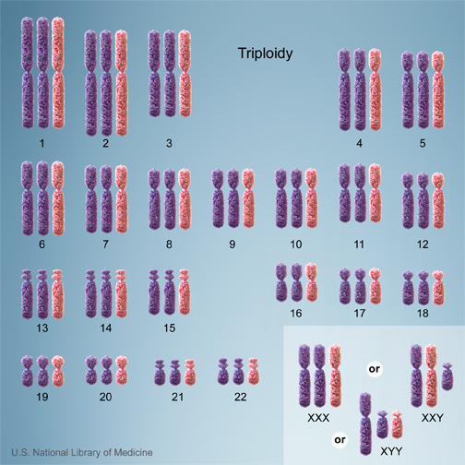
Cells with one additional set of chromosomes, for a total of 69 chromosomes, are called triploid

Slide 23
Tetraploidy
Cells with two additional sets of chromosomes, for a total of 92 chromosomes

Slide 24
Structural Abnormalities

Slide 25
Structural
Break followed up by wrong rearrangement.
One chromosome or more.
Similarities in repetitive sequences

Slide 26
Types of structural Abnormalities
Apparently Balanced
Unbalanced
Two or more Breaks.
Miss reunion.
No phynotypic effect.
Examples:
Reciprocal Translocation
Robertsonian Translocation
Insertional Translocation
Inversion (Pericentric/Paracentric)
Apparent Phenotype.
Examples:
Ring Chromosomes.
Isochromosomes.
Duplication
Deletion

Slide 27
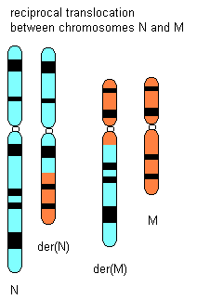
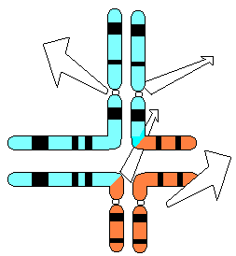
Reciprocal Translocation
Break involving two chromosomes followed by exchange of the broken segments.

Slide 28
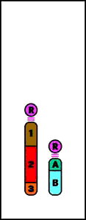
Robertsonian Translocation
Robertsonian
Translocation
http://www.tokyo-med.ac.jp/genet/cai-e.htm

Slide 29
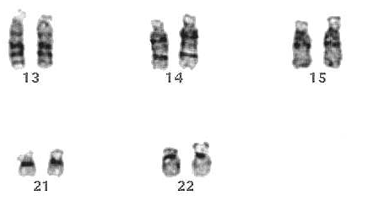
Robertsonian Translocation
Is a fusion of the long arms of two acrocentric chromosomes
One in about 900 babies is born with a Robertsonian translocation
Making it the most common kind of chromosome rearrangement known in human

Slide 30
Robertsonian Translocation
Rob(13q14q)is commonest chromosome arrangement in human (1/1300)
In translocation Down Syndrome Rob(14q21q) is the commonest.
Risk of having live born with DS is 10-15% for carrier female and 2.5-5% for male carriers

Slide 31
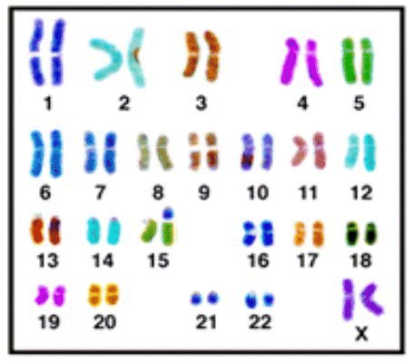
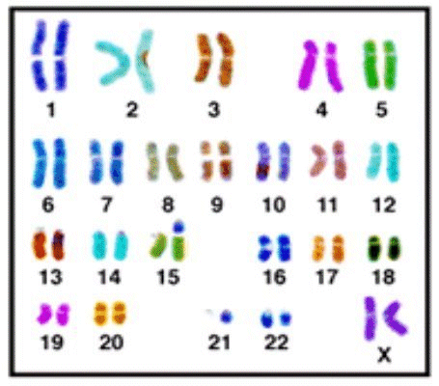
Translocation
46,xx,der(15;21)(q10;q10),+21
45,xx,der(15;21)(q10;q10)

Slide 32
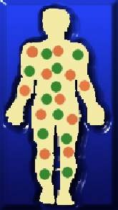
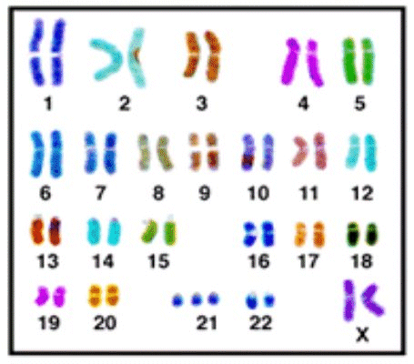
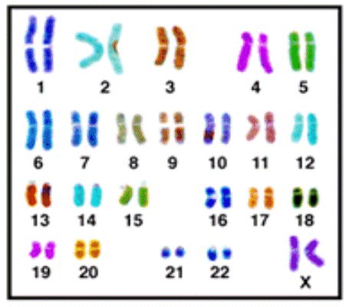
Mosaicism
Is the presence of two (or more) cell lines within an individual
47,xx,+21[10] / 46,xx[12]

Slide 33
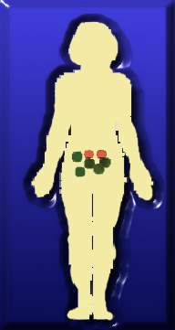
Mosaicism
Germline Mosaicism
Somatic Mosaicism

Slide 34
Modalities of identifying Genetic abnormalities

Slide 35
Cytogenetic Techniques
Karyotyping
FISH
CGH microarray

Slide 36
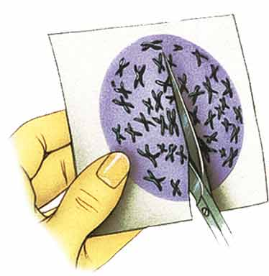
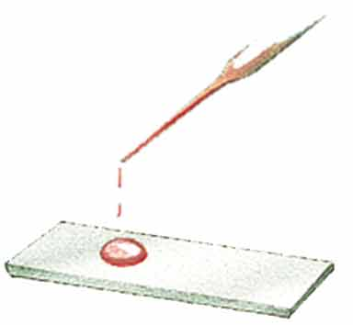
Karyotyping

Slide 37
Karyotyping

Slide 38
FISH
Fluorescence in situ hybridization (FISH) is a laboratory technique for detecting and locating a specific DNA sequence on a chromosome.
The technique relies on exposing chromosomes to a small DNA sequence called a probe that has a fluorescent molecule attached to it.
The probe sequence binds to its corresponding sequence on the
chromosome.

Slide 39
Fluorescence In Situ Hybridisation
FISH

Slide 40
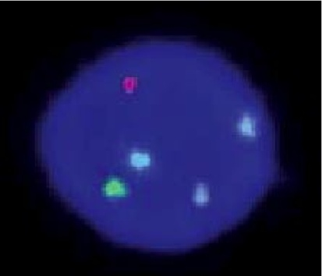
FISH

Slide 41
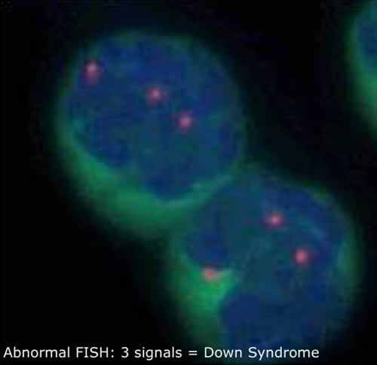
Down Syndrome
mosaicism

Slide 42
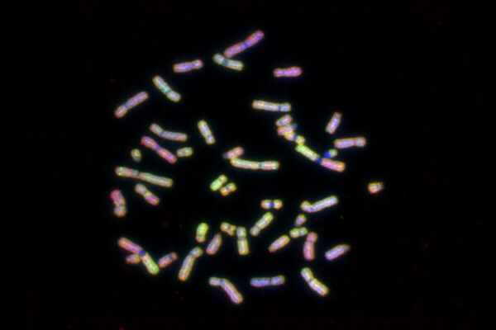
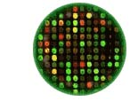
Comparative Genomics
CGH
arrCGH

Slide 43
CGH Microarry
Detect subtle deletion or duplication on the chromosome
Can not detect balanced translocation or low grade mosaicism

Slide 44
Uniparental disomy
A unique feature to imprinted conditions is the unusual situation in which a child inherits both copies of a chromosome from one parent and none from the other
Inheritance of both copy of chromosome 15q11.2 from the mother result in Prader-Willi syndrome
Inheritance of both copy of chromosome 15q11.2 from the father result in Angelman syndrome

Slide 46
Genetic Disorders

Slide 47
Family Pedigree
Pedigree charts show a record of the family of an individual
They can be used to study the transmission of a hereditary condition
They are particularly useful when there are large families and a good family record over several generations.

Slide 48
Symbols used in pedigree charts
A marriage with five children, two daughters and three sons. The eldest son is affected by the condition.
Normal male
Affected male
Normal female
Affected female
Marriage
Eldest child ↔ Youngest child
© 2007 Paul Billiet ODWS

Slide 49
Organising the pedigree chart
A pedigree chart of a family showing 20 individuals

Slide 50
Organising the pedigree chart
Generations are identified by Roman numerals
I
II
III
IV

Slide 51
Organising the pedigree chart
Individuals in each generation are identified by Arabic numerals numbered from the left
Therefore the affected individuals are II3, IV2 and IV3
I
II
III
IV

Slide 52
Mode of Inheritance

Slide 53
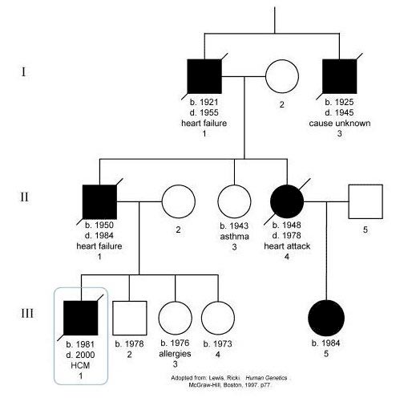
Autosomal Dominant inheritance

Slide 54
Autosomal dominant
Autosomal:the gene in question is located on one of the numbered, or non-sex, chromosomes.
Dominant: single copy of the disease-associated mutation is enough to cause the disease. This is in contrast to a recessive disorder, where two copies of the mutation are needed to cause the disease

Slide 55
Autosomal dominant
What is the risks of sibs?
If one of parents has the disease, what is the risk of offspring?

Slide 56
Autosomal dominant

Slide 57
Examples
Achondroplasia
Neurofibromatosis 1
Marfan syndrome

Slide 58
Autosomal Recessive inheritance

Slide 59
Autosomal:the gene in question is located on one of the numbered, or non-sex, chromosomes.
Recessive: 2 copy of the disease-associated mutation are needed to cause the disease.

Slide 60
Autosomal Recessive
What is the risks of sibs?
If one of parents has the disease, what is the risk of offspring?
If both parents has the disease, what is the risk of offspring?

Slide 61
Autosomal Recessive

Slide 62
Examples
PKU
CF
Sickle cell disease
Β-Thalassemi

Slide 63
X-linked recessive
The mutated gene occurs only on the X chromosome.
More affected males than affected females
Affected grandfather to affected grandson transmission through a carrier female intermediate
No male to male transmission

Slide 65
Examples
Duchene Muscular Dystrophy
Hemophilia A
G6PD
Color blindness

Slide 66
X-linked Dominant
For rare conditions, females are about 2x as likely to be affected than males.
May be lethal in males and usually milder, but variable, in females.
Affected males pass the gene to all of their daughters, who will be affected, and to none of their sons (NO male-to-male transmission)
Sons and daughters of affected females have 50% chance of being affected (similar to autosomal dominant)

Slide 68
Example
Vitamin D-resistent rickets
Incontinentia pegmenti
Rett syndrome

Slide 69
Mitochondrial disorders
We have 2 genome
Mitochondrial genome is single circular double-stranded molecule of mtDNA.
Very compact (37 genes in 16 kb; no introns).
Polyplasmic: ~10³ – 10⁴ copies / cell.
Polymorphic: 0.3%
Maternal transmission

Slide 71
Trinucleutides Repeat Expansion
More than 50% of human DNA appears as repeat sequences
2 or 3 bases repeated over and over again
Expansion of trinucleotide repeates result in several disorders including
Fragile X syndrome
Huntington disease

Slide 72
Molecular techniques
Single gene sequencing
Homozygosity mapping
Whole exome sequencing
Whole genome sequencing
Mitochondrial genome sequencing

Slide 73
Contact
dralfadhelma@gmail.com

