Slide 1
Polyuria, Polydipsia
Prof. Bassam Saleh Bin-Abbas,
MD, FAAP, FACE
Section of Pediatric Endocrinology
King Faisal Specialist Hospital and Research Center

Slide 2
What is the correct spelling?
Diabetes Millitus
Diabetes Melletus
Diabetes Milletus
Precotious Puberty
Precocoius Puberty
Precocouos Puberty
Ambigous Genitalia
Ambigouos Genitalia
Ambiqouos Genitalia

Slide 3
What is the correct spelling?
Diabetes Millitus
Diabetes Melletus
Diabetes Milletus Diabetes Mellitus
Precotious Puberty
Precocoius Puberty
Precocouos Puberty Precocious Puberty
Ambigous Genitalia
Ambigouos Genitalia
Ambiqouos Genitalia Ambiguous Genitalia

Slide 4
Case Scenario
A 10 year old boy presented to you with a 2 week history of polyuira and polydipsia.
Now, what is the differential diagnosis based on the information provided?

Slide 5
Differential diagnosis
Diabetes Mellitus
Diabetes Insipidus

Slide 6
Differential diagnosis
Diabetes Mellitus
Diabetes Insipidus
It is important to know the differential diagnosis, because the history, physical examination and investigation depend on the differential diagnosis.

Slide 7
What are the causes of diabetes Mellitus:

Slide 8
What are the causes of diabetes Mellitus:
I. Type 1 DM (IDDM)
II. Type 2 DM (NIDDM)
III. Other Causes:
A. Genetic defects of insulin secretion
B. Genetic defects of insulin actions
C. Exocrine pancreatic dysfunction
D. Endocrinopathies
E. Drugs
F. Infections
G. Associated syndromes
IV. Gestational DM

Slide 9
What are the differences between T1DM & T2DM
Type 2 DM:
Polyuria
Polydipsia
Polyphagia
Weight gain
Fatigability
Type 1 DM:
Polyuria
Polydipsia
Polyphagia
Weight loss
Fatigability

Slide 10
What are the differences between T1DM & T2DM
Type 1 DM:
Young
Thin
Autoimmune ds
Sudden
Insulin low
+ antibodies
DKA
Type 2 DM:
Old
Obese
Acanthosis
Subacute onset
Insulin high
No antibodies
No DKA

Slide 11
What are the causes of diabetes Mellitus:
I. Type 1 DM (IDDM)
II. Type 2 DM (NIDDM)
III. Other Causes:
A. Genetic defects of insulin secretion
B. Genetic defects of insulin actions
C. Exocrine pancreatic dysfunction
D. Endocrinopathies
E. Drugs
F. Infections
G. Associated syndromes
IV. Gestational DM

Slide 12
Genetic defects of insulin secretion
Maturity Onset Diabetes of Youth (MODY):
NIDDM
Autosomal dominant
Family history of mild hyperglycemia
2 generations affected
Onset 2-3 decade of life
No history of DKA
Mild postprandial hyperglycemia
Mild persistent fasting hyperglycemia

Slide 13
Genetic defects of insulin secretion
Maturity Onset Diabetes of Youth (MODY):
Upregulated reset of insulin secretion (shift to the left)
Absence of type 1 DM antibodies
Absence of typical HLA
Respond to small doses of insulin

Slide 14
What are the causes of diabetes Mellitus:
I. Type 1 DM (IDDM)
II. Type 2 DM (NIDDM)
III. Other Causes:
A. Genetic defects of insulin secretion
B. Genetic defects of insulin actions
C. Exocrine pancreatic dysfunction
D. Endocrinopathies
E. Drugs
F. Infections
G. Associated syndromes
IV. Gestational DM

Slide 15
Genetic defects of insulin actions
Leperchaunism
Rabson-Mendenhall’s syndrome
Congenital lipodystrophy

Slide 16
Genetic defects of insulin actions
IUGR
Coarse face
Loss of SQ fat
Acanthosis nigricans
Hirsutism
Cliteromegaly/large phallus

Slide 17
Exocrine pancreatic dysfunction
Wilson disease (copper accumulation)
Thalassemia (iron accumulation)
Cystic fibrosis

Slide 18
Endocrinopathies
Acromegaly
Hyperthyroidism
Pheochromocytoma
Cushing’s syndrome

Slide 19
Drugs
d
Diazoxide
L-Asparaginase
Epinephrine
Glucagon

Slide 20
Infections:
Enteroviruses
EBV
CMV
Rubella
Mumps
Retrovirus
Rotavirus
Mechanism: direct damage, cross reactivity)
infections

Slide 21
Syndromes:
Down syndrome
Turner syndrome
Klinefelter’s syndrome
Friedriech’s Ataxia
Prader Willi syndrome
Bardet Beidle syndrome
Laurence-Moon syndrome
Myotonic dystrophy
)
Syndromes

Slide 22
Case Scenario
A 10 year old boy presented to you with a 2 week history of polyuira and polydipsia.
So, what are other important points in history?

Slide 23
History
Polyuria
Polydipsia
Polyphagia
Weight loss
Weight gain
Fatigability
Respiratory distress

Slide 24
History
Past Medical history: viral infection, syndromes, endocrine,
Past Medical history: headache, UTI, renal disease
Past Surgical history: surgery
Drug history:
Social history:
Family history:

Slide 25
Physical Exam:
Exam
Height, weight,
Vital signs
Acanthosis
Dysmorphic features
Autoimmune diseases: vetiligo
Thyroid enlargement
DKA: fundi, heart rate, acetone

Slide 26
Lab
What are the normal glucose levels?

Slide 27
Lab
Normal fasting glucose <100mg/dl
Pre-diabetes 100-125mg/dl
Diabetes : > 126mg/dl
Normal post prandial glucose <140mg/dl
Pre-diabetes 140-200mg/dl
Diabetes : > 200mg/dl

Slide 28
Lab
Normal HbA1C <5.7%
Pre diabetes HbA1C 5.7-6.5%
Diabetic HbA1C > 6.5%

Slide 29
What are the other laboratory test:

Slide 30
Other Lab
Insulin level
Antibodies
FT4, TSH
Celiac disease profile
Renal profile
Blood gases

Slide 31
Case Scenario
A 10 year old boy presented to you with a 2 week history of polyuira and polydipsia. There was a history of weight loss post a mild viral infection. No other complaints. Past medical history was unremarkable. Random blood sugar 330mg/dl.
How you will initiate insulin therapy, if needed?

Slide 32
Insulin Management
What are the types of insulin available?

Slide 33
Insulin Management
Rapid acting insulin insulin
Short acting insulin
Intermediate acting insulin
Long acting insulin
Mixed insulin
Mixed insulin

Slide 34
Insulin Management
Rapid acting insulin
insulin
Humalog (Lispro)
Novorapid (Aspart)
Glulisine (Apidra))
Mixed insulin

Slide 35
Insulin Management
Short acting insulin
Regular
Intermediate acting insulin:
NPH
Lente

Slide 36
Insulin Management
Long acting insulin
Lantus
Levemir
Tresibia (degludeg)
Ultra Lente

Slide 37
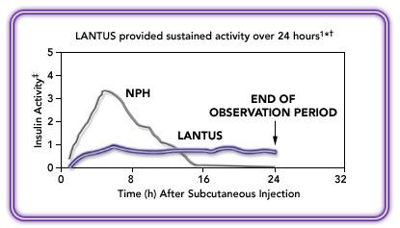
Insulin management

Slide 38
Insulin Management
Mixed insulin
Nixtard: 10/90, 20/80, 30/70, 40/60, 50/50
Novomix: 30/70
Humalog Mix 25/75, 50/50

Slide 39
Insulin management
Insulin type | Onset (hr) | Peak (hr) | Duration (hr)
Lispro | minutes | 1 | 2-3
Aspart | minutes | 1 | 2-3
Regular | 0.5-1 | 2-3 | 4-6
NPH | 3-4 | 6-8 | 10-12
Ultralente | 6-10 | - - - - | 18-24
Lantus | - - - - | - - - - | 24-36

Slide 40
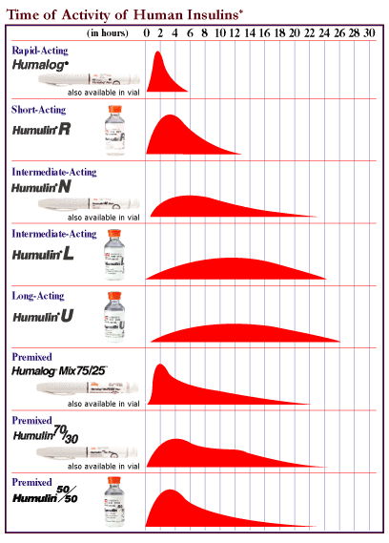

Slide 41
What are the 2 modalities of treating type 1 DM

Slide 42
Conventional insulin therapy Intensive insulin therapy
Insulin Therapy

Slide 43
Conventional insulin therapy Two insulin injections per day Infrequent blood glucose monitoring
Insulin Therapy

Slide 44
Intensive insulin therapy 3 or more insulin injections per day More frequent blood glucose monitoring Frequent clinic visits Proper diet therapy based on carbohydrate counting
Insulin Therapy

Slide 45
Multicenter North American trial Objective: Compare the effect of intensive insulin Rx with conventional in prevention of complications Subjects: 1441 type 1 diabetics yrs)
Diabetes Control and Complication Trial

Slide 46
Intensive Rx: HbA1c 7% Conventional Rx: HbA1c 9% yrs)
Diabetes Control and Complication Trial

Slide 47
Complication Risk reduction Nephropathy 40% Retinopathy 76% Neuropathy 60% yrs)
Diabetes Control and Complication Trial

Slide 48
Diabetes Control and Complication Trial
76%
Risk Reduction
59%
Risk Reduction
39%
Risk Reduction
54%
Risk Reduction
64%
Risk Reduction
60
50
55.0
Conventional
Cumulative Incidence (%)
Intensive
40
30
29.8
20
23.9
16.4
10
13.0
13.4
7.9
5.1
5.0
0
2.5
Retinopathy
Laser Rx¹
Micro-
Albuminuria²
Clinical
Progression¹
albuminuria²
Neuropathy³
DCCT Research Group, Ophthalmology. 1995
DCCT Research Group, Kidney Int.1995
DCCT Research Group. Ann Intern Med. 1995.

Slide 49
Intensive Insulin Therapy: Multiple Daily Injection of Insulin (MDI) Insulin Pump Therapy (CSII)
Insulin Therapy

Slide 50
Multiple Daily Injection of Insulin (MDI)
Intensive Insulin Therapy
Novorapid® (Aspart)
Lantus® (Glargine)
Apidra® (Glulisine)
Levemir® (Detemir)
Humalog® (Lispro)

Slide 51
Multiple Daily Injection of Insulin
Long acting insulin
Rapid
Rapid
Rapid
Breakfast
Lunch
Dinner
Bedtime

Slide 52
Multiple Daily Injection of Insulin (MDI)
Intensive Insulin Therapy
Novorapid® (Aspart)
Novomix® (Novolog)
Apidra® (Glulisine)
HumalogMix®
Humalog® (Lispro)

Slide 53
Multiple Daily Injection of Insulin
Mixed
Rapid
Mixed
Breakfast
Lunch
Dinner
Bedtime

Slide 54
Rapid Acting Insulin Analogues
Decreases postprandial hypogylcemia
Decreases nocturnal hypoglycemia
The best for unpredictable mealtime schedule

Slide 55
Blood Glucose Profiles in Intensified Therapy with Humalog® or Regular Human Insulin
Regular human insulin
Insulin
Humalog
11.0
Meal
200
190
10.0
180
170
Mean blood glucose mmol/L
Mean blood glucos mg/dL
9.0
160
150
8.0
140
7.0
130
before
after
before
after
before
after
3 a.m.
BREAKFAST
LUNCH
SUPPER
BEDTIME
Lalli C et al. Diabetes Care 1999.

Slide 56
Long Acting Acting Insulin Analogues
Lasts for 18-24 hrs with no peak
Can be given once or twice a day
Less blood glucose variability
More predictability and less hypoglycemia
Less weight gain

Slide 57
Levemir® Vs Glargine ®
Insulin detemir (n = 13)
0.4 U/kg
0.8 U/kg
Insulin glargine (n= 14)
3.0
2.5
2.0
Glucose infusion rate
(mg/kg/min)
1.5
1.0
0.5
0
0
2
4
6
8
10
12
14
16
18
20
22
24
Time (h)

Slide 58
Insulin doses Calculation and Adjustment
Conventional insulin therapy
Insulin Initiation:
Total insulin Dose = 0.5-1.0 unit/kg/d
2/3 AM, 1/3 PM
2/3 NPH, 1/3 Reg

Slide 59
Insulin doses Calculation and Adjustment
Conventional insulin therapy
Example:
Body weight: 30kg
Insulin requirement: one unit/kg = 30 units
2/3 AM: 20 units (NPH: 14, R:6)
1/3 PM: 10 units (NPH: 7, R:3)

Slide 60
Insulin doses Calculation and Adjustment
Conventional insulin therapy
Check blood glucose 4 times/day
Pre-breakfast
Pre-lunch
Pre-dinner
pre-bedtime

Slide 61
Insulin doses Calculation and Adjustment
Conventional insulin therapy
Insulin Dose Adjustment
↑ AM NPH if pre-dinner BG is ↑
↑ AM Reg if pre-lunch BG is ↑
↑ PM NPH if pre-breakfast BG is ↑
↑ PM Reg if pre-bedtime BG is ↑

Slide 62
I
Insulin doses Calculation and Adjustment
Intensive insulin therapy
50% as a basal insulin (Glargine/Detemir)
50% as boluses (Aspart/Lispro/Glulisine)
Meal bolus: Ex: 1 unit for 10 grams CHO
Correction boluses: Ex: 1 unit for every 50mg/dl

Slide 63
Insulin pump therapy
Local Experience

Slide 64
“CSII is the most physiological method of insulin delivery currently available”

Slide 65
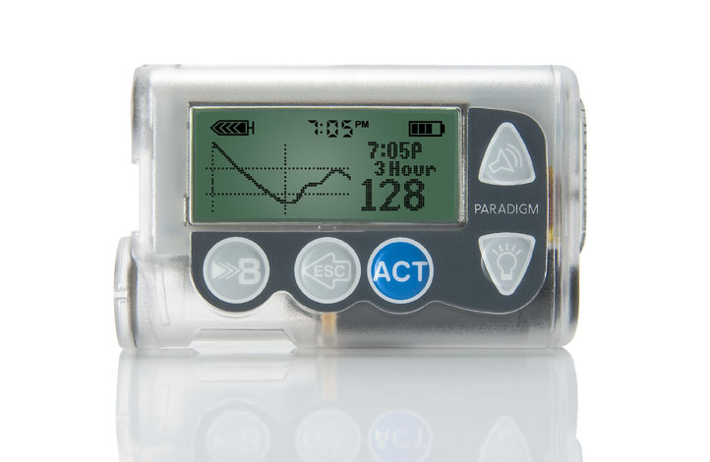
Improvement in Insulin Pump Technology

Slide 66
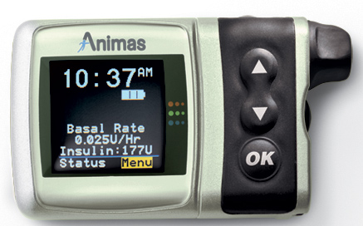
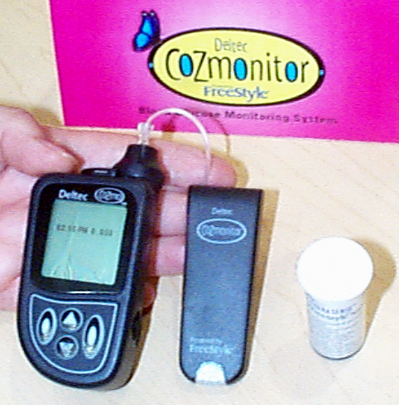
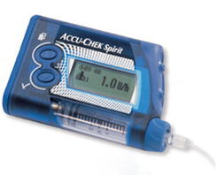
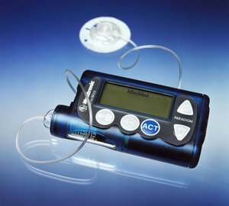
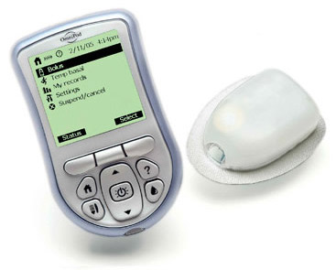
Insulin Pumps
Accu-Chek Spirit
Animas
Deltec CozMore
Omnipod
Medtronic
Dana

Slide 67
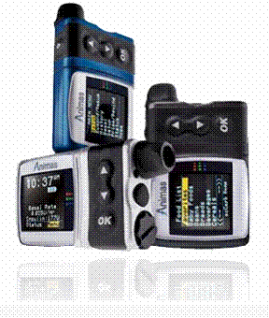
Advantages Of Pumps Over MDI
Mimics normal insulin
Causes less blood glucose variability
Reduces hypoglycemia
Decreases DKAs

Slide 68
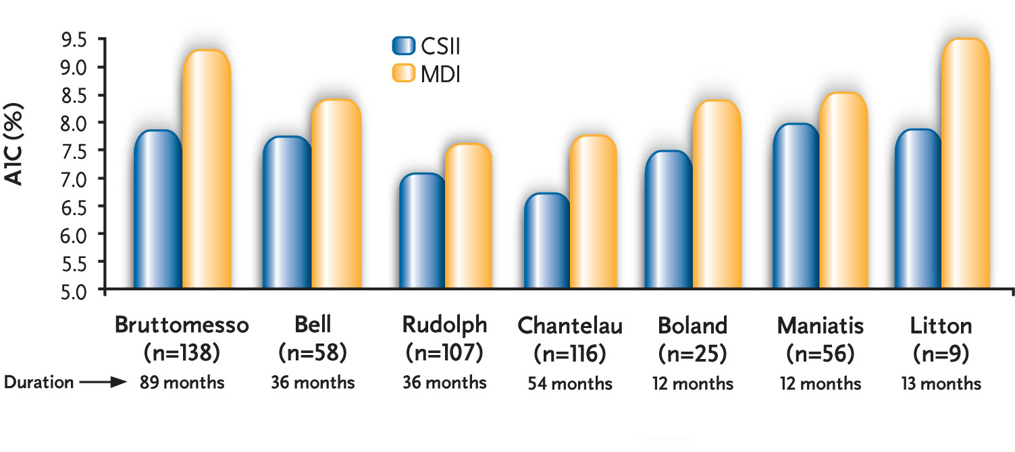
CSII Improves A1C Compared with MDI
A meta-analysis of 52 studies (1,547 patients) shows that CSII is significantly more effective in lowering A1C compared to MDI and conventional insulin therapy (MD 0.95)

Slide 69
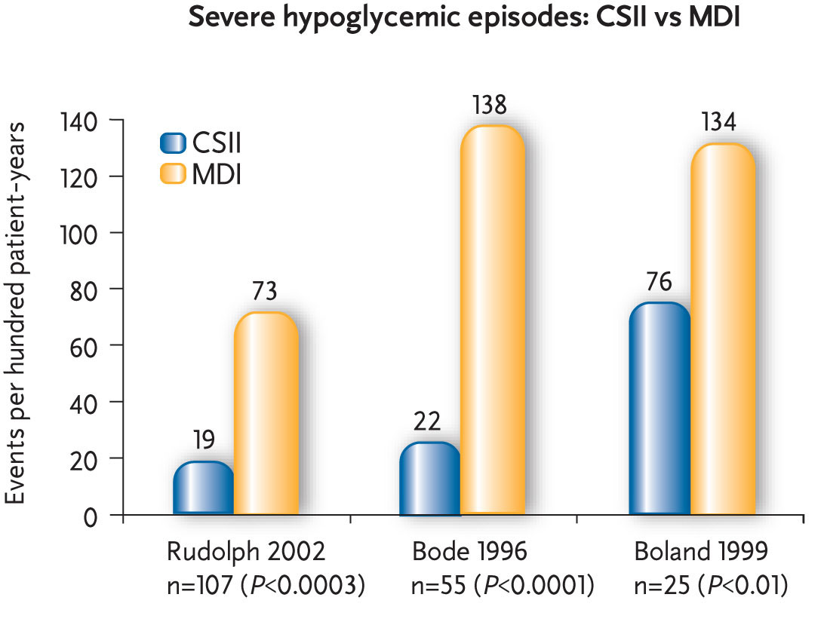
CSII Reduces Incidents of Severe Hypoglycemia
Bode BW, et al., Diabetes Care 1996
Boland EA, et al. Diabetes Care. 1999
Rudolph JW, et al. Endocrine Practice 2002

Slide 70
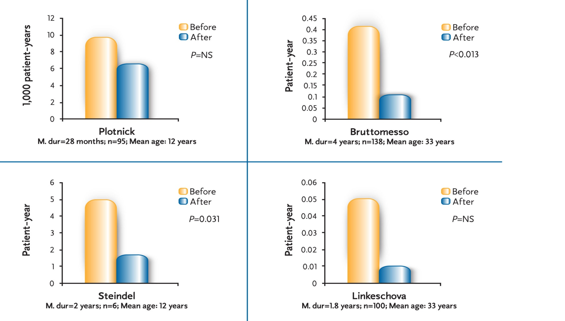
CSII Use Does Not Increase Risk of DKA

Slide 71
Number of Children on Insulin Pump Therapy
2000: one child
2002: 12 children
2006: 60 children
2008: 100 children
2010: >100 children
2014: >500 children
2010: 70 children
Pump it Up

Slide 72
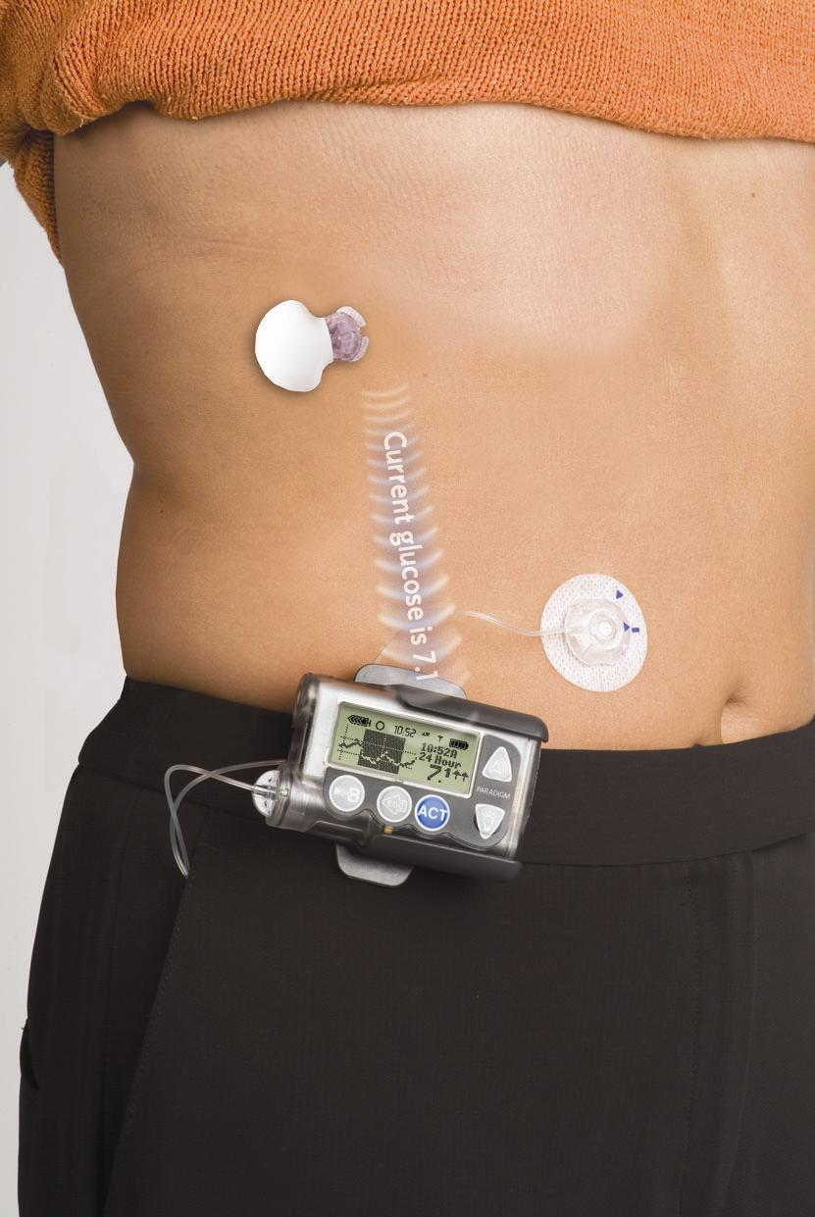
Number of Children on Insulin Pump Therapy

Slide 73
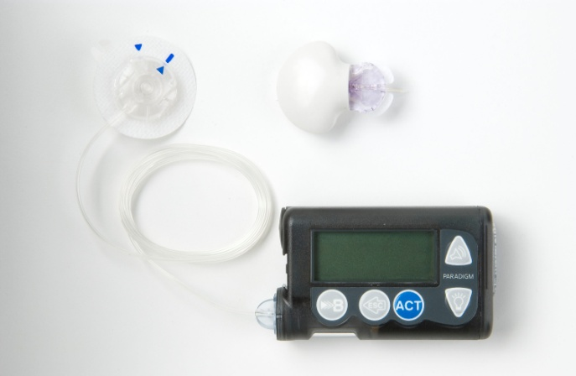
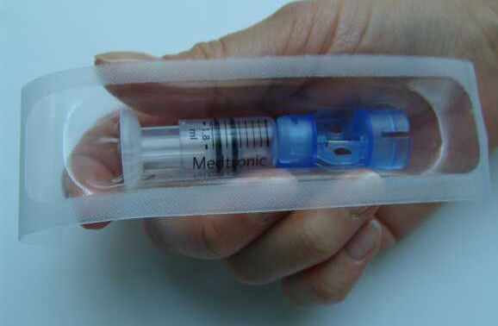
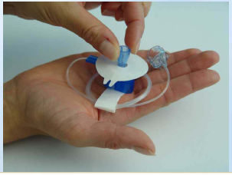
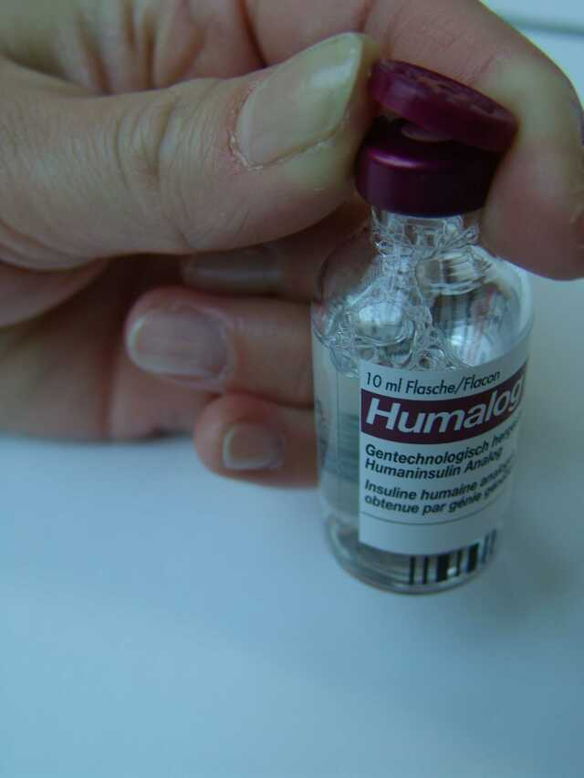
Reservoir
Insulin Pump
Insulin
Infusion Set

Slide 74
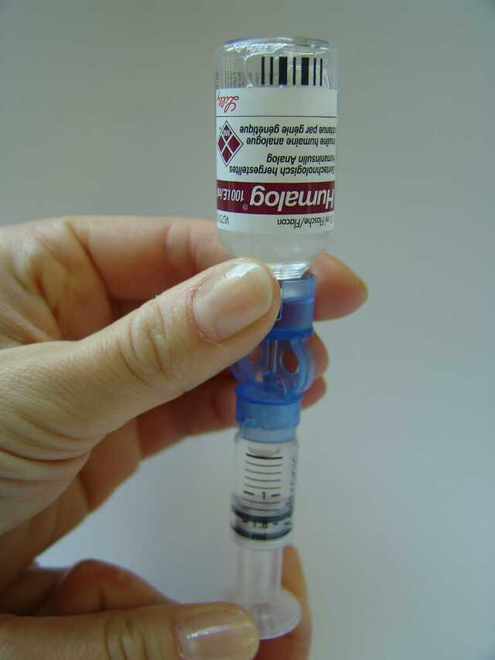
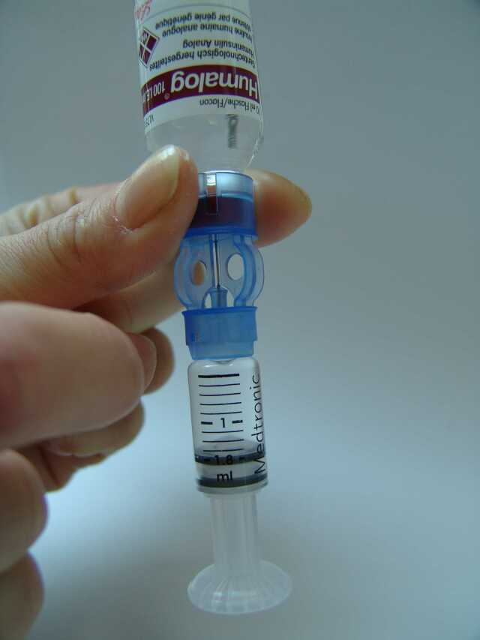
Fill Reservoir with Insulin

Slide 75
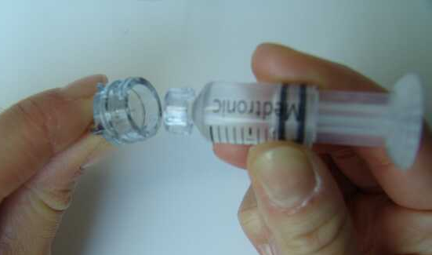
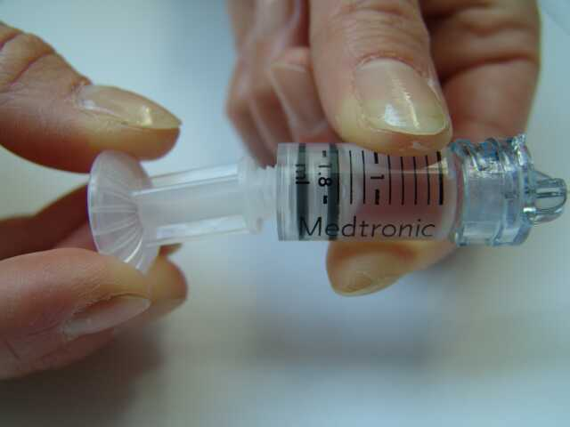
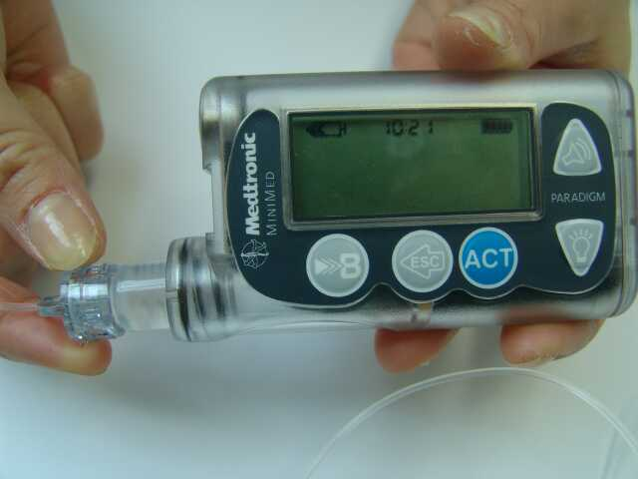
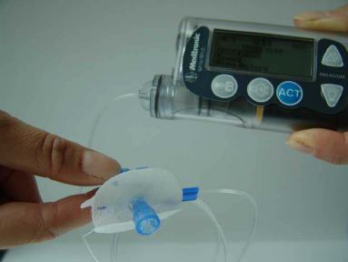
Remove Plunger
Connect to Infusion Set
Connect to Pump
Ready to -prime

Slide 76
Insulin pump therapy in Saudi children: a comparison with conventional insulin therapy
Pre-Insulin Pump Rx Post Insulin Pump Rx
HbA1C 10.2% 7.5%
Mean BG 243 mg/dl 162mg/dl
Hypog 3.5/pt/yr 1.6/pt/yr
Binabbas et al, Saudi Med J 2006

Slide 77
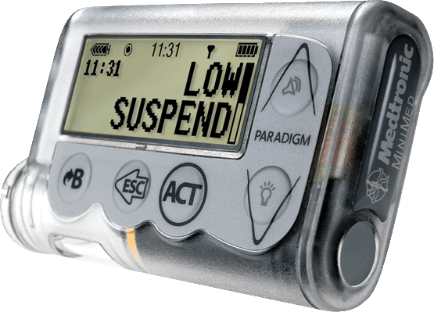
Paradigm Veo Insulin Pump

Slide 78
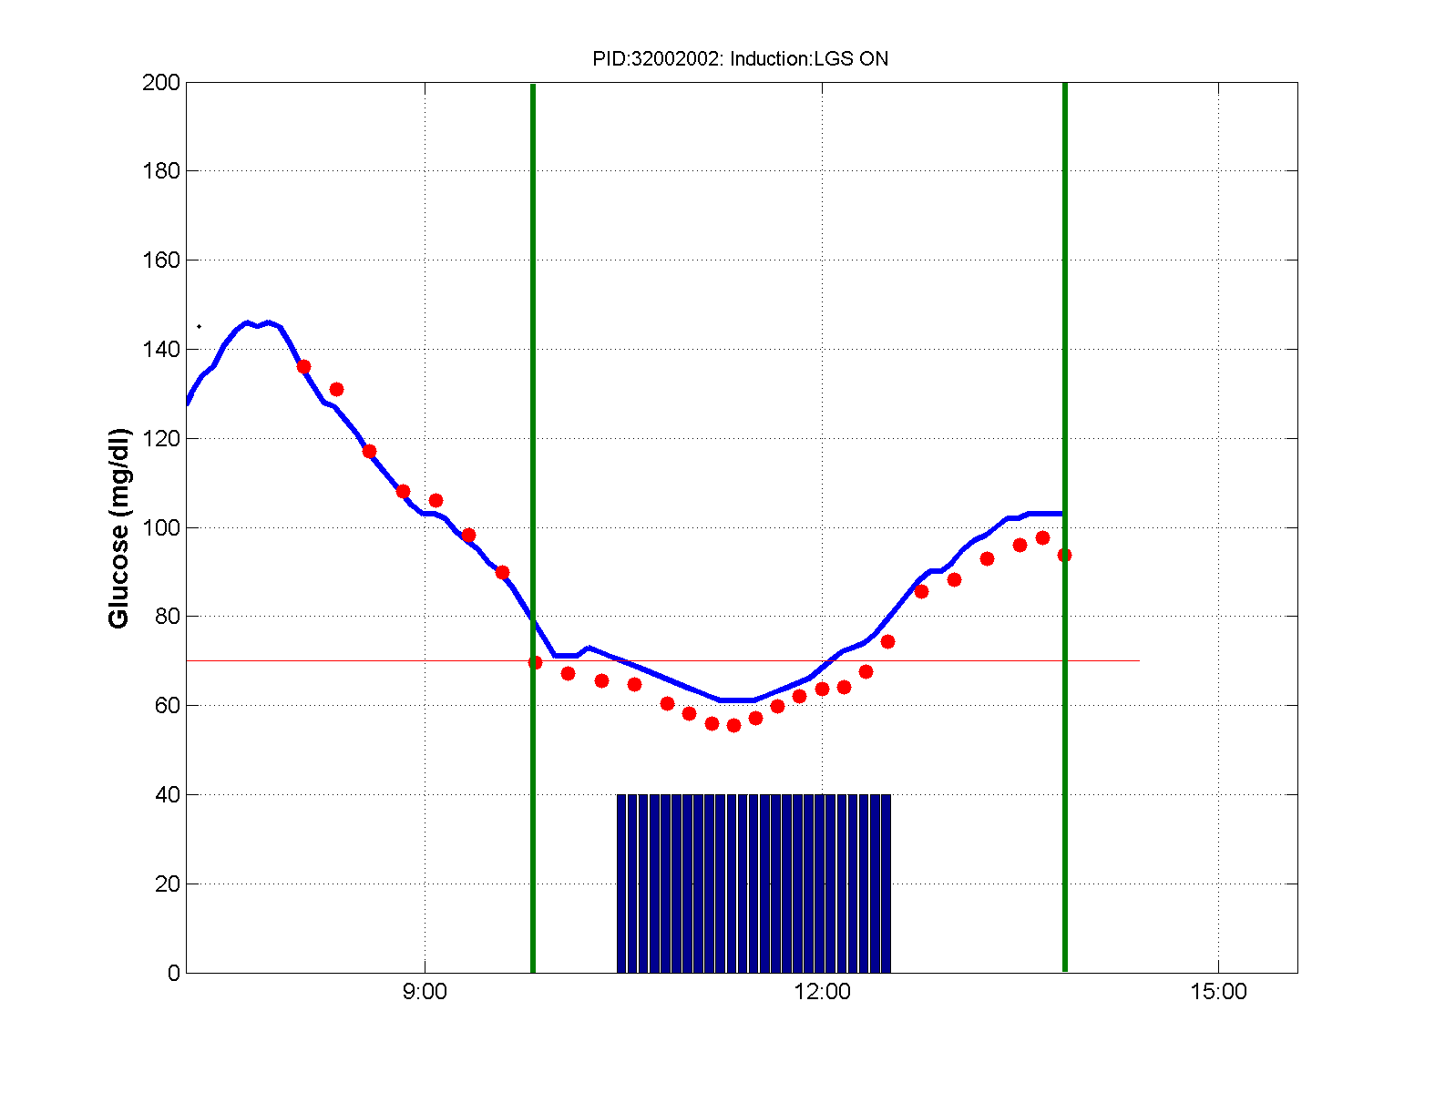
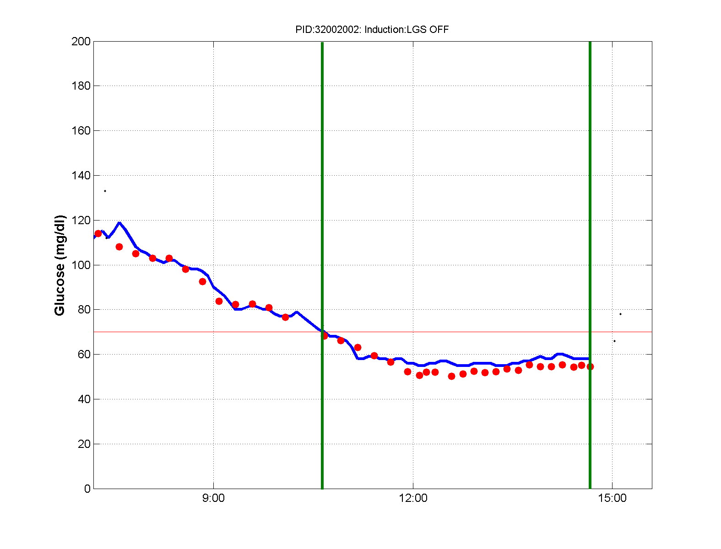
Examples of Successful Inductions

