Slide 1
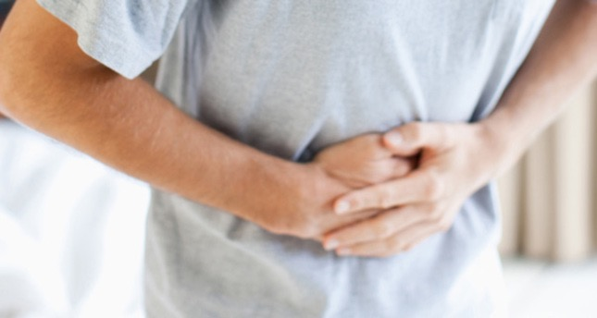
Case #1
24 healthy M with 1 day Hx of abd. pain.
Pain was generalized at first, now worse in right lower abd & radiates to his right groin.
Vomited X2 . No appetite today.
ROS otherwise negative.
Notes:
Basic cases to go through the most common abd pain complaints we see in the ED

Slide 2
Physical exam:
T: 37.8, HR: 95, BP 118/76, R: 18, O2 sat: 100%
Uncomfortable appearing
Abdomen: Soft, non-distended, tender to palpation in RLQ
Genital exam: normal
What is your differential diagnosis and what do you do next?

Slide 3
Appendicitis
Classic presentation
Periumbilical pain
Anorexia, nausea, vomiting
Pain localizes to RLQ
Occurs only in ½ to 2/3 of patients
A pelvic appendix can cause suprapubic pain, dysuria
Males may have pain in the testicles

Slide 4
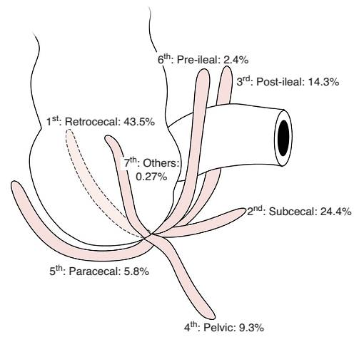
Appendicitis

Slide 5
Appendicitis
Findings ?
Depends on duration of symptoms
Rebound, voluntary guarding, rigidity, tenderness on rectal exam
Psoas sign
Obturator sign
Fever (a late finding)
CBC is not sensitive or specific
CT scan
U/S

Slide 6
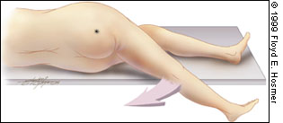
Appendicitis: Psoas Sign

Slide 7
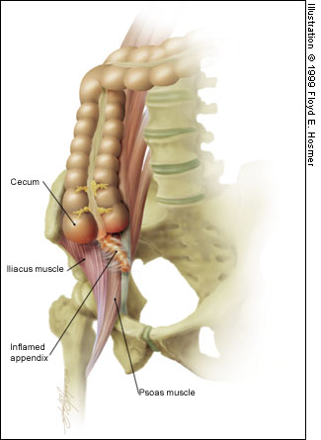
Appendicitis: Psoas Sign

Slide 8
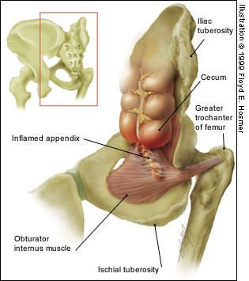
Appendicitis: Obturator Sign
Passively flex
right hip and knee
then internally
rotate the hip

Slide 9
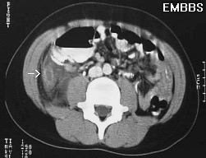
Appendicitis: CT findings
Cecum
Abscess, fat
stranding

Slide 10
Appendicitis
Diagnosis?
WBC
Clinical appendicitis – call your surgeon
Maybe appendicitis - CT scan
Not likely appendicitis – observe for 6-12 hours or re-examination in 12 hours

Slide 11
Appendicitis
Treatment ?
NPO
IVFs
Preoperative antibiotics – decrease the incidence of postoperative wound infections
Analgesia

Slide 12
Case #2
68 yo F with 2 days of LLQ abd pain, diarrhea, fevers/chills, nausea; vomited X1.
PMHx: HTN, diverticulosis
Meds: HCTZ

Slide 13
Case #2 Exam
T: 37.6, HR: 100, BP: 145/90, R: 19, O2sat: 99%
Gen: Looks uncomfortable
CV/Pulmonary: Unremarkable
Abd: soft, Tender LLQ
Rectal: Brown stool
What is your differential diagnosis & what next?

Slide 14
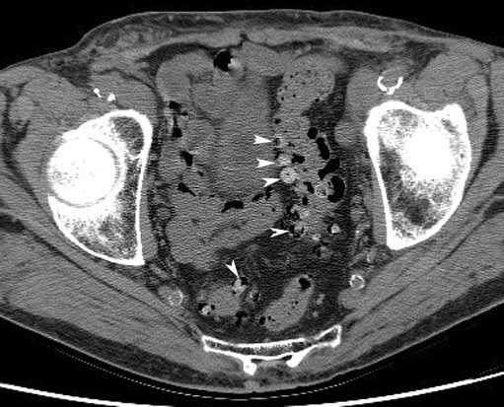
Diverticulitis
Risk factors ?
Diverticula
Old age
Clinical features?
Steady, deep discomfort in LLQ
Change in bowel habits
Urinary symptoms
Tenesmus
Paralytic ileus

Slide 15
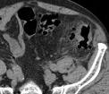
Diverticulitis
Physical Exam
Low-grade fever
Localized tenderness
Rebound and guarding
Left-sided pain on rectal exam
Occult blood
Peritoneal signs
Suggest perforation or abscess rupture

Slide 16
Diverticulitis
Diagnosis?
CT scan
Leukocytosis present in only 36% of patients

Slide 17
Diverticulitis
Treatment ?
Fluids
NPO
Antibiotics
For outpatients (non-toxic)
liquid diet x 48 hours
Cipro and Flagyl

Slide 18
Case #3
46 yo M with hx of alcohol abuse with 3 days of severe upper abd pain, vomiting, subjective fevers.
Social hx: homeless, heavy alcohol use, smokes 2ppd,

Slide 19
Case #3 Exam
V/S: T: 37.4, HR: 115, BP: 98/65, R: 22, O2sat: 95%
General: ill-appearing, appears in pain
CV:, Tachycardia
Lungs: -ve
Abdomen: mildly distended, Tender epigastric, guarding
Rectal: heme neg stool
What is your differential diagnosis & what next?

Slide 20
Pancreatitis
Risk Factors ?
Alcohol
Gallstones
Drugs
Amiodarone, antivirals, diuretics, NSAIDs, antibiotics, more…..
Severe hyperlipidemia
Idiopathic
Clinical Features?
Epigastric pain
Constant, boring pain
Radiates to back
Severe
N/V
bloating

Slide 21
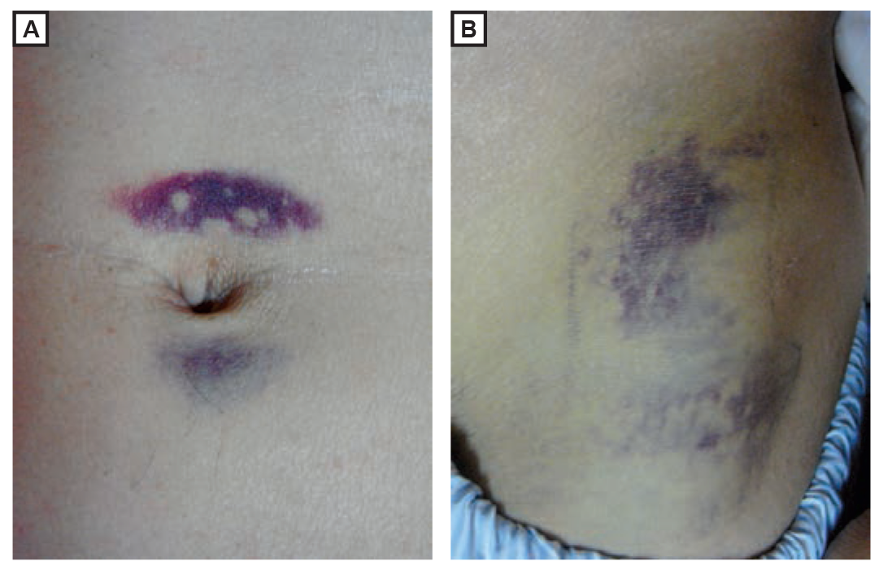
Pancreatitis
Physical Findings ?
Low-grade fevers
Tachycardia, hypotension
Respiratory symptoms
Atelectasis
Pleural effusion
Peritonitis – a late finding
Ileus
Cullen sign*
Grey Turner sign*
*Signs of hemorrhagic pancreatitis

Slide 22
Pancreatitis
Diagnosis
Lipase
Elevated more than 2 times normal
Sensitivity and specificity >90%
Amylase
Nonspecific
Don’t bother…
RUQ US if etiology unknown
CT scan

Slide 23
Pancreatitis
Treatment ?
NPO
IV fluid resuscitation
NGT
No antibiotics unless severe disease
Mild disease, tolerating oral fluids

Slide 24
Case #4
72 yo M with hx of CAD on aspirin and Plavix with several days of dull upper abd pain and now with worsening pain “in entire abdomen” today. Some relief with food until today, now worse after eating lunch.
Med Hx: CAD, HTN, CHF
Surg Hx: appendectomy
Meds: Aspirin, Plavix, Metoprolol, Lasix
Social hx: smokes 1ppd

Slide 25
Case #4 Exam
T: 37.1 , HR: 70, BP: 90/45, R: 22, O2sat: 96%
General: elderly, ill-appearing
CV: -ve
Lungs: clear
Abd: mildly distended and diffusely tender to palpation, +rebound and guarding
Rectal: blood-streaked heme + brown stool
What is your differential diagnosis & what next?

Slide 26
Peptic Ulcer Disease
Risk Factors ?
H. pylori
NSAIDs
Smoking
Hereditary
Clinical Features ?
Burning epigastric pain
Sharp, dull, achy, or “empty” or “hungry” feeling
Relieved by milk, food, or antacids
Awakens the patient at night
Atypical presentations in the elderly

Slide 27
Peptic Ulcer Disease
Physical Findings?
Epigastric tenderness
Severe, generalized pain may indicate perforation with peritonitis
Occult or gross blood per rectum or NGT if bleeding

Slide 28
Peptic Ulcer Disease
Diagnosis ?
Imaging
Rectal exam for blood
CBC
LFTs
Blood gas
Definitive diagnosis is by Endoscopy or upper GI barium study

Slide 29
Peptic Ulcer Disease
Treatment ?
Empiric treatment
Avoid tobacco, NSAIDs, aspirin
PPI or H2 blocker
Immediate referral to GI if:
>45 years
Weight loss
Long h/o symptoms
Anemia
Persistent anorexia or vomiting
GIB

Slide 30
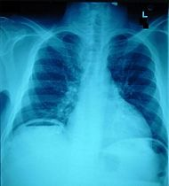
Here is your patient’s x-ray….

Slide 31
Perforated Peptic Ulcer ?
Abrupt onset of severe epigastric pain followed by peritonitis
IV, oxygen, monitor
CBC, Crossmatch, Lipase
Acute abdominal x-ray series
Broad-spectrum antibiotics
Surgical consultation

Slide 32
Case #5
35 yo healthy F to ED c/o nausea and vomiting since yesterday along with generalized abdominal pain, +anorexia. Last stool 2 days ago.
Surg Hx: s/p hysterectomy (for fibroids)

Slide 33
Case #5 Exam
T: 37, HR: 100, BP: 130/85, R: 22, O2 sat: 97%
General: mildly obese female, vomiting
CV: normal
Lungs: clear
Abd: moderately distended, mild Tenderness diffusely,
What is your differential and what next?

Slide 34
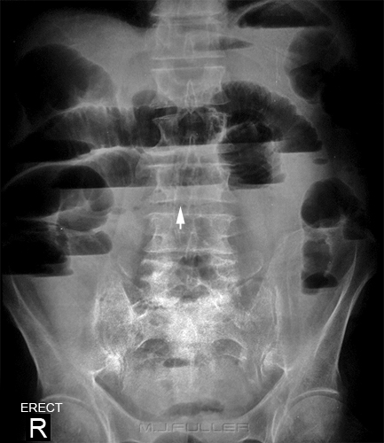
Upright abd x-ray

Slide 35
Bowel Obstruction
Mechanical or nonmechanical causes ?
#1 - Adhesions from previous surgery
#2 - Groin hernia incarceration
Clinical Features ?
Crampy, intermittent pain
Periumbilical or diffuse
Inability to have BM or flatus
N/V
Abdominal bloating
Sensation of fullness, anorexia

Slide 36
Bowel Obstruction
Physical Findings ?
Distention
Tympany
Absent, high pitched or tinkling bowel sound or “rushes”
Abdominal tenderness: diffuse, localized, or minimal

Slide 37
Bowel Obstruction
Diagnosis?
CBC and electrolytes
Abdominal x-ray series
CT scan

Slide 38
Bowel Obstruction
Treatment
Fluid resuscitation
NGT
Analgesia
Surgical consult
Hospital observation for ileus
OR for complete obstruction
Peri-operative antibiotics
Zosyn or unasyn

Slide 39
Case #6
48 obese F with one day hx of upper abd pain after eating, does not radiate, is intermittent cramping pain, +N/V,
No diarrhea, subjective fevers. Med hx: denies

Slide 40
Case #6 Exam
T: 37.9, HR: 96, BP: 135/76, R:18, Sat: 100%
General: obese, no acute distress
CV: normal
Lungs: clear
Abd: Tender RUQ, non-distended, normal bowel sounds
What is your differential and what next?

Slide 41
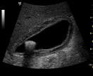
Cholecystitis
Clinical Features ?
RUQ or epigastric pain
Radiation to the back or shoulders
Dull and achy → sharp and localized
Pain lasting longer than 6 hours
N/V/anorexia
Fever, chills

Slide 42
Cholecystitis
Physical Findings ?
Epigastric or RUQ pain
Murphy’s sign
Patient appears ill

Slide 43
Cholecystitis
Diagnosis ?
CBC, LFTs, Lipase
Elevated ALP
Elevated lipase suggests gallstone pancreatitis
RUQ US
Gallstones or sludge
Sonographic murphy sign
If you suspect it, get the US

Slide 44
Cholecystitis
Treatment:
Surgical consult
IV fluids
Analgesia
Antibiotics
NGT if intractable vomiting

Slide 45
Just a few more to go….hang in there
Ovarian torsion
Testicular torsion
GI bleeding

Slide 46
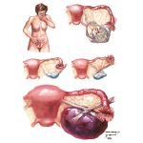
Ovarian Torsion
Acute onset severe pelvic pain
Possible hx of ovarian cysts
Menstrual cycle: midcycle also possibly in pregnancy
Can have variable exam
May look just like Appendicitis
ultrasound
Labs
CBC, Beta-hCG, electrolytes, T&S
IV fluids
NPO
Pain medications
GYN consult
Every walking woman gets
a pregnancy text

Slide 47
Testicular Torsion
Sudden onset of severe testicular pain
If torsion is repaired within 6 hours of the initial insult, salvage rates of 80-100% are typical.
Approximately 5-10% of torsed testes spontaneously detorse, but the risk of retorsion at a later date remains high.
Most occur in males less than 20yrs old but 10% of affected patients are older than 30 years.
Emergent urology consult
Ultrasound with doppler
Detorsion

Slide 48
Mesenteric Ischemia
Consider this diagnosis in all elderly patients with risk factors
Severe pain, often refractory to analgesics
Relatively normal abdominal exam
Embolic source: sudden onset (more gradual if thrombosis)
Nausea, vomiting and anorexia are common
50% will have diarrhea
Metabolic acidosis and extreme leukocytosis when advanced disease is present (bowel necrosis)
Diagnosis requires Contrast CT

Slide 49
Abdominal Aortic Aneurysm
Risk increases with age,
Abdominal pain in 70-80% (not back pain!)
Back pain in 50%
Sudden onset of pain
Atypical locations of pain: Flank, hips, inguinal area
Syncope can occur
Hypotension may be present
Palpation of a tender, enlarged pulsatile mass
Ultrasound / CT abd/pelvis
High suspicion in an unstable patient requires surgical consult and emergent surgery.

Slide 50
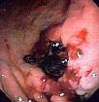
GI Bleeding
Upper
Proximal to Ligament of Treitz
Peptic ulcer disease most common
Erosive gastritis
Esophagitis
Esophageal and gastric varices
Mallory-Weiss tear
Lower
Hemorrhoids most common
Diverticulosis
Angiodysplasia
Notes:
First: r/o upper GI bleed
Lower GI bleed: most common hemorrhoids
Diverticulosis has potential for massive bleeding

Slide 51
Medical History
Common Presentation:
Hematemesis (source proximal to right colon)
Coffee-ground emesis
Melena
Hematochezia (distal colorectal source)
High level of suspicion with
Hypotension
Tachycardia
Angina
Syncope
Weakness
Confusion
Cardiac arrest

Slide 52
Labs and Imaging
Type and crossmatch: Most important!
Other studies: CBC, BUN, creatinine, electrolyte, coagulation studies, LFTs
Initial Hct often will not reflect the actual amount of blood loss
Abdominal and chest x-rays of limited value for source of bleed
Nasogastric (NG) tube
Gastric lavage
Endoscopy/colonoscopy
Notes:
NG tube for all significant bleeds: in 14% of bright red blood or maroon per rectum from upper GI source
Negative NG aspirate does not r/o upper source
Use room temp water for lavage and lavage until clear

Slide 53
Management in the ED
ABCs of Resuscitation
AIRWAY:
Consider definitive airway to prevent aspiration of blood
BREATHING
Supplemental Oxygen
Continuous pulse oximetry

Slide 54
Management in ED
Circulation ?
Cardiac monitoring
Volume replacement
Crystalloids
2 large-bore intravenous lines (18g or larger)
Blood Products
General guidelines for transfusion
Coagulation factors replaced as needed

Slide 55
Management
Early GI consult for severe bleeds
Therapeutic Endoscopy: band ligation or injection sclerotherapy
Drug Therapy: octreotide, PPIs
Surgery: if all else fails
Notes:
Octreotide is 50 µg IV bolus, followed by 50 µg 8–24h
Somatostatin is 250–500 µg IV bolus followed by 250–500 µg per h
Protonix 80mg IV bolus x 1; then 8mg/hr for 72 hours

Slide 56
Abdominal Pain Clinical Pearls
Significant abdominal tenderness should never be attributed to gastroenteritis
Incidence of gastroenteritis in the elderly is very low
consider perform genital examinations when lower abdominal pain is present – in males and females, in young and old
In older patients with renal colic symptoms, exclude AAA
Severe pain should be taken as an indicator of serious disease
Pain awakening the patient from sleep should always be considered signficant
Sudden, severe pain suggests serious disease
Acute cholecystitis is the most common surgical emergency in the elderly
A lack of free air on a chest xray does NOT rule out perforation
Notes:
For free air – instill 500cc of air into stomach via NGT and repeat xray or do noncontrast CT scan

