Slide 1
Metabolic response to surgery
Dr. Nuha Alsaleh
Assistant professor

Slide 2
Mediators of Injery Response
NEURO ENDOCRINE ( HORMONAL)
IMMUNOLOGICAL AXSIS

Slide 3
Immunological mediators

Slide 4
Immune axis
Pro inflammatory phase Counter regulatory phase
IL-1 receptor antagonist (IL- 1Ra) and TNF soluble receptors
(TNF-sR-55 and 75)
Hypothalamus → pyrexia
Acute hepatic phase reaction
Prevent excessive proinflammatory activities
Restore homeostasis

Slide 5
Nature of the injury response
◆ Metabolic response to injury is Graded and evolves with time
◆ the more severe the injury, the greater the response
Immunological

Slide 6
Neuro endocrine axscis
Optimize host defense
Post pond anabolism
Provide substrate for energy expenditure

Slide 7
Endocrine Response
Start of response:
Hypothalamus –pitutary- adrenal axsis
Autonomic nervous system :
Provides rapid response ( fight or flight )
Release adrenaline

Slide 12
Hormones involve in the stress

Slide 13
Diagram summarizes hormonal response

Slide 14
METABOLIC Response phases

Slide 15
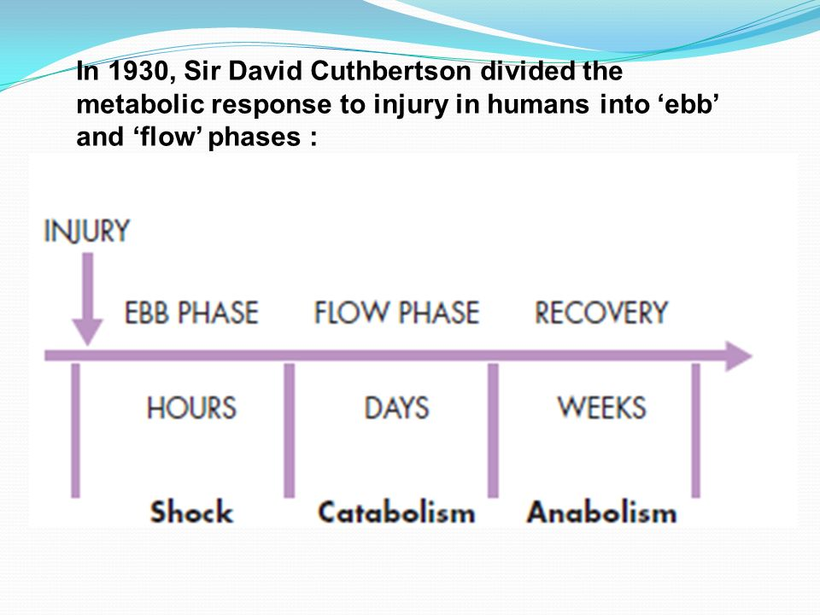
METABOLIC RESPONSE phases

Slide 16
EBB Phase
Start at the time of injery last 24 -48 hours
Main hormones are:
Catecholamine
Cortisol
Aldosterone
It may reverse by proper resuscitation
Main role is conserve circulating volume and energy store for recovery and repair

Slide 17
Flow phase
It lasts for several weeks
This phase mobilization of body energy for repair and recovery
After resuscitation: it could evolve in hypermetabolic = SIRS

Slide 18
If stressor continued ..
It shift from ebb phase to flow phase
Catabolism phase
Aim from this phase to heal damaged cell
The healing of the cells need energy
The energy will come from glucose and fat and proteins

Slide 19
Key catabolic elements for flow phase
Hypermetabolism
Alterations in skeletal muscle protein
Alterations in Liver protein Insulin resistance

Slide 20
HYPERMETABOLISM
-Majority demonstrate energy expenditure up to 15 -25 % above normal level
Factors increase metabolism
Central thermodysregulation
Increase sympathatic activity
Increase protein turnover

Slide 21
BODY natural sources for energy
Main labile energy reserve in the body is FAT
Main labile PROTIEN reserve in the body SKELTAL MUSCLES
LOSS OF PROTIENMASSS HAVE SERIOUS CONSEQUANCE

Slide 22
NUTRITIONAL
ROUT
Enteral
Parenteral
TIMING:
The earlier is better

Slide 23
THANK YOU

