Slide 1
Fluid and Electrolyte Imbalance
Badr Aldawood, FRCPC
Consultant EM-CCM
Assistant Professor
Sept 20,2017

Slide 2
Objective
Define normal ranges of electrolytes
Compare/contrast intracellular, extracellular and intravascular volumes
Compare Fluids “Colloids vs Crystalloids”
Outline methods of determining fluid and acid/base balance
Describe the clinical manifestations of various electrolyte imbalances and treatment.

Slide 3
Total Body Fluids ?

Slide 4
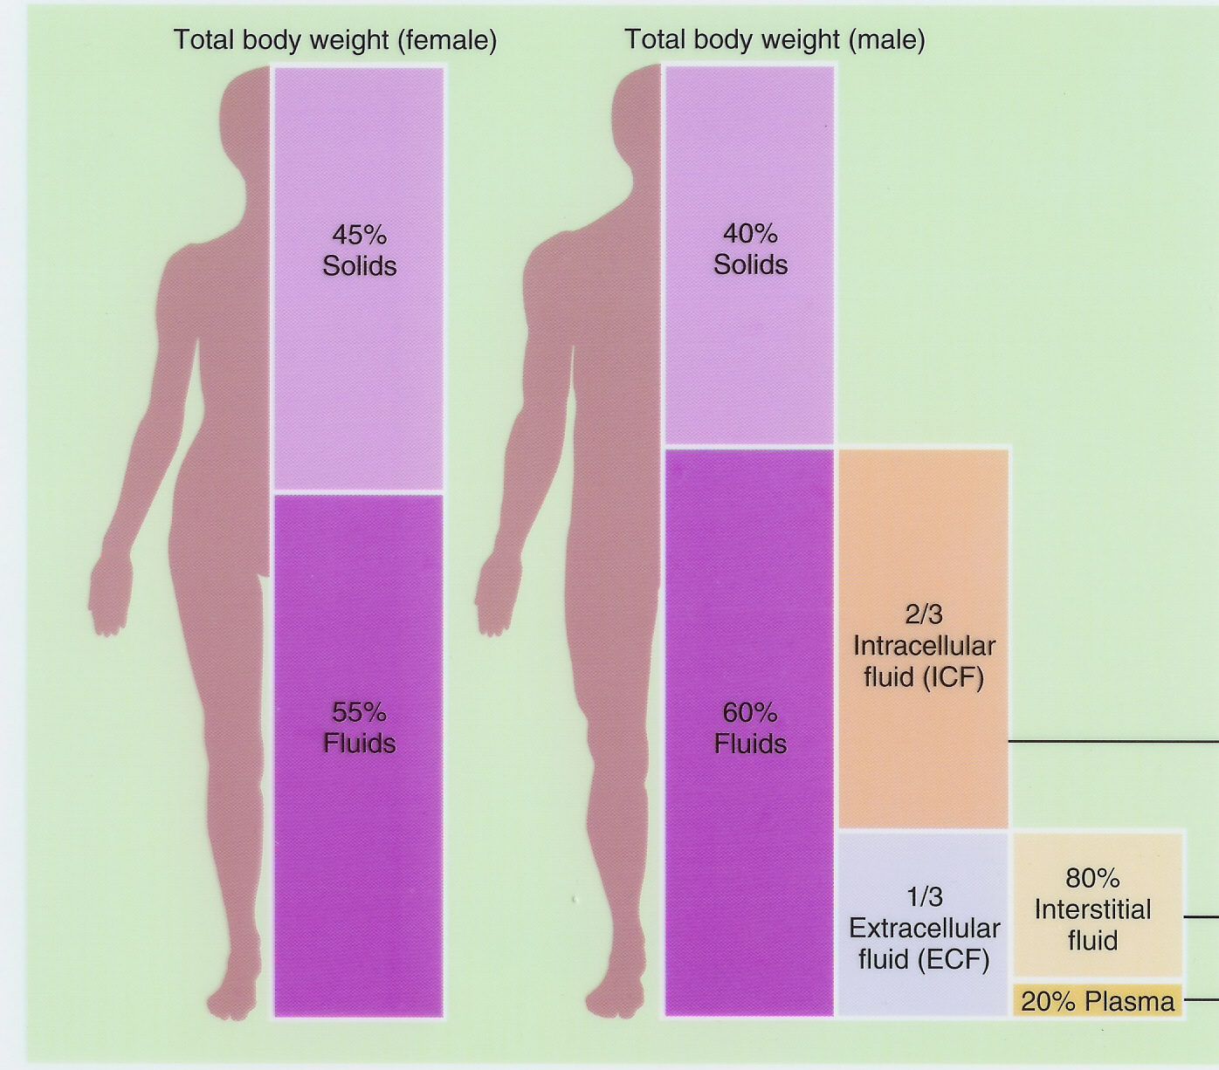

Slide 5
Body Fluid Compartments
2/3 (65%) of TBW is intracellular (ICF)
1/3 extracellular water
25 % interstitial fluid (ISF)
5 - 7 % in plasma (IVF intravascular fluid)
1- 2 % in transcellular fluids – CSF, intraocular fluids, serous membranes, and in GI, respiratory and urinary tracts (third space)

Slide 6
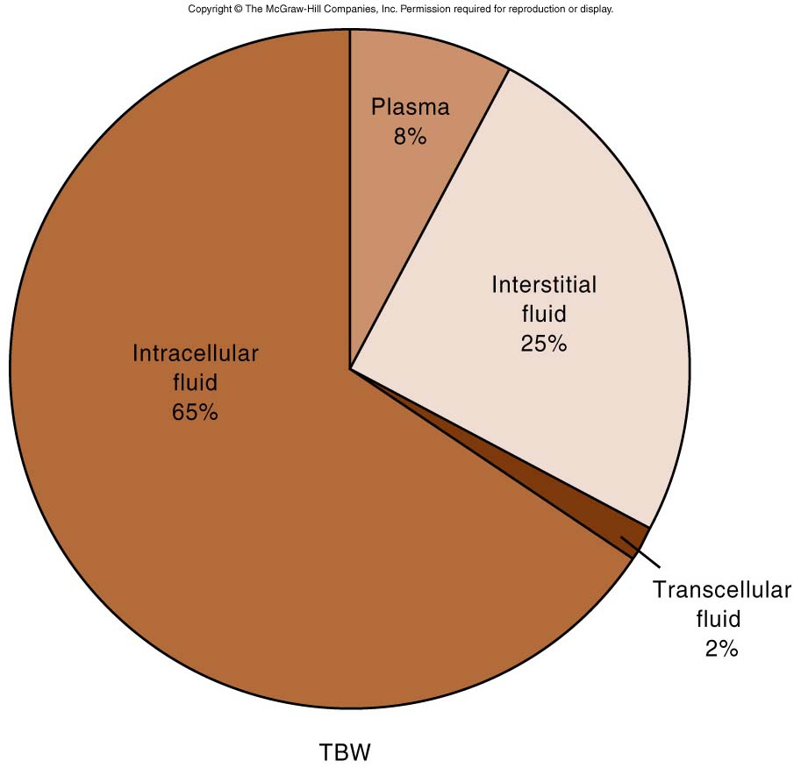

Slide 7
Fluid compartments are separated by membranes that are freely permeable to water.
Movement of fluids due to:
Hydrostatic pressure
Osmotic/Oncotic pressure

Slide 8
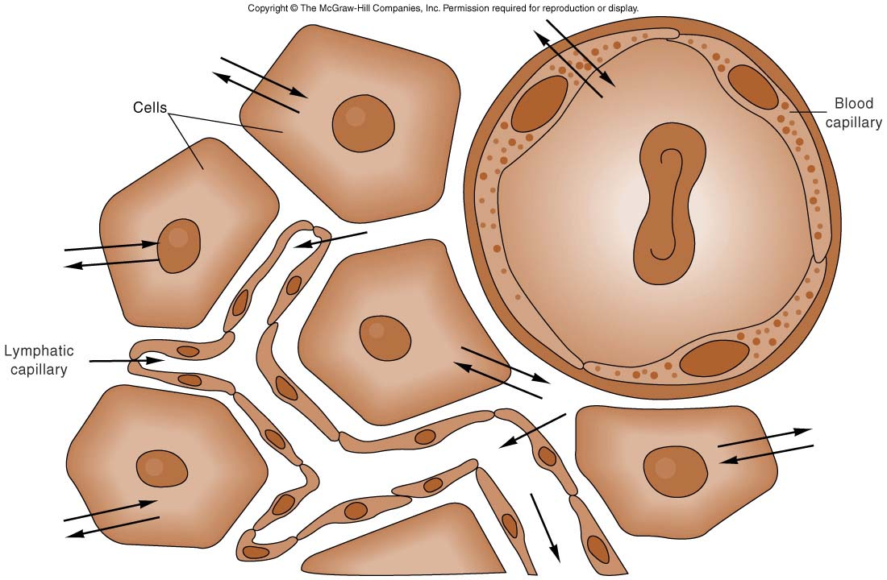

Slide 11
Balance
Fluid and electrolyte homeostasis is maintained in the body
Neutral balance: input = output
Positive balance: input > output
Negative balance: input < output

Slide 12
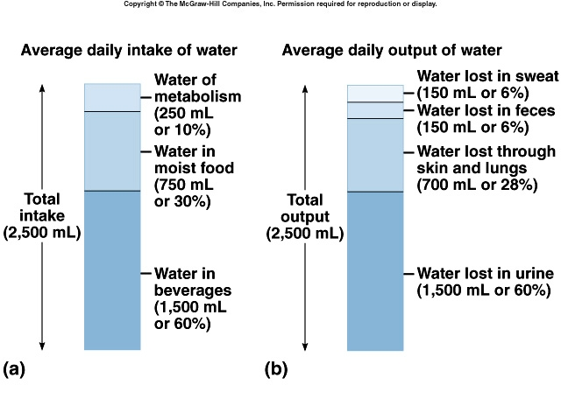

Slide 13
Electrolytes
Electrolytes – charged particles
Cations – positively charged ions
Na⁺, K⁺ , Ca⁺⁺, H⁺
Anions – negatively charged ions
Cl⁻, HCO₃⁻ , PO₄³⁻

Slide 14
Intracellular Fluid Space
40% of body weight
Largest proportion is in skeletal muscle
Larger percentage of water is Intracellular in males (large muscle mass)
Cations = Potassium & Magnesium
Anions = Phosphates and Proteins

Slide 15
Extracellular Fluid Space
20% of body weight
Interstitial 15%, Plasma 5%
Cations = Sodium
Anions = Chloride and Bicarbonate

Slide 16
Homeostasis maintained by:
Ion transport
Water movement
Kidney function

Slide 17
Tonicity:
Isotonic
Hypertonic
Hypotonic

Slide 19
Movement of body fluids “ Where Na goes, H2O follows”
Diffusion – movement of particles down a concentration gradient. Osmosis – diffusion of water across a selectively permeable membrane Active transport – movement of particles up a concentration gradient ; requires energy

Slide 20
Regulation of body water
ADH – AntiDiuretic Hormone + thirst
Decreased amount of water in body
Increased amount of Na+ in the body
Increased blood osmolality
Decreased circulating blood volume
Stimulate osmo-receptors in hypothalamus ➤ ADH released from posterior pituitary ➤ Increased thirst

Slide 21
↑ water consumption ↑ water conservation
↑ water in body
↑ volume
↓Na+ concentration

Slide 22
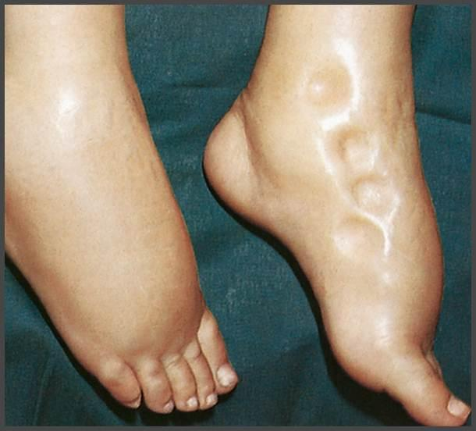

Slide 23
Edema is the accumulation of fluid within the interstitial spaces.
Causes:
↑ hydrostatic pressure
↓ plasma osmotic pressure
↑ capillary membrane permeability

Slide 26
Electrolyte balance
Na ⁺ (Sodium)
90 % of total ECF cations
136 -145 mEq / L
Pairs with Cl⁻ , HCO₃⁻ to neutralize charge
Low in ICF
Most important ion in regulating water balance
Important in nerve and muscle function “Action Potential”

Slide 27
Regulation of Sodium
Renal tubule reabsorption affected by hormones:
Aldosterone
ADH
Renin/angiotensin (ADH/Aldosterone)
Atrial Natriuretic Peptide (ANP)

Slide 28
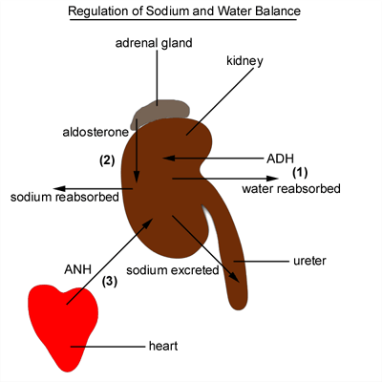

Slide 29
Potassium
Major intracellular cation
ICF conc. = 150- 160 mEq/ L
ECF = 3.5 - 5
Resting membrane potential
Regulates fluid, ion balance inside cell

Slide 30
Alterations in water balance
Fluid loss (Hypovolemia)
↓ECF volume, weight loss, dry skin and mucous membranes, ↓ urine output, and hypovolemia ( rapid heart rate, flattened neck veins, and normal or ↓ B.P. – shock)

Slide 31
Alterations in water balance
Fluid excess (Volume overload)
Excess IV fluids
Hypersecretion of aldosterone
Effect of drugs – cortisone
– weight gain, decreased hematocrit, diluted plasma proteins, distended neck veins.
May lead to edema (↑ capillary hydrostatic pressure) pulmonary edema.

Slide 32
Colloids Vs Crystalloids

Slide 35
Colloids Vs Crystalloids

Slide 36
IV Crytalloids dose
1st 10 Kg: 40 ml/hr
2nd 10 Kg: 20 ml/hr
Then each additional 10 Kg: 10 ml/hr

Slide 37
Electrolyte imbalances: Sodium
Hypernatremia (high levels of sodium)
Plasma Na+ > 145 mEq / L
Due to ↑ Na + or ↓ water

Slide 38
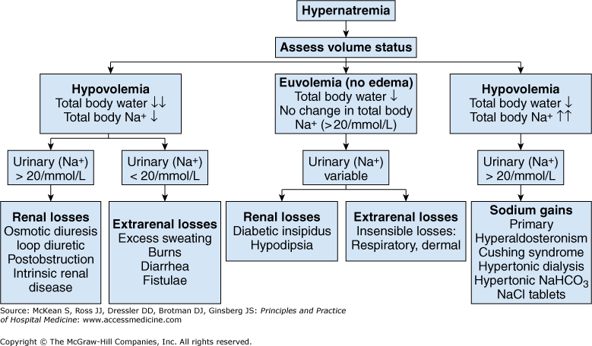

Slide 39
Clinical manifestations of Hypernatremia
Thirst
Lethargy
Neurological dysfunction due to dehydration of brain cells

Slide 40
Treatment of Hypernatremia
Lower serum Na+
Isotonic salt-free IV fluid
Oral solutions preferable
Slow correction
(rapid correction may cause Osmotic Demyelination Syndrome)

Slide 41
Hyponatremia

Slide 42
Clinical manifestations of Hyponatremia
Neurological symptoms
Lethargy, headache, confusion, apprehension, depressed reflexes, seizures and coma
Muscle symptoms: Cramps, weakness, fatigue
GI symptoms: Nausea, vomiting, and diarrhea

Slide 43
Tx of Hyponatremia
Tx
Depends on the volume status and etiology
Usually Limit water intake and discontinue offending meds
Slow correction ( risk of Cerebral edema)

Slide 44
Hypokalemia
Serum K⁺ < 3.5 mEq /L
Beware if diabetic
Insulin shifts K⁺ into cell
Ketoacidosis – H⁺ replaces K⁺, which is lost in urine

Slide 45
Causes of Hypokalemia
Decreased intake of K⁺
Increased K⁺ loss
Chronic diuretics
Acid/base imbalance
Trauma and stress
Increased aldosterone
Insulin

Slide 46
Clinical manifestations of Hypokalemia
Neuromuscular disorders
Weakness, flaccid paralysis, respiratory arrest, constipation
Dysrhythmias, appearance of U wave
Postural hypotension
Cardiac arrest
Treatment-
K⁺ intake, but slowly, preferably by foods
Must correct hypoMg

Slide 47
Hyperkalemia
Serum K+ > 5.5 mEq / L
Causes
Renal disease
Massive cellular trauma
Insulin deficiency
Addison’s disease
Potassium sparing diuretics
Decreased blood pH
Exercise causes K+ to move out of cells

Slide 48
Clinical manifestations of Hyperkalemia
Early – hyperactive muscles , paresthesia
Late - Muscle weakness, flaccid paralysis
Change in ECG pattern
Dysrhythmias
Bradycardia , heart block, cardiac arrest

Slide 49
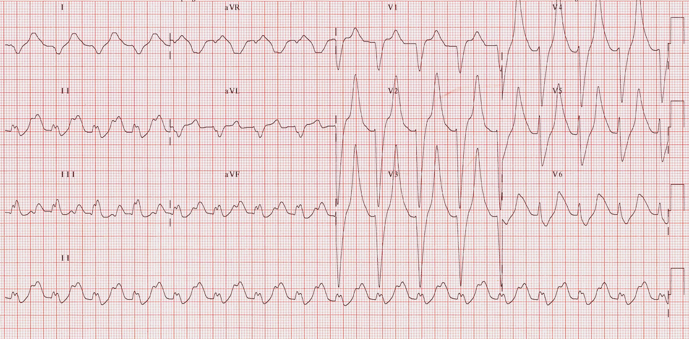

Slide 51
Treatment of Hyperkalemia
Decrease intake and increase renal excretion
Shifting K+ into cells:
Insulin + glucose
HCO3
B-agonists
Ca⁺⁺ gluconate: Cardiac membrane stalilizer to prevent cardiac arrhythmia and cardiac arrest.

Slide 53
Calcium Imbalances
Most in ECF
Regulated by:
Parathyroid hormone
↑Blood Ca⁺⁺ by stimulating osteoclasts
↑GI absorption and renal retention
Calcitonin from the thyroid gland
Promotes bone formation
↑ renal excretion

Slide 54
Hypercalcemia
Results from:
Hyperparathyroidism
Hypothyroid states
Renal disease
Excessive intake of vitamin D
Milk-alkali syndrome
Certain drugs
Malignant tumors – hypercalcemia of malignancy

Slide 55
Hypercalcemia
Effects:
Many nonspecific – fatigue, weakness, lethargy
Increases formation of kidney stones and pancreatic stones
Muscle cramps
Bradycardia, cardiac arrest
Pain
GI upset also common
Metastatic calcification

Slide 56
Hypocalcemia
Hyperactive neuromuscular reflexes and tetany differentiate it from hypercalcemia
Convulsions in severe cases

Slide 57
Hypocalcemia
Caused by:
Renal failure
Lack of vitamin D
Suppression of parathyroid function
Hypersecretion of calcitonin
Malabsorption states
Abnormal intestinal acidity and acid/ base bal.
Widespread infection or peritoneal inflammation

Slide 59
Hypocalcemia
Diagnosis/Signs :
Chvostek’s sign
Trousseau’s sign
Treatment
IV calcium for acute
Oral calcium and vitamin D for chronic

Slide 60
Magnesium
Hypomagnesaemia is common in surgical patients
Hypomagnesaemia:
Clinical manifestation:
muscle weakness, altered mentation, tremors, hyper-reflexia, seizure.
Tachyarrhythmias (Torsades de pointes, atrial fibrillation)
Tx: IV Magnesium

Slide 61
Acid-base balance
H2O ⇔ H+ + OH- (steady state: pH 7
Henderson-Hasselbach Equation
Source of H⁺: intake, metabolism, CO
Elimination of H⁺: kidney, lung (CO₂), gastrointestinal tract, liver

Slide 62
Buffers
A buffer is a substance, that has the ability to bind or release H⁺ in solution, thus keeping the pH of the solution relatevily constant despite of considerable quantities of acid or base
The important buffer systems in blood include proteins, carbonic acid-bicarbonate buffers.
Buffer | pK | Concentration | Buffer capacity
Bicarbonate | 6,1 | 24 mmol/l | 75 %
Hgb | 8,25 | 24 mmol/l | 25 %
oxyHgb | 6,95
Proteins | -
Phosphates | 6,8

Slide 63
Acid-base disorders
Acidosis: pH<7.35 (Acidemai?)
Alkalosis: pH>7.45 (Alkalemia?)
Metabolic disturbance: addition of acid or alkali (stronger than the buffers) or removal of acid or alkali
Respiratory disturbance: rise or decline in arterial pCO₂
Compensation:
Kidneys (HCO3)
Lung (CO2)

Slide 64
Arterial Blood Gas
Arterial
pH 7.37-7.45
pCO2 Hgmm(kPa) 35-46
Standard 21-26/21-26
bicarbonate (mmol/l)
Anion gap (mmol/l) 10-14

Slide 65
Acid-Base
Acidosis:
Metabolic
Respiratory
Alkalosis:
Metabolic
Respiratory

Slide 67
Anion Gap
In Metabolic Acidosis:
AG = (Na⁺+K⁺) - (Cl⁻+HCO₃⁻) = (Na⁺) - (Cl⁻+HCO₃⁻)
Elevated anion gap: lactic acidosis, ketoacidosis, renal failure, exogenous administration of acids
Non-anion gap acidosis: Renal Tubular Acidosis, Vomiting, Iatrogenic acidosis (administration of Cl)

Slide 68
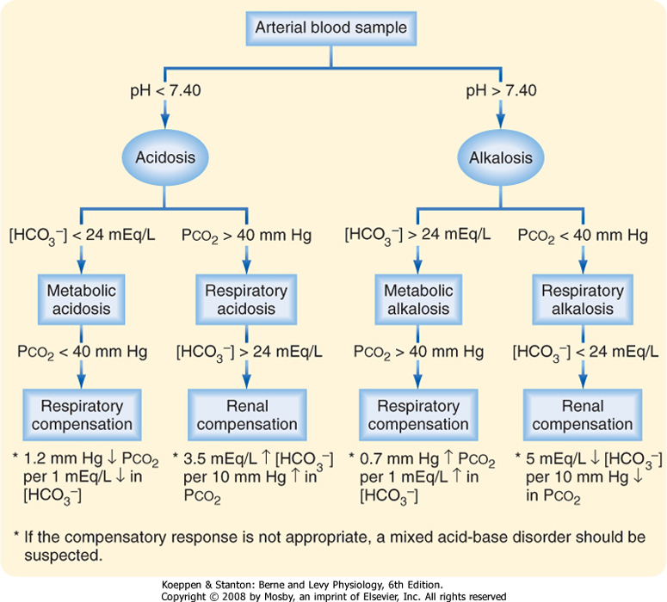

Slide 69
Summary
Know the compositions of IV Fluids
No major clinical superiority between Crystalloids and Colloids
Use Crystalloids as your standard
Correct electrolytes
Electrolytes disturbance can cause arrhythmia and lead to cardiac arrest.
Analyze Acid-base blood gas and calculte AG

Slide 70
???

