Slide 1
Approach to Abdominal pain

Slide 2
Objectives
know the causes of Abdominal pain
assessment :
history
physical exam
investigations choices
management options
disposition

Slide 3
Overview
abdominal pain : 6.7 % of ED presentation
abdominal pain can be
surgical
medical
OB/Gyne
abdominal wall
referred pain
The causes of abdominal pain are best dealt with according to the different regions of the abdomen

Slide 4
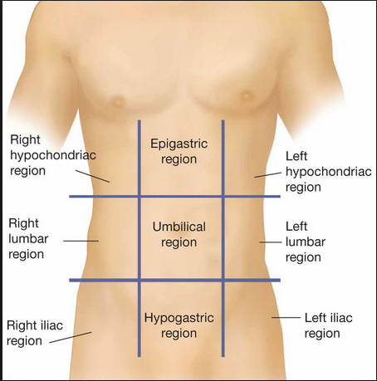
Anatomy of Abdominal compartment

Slide 5
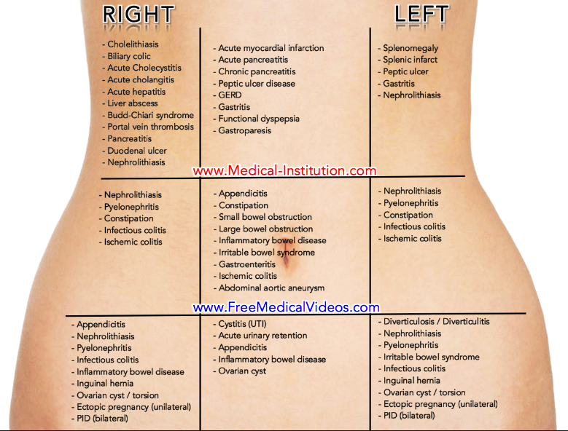
Causes of Abdominal pain according to different regions

Slide 6
Group that need special consideration in the work up:
Elderly
Immunocompromised
Women in reproductive age

Slide 7
Assessment

Slide 8
History 1
patient’s data
description of pain
nature or character of pain
periodicity
constant
colicky
site and radiation
duration
severity
aggravating / relieving factors

Slide 9
History 2
Associated features
nausea
vomiting
change in bowel habit
in adults in the ED, constipation is usually a symptom of an underlying disease not the cause of pain
urinary symptoms
vaginal bleeding / discharge
jaundice
PR bleeding

Slide 10
History 3
Past Medical & Surgical History
i.e. Diabetes —> DKA
previous operation —> bowel obstruction due to adhesions
Medications History :
i.e.amoxicillin —> pseudomembranous colitis
social history :
i.e. Drug abuse , Cocaine —> mesenteric ischaemia and gangrene, due to vasospasm

Slide 12
Physical exam1
Vital signs
HEENT , chest , cardiac
Uncover the abdomen
Inspection
scars
contour
masses
organomegaly
ascites
herniae

Slide 13
Physical exam 2
Palpation
initially light touch
over all areas , then concentrate on pain area
looking for
Tenderness ( rebound tenderness , cross tenderness)
Rigidity ( due to peritoneal inflammation )
voluntary guarding ( varies between exam )
bimanual palpation ( for abdominal organs and mass )

Slide 14
physical exam 3
Percussion
ascites, liver, spleen
Cough test / jump test
reproduction and localization of pain on coughing or jumping
highly predictive of peritonitis if positive

Slide 15
Physical exam 3
Auscultation
listen to 2 minutes
may be
increased : i.e. bowel obstruction
decreased or absent : i.e. constipation, sleep

Slide 16
Physical exam 4
Rectal Exam
indications:
prostate exam i.e. size , smoothness, tenderness
faecal loading
bleeding
mass

Slide 17
Physical exam 5
extra abdominal exam
Jaundice
pallor
lymphadenopathy
genital exam ( examine the Testicles )
urine exam ( dark urine ) i.e. hepatobillary diseases

Slide 18
What is the most common causes of abdominal pain in ED?
What is the life threatening causes of abdominal pain?

Slide 19
Most common causes of abdominal pain in ED:
non specific abdominal pain 34%
Appendicitis 28%
Biliary tract disease 10%
SBO 4%

Slide 20
Life threatening causes of abdominal pain:
Rupture ectopic
Rupture AAA
Mesenteric Ischemia
Intestinal obstruction

Slide 21
5. Perforated viscus
6. Acute pancreatitis
7. Ascending cholangitis
8. complicated diverticulitis or rupture appendicitis.

Slide 22
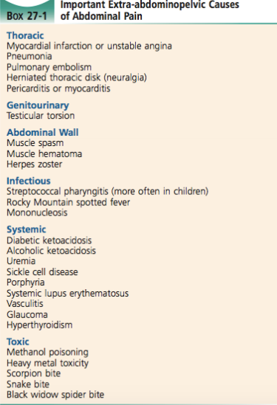

Slide 23
Investigation 1
can be divided into
bed side investigations
laboratory investigations
radiology investigations

Slide 24
Investigation 2
bedside investigations
ECG : i.e. AMI
BGL : i.e. DKA
urine analysis : i.e. UTI, BHCG (women)

Slide 25
Investigation 3
Laboratory investigation
doesn’t take place of good history and exam
select the proper investigation
CBC , LFTs, renal function , lactate , lipase , BHCG ( women )
Urine analysis ( UTI, BHCG )

Slide 26
Investigation 4
WBC count:
neither sensitive or specific to rule in or out serious causes.
never helpful except when they indicate immunosuppression .

Slide 27
Investigation 5
Radiology Investigations
X-ray (erect and supine): R/O perforation (air under diaphragm), bowel obstruction (air fluid level).
U/S: R/O AAA, gynaecological (ectopic pregnancy), Gall bladder.( acute cholecystitis, acute cholangitis)
CT scan: R/O mesenteric ischemia, kidney stones.

Slide 28
Management
analgesia ( crucial )
do not hole analgesia for undeffirntiated abdominal pain
antiemetics
i.e. metoclopromide , ondanstron
may help to avoid NG tube
antibiotics
i.e. abdominal sepsis

Slide 29
Disposition
admission to hospital :
serious life threatening cause i.e. rupture AAA
ill looking patient
elderly patient
immunocompromised
unable to communicate, cognitive impairment
sever pain, vomiting , unable to control with medication
lack of social support

Slide 30
Abdominal pain in special population
Women
think of Obstetrical and Gynaecological problem
BCHG for women of childbearing age
Elderly people ( age >80 years )
have more surgical emergencies than other population
mortality double if incorrect diagnosis at admission

Slide 31
some important examples of abdominal pain causes !
Acute appendicitis | early Periumblical pain then RLQ pain rebound tenderness cross tenderness (Rovsing sign) Psoas sign
Biliary Colic | Female > Male RUQ colicky , resolve within 6h due to GB stone

Slide 32
some important examples of abdominal pain causes !
Cholecystitis | most common in elderly patient RUQ Murphy sign +ve Jaundice of CBD obstructed
Mesenteric ischaemia due to mesenteric artery occlusion | history of AF pain out of proportion to physical exam increase lactate >4 —> metabolic acidosis
Pancreatitis | epigastric pain —> back GB stone , alcohol Hx high lipase

Slide 33
some important examples of abdominal pain causes !
PUD | Hx of H Pylori , NSAIDs epigastric pain complication : bleeding , perforation
Renal colic | ureteric stone flank —> pelvis R/O AAA in elderly people sudden , sever pain
AAA | elderly people hx of atherosclerosis , CVS mid abdomen / flank —> back pulsatile mass diagnosed by bedside USS risk of rupture if > 5.5 cm ( <3cm)

Slide 34
some important examples of abdominal pain causes !
rupture ectopic pregnancy | hx : previous ectopic, IUCD, PID, tubal surgery lower abdominal pain pregnancy test is important ultrasound for diagnosis
Ovarian Torsion | sudden onset RLQ or LLQ adnexal mass diagnosis : by US
PID | sexually transmitted RLQ or LLQ vagnial discharge cervical motion / adnexal tenderness in vaginal exam complicated by tubo-overian abscess

Slide 35
Thank you !

Slide 36
references
Emergency medicine manual , 6th edition , Dunn
Tintinalli’s EM, a comprehensive study guide, 7th edition
life in the fast lane / abdominal pain
Alok Tiwari, Mohammed Moghal, and Luke Meleagros J R Soc Med. 2006 Feb; 99(2): 51–52.doi: 10.1258/jrsm.99.2.51

