Slide 1
Esophageal disease

Slide 2
Outlines
Case1 :Esophageal Cancer
Diagnosis
Management
Case2 : Achalasia
Diagnosis
Management
Case3 : GERD
Diagnosis
Management

Slide 3
Case1: Esophageal disease
65 years old complaining of dysphagia.
How will approach him?

Slide 4
Esophageal disease
History and clinical examination:

Slide 5
History
onset
duration
site
progression
associated symptoms
Odynophagia
Cough
hoarseness

Slide 6
Clinical examination
Lymphadenopathy

Slide 7
Investigations
CBC- U/E
CXR
ECG

Slide 8
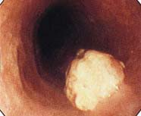
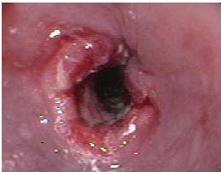
Specific Investigations
-Upper GI endoscopy

Slide 9
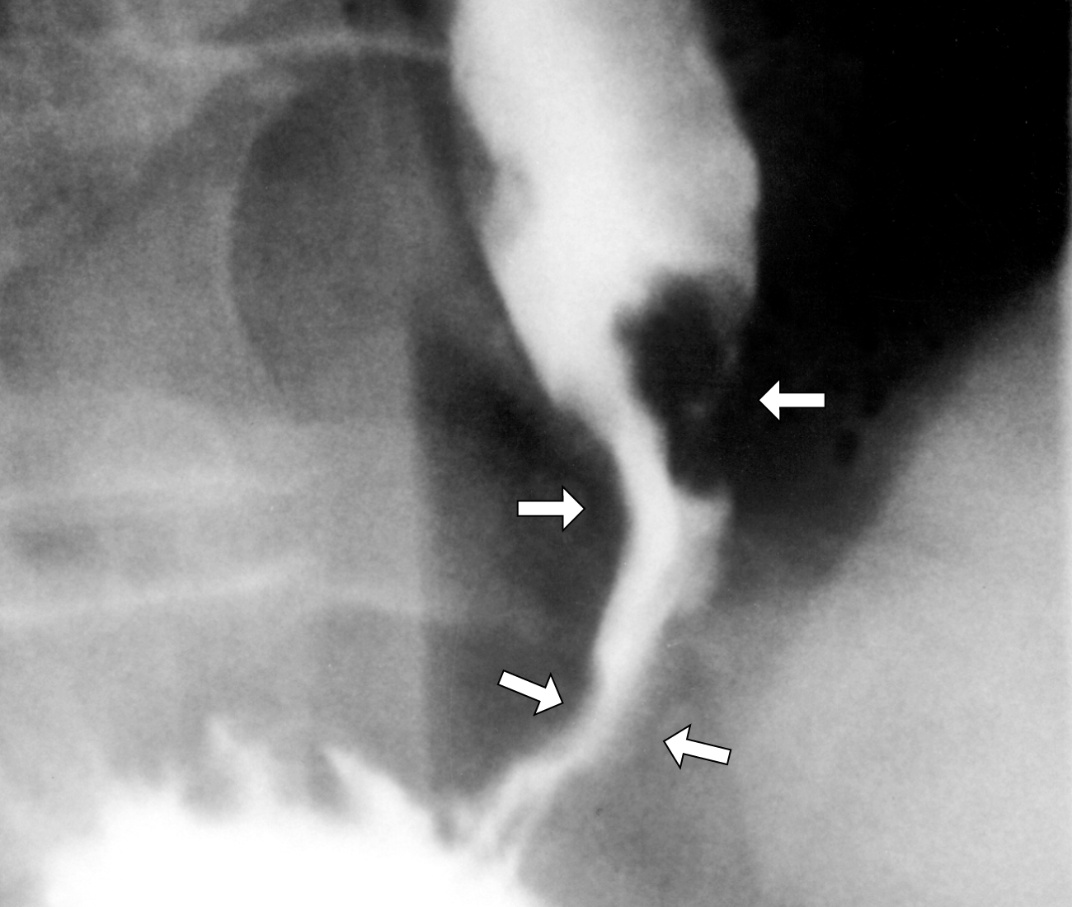

Slide 10
Upper GI endoscopy
Location
Size
Obstructing?
Biopsy

Slide 11
The contrast study
Location
Size
Obstructing?

Slide 12
Staging
- TNM staging by doing CT (cap)

Slide 13
Treatment
Conservative
Surgical

Slide 14
Types of esophageal cancer
Adenocarcinoma
Squamous carcinoma

Slide 15
Conservative management
Nutritional status support
Endoscopic dilatation &stenting
TPN
Gastrostomy tube
Chemo radiotherapy

Slide 16
Surgical management
Esophagectomy:
Trans hiatal esophagectomy
Transthoracic esophagectomy

Slide 17
Achalasia
30 years old complaining of dysphagia.
How will approach him?

Slide 18
Achalasia
History and clinical examination:

Slide 19
History
Onset
Duration
Site
Progression
Associated symptoms

Slide 20
Clinical examination
Unremarkable

Slide 21
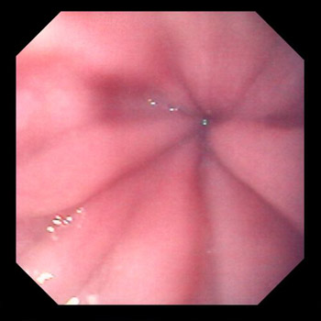
Investigations
Upper GI endoscopy

Slide 22
The contrast study
Bird’s beak or Rat’s tail
Obstructing?
Regular stricture edges

Slide 23
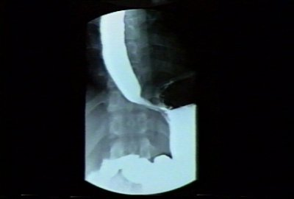
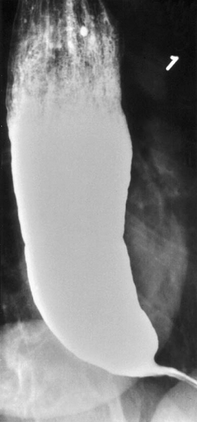
Contrast study

Slide 24
Specific investigation
Manometry study:
High LES pressure
Aperstalises
Fail of LES relaxation

Slide 25
Treatment
Conservative
Surgical

Slide 26
Conservative management
Pneumatic dilatation
Calcium channel blockers
Botulinum toxin injection

Slide 27
Surgical management
Laparoscopy or laparotomy and Heller myotomy

Slide 28
Case 3: Esophageal disease
30 years old complaining of heartburn and regurgitations.
How will approach him?

Slide 29
Esophageal disease
History and clinical examination:

Slide 30
History
Onset
Duration
Associated symptoms
Has he treated before
Responding to medications

Slide 31
Clinical examination
Unremarkable

Slide 32
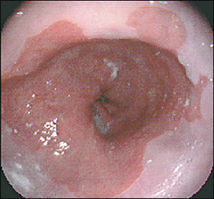
Investigations
Upper GI endoscopy

Slide 33
Contrast study
Barium swallow:
Reflux of the material to the esophagus

Slide 34
Specific investigation
Ambulatory 24 h PH monitoring
Demester score >14.7

Slide 35
Treatment
Conservative
Surgical

Slide 36
Conservative management
Changing life style
PPI

Slide 37
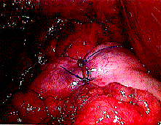
Surgical management
Laparoscopy or laparotomy and Nissen fundoplication

Slide 38
Complications of GERD
Esophagitis
Peptic stricture
Barrit esophagus :The most serious one as it consider as a pre malignancy (intestinal metaplasia in the lower esophagus).

Slide 39
Thank you

